Slide 1
CS585/DS503 Big Data Management Spring 2019
Relational DBs: Overview
Elke Rundensteiner

Slide 2




Relational DBs: History
Traditional
Applications
Started in mid 70s
IBM developed the relational DB model
System R
Banking
Retail Sys
Airlines
Universities

Slide 3
Relational DBs: Core Assumptions
Data is nicely structured (known in advance)
Data is correct & certain
Data is relatively static & small-mid size
Access pattern: Mix Read/Write
Notion of transactions (Interactive)
How these affected the design of DB Systems

Slide 4
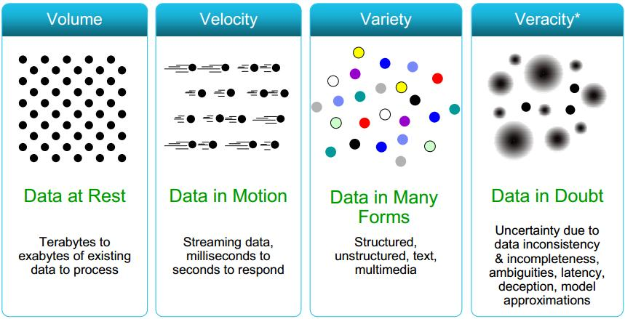
Contradicting Assumptions:Big Data
Data is nicely structured (known in advance)
Data is correct & certain
Data is relatively static & small-mid size
Access pattern: Mix Read/Write
Notion of transactions
In Big Data: It is read only, No notion of transactions

Slide 5
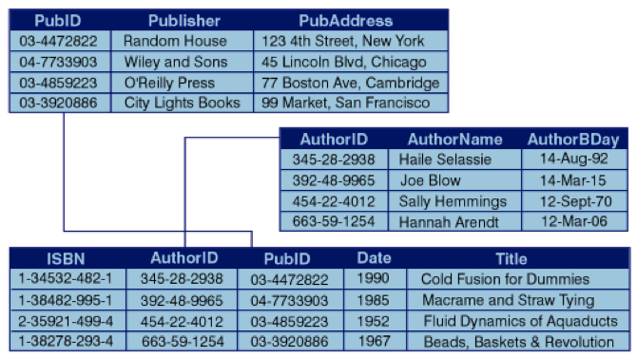

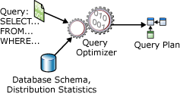



Assumptions →Design/Solution
Simple data types, Straightforward processing
Data is nicely structured (known in advance)
Data is correct & certain
Data is relatively static & small-mid size
Access pattern: Mix Read/Write
Notion of transactions (Interactive)
Disk-based Processing
Centralized
Concurrency Control
ACID Properties
Recovery Control

Slide 6
Relational Model
Order of rows & columns does not matter
DB is a set of interconnected relations

Slide 7
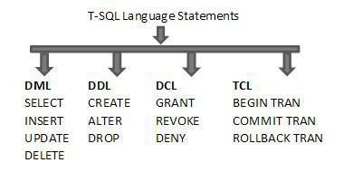
SQL: Structured Query Language
The interface for interaction with DBMSs
CREATE TABLE Students
(sid CHAR(20) Primary Key,
name CHAR(20),
login CHAR(10) Unique,
age INTEGER,
gpa REAL);
CREATE TABLE Courses
(cid Varchar2(20) Primary Key,
name varchar2(50),
maxCredits integer,
graduateFlag char(1));
High-Level Declarative Language

Slide 8
Foreign Keys in SQL
Create “Students” relation
Create “Courses” relation
CREATE TABLE Students
(sid CHAR(20) Primary Key ,
name CHAR(20) NOT NULL,
login CHAR(10),
age INTEGER,
gpa REAL Default 0);
CREATE TABLE Courses
(cid Varchar2(20) Primary Key,
name varchar2(50),
maxCredits integer,
graduateFlag char(1));
Create “Enrolled” relation
CREATE TABLE Enrolled
(sid: CHAR(20) Foreign Key References Students (sid),
X: Varchar2(20),
enrollDate: date,
grade: CHAR(2),
Constraint fk_cid Foreign Key (X) References Courses (cid));
Two ways to
define the FK constraint
while creating a table

Slide 9
SQL: Insert, Update, & Delete Data
Performed using Data Manipulation Language of SQL (DML)
Insertion
Insert into Students values (‘1111’, …);
Deletion
Delete from Students Where sid = ‘1111’;
Update
Update Students Set GPA = GPA + 0.4 Where sid = ‘1111’;
Record-Level Operations

Slide 10
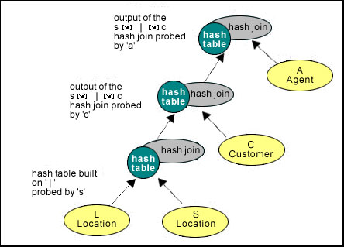
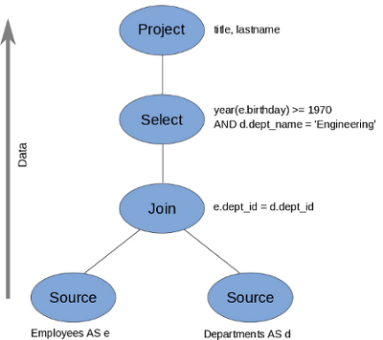
SQL: Query Data (Select Stmt)
SELECT <projection list>
FROM <relation names>
WHERE <conditions>
GROUP BY <grouping columns>
HAVING <grouping conditions>
ORDER BY <order columns>;
Will be mapped to the algebraic operators
Query Plans
Very Powerful
Query Language

Slide 11
Query Processing (Ch. 15 & 16)
Book ➔ Database Systems: The Complete Book, Second Edition

Slide 12
Example
Data:
relation R (A, B, C)
relation S (C, D, E)
Query:
Select B, D
From R, S
Where R.A = “c” And S.E = 2 And R.C=S.C

Slide 13
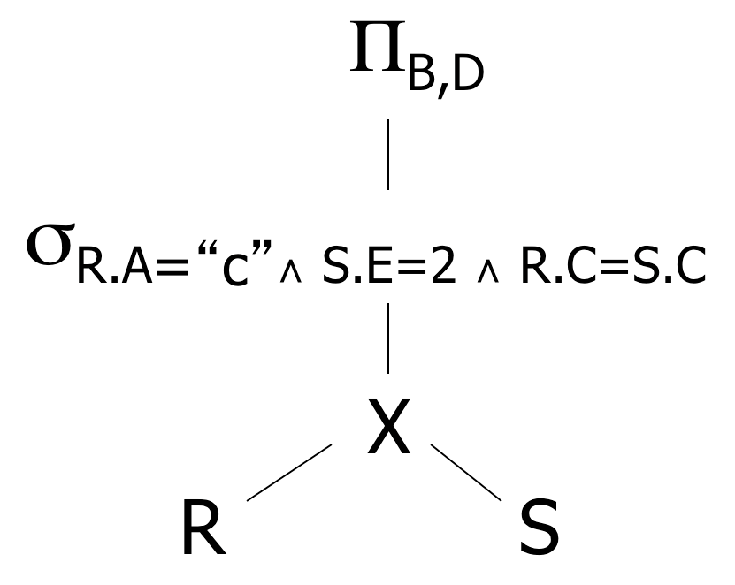
Relational Algebra – Possible Query Plans
Select B, D From R, S Where R.A = “c” And S.E = 2 And R.C=S.C
Plan 1
OR: Π_{B,D} [ σ_{R.A=“c”∧ S.E=2 ∧ R.C = S.C} (R X S)]

Slide 14
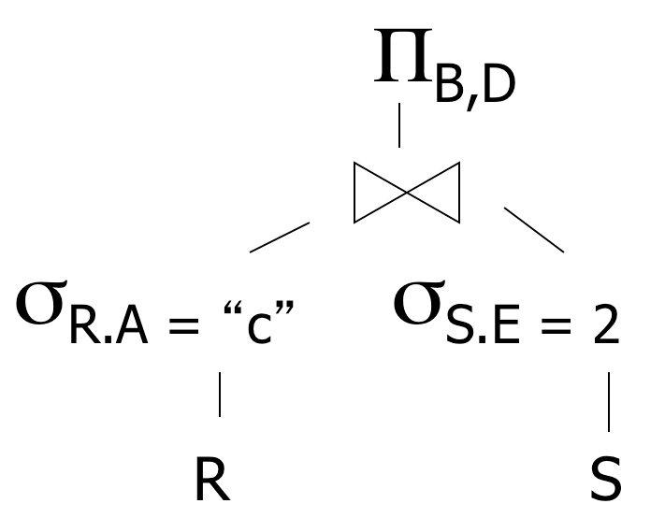
Relational Algebra – Possible Query Plans
Select B, D From R, S Where R.A = “c” And S.E = 2 And R.C=S.C
Plan 2
Natural join
(C is common column)

Slide 15
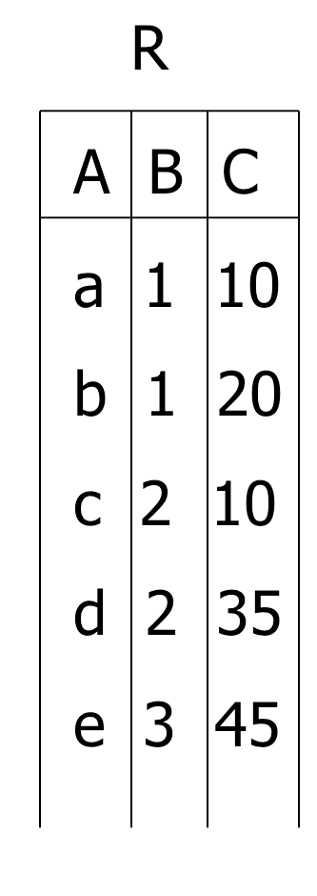
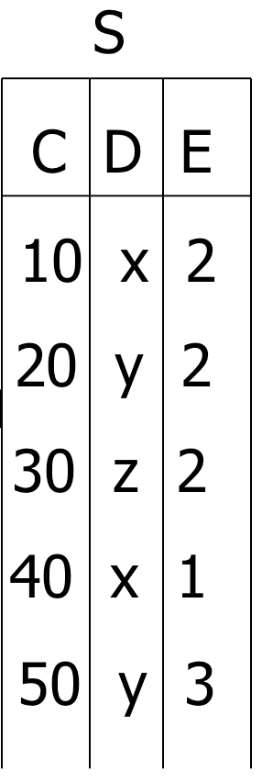
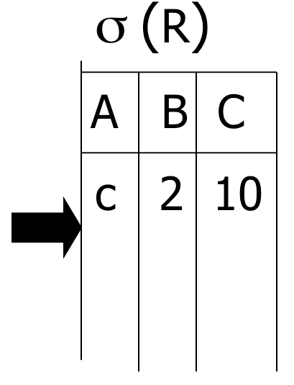
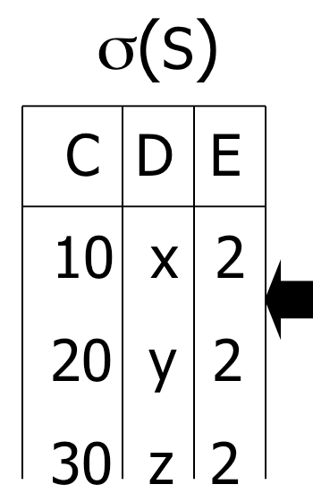

Select B, D From R, S Where R.A = “c” And S.E = 2 And R.C=S.C
Plan 2

Slide 16
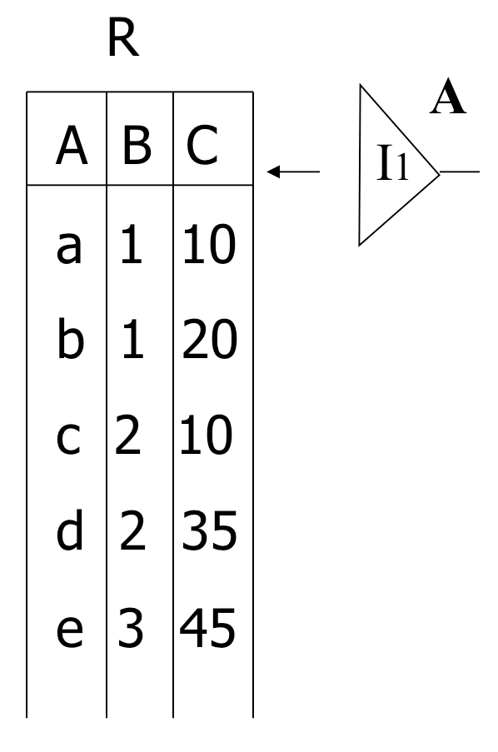
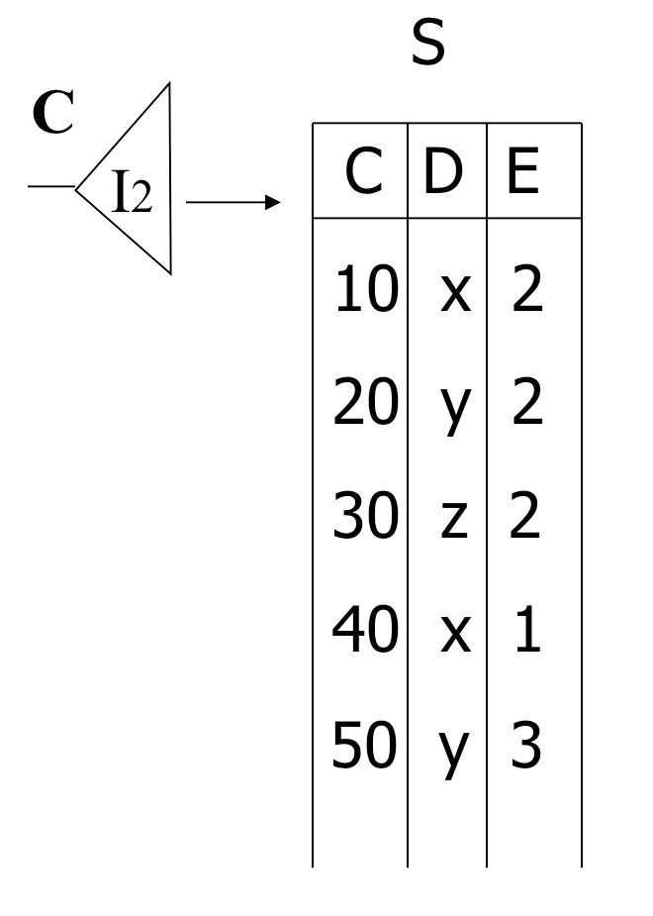
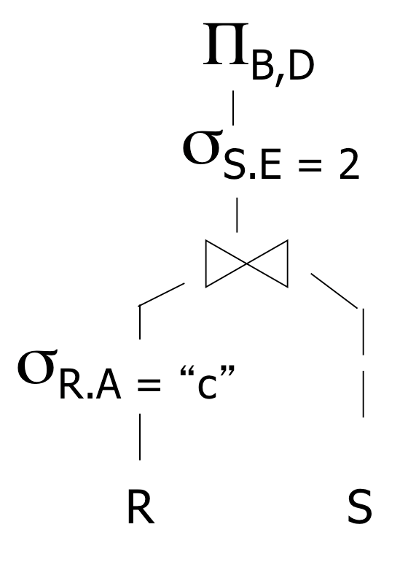
Select B, D From R, S Where R.A = “c” And S.E = 2 And R.C=S.C
Assume indexes on R.A and S.C
Plan 3
=“c”
<c,2,10>
<10,x,2>
Check E=2?
output: <2,x>

Slide 17
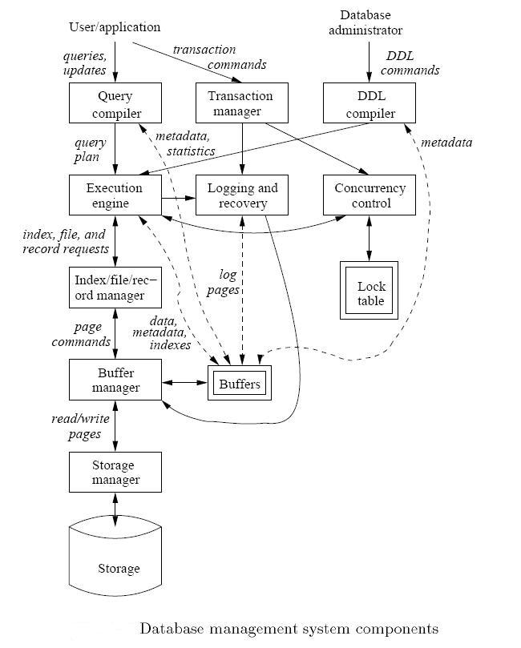
Query Compilation, Optimization and Execution
DB has the ability to optimize because:
Schema & structure is known
The query is known

Slide 18
Overview of Query Execution
SQL Query ➔ Compile ➔ Optimize ➔ Execute

Slide 19
Example
Query : Find the movies with stars born in 1960
SELECT title
FROM StarsIn
WHERE starName IN (
SELECT name
FROM MovieStar
WHERE birthdate LIKE ‘%1960’);

Slide 20
Step 1: Generate Parse Tree

Slide 21
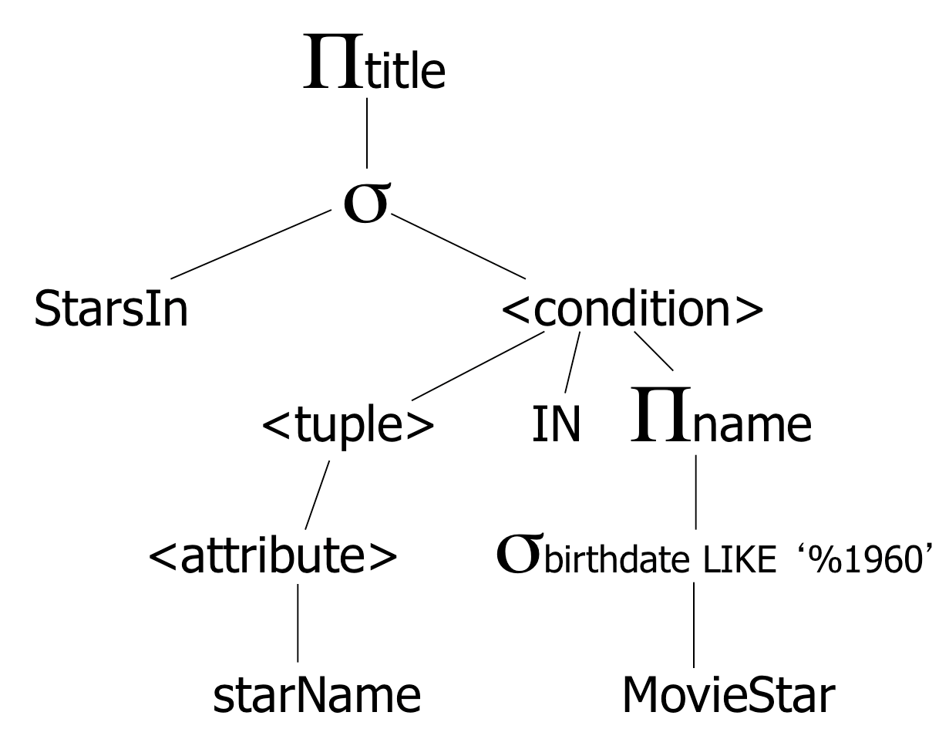
Step 2: Relational Algebra & Logical Plan
SELECT title
FROM StarsIn
WHERE starName IN (
SELECT name FROM MovieStar WHERE birthdate LIKE ‘%1960’);
Expression Tree
Logical Query Plan
Expression Tree is a midway between a parse tree and relational algebra

Slide 22
Step 3: Optimize & Create Several Logical Plans
SELECT title
FROM StarsIn
WHERE starName IN (
SELECT name FROM MovieStar WHERE birthdate LIKE ‘%1960’);
Plan 1
Plan 2
Question:
Push project to
StarsIn?

Slide 23

Overview of Query Execution
SQL Query ➔ Compile ➔ Optimize ➔ Execute

Slide 24
Step 4: Estimate the Sizes
That is done for each plan
Statistics Collection
For the entire relation
For each column
…

Slide 25
Step 5: Consider Physical Plans
Physical plan means how each operator will execute (which algorithm)
E.g., Join can be nested-loop, hash-based, merge-based, or sort-based
Each logical plan will map to multiple physical plans
Logical Plan
One Physical Plan

Slide 26
Overview of Query Execution
SQL Query ➔ Compile ➔ Optimize ➔ Execute

Slide 27
Step 6: Estimate the Cost
This is done for each physical plan
Select the cheapest to execute…

Slide 28
Overview of Query Execution
SQL Query ➔ Compile ➔ Optimize ➔ Execute

