Slide 1
RGB Cinema
Group 5

Slide 2
Supervisor
Members
Group 5
Ngo Van Thuan
Nguyen Tuan Loc
Hua Le Quang
Nguyen Phat Tai

Slide 3
Contents
Introduction
Overview
User Requirements
Technology
Management Plan
Task list

Slide 4
Introduction
The cinema industry offers a variety of business opportunities. We took inspiration from some existing systems like CGV, BookMyShow, …
To create a web project and mobile app for cinema ticket booking, it will need to consider the specific features and functionality that customer require

Slide 5
Limitations
A cinema ticket booking web project can require many complex elements and features to serve users in the best way. However, there are some of the common limitations encountered in our project: quality control, theater or seat look and feel, customer support, payment feature limitations

Slide 6
User requirements
Customer
Admin
Manager
Staff
Book tickets and use all the services provided.
Full control of the system. Adding staffs, managers and check invoices.
Staff management, theater management
Update movies in a theater, check customer booking

Slide 7
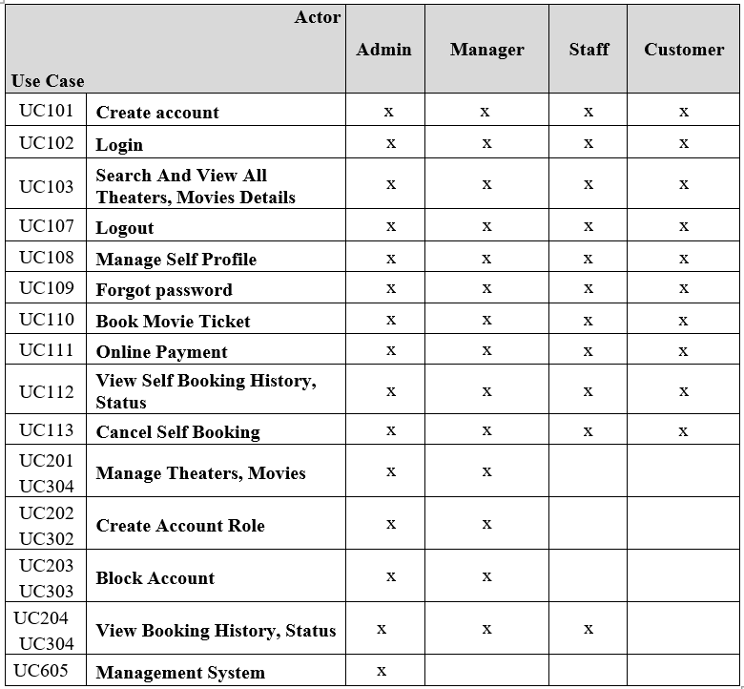

Slide 8
Management plan
The project started on 14 March and will be handed over on 18 April, so overall there will be 5 weeks for planning, training, and implementation

Slide 9
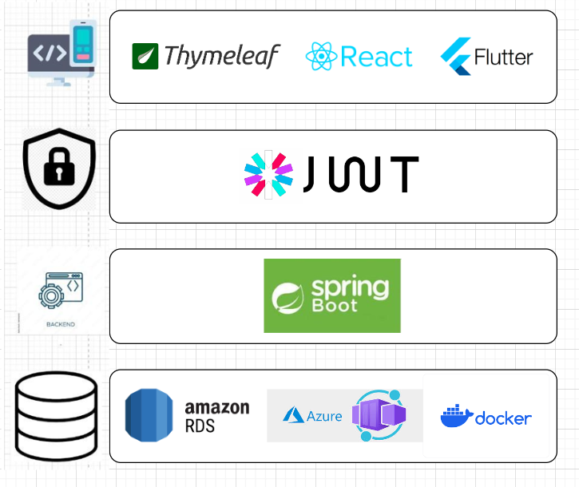
Technology
Architecture Design

Slide 10
TAsk
Group 5
RGB Project

Slide 11
Task list

Slide 12
Admin Account Management
Mobile Account Management
Nguyen Tuan Loc
Mobile View Movies
Mobile Booking

Slide 13

Nguyen Phat Tai
Admin Theater Management
Admin Movie Management
Admin User Management

Slide 14
Hua Le Quang
Customer Booking
Customer Account Management
View, Search Movies
Customer Cart, Payment
User Forgot Password

Slide 15
Thanks
Do you have any questions ?

