Slide 1
F1Flashback
Shaohua Yue

Slide 2
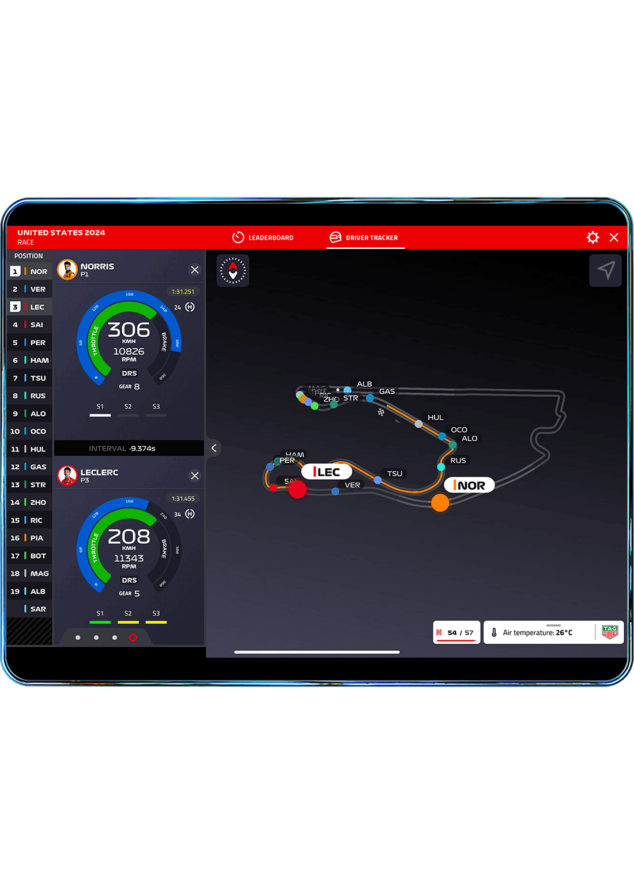
Motivation
Passion
Subscription
openf1.org

Slide 3
Data
Location
https://api.openf1.org/v1/location?session_key=9161&driver_number=81&date>2023-09-16T13:03:35.200&date<2023-09-16T13:03:35.800
{
"date": "2023-09-16T13:03:35.292000+00:00",
"driver_number": 81,
"session_key": 9161,
"x": 567, "y": 3195, "z": 187
}

Slide 4
Before we begin...
The data size.
location data + car data + ranking data > 300MB
fetch location data by API calls
locally saved: Car data, ranking data

Slide 5
Fetch data and map setup
Data fetch: Retry mechanism(3 times)
Scale
canvas size is smaller than coordinates data, find the border of coordinates data, compute the scale, then apply to the all coordinates
Offset
location data uses the centered coordinate system while canvas uses screen Coordinate System
Linear interpolation
low coordinate sampling rate
interpolated coordinate = coordinate(next – current) * ratio

Slide 6
Animation
requestAnimationFrame((timestamp) => updatePoint(timestamp))
Execute on each screen refresh
Use two parameters to control whether to refresh:
interval = location[index + 1].date - location[index].date
elapsed time = current time – last_start_time
if(elapsed time >= interval) update_index() & update last_start_time()

Slide 7
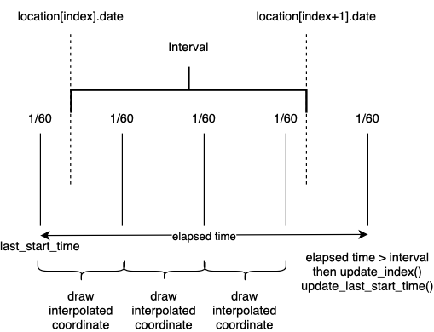
Animation

Slide 8
Progress Bar
Update progress bar in every refresh
Listen to mouse event
find the new index of location data
resume the animation

Slide 9
Thank you!

