Slide 1
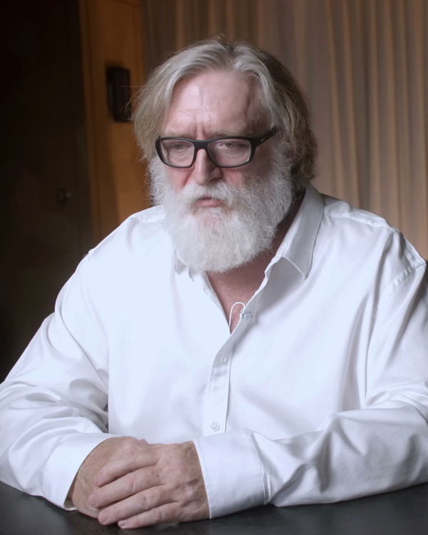
FOUNDATIONAL PHILOSOPHY • THE ECONOMIC & CREATIVE LOGIC
Gabe Newell's Ideology: Why Hierarchies Destroy Creative Value
From Ronald Coase's transaction costs to human leverage: why Valve eliminated bosses to unleash potential
✦ THE FOUNDER'S VISION & LOGIC
01 • TRANSACTION COSTS
Why Traditional Hierarchies Break in Creative Work
• The Industrial Legacy: Ronald Coase showed firms exist to cut transaction costs. Hierarchies worked for factories, but in creative education, corporate managers actually introduce massive friction, red tape, and delay.
• Zero Internal Friction: By eliminating middle management, Valve operates as an agile internal network. Ideas move at the speed of direct conversation without waiting weeks for supervisor approvals.
02 • CREATIVE LEVERAGE
Autonomy Multiplies Creative Leverage Over Direct Orders
• The Management Bottleneck: When supervisors dictate daily tasks, educators can only produce what one manager imagines. Dictating tasks to masters caps their creative output at average execution.
• Unlocking Full Leverage: When educators own their curriculum directly, their impact multiplies. They spot subtle student confusions, craft engaging pronunciation games, and take personal pride in every outcome.
Gabe Newell
Co-Founder & CEO • Valve Corporation
“If you hire smart, creative people and then tell them what to do, you destroy most of their value. You want people who figure out what is valuable and just go do it.”
— Gabe Newell (University of Texas & Washington Post)
03 • LEARNER FIRST
Eliminating Office Politics to Focus 100% on the Student
• Ending 'Managing Up': In corporate ladders, people waste half their mental energy managing impressions and pleasing bosses. Without managers, internal politics and defensive turf wars evaporate.
• One True North Star: 100% of energy is directed outward: “Does this genuinely help students learn?” When the learner is the only judge, quality remains uncompromising and transparent.
💡 HOW GABE'S FOUNDING LOGIC EMPOWERS OUR TEACHING TEAM
“We aren't making software, but educational design is deeply creative knowledge work. You don't need an administrator's permission slip to make a lesson better. When we trust each other as equals, our students get the very best curriculum.”

