Slide 1
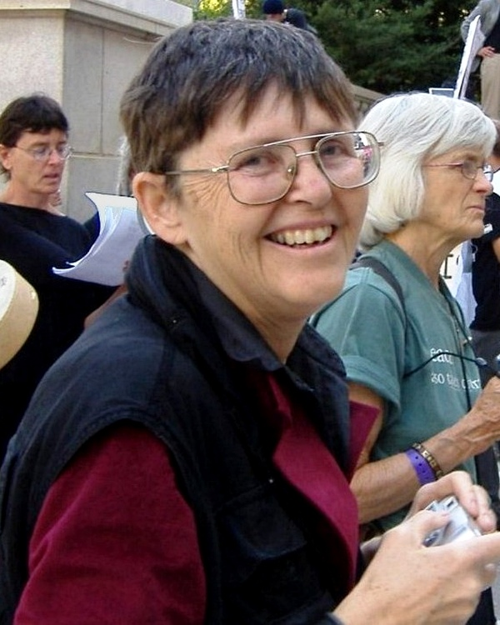
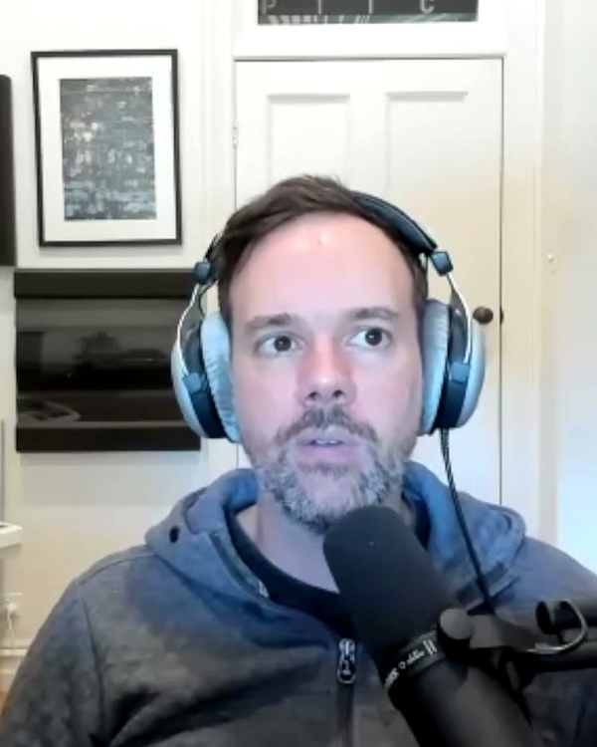
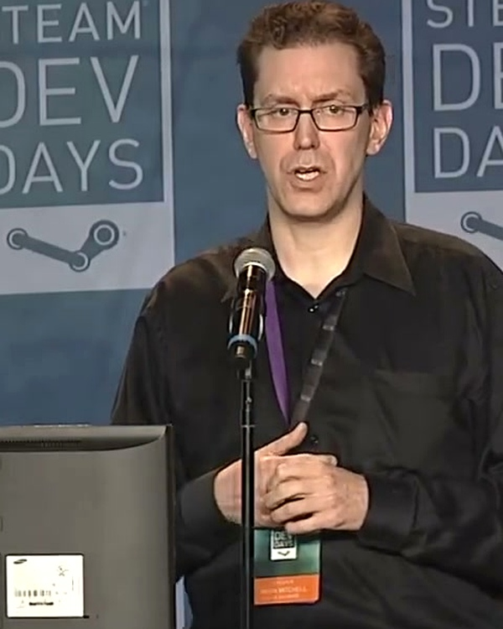
ORGANIZATIONAL SOCIOLOGY • HISTORICAL PITFALLS
The Documented Traps: What We Guard Against
Drawing from 50 years of organizational literature to engineer explicit cultural defenses:
⚠️ TRAP 01 • FREEMAN (1972) & ELLSWORTH
⚠️ TRAP 02 • VALVE HANDBOOK & WEIER
⚠️ TRAP 03 • RICH GELDREICH (2015) & VALVE
Shadow Barons
⚠️ The Tyranny of Structurelessness
Jo Freeman • Author (1972)
Phantom Crunch
⚠️ Guilt-Driven Overtime
Josh Weier • Valve Project Lead
Stack Ranking
⚠️ The Peer Grading Trap
Rich Geldreich • Valve Software Engineer
THE THREAT:
Removing formal hierarchy does NOT abolish power; it merely pushes power underground into unaccountable social cliques, popularity contests, and hallway whisper networks.
OUR ENGINEERED DEFENSE:
Explicit Democratic Structuring & The Advice Process: All major curriculum decisions are logged openly in the living Bible. Technical merit and empirical data override social seniority.
“Cliques form in the dark; radical transparency keeps Flatland flat.”
THE THREAT:
Without managers setting explicit boundaries, dedicated professionals work until 2 AM out of unspoken guilt. The Valve Handbook explicitly warned that overtime is a failure in planning.
OUR ENGINEERED DEFENSE:
The Sustainable Cadence: 6 hours/day of deep collaborative focus, 4 days/week. The 5th day is 100% protected for solo drafting, quiet tool testing, and rest. Zero late-night messaging.
“Crunch means our predictions failed, not that we are heroes.”
THE THREAT:
Valve ranked peers against each other for compensation, unintentionally breeding cutthroat politics, risk aversion, and fear of challenging popular veterans with bold innovations.
OUR ENGINEERED DEFENSE:
Shared Objective Outcomes: 100% alignment around student pronunciation mastery. Zero internal stack ranking, zero peer competition for fixed bonus pools. All incentives share student success.
“Never turn colleagues into rivals for a fixed reward pool.”

Slide 2
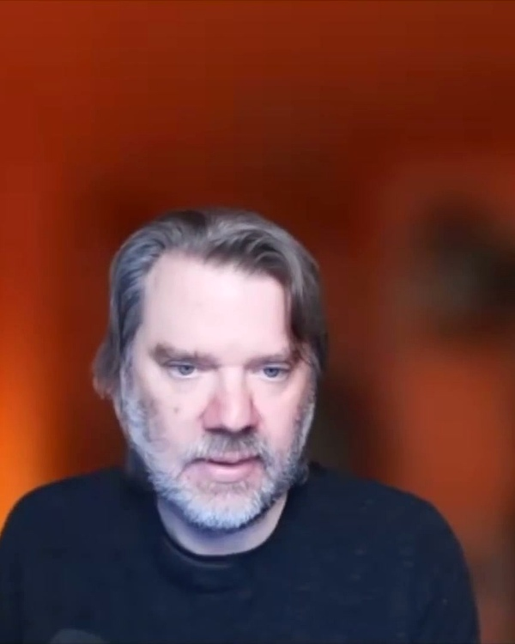
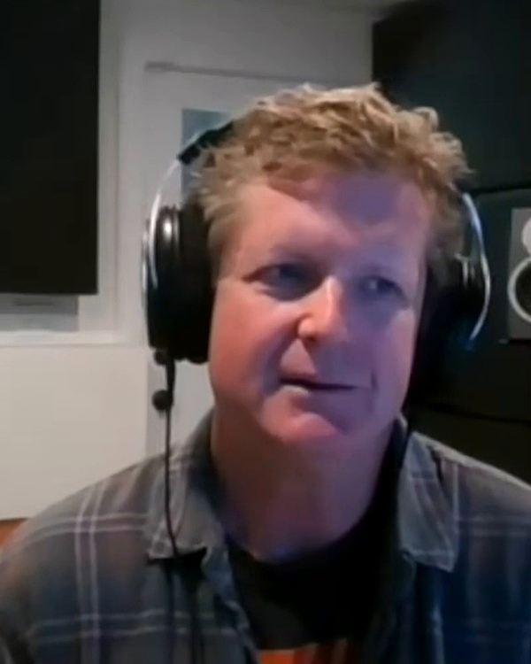
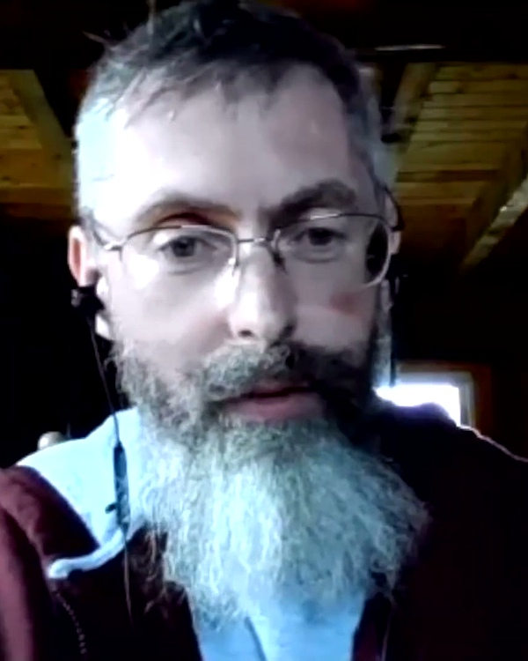
VETERAN WISDOM • PRIMARY SOURCE INTERVIEWS
Voices from Flatland: The Valve Veteran Cadre
Direct wisdom from the creators of Half-Life, Portal, Left 4 Dead, and Team Fortress 2 on autonomy and craft:
✦ WRITING & PROTOTYPES
✦ PROJECT LEADERSHIP
✦ AUDIO & CABAL LOOPS
✦ PLAYTEST & GAMEPLAY
Chet Faliszek
Writer & VR Lead • Left 4 Dead, Portal
“Nobody tells you what to do. You see a problem, you go fix it. The people who thrive are the ones who don't wait for permission — they build the prototype and let data speak.”
✦ R&D APPLICATION: ZERO-PERMISSION BIAS
Don't write proposals for vowel drills — build the prototype in 2 hours and test it directly with students.
Josh Weier
Project Lead • Portal 2, Half-Life 2
“At Valve, if you're working until 2 AM, nobody thinks you're a hero. They think the process failed. Sustainable creative teams guard their focus, recharge, and sleep.”
✦ R&D APPLICATION: SUSTAINABLE PACE
6 hours of deep Cabal collaboration beats 60 hours of isolated, exhausted grinding. Guard the 5th day.
Mike Morasky
Audio Director • Portal 2, TF2, HL: Alyx
“The Cabal wasn't a meeting. It was sitting in the same room where audio, design, and code fed into each other every 10 seconds. You don't write music in a silo — you compose as it plays.”
✦ R&D APPLICATION: CLOSED-LOOP AUDIO
Synthesize Kokoro phonemes in 2 minutes right alongside the curriculum designer at the shared workbench.
Erik Wolpaw
Lead Writer • Portal 1 & 2, Psychonauts
“Writing for games is about leaving your ego at the door. You write dialogue, watch a playtester in silence, and if it slows them down or confuses them, you cut it on the spot.”
✦ R&D APPLICATION: EGO-FREE ITERATION
If a pronunciation drill line confuses the learner, cut it immediately without defensiveness.

Slide 3
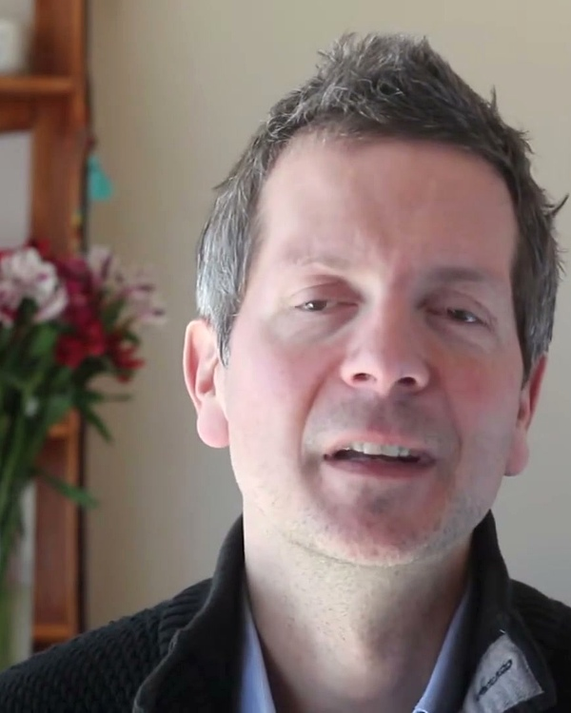
DECISION ARCHITECTURE • DENNIS BAKKE & FRÉDÉRIC LALOUX
Decision Architecture: The 5-Stage Advice Process
How any autonomous educator drives high-stakes decisions without supervisory orders or consensus paralysis:
STAGE 01
STAGE 02
STAGE 03
STAGE 04
STAGE 05
Spot Friction
✦ The Initiator Steps Up
You notice a confusing pronunciation rubric, unnatural audio cadence, or tool bottleneck.
Initiative Rule: The person who spots the friction owns driving the fix.
“Never wait for someone else to log a ticket.”
Prototype
✦ Tangible Draft
Draft a 1-page spec or generate a 20-second Kokoro audio sample before calling meetings.
Prototype Rule: No abstract philosophical debates without a tangible draft.
“Discussions without prototypes breed debate.”
Seek Advice
✦ MANDATORY GATE
Consult 2 parties:
1. Affected Peers
2. Domain Specialists (phoneticians, audio leads).
⚠️ Iron Gate: Advice is counsel, NOT a veto! No consensus required.
“You must seek advice; you do NOT need agreement.”
Decide & Ship
✦ Sole Ownership
Weigh all feedback, integrate valid peer insights, and decide yourself.
Ownership Rule: You do not ask permission. You pull the trigger.
“Total ownership of both victory and failure.”
Inform & Audit
✦ Radical Transparency
Broadcast the decision openly in the shared Bible and publish real learner playtest data.
Audit Rule: Real learner data replaces bureaucratic supervision.
“If it fails, revert openly. Transparency is safety.”
⚡ FRÉDÉRIC LALOUX • AUTHOR, REINVENTING ORGANIZATIONS
“Anyone can make any decision, provided they seek advice from experts and those affected. Advice is NOT permission — ownership stays 100% with the decision-maker.”
Peer consultation replaces bureaucratic approval gates. Data and student playtest outcomes override administrative seniority.

Slide 4
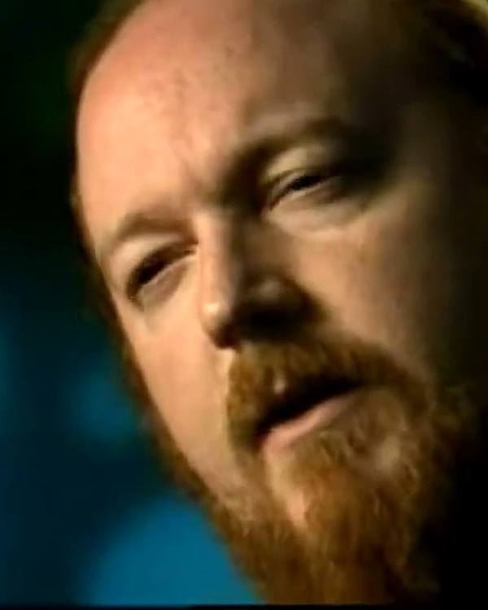
SUSTAINABLE CADENCE • PHASE 2 LAUNCH
Sustainable Cadence: Launching Phase 2
The 4-day collaborative rhythm, the protected 5th day, and our 12-week production horizon:
THE KEN BIRDWELL CADENCE (VALVE 1999)
THE 12-WEEK PRODUCTION HORIZON
High Velocity, Zero Burnout
• Monday to Thursday (10 AM – 5 PM): 6 hours/day of deep collaborative synthesis at the shared Cabal bench (1h lunch). High-density co-creation.
• Friday (100% Protected Deep Work): Strictly reserved for solo drafting, quiet tool testing, and mental recovery. Zero meetings.
• Evenings & Weekends (Zero Messaging): Overtime is recognized as a planning failure, never celebrated as heroism.
50 Empirically Validated Modules
🚀 Sprint 1 (Weeks 1–4): Vowels 01–20
Articulatory mouth tension, minimal pair listening games, and AI audio calibration. Week 5: Alpha Gate (20 ESL learners).
🚀 Sprint 2 (Weeks 6–9): Consonants 21–40
Aspiration, voiced vs. unvoiced stops, and consonant clusters. Week 10: Beta Gate (50 ESL learners under automated STT).
🚀 Sprint 3 (Weeks 11–12): Prosody 41–50
Sentence rhythm, tonic syllables, and communicative pitch contour integration.
Ken Birdwell
Author, The Cabal (1999)
“6 focused hours beats 60h grinding.”
🚀 PHASE 2 PRODUCTION COMMENCES TODAY
“We lead by serving, clearing obstacles, and fostering radical peer safety. Let's engineer the future of pronunciation.”
Cabal assignments and pod workspaces go live this afternoon. Week 1 Priority: Drafting the Living Syllabus Bible and engineering our first Alpha playtest prototypes.

