Slide 1
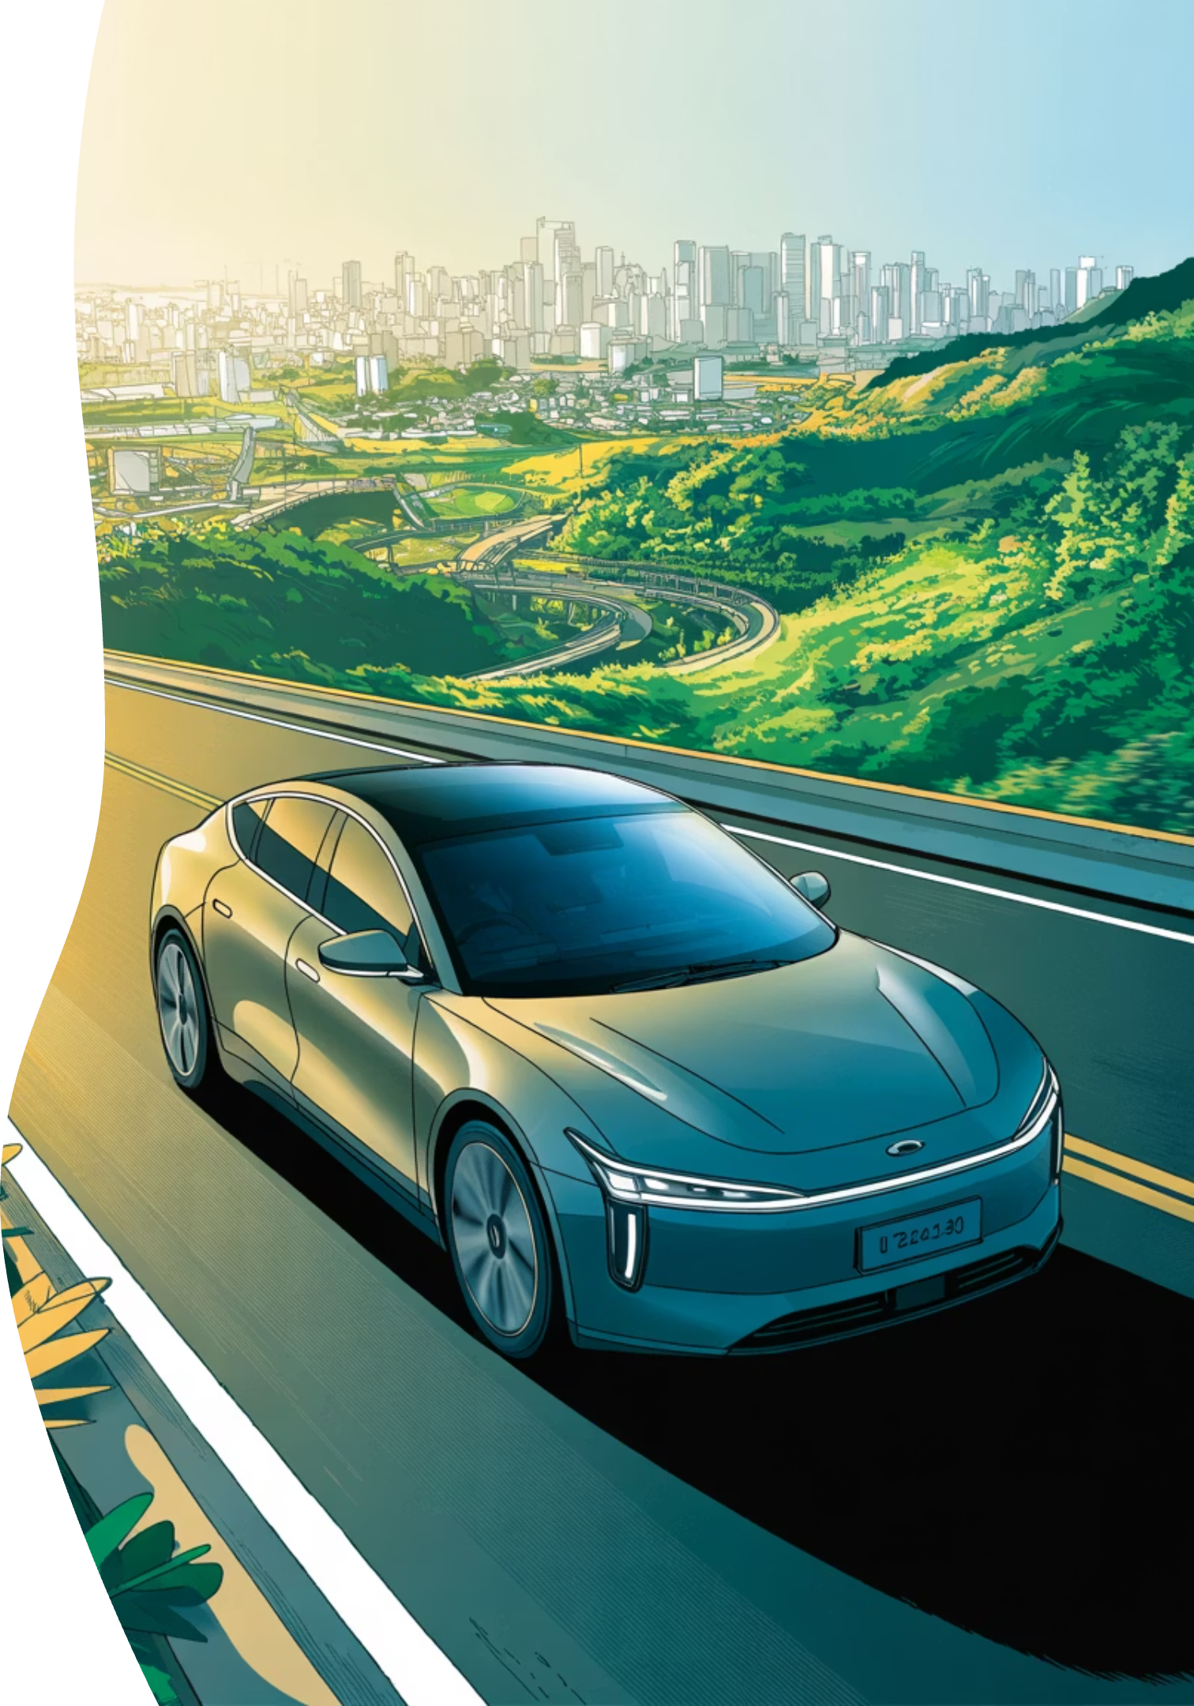
T Map
The EV Mobility Platform for Vietnam
Built for Vietnamese EV reality.

Slide 2

EV adoption is growing fast — but EV travel is still stressful.
Range Anxiety
Will I make it? No reliable SOC-aware routing exists for Vietnam's roads.
Fragmented Data
Charger status is scattered, outdated, or simply unavailable in real time.
Broken Chargers
Arriving at a station only to find it broken or fully occupied.
No Unified App
Google Maps isn't EV-native. No single platform covers the full journey.

Slide 3

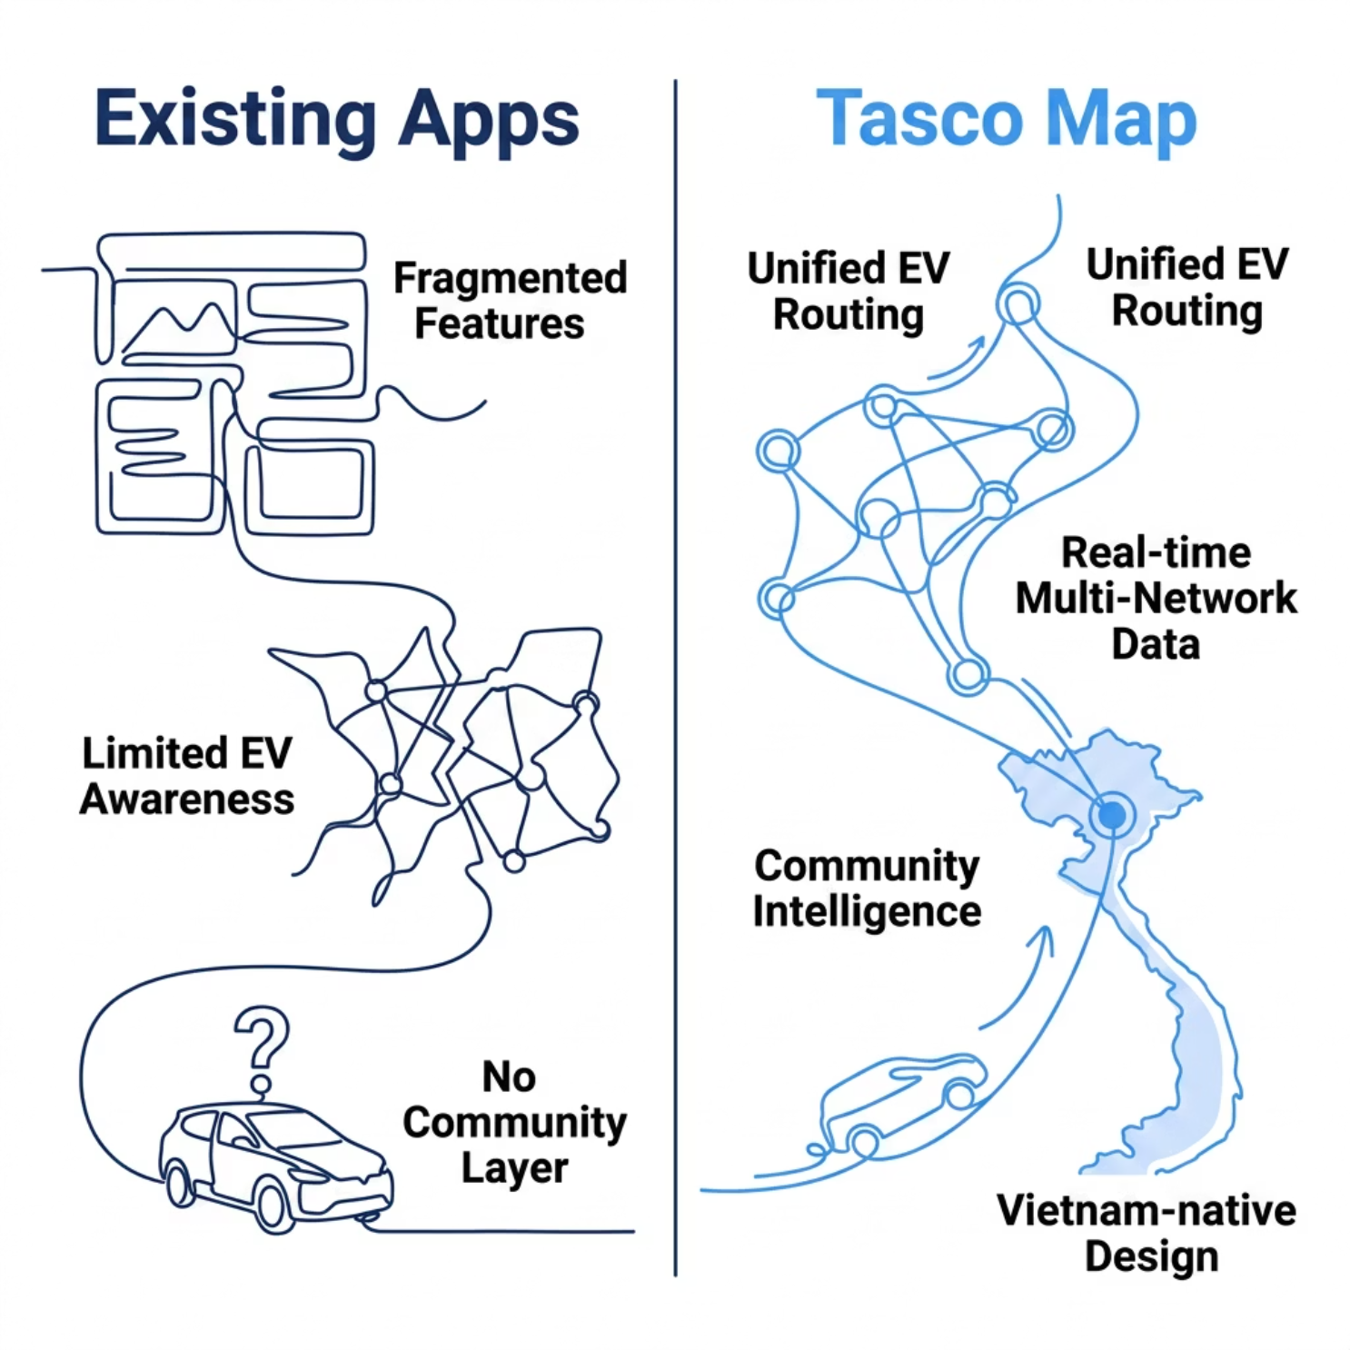
Why Existing Solutions Fall Short
Current apps show roads. T Map understands EV travel.
T Map
Feature
Google Maps
Charger Apps
T Map
EV-aware routing
❌
⚠️
✅
Multi-network chargers
❌
⚠️
✅
Community reports
⚠️
⚠️
✅
Route sharing
❌
❌
✅
EV-friendly hotels
❌
❌
✅
Vietnam-specific EV reality
❌
❌
✅

Slide 4
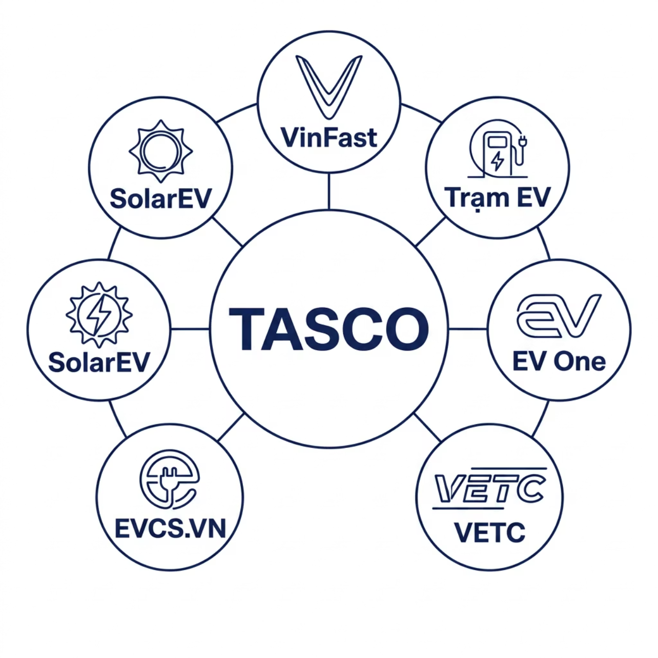


An Open EV Ecosystem — Built for Partners
T Map creates value for every stakeholder in the EV journey — from charger operators to hotels, cafes, malls, and rescue services.
Customer Acquisition
Visibility & Analytics
Increased Utilization
Direct access to engaged EV drivers
Data-driven insights on EV travel behavior
Drive traffic to underused charging assets
Business Model: Promoted locations · Premium visibility · Analytics subscriptions · Ecosystem loyalty · Future API platform

Slide 5

Our Moat Is Not Maps. It's EV Reality Data.
Google has maps. T Map has EV intelligence. Proprietary data that compounds over time and cannot be replicated.
6+
1st
Unique Data Layers
Vietnam-Native
Charger reliability, real-world consumption, community reports, overnight charging, route patterns, and Vietnam-specific mobility behavior
The only platform purpose-built for Vietnamese EV infrastructure, roads, and driver behavior
∞
Network Effects
Every journey, report, and review makes the platform smarter and harder to replicate

Slide 6
One App for Every EV Journey
T Map is the complete EV travel companion — from planning to arrival.
Smart EV Routing
Live Charger Info
SOC-aware navigation with optimized charging stops and safety buffers.
Real-time status, reliability scores, and queue predictions across all networks.
Community Alerts
EV-Friendly Destinations
Live reports, reviews, and shared routes from the EV community.
Overnight charging hotels, EV-friendly cafes, and rescue network access.

Slide 7
Key Features, Deeply Integrated
Smart Routing
Community
SOC-aware navigation
Charger optimization
Safety buffer calculation
Food & rest stop routing
Live charger reports
Charger reviews
Route sharing
Convoys & EV clubs
EV Lifestyle
Just one wallet
Overnight charging hotels
EV-friendly cafes
Roadside rescue network
VETC
Electric bill
Community score

Slide 8
Smart EV Routing
Find optimal routes based on:
Battery level
Vehicle model
Destination
Multiple route options:
Fastest
Lowest battery anxiety
Best charging/rest stops

Slide 9
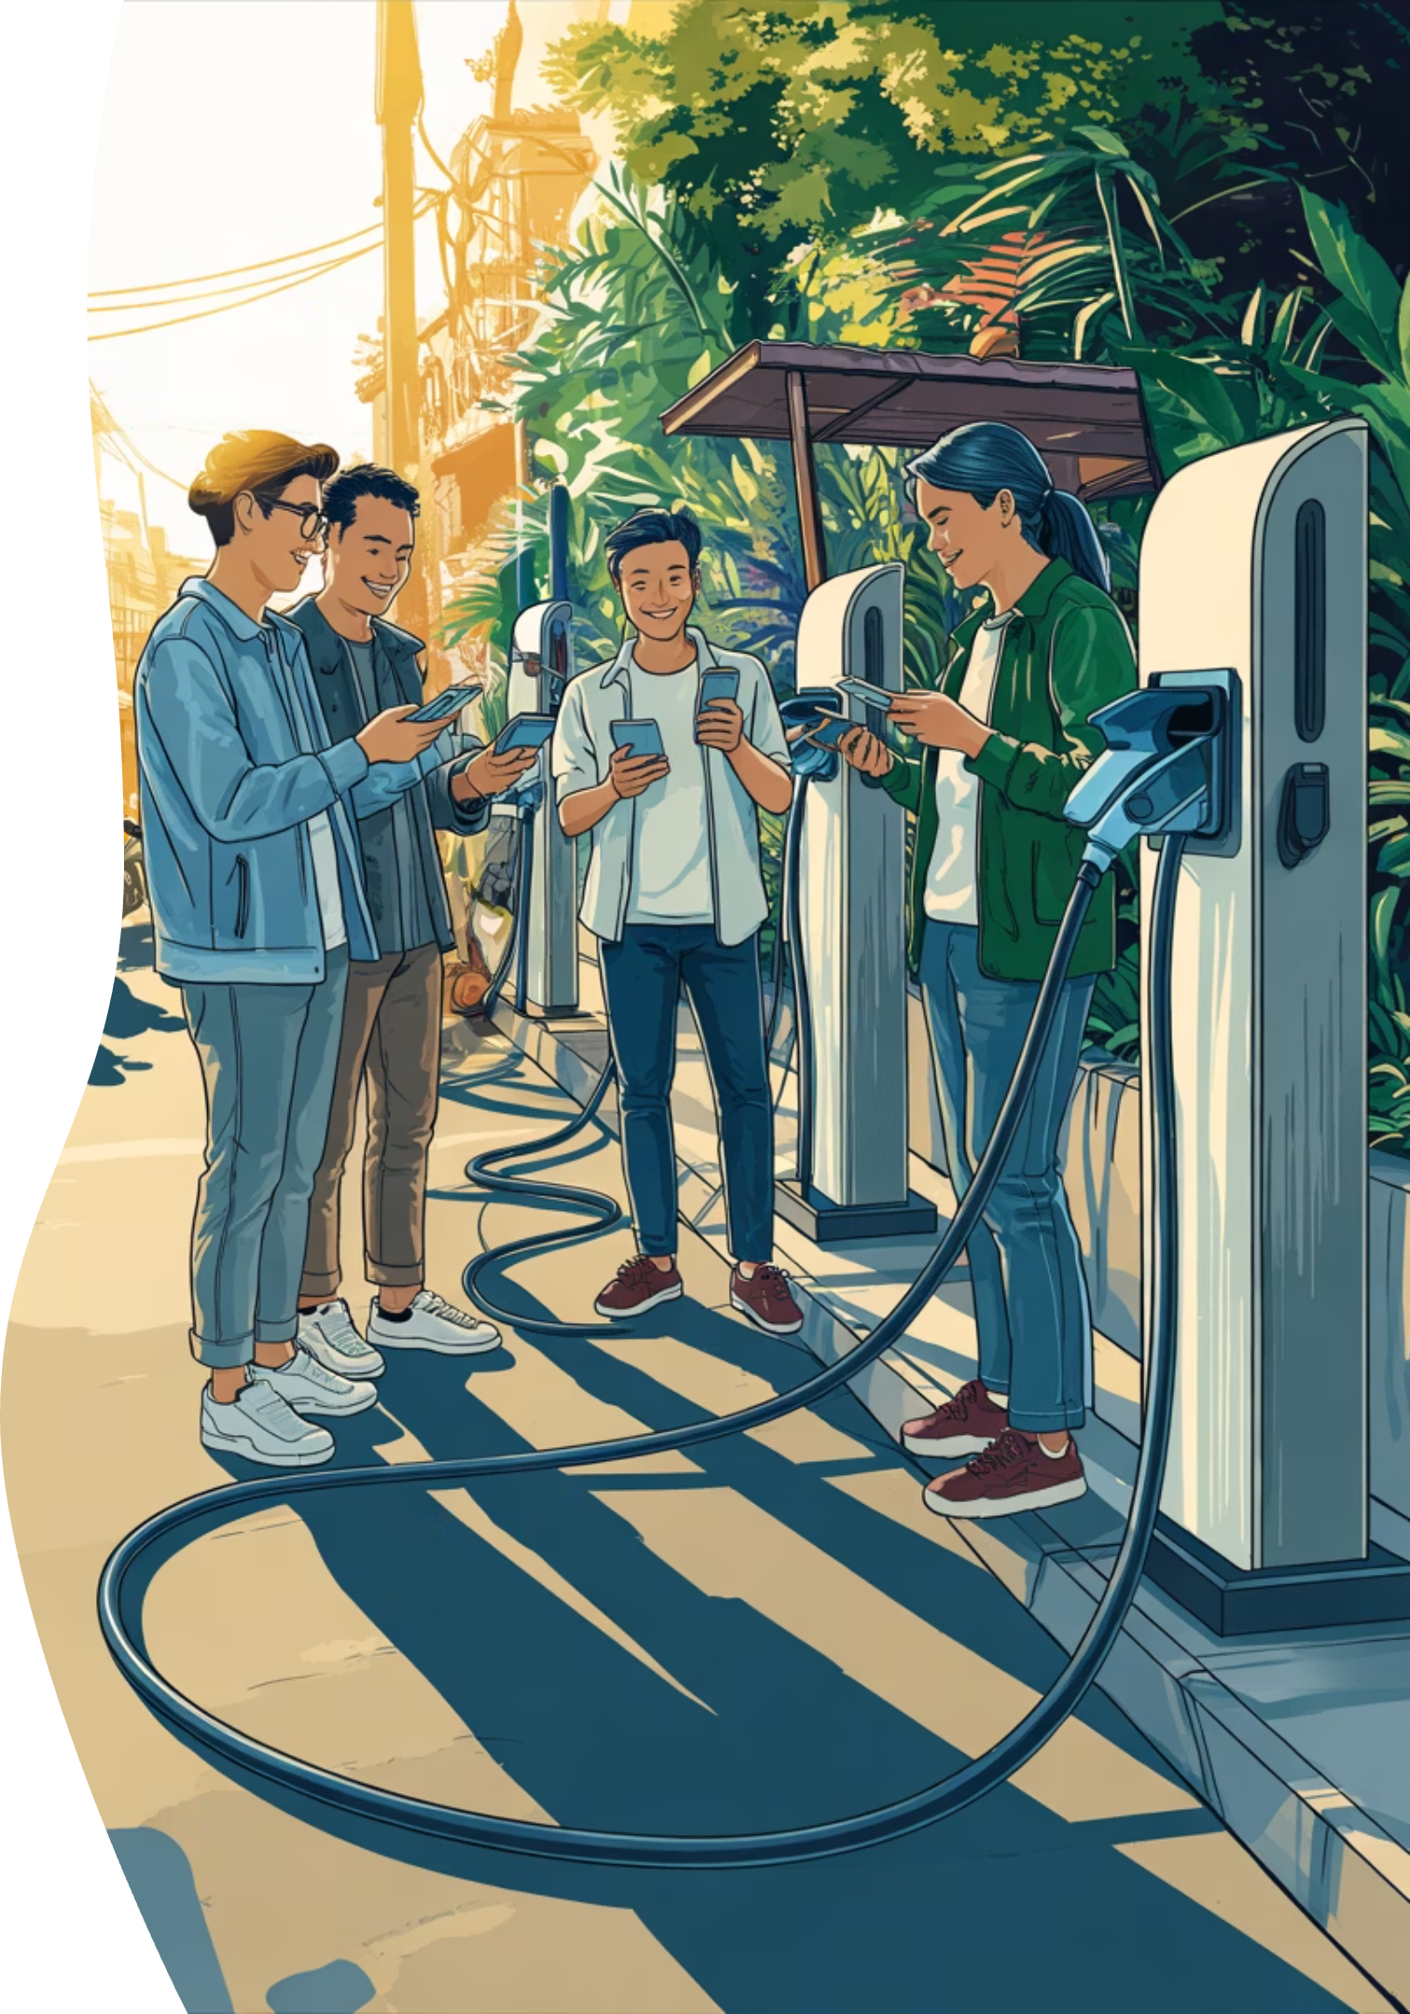
Community-Powered EV Experience
T Map thrives on the power of its community, transforming individual journeys into collective intelligence.
Share routes
Seamlessly share optimized routes with friends or other EV enthusiasts.
Review chargers
Contribute to charger reliability scores and help others make informed decisions.
Report real-time issues
Instantly report broken chargers or long queues, keeping the community updated.
Build EV communities
Connect with local EV clubs, organize convoys, and foster a supportive network.

Slide 10

Roadmap: From Utility to Platform
Phase 1 — Utility
1
Charger map, EV routing, SOC prediction, reviews & reports. Launch the core experience.
2
Phase 2 — Trust
Real-time occupancy, reliability scoring, hotel integrations, community features. Build user confidence.
Phase 3 — Platform
3
Route sharing, loyalty ecosystem, analytics platform, full EV mobility network. Become the operating layer.
Each phase unlocks new partner opportunities and deepens the data moat — creating a compounding competitive advantage.

Slide 11

T Map
The Best App for EV Drivers in Vietnam
Not just navigation.
Powered by community.
Confidence for every EV journey.
Real drivers, real data, real trust.
Powered by T.
The operating layer for Vietnam's EV future.

