Slide 1
UDS Investigation
Author: Hua Van Thong

Slide 2
Agenda
UDS Overview
Automotive Diagnostic System
General Info & Context
What is python-udsoncan and python-uds?

Slide 3
Unified diagnostic services (UDS) An overview

Slide 4
What is UDS?
UDS (Unified Diagnostic Service) is a protocol to communicate with (typically) automotive ECUs
Used for generally any interaction to control or query an ECU, from resetting DTCs to flashing new firmware images
It has been around for a long time, so most likely everyone’s car supports it
Can be used on most automotive physical layer systems (CAN, LIN, Ethernet, DoIP, FlexRay, K-Line)
Notes:
UDS is a application level protocol which provides diagnostic interfaces to ECU
It’s been around in various forms for over a decade so most of your cars probably have ECUs which support UDS
As its an application level protocol, its built on the basic lower level communications protocols on the cars. Some of the common ones are
CAN – Controller Area Network – High reliability / medium bandwidth, safety critical
LIN – Local Interconnect Network – Low bandwidth non safety critical
Ethernet – High bandwidth, not very prevalent in automotive for a number of reasons I won’t get into
DoIP – Essentially ethernet with some specific parameter constraints
FlexRay – High reliability high bandwidth, safety critical. Was supposed to be the CAN replacement
K-Line – Low bandwidth, mostly obsolete and was the precursor to can.

Slide 5
Why should you care what UDS is?
If you ever want to tinker with vehicle data, UDS provides a nice interface
Easy to get started
Don’t have to reverse engineer raw CAN data (This can range from simple to incredibly complex)
There are standard parameters for some data such as; engine speed, engine temp, throttle position, fuel trim, etc (links later)
UDS data can also help when reverse engineering to provide references from known data sources
You can read and clear DTCs (the scourge of modern cars!)
Notes:
UDS is a fairly nice protocol, it’s relatively simple with a nice structure and has some defined standardisation
Raw CAN data is hard to read and interpret without a definition file, commonly termed a DBC for a Vector Informatik file format
There are standardised protocols such as OBD which is built on UDS which I’ll go into later
It can also help to provide a reference point for either reverse engineering raw CAN data or for reverse engineering ECU code. One of the standard entry points was to find the UDS / OBD code to find RAM variables for parameters such as ignition timing or engine speed
UDS and OBD allow you to clear DTCs on your car, which is also nice, but to be honest most can be cleared with a £10 dongle from amazon

Slide 6
Automotive Diagnostic System
Set up system for diagnostic
Notes:
Just going to cover some basics / terminology just to make sure people get what I’m talking about.

Slide 7
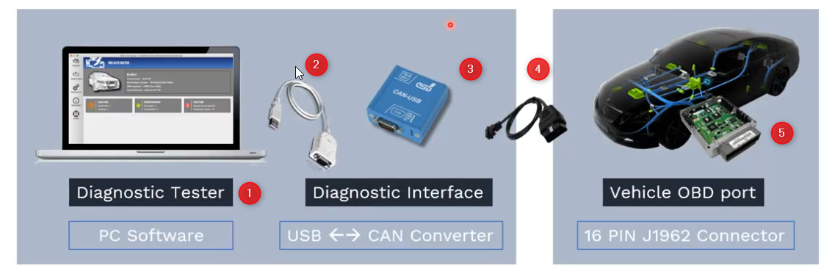
Automotive Diagnostic System (UDS)
This slide, we will consider how to set up system for diagnostic with UDS.
Here is a system for diagnostic between PC and Vehicle:
PC Software: where application send UDS message
USB Cable: 1 side is USB and the other side is RS-232 Connectors
Protocol converter: converts the USB signal into CAN or any protocol
4. Cable to connect OBD port.
5. Many ECUs are available in CAR a

Slide 8
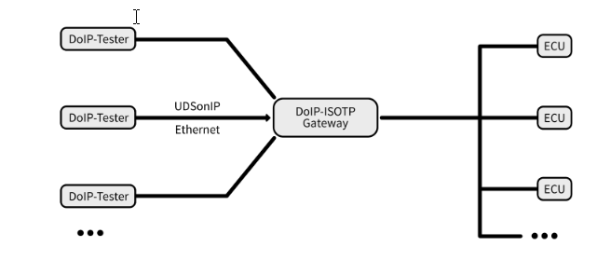
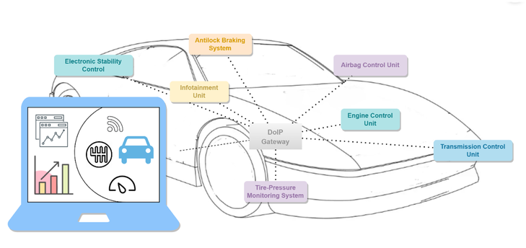
Automotive Diagnostic System (DoIP)
a desired ECU
With DoIP, tester can remote access to ECU through internet.
Requests of the tester are forwarded to internal networks so that a desired ECU can receive and process them. As soon as a response from the requested ECU is available, the gateway routes this back to the tester.

Slide 9
The difference between DoIP and UDS?
DoIP (Diagnostics over Internet Protocol):
DoIP is used to establish a connection and communicate with the target device (typically an Electronic Control Unit or ECU in a car) over the Internet Protocol (IP) network.
DoIP provides the capability for remote diagnostics and connectivity over the network, enabling access and control of remote diagnostic functions.
UDS (Unified Diagnostic Services):
UDS is a unified diagnostic protocol used for communication between diagnostic devices and control components within the vehicle.
Once the connection via DoIP is established, UDS is utilized to send specific diagnostic commands and receive feedback from the target device.
Notes:
UDS is a fairly nice protocol, it’s relatively simple with a nice structure and has some defined standardisation
Raw CAN data is hard to read and interpret without a definition file, commonly termed a DBC for a Vector Informatik file format
There are standardised protocols such as OBD which is built on UDS which I’ll go into later
It can also help to provide a reference point for either reverse engineering raw CAN data or for reverse engineering ECU code. One of the standard entry points was to find the UDS / OBD code to find RAM variables for parameters such as ignition timing or engine speed
UDS and OBD allow you to clear DTCs on your car, which is also nice, but to be honest most can be cleared with a £10 dongle from amazon

Slide 10
General Info / Context
Stuff about UDS & cars
Notes:
Just going to cover some basics / terminology just to make sure people get what I’m talking about.

Slide 11
Electronic Control Units (ECUs)
A modern car can have upwards of 20 individual ECUs and 3 communication bus
A modern Land Rover Discovery has 50+ ECUs, 6 CAN bus, 1 FlexRay bus and a DoIP (automotive ethernet) diagnostics connection (there are actually more networks as well….)
For CAN (which is the most common) each ECU is given two unique addresses. The Request ID (Tx) and Response ID (Rx)
For an engine ECU this is: 0x7E0 (Tx) and 0x7E8 (Rx)
For a transmission ECU this is: 0x7E1 (Tx) and 0x7E9 (Rx)
ECUs can also listen to the broadcast ID 0x7DF (Tx) and will respond on their own Response ID
Notes:
VAMP

Slide 12
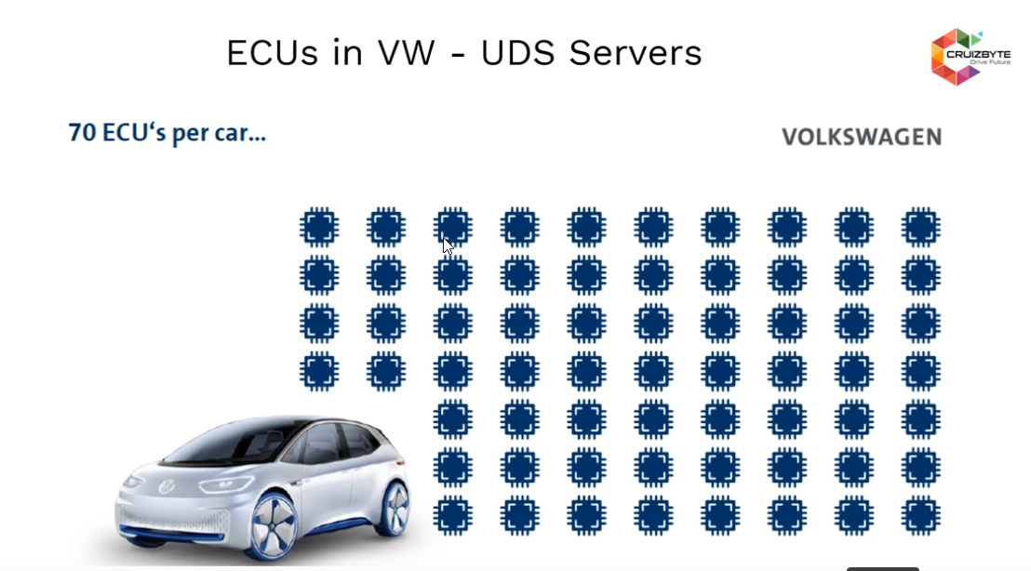
Example ECU’s per car
The question that how to set up the client diagnostic to all ECUs above?

Slide 13
UDS ECUs and Testers
UDS classifies endpoints as Servers (Typically ECUs) or Testers / Clients (Diagnostic equipment)
Servers can not initiate communications on their own
There are instances of ECUs using UDS to talk to each other, but this is generally non-standard and there are other protocols that better solve this need
A tester is the tool that a garage will use to communicate with the ECUs
This is typically an (overpriced) laptop with a (very overpriced) hardware interface, but there are handheld versions for simple diagnostics
There are also UDS gateways but these are usually transparent
Typically used to present 1 interface to multiple networks

Slide 14
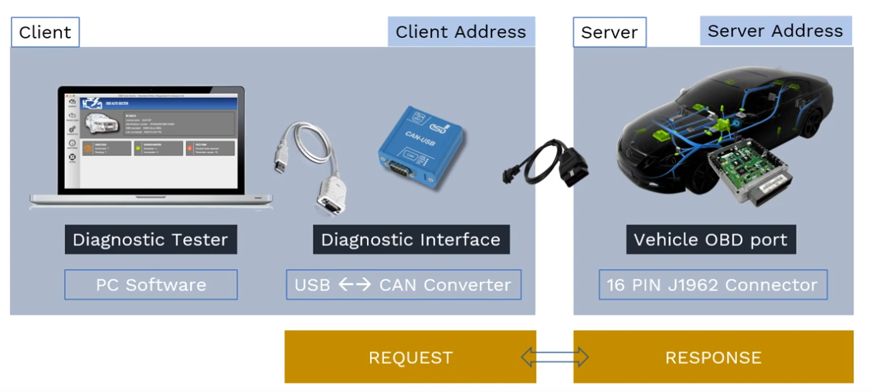
UDS ECUs and Testers
Notes:
Next slide, we will talk about what the format of message?

Slide 15
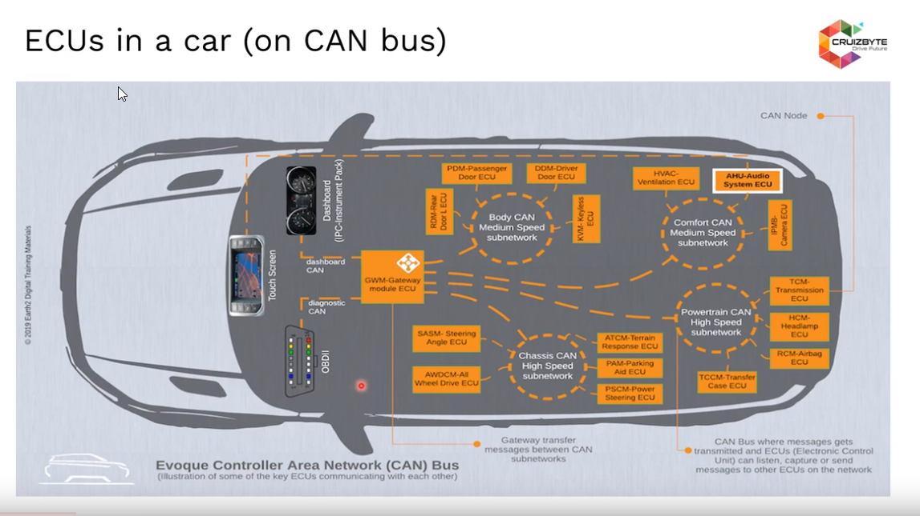
Demo ECUs in a car
Every ECU inside the vehicle as assigned a unique identifier as their address

Slide 16
UDS Messages
UDS messages have a common format
This is an example of the OBD-II⁽¹⁾ Mode 1 Engine Speed Parameter
Request: 01 12
Response: 41 12 1F 40
Green is the service
Yellow is the response code⁽²⁾
Blue is the mode
Orange is the Data
In this example the scaling is simply y=0.25x
which in this example is 2000 rpm
(1) OBD (on-board diagnostics) is an industry standard protocol built on UDS. Look at https://en.wikipedia.org/wiki/OBD-II_PIDs for more information
(2) A valid response adds 0x40 to the service request (0x01 -> 0x41).
An invalid response is 0x7F which represents an error. The error code is then included in the payload.
There are other responses but they are more complex and generally relate to flow control so we’ll skip these
Notes:
All UDS messages have a fixed structure with a few common parts.
All UDS messages start with a service which is the green text, a successful response adds 0x40 to the service and a 0x7F is a special code to say the request has failed.
The rest of the message depends on the service and is defined in either the OBD or UDS standards
In this example we’re looking at the OBD-ii Mode 01 Service which defines a set of diagnostic data parameters. Each parameter has a 1 byte code in this example we’re using engine speed which is 0x12.
The response from the ECU in this case is a successful response, 0x41 and then the value in this case 2 bytes 0x1F40. When put through the scaling formula this gives 2000 rpm.

Slide 17
UDS Messages – More examples
Read ECU Serial Number
Request: 0x22 0xF1 0x8C
Response: 0x62 0xF1 0x8C 0x30 0x30 0x30 0x31 0x32 0x33
Write Version number
Request: 0x2E 0xF1 0x12 0x00 0x00 0x00 0x01 0x02 0x03
Response: 0x6E 0xF1 0x12
Remote IO Control
Request: 0x2F 0x01 0x10 0x00 0x1F 0x40
Response: 0x6F 0x01 0x10 0x00

Slide 18
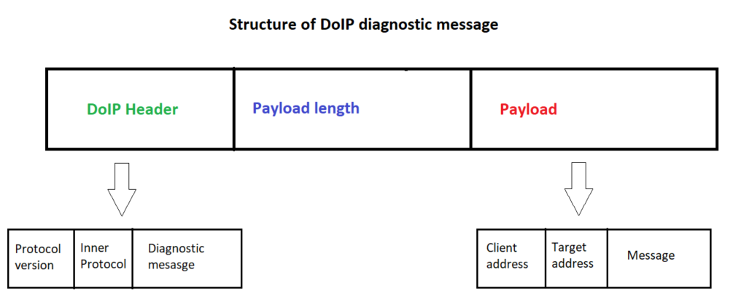
DoIP Diagnostic Message
DoIP diagnostic messages have the format below:
Notes:
All UDS messages have a fixed structure with a few common parts.
All UDS messages start with a service which is the green text, a successful response adds 0x40 to the service and a 0x7F is a special code to say the request has failed.
The rest of the message depends on the service and is defined in either the OBD or UDS standards
In this example we’re looking at the OBD-ii Mode 01 Service which defines a set of diagnostic data parameters. Each parameter has a 1 byte code in this example we’re using engine speed which is 0x12.
The response from the ECU in this case is a successful response, 0x41 and then the value in this case 2 bytes 0x1F40. When put through the scaling formula this gives 2000 rpm.

Slide 19
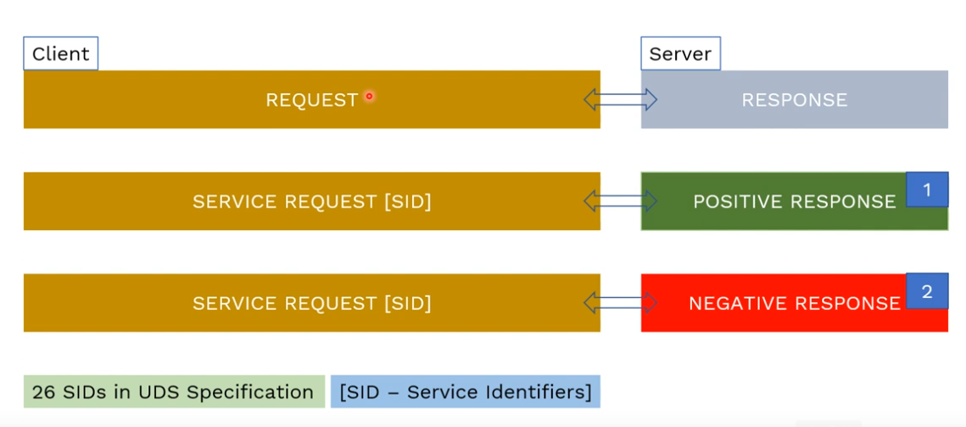
Simple workflow for diagnostic
The client request for a specific service which needs to be executed in the ECU.
The server respond to the tester with the response and allows ECU software functions to perform necessary diagnostic operations. There are two direct response:
A positive response inform the tester that ECU can perform the requested operation successfully.
A negative response inform the tester that the requested service from the tester is not supported.
Notes:
Next slide, we will talk about what the format of message?

Slide 20
UDS Services and DIDs
There are a large number of services defined
0x01 – 0x0A are standardised by the OBD-II standard and include basic diagnostic information, manufacturers have to conform to the exact structure of the service and its parameters
0x10 upwards are partially standardised
IDs are fixed to certain purposes (read data = 0x22, write data = 0x2E, remote IO = 0x2F)
The content is more flexible and parameters are optional
Diagnostic Identifiers (DIDs) are used to represent individual parameters
DIDs are common across services
There are some standardised DIDs (Serial Number, software version number etc) but these are up to the manufacturer to define

Slide 21
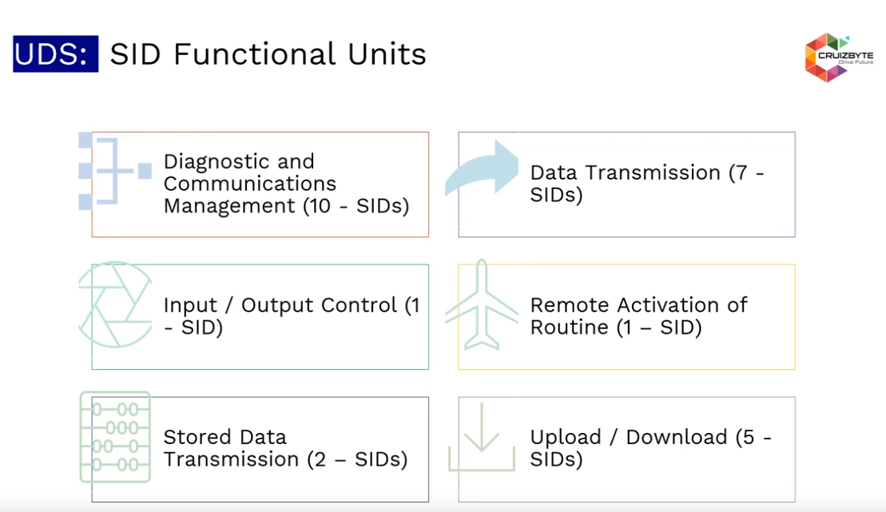
UDS Services and DIDs

Slide 22
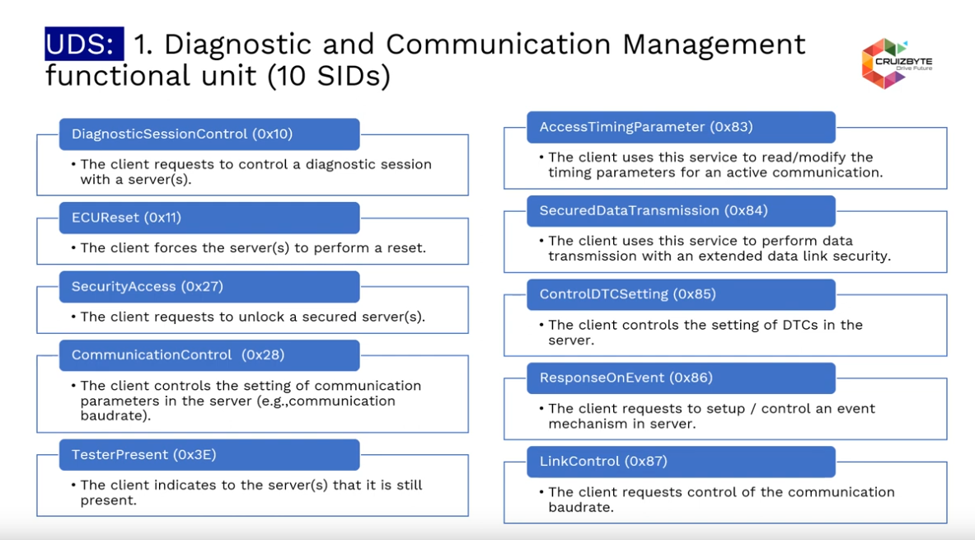
UDS Services and DIDs

Slide 23
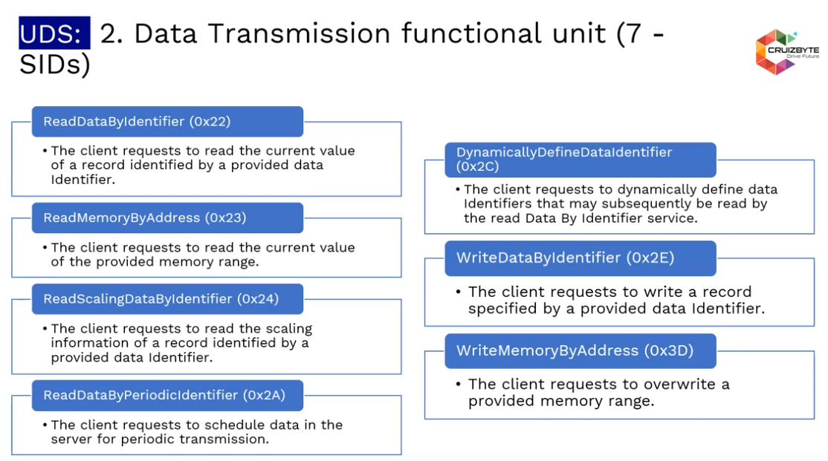
UDS Services and DIDs

Slide 24
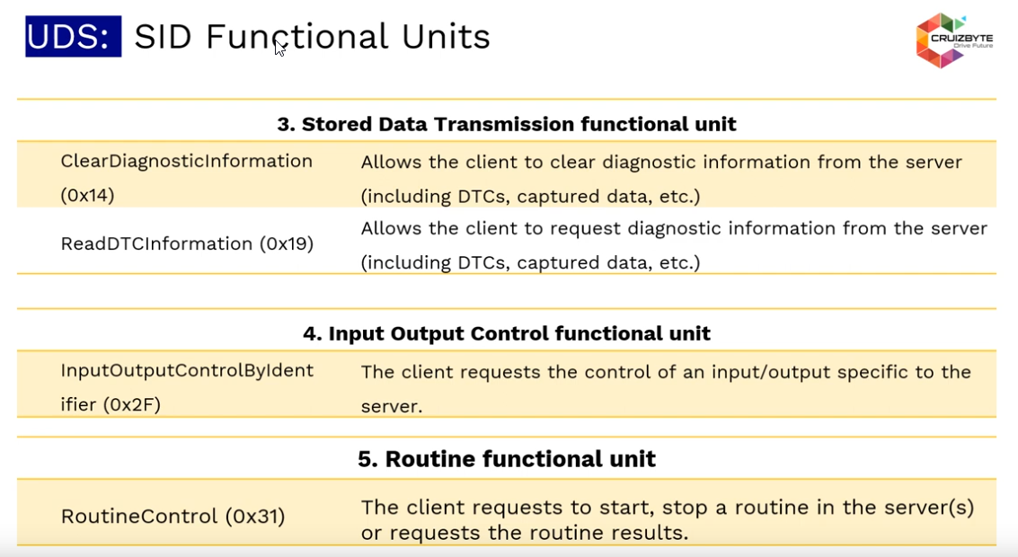
UDS Services and DIDs

Slide 25
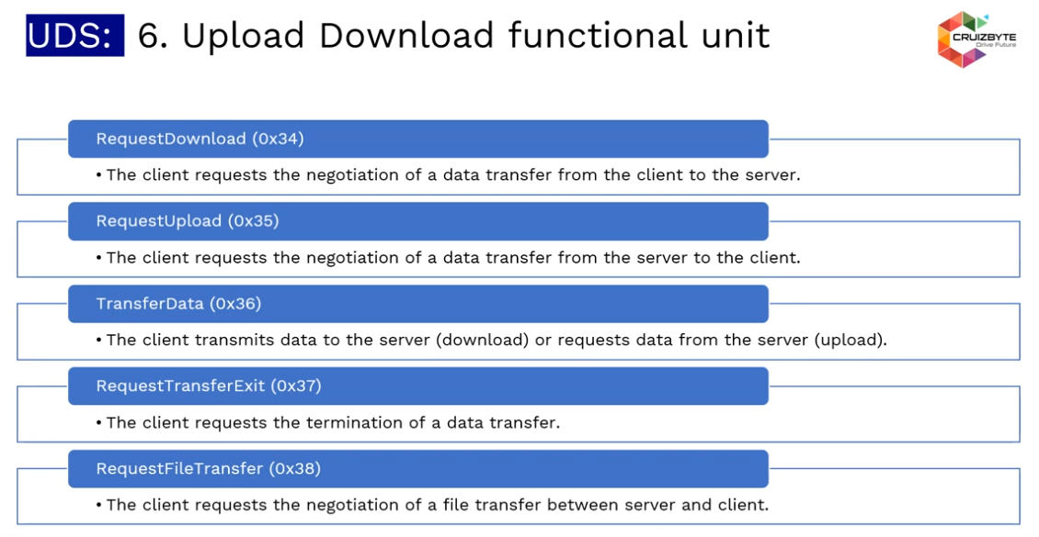
UDS Services and DIDs

Slide 26
Transport Protocols
Most of the automotive communications networks were not designed for high bandwidth
CAN / LIN both have an 8 byte payload
FlexRay and Ethernet can utilise larger payloads but still sometimes rely on transport protocols)
This means that most useful data must be transmitted and received across multiple messages

Slide 27
CAN Transport Protocol – Example
Legend
Green = Message type
Blue = Total Payload Size
Dark orange = Payload
Red = Block size
Purple = Min timing interval
Black = Seqence number
The message to set the ECU serial number:
2E F1 8C 01 02 03 04 05 06 07 08 09 0A 0B 0C 0D 0E 0F
Is too long for 1 CAN payload, so the transport protocol would split it into several.
It starts with a “First Frame” from the sender
10 12 2E F1 8C 01 02 03
The “Flow Control” from the receiver gives the information about how to send the rest of the data (not covered here but it specified timing and sizing for the remaining consecutive frames)
30 10 05 00 00 00 00 00
The sender would then send “Consecutive Frames” until the paylod is sent
21 04 05 06 07 08 09 0A 0B
22 0C 0D 0E 0F
This way CAN is able to transmit up to 4095 bytes in a single UDS message, larger messages need a further transport protocol (there are standardised functions for transmitting configuration or programming ECUs which generally have 1 - 3 Mb of ROM)

Slide 28
What is python-udsoncan and python-uds?
Notes:
Just going to cover some basics / terminology just to make sure people get what I’m talking about.

Slide 29
Python-udsoncan
An implementation of the Unified Diagnostic Services (UDS) protocol defined by ISO-14229 written in Python 3.
The goal of this project is to provide with a set of tool to interact with a UDS server by building/interpreting UDS payload and detecting malformed messages.
More details: https://udsoncan.readthedocs.io/en/latest/index.html

Slide 30
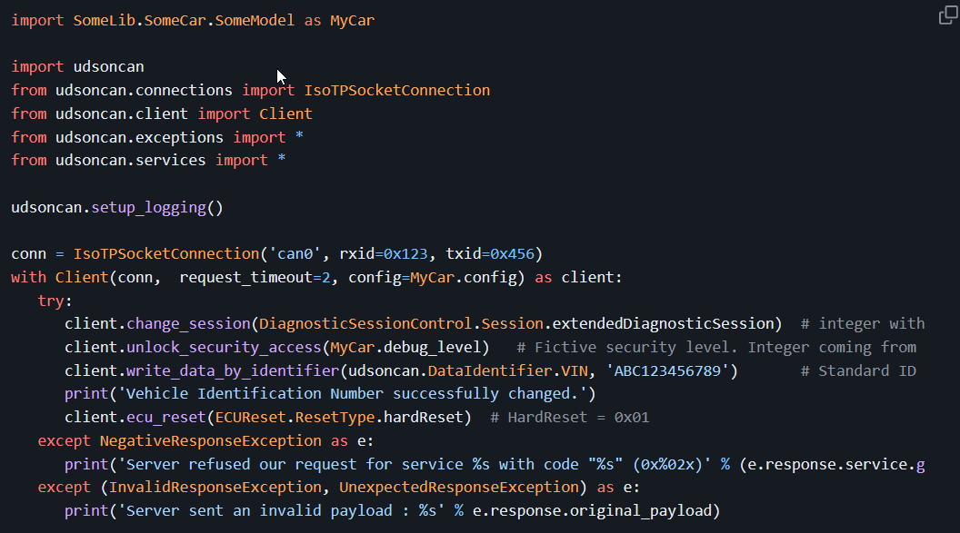
Python-udsoncan
Refer: https://github.com/pylessard/python-udsoncan/tree/master

Slide 31
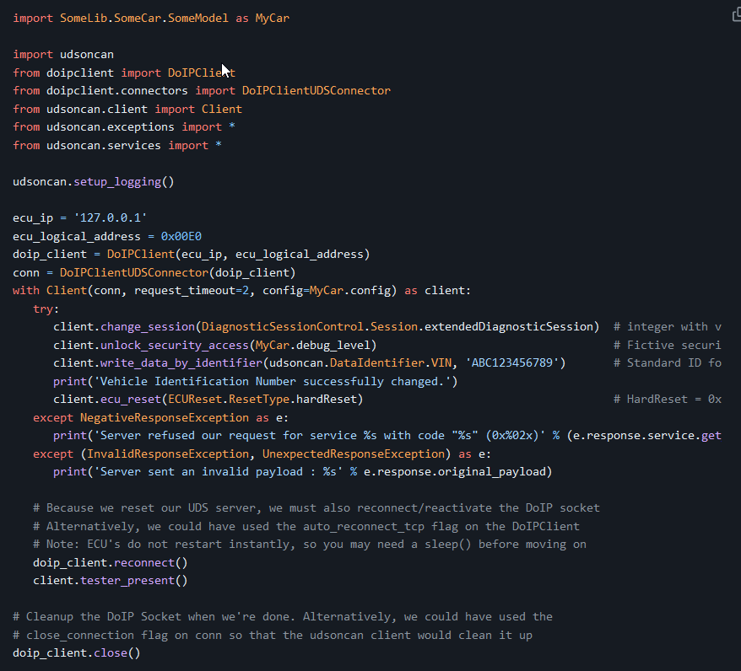
Python-udsoncan + DoIP
With DoIP, we will establish a connection using the DoIP protocol instead of the TP Socket.
Refer: https://github.com/jacobschaer/python-doipclient

Slide 32
Python-uds
An extensible UDS library for python including the diagnostic service definitions from the ISO-14229 standard.
Currently supports CAN connections using the [Python-CAN] (https://github.com/hardbyte/python-can) package and a standalone ISO-15765 transport protocol.
It was designed to provide a high-level uds interface which can utilise any communication protocol (e.g. LIN, FlexRay, DoIP). It has a parser tool which can parse an ODX file and produce an easy-to-use interface based on the ODX definition.
More details: https://python-uds.readthedocs.io/en/latest/index.html

Slide 33
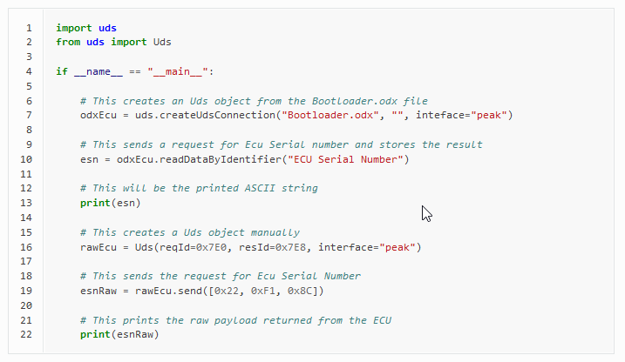
Python-uds
With Python-UDS, we can create a connection by reading .odx file configuration.
Then, we send/read data from ECU.
Refer: https://python-uds.readthedocs.io/en/latest/index.html

Slide 34
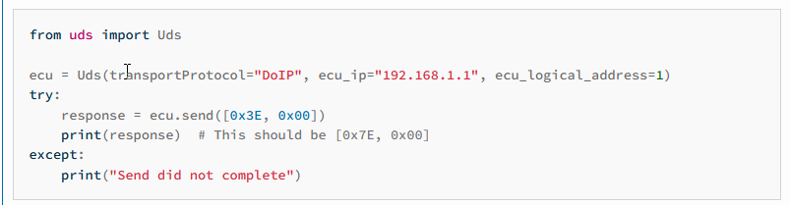
Python-uds + DoIP
With Python-UDS + DoIP, we create a connection to target ECU.
Then, we send/read data from ECU.
Refer: https://github.com/jacobschaer/python-doipclient

Slide 35
Reference:
UDS on CAN: https://www.youtube.com/watch?v=1AVTidd5E94&list=PLeXqwzlpsBllQUfPsm_u6AS0bC7ObWGAc&index=18&t=888s
History OBD2: https://www.csselectronics.com/pages/obd2-explained-simple-intro
PythonUDS documents: https://python-uds.readthedocs.io/en/latest/index.html
PythonUDS on CAN documents: https://udsoncan.readthedocs.io/en/latest/udsoncan/intro.html

