Slide 1
Processes and Exceptional Control Flows

Slide 2
Outline
The Process Abstraction
Process Details
Exceptional Control Flow

Slide 3
Processes
Definition: A process is an instance of a running program.
One of the most profound ideas in computer science
Not the same as “program” or “processor”
Process provides each program with two key abstractions:
Logical control flow
Each program seems to have exclusive use of the CPU
Private copy of program state
Register values (PC, stack pointer, general registers, condition codes)
Private virtual address space
Program has exclusive access to main memory
Including stack
Memory
Stack
CPU
Registers

Slide 4
Multiprocessing: The Illusion
Memory
Memory
Memory
Stack
Stack
Stack
• • •
CPU
CPU
CPU
Registers
Registers
Registers
Computer runs many processes simultaneously
Applications for one or more users
Web browsers, email clients, editors, …
Background tasks
Monitoring network & I/O devices

Slide 5
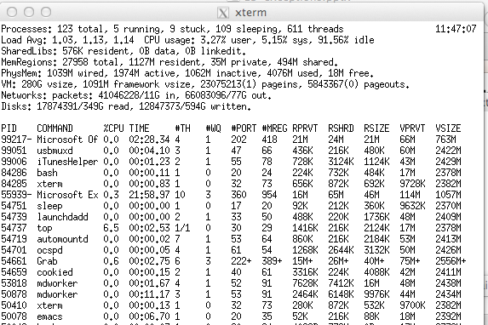
Multiprocessing Example
Running program “top” on Mac
System has 123 processes, 5 of which are active
Identified by Process ID (PID)

Slide 6
Multiprocessing: The (Traditional) Reality
Memory
Stack
Stack
Stack
• • •
CPU
Registers
Saved Registers
Saved Registers
Single Processor Executes Multiple Processes Concurrently
Process executions interleaved (multitasking)
Address spaces managed by virtual memory system
Register values for non-executing processes saved in memory

Slide 7
Multiprocessing: The (New) Reality
Memory
Stack
Stack
Stack
• • •
CPU
CPU
Registers
Registers
Saved Registers
Multicore processors
Multiple CPUs on single chip
Share main memory (and some of the caches)
Each can execute a separate process
Scheduling of processes onto cores done by OS

Slide 8
Multithreading: The Illusion
Memory
Stack
Stack
• • •
Stack
CPU
CPU
CPU
Registers
Registers
• • •
Registers
Single process runs multiple threads concurrently
Each has own control flow and runtime state
But view part of memory as shared among all threads
One thread can read/write the state of another
We will talk about this later in the term
For today, just consider one thread / process executing on single core

Slide 9
Outline
The Process Abstraction
Process Details
Exceptional Control Flow

Slide 10
Concurrent Processes
Two processes run concurrently (are concurrent) if their flows overlap in time
Otherwise, they are sequential
Examples (running on single core):
Concurrent: A & B, A & C
Sequential: B & C
Process A
Process B
Process C
Time

Slide 11
User View of Concurrent Processes
Control flows for concurrent processes are physically disjoint in time
However, we can think of concurrent processes as running in parallel with each other
Process A
Process B
Process C
Time

Slide 12
Context Switching
Processes are managed by a shared chunk of OS code called the kernel
Important: the kernel is not a separate process, but rather runs as part of some user process
Control flow passes from one process to another via a context switch
Process A
Process B
user code
kernel code
context switch
Time
user code
kernel code
context switch
user code

Slide 13
fork: Creating New Processes
int fork(void)
creates a new process (child process) that is identical to the calling process (parent process)
(Appears to) create complete new copy of program state
Child & parent then execute as independent processes
Writes by one don’t affect reads by other
But … share any open files
Before Call
Parent
Child
Memory
Memory
Memory
Stack
Stack
Stack
➔
CPU
CPU
CPU
Registers
Registers
Registers

Slide 14
fork: Details
int fork(void)
creates a new process (child process) that is identical to the calling process (parent process)
returns 0 to the child process
returns child’s pid (process id) to the parent process
Fork is interesting (and often confusing) because it is called once but returns twice
pid_t pid = fork();
if (pid == 0) {
printf("hello from child\n");
} else {
printf("hello from parent\n");
}

Slide 15
Understanding fork
Process n
Child Process m
pid_t pid = fork();
if (pid == 0) {
printf("hello from child\n");
} else {
printf("hello from parent\n");
}
pid_t pid = fork();
if (pid == 0) {
printf("hello from child\n");
} else {
printf("hello from parent\n");
}
pid_t pid = fork();
if (pid == 0) {
printf("hello from child\n");
} else {
printf("hello from parent\n");
}
pid_t pid = fork();
if (pid == 0) {
printf("hello from child\n");
} else {
printf("hello from parent\n");
}
pid = m
pid = 0
pid_t pid = fork();
if (pid == 0) {
printf("hello from child\n");
} else {
printf("hello from parent\n");
}
pid_t pid = fork();
if (pid == 0) {
printf("hello from child\n");
} else {
printf("hello from parent\n");
}
hello from parent
Which one is first?
hello from child

Slide 16
Fork Example #1
Parent and child both run same code
Distinguish parent from child by return value from fork
Start with same state, but each has private copy
Including shared output file descriptor
Relative ordering of their print statements undefined
void fork1()
{
int x = 1;
pid_t pid = fork();
if (pid == 0) {
printf("Child has x = %d\n", ++x);
} else {
printf("Parent has x = %d\n", --x);
}
printf("Bye from process %d with x = %d\n", getpid(), x);
}

Slide 17
Fork Example #2
Two consecutive forks
void fork2()
{
printf("L0\n");
fork();
printf("L1\n");
fork();
printf("Bye\n");
}
Bye
L1
Bye
Bye
L0
L1
Bye

Slide 18
Fork Example #3
Three consecutive forks
void fork3()
{
printf("L0\n");
fork();
printf("L1\n");
fork();
printf("L2\n");
fork();
printf("Bye\n");
}
Bye
L2
Bye
Bye
L1
L2
Bye
Bye
L2
Bye
Bye
L0
L1
L2
Bye

Slide 19
Fork Example #4
Nested forks in parent
void fork4()
{
printf("L0\n");
if (fork() != 0) {
printf("L1\n");
if (fork() != 0) {
printf("L2\n");
fork();
}
}
printf("Bye\n");
}
Bye
Bye
Bye
L0
L1
L2
Bye

Slide 20
Fork Example #5
Nested forks in children
void fork5()
{
printf("L0\n");
if (fork() == 0) {
printf("L1\n");
if (fork() == 0) {
printf("L2\n");
fork();
}
}
printf("Bye\n");
}
Bye
L2
Bye
L1
Bye
L0
Bye

Slide 21
exit: Ending a process
void exit(int status)
exits a process
Normally return with status 0
atexit() registers functions to be executed upon exit
void cleanup(void) {
printf("cleaning up\n");
}
void fork6() {
atexit(cleanup);
fork();
exit(0);
}

Slide 22
Zombies
Idea
When process terminates, still consumes system resources
Various tables maintained by OS
Called a “zombie”
Living corpse, half alive and half dead
Reaping
Performed by parent on terminated child (using wait or waitpid)
Parent is given exit status information
Kernel discards process
What if parent doesn’t reap?
If any parent terminates without reaping a child, then child will be reaped by init process (pid == 1)
So, only need explicit reaping in long-running processes
e.g., shells and servers

Slide 23
Zombie Example
void fork7()
{
if (fork() == 0) {
/* Child */
printf("Terminating Child, PID = %d\n",
getpid());
exit(0);
} else {
printf("Running Parent, PID = %d\n",
getpid());
while (1)
; /* Infinite loop */
}
}
linux> ./forks 7 &
[1] 6639
Running Parent, PID = 6639
Terminating Child, PID = 6640
linux> ps
PID TTY TIME CMD
6585 ttyp9 00:00:00 tcsh
6639 ttyp9 00:00:03 forks
6640 ttyp9 00:00:00 forks <defunct>
6641 ttyp9 00:00:00 ps
linux> kill 6639
[1] Terminated
linux> ps
PID TTY TIME CMD
6585 ttyp9 00:00:00 tcsh
6642 ttyp9 00:00:00 ps
ps shows child process as “defunct”
Killing parent allows child to be reaped by init

Slide 24
Orphan process: Nonterminating Child process
void fork8()
{
if (fork() == 0) {
/* Child */
printf("Running Child, PID = %d\n",
getpid());
while (1)
; /* Infinite loop */
} else {
printf("Terminating Parent, PID = %d\n",
getpid());
exit(0);
}
}
linux> ./forks 8
Terminating Parent, PID = 6675
Running Child, PID = 6676
linux> ps
PID TTY TIME CMD
6585 ttyp9 00:00:00 tcsh
6676 ttyp9 00:00:06 forks
6677 ttyp9 00:00:00 ps
linux> kill 6676
linux> ps
PID TTY TIME CMD
6585 ttyp9 00:00:00 tcsh
6678 ttyp9 00:00:00 ps
Child process still active even though parent has terminated
Must kill explicitly, or else will keep running indefinitely

Slide 25
wait: Synchronizing with Children
Parent reaps child by calling the wait function
int wait(int *child_status)
suspends current process until one of its children terminates
return value is the pid of the child process that terminated
if child_status != NULL, then the object it points to will be set to a status indicating why the child process terminated

Slide 26
wait: Synchronizing with Children
void fork9() {
int child_status;
if (fork() == 0) {
printf("HC: hello from child\n");
}
else {
printf("HP: hello from parent\n");
wait(&child_status);
printf("CT: child has terminated\n");
}
printf("Bye\n");
exit();
}
HC
Bye
HP
CT
Bye

Slide 27
wait() Example
If multiple children completed, will take in arbitrary order
Can use macros WIFEXITED and WEXITSTATUS to get information about exit status
void fork10()
{
pid_t pid[N];
int i;
int child_status;
for (i = 0; i < N; i++)
if ((pid[i] = fork()) == 0)
exit(100+i); /* Child */
for (i = 0; i < N; i++) {
pid_t wpid = wait(&child_status);
if (WIFEXITED(child_status))
printf("Child %d terminated with exit status %d\n",
wpid, WEXITSTATUS(child_status));
else
printf("Child %d terminate abnormally\n", wpid);
}
}

Slide 28
waitpid(): Waiting for a Specific Process
waitpid(pid, &status, options)
suspends current process until specific process terminates
various options (see textbook)
void fork11()
{
pid_t pid[N];
int i;
int child_status;
for (i = 0; i < N; i++)
if ((pid[i] = fork()) == 0)
exit(100+i); /* Child */
for (i = N-1; i >= 0; i--) {
pid_t wpid = waitpid(pid[i], &child_status, 0);
if (WIFEXITED(child_status))
printf("Child %d terminated with exit status %d\n",
wpid, WEXITSTATUS(child_status));
else
printf("Child %d terminated abnormally\n", wpid);
}
}

Slide 29
execve: Loading and Running Programs
Stack bottom
Null-terminated
env var strings
int execve( char *filename, char *argv[], char *envp[] )
Loads and runs in current process:
Executable filename
With argument list argv
And environment variable list envp
Does not return (unless error)
Overwrites code, data, and stack
keeps pid, open files and signal context
Environment variables:
“name=value” strings
getenv and putenv
Null-terminated
cmd line arg strings
unused
envp[n] == NULL
envp[n-1]
…
envp[0]
environ
argv[argc] == NULL
argv[argc-1]
…
argv[0]
Linker vars
envp
argv
argc
Stack frame for
main
Stack top

Slide 30
execve Example
if ((pid = Fork()) == 0) { /* Child runs user job */
if (execve(argv[0], argv, environ) < 0) {
printf("%s: Command not found.\n", argv[0]);
exit(0);
}
}
argv[argc] = NULL
argv[argc-1]
“/usr/include”
…
“-lt”
argv[0]
“ls”
argv
envp[n] = NULL
envp[n-1]
“PWD=/usr/droh”
…
“PRINTER=iron”
envp[0]
“USER=droh”
environ

Slide 31
Outline
The Process Abstraction
Process Details
Exceptional Control Flow

Slide 32
Control Flow
Processors do only one thing:
From startup to shutdown, a CPU simply reads and executes (interprets) a sequence of instructions, one at a time
This sequence is the CPU’s control flow (or flow of control)
Physical control flow
<startup>
inst₁
inst₂
inst₃
…
inst_{n}
<shutdown>
Time

Slide 33
Altering the Control Flow
Up to now: two mechanisms for changing control flow:
Jumps and branches
Call and return
Both react to changes in program state
Insufficient for a useful system: Difficult to react to changes in system state
data arrives from a disk or a network adapter
instruction divides by zero
user hits Ctrl-C at the keyboard
System timer expires
System needs mechanisms for “exceptional control flow”

Slide 34
Exceptional Control Flow
Exists at all levels of a computer system
Low level mechanisms
Exceptions
change in control flow in response to a system event (i.e., change in system state)
Implemented via combination of hardware and OS software
Higher level mechanisms
Process context switch
Signals
Nonlocal jumps: setjmp()/longjmp()
Implemented by either:
OS software (context switch and signals)
C language runtime library (nonlocal jumps)

Slide 35
Exceptions
An exception is a transfer of control to the OS in response to some event (i.e., change in processor state)
Examples: div by 0, arithmetic overflow, page fault, I/O request completes, Ctrl-C
User Process
OS
event
I_current
exception
I_next
exception processing
by exception handler
return to I_current or
return to I_next or
abort

Slide 36
Exception Tables
Exception
numbers
code for
exception handler 0
Each type of event has a unique exception number k
k = index into exception table (a.k.a. interrupt vector)
Handler k is called each time exception k occurs
Exception
Table
code for
exception handler 1
0
1
code for
exception handler 2
2
...
n-1
...
code for
exception handler n-1

Slide 37
Asynchronous Exceptions (Interrupts)
Caused by events external to the processor
Indicated by setting the processor’s interrupt pin
Handler returns to “next” instruction
Examples:
I/O interrupts
hitting Ctrl-C at the keyboard
arrival of a packet from a network
arrival of data from a disk
Hard reset interrupt
hitting the power button
Soft reset interrupt
hitting Ctrl-Alt-Delete on a PC

Slide 38
Synchronous Exceptions
Caused by events that occur as a result of executing an instruction:
Traps
Intentional
Examples: system calls, breakpoint traps, special instructions
Returns control to “next” instruction
Faults
Unintentional but possibly recoverable
Examples: page faults (recoverable), protection faults (unrecoverable), floating point exceptions
Either re-executes faulting (“current”) instruction or aborts
Aborts
unintentional and unrecoverable
Examples: parity error, machine check
Aborts current program

Slide 39
Trap Example: Opening File
User calls: open(filename, options)
Function open executes system call instruction int
OS must find or create file, get it ready for reading or writing
Returns integer file descriptor
0804d070 <__libc_open>:
. . .
804d082: cd 80 int $0x80
804d084: 5b pop %ebx
. . .
User Process
OS
int
exception
pop
open file
returns

Slide 40
Fault Example: Page Fault
int a[1000];
main ()
{
a[500] = 13;
}
User writes to memory location
That portion (page) of user’s memory is currently on disk
Page handler must load page into physical memory
Returns to faulting instruction
Successful on second try
80483b7: c7 05 10 9d 04 08 0d movl $0xd,0x8049d10
User Process
OS
exception: page fault
movl
Create page and
load into memory
returns

Slide 41
Fault Example: Invalid Memory Reference
int a[1000];
main ()
{
a[5000] = 13;
}
80483b7: c7 05 60 e3 04 08 0d movl $0xd,0x804e360
User Process
OS
exception: page fault
movl
detect invalid address
signal process
Page handler detects invalid address
Sends SIGSEGV signal to user process
User process exits with “segmentation fault”

Slide 42
Exception Table IA32 (Excerpt)
Exception Number | Description | Exception Class
0 | Divide error | Fault
13 | General protection fault | Fault
14 | Page fault | Fault
18 | Machine check | Abort
32-127 | OS-defined | Interrupt or trap
128 (0x80) | System call | Trap
129-255 | OS-defined | Interrupt or trap
Check Table 6-1:
http://download.intel.com/design/processor/manuals/253665.pdf

Slide 43
Summary
Exceptions
Events that require nonstandard control flow
Generated externally (interrupts) or internally (traps and faults)
Processes
At any given time, system has multiple active processes
Only one can execute at a time on a single core, though
Each process appears to have total control of processor + private memory space

Slide 44
Summary (cont.)
Spawning processes
Call fork
One call, two returns
Process completion
Call exit
One call, no return
Reaping and waiting for processes
Call wait or waitpid
Loading and running programs
Call execve (or variant)
One call, (normally) no return

Slide 45
Exceptional Control Flow (ECF): Exists at All Levels of a System
Exceptions
Hardware and operating system kernel software
Process Context Switch
Hardware timer and kernel software
Signals
Kernel software and application software
Nonlocal jumps
Application code

Slide 46
Outline
Multitasking, shells
Signals
Nonlocal jumps

Slide 47
The World of Multitasking
System runs many processes concurrently
Process: executing program
State includes memory image + register values + program counter
Regularly switches from one process to another
Suspend process when it needs I/O resource or timer event occurs
Resume process when I/O available or given scheduling priority
Appears to user(s) as if all processes executing simultaneously
Even though systems can only execute one process (or a small number of processes) at a time
Except possibly with lower performance than if running alone

Slide 48
Programmer’s Model of Multitasking
Basic functions
fork spawns new process
Called once, returns twice
exit terminates own process
Called once, never returns
Puts it into “zombie” status
wait and waitpid wait for and reap terminated children
execve runs new program in existing process
Called once, (normally) never returns
Programming challenge
Understanding the nonstandard semantics of the functions
Avoiding improper use of system resources
E.g. “Fork bombs” can disable a system

Slide 49
Unix Process Hierarchy
[0]
init [1]
Daemon
e.g. httpd
Login shell
Child
Child
Child
Grandchild
Grandchild

Slide 50
Shell Programs
A shell is an application program that runs programs on behalf of the user.
sh Original Unix shell (Stephen Bourne, AT&T Bell Labs, 1977)
csh BSD Unix C shell (tcsh: enhanced csh at CMU and elsewhere)
bash “Bourne-Again” Shell
int main() {
char cmdline[MAXLINE];
while (1) {
/* read */
printf("> ");
Fgets(cmdline, MAXLINE, stdin);
if (feof(stdin))
exit(0);
/* evaluate */
eval(cmdline);
}
}
Execution is a sequence of read/evaluate steps

Slide 51
Simple Shell eval Function
void eval(char *cmdline) {
char *argv[MAXARGS]; /* argv for execve() */
int bg; /* should the job run in bg or fg? */
pid_t pid; /* process id */
bg = parseline(cmdline, argv);
if (!builtin_command(argv)) {
if ((pid = Fork()) == 0) { /* child runs user job */
if (execve(argv[0], argv, environ) < 0) {
printf("%s: Command not found.\n", argv[0]);
exit(0);
}
}
if (!bg) { /* parent waits for fg job to terminate */
int status;
if (waitpid(pid, &status, 0) < 0)
unix_error("waitfg: waitpid error");
}
else /* otherwise, don’t wait for bg job */
printf("%d %s", pid, cmdline);
}
}

Slide 52
What Is a “Background Job”?
Users generally run one command at a time
Type command, read output, type another command
Some programs run “for a long time”
Example: “delete this file in two hours”
A “background” job is a process we don't want to wait for
unix> sleep 7200; rm /tmp/junk # shell stuck for 2 hours
unix> (sleep 7200 ; rm /tmp/junk) &
[1] 907
unix> # ready for next command

Slide 53
Problem with Simple Shell Example
Our example shell correctly waits for and reaps foreground jobs
But what about background jobs?
Will become zombies when they terminate
Will never be reaped because shell (typically) will not terminate
Will create a memory leak that could run the kernel out of memory
Modern Unix: once you exceed your process quota, your shell can't run any new commands for you: fork() returns -1
unix> limit maxproc # csh syntax
maxproc 202752
unix> ulimit -u # bash syntax
202752

Slide 54
ECF to the Rescue!
Problem
The shell doesn't know when a background job will finish
By nature, it could happen at any time
The shell's regular control flow can't reap exited background processes in a timely fashion
Regular control flow is “wait until running job completes, then reap it”
Solution: Exceptional control flow
The kernel will interrupt regular processing to alert us when a background process completes
In Unix, the alert mechanism is called a signal

Slide 55
Outline
Multitasking, shells
Signals
Nonlocal jumps

Slide 56
Signals
A signal is a small message that notifies a process that an event of some type has occurred in the system
akin to exceptions and interrupts
sent from the kernel (sometimes at the request of another process) to a process
signal type is identified by small integer ID’s (1-30)
only information in a signal is its ID and the fact that it arrived
ID | Name | Default Action | Corresponding Event
2 | SIGINT | Terminate | Interrupt (e.g., ctl-c from keyboard)
9 | SIGKILL | Terminate | Kill program (cannot override or ignore)
11 | SIGSEGV | Terminate & Dump | Segmentation violation
14 | SIGALRM | Terminate | Timer signal
17 | SIGCHLD | Ignore | Child stopped or terminated

Slide 57
Sending a Signal
Kernel sends (delivers) a signal to a destination process by updating some state in the context of the destination process
Kernel sends a signal for one of the following reasons:
Kernel has detected a system event such as divide-by-zero (SIGFPE) or the termination of a child process (SIGCHLD)
Another process has invoked the kill system call to explicitly request the kernel to send a signal to the destination process

Slide 58
Receiving a Signal
A destination process receives a signal when it is forced by the kernel to react in some way to the delivery of the signal
Three possible ways to react:
Ignore the signal (do nothing)
Terminate the process (with optional core dump)
Catch the signal by executing a user-level function called signal handler
Akin to a hardware exception handler being called in response to an asynchronous interrupt

Slide 59
Pending and Blocked Signals
A signal is pending if sent but not yet received
There can be at most one pending signal of any particular type
Important: Signals are not queued
If a process has a pending signal of type k, then subsequent signals of type k that are sent to that process are discarded
A process can block the receipt of certain signals
Blocked signals can be delivered, but will not be received until the signal is unblocked
A pending signal is received at most once

Slide 60
Signal Concepts
Kernel maintains pending and blocked bit vectors in the context of each process
pending: represents the set of pending signals
Kernel sets bit k in pending when a signal of type k is delivered
Kernel clears bit k in pending when a signal of type k is received
blocked: represents the set of blocked signals
Can be set and cleared by using the sigprocmask function

Slide 61
Process Groups
Every process belongs to exactly one process group
Shell
pid=10
pgid=10
pid=20
pgid=20
Fore-
ground
job
Back-
ground
job #1
Back-
ground
job #2
pid=32
pgid=32
pid=40
pgid=40
Background
process group 32
Background
process group 40
Child
Child
pid=21
pgid=20
pid=22
pgid=20
getpgrp() Return process group of current process
setpgid() Change process group of a process
Foreground
process group 20

Slide 62
Sending Signals with /bin/kill Program
/bin/kill program sends arbitrary signal to a process or process group
Examples
/bin/kill –9 24818 Send SIGKILL to process 24818
/bin/kill –9 –24817 Send SIGKILL to every process in process group 24817
linux> ./forks 16
Child1: pid=24818 pgrp=24817
Child2: pid=24819 pgrp=24817
linux> ps
PID TTY TIME CMD
24788 pts/2 00:00:00 tcsh
24818 pts/2 00:00:02 forks
24819 pts/2 00:00:02 forks
24820 pts/2 00:00:00 ps
linux> /bin/kill -9 -24817
linux> ps
PID TTY TIME CMD
24788 pts/2 00:00:00 tcsh
24823 pts/2 00:00:00 ps
linux>

Slide 63
Sending Signals from the Keyboard
Typing ctrl-c (ctrl-z) sends a SIGINT (SIGTSTP) to every job in the foreground process group.
SIGINT – default action is to terminate each process
SIGTSTP – default action is to stop (suspend) each process
Shell
pid=10
pgid=10
pid=20
pgid=20
Fore-
ground
job
Back-
ground
job #1
Back-
ground
job #2
pid=32
pgid=32
pid=40
pgid=40
Background
process group 32
Background
process group 40
Child
Child
pid=21
pgid=20
pid=22
pgid=20
Foreground
process group 20

Slide 64
Example of ctrl-c and ctrl-z
bluefish> ./forks 17
Child: pid=28108 pgrp=28107
Parent: pid=28107 pgrp=28107
<types ctrl-z>
Suspended
bluefish> ps w
PID TTY STAT TIME COMMAND
27699 pts/8 Ss 0:00 -tcsh
28107 pts/8 T 0:01 ./forks 17
28108 pts/8 T 0:01 ./forks 17
28109 pts/8 R+ 0:00 ps w
bluefish> fg
./forks 17
<types ctrl-c>
bluefish> ps w
PID TTY STAT TIME COMMAND
27699 pts/8 Ss 0:00 -tcsh
28110 pts/8 R+ 0:00 ps w
STAT (process state) Legend:
First letter:
S: sleeping
T: stopped
R: running
Second letter:
s: session leader
+: foreground proc group
See “man ps” for more
details

Slide 65
Sending Signals with kill Function
void fork12()
{
pid_t pid[N];
int i, child_status;
for (i = 0; i < N; i++)
if ((pid[i] = fork()) == 0)
while(1); /* Child infinite loop */
/* Parent terminates the child processes */
for (i = 0; i < N; i++) {
printf("Killing process %d\n", pid[i]);
kill(pid[i], SIGINT);
}
/* Parent reaps terminated children */
for (i = 0; i < N; i++) {
pid_t wpid = wait(&child_status);
if (WIFEXITED(child_status))
printf("Child %d terminated with exit status %d\n",
wpid, WEXITSTATUS(child_status));
else
printf("Child %d terminated abnormally\n", wpid);
}
}

Slide 66
Receiving Signals
Suppose kernel is returning from an exception handler and is ready to pass control to process p
Process A
Process B
user code
kernel code
context switch
Time
user code
kernel code
context switch
user code
Important: All context switches are initiated by calling some exceptional hander.

Slide 67
Receiving Signals
Suppose kernel is returning from an exception handler and is ready to pass control to process p
Kernel computes pnb = pending & ~blocked
The set of pending nonblocked signals for process p
If (pnb == 0)
Pass control to next instruction in the logical flow for p
Else
Choose least nonzero bit k in pnb and force process p to receive signal k
The receipt of the signal triggers some action by p
Repeat for all nonzero k in pnb
Pass control to next instruction in logical flow for p

Slide 68
Default Actions
Each signal type has a predefined default action, which is one of:
The process terminates
The process terminates and dumps core
The process stops until restarted by a SIGCONT signal
The process ignores the signal

Slide 69
Installing Signal Handlers
The signal function modifies the default action associated with the receipt of signal signum:
handler_t *signal(int signum, handler_t *handler)
Different values for handler:
SIG_IGN: ignore signals of type signum
SIG_DFL: revert to the default action on receipt of signals of type signum
Otherwise, handler is the address of a signal handler
Called when process receives signal of type signum
Referred to as “installing” the handler
Executing handler is called “catching” or “handling” the signal
When the handler executes its return statement, control passes back to instruction in the control flow of the process that was interrupted by receipt of the signal

Slide 70
Signal Handling Example
void int_handler(int sig) {
safe_printf("Process %d received signal %d\n", getpid(), sig);
exit(0);
}
void fork13() {
pid_t pid[N];
int i, child_status;
signal(SIGINT, int_handler);
for (i = 0; i < N; i++)
if ((pid[i] = fork()) == 0) {
while(1); /* child infinite loop
}
for (i = 0; i < N; i++) {
printf("Killing process %d\n", pid[i]);
kill(pid[i], SIGINT);
}
for (i = 0; i < N; i++) {
pid_t wpid = wait(&child_status);
if (WIFEXITED(child_status))
printf("Child %d terminated with exit status %d\n",
wpid, WEXITSTATUS(child_status));
else
printf("Child %d terminated abnormally\n", wpid);
}
}

Slide 71
Signal Handling Example
void int_handler(int sig) {
safe_printf("Process %d received signal %d\n", getpid(), sig);
exit(0);
}
void fork13() {
pid_t pid[N];
int i, child_status;
signal(SIGINT, int_handler);
for (i = 0; i < N; i++)
if ((pid[i] = fork()) == 0) {
while(1); /* child infinite loop
}
for (i = 0; i < N; i++) {
printf("Killing process %d\n", pid[i]);
kill(pid[i], SIGINT);
}
for (i = 0; i < N; i++) {
pid_t wpid = wait(&child_status);
if (WIFEXITED(child_status))
printf("Child %d terminated with exit status %d\n",
wpid, WEXITSTATUS(child_status));
else
printf("Child %d terminated abnormally\n", wpid);
}
}
linux> ./forks 13
Killing process 25417
Killing process 25418
Killing process 25419
Killing process 25420
Killing process 25421
Process 25417 received signal 2
Process 25418 received signal 2
Process 25420 received signal 2
Process 25421 received signal 2
Process 25419 received signal 2
Child 25417 terminated with exit status 0
Child 25418 terminated with exit status 0
Child 25420 terminated with exit status 0
Child 25419 terminated with exit status 0
Child 25421 terminated with exit status 0
linux>

Slide 72
Signals Handlers as Concurrent Flows
A signal handler is a separate logical flow (not process) that runs concurrently with the main program
“concurrently” in the “not sequential” sense
Process A
while (1)
;
Process A
handler(){
…
}
Process B
Time

Slide 73
Another View of Signal Handlers as Concurrent Flows
Process A
Process B
Signal delivered
I_{curr}
user code (main)
kernel code
context switch
user code (main)
kernel code
context switch
Signal received
user code (handler)
kernel code
I_{next}
user code (main)

Slide 74
Signal Handler Funkiness
int ccount = 0;
void child_handler(int sig)
{
int child_status;
pid_t pid = wait(&child_status);
ccount--;
safe_printf(
"Received signal %d from process %d\n",
sig, pid);
}
void fork14()
{
pid_t pid[N];
int i, child_status;
ccount = N;
signal(SIGCHLD, child_handler);
for (i = 0; i < N; i++)
if ((pid[i] = fork()) == 0) {
sleep(1); /* deschedule child */
exit(0); /* Child: Exit */
}
while (ccount > 0)
pause(); /* Suspend until signal occurs */
}
Pending signals are not queued
For each signal type, just have single bit indicating whether or not signal is pending
Even if multiple processes have sent this signal
This program may get stuck in final loop

Slide 75
Signal Handler Funkiness
int ccount = 0;
void child_handler(int sig)
{
int child_status;
pid_t pid = wait(&child_status);
ccount--;
safe_printf(
"Received signal %d from process %d\n",
sig, pid);
}
void fork14()
{
pid_t pid[N];
int i, child_status;
ccount = N;
signal(SIGCHLD, child_handler);
for (i = 0; i < N; i++)
if ((pid[i] = fork()) == 0) {
sleep(1); /* deschedule child */
exit(0); /* Child: Exit */
}
while (ccount > 0)
pause(); /* Suspend until signal occurs */
}
Pending signals are not queued
For each signal type, just have single bit indicating whether or not signal is pending
Even if multiple processes have sent this signal
This program may get stuck in final loop
linux> ./forks 14
Received SIGCHLD signal 17 for process 21344
Received SIGCHLD signal 17 for process 21345

Slide 76
Living With Nonqueuing Signals
Must wait for all terminated jobs
Have handler loop with waitpid to get all jobs
void child_handler2(int sig)
{
int child_status;
pid_t pid;
int n = 0;
while ((pid = waitpid(-1, &child_status, WNOHANG)) > 0) {
ccount--;
safe_printf("Received signal %d from process %d. n = %d\n",
sig, pid, n++);
}
}
void fork15()
{
. . .
signal(SIGCHLD, child_handler2);
. . .
}

Slide 77
Living With Nonqueuing Signals
Must wait for all terminated jobs
Have handler loop with waitpid to get all jobs
void child_handler2(int sig)
{
int child_status;
pid_t pid;
int n = 0;
while ((pid = waitpid(-1, &child_status, WNOHANG)) > 0) {
ccount--;
safe_printf("Received signal %d from process %d. n = %d\n",
sig, pid, n++);
}
}
void fork15()
{
. . .
signal(SIGCHLD, child_handler2);
. . .
}
greatwhite> forks 15
Received signal 17 from process 27476. n = 0
Received signal 17 from process 27477. n = 0
Received signal 17 from process 27478. n = 0
Received signal 17 from process 27479. n = 1
Received signal 17 from process 27480. n = 0
greatwhite>

Slide 78
More Signal Handler Funkiness
Signal arrival during long system calls (say a read)
Signal handler interrupts read call
Linux: upon return from signal handler, the read call is restarted automatically
Some other flavors of Unix can cause the read call to fail with an EINTR error number (errno) in this case, the application program can restart the slow system call

Slide 79
A Program That Reacts to Externally Generated Events (Ctrl-c)
#include <stdlib.h>
#include <stdio.h>
#include <signal.h>
void handler(int sig) {
safe_printf("You think hitting ctrl-c will stop the bomb?\n");
sleep(2);
safe_printf("Well...");
sleep(1);
printf("OK\n");
exit(0);
}
main() {
signal(SIGINT, handler); /* installs ctl-c handler */
while(1) {
}
}
linux> ./external
<ctrl-c>
You think hitting ctrl-c will stop the bomb?
Well...OK
linux>
external.c

Slide 80
A Program That Reacts to Internally Generated Events
#include <stdio.h>
#include <signal.h>
int beeps = 0;
/* SIGALRM handler */
void handler(int sig) {
safe_printf("BEEP\n");
if (++beeps < 5)
alarm(1);
else {
safe_printf("BOOM!\n");
exit(0);
}
}
main() {
signal(SIGALRM, handler);
alarm(1); /* send SIGALRM in
1 second */
while (1) {
/* handler returns here */
}
}
linux> ./internal
BEEP
BEEP
BEEP
BEEP
BEEP
BOOM!
bass>
internal.c

Slide 81
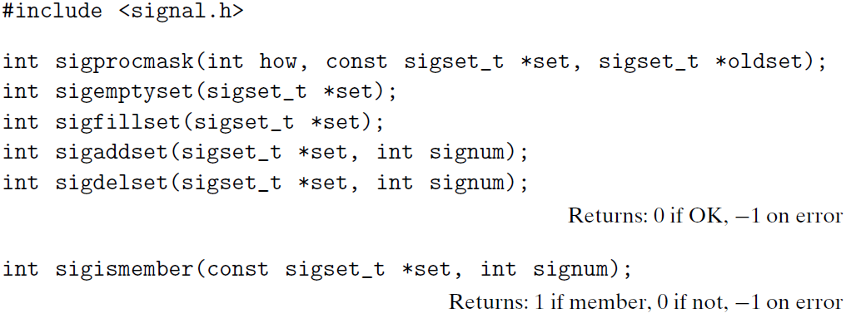
Explicitly Blocking and Unblocking Signals
The sigprocmask function changes the set of currently blocked signals. The specific behavior depends on the value of how:
SIG_BLOCK: Add the signals in set to blocked (blocked = blocked | set).
SIG_UNBLOCK: Remove the signals in set from blocked (blocked =blocked & ~set).
SIG_SETMASK: blocked = set.

Slide 82
Explicitly Blocking and Unblocking Signals
If oldset is non-NULL, the previous value of the blocked bit vector is stored in oldset.
The sigemptyset initializes set to the empty set. The sigfillset function adds every signal to set. The sigaddset function adds signum to set, sigdelset deletes signum from set, and sigismember returns 1 if signum is a member of set, and 0 if not.

Slide 83
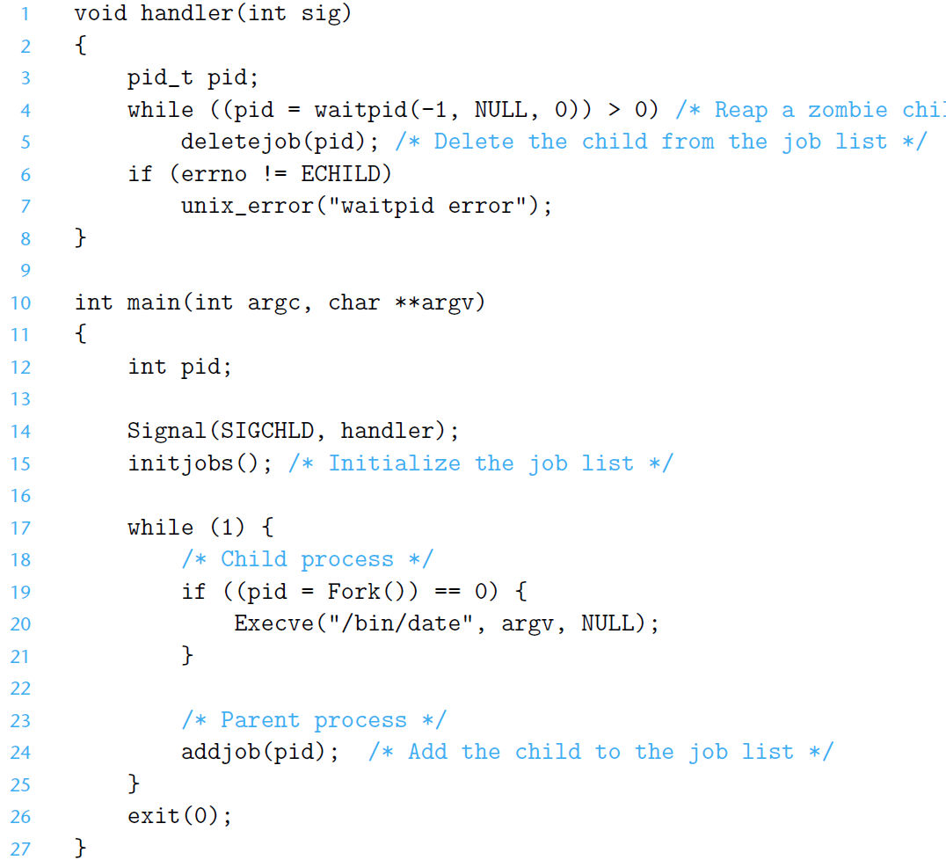
Race Condition

Slide 84
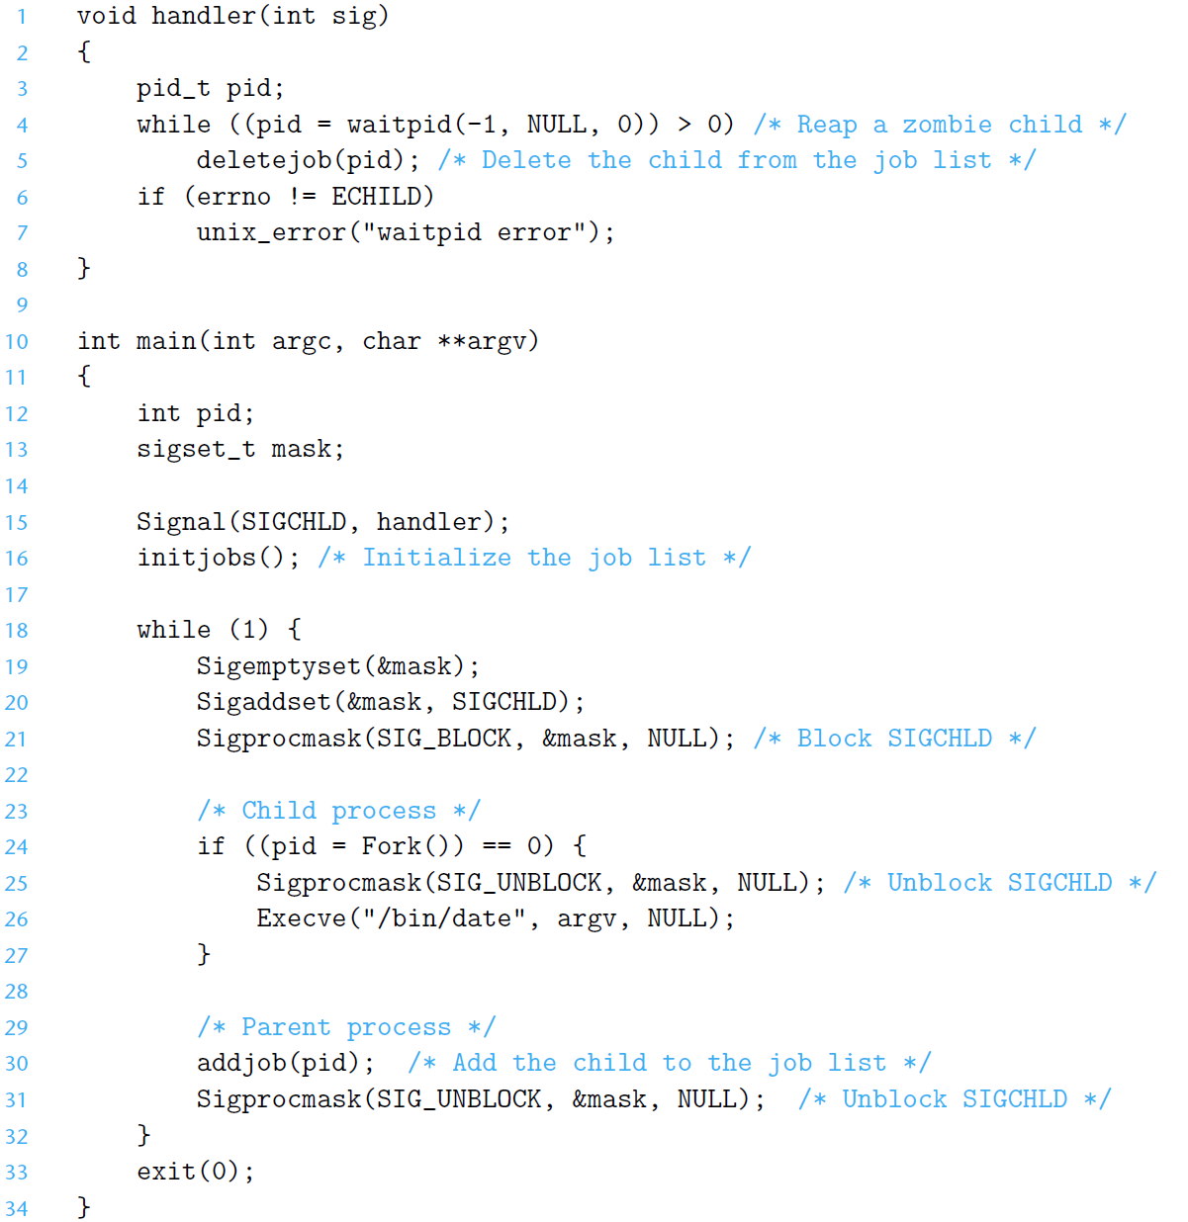
Eliminate Race Condition by Blocking Signals

Slide 85
Outline
Multitasking, shells
Signals
Nonlocal jumps

Slide 86
Nonlocal Jumps: setjmp/longjmp
Powerful (but dangerous) user-level mechanism for transferring control to an arbitrary location
Controlled to way to break the procedure call / return discipline
Useful for error recovery and signal handling
int setjmp(jmp_buf j)
Must be called before longjmp
Identifies a return site for a subsequent longjmp
Called once, returns one or more times
Implementation:
Remember where you are by storing the current register context, stack pointer, and PC value in jmp_buf
Return 0

Slide 87
setjmp/longjmp (cont)
void longjmp(jmp_buf j, int i)
Meaning:
return from the setjmp remembered by jump buffer j again ...
… this time returning i instead of 0
Called after setjmp
Called once, but never returns
longjmp Implementation:
Restore register context (stack pointer, base pointer, PC value) from jump buffer j
Set %eax (the return value) to i
Jump to the location indicated by the PC stored in jump buf j

Slide 88
setjmp/longjmp Example
#include <setjmp.h>
jmp_buf buf;
main() {
if (setjmp(buf) != 0) {
printf("back in main due to an error\n");
else
printf("first time through\n");
p1(); /* p1 calls p2, which calls p3 */
}
...
p3() {
<error checking code>
if (error)
longjmp(buf, 1)
}

Slide 89
Limitations of Nonlocal Jumps
Works within stack discipline
Can only long jump to environment of function that has been called but not yet completed
Before longjmp
After longjmp
jmp_buf env;
P1()
{
if (setjmp(env)) {
/* Long Jump to here */
} else {
P2();
}
}
P2()
{ . . . P2(); . . . P3(); }
P3()
{
longjmp(env, 1);
}
env
P1
P1
P2
P2
P2
P3

Slide 90
Limitations of Long Jumps (cont.)
Works within stack discipline
Can only long jump to environment of function that has been called but not yet completed
P1
jmp_buf env;
P1()
{
P2(); P3();
}
P2()
{
if (setjmp(env)) {
/* Long Jump to here */
}
}
P3()
{
longjmp(env, 1);
}
P2
env
At setjmp
P1
env
P2
X
P2 returns
P1
env
P3
X
At longjmp

Slide 91
Putting It All Together: A Program That Restarts Itself When ctrl-c’d
#include <stdio.h>
#include <signal.h>
#include <setjmp.h>
sigjmp_buf buf;
void handler(int sig) {
siglongjmp(buf, 1);
}
main() {
signal(SIGINT, handler);
if (!sigsetjmp(buf, 1))
printf("starting\n");
else
printf("restarting\n");
while(1) {
sleep(1);
printf("processing...\n");
}
}
greatwhite> ./restart
starting
processing...
processing...
processing...
restarting
processing...
processing...
restarting
processing...
processing...
processing...
Ctrl-c
Ctrl-c
restart.c

Slide 92
Summary
Signals provide process-level exception handling
Can generate from user programs
Can define effect by declaring signal handler
Some caveats
Very high overhead
>10,000 clock cycles
Only use for exceptional conditions
Don’t have queues
Just one bit for each pending signal type
Nonlocal jumps provide exceptional control flow within process
Within constraints of stack discipline

