Slide 1
CS161 – Design and Architecture of Computer Systems
Summer 2019

Slide 2
Welcome!

Slide 3
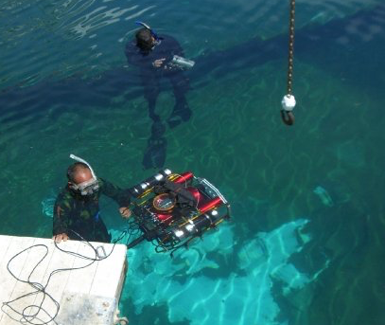
Why Computer Architecture?
AUVSI 2009 (RoboSub)

Slide 4
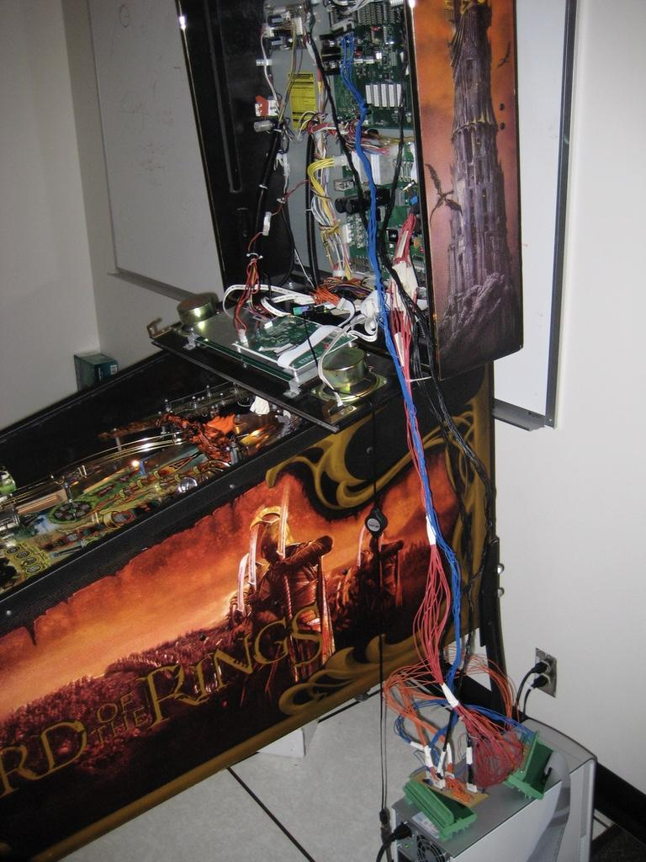
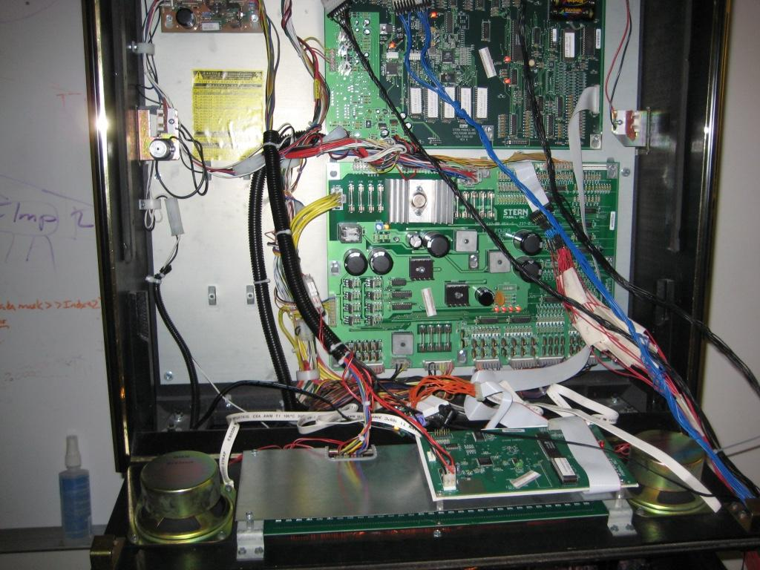
Why Computer Architecture?
Pinball Machines!

Slide 5
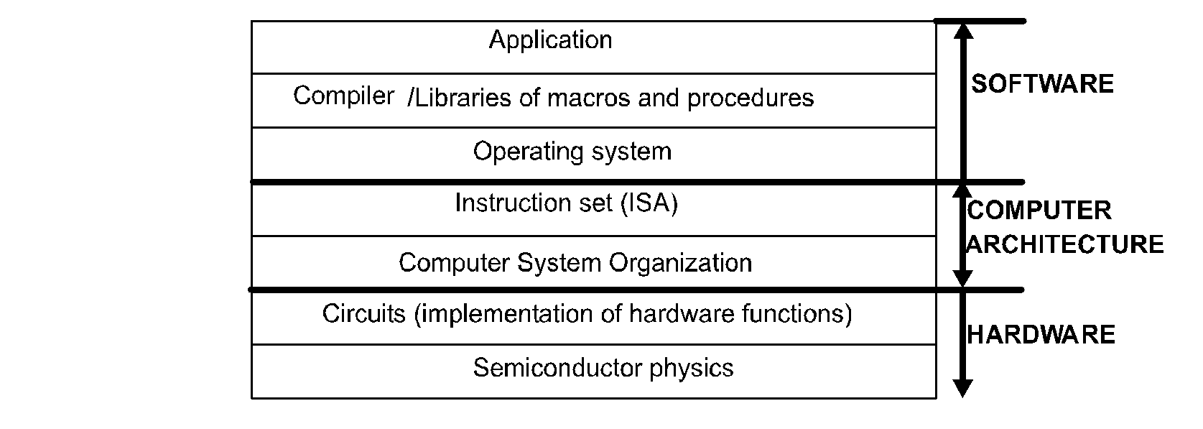
What is Computer Architecture?
Hardware organization of computers
how to build computers
Layered view of computer systems
Role of the computer architect:
To make design trade-offs across the hw/sw interface to meet functional, performance and cost requirements

Slide 6
Why learn Comp Arch?
Computer Architecture is the glue that binds software and hardware
Inter-disciplinary in nature
Devices, Circuits, OS, Runtime, PL, Compilers
Advancement of computer architecture is vital to all other areas of computing
IoT, Embedded
Mobile
Data centers, HPC

Slide 7
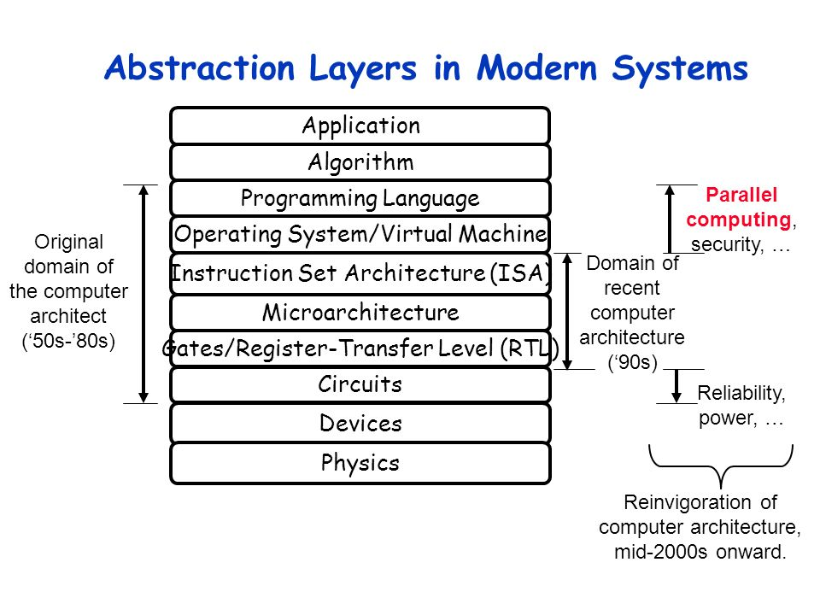
Layers of abstractions

Slide 8
Eight ideas
Design for Moore’s law
Abstraction to simplify design process
Make common case fast
Performance via Parrallelism
Performance via Pipelining
Performance via Prediction
Hierarchy of memories
Dependability via Redundancy

Slide 9
CS161 Goal
Introduction to Computer Architecture
Familiarity with processor components (pipeline, caches, registers, etc. )
Provide foundation for further comp arch courses
CS162 – Computer Architecture
CS203 – Advanced Computer Architecture
EE147 – GPU Programming
CS/EE 217 – GPU Architecture

Slide 10
Topics Covered
Background
Quantifying Performance, Technology Trends, …
Instruction Set Architecture
CPU Design
Single cycle, Multi cycle
Processor Pipelining
5-stage pipeline
Memory hierarchy
Memory, Cache, Virtual Memory
Reliability
RAID

Slide 11
Textbook
(Required) Computer Organization and Design, 5th Edition By Patterson and Hennessy

Slide 12
Attendance/Grading
Attendance
You are expected to attend all lectures and discussion.
Some slides only make sense in lecture. ☺
Grade Breakdown
Homework: 10%
Quizes: 15%
Exam #1: 35%
Exam # 2: 35%
Participation: 5%

Slide 13
Assignment Policies
Assignments will be posted in iLearn
No late work accepted
No extensions will be given
Assignments should be uploaded to gradescope

Slide 14
Contact
Instructor: Kelly Downey
Email: kelly@cs.ucr.edu
Office: WCH 105
Office Hours: by appointment
TA: Jason Zellmer
Email: jason.zellmer@email.ucr.edu
Office Hours: by appointment

