Slide 1
CSE 161 – Design and Architecture of Computer Systems
Chapter 2
Instructions: Language of the Computer

Slide 2
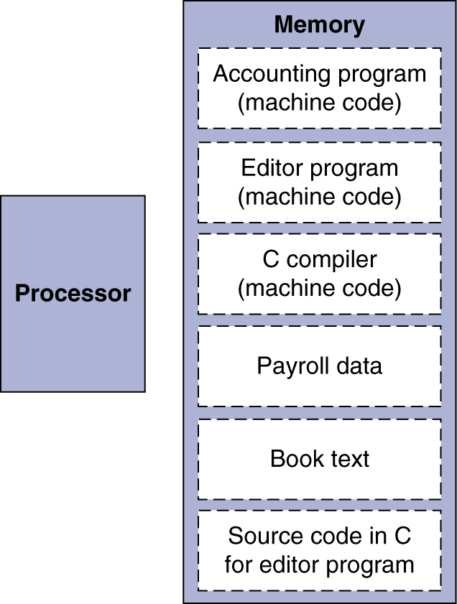
stored program computers
The BIG Picture
Instructions represented in binary, just like data
Instructions and data stored in memory
Programs can operate on programs
e.g., compilers, linkers, …
Binary compatibility allows compiled programs to work on different computers
Standardized ISAs

Slide 3
the ISA
Instruction Set Architecture
The ISA defines the CPU, or a CPU family (e.g. x86)
not only a collection of instructions,
includes the CPU view of memory, registers number and roles, etc.
The ISA is the contract between s/w and h/w
ISA ≠ CPU architecture (μ-architecture)
E.g x86: Xeon ≠ Celeron, same ISA

Slide 4
ISA and technology
in the 60s & 70s
cost of memory $1/bit and very slow memory ➔
small memories
program runtime determined by program size
impact on ISA
complex instructions that pack a LOT of work
example: MOV @(r1), @(r2), r3
r1: starting address
r2: destination address
r3: number of bytes to move (copy)

Slide 5
parameters of ISA designs
two or three operands
add r1, r2 % r1 🡸 r1 + r2
add r1, r2, r3 % r1 🡸 r2 + r3, non-destructive
where is an operand
register or memory?
memory: provide address? pointer to address?
how is operand address computed?
with offset, with index, auto-increment (decrement)?
conditional branches
condition computed in br instruction or before (compare)?
general purpose registers or condition registers?

Slide 6
backward compatibility
will the newest processor run old programs?
without recompilation
never mind that the current compiler is much better than the original one
➔once a feature is introduced in the ISA
it can NEVER be taken out!
all future designs must support it
➔ISA size always grows, never shrinks
a big challenge to CPU manufacturers

Slide 7
MIPS ISA

Slide 8
MIPS ISA
Used as the example throughout the book
Stanford MIPS commercialized by MIPS Technologies (www.mips.com)
Large share of embedded core market
Applications in consumer electronics, network/storage equipment, cameras, printers, …
Typical of many modern ISAs
See MIPS Reference Data tear-out card, and Appendix A

Slide 9
MIPS ISA
Design principles
small, regular & simple design ➔ fast
make the common case fast
good design requires good compromises
Features
32 32-bit registers, r₀ = 0 always
only load and store instructions access memory
32-bit instructions, fixed size opcode, leftmost 6 bits
fixed-field decoding
all ALU operations are 3 address register operations
add r1, r2, r3, meaning: r3 🡸 r1 + r2

Slide 10
representing instructions
Instructions are encoded in binary
Called machine code
MIPS instructions
Encoded as 32-bit instruction words
Small number of formats encoding operation code (opcode), register numbers, …
Regularity!
Register numbers
$t0 – $t7 are reg’s 8 – 15
$t8 – $t9 are reg’s 24 – 25
$s0 – $s7 are reg’s 16 – 23
convention, used for code interoperability

Slide 11
MIPS R-format instructions
op
rs
rt
rd
shamt
funct
6 bits
5 bits
5 bits
5 bits
5 bits
6 bits
Instruction fields
op: operation code (opcode)
rs: first source register number
rt: second source register number
rd: destination register number
shamt: shift amount (00000 for now)
funct: function code (extends opcode)
Used only for ALU instructions

Slide 12
R-format example
op
rs
rt
rd
shamt
funct
6 bits
5 bits
5 bits
5 bits
5 bits
6 bits
add $r8, $r17, $r18
special
$r17
$r18
$r8
0
add
0
17
18
8
0
32
000000
10001
10010
01000
00000
100000
00000010001100100100000000100000₂ = 02324020₁₆

Slide 13
arithmetic operations
Add and subtract, three operands
Two sources and one destination
add a, b, c # a gets b + c
All arithmetic operations have this form
Design Principle 1: Simplicity favours regularity
Regularity makes implementation simpler
Simplicity enables higher performance at lower cost

Slide 14
arithmetic example
C code:
f = (g + h) - (i + j);
Compiled MIPS code:
add t0, g, h # temp t0 = g + h add t1, i, j # temp t1 = i + j sub f, t0, t1 # f = t0 - t1

Slide 15
register operands
Arithmetic instructions use register operands
MIPS has a 32 × 32-bit register file
Use for frequently accessed data
Numbered 0 to 31
32-bit data called a “word”
Assembler names
$t0, $t1, …, $t9 for temporary values
$s0, $s1, …, $s7 for saved variables
Design Principle 2: Smaller is faster
c.f. main memory: millions of locations

Slide 16
register operand example
C code:
f = (g + h) - (i + j);
f, …, j in $s0, …, $s4
Compiled MIPS code:
add $t0, $s1, $s2 add $t1, $s3, $s4 sub $s0, $t0, $t1

Slide 17
MIPS I-format instructions
op
rs
rt
immediate or offset
6 bits
5 bits
5 bits
16 bits
Immediate arithmetic and load/store instructions
rt: destination or source register number
Constant: –2¹⁵ to +(2¹⁵ – 1), used as immediate
Address: offset added to base address in rs
Good design demands good compromises
Different formats complicate decoding, but allow 32-bit instructions uniformly
Keep formats as similar as possible

Slide 18
I-format: load
op
rs
rt
immediate or offset
6 bits
5 bits
5 bits
16 bits
lw $r8, 8($r17)# $r8 🡸 Mem[8+$r17]
lw
$r17
$r8
constant or address
35₁₀
17
8
8
100011
10001
01000
0000000000001000
10001110001010000000000000001000₂ = 8E280008₁₆

Slide 19
I-format: store
op
rs
rt
immediate or offset
6 bits
5 bits
5 bits
16 bits
sw $r8, 8($r17) # Mem[8+$r17] 🡸 $r8
sw
$r17
$r8
constant or address
43₁₀
17
8
8
101011
10001
01000
0000000000001000
10101110001010000000000000001000₂ = AE280008₁₆

Slide 20
I-format: addi
op
rs
rt
immediate or offset
6 bits
5 bits
5 bits
16 bits
addi $r8,$r17, 8 # $r8 🡸 8+$r17
addi
$r17
$r8
constant or address
8₁₀
17
8
8
001000
10001
01000
0000000000001000
00100010001010000000000000001000₂ = 22280008₁₆

Slide 21
I-format: beq
op
rs
rt
offset
6 bits
5 bits
5 bits
16 bits
beq $r8,$r17, 8 # if ($r8==$r17) PC 🡸 PC+4+8
beq
$r17
$r8
offset
4₁₀
17
8
8
000100
10001
01000
0000000000001000
00010010001010000000000000001000₂ = 12280008₁₆

Slide 22
memory operands
Main memory used for composite data
Arrays, structures, dynamic data
To apply arithmetic operations
Load values from memory into registers
Store result from register to memory
Memory is byte addressed
Each address identifies an 8-bit byte
Words are aligned in memory
Address must be a multiple of 4
MIPS is Big Endian
Most-significant byte at least address of a word
c.f. Little Endian: least-significant byte at least address

Slide 23
memory operand example 1
C code:
g = h + A[8];
g in $s1, h in $s2, base address of A in $s3
Compiled MIPS code:
Index 8 requires offset of 32
4 bytes per word
lw $t0, 32($s3) # load word add $s1, $s2, $t0
offset
base register

Slide 24
memory operand example 2
C code:
A[12] = h + A[8];
h in $s2, base address of A in $s3
Compiled MIPS code:
Index 8 requires offset of 32
lw $t0, 32($s3) # load word add $t0, $s2, $t0 sw $t0, 48($s3) # store word

Slide 25
registers vs. memory
Registers are faster to access than memory
Operating on memory data requires loads and stores
More instructions to be executed
Compiler must use registers for variables as much as possible
Only spill to memory for less frequently used variables
Register optimization is important!

Slide 26
immediate operands
Constant data specified in an instruction
addi $s3, $s3, 4
No subtract immediate instruction
Just use a negative constant
addi $s2, $s1, -1
Design Principle 3: Make the common case fast
Small constants are common
Immediate operand avoids a load instruction

Slide 27
32-bit constants
Most constants are small
16-bit immediate is sufficient
For the occasional 32-bit constant
lui rt, constant
Copies 16-bit constant to left 16 bits of rt
Clears right 16 bits of rt to 0
lui $s0, 61
0000 0000 0111 1101 0000 0000 0000 0000
ori $s0, $s0, 2304
0000 0000 0111 1101 0000 1001 0000 0000

Slide 28
the constant zero
MIPS register 0 ($zero) is the constant 0
Cannot be overwritten
Useful for common operations
E.g., move between registers
add $t2, $s1, $zero

Slide 29
character data
Byte-encoded character sets
ASCII: 128 characters
95 graphic, 33 control
Latin-1: 256 characters
ASCII, +96 more graphic characters
Unicode: 32-bit character set
Used in Java, C++ wide characters, …
Most of the world’s alphabets, plus symbols
UTF-8, UTF-16: variable-length encodings

Slide 30
byte/halfword operations
Could use bitwise operations
MIPS byte/halfword load/store
String processing is a common case
lb rt, offset(rs) lh rt, offset(rs)
Sign extend to 32 bits in rt
lbu rt, offset(rs) lhu rt, offset(rs)
Zero extend to 32 bits in rt
sb rt, offset(rs) sh rt, offset(rs)
Store just rightmost byte/halfword

Slide 31
conditional operations
Branch to a labeled instruction if a condition is true
Otherwise, continue sequentially
beq rs, rt, L1
if (rs == rt) branch to instruction labeled L1;
bne rs, rt, L1
if (rs != rt) branch to instruction labeled L1;
j L1
unconditional jump to instruction labeled L1

Slide 32
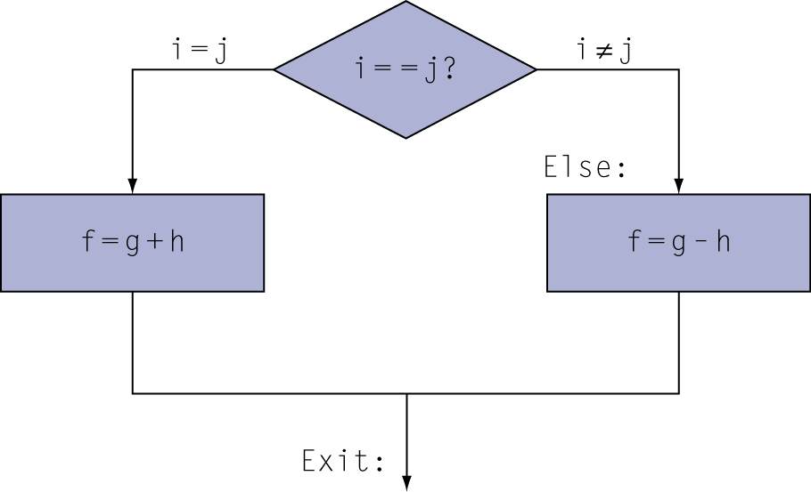
compiling if statements
C code:
if (i==j) f = g+h; else f = g-h;
f, g, … in $s0, $s1, …
Compiled MIPS code:
bne $s3, $s4, Else add $s0, $s1, $s2 j Exit Else: sub $s0, $s1, $s2 Exit: …
Assembler calculates addresses

Slide 33
compiling loop statements
C code:
while (save[i] == k) i += 1;
i in $s3, k in $s5, address of save in $s6
Compiled MIPS code:
Loop: sll $t1, $s3, 2 add $t1, $t1, $s6 lw $t0, 0($t1) bne $t0, $s5, Exit addi $s3, $s3, 1 j Loop Exit: …

Slide 34
basic blocks
A basic block is a sequence of instructions with
No embedded branches (except at end)
No branch targets (except at beginning)
A compiler identifies basic blocks for optimization
An advanced processor can accelerate execution of basic blocks

Slide 35
more conditional operations
Set result to 1 if a condition is true
Otherwise, set to 0
slt rd, rs, rt
if (rs < rt) rd = 1; else rd = 0;
slti rt, rs, constant
if (rs < constant) rt = 1; else rt = 0;
Use in combination with beq, bne
slt $t0, $s1, $s2 # if ($s1 < $s2) bne $t0, $zero, L # branch to L

Slide 36
signed vs. unsigned
Signed comparison: slt, slti
Unsigned comparison: sltu, sltui
Example
$s0 = 1111 1111 1111 1111 1111 1111 1111 1111
$s1 = 0000 0000 0000 0000 0000 0000 0000 0001
slt $t0, $s0, $s1 # signed
–1 < +1 ⇒ $t0 = 1
sltu $t0, $s0, $s1 # unsigned
+4,294,967,295 > +1 ⇒ $t0 = 0

Slide 37
branch instruction design
Why not blt, bge, etc?
Hardware for <, ≥, … slower than =, ≠
Combining with branch involves more work per instruction, requiring a slower clock
All instructions penalized!
beq and bne are the common case
This is a good design compromise

Slide 38
branch addressing
Branch instructions specify
Opcode, two registers, target address
Most branch targets are near branch
Forward or backward
op
rs
rt
constant or address
6 bits
5 bits
5 bits
16 bits
PC-relative addressing
Target address = PC + offset × 4
PC already incremented by 4 by this time

Slide 39
jump addressing
Jump (j and jal) targets could be anywhere in text segment
Encode full address in instruction
op
address
6 bits
26 bits
(Pseudo)Direct jump addressing
Target address = PC_{31…28} : (address × 4)

Slide 40
target addressing example
Loop code from earlier example
Assume Loop at location 80000
Loop: sll $t1, $s3, 2 | 80000 | 0 | 0 | 19 | 9 | 4 | 0
add $t1, $t1, $s6 | 80004 | 0 | 9 | 22 | 9 | 0 | 32
lw $t0, 0($t1) | 80008 | 35 | 9 | 8 | 0
bne $t0, $s5, Exit | 80012 | 5 | 8 | 21 | 2
addi $s3, $s3, 1 | 80016 | 8 | 19 | 19 | 1
j Loop | 80020 | 2 | 20000
Exit: … | 80024

Slide 41
branching far away
If branch target is too far to encode with 16-bit offset, assembler rewrites the code
Example
beq $s0,$s1, L1
↓
bne $s0,$s1, L2 j L1 L2: …

Slide 42
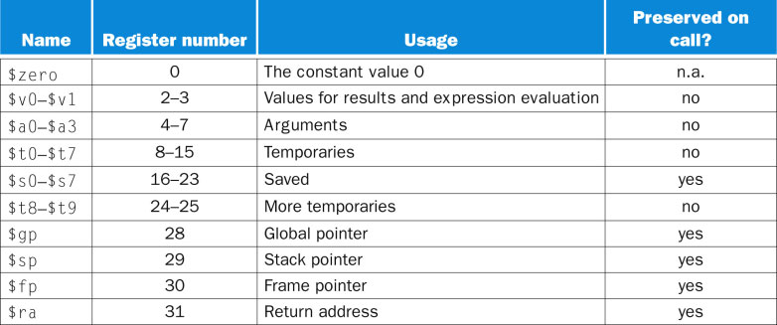
MIPS ISA register names

Slide 43
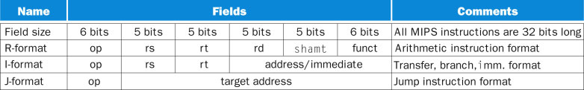
MIPS instruction formats

Slide 44
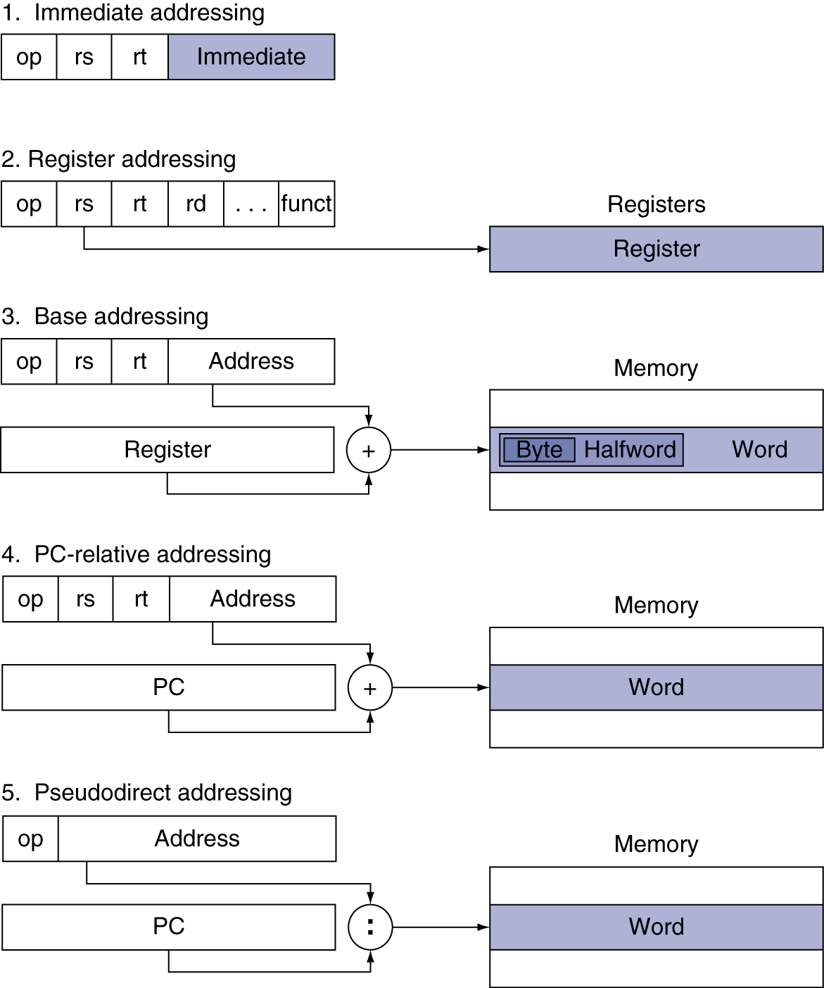
addressing mode summary

Slide 45
synchronization
Two processors sharing an area of memory
P1 writes, then P2 reads
Data race if P1 and P2 don’t synchronize
Result depends of order of accesses
Hardware support required
Atomic read/write memory operation
No other access to the location allowed between the read and write
Could be a single instruction
E.g., atomic swap of register ↔ memory
Or an atomic pair of instructions

Slide 46
synchronization in MIPS
Load linked: ll rt, offset(rs)
Store conditional: sc rt, offset(rs)
Succeeds if location not changed since the ll
Returns 1 in rt
Fails if location is changed
Returns 0 in rt
Example: atomic swap (to test/set lock variable)
try: add $t0,$zero,$s4 ;copy exchange value
ll $t1,0($s1) ;load linked
sc $t0,0($s1) ;store conditional
beq $t0,$zero,try ;branch store fails
add $s4,$zero,$t1 ;put load value in $s4

Slide 47
PROCEDURE CALLING

Slide 48
procedure calling
Steps required
Place parameters in registers
Transfer control to procedure
Acquire storage for procedure
Perform procedure’s operations
Place result in register for caller
Return to place of call

Slide 49
MIPS register usage
$a0 – $a3: arguments (reg’s 4 – 7)
$v0, $v1: result values (reg’s 2 and 3)
$t0 – $t9: temporaries
Can be overwritten by callee
$s0 – $s7: saved
Must be saved/restored by callee
$gp: global pointer for static data (reg 28)
$sp: stack pointer (reg 29)
$fp: frame pointer (reg 30)
$ra: return address (reg 31)

Slide 50
procedure call instructions
Procedure call: jump and link
jal ProcedureLabel
Address of following instruction put in $ra
Jumps to target address
Procedure return: jump register
jr $ra
Copies $ra to program counter
Can also be used for computed jumps
e.g., for case/switch statements

Slide 51
leaf procedure example
C code:
int leaf_example (int g, h, i, j) { int f; f = (g + h) - (i + j); return f; }
Arguments g, …, j in $a0, …, $a3
f in $s0 (hence, need to save $s0 on stack)
Result in $v0

Slide 52
leaf procedure example
MIPS code:
leaf_example: addi $sp, $sp, -4 sw $s0, 0($sp) // Save $s0 on stack add $t0, $a0, $a1 add $t1, $a2, $a3 sub $s0, $t0, $t1 add $v0, $s0, $zero lw $s0, 0($sp) // Restore $s0 addi $sp, $sp, 4 jr $ra // Return

Slide 53
non-leaf procedures
Procedures that call other procedures
For nested call, caller needs to save on the stack:
Its return address
Any arguments and temporaries needed after the call
Restore from the stack after the call

Slide 54
non-leaf procedure example
C code:
int fact (int n) { if (n < 1) return f; else return n * fact(n - 1); }
Argument n in $a0
Result in $v0

Slide 55
non-leaf procedure example
MIPS code:
fact: addi $sp, $sp, -8 # adjust stack for 2 items sw $ra, 4($sp) # save return address sw $a0, 0($sp) # save argument slti $t0, $a0, 1 # test for n < 1 beq $t0, $zero, L1 # branch if n = 0
addi $v0, $zero, 1 # if so, result is 1 addi $sp, $sp, 8 # pop 2 items from stack jr $ra # and return L1: addi $a0, $a0, -1 # else decrement n jal fact # recursive call lw $a0, 0($sp) # restore original n lw $ra, 4($sp) # and return address addi $sp, $sp, 8 # pop 2 items from stack mul $v0, $a0, $v0 # multiply to get result jr $ra # and return

Slide 56
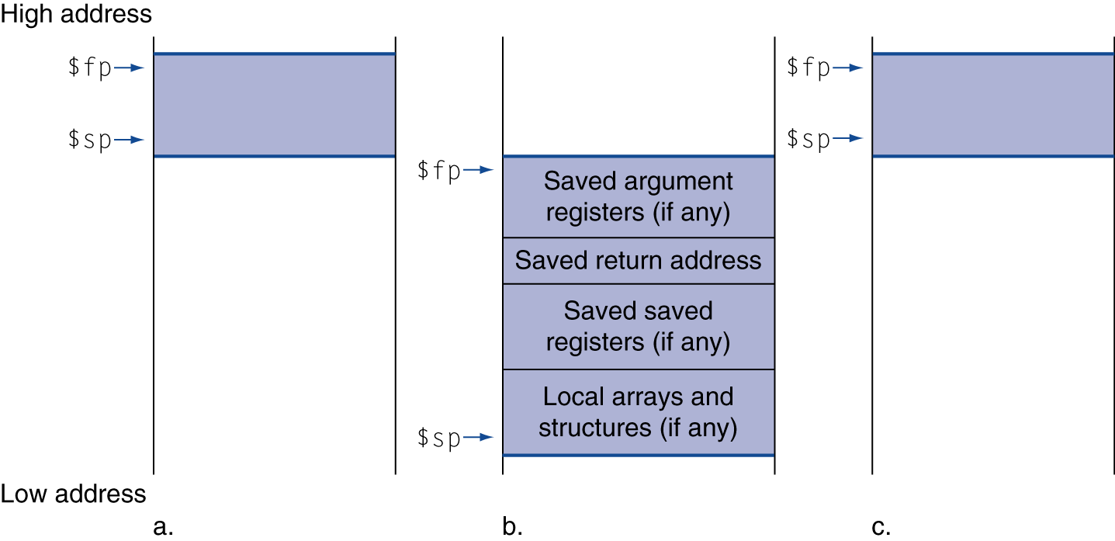
local data on the stack
Local data allocated by callee
e.g., C automatic variables
Procedure frame (activation record)
Used by some compilers to manage stack storage

Slide 57
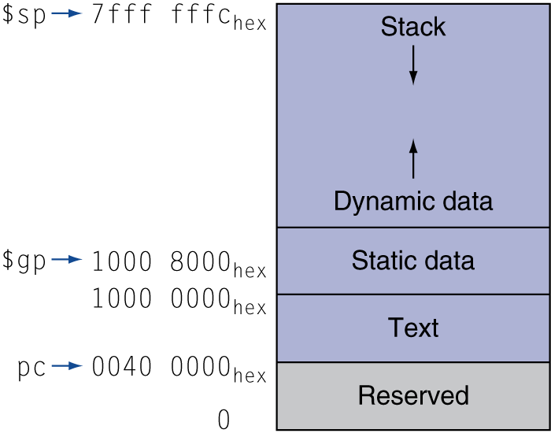
memory layout
Text: program code
Static data: global variables
e.g., static variables in C, constant arrays and strings
$gp initialized to address allowing ±offsets into this segment
Dynamic data: heap
E.g., malloc in C, new in Java
Stack: automatic storage

Slide 58
string copy example
C code (naïve):
Null-terminated string
void strcpy (char x[], char y[]) { int i; i = 0; while ((x[i]=y[i])!='\0') i += 1; }
Addresses of x, y in $a0, $a1
i in $s0

Slide 59
string copy example
MIPS code:
strcpy: addi $sp, $sp, -4 # adjust stack for 1 item sw $s0, 0($sp) # save $s0 add $s0, $zero, $zero # i = 0 L1: add $t1, $s0, $a1 # addr of y[i] in $t1 lbu $t2, 0($t1) # $t2 = y[i] add $t3, $s0, $a0 # addr of x[i] in $t3 sb $t2, 0($t3) # x[i] = y[i] beq $t2, $zero, L2 # exit loop if y[i] == 0 addi $s0, $s0, 1 # i = i + 1 j L1 # next iteration of loop L2: lw $s0, 0($sp) # restore saved $s0 addi $sp, $sp, 4 # pop 1 item from stack jr $ra # and return

Slide 60
C sort example
Illustrates use of assembly instructions for a C bubble sort function
Swap procedure (leaf)
void swap(int v[], int k) { int temp; temp = v[k]; v[k] = v[k+1]; v[k+1] = temp; }
v in $a0, k in $a1, temp in $t0

Slide 61
the procedure swap
MIPS code:
swap: sll $t1, $a1, 2 # $t1 = k * 4
add $t1, $a0, $t1 # $t1 = v+(k*4)
# (address of v[k])
lw $t0, 0($t1) # $t0 (temp) = v[k]
lw $t2, 4($t1) # $t2 = v[k+1]
sw $t2, 0($t1) # v[k] = $t2 (v[k+1])
sw $t0, 4($t1) # v[k+1] = $t0 (temp)
jr $ra # return to calling routine

Slide 62
the sort procedure in C
Non-leaf (calls swap)
void sort (int v[], int n)
{
int i, j;
for (i = 0; i < n; i += 1) {
for (j = i – 1;
j >= 0 && v[j] > v[j + 1];
j -= 1) {
swap(v,j);
}
}
}
v in $a0, k in $a1, i in $s0, j in $s1

Slide 63
the procedure body
move $s2, $a0 # save $a0 into $s2
move $s3, $a1 # save $a1 into $s3
move $s0, $zero # i = 0
for1tst: slt $t0, $s0, $s3 # $t0 = 0 if $s0 ≥ $s3 (i ≥ n)
beq $t0, $zero, exit1 # go to exit1 if $s0 ≥ $s3 (i ≥ n)
addi $s1, $s0, –1 # j = i – 1
for2tst: slti $t0, $s1, 0 # $t0 = 1 if $s1 < 0 (j < 0)
bne $t0, $zero, exit2 # go to exit2 if $s1 < 0 (j < 0)
sll $t1, $s1, 2 # $t1 = j * 4
add $t2, $s2, $t1 # $t2 = v + (j * 4)
lw $t3, 0($t2) # $t3 = v[j]
lw $t4, 4($t2) # $t4 = v[j + 1]
slt $t0, $t4, $t3 # $t0 = 0 if $t4 ≥ $t3
beq $t0, $zero, exit2 # go to exit2 if $t4 ≥ $t3
move $a0, $s2 # 1st param of swap is v (old $a0)
move $a1, $s1 # 2nd param of swap is j
jal swap # call swap procedure
addi $s1, $s1, –1 # j –= 1
j for2tst # jump to test of inner loop
exit2: addi $s0, $s0, 1 # i += 1
j for1tst # jump to test of outer loop

Slide 64
the full procedure
sort: addi $sp,$sp, –20 # make room on stack for 5 registers
sw $ra, 16($sp) # save $ra on stack
sw $s3,12($sp) # save $s3 on stack
sw $s2, 8($sp) # save $s2 on stack
sw $s1, 4($sp) # save $s1 on stack
sw $s0, 0($sp) # save $s0 on stack
… # procedure body
…
exit1: lw $s0, 0($sp) # restore $s0 from stack
lw $s1, 4($sp) # restore $s1 from stack
lw $s2, 8($sp) # restore $s2 from stack
lw $s3,12($sp) # restore $s3 from stack
lw $ra,16($sp) # restore $ra from stack
addi $sp,$sp, 20 # restore stack pointer
jr $ra # return to calling routine

Slide 65
TRANSLATING PROGRAMS
From high-level languages to ISAs

Slide 66
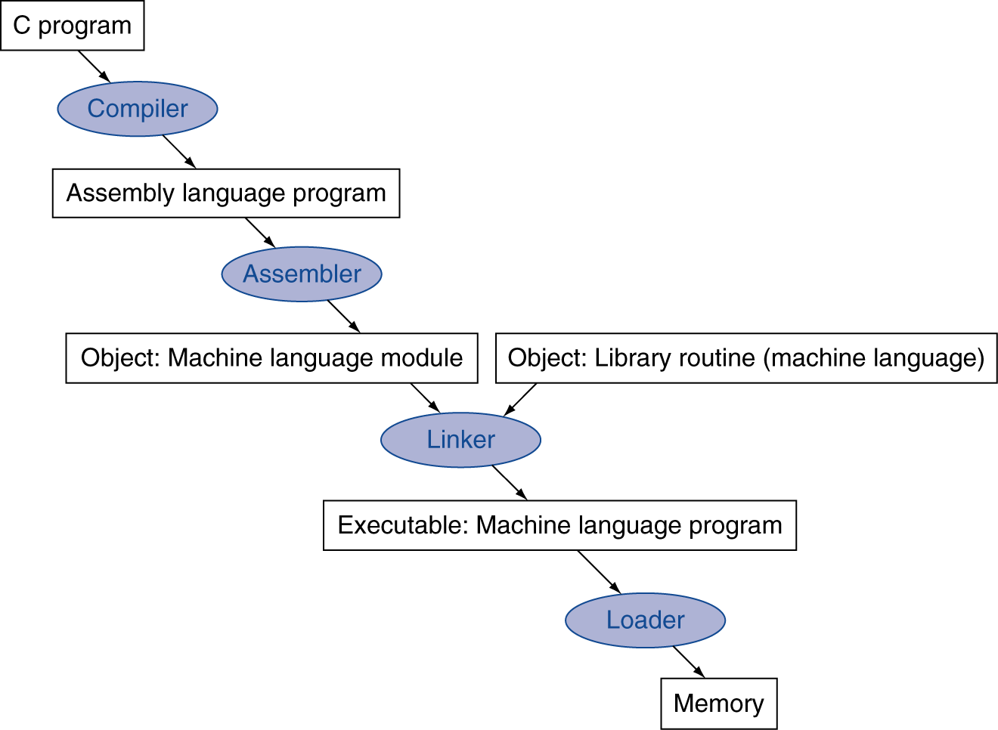
translation and startup
Many compilers produce object modules directly
Static linking

Slide 67
assembler pseudo-instructions
Most assembler instructions represent machine instructions one-to-one
Pseudoinstructions: figments of the assembler’s imagination
move $t0, $t1 → add $t0, $zero, $t1
blt $t0, $t1, L → slt $at, $t0, $t1 bne $at, $zero, L
$at (register 1): assembler temporary

Slide 68
producing an object module
Assembler (or compiler) translates program into machine instructions
Provides information for building a complete program from the pieces
Header: described contents of object module
Text segment: translated instructions
Static data segment: data allocated for the life of the program
Relocation info: for contents that depend on absolute location of loaded program
Symbol table: global definitions and external refs
Debug info: for associating with source code

Slide 69
linking object modules
Produces an executable image
1. Merges segments
2. Resolve labels (determine their addresses)
3. Patch location-dependent and external refs
Could leave location dependencies for fixing by a relocating loader
But with virtual memory, no need to do this
Program can be loaded into absolute location in virtual memory space

Slide 70
loading a program
Load from image file on disk into memory
1. Read header to determine segment sizes
2. Create virtual address space
3. Copy text and initialized data into memory
Or set page table entries so they can be faulted in
4. Set up arguments on stack
5. Initialize registers (including $sp, $fp, $gp)
6. Jump to startup routine
Copies arguments to $a0, … and calls main
When main returns, do exit syscall

Slide 71
dynamic linking
Only link/load library procedure when it is called
Requires procedure code to be relocatable
Avoids image bloat caused by static linking of all (transitively) referenced libraries
Automatically picks up new library versions

Slide 72
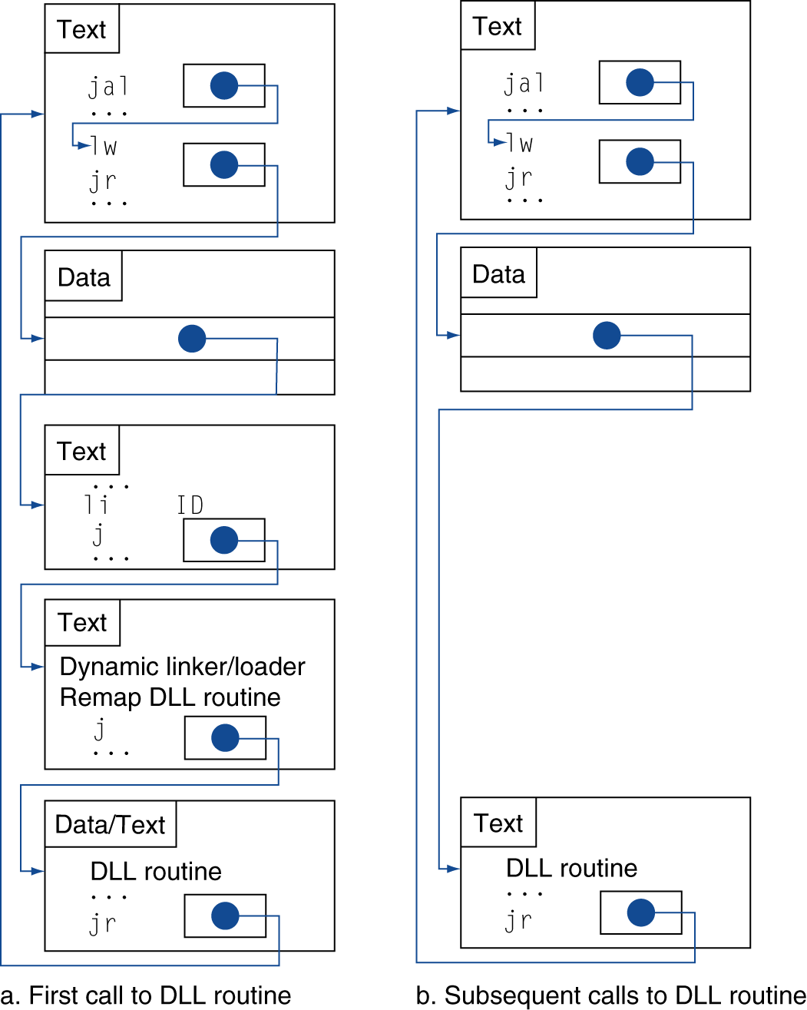
lazy linkage
Indirection table
Stub: Loads routine ID, Jump to linker/loader
Linker/loader code
Dynamically mapped code

Slide 73
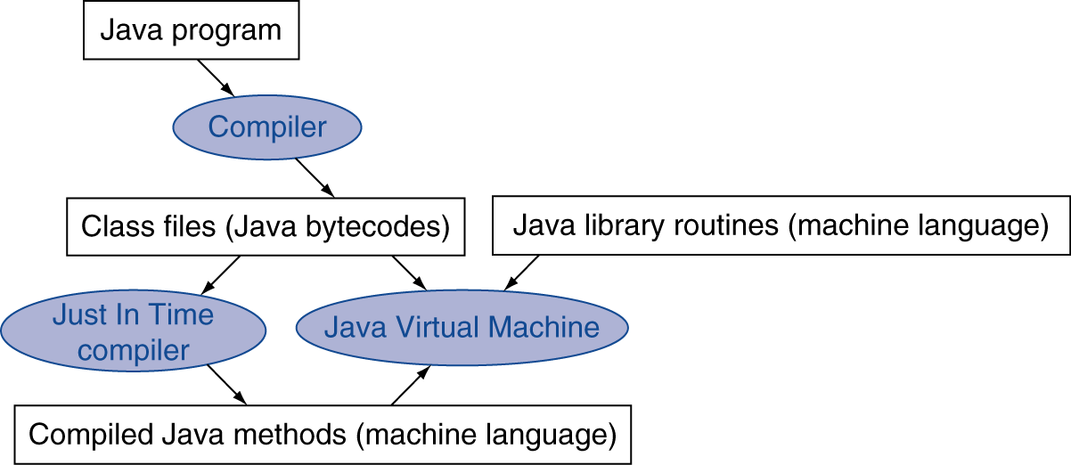
starting java applications
Simple portable instruction set for the JVM
Compiles bytecodes of “hot” methods into native code for host machine
Interprets bytecodes

Slide 74
effect of compiler optimization
Compiled with gcc for Pentium 4 under Linux

Slide 75
effect of language and algorithm

Slide 76
lessons learnt
Instruction count and CPI are not good performance indicators in isolation
Compiler optimizations are sensitive to the algorithm
Java/JIT compiled code is significantly faster than JVM interpreted
Comparable to optimized C in some cases
Nothing can fix a dumb algorithm!

Slide 77
arrays vs. pointers
Array indexing involves
Multiplying index by element size
Adding to array base address
Pointers correspond directly to memory addresses
Can avoid indexing complexity

Slide 78
Example: Clearing an array
clear1(int array[], int size) { int i; for (i = 0; i < size; i += 1) array[i] = 0; } | clear2(int *array, int size) { int *p; for (p = &array[0]; p < &array[size]; p = p + 1) *p = 0; }
move $t0,$zero # i = 0 loop1: sll $t1,$t0,2 # $t1 = i * 4 add $t2,$a0,$t1 # $t2 = # &array[i] sw $zero, 0($t2) # array[i] = 0 addi $t0,$t0,1 # i = i + 1 slt $t3,$t0,$a1 # $t3 = # (i < size) bne $t3,$zero,loop1 # if (…) # goto loop1 | move $t0,$a0 # p = & array[0] sll $t1,$a1,2 # $t1 = size * 4 add $t2,$a0,$t1 # $t2 = # &array[size] loop2: sw $zero,0($t0) # Memory[p] = 0 addi $t0,$t0,4 # p = p + 4 slt $t3,$t0,$t2 # $t3 = #(p<&array[size]) bne $t3,$zero,loop2 # if (…) # goto loop2

Slide 79
Comparison of Array vs. Ptr
Multiply “strength reduced” to shift
Array version requires shift to be inside loop
Part of index calculation for incremented i
c.f. incrementing pointer
Compiler can achieve same effect as manual use of pointers
Induction variable elimination
Better to make program clearer and safer

Slide 80
ARM & MIPS ISA

Slide 81
ARM & MIPS similarities
ARM: the most popular embedded core
Similar basic set of instructions to MIPS
 | ARM | MIPS
Date announced | 1985 | 1985
Instruction size | 32 bits | 32 bits
Address space | 32-bit flat | 32-bit flat
Data alignment | Aligned | Aligned
Data addressing modes | 9 | 3
Registers | 15 × 32-bit | 31 × 32-bit
Input/output | Memory mapped | Memory mapped

Slide 82
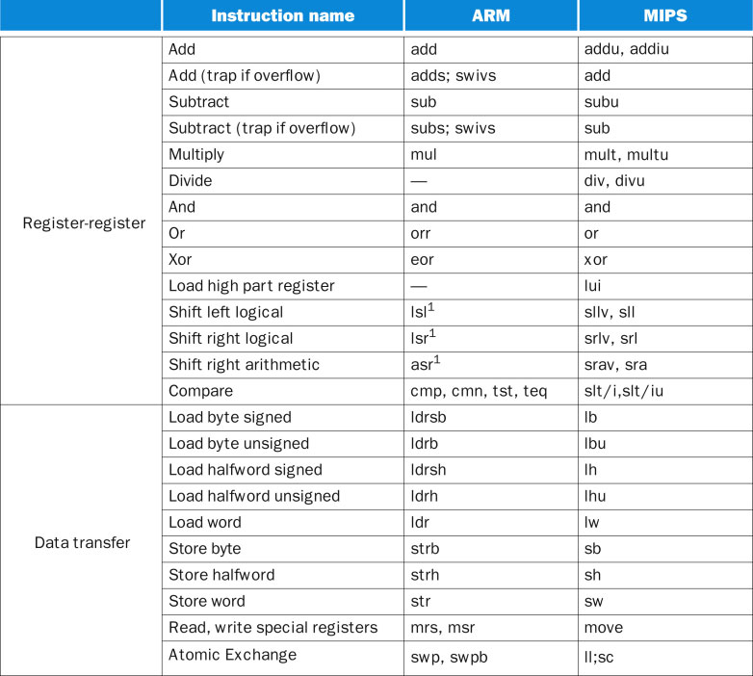
ISA comparison

Slide 83
compare and branch in ARM
Uses condition codes for result of an arithmetic/logical instruction
Negative, zero, carry, overflow
Compare instructions to set condition codes without keeping the result
Each instruction can be conditional
Top 4 bits of instruction word: condition value
Can avoid branches over single instructions

Slide 84
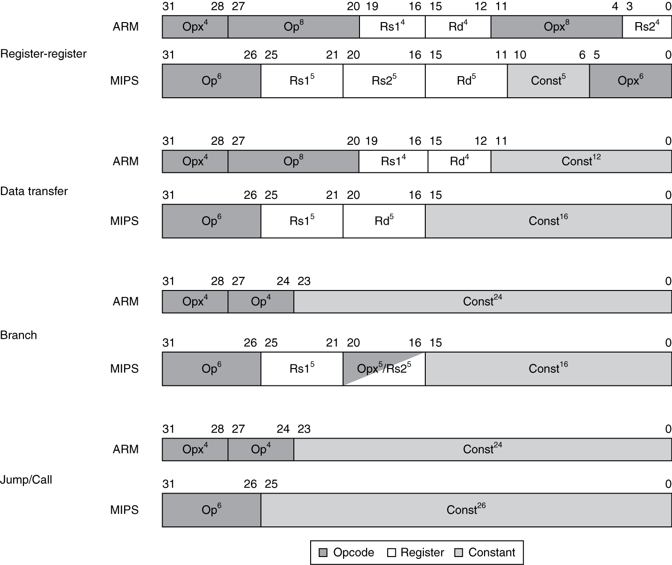
instruction encoding

Slide 85
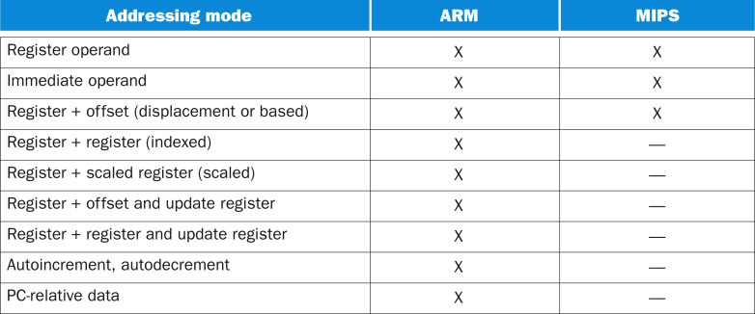
ARM & MIPS addressing modes

Slide 86
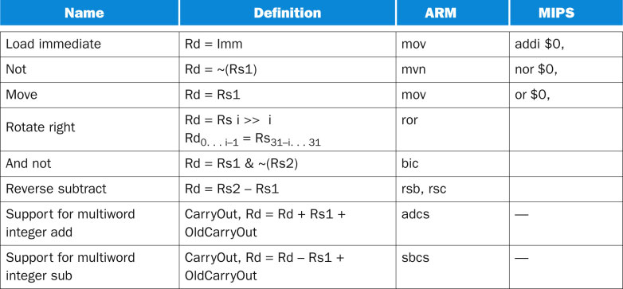
ARM arithmetic not in MIPS

Slide 87
INTEL X86 ISA

Slide 88
Intel x86 ISA
Evolution with backward compatibility
8080 (1974): 8-bit microprocessor
Accumulator, plus 3 index-register pairs
8086 (1978): 16-bit extension to 8080
Complex instruction set (CISC)
8087 (1980): floating-point coprocessor
Adds FP instructions and register stack
80286 (1982): 24-bit addresses, MMU
Segmented memory mapping and protection
80386 (1985): 32-bit extension (now IA-32)
Additional addressing modes and operations
Paged memory mapping as well as segments

Slide 89
Intel x86 ISA
Further evolution…
i486 (1989): pipelined, on-chip caches and FPU
Compatible competitors: AMD, Cyrix, …
Pentium (1993): superscalar, 64-bit datapath
Later versions added MMX (Multi-Media eXtension) instructions
The infamous FDIV bug
Pentium Pro (1995), Pentium II (1997)
New microarchitecture (see Colwell, The Pentium Chronicles)
Pentium III (1999)
Added SSE (Streaming SIMD Extensions) and associated registers
Pentium 4 (2001)
New microarchitecture
Added SSE2 instructions

Slide 90
Intel x86 ISA
And further…
AMD64 (2003): extended architecture to 64 bits
EM64T – Extended Memory 64 Technology (2004)
AMD64 adopted by Intel (with refinements)
Added SSE3 instructions
Intel Core (2006)
Added SSE4 instructions, virtual machine support
AMD64 (announced 2007): SSE5 instructions
Intel declined to follow, instead…
Advanced Vector Extension (announced 2008)
Longer SSE registers, more instructions
If Intel didn’t extend with compatibility, its competitors would!
Technical elegance ≠ market success

Slide 91
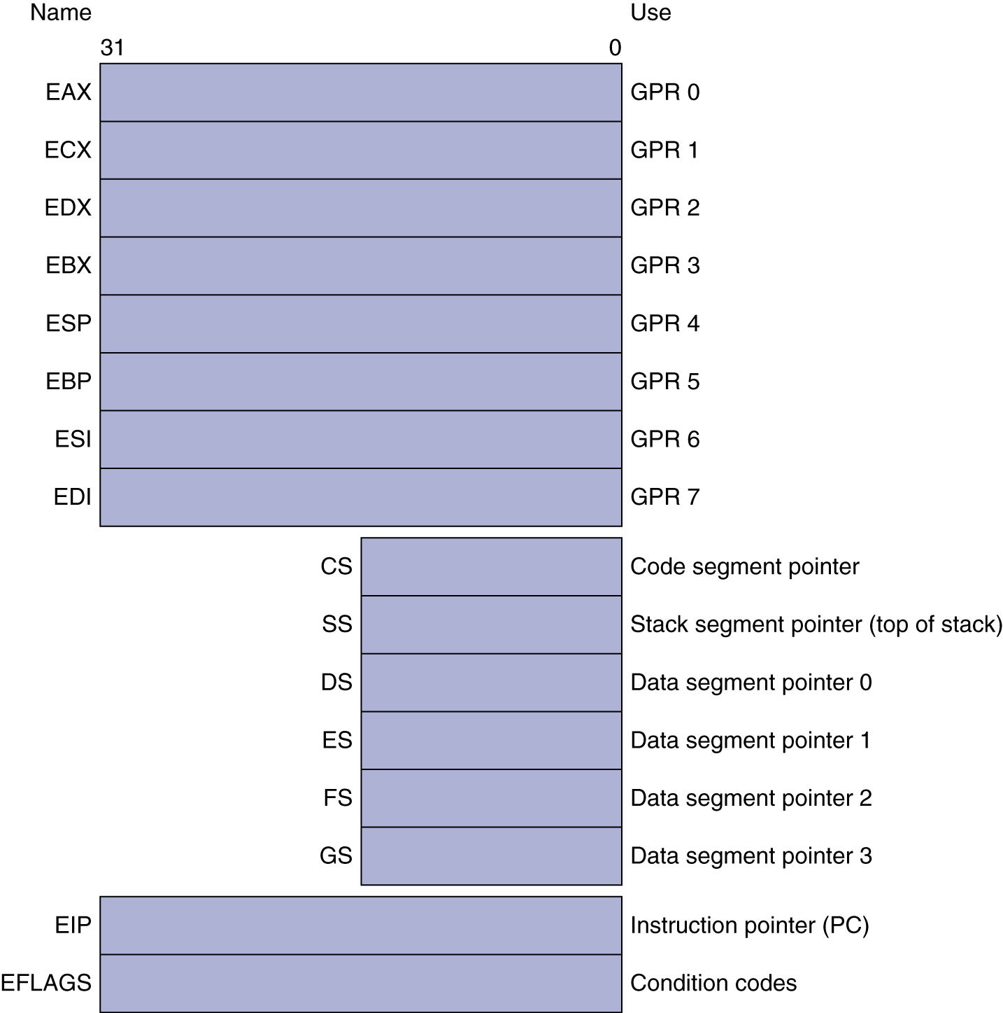
basic x86 registers

Slide 92
basic x86 addressing modes
Two operands per instruction
Source/dest operand | Second source operand
Register | Register
Register | Immediate
Register | Memory
Memory | Register
Memory | Immediate
Memory addressing modes
Address in register
Address = R_{base} + displacement
Address = R_{base} + 2^{scale} × R_{index} (scale = 0, 1, 2, or 3)
Address = R_{base} + 2^{scale} × R_{index} + displacement

Slide 93
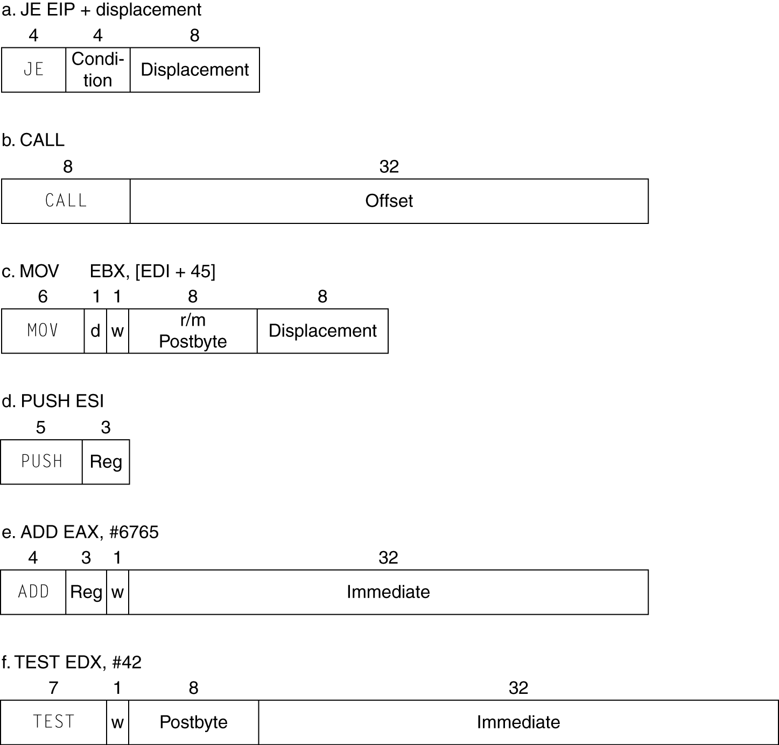
x86 instruction encoding
Variable length encoding
Postfix bytes specify addressing mode
Prefix bytes modify operation
Operand length, repetition, locking, …

Slide 94
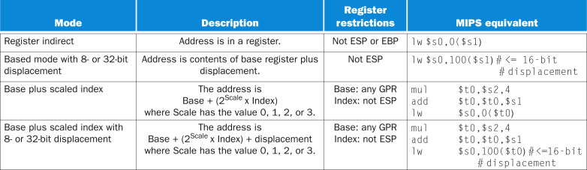
x86 addressing modes not in MIPS
FIGURE 2.38 x86 32-bit addressing modes with register restrictions and the equivalent MIPS code. The Base plus Scaled Index addressing mode, not found in ARM or MIPS, is included to avoid the multiplies by 4 (scale factor of 2) to turn an index in a register into a byte address (see Figures 2.25 and 2.27). A scale factor of 1 is used for 16-bit data, and a scale factor of 3 for 64-bit data. A scale factor of 0 means the address is not scaled. If the displacement is longer than 16 bits in the second or fourth modes, then the MIPS equivalent mode would need two more instructions: a lui to load the upper 16 bits of the displacement and an add to sum the upper address with the base register $s1. (Intel gives two different names to what is called Based addressing mode—Based and Indexed—but they are essentially identical and we combine them here.)

Slide 95
implementing IA-32
Complex instruction set makes implementation difficult
Hardware translates instructions to simpler micro-operations
Simple instructions: 1–1
Complex instructions: 1–many
Micro-engine is a RISC processor
Market share makes this economically viable
Comparable performance to RISC
Compilers avoid complex instructions

Slide 96
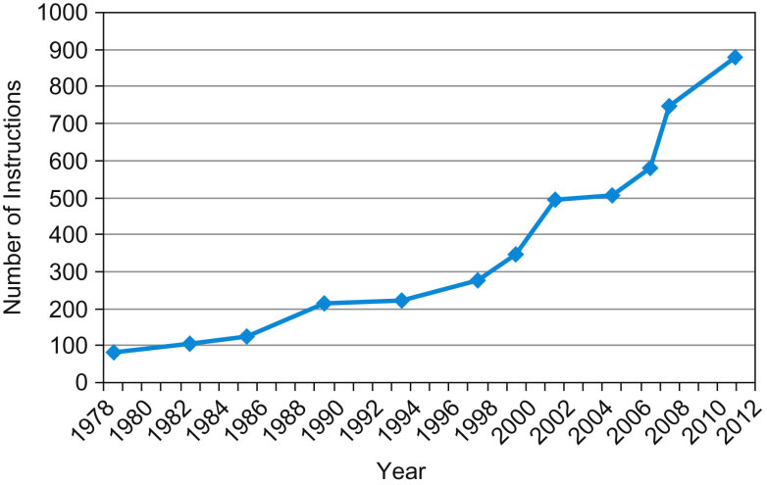
x86 ISA over time
FIGURE 2.43 Growth of x86 instruction set over time. While there is clear technical value to some of these extensions, this rapid change also increases the difficulty for other companies to try to build compatible processors.

Slide 97
CONCLUSION

Slide 98
Fallacies
Powerful instruction => higher performance
Fewer instructions required
But complex instructions are hard to implement
May slow down all instructions, including simple ones
Compilers are good at making fast code from simple instructions
Use assembly code for high performance
But modern compilers are better at dealing with modern processors
More lines of code => more errors and less productivity

Slide 99
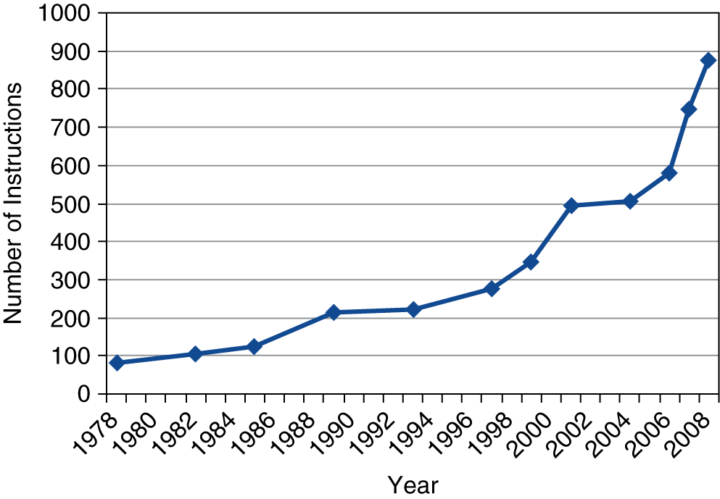
Fallacies
Backward compatibility ⇒ instruction set doesn’t change
But they do accrete more instructions
x86 instruction set

Slide 100
Pitfalls
Sequential words are not at sequential addresses
Increment by 4, not by 1!
Keeping a pointer to an automatic variable after procedure returns
e.g., passing pointer back via an argument
Pointer becomes invalid when stack popped

Slide 101
Concluding Remarks
Design principles
1. Simplicity favors regularity
2. Smaller is faster
3. Make the common case fast
4. Good design demands good compromises
Layers of software/hardware
Compiler, assembler, hardware
MIPS: typical of RISC ISAs
c.f. x86

Slide 102
Concluding Remarks
Measure MIPS instruction executions in benchmark programs
Consider making the common case fast
Consider compromises
Instruction class | MIPS examples | SPEC2006 Int | SPEC2006 FP
Arithmetic | add, sub, addi | 16% | 48%
Data transfer | lw, sw, lb, lbu, lh, lhu, sb, lui | 35% | 36%
Logical | and, or, nor, andi, ori, sll, srl | 12% | 4%
Cond. Branch | beq, bne, slt, slti, sltiu | 34% | 8%
Jump | j, jr, jal | 2% | 0%

Slide 103
REVIEW SLIDES
this was covered in CS 61 or CS 120A

Slide 104
Unsigned Binary Integers
Given an n-bit number
Range: 0 to +2^{n} – 1
Example
0000 0000 0000 0000 0000 0000 0000 1011₂ = 0 + … + 1×2³ + 0×2² +1×2¹ +1×2⁰ = 0 + … + 8 + 0 + 2 + 1 = 11₁₀
Using 32 bits
0 to +4,294,967,295

Slide 105
2s-Complement Signed Integers
Given an n-bit number
Range: –2^{n – 1} to +2^{n – 1} – 1
Example
1111 1111 1111 1111 1111 1111 1111 1100₂ = –1×2³¹ + 1×2³⁰ + … + 1×2² +0×2¹ +0×2⁰ = –2,147,483,648 + 2,147,483,644 = –4₁₀
Using 32 bits
–2,147,483,648 to +2,147,483,647

Slide 106
2s-Complement Signed Integers
Bit 31 is sign bit
1 for negative numbers
0 for non-negative numbers
–(–2^{n – 1}) can’t be represented
Non-negative numbers have the same unsigned and 2s-complement representation
Some specific numbers
0: 0000 0000 … 0000
–1: 1111 1111 … 1111
Most-negative: 1000 0000 … 0000
Most-positive: 0111 1111 … 1111

Slide 107
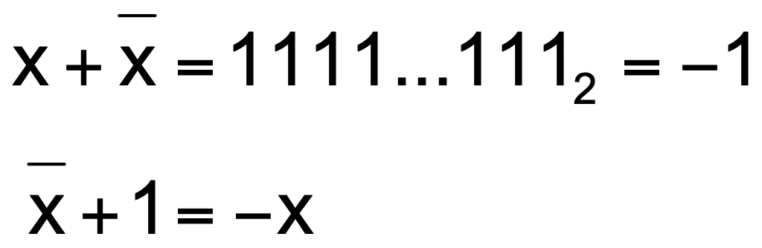
Signed Negation
Complement and add 1
Complement means 1 → 0, 0 → 1
Example: negate +2
+2 = 0000 0000 … 0010₂
–2 = 1111 1111 … 1101₂ + 1 = 1111 1111 … 1110₂

Slide 108
Sign Extension
Representing a number using more bits
Preserve the numeric value
In MIPS instruction set
addi: extend immediate value
lb, lh: extend loaded byte/halfword
beq, bne: extend the displacement
Replicate the sign bit to the left
c.f. unsigned values: extend with 0s
Examples: 8-bit to 16-bit
+2: 0000 0010 => 0000 0000 0000 0010
–2: 1111 1110 => 1111 1111 1111 1110

Slide 109
Hexadecimal
Base 16
Compact representation of bit strings
4 bits per hex digit
0 | 0000 | 4 | 0100 | 8 | 1000 | c | 1100
1 | 0001 | 5 | 0101 | 9 | 1001 | d | 1101
2 | 0010 | 6 | 0110 | a | 1010 | e | 1110
3 | 0011 | 7 | 0111 | b | 1011 | f | 1111
Example: eca8 6420
1110 1100 1010 1000 0110 0100 0010 0000

Slide 110
Logical Operations
Instructions for bitwise manipulation
Operation | C | Java | MIPS
Shift left | << | << | sll
Shift right | >> | >>> | srl
Bitwise AND | & | & | and, andi
Bitwise OR | | | | | or, ori
Bitwise NOT | ~ | ~ | nor
Useful for extracting and inserting groups of bits in a word

Slide 111
Shift Operations
op
rs
rt
rd
shamt
funct
6 bits
5 bits
5 bits
5 bits
5 bits
6 bits
shamt: how many positions to shift
Shift left logical
Shift left and fill with 0 bits
sll by i bits multiplies by 2^{i}
Shift right logical
Shift right and fill with 0 bits
srl by i bits divides by 2^{i} (unsigned only)

Slide 112
AND Operations
Useful to mask bits in a word
Select some bits, clear others to 0
and $t0, $t1, $t2
$t2
0000 0000 0000 0000 0000 1101 1100 0000
$t1
0000 0000 0000 0000 0011 1100 0000 0000
$t0
0000 0000 0000 0000 0000 1100 0000 0000

Slide 113
OR Operations
Useful to include bits in a word
Set some bits to 1, leave others unchanged
or $t0, $t1, $t2
$t2
0000 0000 0000 0000 0000 1101 1100 0000
$t1
0000 0000 0000 0000 0011 1100 0000 0000
$t0
0000 0000 0000 0000 0011 1101 1100 0000

Slide 114
NOT Operations
Useful to invert bits in a word
Change 0 to 1, and 1 to 0
MIPS has NOR 3-operand instruction
a NOR b == NOT ( a OR b )
nor $t0, $t1, $zero
Register 0: always read as zero
$t1
0000 0000 0000 0000 0011 1100 0000 0000
$t0
1111 1111 1111 1111 1100 0011 1111 1111

