Slide 1

[state$, actions]

Slide 2
dispatcher$
Actions
Hub
Store
[state$, actions]

Slide 3
dispatcher$
replay of action sent to effect
Hub
fetchTodosEffect$
Action: FETCH_TODOS
Action:
FETCH_TODOS_SUCCESS
Store
[state$, actions]

Slide 4
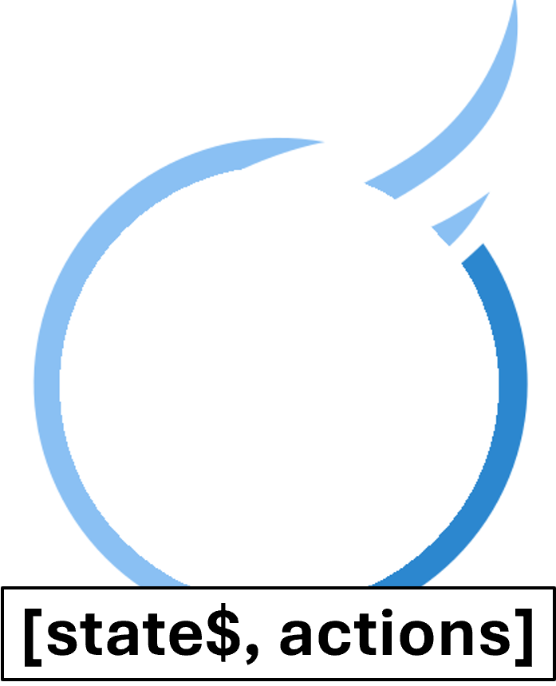
[state$, actions]

