Slide 1
Angular 2/4 by Jerum Hubbert

Slide 2
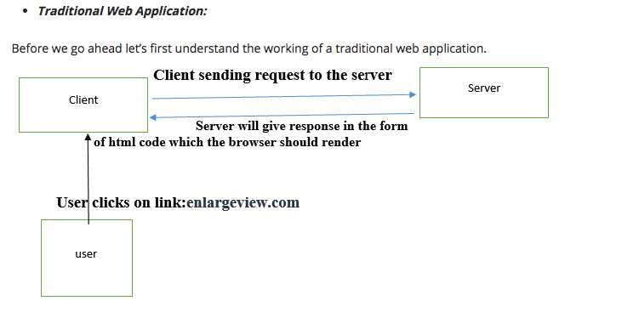
Traditional Web Application (MPA)
Client on the receiving the request from user sends the request to the server and then the server reciprocates in the form of HTML code the browser renders.
Cons:
Depends heavy on the speed of the connection.
User is constantly reloading the same data.
Pros:
Can be easier to build
Server processing = more computing power.
Older so majority of problems are solved.

Slide 3
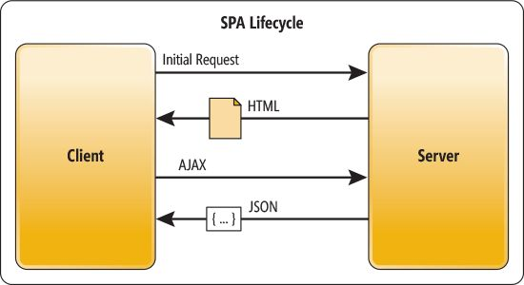
What is a Single Page Application (SPA)
Wikipedia Def.
A single-page application (SPA) is a web application or web site that interacts with the user by dynamically rewriting the current page rather than loading entire new pages from a server. This approach avoids interruption of the user experience between successive pages, making the application behave more like a desktop application.

Slide 4
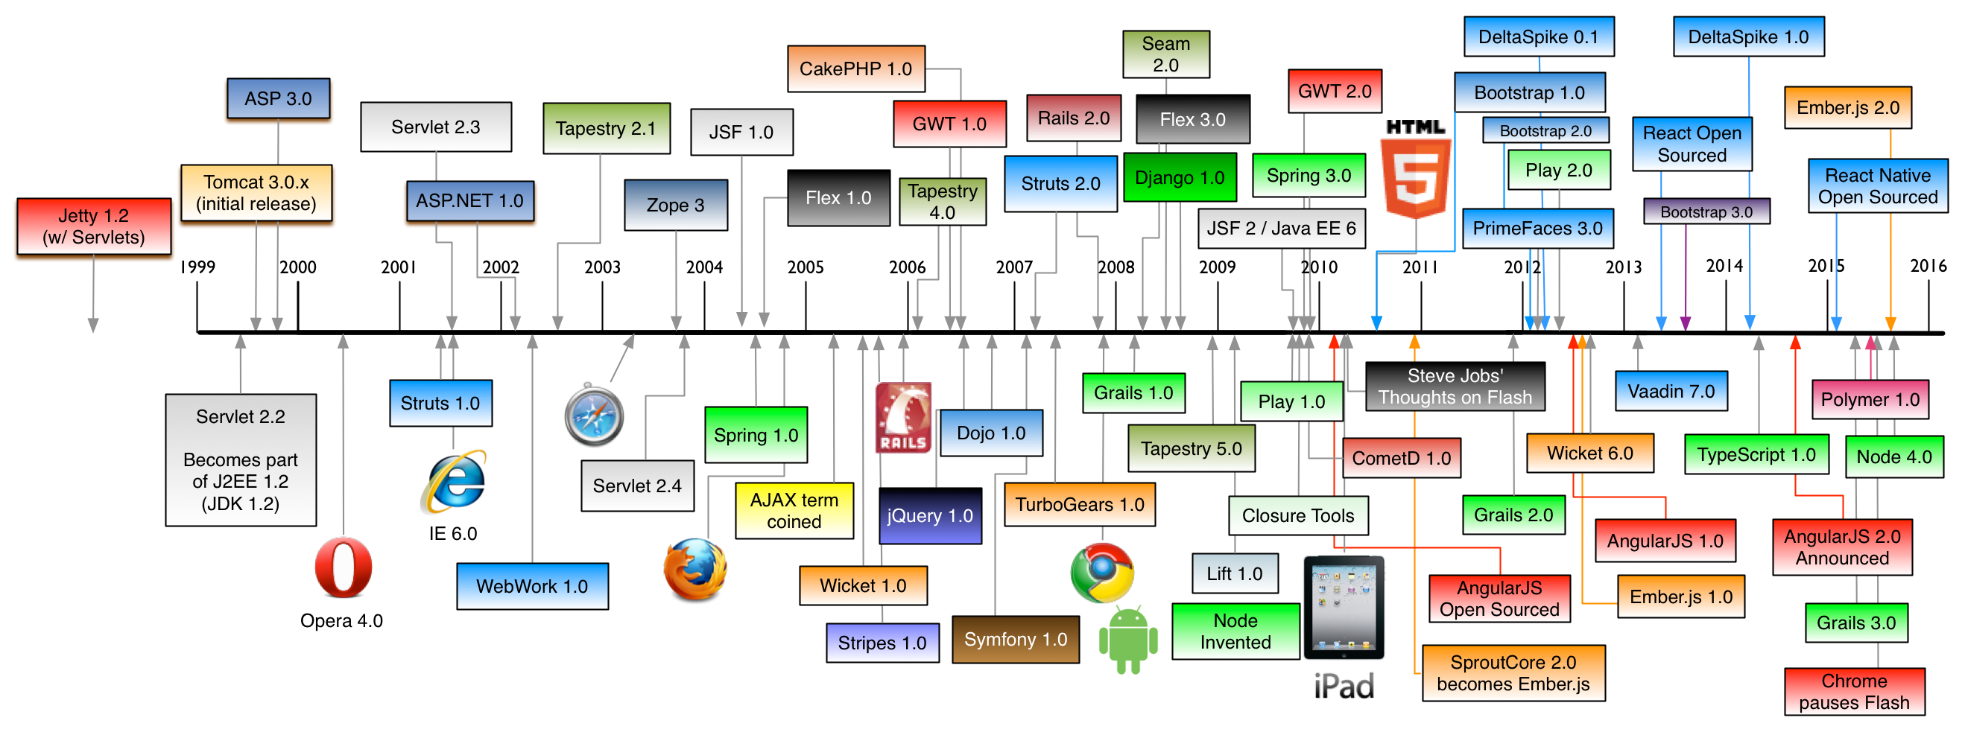
History of SPA
Notes:
jQuery (August 26, 2006)
AJAX (??)

Slide 5
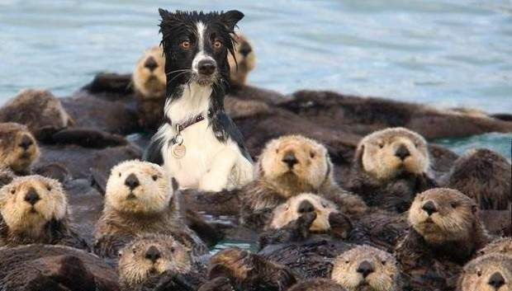

Slide 6
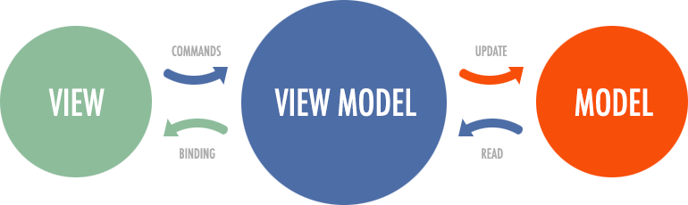
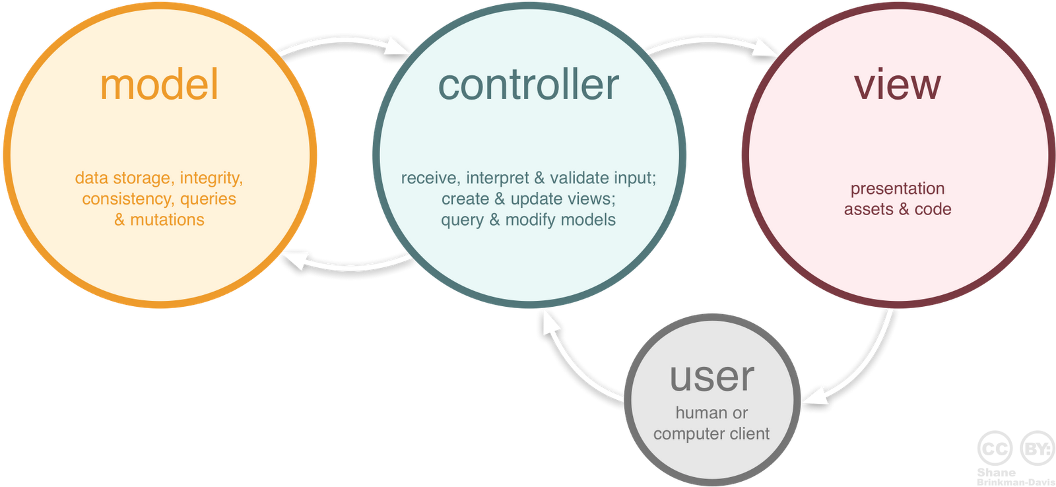
Basics of a SPA Framework
Router – A way to define routes /home, /login, /logout etc..
Browser history
Route security
Templates
Structure MVC or MVVM
Model–view–viewmodel (MVVM) is a software architectural pattern.
MVVM facilitates a separation of development of the graphical user interface – be it via a markup language or GUI code – from development of the business logic or back-end logic (the data model). The view model of MVVM is a value converter,^{[1]} meaning the view model is responsible for exposing (converting) the data objects from the model in such a way that objects are easily managed and presented

Slide 7
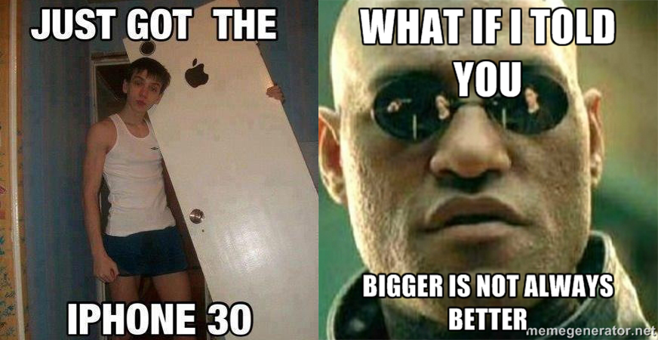
Quick Look at BackboneJS
Can be found at http://backbonejs.org/
Made by Jeremy Ashkenas
October 13, 2010
Little weight only 7.5 KB production, 72 KB development. Less is better?
Notes:
Example at softvision-lasVegas-spa-Angular2-Angular4/src/Backbone_SPA_Examples

Slide 8
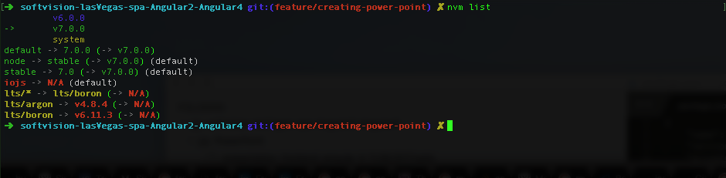
Into To NPM, What is NPM… Node Package Manager
https://www.npmjs.com/
Claims to be the largest JS library in the world.
All open source (Free)
Installation
Windows:
Just download nodeJS and you get it via command line.
Check if you have it just run
npm –v
Mac:
Can install via homebrew
brew install node
Look into installing a node version manager or another version manager, can save you a lot of headaches.

Slide 9
Package.json Structure https://docs.npmjs.com/files/package.json
Important stuff
Name – The name of the package
Scripts – The running of the program, accessed via npm run <script_name>
Dependencies – Other npm packages which this package needs.
Dev-dependencies – Packages only needed for development scripts. Not production.
Main – Defines the .js file which will be exposed when someone accessed the package via require(<package_name>). If no main is defined we expose the index.js
How to publish a package.
Required fields are name, version
Create a user
`npm adduser`
Or
`npm login`
Verify user is created
`npm config ls`
Finally, to publish the package its just `npm publish`
Notes:
https://docs.npmjs.com/getting-started/publishing-npm-packages

Slide 10
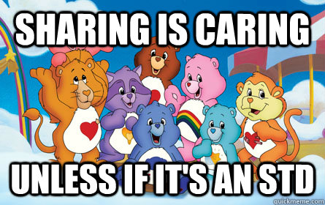

Slide 11
Angular 2 Into
MVVM design
Consider what html should be if it was intended for web applications use.
Maintained by Google.
The most popular JS framework, currently.
What it offers
Dynamic HTML
Powerful templates
HTTP
Component encapsulation
Routing
Event handling
Form and input handling
It does most the heavy lifting for you!

Slide 12
Forget Angular 1 ever existed...
Angular 2 is a complete write from google, so why did they do this?
Angular 1 was build in October 20, 2010 and doesn’t take advantage of the new ES6 features.
Its was to complex.
They wanted to add more structure, Typescript.

Slide 13
Angular 4 Basics
Components – Main way to build and specify elements and logic on the page.

Slide 14
LET’S REVIEW SOME CONCEPTS
Yellow
Is the color of gold, butter and ripe lemons. In the spectrum of visible light, yellow is found between green and orange.
Blue
Is the colour of the clear sky and the deep sea. It is located between violet and green on the optical spectrum.
Red
Is the color of blood, and because of this it has historically been associated with sacrifice, danger and courage.
Yellow
Is the color of gold, butter and ripe lemons. In the spectrum of visible light, yellow is found between green and orange.
Blue
Is the colour of the clear sky and the deep sea. It is located between violet and green on the optical spectrum.
Red
Is the color of blood, and because of this it has historically been associated with sacrifice, danger and courage.

Slide 15
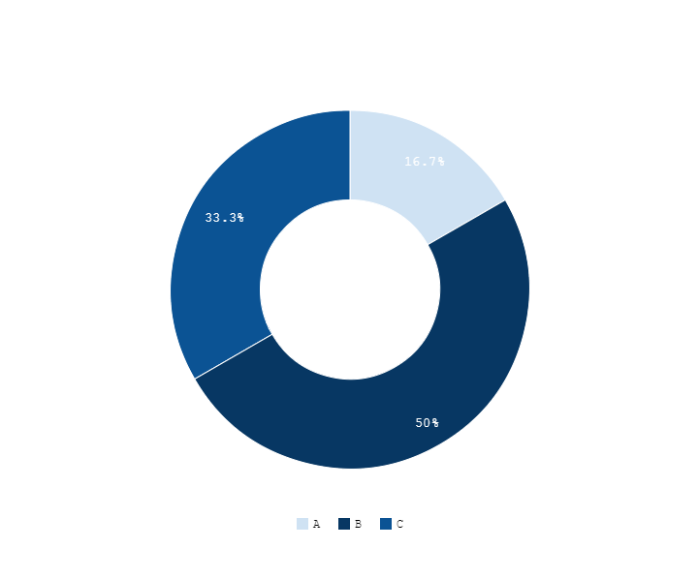
You can copy&paste graphs from Google Sheets

Slide 16
ANDROID PROJECT
Show and explain your web, app or software projects using these gadget templates.
Place your screenshot here

Slide 17
iPHONE PROJECT
Show and explain your web, app or software projects using these gadget templates.
Place your screenshot here

Slide 18
TABLET PROJECT
Show and explain your web, app or software projects using these gadget templates.
Place your screenshot here

Slide 19
DESKTOP PROJECT
Show and explain your web, app or software projects using these gadget templates.
Place your screenshot here

Slide 20
Thanks!
ANY QUESTIONS?
You can find me at:
@username user@mail.me

Slide 21
CREDITS
Special thanks to all the people who made and released these awesome resources for free:
Presentation template by SlidesCarnival
Photographs by Unsplash

Slide 22

Presentation design
This presentations uses the following typographies:
Titles & Body copy: Cousine
You can download the fonts on this page:
https://www.google.com/fonts#UsePlace:use/Collection:Cousine
Click on the “arrow button” that appears on the top right
You don’t need to keep this slide in your presentation. It’s only here to serve you as a design guide if you need to create new slides or download the fonts to edit the presentation in PowerPoint®

Slide 23
SlidesCarnival icons are editable shapes.
This means that you can:
Resize them without losing quality.
Change fill color and opacity.
Isn’t that nice? :)
Examples:

Slide 24
😉
Now you can use any emoji as an icon!
And of course it resizes without losing quality and you can change the color.
How? Follow Google instructions https://twitter.com/googledocs/status/730087240156643328
✋👆👉👍👤👦👧👨👩👪💃🏃💑❤😂😉😋😒😭👶😸🐟🍒🍔💣📌📖🔨🎃🎈🎨🏈🏰🌏🔌🔑 and many more...

