Slide 1
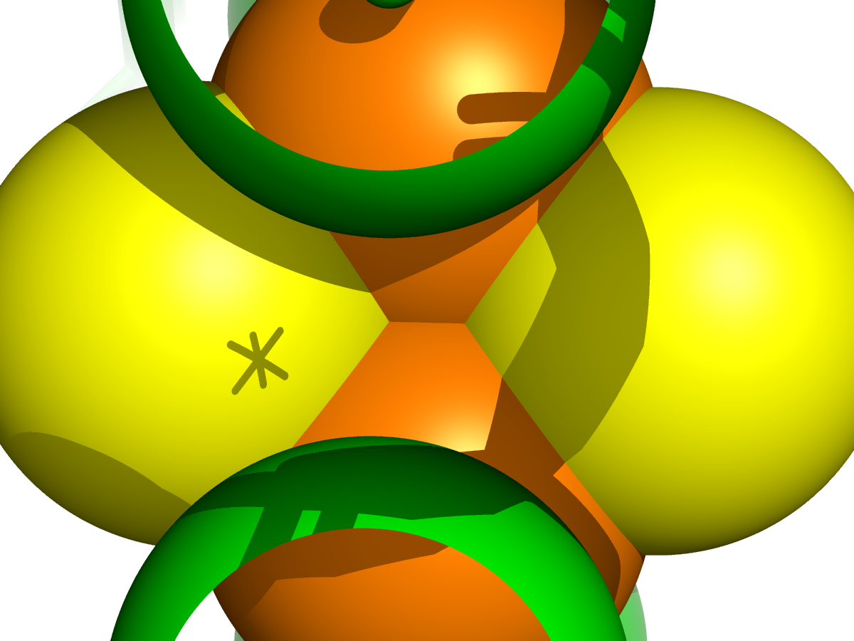
EXECUTIVE PITCH | PROBLEM DEFINITION & BIOPHYSICAL FRONTIER
Engineering Nature's Electrical Wiring: Predicting Metalloprotein Redox Potentials
Why Iron-Sulfur ([Fe-S]) cluster redox potential (Em) prediction is a multi-million dollar biophysical bottleneck
1. WHAT WE DO & WHY IT MATTERS
2. WHY IT IS AN EXTREMELY HARD PROBLEM
• Nature's Universal Bio-Batteries: Iron-Sulfur ([Fe-S]) proteins are the electrical grid of all living organisms. They drive essential electron-transport cascades in cellular respiration (Complex I), photosynthesis (Photosystem I), nitrogen fixation (nitrogenase), and DNA repair.
• Hyper-Sensitivity (The 60 mV Rule): In electron transfer, thermodynamics dictates that a mere ±60 mV shift in redox potential (Em) alters electron transfer kinetics by a full order of magnitude (10x), easily halting vital metabolic fluxes.
• The High-Value Mission: Accurately predicting Em directly from 3D molecular structures without cost-prohibitive quantum chemistry unlocks rational de novo metalloenzyme design, green hydrogen biocatalysis, and synthetic bio-circuitry.
• The Current Bottleneck: Wet-lab electrochemistry requires costly protein purification ($1,000s/mutant), while DFT quantum calculations require days of supercomputing per cluster and fail on dynamic protein dielectric environments.
• The 1,000 mV Paradox: Chemically identical [4Fe-4S] cubane clusters span a massive 1,200 mV physiological range—from -700 mV in Ferredoxins to +500 mV in HiPIPs. The chemical core is identical; the protein microenvironment alone controls the voltage.
• Sub-Angstrom Quantum Sensitivity: A single hydrogen bond (N-H···S) from the peptide backbone shifts Em by +60 to +100 mV. Subtle changes in solvent accessibility (SASA), dielectric screening, and pH titration completely alter cluster potential.
3. QUANTUM ACTIVE SITE: [4Fe-4S] CLUSTER MICROENVIRONMENT
▸ Inorganic Cubane Core: Fe4S4 cluster undergoing reversible [Fe4S4]2+/1+ redox transitions.
▸ Cysteine Coordination: 4 invariant Cys-Sγ coordinate bonds providing primary electron pathways.
▸ Outer Dielectric Shell: Polarity and pH modulate electrostatic charge stabilization.

Slide 2
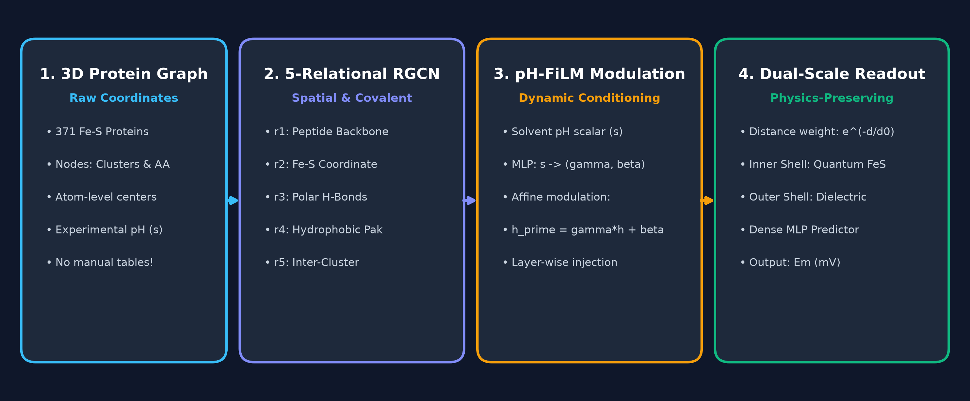
METHODOLOGY & ARCHITECTURAL INNOVATION | FILM-RGCN
Overcoming Broken Baselines with Physics-Conditioned Graph Message Passing
How we diagnosed prior literature failures and designed a continuous multi-relational graph neural network
PRIOR LITERATURE & HIDDEN PITFALLS
OUR SOLUTION: PHYSICS-CONDITIONED FiLM-RGCN
✖ The Published Baseline (JCIM 2025): Persico et al. proposed tabular feature extraction with XGBoost, claiming ~40 mV on a subset, but their GitHub code yielded massive errors (~143-165 mV, R² ≈ 0.18).
✖ Our Reproduction & Bug Discovery: Running the exact repository revealed severe dictionary key collisions in feature extraction, generating hundreds of corrupted NaN/zero columns and breaking model training.
✖ Why Standard GNNs Fail: Standard GCNs and GATs suffer from Signal Dilution (averaging across 300+ bulk residues drowns the active site) and Boundary Cliffs (rigid distance cutoffs create artificial discontinuities).
✔ 1. Curated 96 Biophysical Descriptors: Completely resolved key collisions; non-redundant descriptors drop baseline error directly to 48.26 mV.
✔ 2. 5-Relational Molecular Topology: Replaces generic spatial edges with chemically explicit message passing: (1) Covalent Backbone, (2) Fe-S Coordinate, (3) Polar H-Bonds (N-H···S), (4) Hydrophobic, (5) Cluster-Cluster.
✔ 3. Layer-Wise pH-FiLM Affine Modulation: Injects solvent pH into every GNN layer as an affine transformation (h' = γ(pH) ⊙ h + β(pH)), modeling protonation dynamics.
✔ 4. Dual-Scale Exponential Distance Readout: Continuous physics-based pooling w(d) = exp(-d/d0) ensures inner-shell quantum atoms dominate over bulk solvent.
END-TO-END FiLM-RGCN DEEP LEARNING PIPELINE

Slide 3
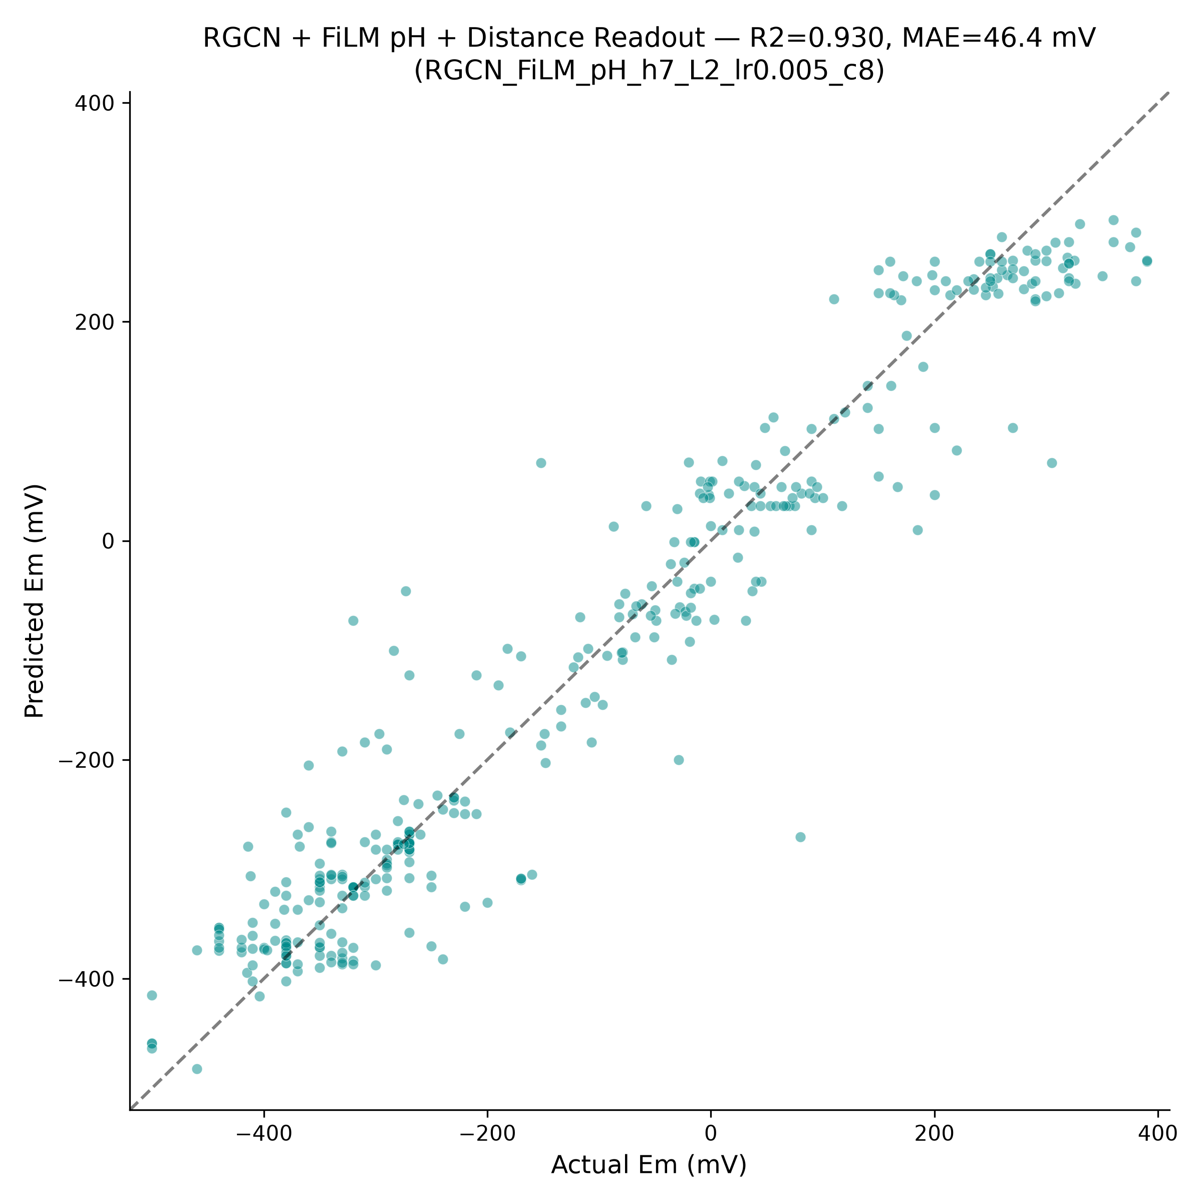
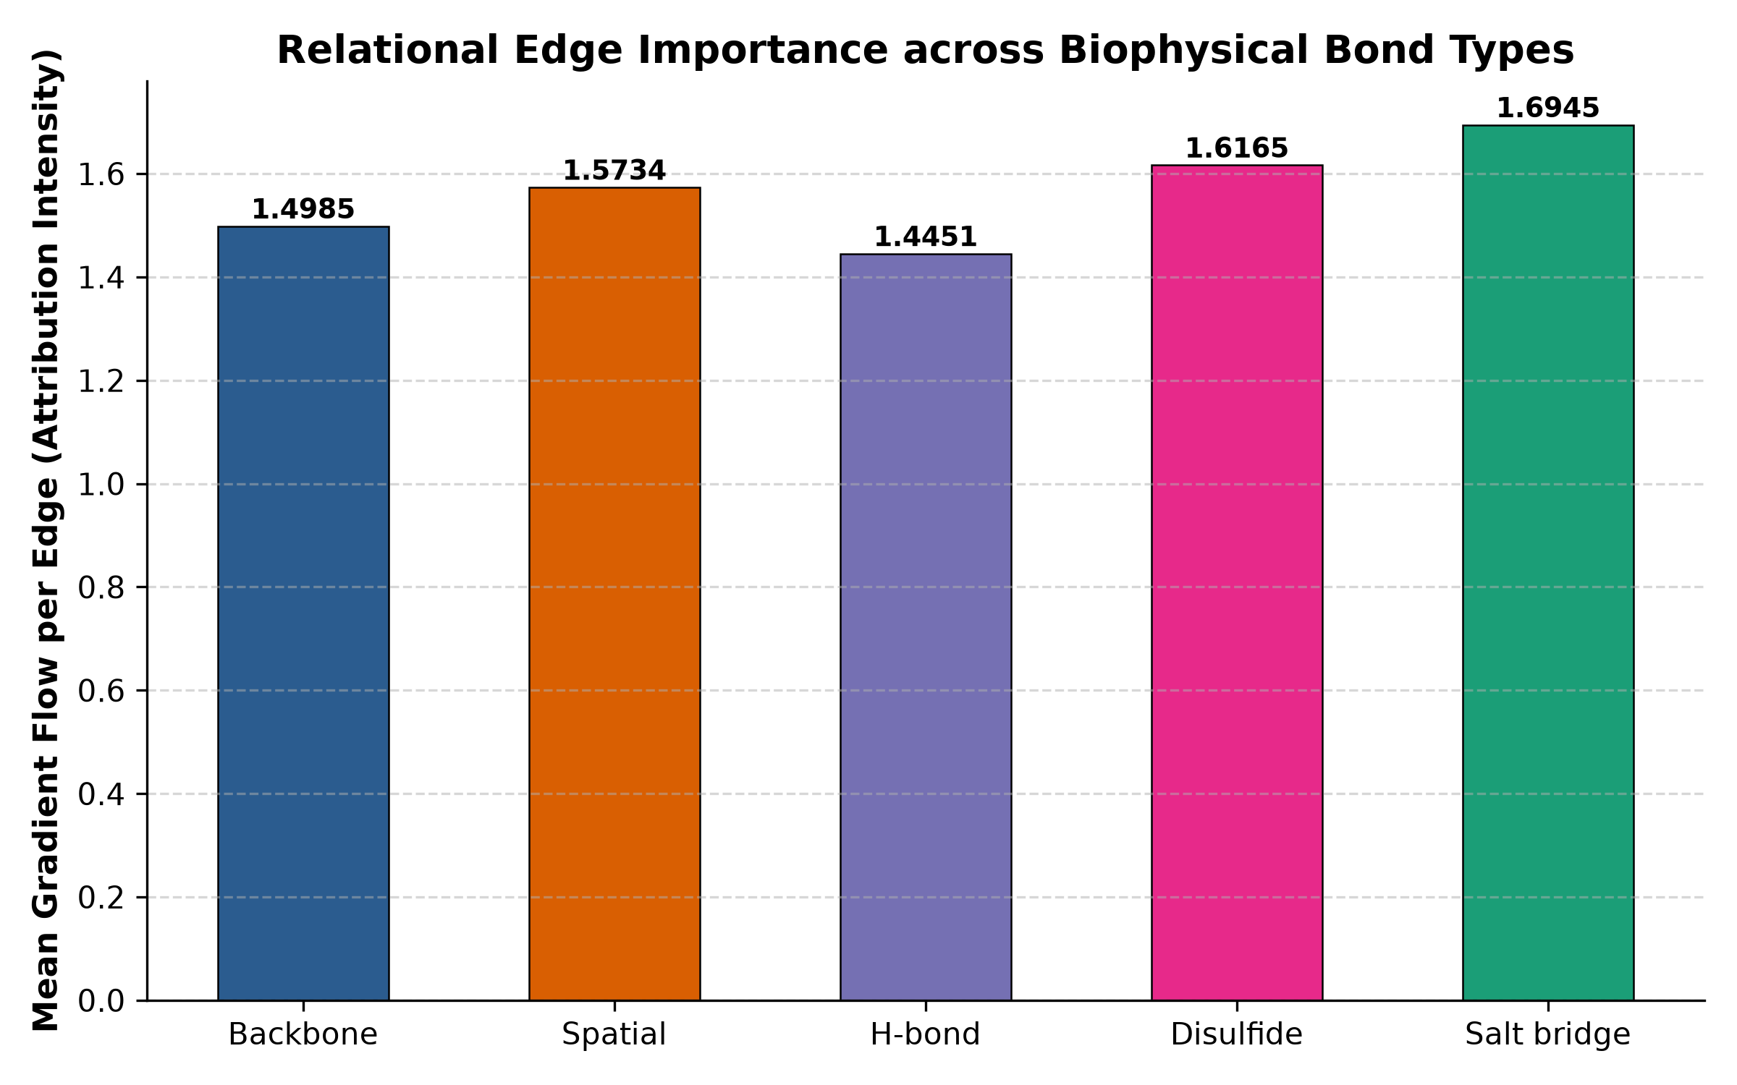
BREAKTHROUGH RESULTS & REAL-WORLD APPLICATION | IMPACT PITCH
Unprecedented Accuracy, Mechanistic Explainability & In Silico Design
How our model sets a new standard for computational metalloenzyme engineering and green synthetic biology
1. BENCHMARK TRIUMPH
2. MECHANISTIC EXPLAINABILITY (XAI)
3. WHY IT MATTERS & FUTURE IMPACT
★ De Novo Protein Design: Screen millions of computationally generated protein backbones (e.g. from RFdiffusion/Chroma) in seconds for optimal redox potentials.
★ Zero Wet-Lab Wastage: Filter out 95% of non-viable synthetic candidates before expensive gene synthesis and expression in the lab.
★ Green Tech & Bio-Hydrogen: Optimize [FeFe]- and [NiFe]-hydrogenases to match renewable photovoltaic electrode potentials for ultra-efficient carbon-neutral H2 production.
★ Metabolic Circuit Optimization: Tune electron transfer bottlenecks in engineered synthetic microbes for bio-manufacturing of pharmaceuticals and fuels.
★ Instant Inference (<15 ms): 10,000x faster than DFT; enables interactive point mutation screening on a standard laptop.
▸ Rediscovering Real Physics: SHAP analysis proves the model learned true bioinorganic principles rather than dataset noise.
▸ H-Bonding Primacy: Backbone N-H···S hydrogen bonds carry the highest positive weight (+60 to +100 mV per bond).
▸ Dielectric & SASA Shielding: Solvent exposure promotes solvent reorganization energy, sharply depressing Em.
▸ pH Nernstian Response: Captures physiological proton-coupled electron transfer (PCET) titration curves.
• Champion Accuracy: MAE = 46.35 mV, R² = 0.929, Pearson r = 0.965 across all 371 proteins.
• >70% Error Reduction: Slashes error from author's repo (164.8 mV) down to 46.35 mV.
• Full-Range Parity: Consistent fidelity from -700 mV ferredoxins to +500 mV HiPIPs without boundary artifacts.

