Slide 1

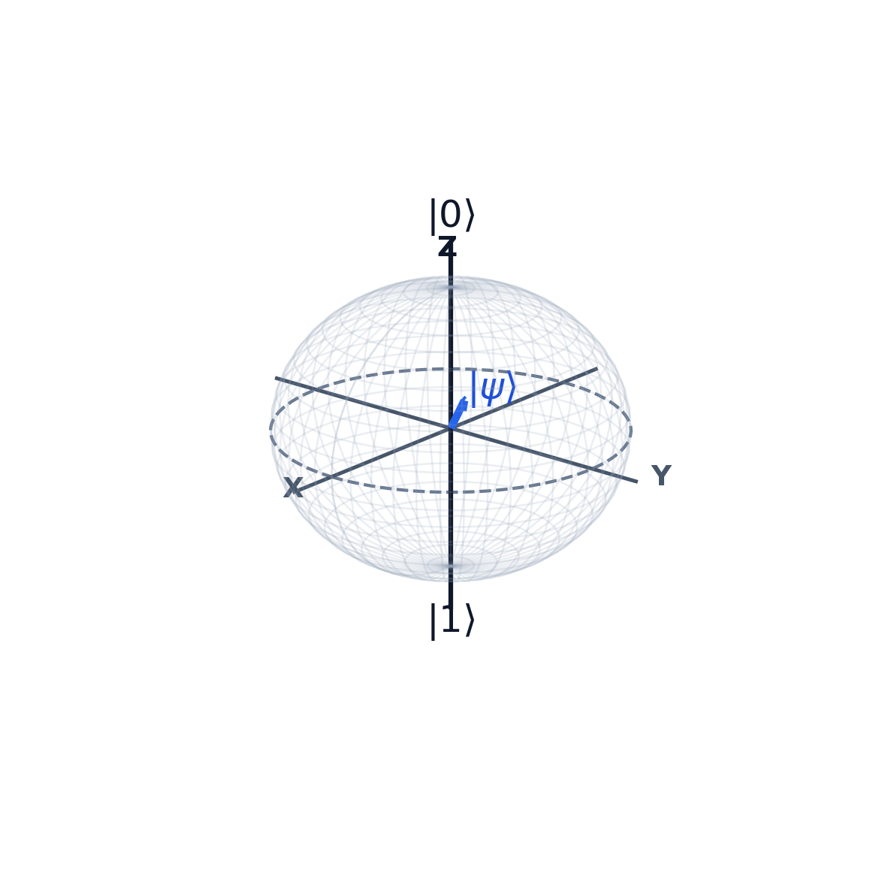
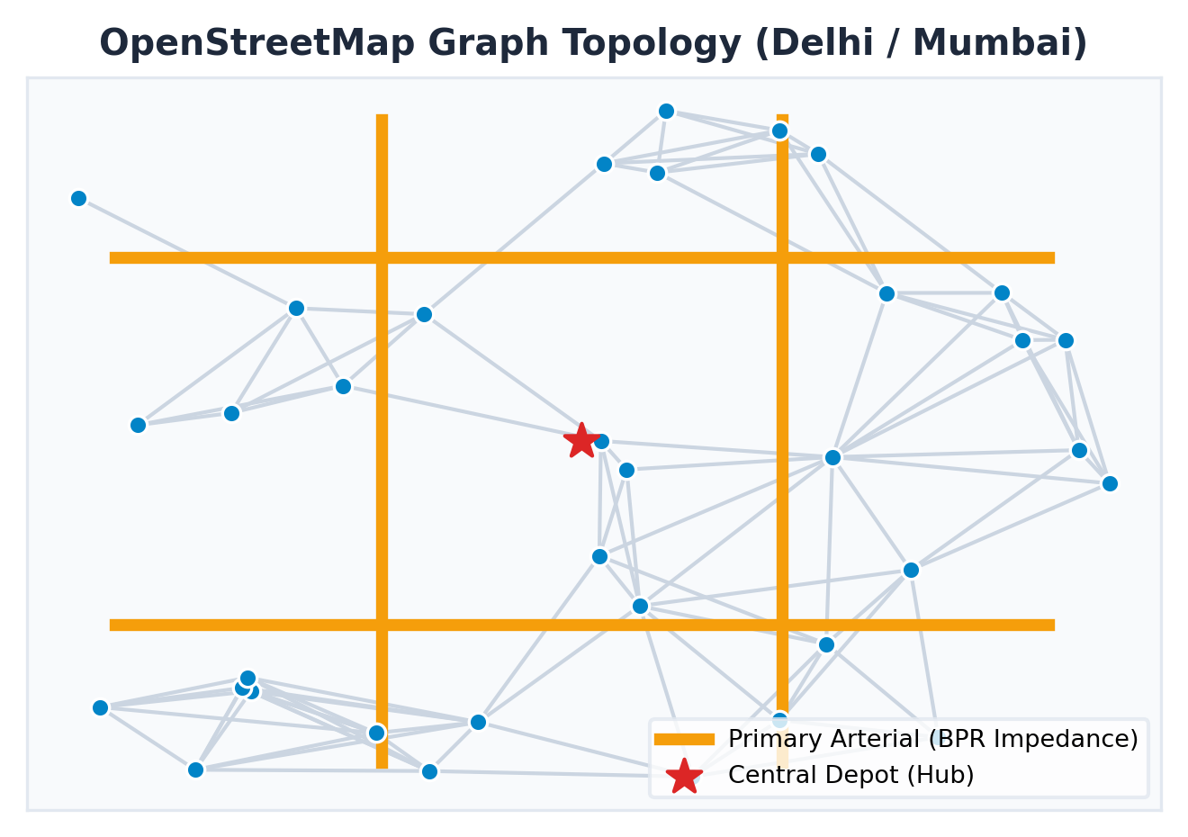
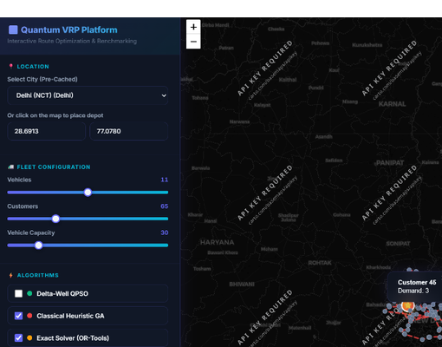
Quantum Optimize
QUANTUM-INSPIRED HYBRID VRP ENGINE (Q-HQGLS)
Dynamic Congestion-Aware Multi-Depot Fleet Optimization for Indian Megacities
◆ Technical Approach & Implementation Methodology (4-Stage Pipeline)
[CORE ENGINE] Python 3.11 Vectorized Algorithmic Core
• Vectorized NumPy & SciPy: All-pairs shortest path matrix computations in millisecond latency.
• CSR-sparse graph representation accelerates Dijkstra lookups by >10x.
• Multi-centroid clustering and radial polar sweeps for diverse attraction basins.
• Scales to 200 depots & 2,000+ customers in < 23s on commodity CPU.
[STAGE 1] Road Graph Extraction & Matrix Construction
• Ingests authentic OpenStreetMap road graphs for target metropolitan territories.
• Computes exact all-pairs shortest travel-time and distance matrices via CSR-sparse Dijkstra.
• Generates free-flow vs congested BPR delay matrices for dynamic peak-hour routing.
[STAGE 2] Quantum Superposition State Initialization
• Maps vehicle clusters onto a spherical Bloch manifold: |psi> = cos(theta/2)|0> + exp(i*phi)sin(theta/2)|1>.
• Combines multi-parameterized Clarke-Wright savings with radial polarization to seed diverse attraction basins.
• Eliminates initial territorial overlap via Alan Turing (1952) Reaction-Diffusion Morphogenesis.
[SPATIAL GIS] OpenStreetMap & BPR Dynamic Congestion Engine
• Real-World Metropolitan Graph Modeling via OSMnx & NetworkX.
• Captures actual speed limits, turning restrictions, and one-way avenue topology.
• Dynamic Traffic & Congestion Coupling (BPR Model: te = te0 * [1 + alpha*(v/c)^beta]).
• Evaluates non-linear bottleneck impedance across 10 major Indian megacities.
[STAGE 3] Transverse-Field Quantum Tunneling Search (HQ-GLS)
• Perturbs route boundaries with simulated transverse field Gamma(t), tunneling through steep fitness ridges.
• Integrates Adaptive Large Neighborhood Search (ALNS) Shaw ruin removal + Regret-2 recreate.
• Alan Turing (1940) Banburismus Deciban evidence pruning (Wij < -10 db) eliminates >75% of dead ends.
[STAGE 4] Live Fleet Simulation, Verification & Telemetry
• Evaluated across 10 Indian megacities & 1-10 depots; certified 100% capacity and time-window feasibility.
• Statistically certified within [+0.43%, +2.10%] of Google OR-Tools exact optima at up to 8.6x speedup.
• Interactive web HUD provides real-time vehicle dispatch animation, delivery states, and telemetry.
[SOTA SOLVER] Quantum HQ-GLS Engine
Proprietary hybrid metaheuristic combining Transverse-Field Quantum Tunneling, Bloch sphere superposition, and Alan Turing Deciban pruning.
[EXACT BASELINE] Mathematical Benchmark
Rigorous baseline verification against Google OR-Tools (Exact Guided Local Search & Branch-and-Bound solver) guaranteeing proven optimality bounds.
[WEB PLATFORM] Interactive UI & Simulation
Vanilla CSS3 glassmorphic HUD, Leaflet.js real-time vehicle dispatch animation, pin state delivery tracking, and Python Flask microservice.
[HARDWARE READY] Edge-Ready Deployment
CPU-efficient (< 3.0s runtimes), edge-ready with zero specialized quantum hardware required (fully NISQ & classical edge compatible).
@SIH Idea submission- Template 2

