Slide 1
Coding Projects
Hubert Wójcik

Slide 2


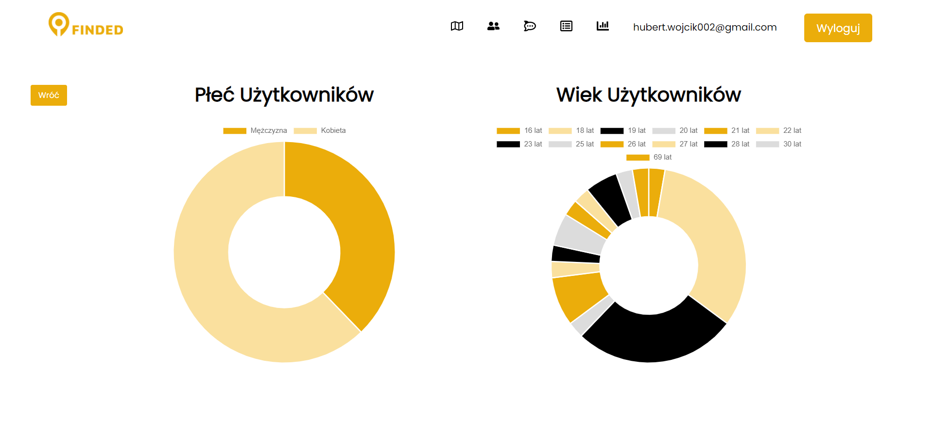
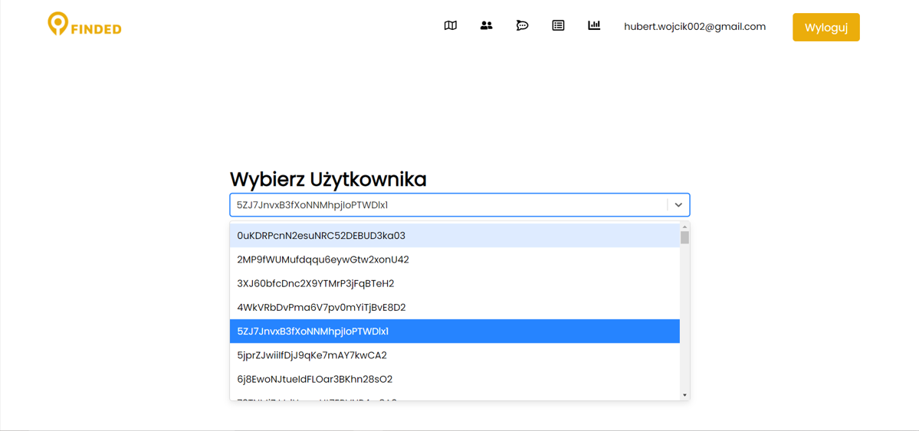
Finded Admin Panel

Slide 3
Finded Admin Panel
An admin panel for a small polish start-up.
Features:
Displaying users in certain area (Google Maps API) and their account information
Managing users’ reports
App statistics (ChartJS)
Framework - ReactJS
Database - Firebase Firestore & RealtimeDB

Slide 4

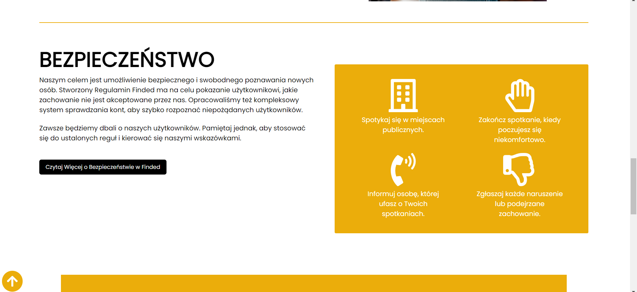
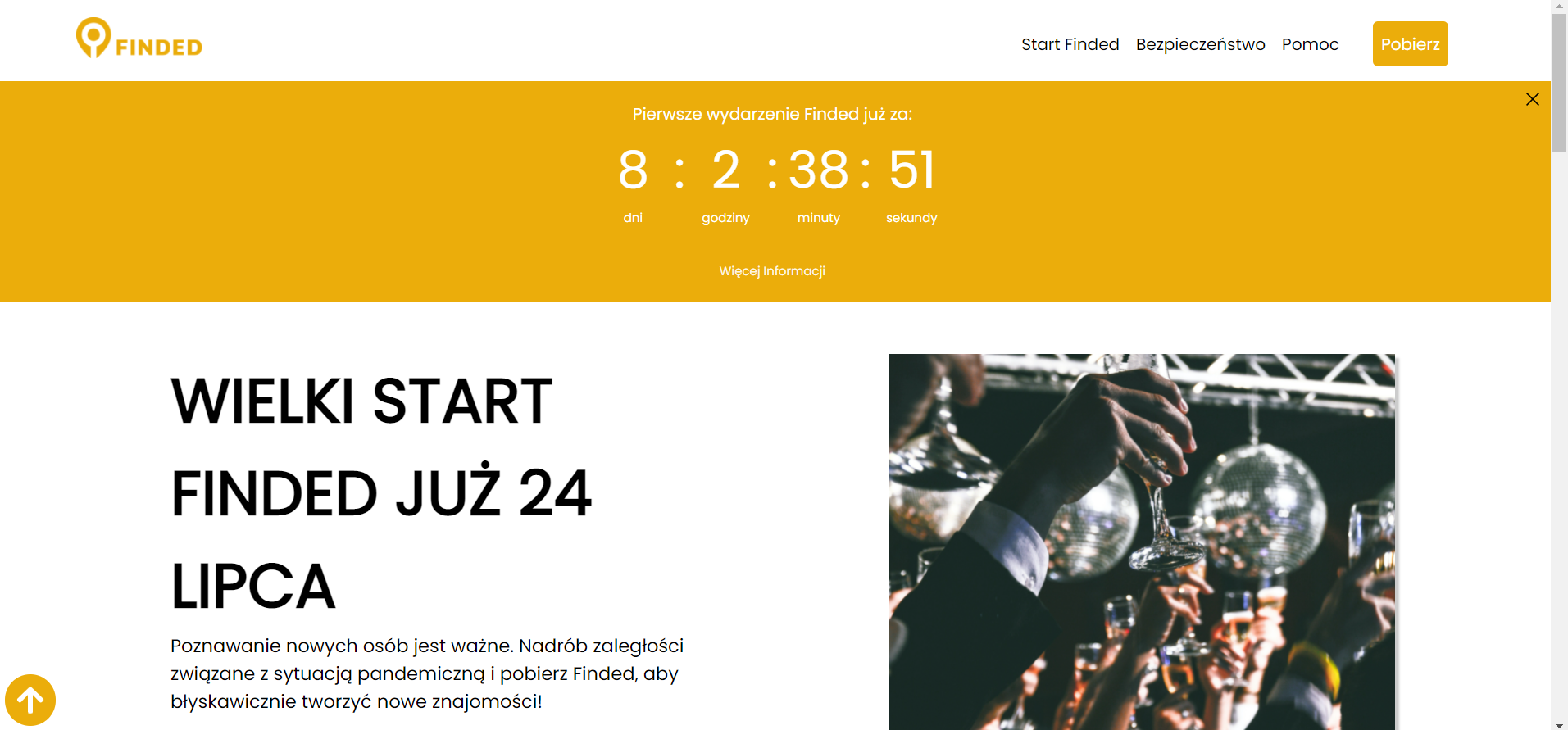
Finded - Website

Slide 5
Finded Website
A website for the start-up mentioned previously.
Features:
Application’s blog
Help section
Contact form
Framework - NextJS

Slide 6

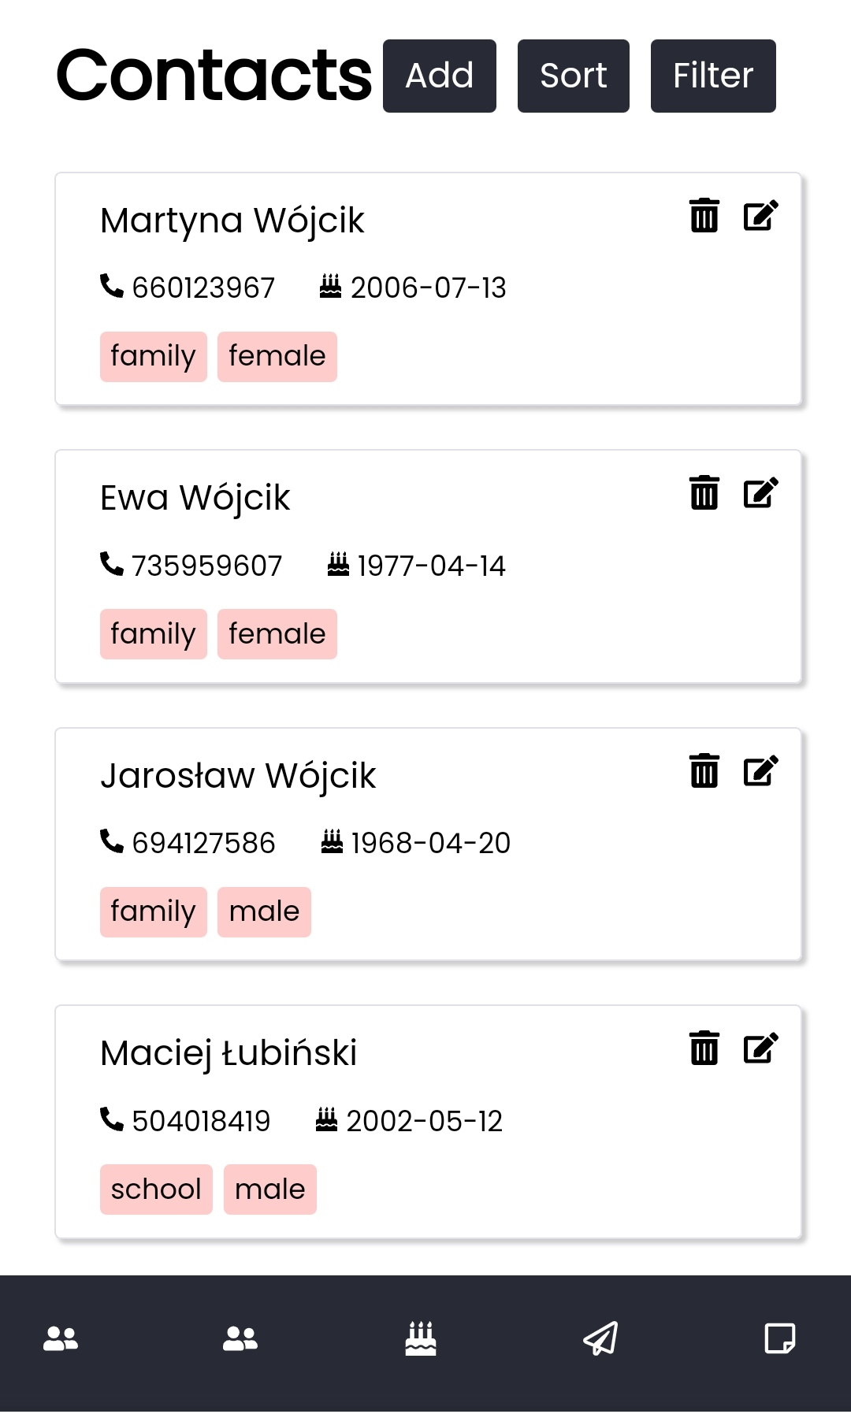
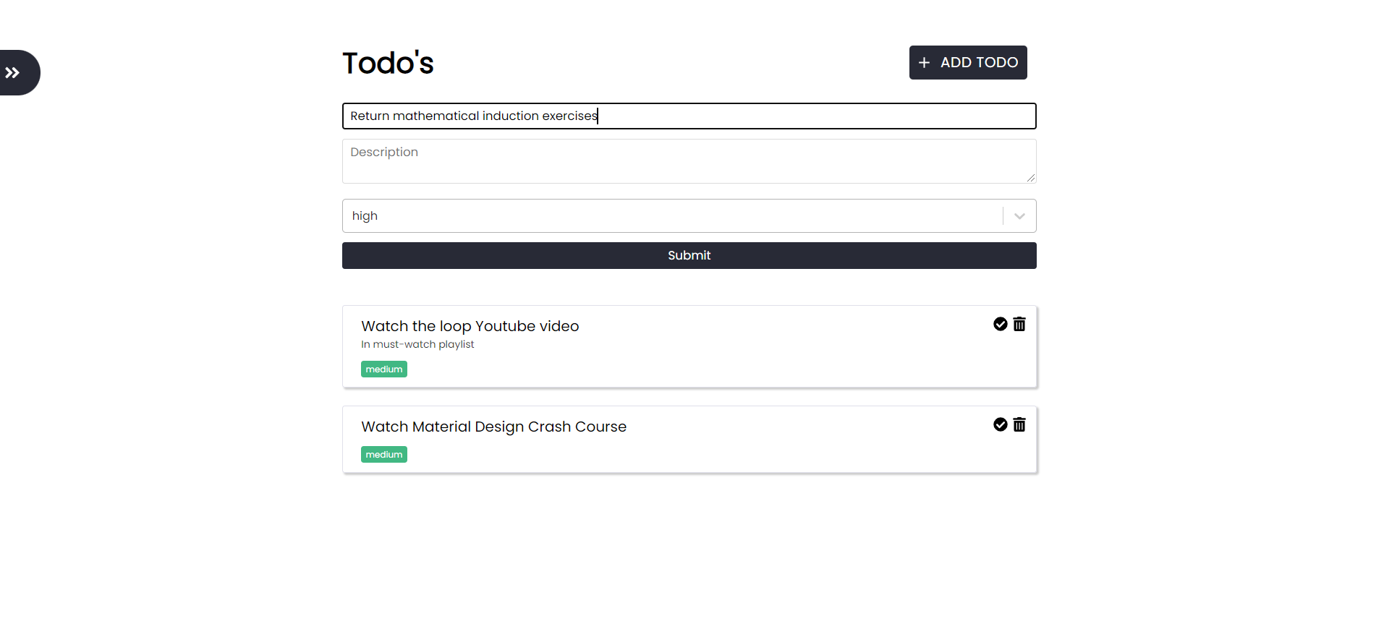
Personal Database

Slide 7
Personal Database
My own personal database.
Features:
Contacts list
Todo’s list
Incoming birthdays
Framework - ReactJS
Database - Supabase

Slide 8

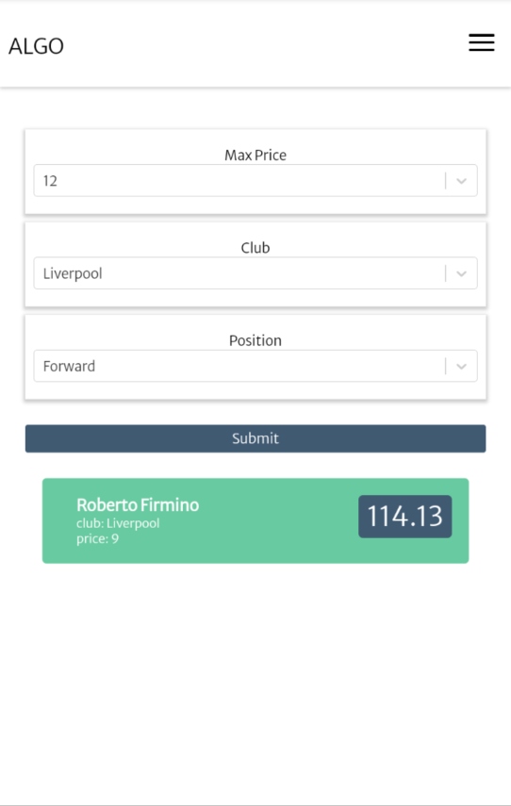
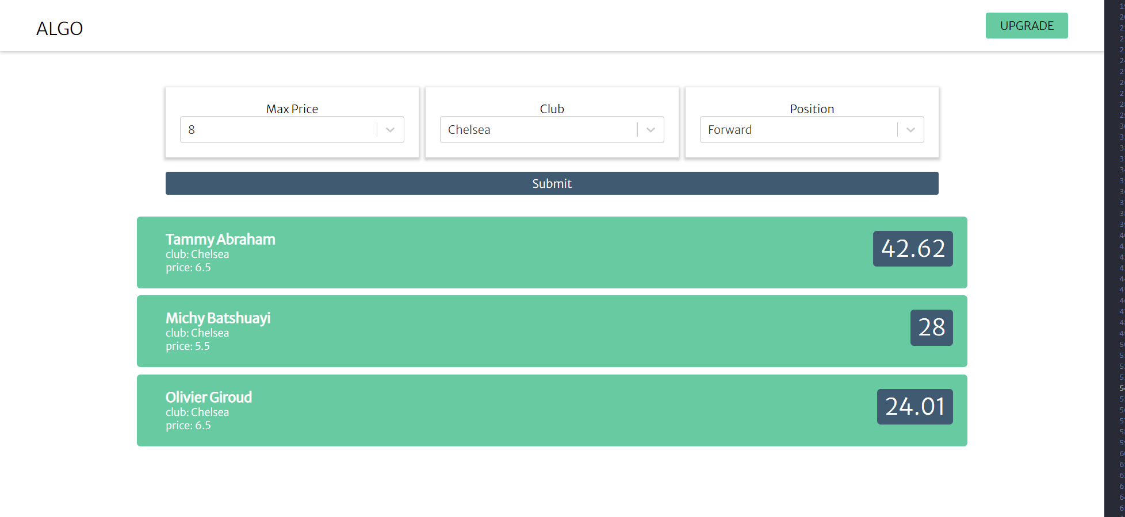
FPL Algo

Slide 9
FPL Algo
I collected footballers’ data from Fantasy Premier League API and created an algorythm, which assigned each player a value. The higher the value, the better the footballer is in a game called Fantasy Premier League.
Frontend Framework - NextJS
Languages - Javascript, Python

