Slide 1


NESTML Tutorial
Charl Linssen & Jochen M. Eppler

Slide 2
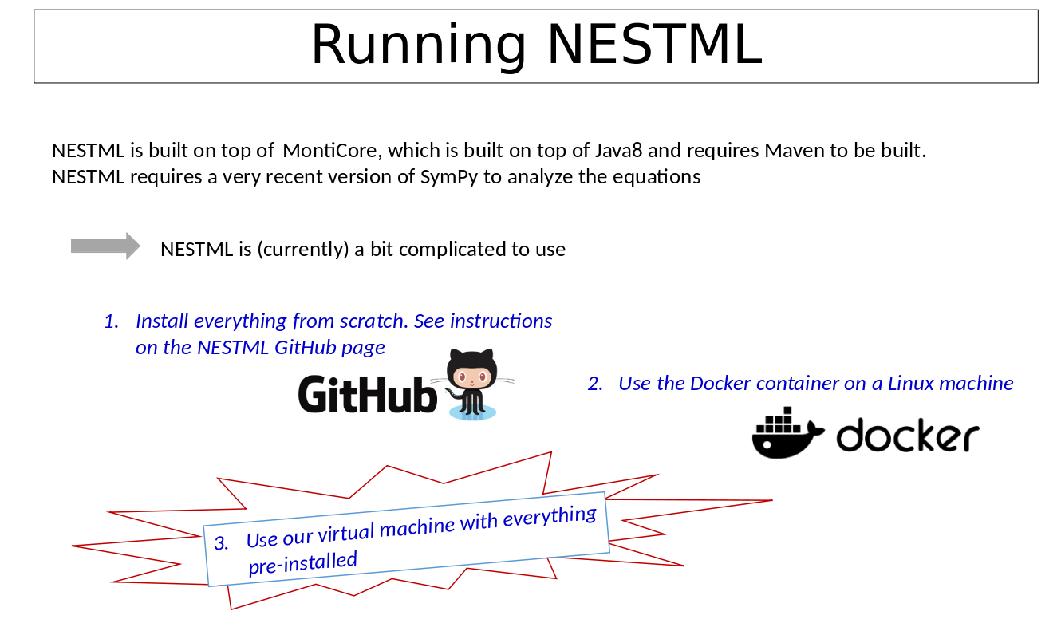
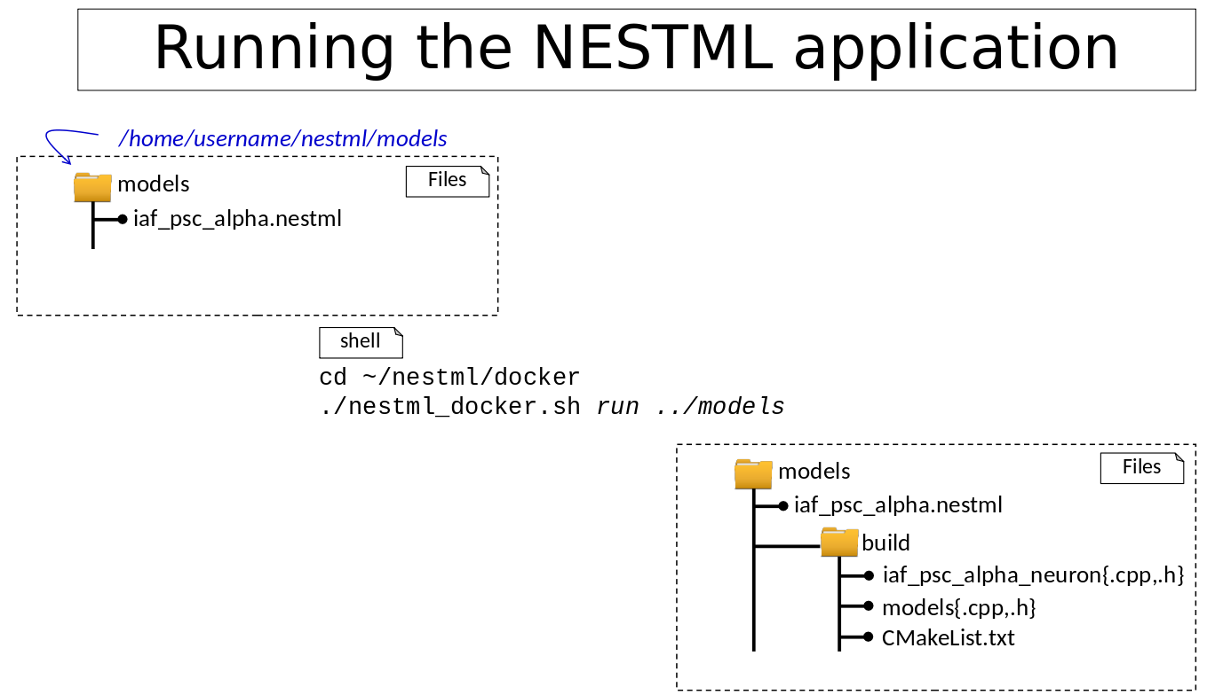
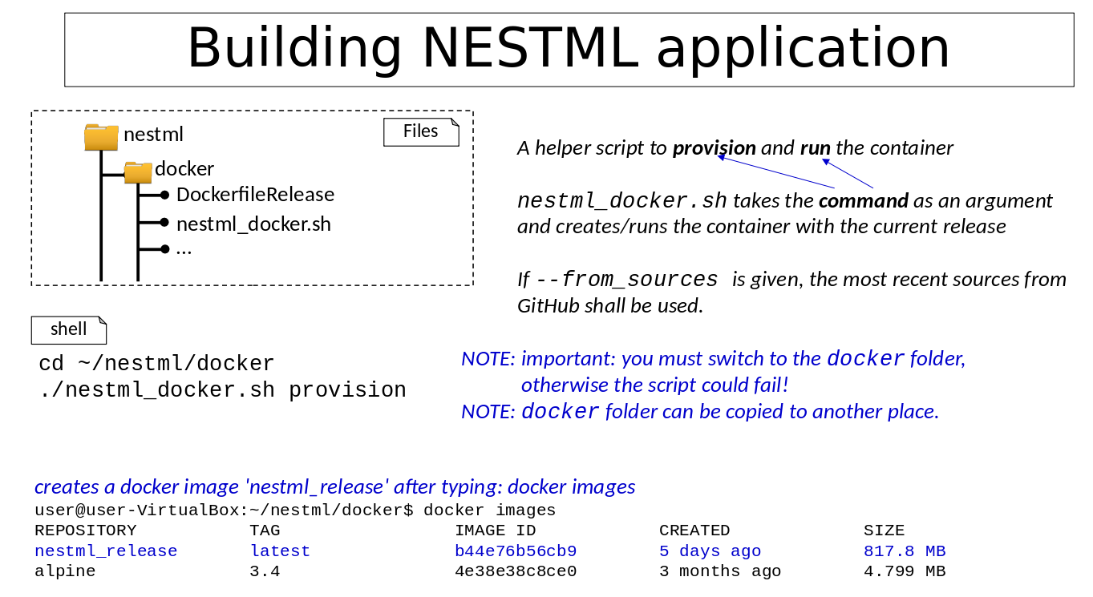
Installing NESTML

Slide 3
Installing NESTML

Slide 4
Installing NESTML
pip3 install nestml

Slide 5

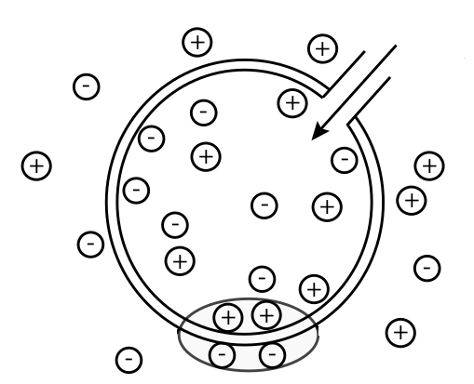
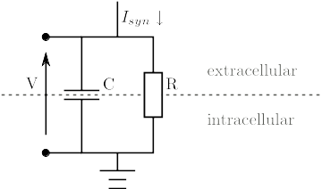
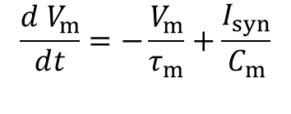

Modelling biological neurons
m
m

Slide 6
Mapping biological neurons to NESTML
Model
NESTML
neuron rc_neuron:
end
<<rc_neuron.nestml>>
neuron-model based on an RC-circuit

Slide 7
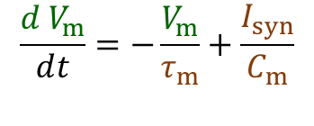
Mapping biological neurons to NESTML
Model
NESTML
<<rc_neuron.nestml>>
neuron rc_neuron:
initial_values:
V_m mV = 0mV
end
equations:
V_m' = -V_m/tau_m + I_syn/C_m
end
parameters:
# values taken from experiments
C_m pF = 250pF
tau_m ms = 10ms
I_syn pA = 10pA
end
update:
integrate_odes()
end
end

Slide 8
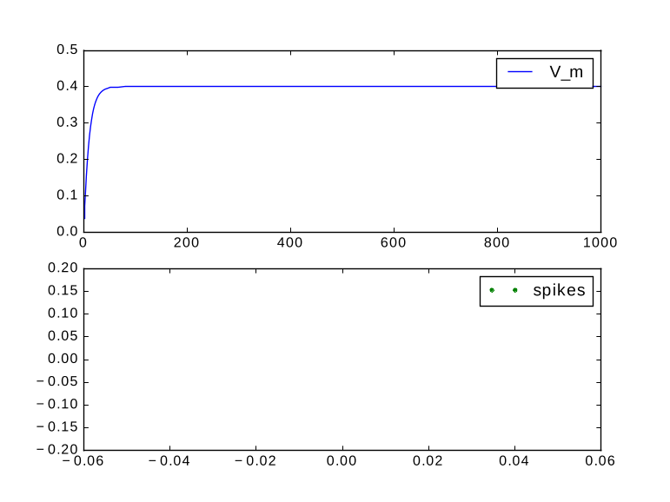
Simulating rc_neuron
Simulating rc_neuron for 1000ms with constant input current of 10pA
Strictly positive membrane potential
No spikes
NEST
<<Runtime>>

Slide 9
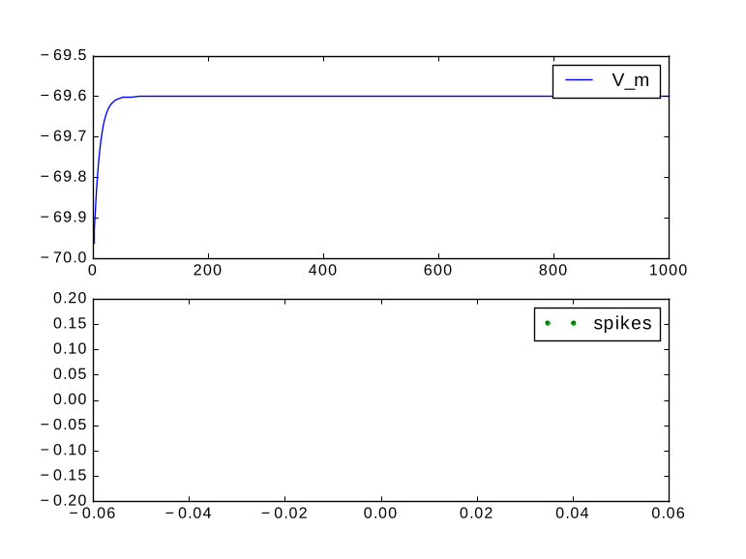
Adding the resting potential E_L
Shift V_m by E_L:
Still no spikes
NEST
<<Runtime>>
neuron rc_neuron_rest:
initial_values:
V_m mV = E_L
end
equations:
V_m' = -(V_m-E_L)/tau_m + I_syn/C_m
end
parameters:
E_L mV = -70mV
end
...
end
NESTML
<<rc_neuron_rest.nestml>>

Slide 10
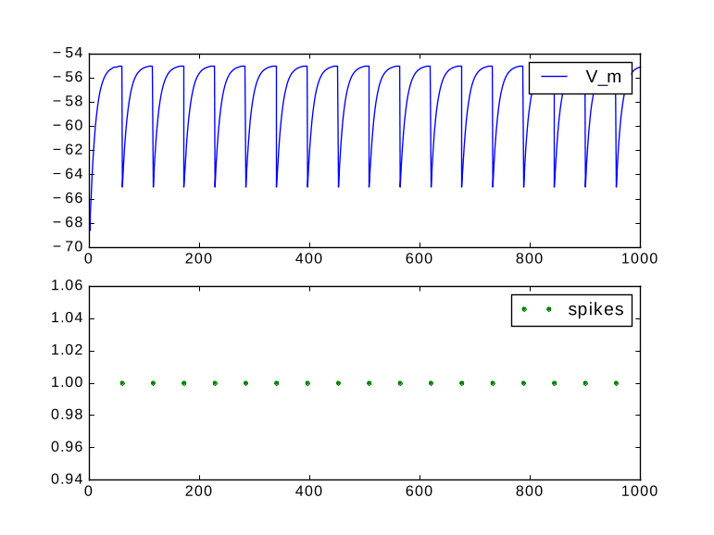
Spiking and reset
Model
NEST
<<Runtime>>
integrate_odes()
AD
[V_m > V_th]
Integrate
Reset
emit_spike()
V_m=V_reset
neuron rc_fire:
parameters:
V_th mV = -55mV - E_L
end
update:
integrate_odes()
if V_m > V_th:
V_m = V_reset
emit_spike()
end
end
...
end
NESTML
<<rc_fire.nestml>>

Slide 11
Refractoriness
Model
NESTML
<<rc_refractory>>
...
AD
neuron rc_refractory:
parameters:
ref_counts integer = 0
ref_timeout ms = 2ms
end internals:
timeout_ticks integer = steps(ref_timeout)
end
update:
if ref_counts == 0:
integrate_odes()
if V_m > V_th:
emit_spike()
ref_counts = timeout_ticks
V_m = V_reset
end
else:
ref_counts -= 1
end
end
end
integrate_odes()
[V_m > V_th]
Integrate
Fire
set_refractory(2ms)
Refractory
[not is_refractory()]

Slide 12
Simulating rc_refractory
NEST
<<Runtime>>

Slide 13
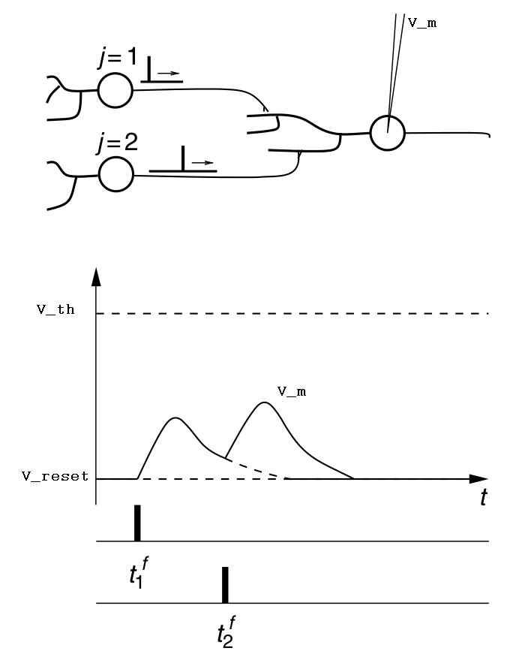
Input handling
(Source: Wulfram Gerstner, Werner M. Kistler, Richard Naud, Liam Paninski-Neuronal
Dynamics From Single Neurons to Networks and Models of Cognition)

Slide 14
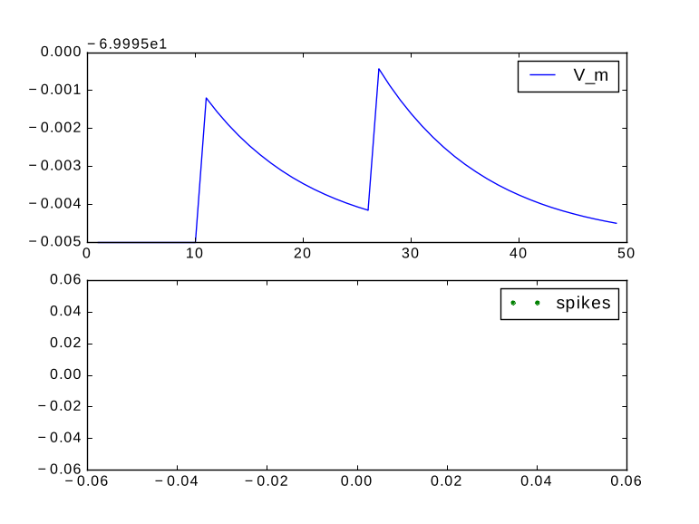

Spike input
neuron rc_input:
initial_values:
V_m mV = E_L
end
equations:
V_m' = -(V_m-E_L)/tau_m + I_syn/C_m
end
parameters:
E_L mV = -70mV
...
end
input:
I_syn pA <- spike
end
output: spike
end
NESTML
NEST
<<rc_input>>
<<Runtime>>
buffer can be inhibitory ,
excitatory or both (if nothing else
stated)

Slide 15
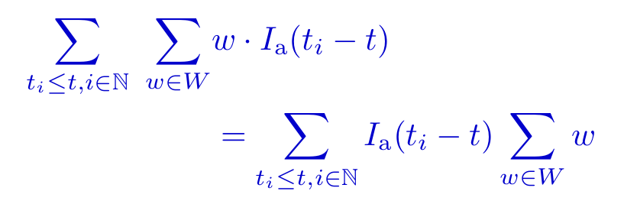
Synaptic response
neuron rc_alpha_response:
initial_values:
V_m mV = E_L
I_a real = 0
I_a' 1/ms = e/tau_syn
end
equations:
shape I_a'' = (-2/tau_syn) * I_a'-(1/tau_syn**2) * I_a
V_m' = -(V_m-E_L)/tau_m + convolve(I_a, spikes)/C_m
end
input:
spikes pA <- spike
end
output: spike
update:
integrate_odes()
...
end
end
NESTML
<<rc_alpha>>
ODEs of order n require
all initial values of the
derivatives from 0 to n-1

Slide 16
Simulating rc_alpha_response
NEST
<<Runtime>>

Slide 17
Shape notation
neuron rc_alpha_response_shape:
state:
V_m mV = E_L
end
equations:
shape I_a = (e/tau_syn) * t * exp(-t/tau_syn)
V_m' = -(V_m-E_L)/tau_m + convolve(I_a, spikes)/C_m
end
input:
spikes pA <- spike
end
output: spike
update:
integrate_odes()
...
end
end
NESTML
<<rc_shape>>
initial values
computed automatically

Slide 18
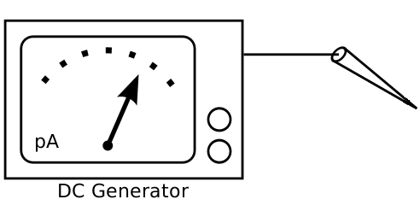
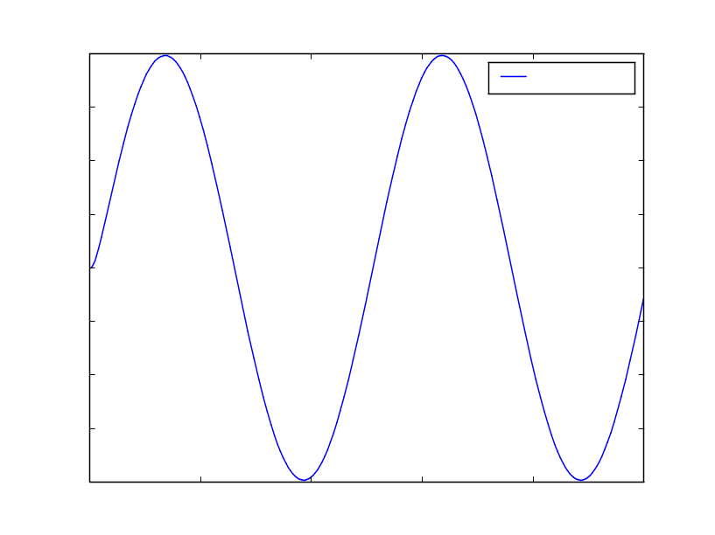
Injecting currents
PyNEST
currents = nest.Create('ac_generator', 1,
{'amplitude': 100.0,
'frequency': 2.0})
nest.Connect(currents , rc_currents)
neuron rc_currents:
...
equations:
I_syn pA = I_e + convolve(I_a, spikes) + currents
V_m' = -V_m/tau_m + I_syn/C_m
end
input:
currents <- current
spikes pA <- spike
end
output: spike
...
end
NEST
<<Runtime>>

Slide 19

Using NESTML (command line)
models
Files
iaf_psc_alpha.nestml
reads
NESTML Runtime
nestml
CMake compiles to
NEST Simulator
models
models.so
build
loads dynamically
iaf_psc_alpha_neuron.cpp
iaf_psc_alpha_neuron.h
models.cpp
models.h
CMakeList.txt
NEST Kernel
models.so
make install
loads & instantiates
PyNEST
from nest import *
Install("models")
neuron = Create("iaf_psc_alpha_neuron")
cmake -Dwith-nest=${NEST_INSTALL_DIR}/bin/nest-config .

Slide 20
Using NESTML (Python)
models
Files
iaf_psc_alpha.nestml
Make the functions available:
from pynestml.frontend.pynestml_frontend import to_nest, install_nest
Generate the C++ code:
to_nest(input_path="models", target_path="/tmp/module", logging_level="INFO")
Compile and install the C++ code:
install_nest("/tmp/module", "/home/johndoe/nest-simulator-build")

Slide 21
PyNEST API of generated NEST module
import nest.*
nest.Install("models")
neuron = Create("rc_neuron")
SetStatus(neuron, {"V_m":-72.0,
"C_m":300.0})
mmeter=Create('multimeter')
SetStatus(multimeter1, {"record_from":["V_m"]})
Connect(mmeter, neuron)
neuron rc_neuron:
initial_values:
V_m mV = -70mV
end
equations:
V_m' = -(V_m-70mV)/tau_m + I_syn/C_m
end
parameters:
C_m pF = 250pF
tau_m ms = 10ms
I_syn = 10pA
end
end
PyNEST
NESTML
<<rc_neuron.nestml>>

Slide 22
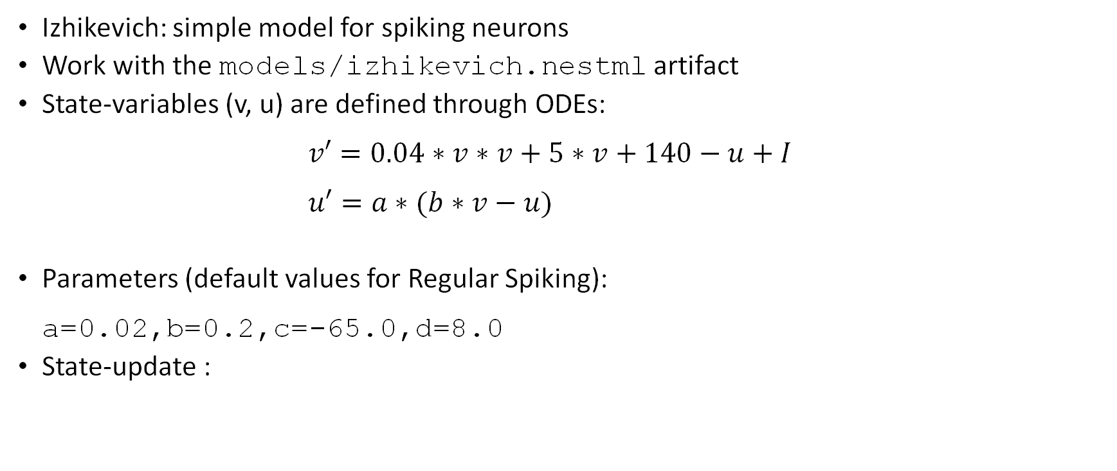



Practical exercise: implementing Izhikevich model
Izhikevich regular spiking plot

Slide 23
Practical exercise: using PyNEST API
Adjust the run_izhikevich.py script
Change model's parameter to produce chattering spikes
Parameters (TODO Chattering): a=0.02,b=0.2,c=-50.0,d=2.0
Use the following PyNEST-API
Change how the neuron is created, e.g.:
model_params = {'a': 0.02, ...}
neuron = nest.Create(modelNestml, 1, model_params)

