Slide 1
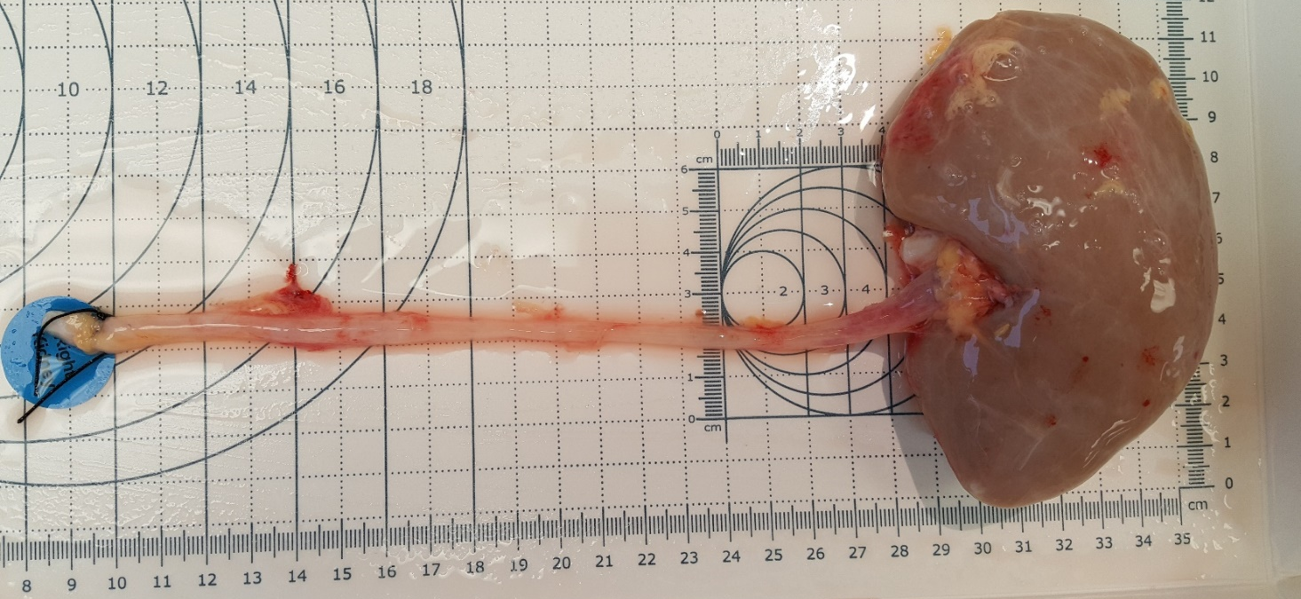
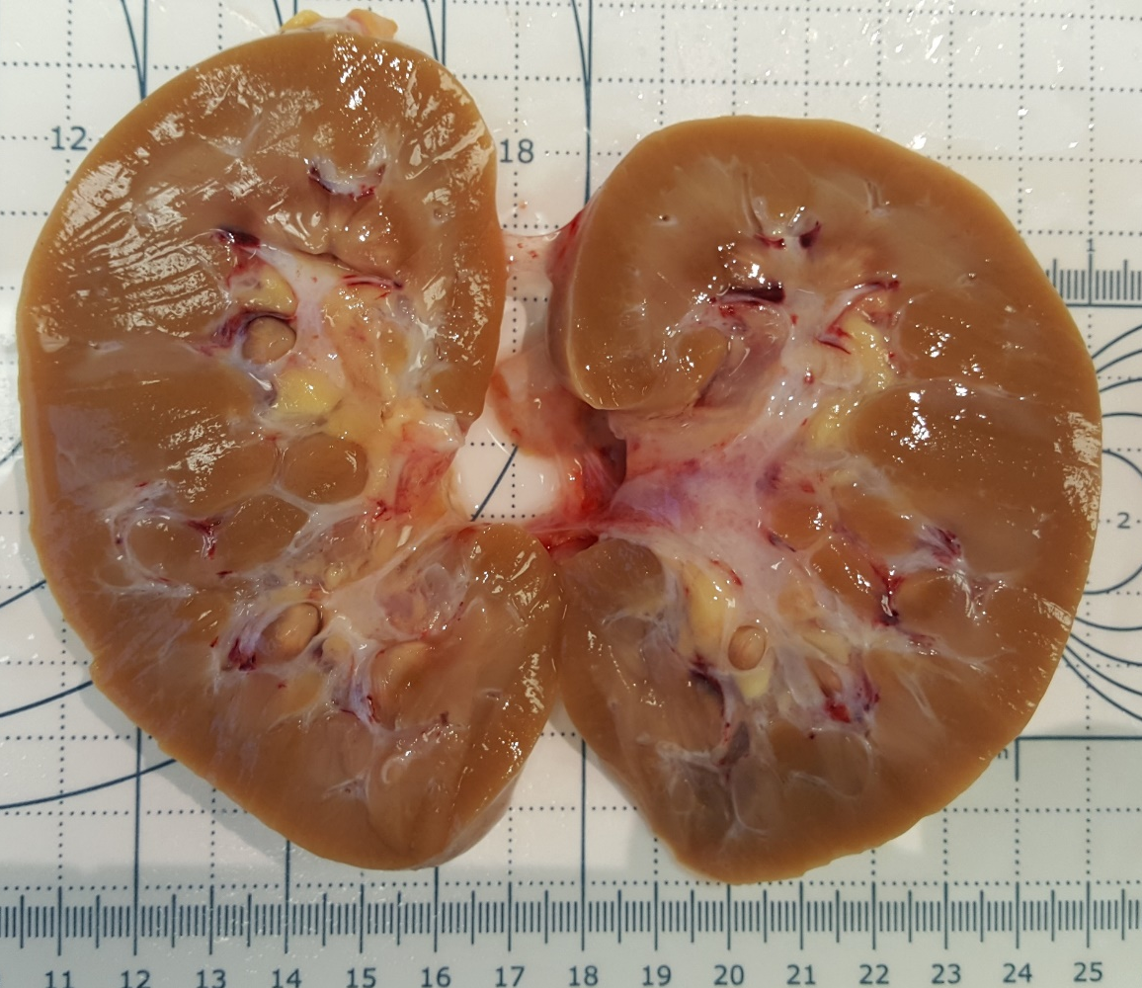
ID#3505
UPPER POLE
Distal ureter
Proximal
ureter
Deceased donor right kidney, approximate 11.5x8cm.
EXAMPLE of right kidney used for tissue procurement. The blue and yellow boxes indicate location of dissected specimens.
LOWER POLE

