Slide 1




Green Guard: Urban Air Quality Detection
Team Members:
1. Sukalp Warhekar
2. Arnav Padole
3. Aryesh Jirafe

Slide 2

Learning Objectives
Apply machine learning to real-world sustainability problems.
Forecast urban air pollution using LSTM time-series modeling
Promote green skills deployment in high-impact areas.
Provide a public-friendly dashboard for real-time awareness.
Analyze and rank sources contributing to urban air pollution.
GOAL

Slide 3
Tools and Technology used
Languages: Python
Libraries: TensorFlow, Keras, Pandas, Scikit-learn, Matplotlib
Techniques: LSTM, MinMaxScaler, Feature Engineering, Explainable AI
Deployment: Streamlit, VS Code
Data Sources: OpenAQ, CPCB AQI Datasets

Slide 4
Methodology
Data Collection – Gather AQI, weather, and urban activity data.
Preprocessing – Handle missing values, normalize, sequence format.
Modeling – Use LSTM to predict AQI
Visualization – Plot trends, predictions in Streamlit dashboard.
Recommendation Engine – Provide eco-action tips and green workforce targeting.

Slide 5
Problem Statement
Urban areas face a growing air quality crisis due to traffic, industrialization, and lack of proactive measures. There’s no AI tool that forecasts AQI and helps planners act before air pollution peaks.
Challenge: Build a platform to predict AQI and align action plans with sustainable practices and green jobs.

Slide 6
Solution
Forecast AQI using AI (LSTM)
Identify top contributing factors using explainable AI
Display clean dashboards for citizens and policymakers
Recommend real-time actions like traffic control, green zones
Integrate green job planning via geospatial analysis

Slide 7
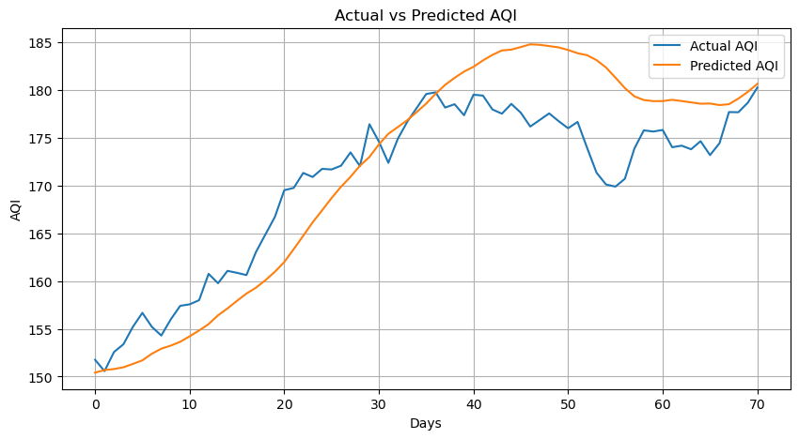
Screenshot of Output
Forecast the Next Day AQI
last_seq = scaled_data[-SEQ_LENGTH:]
input_seq = last_seq.reshape((1, SEQ_LENGTH, 1))
forecast = model.predict(input_seq)
forecast_aqi = scaler.inverse_transform(forecast)[0][0]
print("📅 Forecasted AQI for Tomorrow:", round(forecast_aqi, 2))

Slide 8
Conclusion
GreenGuard proves how AI can empower environmental governance.
It predicts future AQI levels, promotes green actions, and helps deploy sustainability-oriented workforce.
GitHub Repository Link: CapstoneProject_AQI_Prediction

