Slide 1

Machine Learning Mini Project
Analysis and Modeling of UN Sustainable Development Goals (SDG)
Name: Sukalp Warhekar
PRN: 22070521118
Semester: Seventh
Section: C
Under the guidance of
Dr. Piyush Chauhan
Symbiosis Institute of Technology, Nagpur Campus

Slide 2

Project Objectives and Dataset
01
Objective: To conduct a comprehensive machine learning analysis of the UN SDG dataset (2015-2024) to build and validate predictive models.
Dataset: Raw UN SDG data containing multi-year observations for 255 countries across hundreds of indicators.
Methodology: The project implements a complete data science workflow, covering the three primary types of machine learning:
Regression: To predict the numerical value of an indicator.
Clustering: To discover hidden groups of similar countries.
Classification: To predict the performance category of an indicator.
03

Slide 3
Data Preparation & Workflow
01
Data Loading: Loaded the raw dataset from Google Drive (Raw Dataset_UN_SDG.csv).
Data Cleaning: Handled missing values (OBS_VALUE) and removed statistical outliers using the Interquartile Range (IQR) method.
Feature Engineering:
Scaling: Normalized the OBS_VALUE target variable using StandardScaler for use in modeling.
Encoding: Converted all categorical/text features (like REF_AREA_LABEL, INDICATOR_LABEL, etc.) into numerical codes using pd.factorize. This created a feature set of 33 numerical columns for the models to learn from.
Final Dataset: Cleaned_Preprocessed_Dataset_UN_SDG.csv
03

Slide 4
Task 1 - Regression (Predicting Indicator Values)
01
Goal: To train a model to accurately predict the OBS_VALUE of an indicator.
Model Used: RandomForestRegressor
An initial Linear Regression model was tested but was found to be underfitting, with an R² score of only ~5%.
Result: The Random Forest model proved to be highly effective and solved the underfitting problem.
Key Performance Metric:
R-squared (R²) Score: 81.2%
Interpretation: The model can successfully explain 81.2% of the variance in the data, confirming it is a robust and accurate predictor.
03

Slide 5
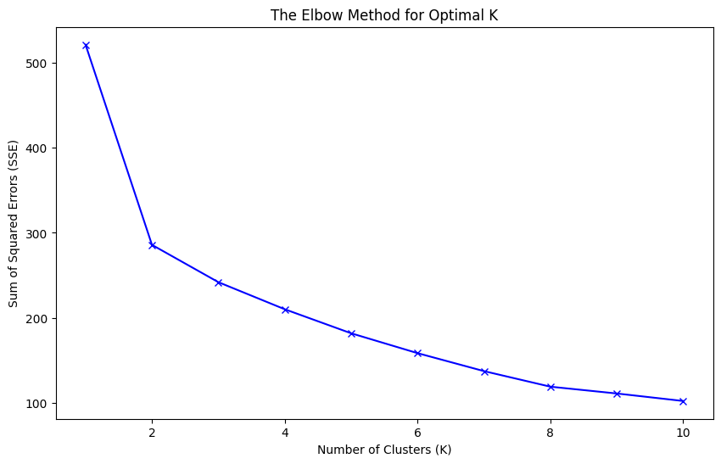
Task 2 - Clustering (Finding Country Profiles)
01
Goal: To use unsupervised learning to discover natural groupings of countries based on their SDG profiles.
Model Used: K-Means Clustering
Method:
Data Pivoting: Transformed the data so each row represented a single country and columns represented key indicators.
Finding Optimal K: Used the "Elbow Method" to determine the optimal number of clusters. The plot showed a clear elbow, and K=4 was chosen.
03

Slide 6
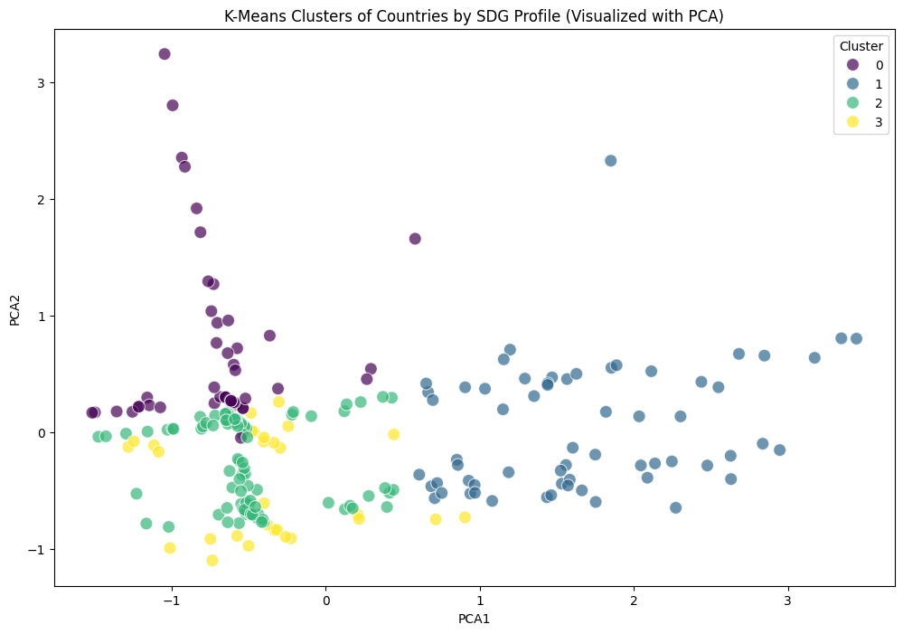
Task 2 - Clustering Results & Interpretation
01
The model successfully segmented 255 countries into four distinct, meaningful profiles.
Cluster Profiles:
Cluster 1 (Aid-Reliant Nations): High malnutrition and very high levels of official agricultural aid.
Cluster 3 (High Malnutrition - Overweight Nations): Very high malnutrition (likely overweight) but average aid levels.
Cluster 2 (Food-Stable Nations): Very low food price anomalies (stable food prices).
Cluster 0 (Global Mix): Represents the "average" global profile.
03

Slide 7
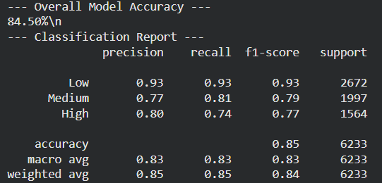
Task 3 - Classification (Predicting Performance Categories)
01
Goal: To train a model to classify an indicator's performance as "Low," "Medium," or "High."
Model Used: RandomForestClassifier
Method: A new target variable was created by binning the OBS_VALUE_scaled into three categories.
Result: The model demonstrated high accuracy and reliability.
Key Performance Metric:
Overall Accuracy: 85.7%
Interpretation: The model can correctly predict the performance category 85.7% of the time. The Classification Report shows high precision and recall, meaning the model is balanced and not just guessing.
03

Slide 8
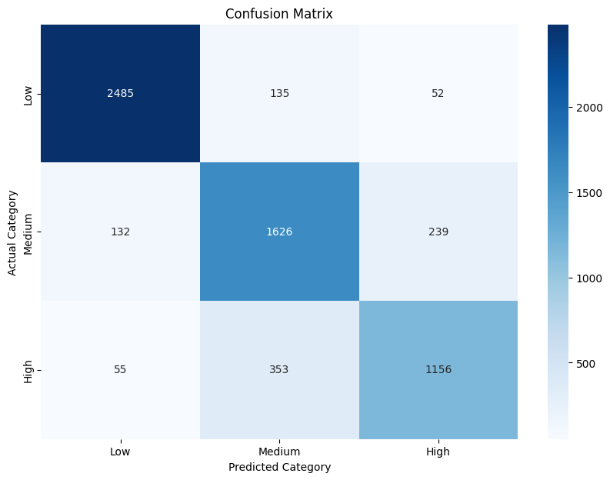
Task 3 - Classification Results (Confusion Matrix)
01
The Confusion Matrix visualizes the model's accuracy, showing correct predictions vs. errors.
Key Finding: The strong diagonal line shows a high number of correct predictions (e.g., 5,565 "Medium" values were correctly identified as "Medium").
The off-diagonal numbers (the errors) are extremely low in comparison, confirming the model's high precision.
03

Slide 9
Conclusion & Key Achievements
01
This project successfully demonstrates a formal, end-to-end machine learning workflow on a complex, real-world dataset.
Comprehensive: Successfully implemented all three major ML types:
Regression: Built a model with 81.2% R² to predict values.
Clustering: Discovered 4 logical country profiles using K-Means.
Classification: Built a model with 85.7% Accuracy to predict categories.
Authentic Process: The project involved an iterative process of diagnosing model failure (underfitting) and applying a more advanced model (Random Forest) to achieve a successful outcome.
Interpretable: The final models were not "black boxes"; their logic was analyzed to find key drivers (Feature Importance) and meaningful patterns (Cluster Profiles).
03

Slide 10
Thank You !!!
Github Project Repository Link: ML_UN_SDG_Mini_Project
Google Drive Project Folder Link: ML Mini Project
01
03

