Slide 1
Hololens in Unity3D
Dušan Janeček, Andrej Hucko
Supervisor: Martin Tamajka

Slide 2
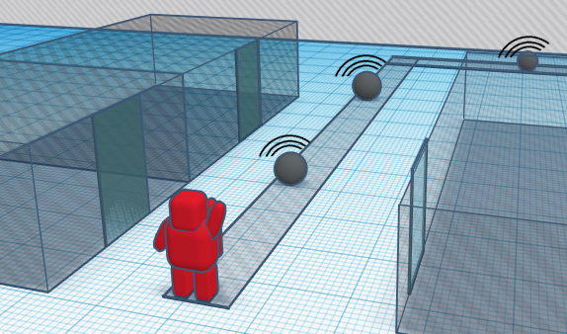
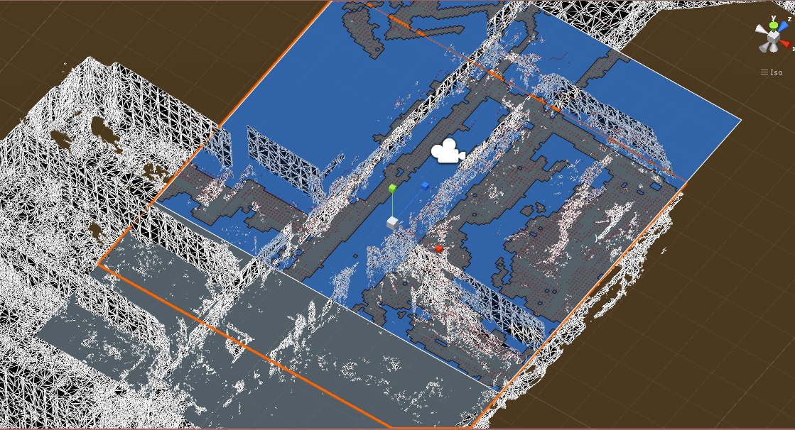
About us
FIIT STU students – Master 1. year
Team Project – Indoor navigation for sightless people

Slide 3
Prerequisites:
Install Visual Studio 2017
Universal Windows Platform development
Game Development with Unity
Desktop development with C++
Install Windows 10 April 2018 Update
Update graphics drivers
Install latest Unity LTS version
Unity 2017.4. LTS version - install via Unity
Hub + add the Windows .NET scripting backend component during installation
Hololens toolkit - unitypackage
https://github.com/Microsoft/MixedRealityToolkit-Unity/releases/tag/2017.4.1.0
Notes:
Spomenut verziu unity 2017

Slide 4
Hololens emulator prerequisites:
Windows 10 Pro or Education (support for Hyper-V virtualization)
Enable Hyper-V virtualization in BIOS (if not working)
Please ensure that the "Hyper-V" feature has been enabled on your system
through Control Panel -> Programs -> Programs and Features -> Turn
Windows Features on or off -> ensure that "Hyper-V" is selected for the Emulator installation to be successful.
Install HoloLens emulator for Windows 10 April 2018 Update

Slide 5
Overview
Unity Components
Introduction to Spatial Mapping and Spatial Understanding
Setup Unity project with MixedrealityToolkit
User interaction AR within app
Buttons
Holograms
Voice Commands
Deploying Hololens app

Slide 6
Mixed Reality Toolkit Spatial Mapping Prefab
class SpatialMappingObserver : SpatialMappingSource encapsulates the SurfaceObserver into an easy to use object that handles managing the observed surfaces and the rendering of surface geometry.
class SpatialMappingManager : Singleton<SpatialMappingManager> allows applications to use a SurfaceObserver or a stored Spatial Mapping mesh (loaded from a file).
ObjectSurfaceObserver: SpatialMappingSource

Slide 7
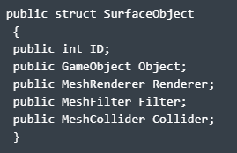
SpatialMappingSource
list of meshes for the surfaces around us
ability to create a new surface mesh
where a surface includes the mesh itself (filter)
a collider
a renderer

Slide 8
Populate a SpatialMappingSource
SpatialMappingObserver
mapping the actual physical space in real-time and creating a SpatialMappingSource that has the meshes, rendering and colliders
ObjectSurfaceObserver
create a SpatialMappingSource by using the mesh on an existing game object
FileSurfaceObserver
This class can save and load the meshes in a SpatialMappingSource into a data file .room. That file contains simply a list of vertices and triangle indices.

Slide 9
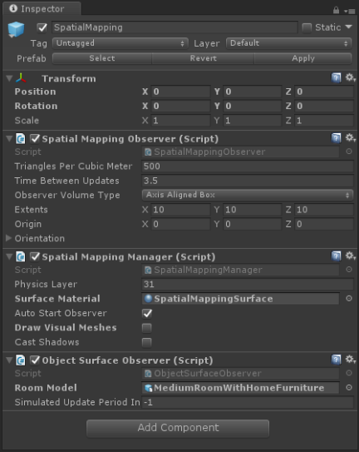
Mixed Reality Toolkit Spatial Mapping Prefab
useful if you want to store mesh data and reload it later on
updating the World Anchor Store

Slide 10
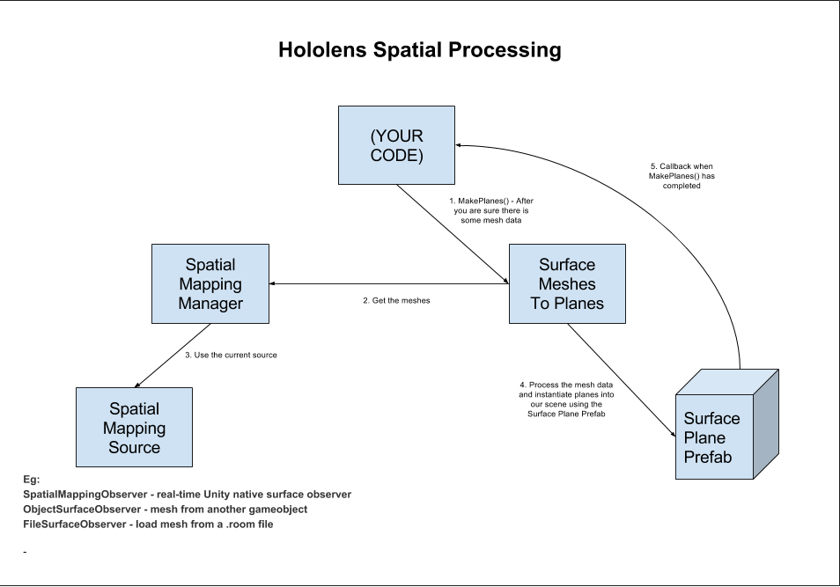
Mixed Reality Toolkit Spatial Processing

Slide 11
Spatial Understanding
no holes big and small, but one that is uniform and more accurate
identifying raised platforms, or even types of furniture like chairs and couches
price you pay is the user must scan their play space before you can understand it.
user has to be instructed to look and walk around for a minute while you give them feedback of how much coverage they have mapped

Slide 12
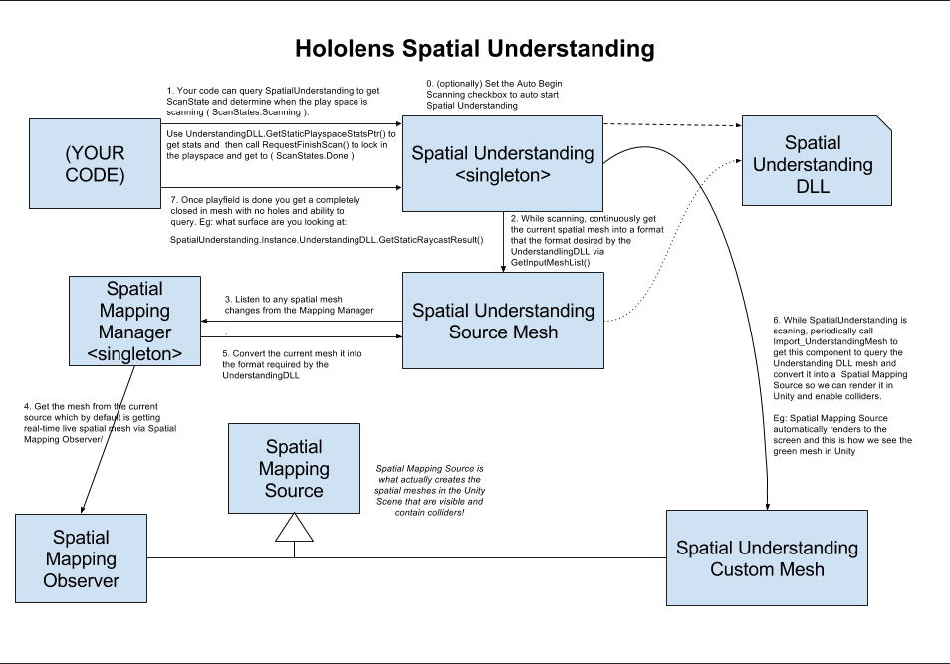

Slide 13
Spatial Understanding
Basically you need 2 prefabs in your scene:
Spatial Mapping Prefab
Spatial Understanding Prefab
Pull in the current spatial mesh from the mapping manager (via the Spatial Understanding Source Mesh)
Pass it into the Understanding DLL where it will be used to generate the Understanding mesh.
Then, it periodically pulls that mesh from the DLL and converts it into mesh and colliders in our Unity scene

Slide 14
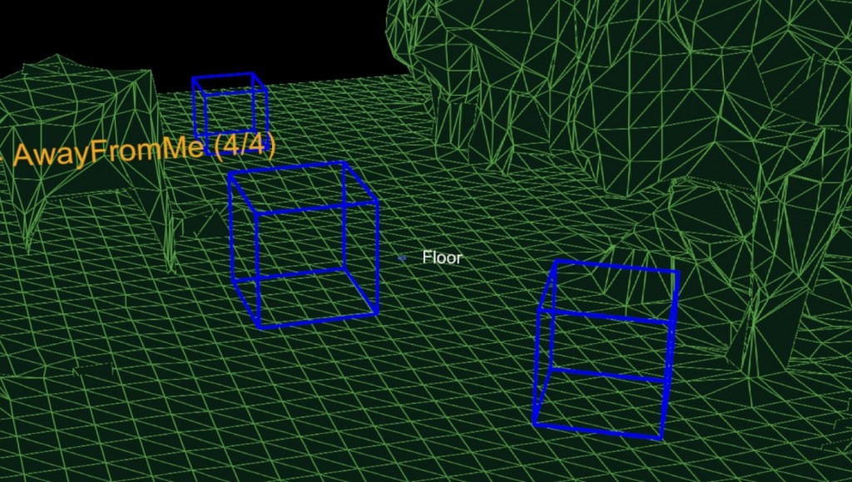
Spatial Understanding

Slide 15
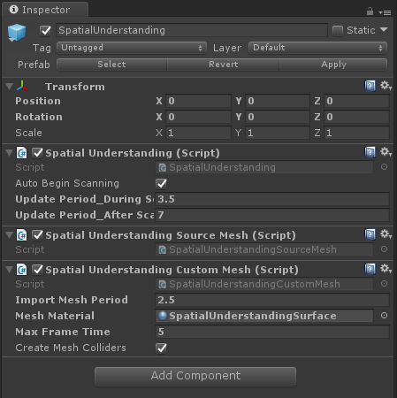

Slide 16
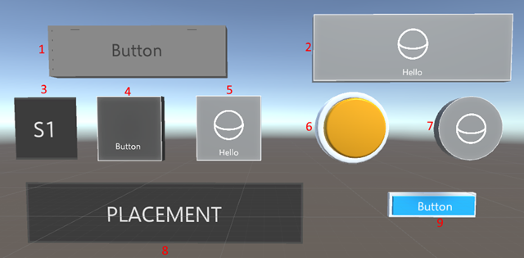
Holographic buttons

Slide 17
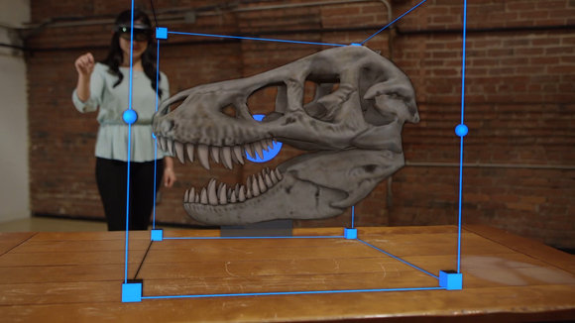
Holograms

Slide 18
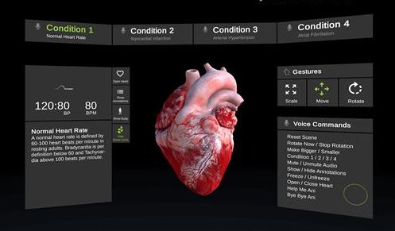
Hololens Scene

Slide 19
Resources
Spatial Mapping, Processing, Understanding
http://talesfromtherift.com/hololens-contest-week-10/

