Slide 1


Researching improvements to rental price statistics: regional and revisable RPIs for new tenancies
Presentation for the Housing Technical Working Group, 10 May 2022
Alan Bentley and Frances Krsinich

Slide 2
Overview
A tale of two twins: the RPI twins
Beware the bias in bond data (and statistical remedies)
Revisions policy revisited
Pure price change: The value of quality adjustments

Slide 3
A tale of two twins: the RPI twins
Born in 2000
CPI, rent (‘actual rentals for housing’ class)
Postal survey, matched-pairs quality adjustment
Born in 2019
Flow, RPI
New Tenancies
Stock, RPI
All Tenancies
Inherited CPI conventions
New method & data source since 2019
CPI ‘stock’ concept: price change across all tenancies
Non-revisable
Limited regional breakdowns
Opportunities in 2022:
Regional?
Revisable?
Longer timeseries?

Slide 4
RPI family
Born in 1989
Born in 2000
CPI, rent (‘actual rentals for housing’ class)
Postal survey, matched-pairs quality adjustment
Tenancy Bond data
Born in 2019
Flow, RPI
New Tenancies
Stock, RPI
All Tenancies
Geometric mean of rental costs
New Tenancies
Median
of rental costs
New Tenancies
Inherited CPI conventions
Raw average prices
No quality adjustment
Substantial real-time bias
New method & data source since 2019
CPI ‘stock’ concept
Non-revisable
Limited regional breakdowns
Opportunities in 2022:
Regional?
Revisable?
Longer timeseries?
The full story:
Bentley, A. (2022). Rentals for Housing: A Property Fixed-Effects Estimator of Inflation from Administrative Data. Journal of Official Statistics, vol.38, no.1, 2022, pp.187-211. https://doi.org/10.2478/jos-2022-0009
Bentley, A. (2021). Sticky Rents and The Affordability of Rentals for Housing in New Zealand. New Zealand population review 47:145-170. Population Association of New Zealand.

Slide 5
Beware the bias in Tenancy Bond data

Slide 6

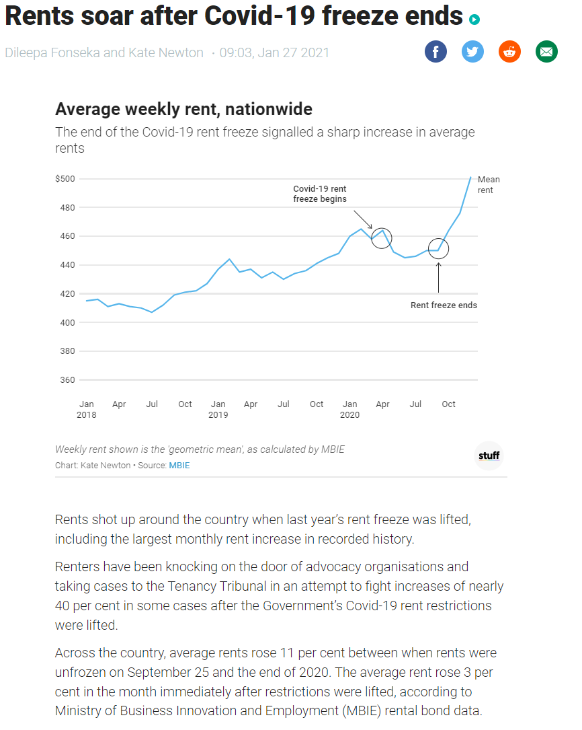
Source: https://www.stuff.co.nz/life-style/homed/renting/124052014/rents-soar-after-covid19-freeze-ends

Slide 7
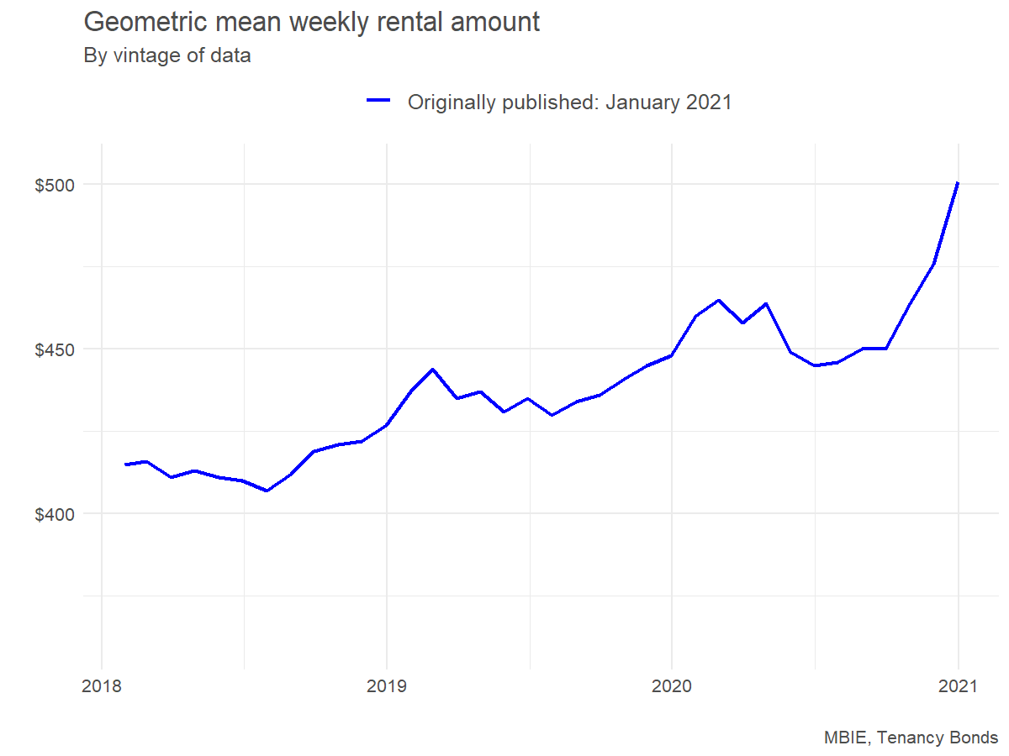
Raw average price: Looks like big increase in real time (without treatment)

Slide 8
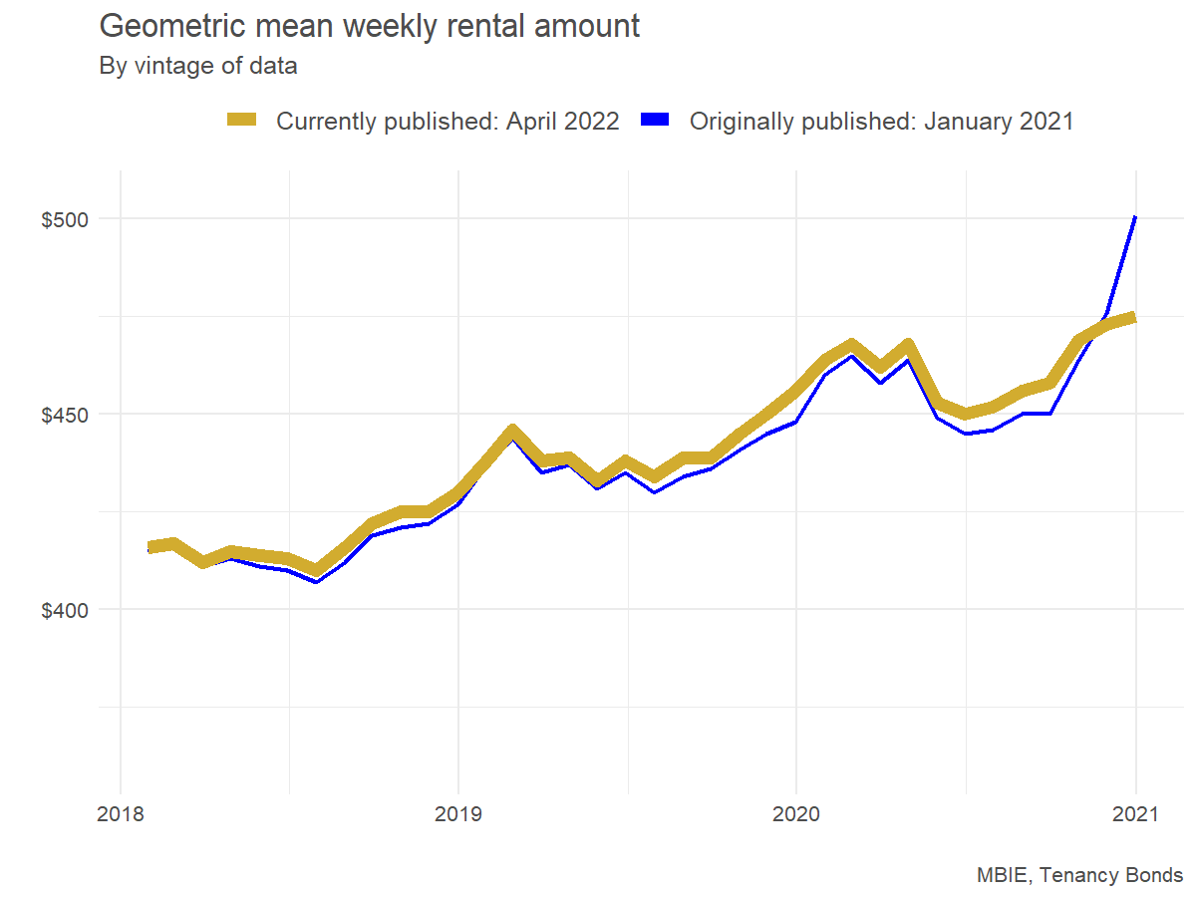
Substantial revision bias (without treatment)

Slide 9
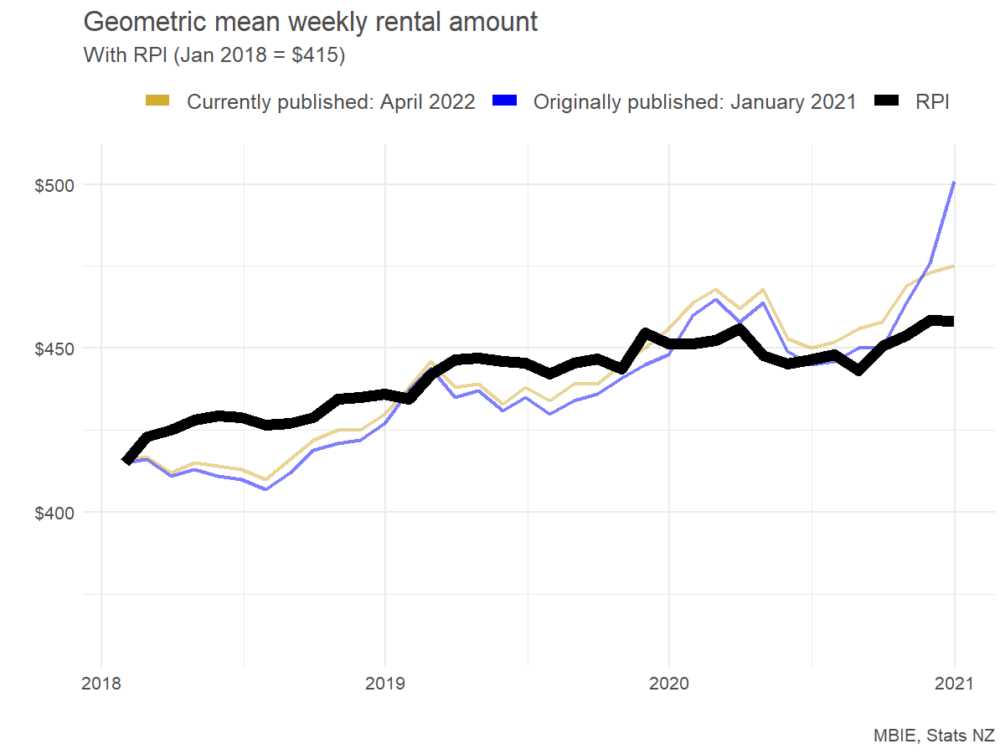
Little to report after statistical treatment: Price index, with consistent input data
Annual change to Dec 21
NZ
Raw average, original: 11.8%
Raw average, revised: 4.2%
RPI: 1.5%
Auckland
Raw average, original: 13.8%
Raw average, revised: 3.1%
RPI: 0.0%

Slide 10
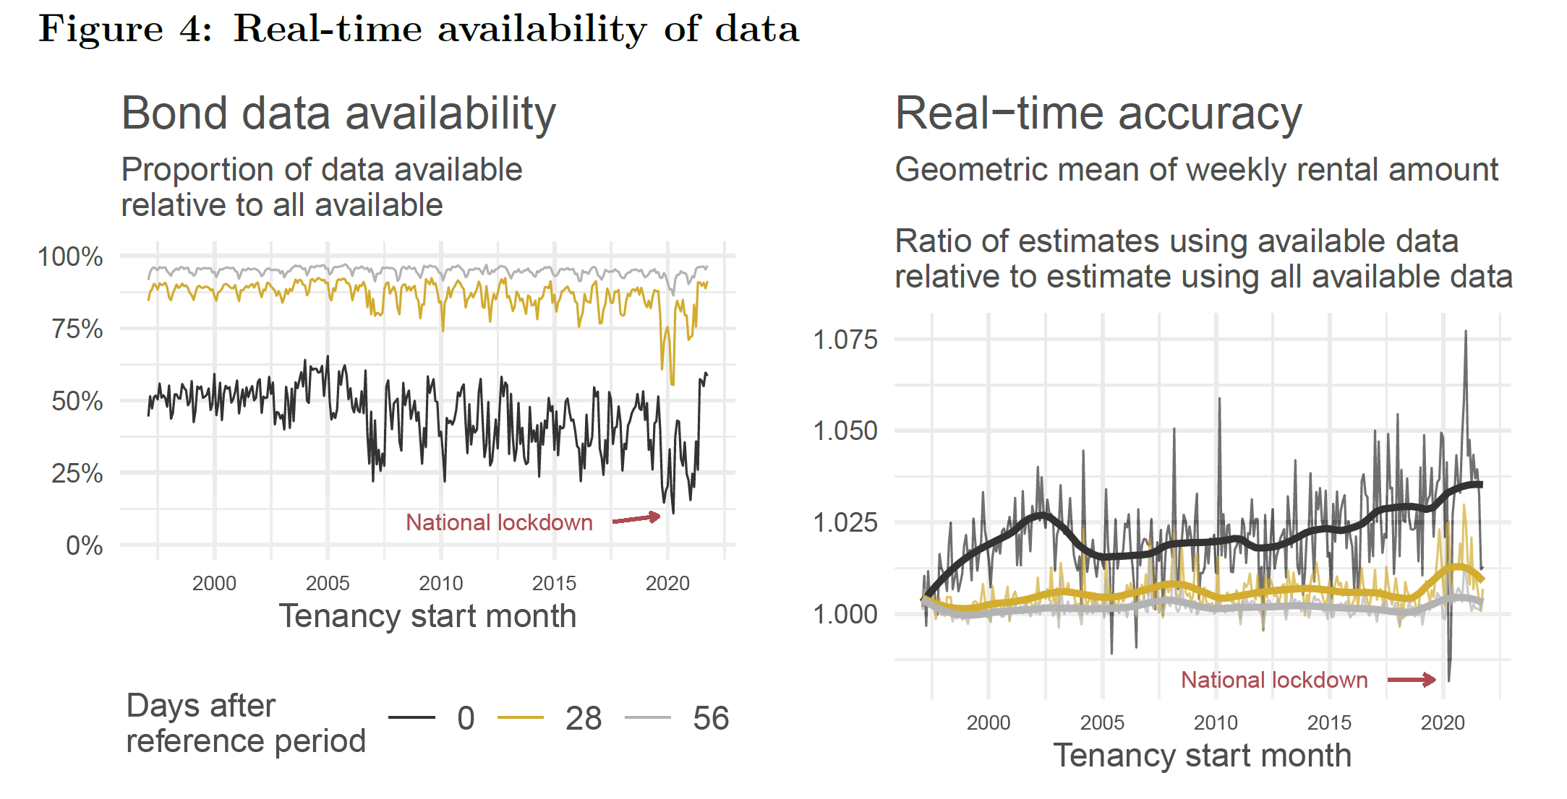
Substantial revision bias (without treatment)

Slide 11
Revisions policy revisited

Slide 12
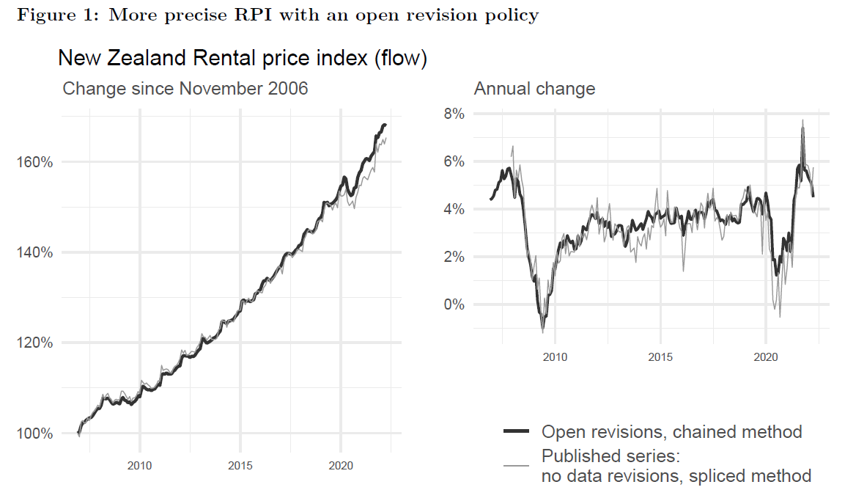
Revisions policy revisited

Slide 13
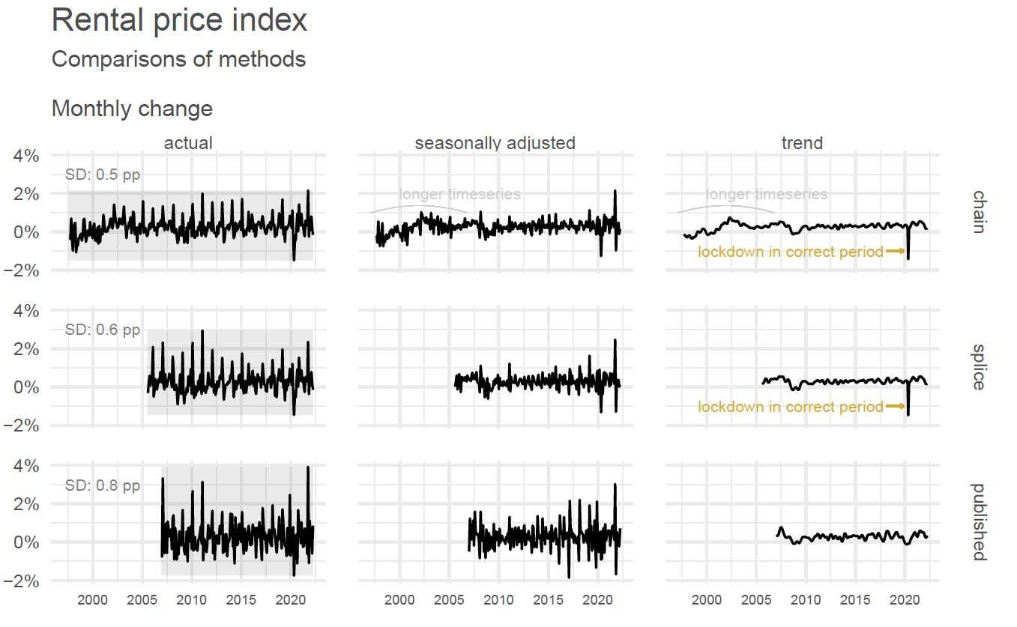
Benefits of revisable series
Less volatility
Longer timeseries
Shocks in correct time period

Slide 14
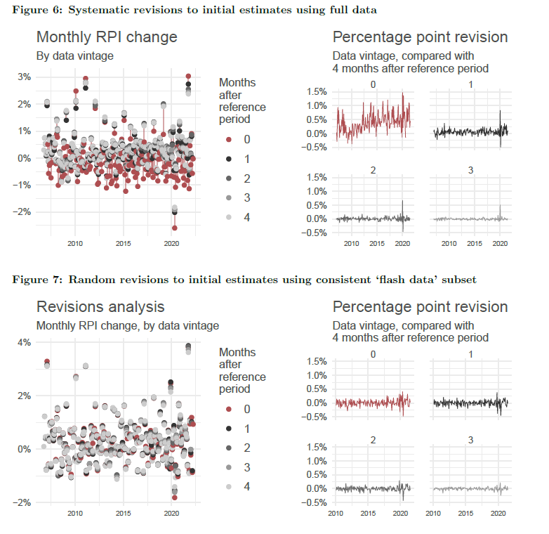
Treatment of real-time bias
Price index methodology controls for most of the bias, BUT …
Consistent subset of data need for initial month to minimise systematic revisions

Slide 15
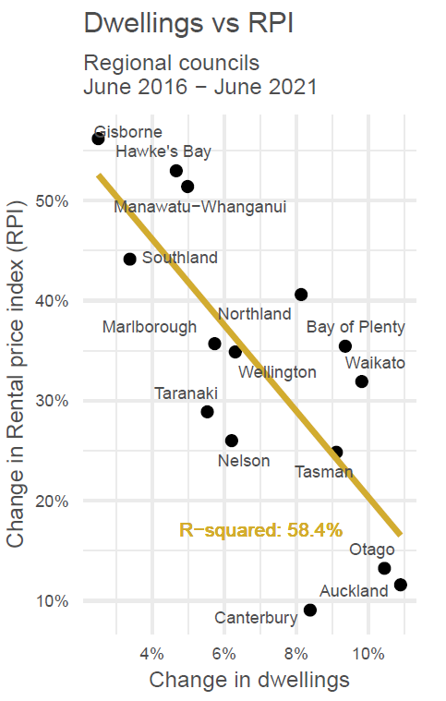
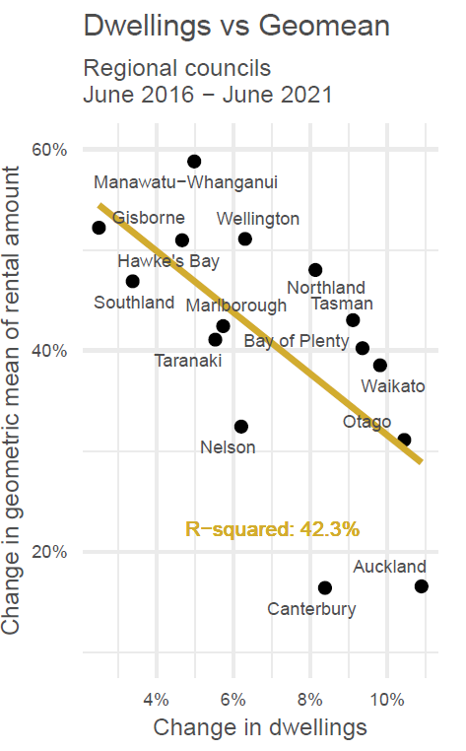
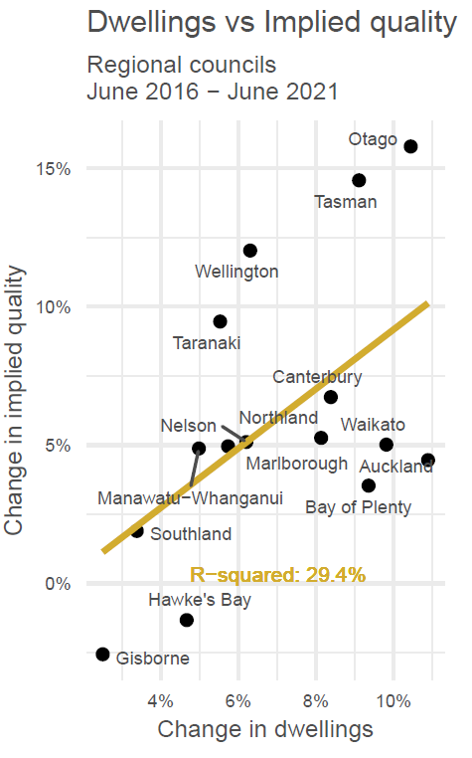
Pure price change: Value of quality adjustment
Growth in dwellings correlates better with RPI, compared with raw geometric mean
Pure price change: RPI
Raw geometric mean
Implied quality change

Slide 16
Discussion
Views on revision policy: Revisable flow RPI?
Views on practicalities
Additional regional RPIs available after ~6 weeks
Small regions (< 15,000 rental properties) to use 3 month rolling data
Views on correlations, connections to house prices

