Slide 1

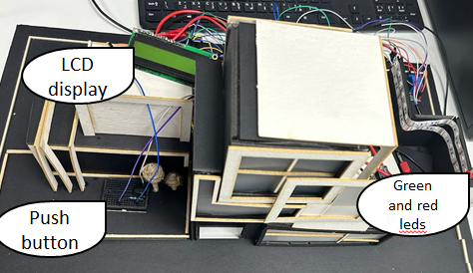
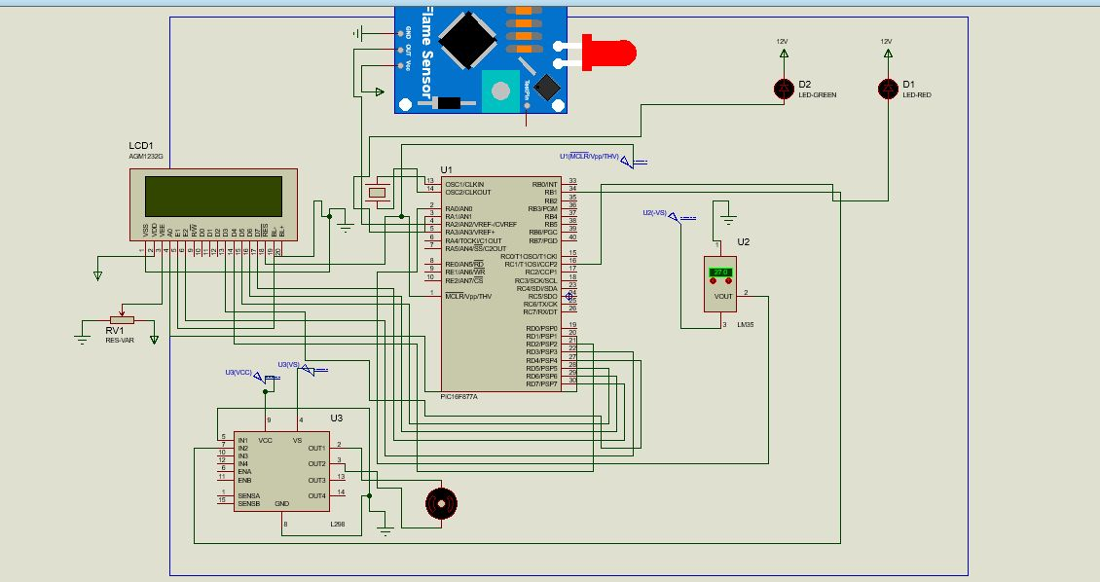
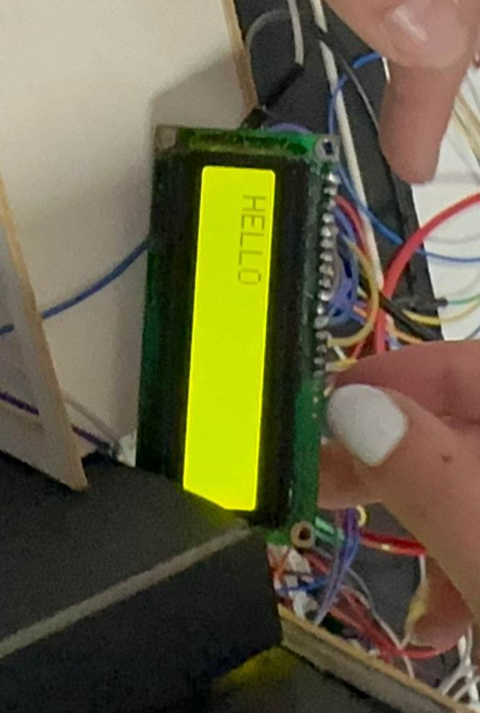
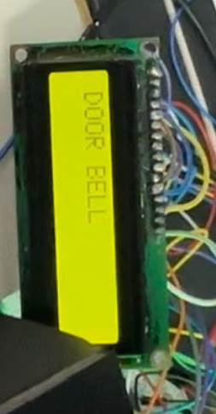
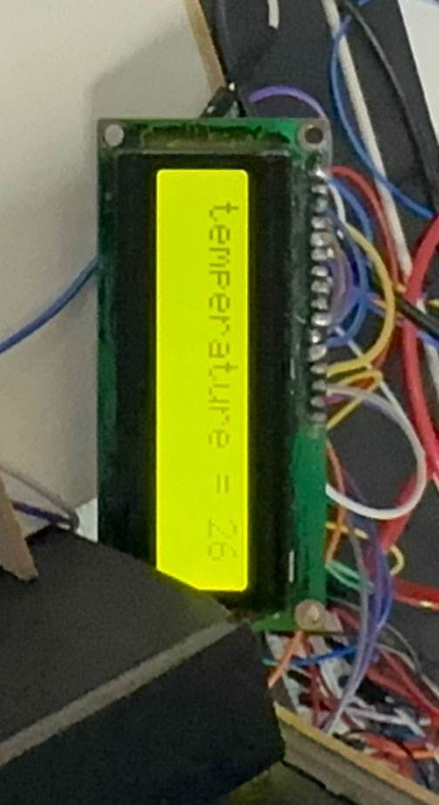
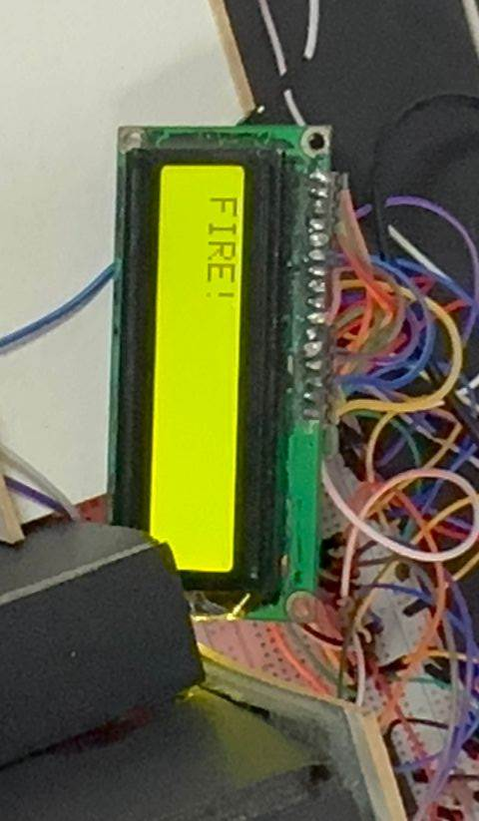
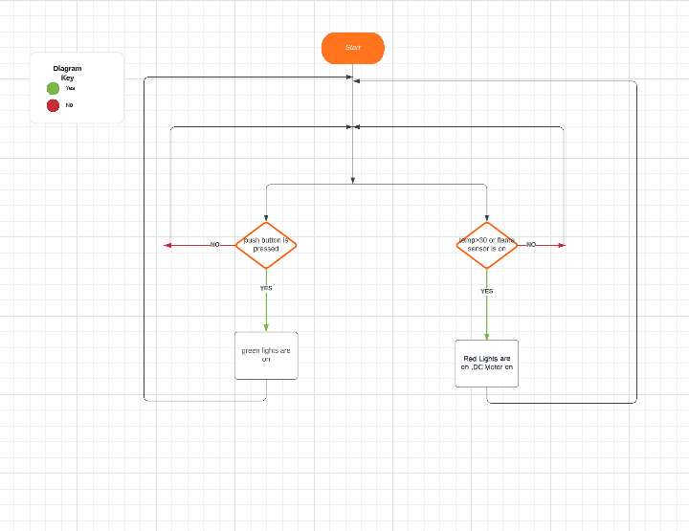
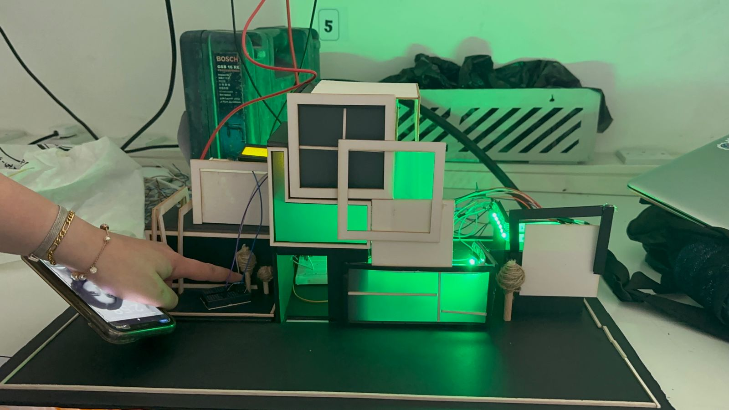
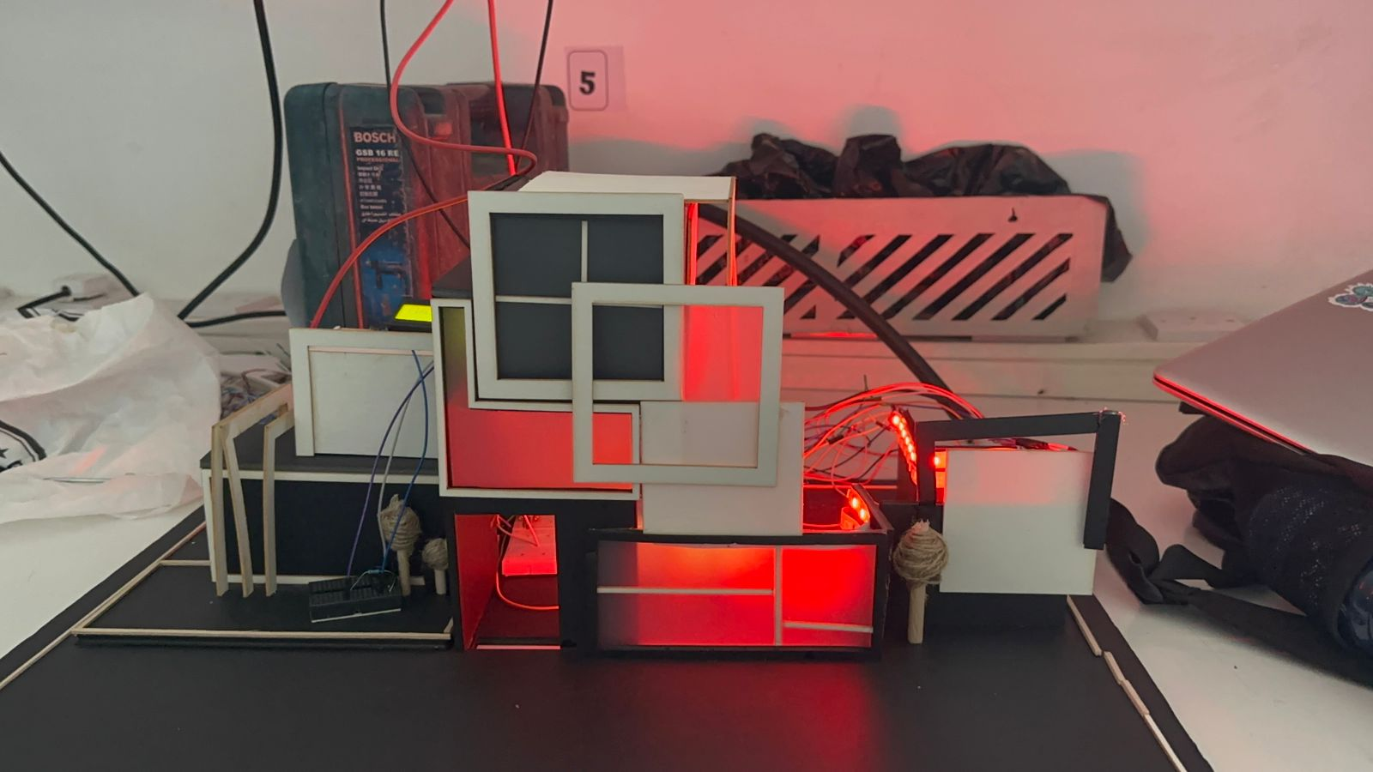
Emergency system For Deaf people
A. Taha, E. Qiasieh, H. Altaie
Supervisor: Dr. Belal Sababha
Embedded Systems Final Design Project, Spring 2023
King Abdullah II School of Engineering
Princess Sumaya University for Technology
Introduction
The smart home for deaf people is system that will display the events in lights instead of sound for deaf people. This poster will provide an overview of the hardware and software components used to build this system using the PIC16F877A microcontroller, DC motor ,Relays, temperature sensor, flame sensor, LCD Display. The PIC16F877A will be used to show the room temperature on the LCD Display and if it is more than a certain temperature or there is a flame, red lights will turn on and the door will automatically open using a DC motor. Also, if the bell rang green lights will turn on with “DOOR BELL” sentence on the LCD Display
Results
The final design of the emergency alarm system has two main functions : door bell and fire alarm .
Figure 4: the final design of the emergency system .
Figure 5: the output of LCD for the living person
(a) is the first word when the system is powered on , (b) “door bell” appears when the push button is presses , green lights are on also . (c) the system is testing the temperature . (d) if the temp > 30 and the flame sensor is on “FIRE” will appear on the display and red lights are on.
Figure 6: LEDs are on.
.
Design
Figure 2 : Electric schematic design
Figure 3: Software logic design
Conclusion
The broader significance of our project lies in fostering inclusivity and independence for the deaf community. By utilizing light instead of sound, we aimed to bridge the communication gap and provide equal access to vital information and alerts. Our smart home system empowered deaf individuals to live more confidently, knowing that they would not miss out on important notifications or be unaware of potential hazards.
By addressing the unique needs of the deaf community, we hope to inspire further innovation and encourage the adoption of accessible design principles in smart home systems.

