Slide 1

Note: The data and information in this document is reflective of a hypothetical situation and client. This document is to be used for KPMG Virtual Internship purposes only.
Sprocket Central Pty Ltd
Data analytics approach
Huda Irfan Thalib

Slide 2
Note: The data and information in this document is reflective of a hypothetical situation and client. This document is to be used for KPMG Virtual Internship purposes only.
Agenda
Introduction
Data Exploration
Model Development
Interpretation

Slide 3
Note: The data and information in this document is reflective of a hypothetical situation and client. This document is to be used for KPMG Virtual Internship purposes only.
Introduction
Outline
Goal: Boost sales by identifying high value target customers
Analyze Customer Demographics and Trends: Gender, Job Industry, Wealth Segment, Profit and State
Methodology Used: RFM Analysis

Slide 4
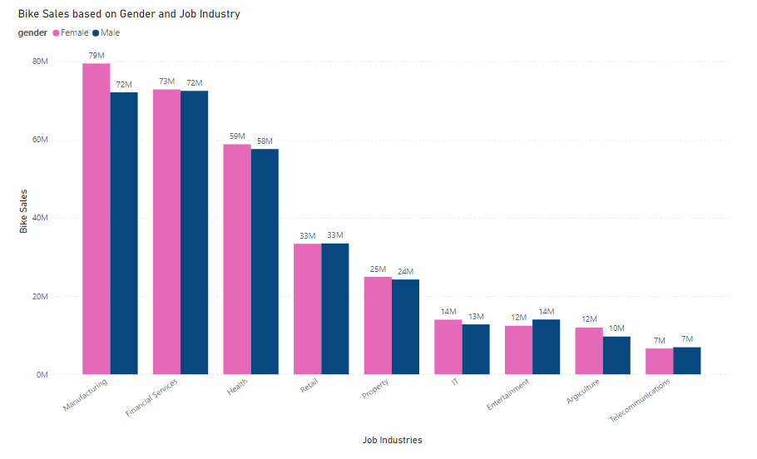
Note: The data and information in this document is reflective of a hypothetical situation and client. This document is to be used for KPMG Virtual Internship purposes only.
Data Exploration
Sales Distribution by Gender and Job Industry
Manufacturing and Financial Services Sector have the highest sales in the past 3 years for both genders.
Females must be the main focus as they contribute to more sales than males.

Slide 5
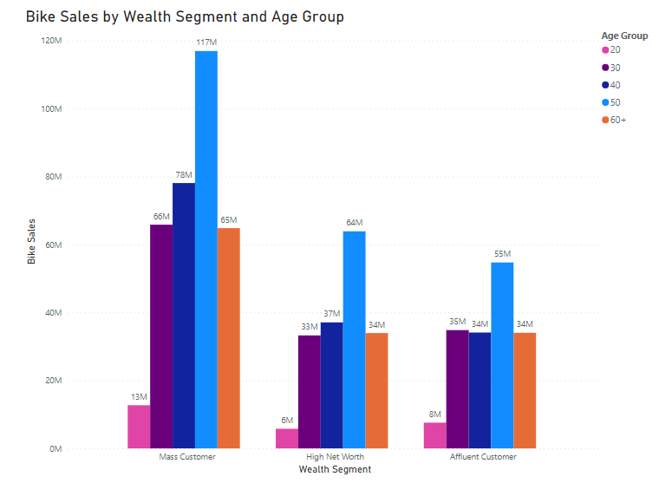
Note: The data and information in this document is reflective of a hypothetical situation and client. This document is to be used for KPMG Virtual Internship purposes only.
Data Exploration
Sales Distribution by Wealth Segment and Age Group
Mass Customer has the highest Sales, followed by High net worth and Affluent Customer
The target age group must be 20 – 50 but the primary focus must be the 50s.

Slide 6
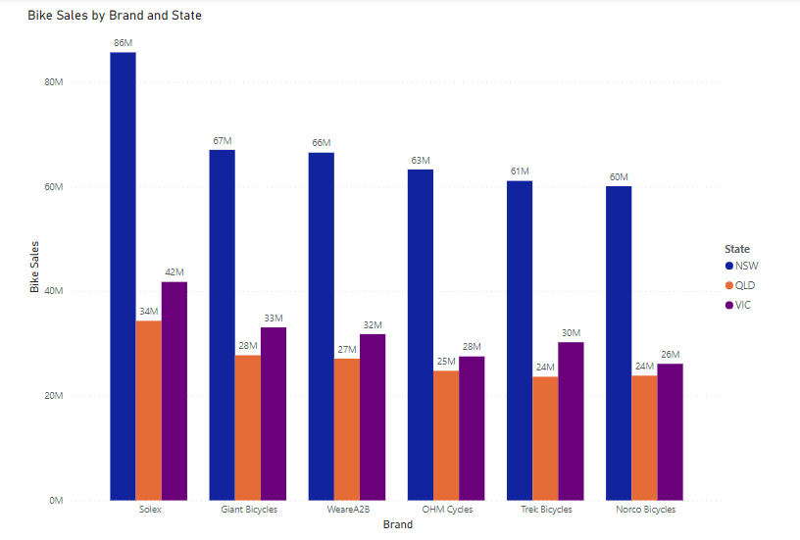
Note: The data and information in this document is reflective of a hypothetical situation and client. This document is to be used for KPMG Virtual Internship purposes only.
Data Exploration
Sales Distribution by Brand and State
New South Wales seems to have the highest sales followed by QLD and then Victoria
Solex is the most preferred brand for customers in all states

Slide 7
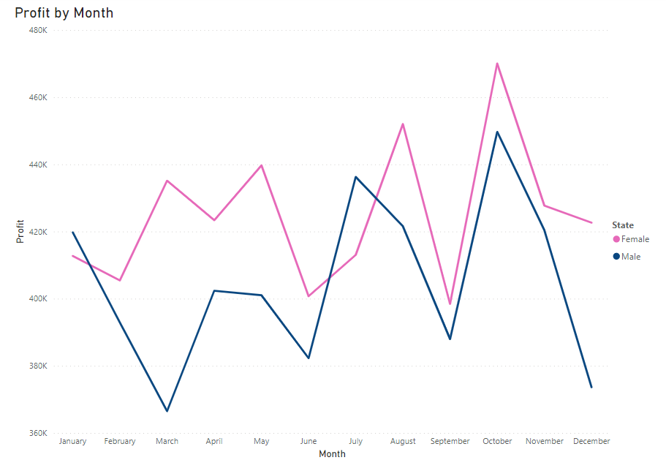
Note: The data and information in this document is reflective of a hypothetical situation and client. This document is to be used for KPMG Virtual Internship purposes only.
Data Exploration
As noticed in the sales distribution, profit is mainly contributed by females when compared to the males.

Slide 8
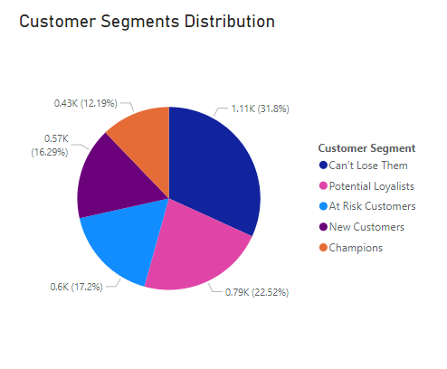
Note: The data and information in this document is reflective of a hypothetical situation and client. This document is to be used for KPMG Virtual Internship purposes only.
Model Development
RFM Analysis
RFM (Recency, Frequency, Monetary value) analysis helps businesses gain insights into customer segments which can help to identify valuable customers for targeted promotions, win back inactive customers, or personalize communication based on the customer's individual behavior.

Slide 9
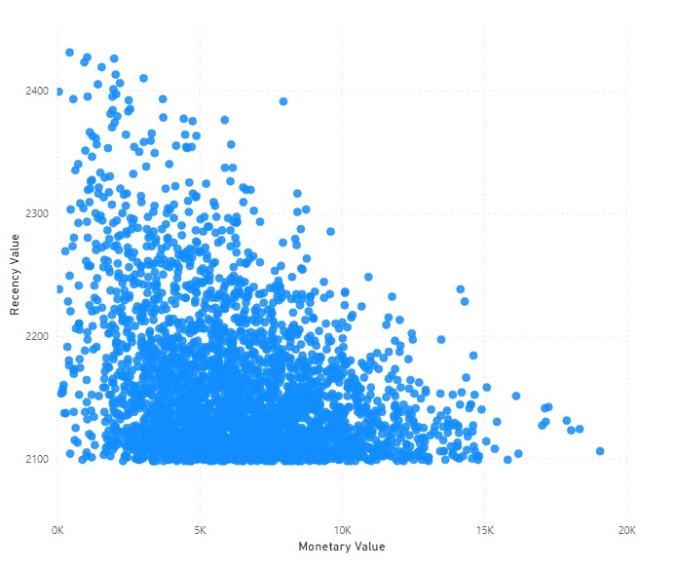
Note: The data and information in this document is reflective of a hypothetical situation and client. This document is to be used for KPMG Virtual Internship purposes only.
Model Development
RFM Analysis
Customers who have made more recent purchases tend to have a higher monetary value

Slide 10
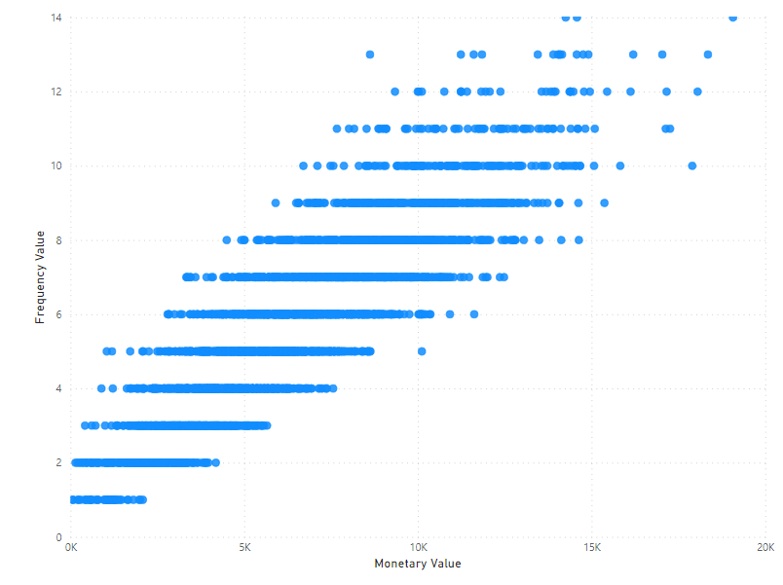
Note: The data and information in this document is reflective of a hypothetical situation and client. This document is to be used for KPMG Virtual Internship purposes only.
Model Development
RFM Analysis
Customers who make more frequent purchases tend to have a higher monetary value.

Slide 11
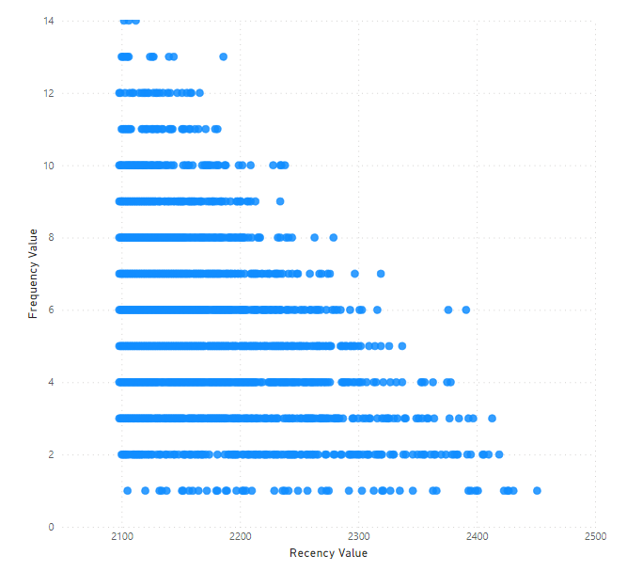
Note: The data and information in this document is reflective of a hypothetical situation and client. This document is to be used for KPMG Virtual Internship purposes only.
Model Development
RFM Analysis
Customers who have made more recent purchases have low frequency and the customers who make frequent purchases have slightly low recency value.

Slide 12
Note: The data and information in this document is reflective of a hypothetical situation and client. This document is to be used for KPMG Virtual Internship purposes only.
Interpretation
Customer Segments
Champions - most recently, most often, and are heavy spenders
Potential Loyalists - most recent customers with average frequency and who spent a good amount
New Customers - customers who have a high overall RFM score but are not frequent shoppers
At Risk Customers - customers who purchased often and spent big amounts, but haven’t purchased recently
Can’t Lose Them - customers who used to visit and purchase quite often, but haven’t been visiting recently

Slide 13
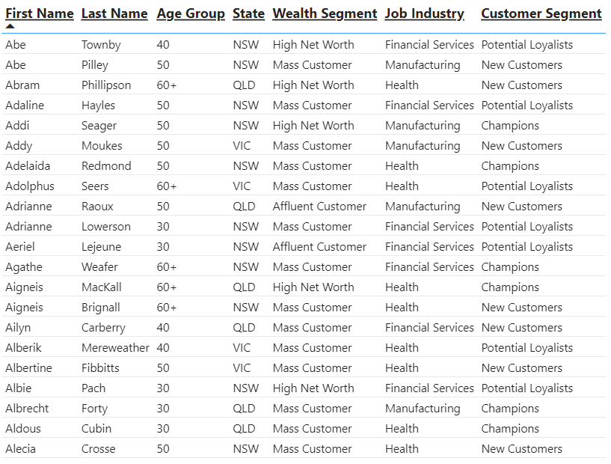
Note: The data and information in this document is reflective of a hypothetical situation and client. This document is to be used for KPMG Virtual Internship purposes only.
Interpretation
Top 1000 Customers
Champions, Potential Loyalists and New customers
NSW – main focus (VIC and QLD – second priority)
40 – 50 age group as well as 30s and 60+
Manufacturing, Financial Services and Health
Main Focus must be females

Slide 14
Note: The data and information in this document is reflective of a hypothetical situation and client. This document is to be used for KPMG Virtual Internship purposes only.
Appendix

Slide 15
Note: The data and information in this document is reflective of a hypothetical situation and client. This document is to be used for KPMG Virtual Internship purposes only.
Appendix
RFM analysis for Customer Segmentation. CleverTap. (2023, September 27). https://clevertap.com/blog/rfm-analysis/#:~:text=RFM%20stands%20for%20Recency%2C%20Frequency,retention%2C%20a%20measure%20of%20engagement.
Tubsamon, P. (2023, January 7). RFM analysis for customer segmentation with Power Bi. Medium. https://ploiitubsamon.medium.com/rfm-analysis-for-customer-segmentation-with-power-bi-5d2f5bd62038

