Slide 1




LifeTech Business Intelligence Analysis
Turning Business Data into Strategic Insights
Digital Egypt Pioneers Initiative (DEPI) Data Analysis Track – 2026

Slide 2





Meet Our Team
Ahmed Khalil
Data Collection & Data Cleaning
Asmaa Helmy Business Understanding & Project Foundation
Esraa Mostafa
SQL Processing & Data Transformation
Esraa Abdelsallam
Data Modeling & DAX Development
Huda Abdullah Dashboard Development & Business Analysis
Momen Salem Strategic Recommendations & Future Actions

Slide 3
Project Foundation
Business Problem • Objectives • Data Sources
Technical Process
Data Cleaning • Power Query • Data Modeling
DAX Calculations
Business Analysis
Dashboard Development • KPI Analysis • Business Insights
Strategic Outcome
Recommendations • Forecasting • Future Actions
Table of Contents

Slide 4






About LifeTech
LifeTech is a smart home solutions company specializing in :
Smart Lighting Home Cinema Smart HVAC Full Automation
Security Systems
The company operates through multiple sales and marketing channels across different cities.
Its business operations rely heavily on CRM systems, sales tracking, customer feedback, and marketing performance monitoring.

Slide 5






Business Problem
Despite having a CRM system, LifeTech faced major challenges in data organization and reporting. Business data was stored in multiple unstructured Excel files containing:
Inconsistent formats Missing values Duplicate records
Unclear column structures
Poor integration between datasets
As a result, the company struggled to:
Generate accurate reports Track business performance Analyze customer behavior Identify sales issues
Create forecasting models Enable data-driven decisions

Slide 6


Project Objectives
The project aimed to :
Build a structured analytical environment Clean and transform raw business data Develop interactive dashboards
Improve business visibility
Analyze sales and marketing performance Identify customer feedback patterns Generate actionable recommendations Support future forecasting

Slide 7
Data Collection & Sources
Data was extracted from the company CRM system through multiple exported Excel files,
including:
Customers Data Sales Data
CRM Feedback
Sales Team Performance
Detailed Sales Reports
The datasets were later cleaned, transformed, and integrated for analysis.

Slide 8
Data Cleaning Workflow
Removed duplicate records Handled missing values Standardized column names Unified date and text formats
Corrected inconsistent values Filtered irrelevant records Prepared datasets for integration

Slide 9
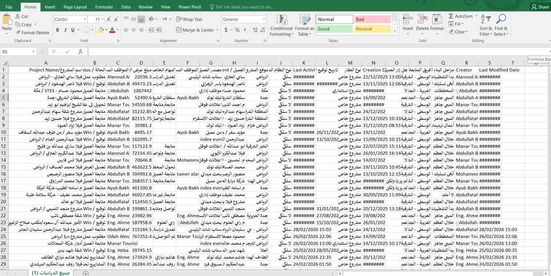
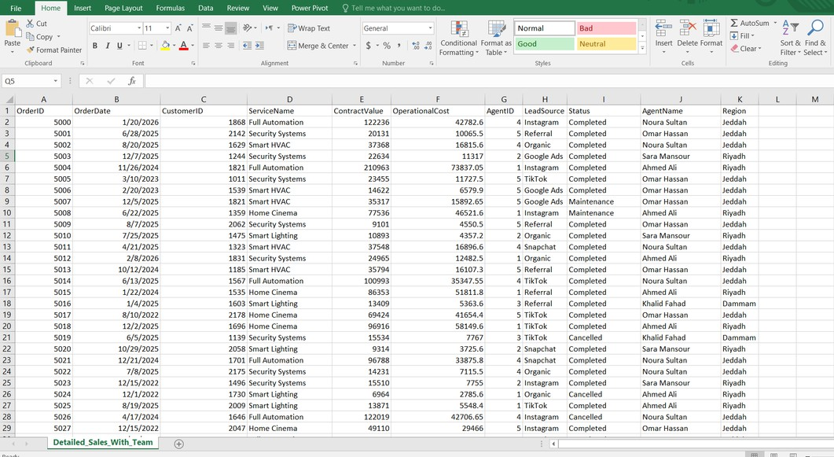
Data Cleaning & Preparation
Before Cleaning
Unstructured columns
Mixed languages and formats
Missing and unclear values Difficult to analyze or integrate
After Cleaning
Standardized structure
Organized columns and data types
Ready for SQL processing and analysis Improved data consistency

Slide 10

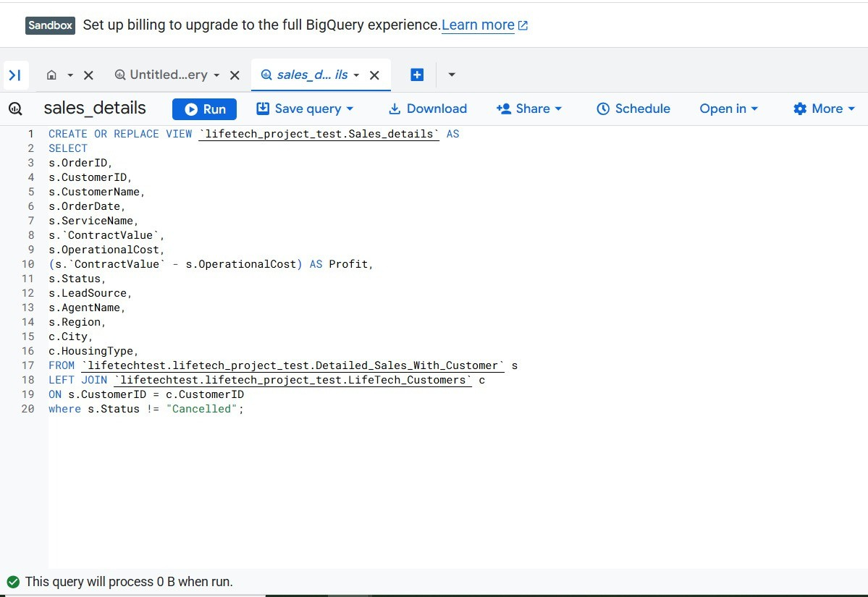

SQL Processing & BigQuery Integration
SQL queries were used to:
Merge datasets
Create analytical views
Calculate profit metrics Filter cancelled orders
Prepare data for Power BI
Technologies Used:
Google BigQuery SQL
Cloud Data Processing

Slide 11
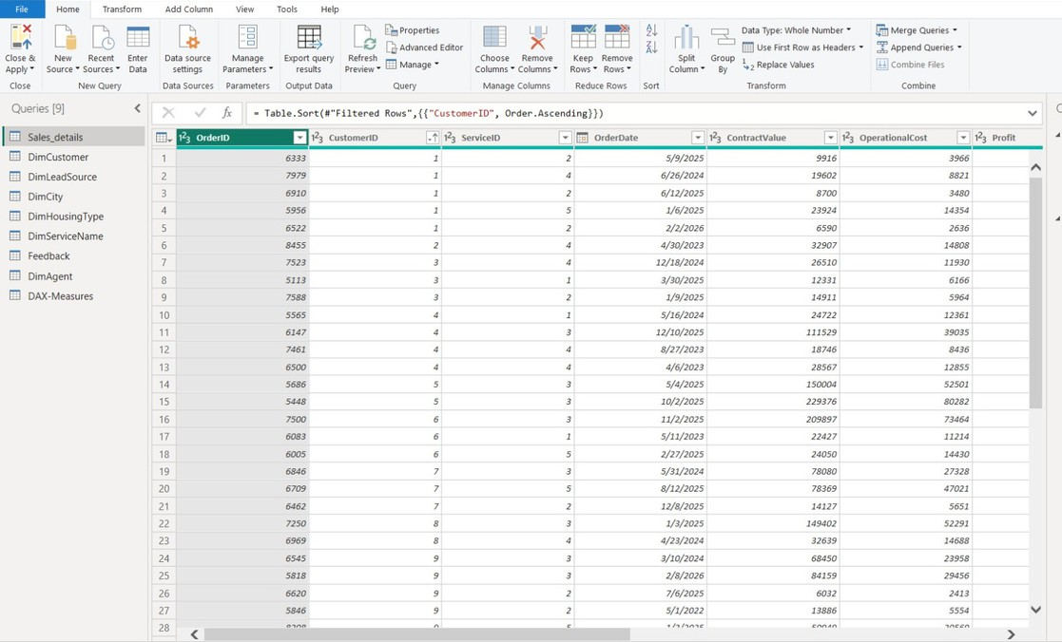
Power Query Data Transformation
Power Query was used to transform and prepare the datasets before modeling.
Main transformations included:
Cleaning columns Standardizing data types Sorting and filtering records
Creating structured analytical tables
Preparing fact and dimension tables

Slide 12

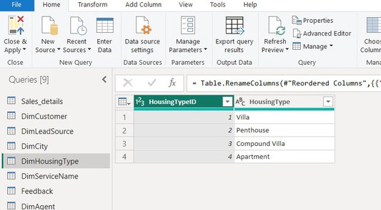
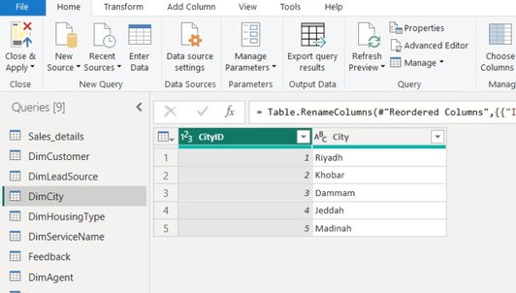
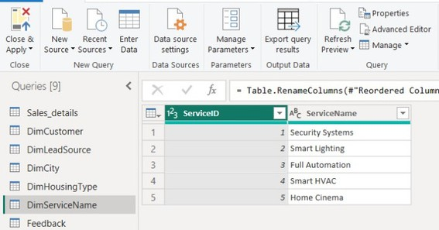
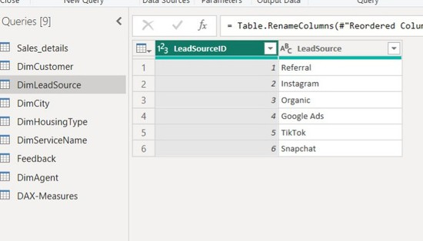
Building Dimension Tables
DimHousingType
DimCity
Dimension tables were created to:
Organize categorical data Reduce data redundancy Reduce data redundancy Support Star Schema design
DimServiceName
DimLeadSource

Slide 13
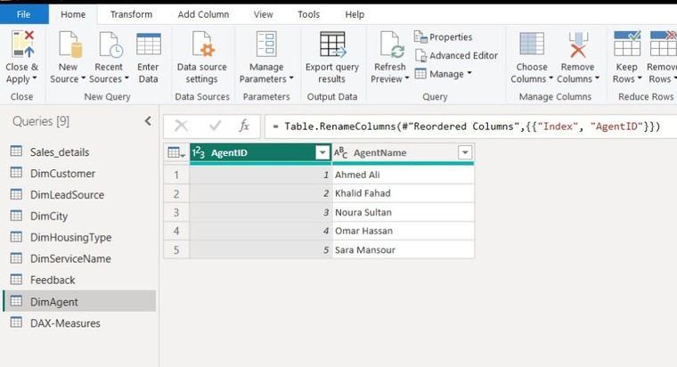
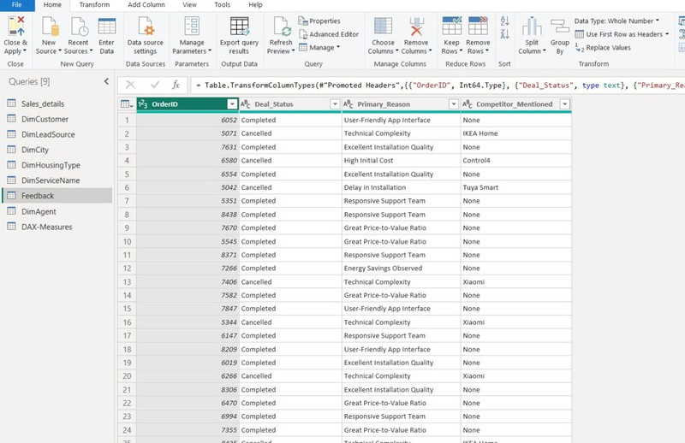
Additional Supporting Tables
DimAgent Query
Additional dimension tables were prepared for:
Customer feedback analysis Competitor tracking
Sales agent performance analysis
Feedback Query

Slide 14
Data Modeling & Relationships
After cleaning and transforming the datasets, a relational data model was created in Power BI using a Star Schema structure.
Star Schema Design in Power BI

Slide 15
Data Modeling & Relationships
The model included:
A central fact table: Sales_details Multiple dimension tables:
Customers Cities Services Lead Sources Housing Types
Agents
Calendar
Feedback
Relationships were created between tables to enable:
Accurate filtering Faster analysis
Better dashboard performance Cross-functional business insights

Slide 16
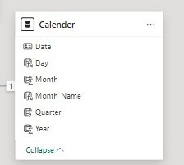
Calendar Table & DAX Functions
Calendar Table & Time Intelligence
A dedicated Calendar Table was created using DAX functions to support time-based analysis and reporting.
This enabled:
Monthly and yearly comparisons Trend analysis
Time intelligence calculations Dynamic dashboard filtering

Slide 17

DAX Measures & Business Calculations
DAX Measures & KPI Calculations
1. Total Revenue
Calculates the company’s total generated revenue from all sales orders.
Net Operating Profit
Measures the actual operating profit after deducting operational costs.
Profit Margin %
Evaluates profitability efficiency by measuring profit relative to revenue.
Current Year Revenue (YTD)
Supports time intelligence analysis using Year-To-Date calculations.
DAX measures were created to calculate KPIs, profitability metrics, and time-based performance indicators used across the dashboard.

Slide 18
From Data Processing to Business Insights
After completing the data cleaning, transformation, modeling, and DAX calculations stages, the final step was building an interactive Power BI dashboard.
The dashboard was designed to transform raw business data into clear visual insights that support:
Executive business monitoring Sales and revenue analysis
Marketing channel performance evaluation Customer feedback and behavior analysis Profitability and operational performance tracking Trend analysis and revenue forecasting Supporting data-driven business decisions

Slide 19

Strategic Recommendations
1. Business & Operational Recommendations
Focus on expanding high-performing services such as Smart Lighting, Home Cinema, and Security Systems to maximize business growth and profitability.
Prioritize premium residential segments, especially Penthouse and Villa projects, as they generate stronger profitability compared to other housing types.
Improve project management and installation scheduling processes to reduce delays and enhance customer satisfaction.

Slide 20

Strategic Recommendations
1. Business & Operational Recommendations
Simplify technical consultation and onboarding processes to reduce customer confusion and minimize deal losses caused by technical complexity.
Expand customization capabilities and offer more flexible smart home packages tailored to different customer needs and property types.
Position the company as a premium smart home provider that delivers German-quality solutions with strong value for money through its partnership with Morgin.

Slide 21

Strategic Recommendations
2. Marketing Recommendations
Increase investment in Google Ads campaigns as they demonstrated the strongest revenue and profitability performance among all lead sources.
Re-optimize lower-performing marketing channels such as TikTok and Referral campaigns through improved audience targeting and campaign strategies.
Concentrate marketing efforts in high-performing cities such as Madinah and Riyadh to maximize return on advertising spend.
Develop targeted campaigns focused on Smart Lighting solutions since they represent the company’s highest revenue-generating service category.

Slide 22

Strategic Recommendations
2. Marketing Recommendations
Use customer-centered messaging that highlights:
- Excellent installation quality
-Ease of use
-Energy-saving benefits
-Competitive pricing and value for money
Develop educational and awareness campaigns to simplify smart home concepts and reduce customer concerns related to technical complexity.
Increase localized campaigns and targeted promotions in high-performing markets and service categories to maximize conversion opportunities.

Slide 23



Slide 24


