Slide 1
NVX Front-end Framework
A Modern Approach to Front-end Development

Slide 2
Web App Architecture

Slide 3
Server-side Rendering

Slide 4
Single Page App (SPA)

Slide 5
Hybrid Client-side Rendering

Slide 6
SPA vs. Multi-page

Slide 7
Building the Framework

Slide 8
Goals
Proper dependency management
Managed dependency graph
Modular JavaScript code
Client-side rendering
Automated and repeatable build process
Packaged and optimised assets

Slide 9
Goals + Technology
Proper dependency management
Managed dependency graph
Modular JavaScript code
Client-side rendering
Automated and repeatable build process
Packaged and optimised assets
Node & NPM

Slide 10
Goals + Technology
Proper dependency management
Managed dependency graph
Modular JavaScript code
Client-side rendering
Automated and repeatable build process
Packaged and optimised assets
Knockout JS

Slide 11
Goals + Technology
Proper dependency management
Managed dependency graph
Modular JavaScript code
Client-side rendering
Automated and repeatable build process
Packaged and optimised assets
Webpack

Slide 12
Front-end Tech Stack

Slide 13
Technologies Used

Slide 14
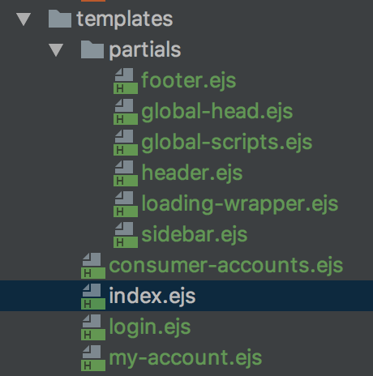
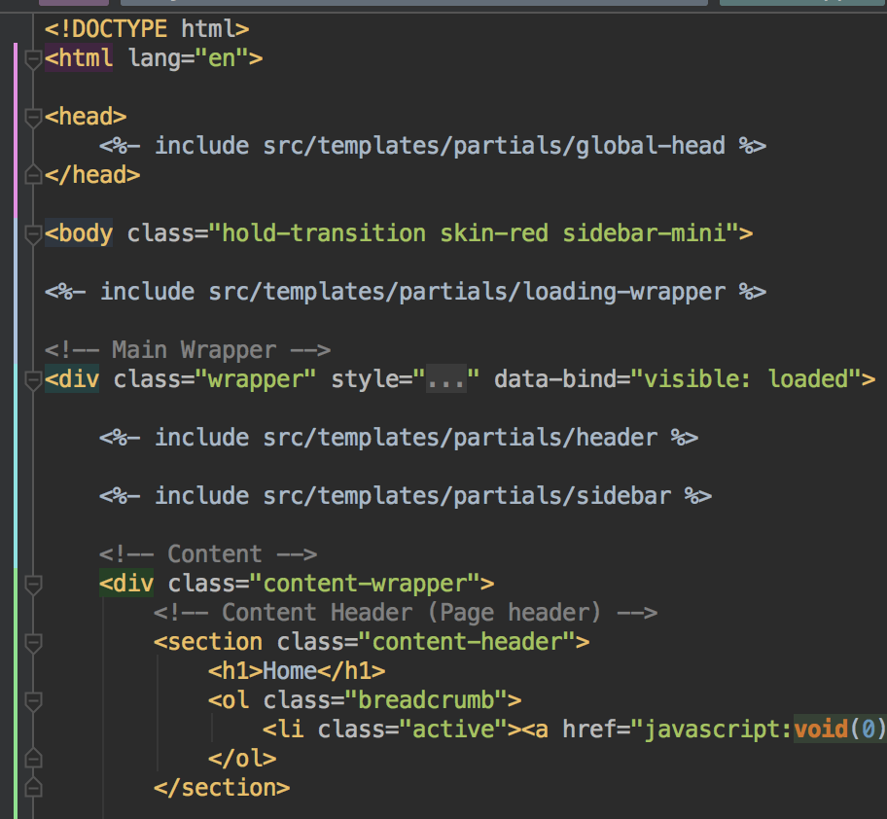
HTML: Templating
EJS – Embedded Javascript Templates

Slide 15
CSS: Framework
Bootstrap 3 – Base, Common Elements
AdminLTE – Skin, Layout
Kendo UI – Business Logic Components
Others:
Font Awesome
Ionicons
No preprocessor?
Learning curve

Slide 16
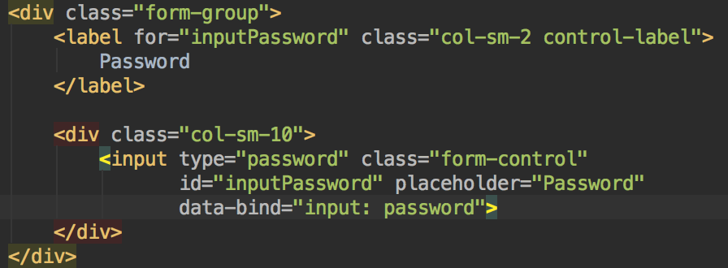
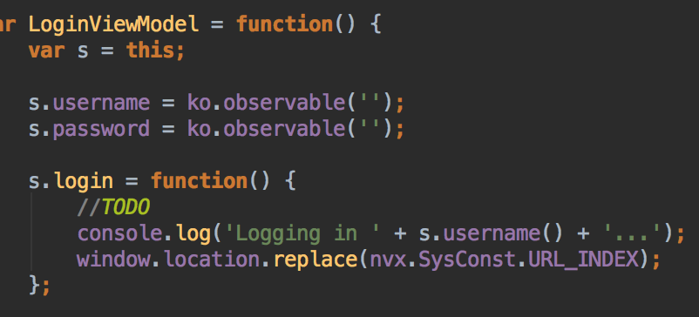
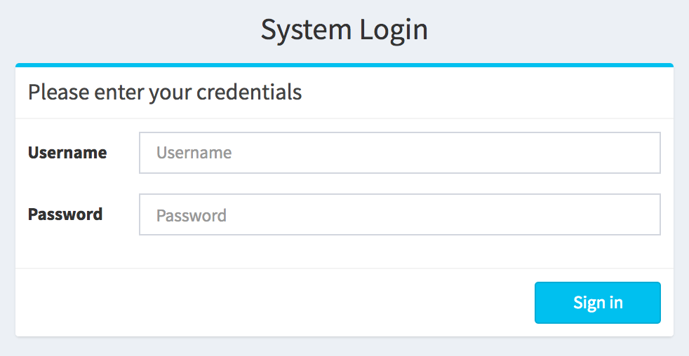
JS: Framework
KnockoutJS – Data Binding for Client-side Rendering

Slide 17
JS: Libraries
jQuery – Base, Utilities, DOM Manipulation
Kendo UI – Business Logic Components
Moment – Date handling
Others:
JSON3
Why not React (or Angular2)?
Learning curve, SPA architecture

Slide 18
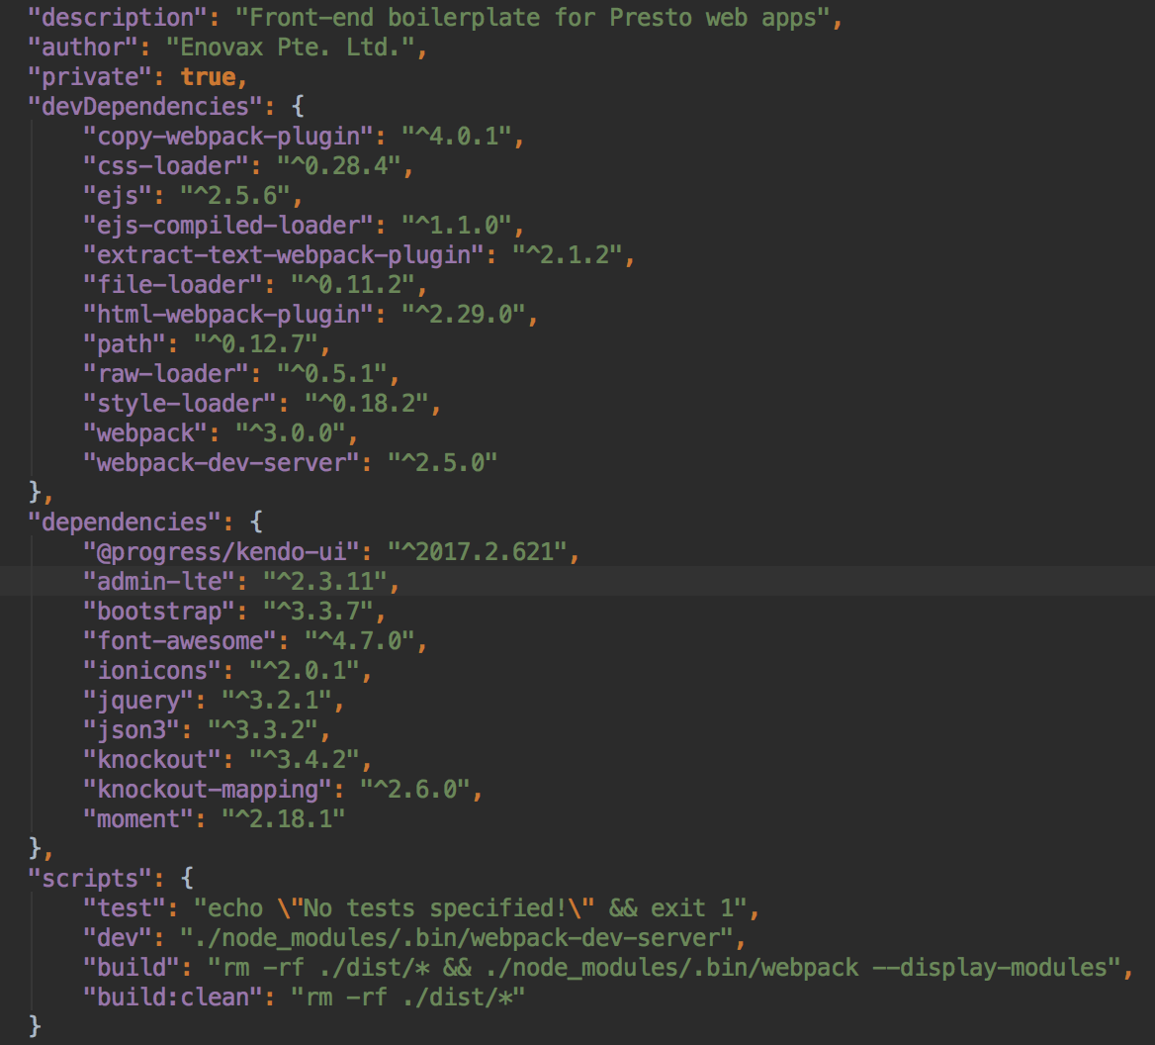
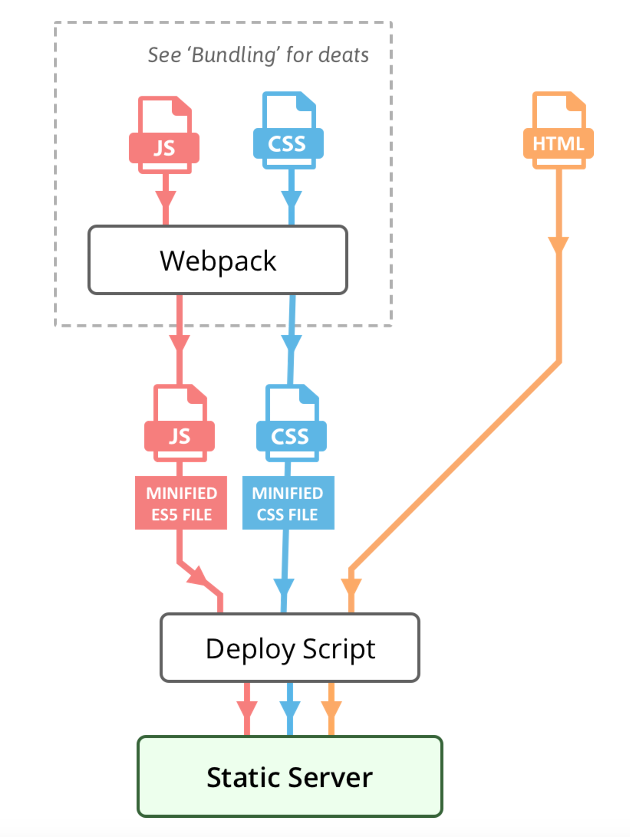
Build Tools
Webpack – Module Bundler
NPM – Dependency Management, Script Runner

Slide 19
Development & Build Process

Slide 20
Development & Build Process

Slide 21
Module Bundling and Webpack

Slide 22
Webpack - Overview

Slide 23
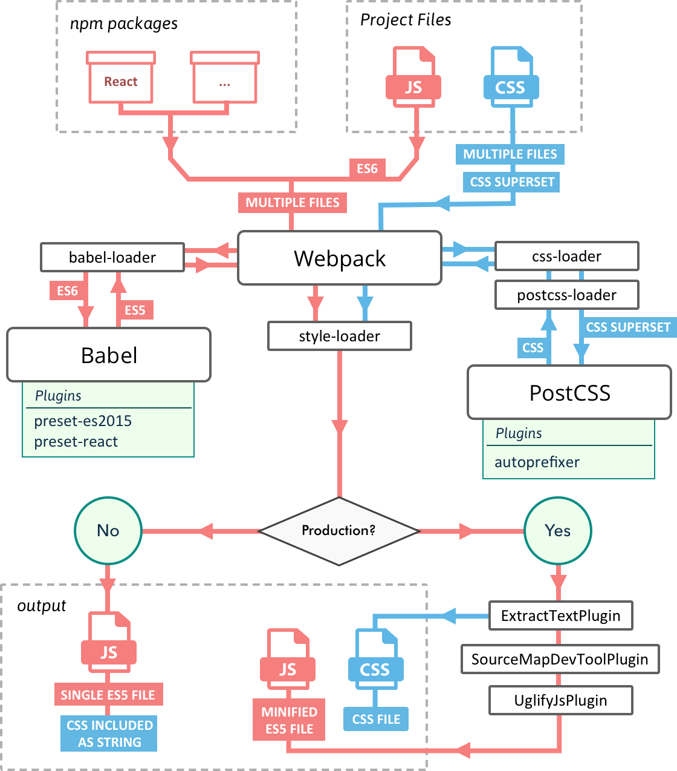
Webpack - Details

Slide 24
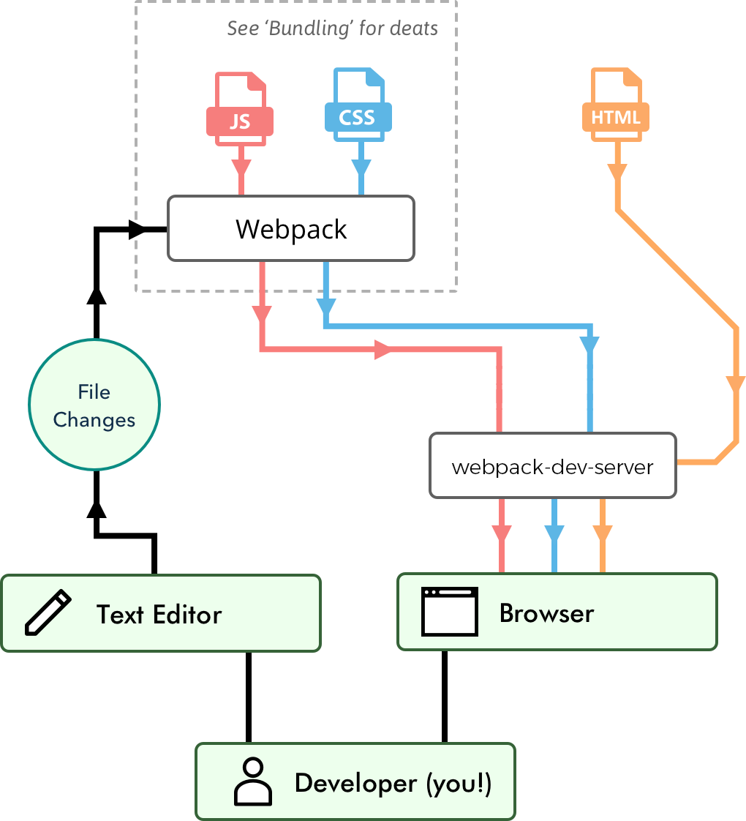
Webpack - Development

Slide 25
Current Setup

Slide 26
Using the Framework

Slide 27
Environment Setup
IDE or text editor (Intellij IDEA, Sublime)
Git and git repository access (GitHub)
Install NVM
NVM guide: https://garywoodfine.com/install-nodejs-nvm-osx/
NVM official repo: repo: https://github.com/creationix/nvm
Install NodeJS / NPM (latest version) using NVM
nvm install node

Slide 28
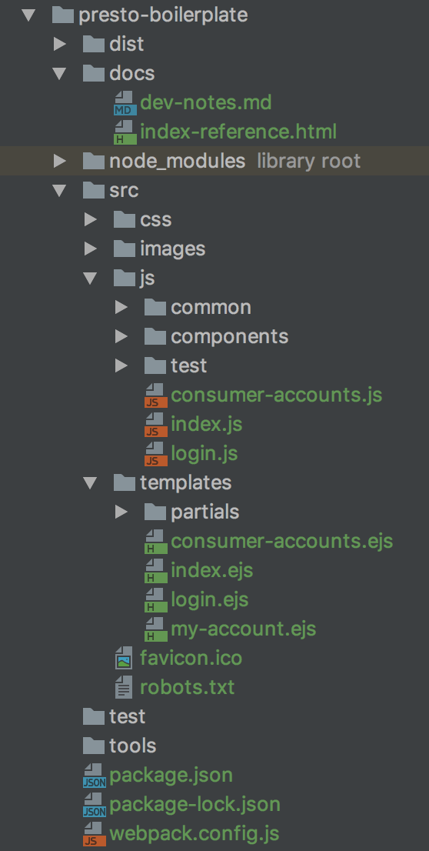
Project Structure
/src – project source
/node_modules – libraries (NPM)
/dist – compiled files for deployment
package.json – dependency management
webpack.config.js – build configuration

Slide 29
Quickstart
Clone project from git repository
Navigate to the project root (where package.json is located)
Execute npm install to download project dependencies
Execute npm run dev to start up the server at http://localhost:9000
Begin poking around

Slide 30
Quickstart – The Relevant Parts
package.json – contains dependencies and scripts
devDependencies – development dependencies (e.g. webpack)
dependencies – browser run-time dependencies (e.g. jQuery)
scripts – running various tasks (e.g. build, start server)

Slide 31
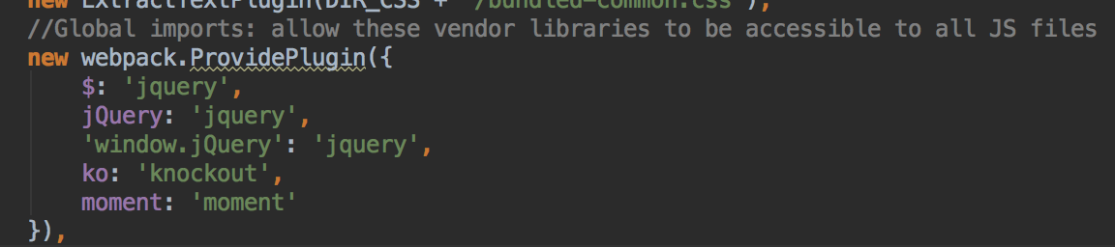
Quickstart – The Relevant Parts
webpack.config.js – contains configuration for Webpack
Fully JavaScript (code-based configuration)
Extended through loaders / plugins
Configure once, run continuously
Project extra: common JS vendor libs are configured globally (except Kendo)

Slide 32
Quickstart – The Relevant Parts
./node_modules/.bin/webpack-dev-server
LIVE RELOADING server
Compile and build in-memory
(http://localhost:9000/webpack-dev-server)
Project shortcut: npm run dev

Slide 33
Multi-page Approach
Each page has one (1) set of source files with its own business logic:
page.ejs – HTML
page.js – Main JS file
Import/require common modules as needed (JS/CSS/etc.)
Shareable code must be placed in common modules
Straightforward Webpack configuration

Slide 34
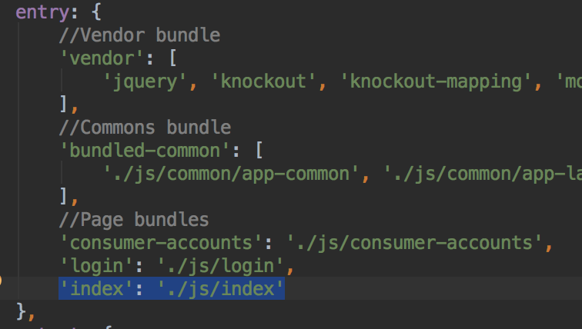
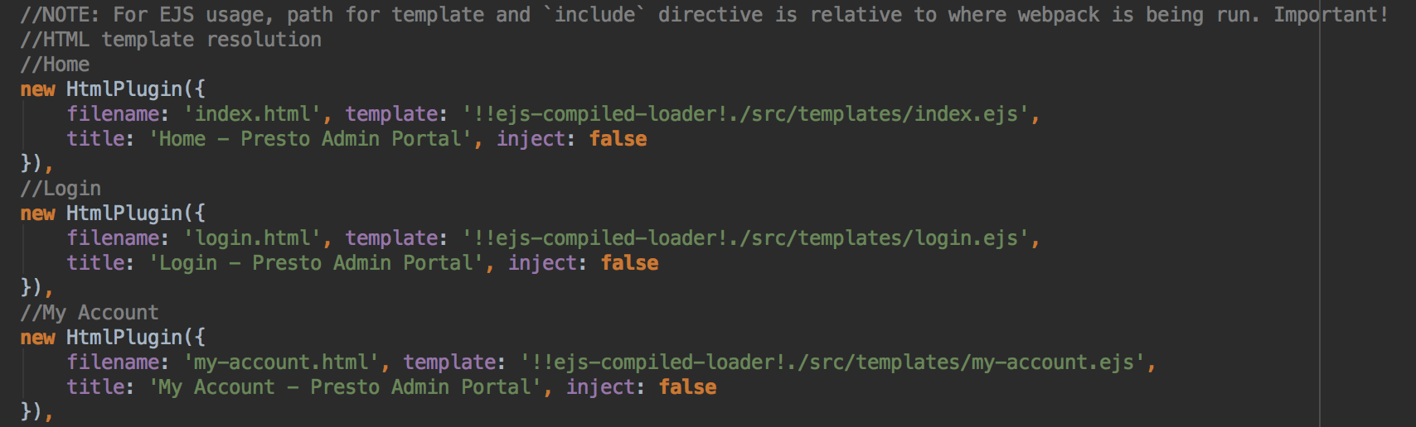
Quickstart – New Page
Configure the HTML and JS entry points in webpack.config.js

Slide 35
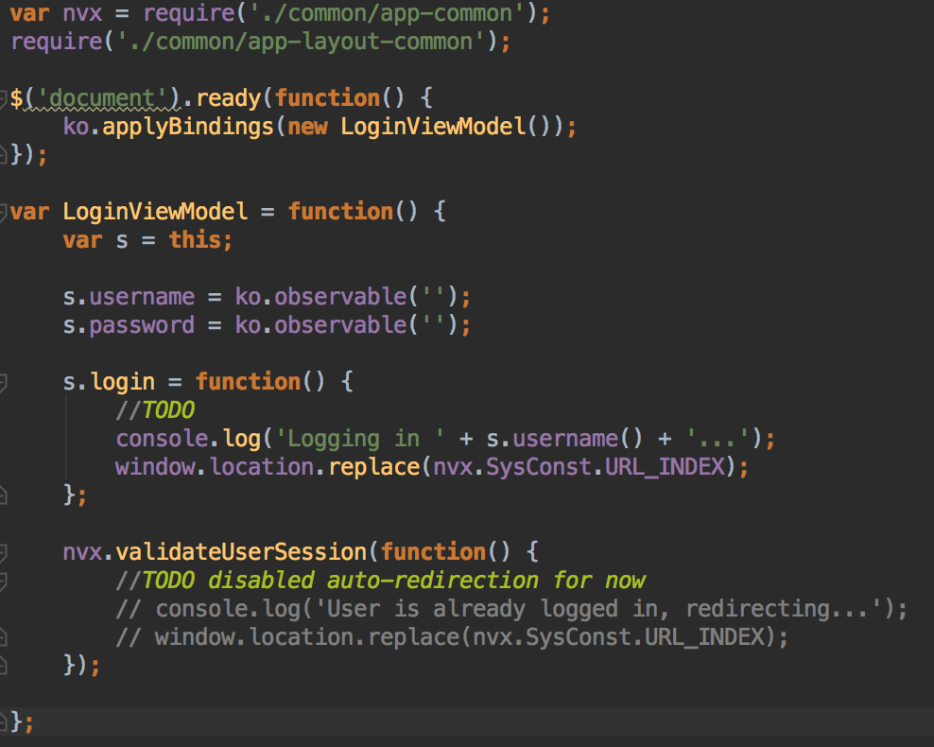
Quickstart – New Page
Create the following files in the corresponding directories:
/src/templates/new-page.ejs – HTML template
/src/js/new-page.js – JS logic entry point
Start coding!
Use require syntax to manage JS module imports

Slide 36
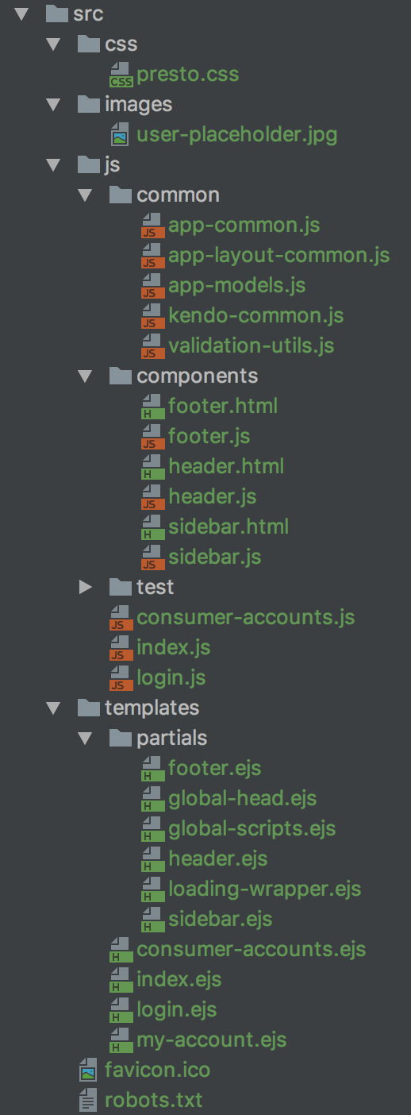
Quickstart – New Page
Use or create common code as needed!
Common JS – use/create common code, e.g. models, validations, etc.
/src/js/ (remember to use require statements to import them in other files!)
HTML partials – use/create partial page elements (e.g. header)
/src/templates/partials/
Custom CSS – use/create custom CSS
/src/css/
Other static resources – use static resources as needed
/src/images/ -or- create your own folder (but update webpack.config.js)

Slide 37
Framework Roadmap

Slide 38
Improvements
Webpack best practices
Development vs production configuration
Automated resource path injection to HTML files
Concatenate and minify step for CSS
Automated deployment e.g. to Amazon S3 (Jenkins, etc.)
Integrated debugging with Intellij

Slide 39
Version 2.0
ES2015 JavaScript modules and syntax
Adopt a fully SPA approach (React, Angular2, Vue)
Fully bundled Webpack build

Slide 40
References

Slide 41
References - General
Anatomy of a Static Site > http://andrewhfarmer.com/static-site-anatomy/
Grab: Front-end Guide > https://github.com/grab/front-end-guide
Front-end Dev Roadmap > https://github.com/kamranahmedse/developer-roadmap#-frontend-roadmap
Getting Started with Webpack > https://blog.madewithenvy.com/getting-started-with-webpack-2-ed2b86c68783
Intro to Webpack [Video] > https://egghead.io/lessons/javascript-intro-to-webpack

Slide 42
References - Libraries
Bootstrap 3 > http://getbootstrap.com/
AdminLTE > https://adminlte.io/docs/2.4/layout
Kendo UI > http://demos.telerik.com/kendo-ui/
KnockoutJS > http://knockoutjs.com/
EJS > http://www.embeddedjs.com/

Slide 43
Thank you!

