Slide 1
AI-Powered Collections Strategy
Leveraging Agentic AI for Scalable, Fair, and Effective Debt Management at Geldium

Slide 2
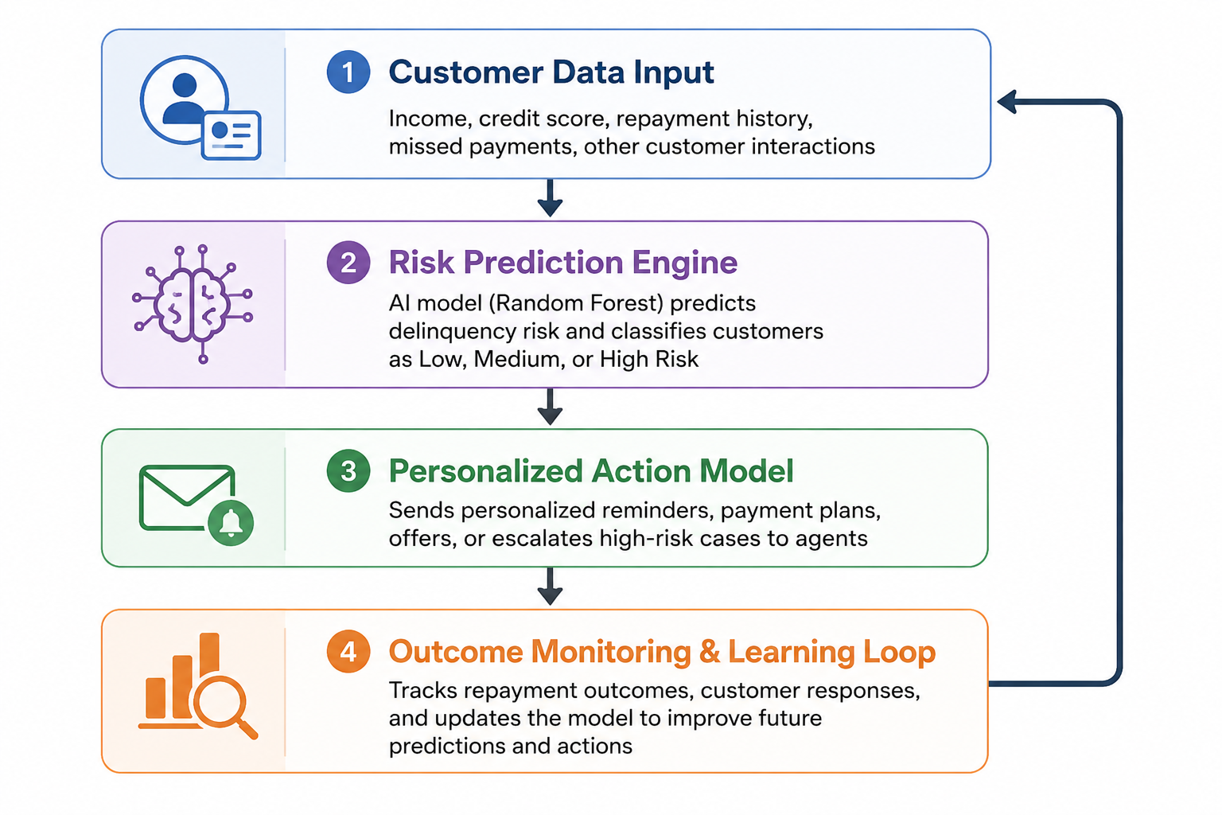
How the System Works
Customer Data Input: Income, credit score, repayment history, missed payments
Decision Logic Engine: Random Forest AI model predicts delinquency risk
Action Module: Sends reminders, support offers, or escalations
Learning Loop: Improves predictions using repayment outcomes

Slide 3
Role of Agentic AI
Autonomous
- Send payment reminders
- Identify high-risk customers
- Monitor repayment behaviour
Human Oversight
- Review hardship cases
- Approve major financial actions
- Monitor fairness and compliance

Slide 4
Responsible AI Guardrails
Fairness Checks: Monitor and reduce biased outcomes across customer groups
Explainable AI: Clearly explain why customers are flagged as high-risk
Regulatory Compliance: Ensure compliance with ECOA, GDPR, and financial regulations
Human Oversight: Human review for critical or high-impact decisions
Continuous Monitoring: Regular audits to track model fairness and performance

Slide 5
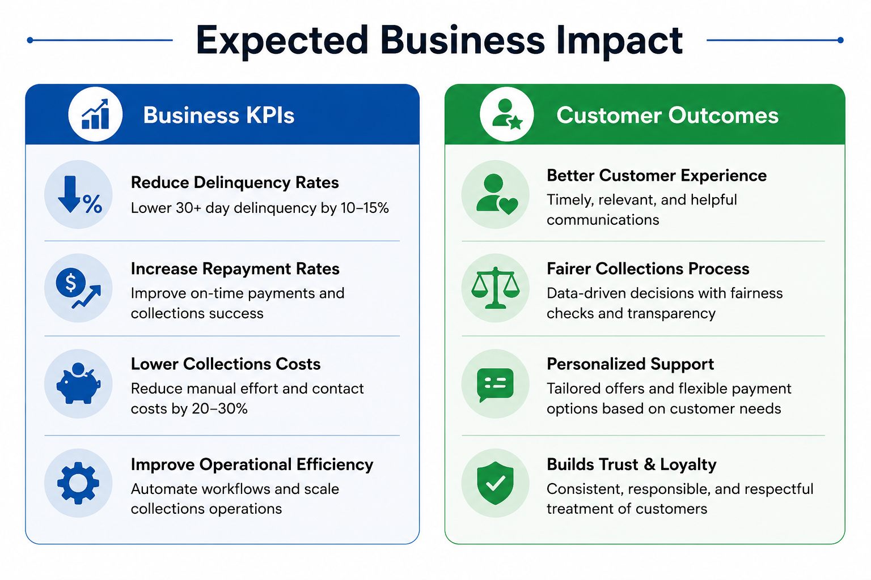
Expected Business Impact

Slide 6
Conclusion & Key Takeaways
AI-powered collections can improve repayment outcomes and reduce delinquency risk
Random Forest helps identify high-risk customers more accurately
Agentic AI enables faster, scalable, and personalized collections actions
Responsible AI guardrails ensure fairness, transparency, and compliance
Human oversight remains essential for critical financial decisions
“The proposed system helps Geldium create a smarter, fairer, and more efficient collections strategy.”

