Slide 1
Project #4: Machine Learning Integration
Titanic Data
UPenn Data Science Boot Camp
09/17/22
Walter Wilson, Matthew Hill, Anthony Davey, Chang Woon Jang

Slide 2
Motivation
Predict survivability using machine learning models based on given data sets
Analytical Models : Supervised, Unsupervised, CNN, etc

Slide 3
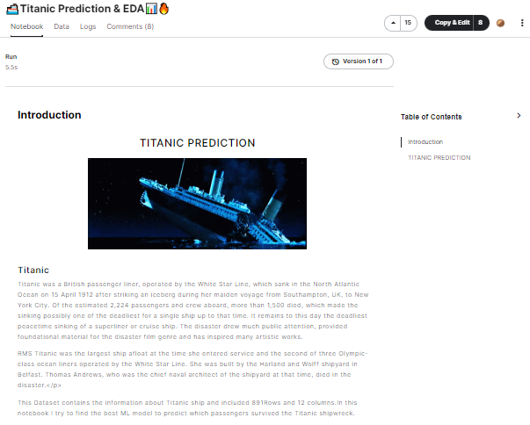
Where are datasets from?

Slide 4
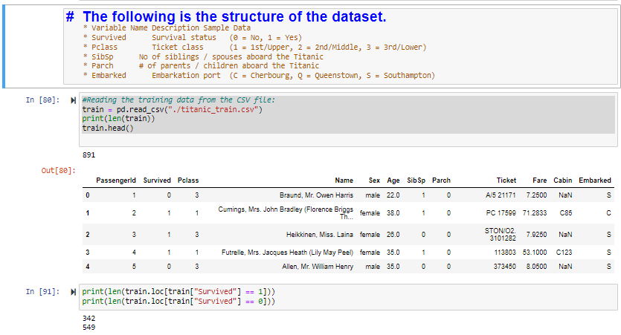
ETL

Slide 5
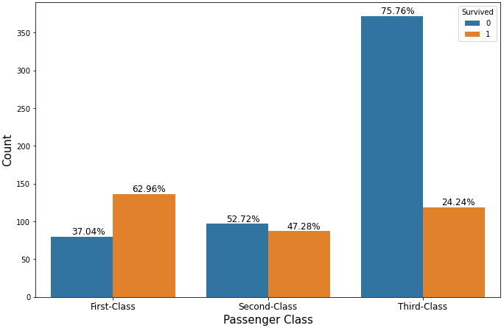
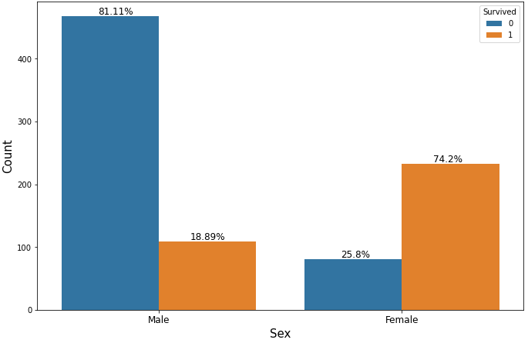
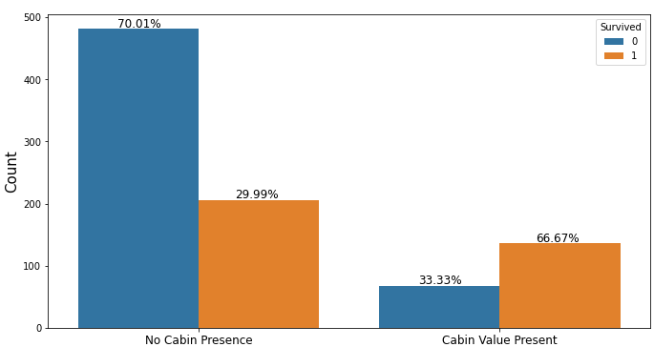
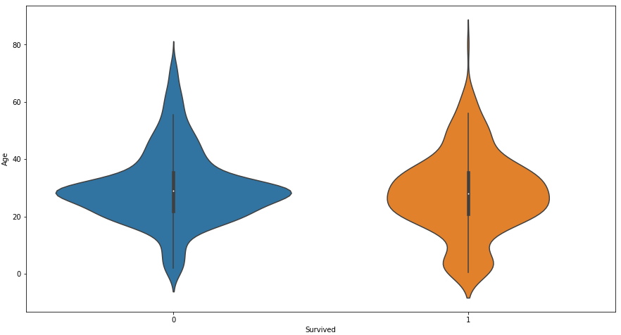
Plots
Passenger Class
Sex
Age
Cabin Present
Age
Survived

Slide 6
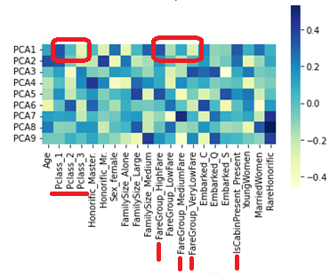
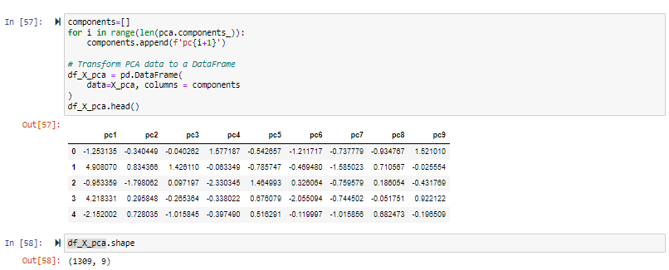
Principle Component Analysis

Slide 7
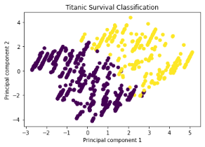
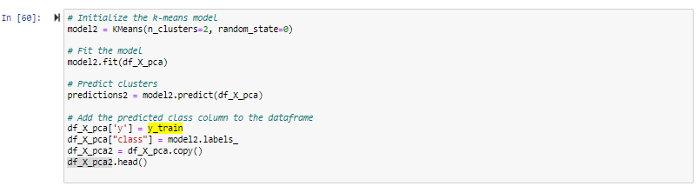
Model 1: Unsupervised K-Means Clustering

Slide 8
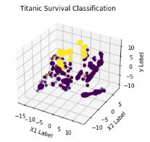
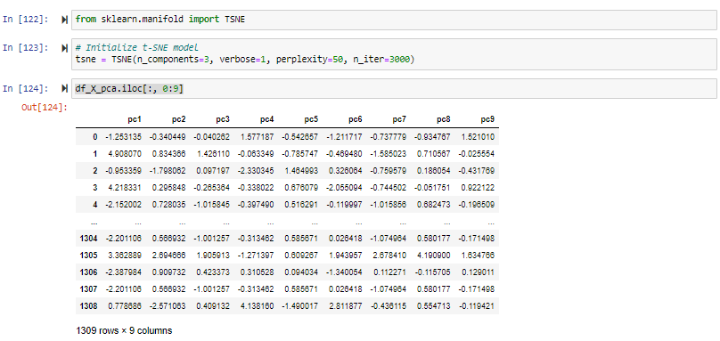
Model 2: Unsupervised T-SNE

Slide 9
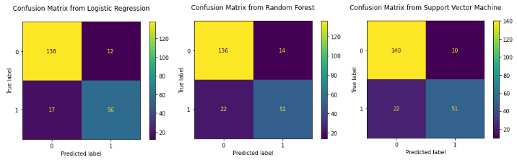
Model 3: Supervised ML (LR, RF, SVM)
Accuracy Score: 83%, 81%, 85%

