Slide 1
Project #4: Machine Learning Integration
Titanic Data
UPenn Data Science Boot Camp
09/17/22
Walter Wilson, Matthew Hill, Anthony Davey, Chang Woon Jang

Slide 2
Motivation

Slide 3
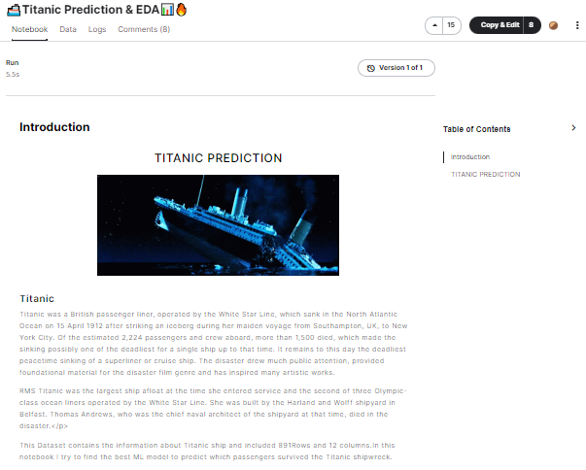
Where are datasets from?

Slide 4
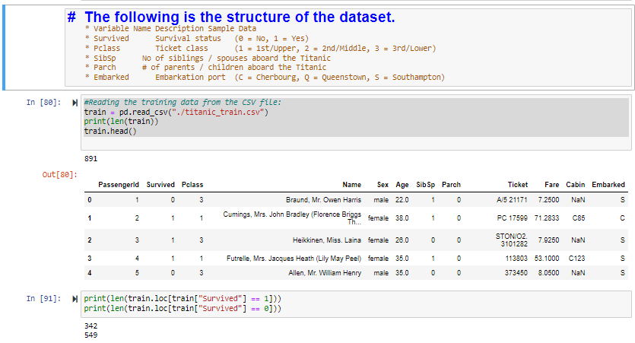
ETL

Slide 5
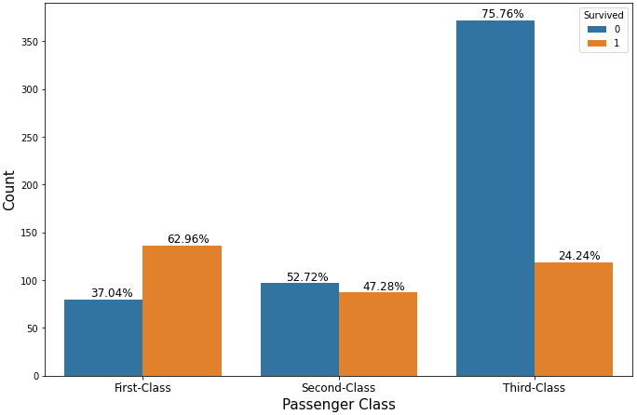
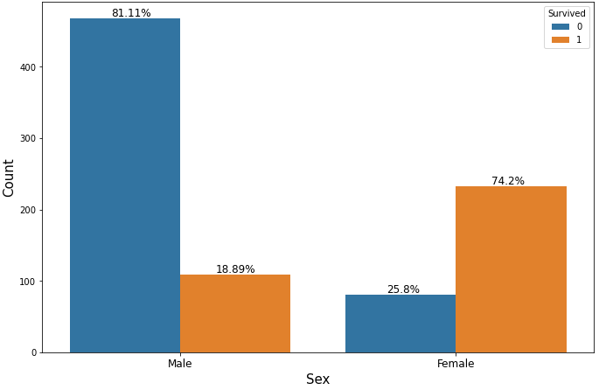
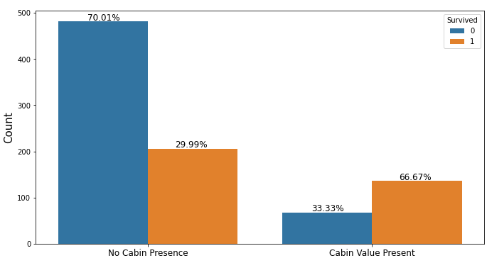
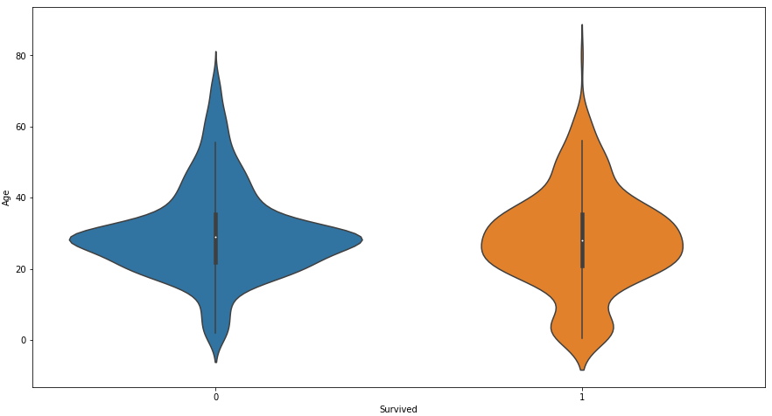
Survivability upon:
Pclass
Sex
Age
Cabin Present
Age
Survived

Slide 6
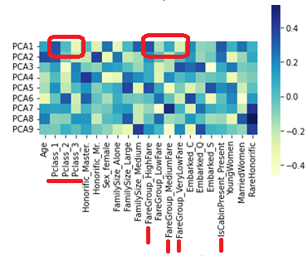
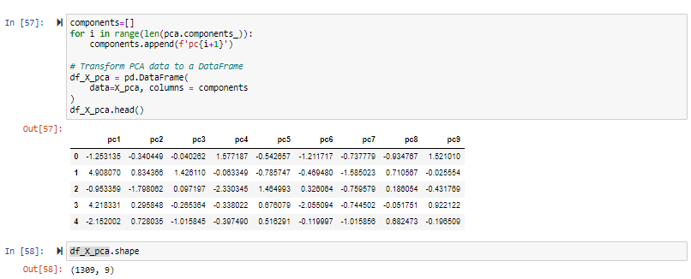
Principle Component Analysis

Slide 7
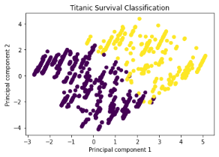
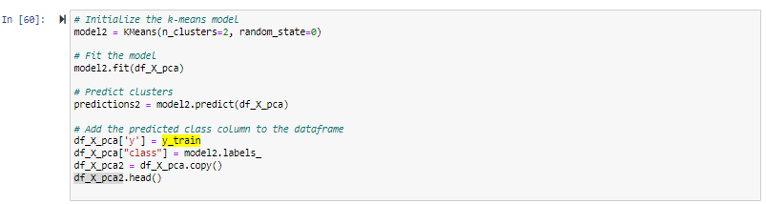
Model 1: K-Means Clustering

Slide 8
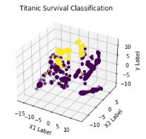
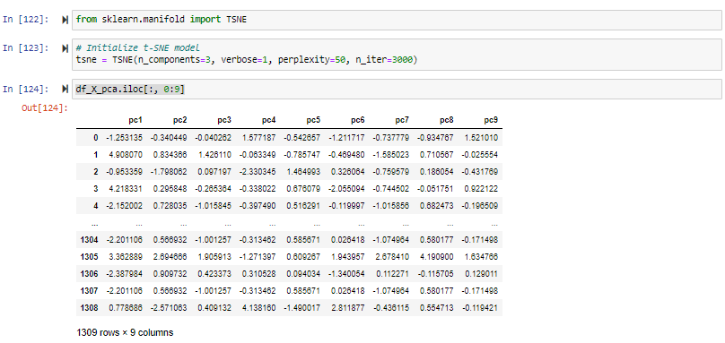
Model 2: T-SNE

