Slide 1

Code Python for Topographic Correction

Slide 2
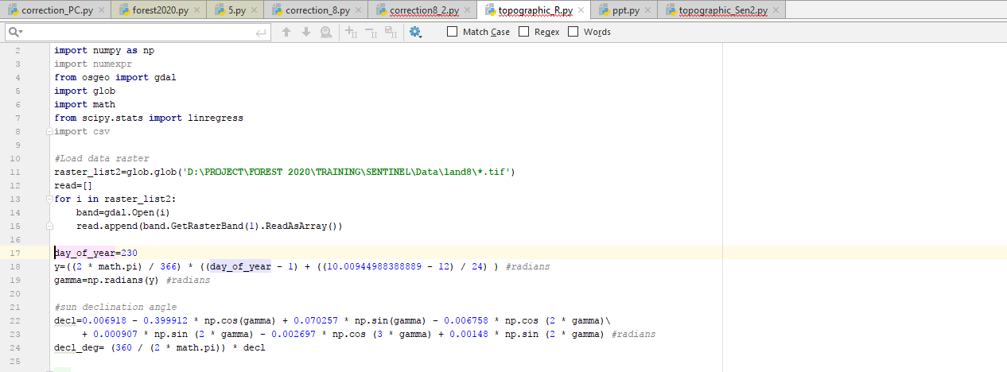
Load data from folder
Calculate Sun Position Calculation (Adopted from NOAA (2014) as suggested by Prinsloo and Dobson (2015)

Slide 3
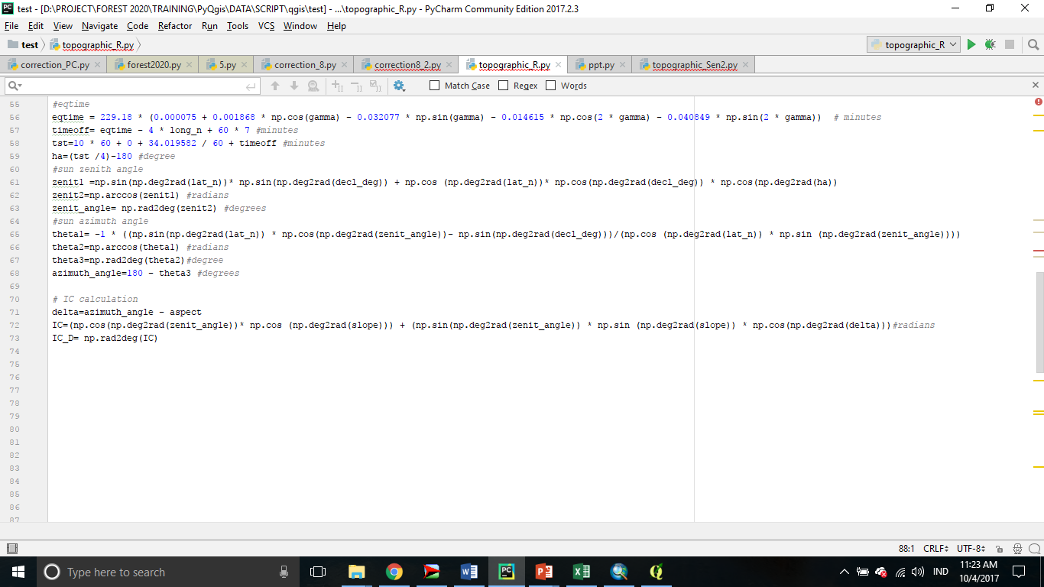
Topographic Correction Using Rotation Model (Adopted from Tan, et al. (2013))

