Slide 1
ETC Bootcode
Hari Udayakumar
20/7/2015

Slide 2
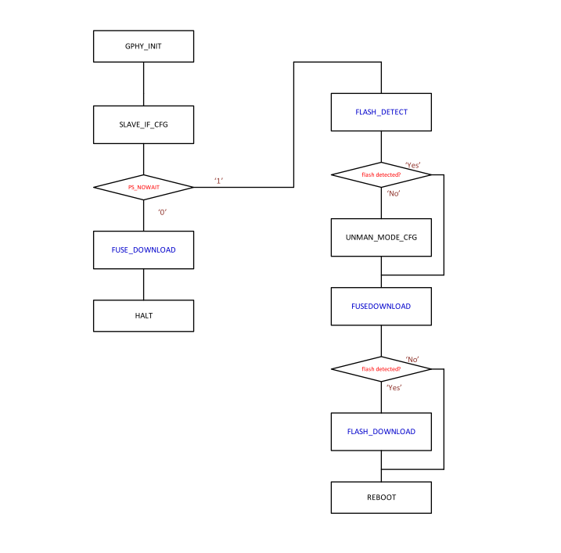
Boot Code Data Flow

Slide 3
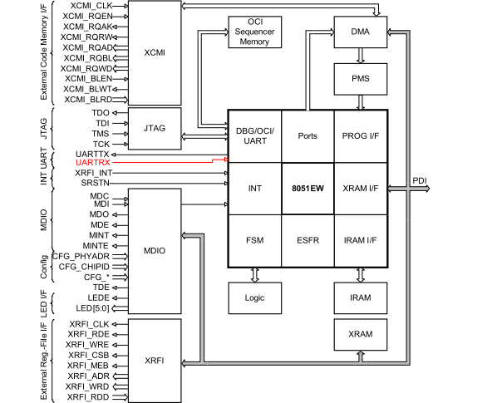
On Chip uC

Slide 4
On Chip uC
An uC 8051 subsystem is integrated
Boot from on-chip ROM
Code download from on-chip ROM, on-chip RAM or external ROM
Hardware modules and external interrupt pins are mapped to uC interrupt controller

Slide 5
Pin Strapping
At Reset the PS0 and PS1 Register are update based on the Pin Strap setting
The Pin Strap setting describes the
Configuration of the device.
Debug Interface Selected
Functionality shares the LED pins, SPI and TDO signals.
Internal pull up for the pin strapping shall be disabled after reset.

Slide 6
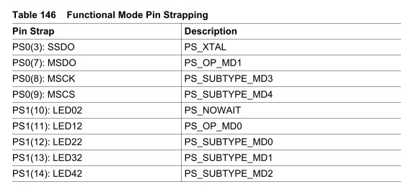
Pin Strapping

Slide 7
Firmware Address Offset Configuration Register
Each GPHY Macro and uC subsystem can be configured to boot from internal ROM/RAM or external E2PROM controlled through register GPHY0_FCR/1/2/3/4
Address inversion and address offset are also configurable via the same registers.

Slide 8
SDCC Complier
The Small Device C Compiler is specifically built for programming microcontrollers including the 8051 series microcontroller.
SDCC is a free and open source software available for download to anyone
Only limitation is the optimization.
For future use the code can be migrated to Keil C compiler

Slide 9
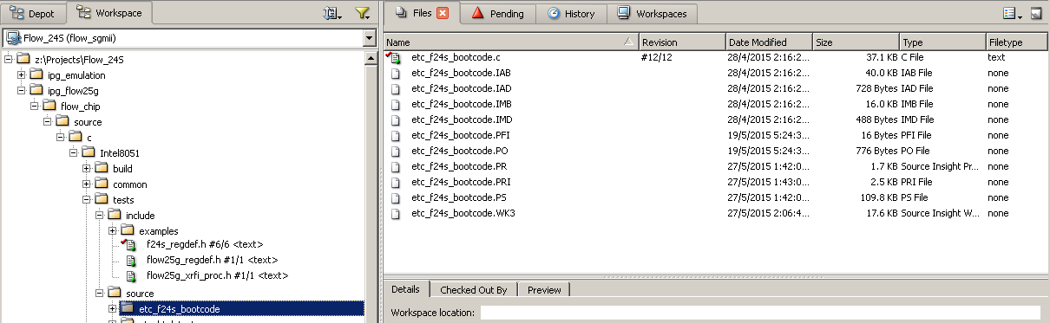
Directory Structure

