Slide 1
Fundamentals of Git
By Zachary Ling
29th, Aug, 2011

Slide 2
Outline
History of Git
Distributed V.S Centralized Version Control
Getting started
Branching and Merging
Working with remote
Summary

Slide 3
A Brief History of Git
Linus uses BitKeeper to manage Linux code
Ran into BitKeeper licensing issue
  Liked functionality
  Looked at CVS as how not to do things
April 5, 2005 - Linus sends out email showing first version
June 15, 2005 - Git used for Linux version control

Slide 4

Git is Not an SCM
Never mind merging. It's not an SCM, it's a distribution and archival mechanism. I bet you could make a reasonable SCM on top of it, though. Another way of looking at it is to say that it's really a content-addressable filesystem, used to track directory trees.
Linus Torvalds, 7 Apr 2005
http://lkml.org/lkml/2005/4/8/9

Slide 5
Centralized Version Control
Traditional version control system
  Server with database
  Clients have a working version
Examples
  CVS
  Subversion
  Visual Source Safe
Challenges
  Multi-developer conflicts
  Client/server communication

Slide 6
Distributed Version Control
Authoritative server by convention only
Every working checkout is a repository
Get version control even when detached
Backups are trivial
Other distributed systems include
  Mercurial
  BitKeeper
  Darcs
  Bazaar

Slide 7
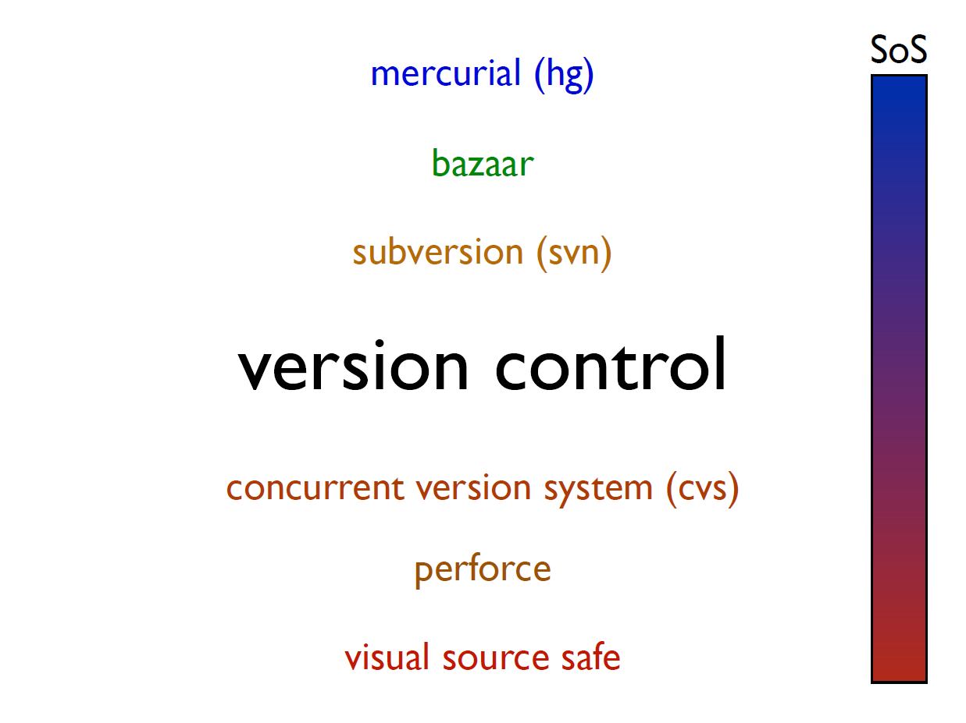

Slide 8
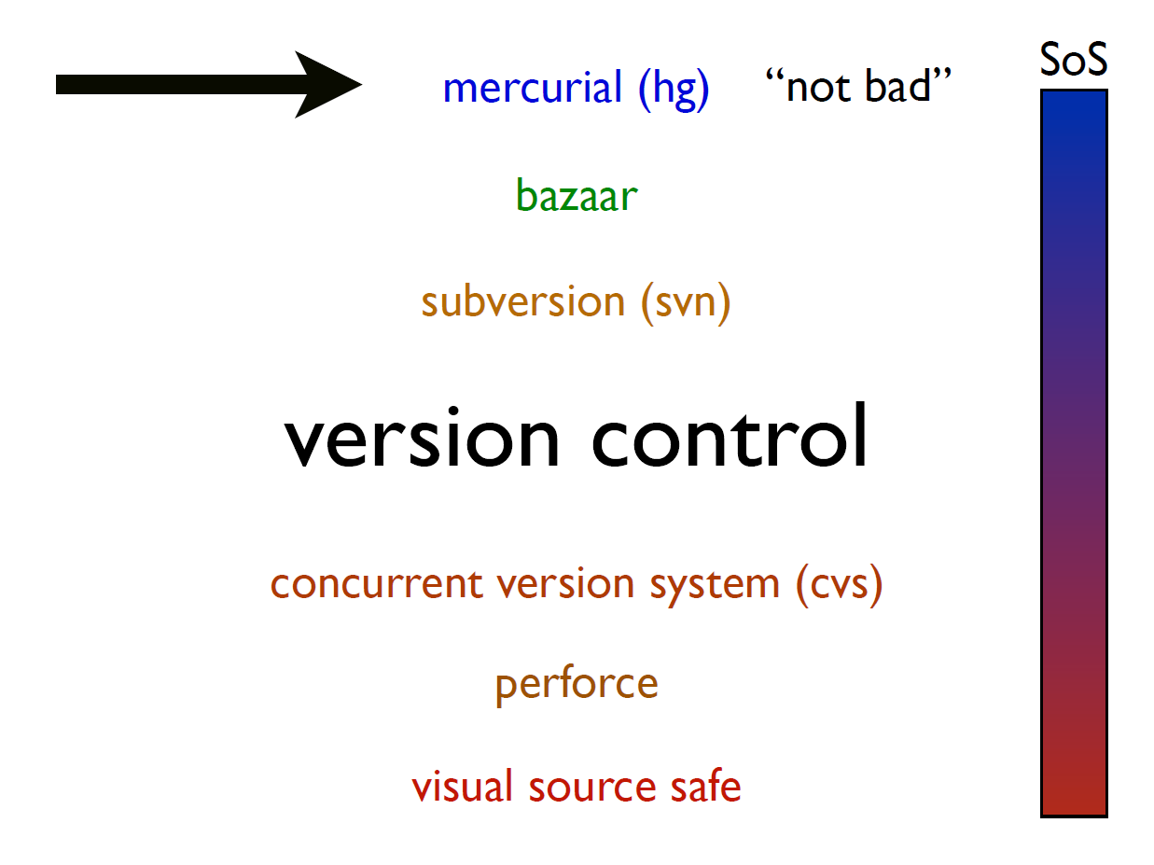

Slide 9
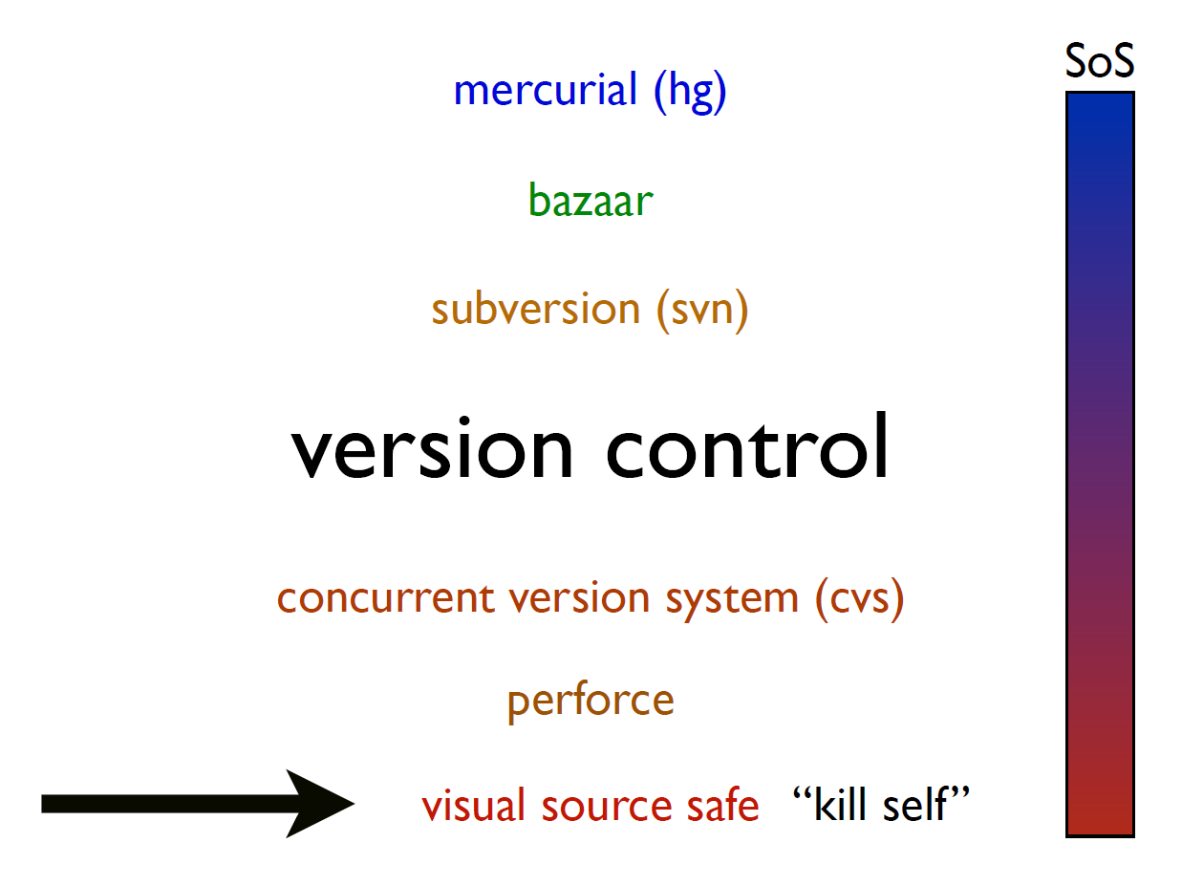

Slide 10
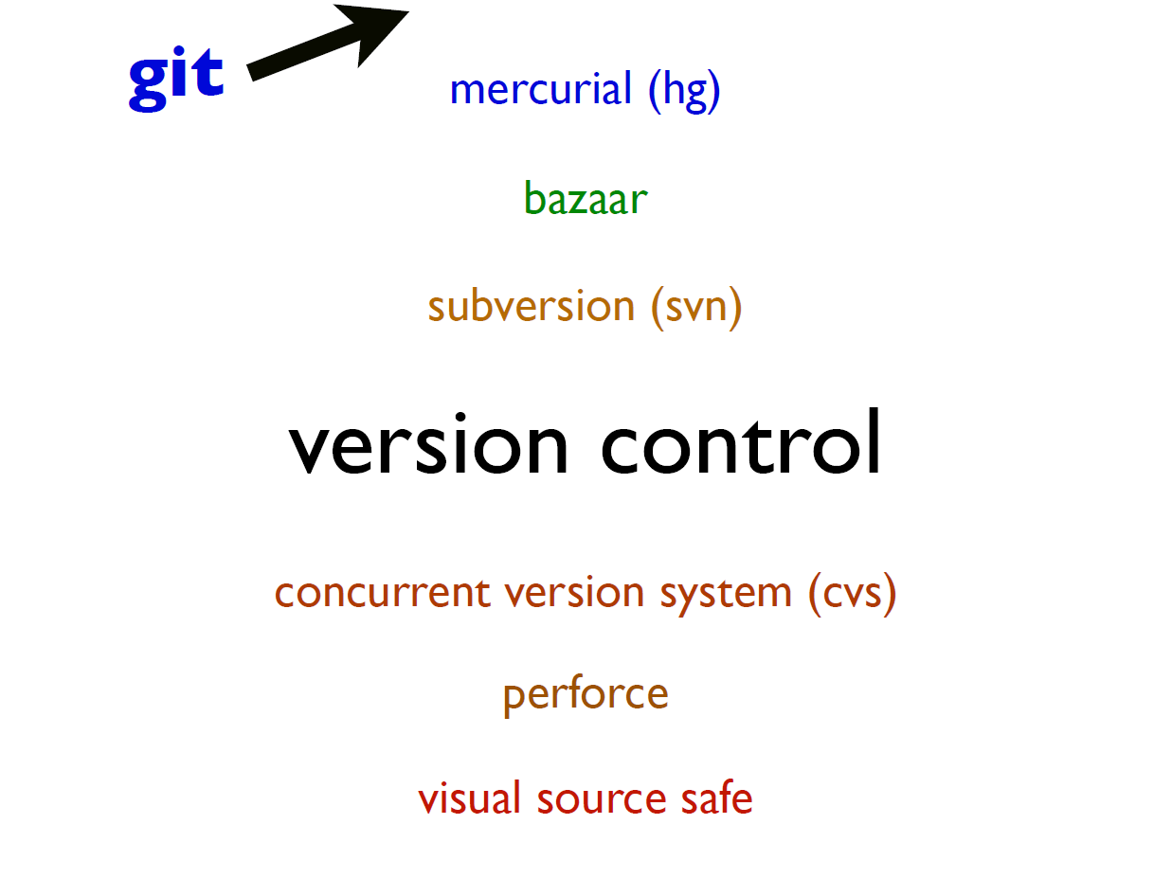

Slide 11
Git Advantages
Resilience
  No one repository has more data than any other
Speed
  Very fast operations compared to other VCS (I’m looking at you CVS and Subversion)
Space
  Compression can be done across repository not just per file
  Minimizes local size as well as push/pull data transfers
Simplicity
  Object model is very simple
Large userbase with robust tools

Slide 12
Some GIT Disadvantages
Definite learning curve, especially for those used to centralized systems
  Can sometimes seem overwhelming to learn
    Conceptual difference
    Huge amount of commends

Slide 13
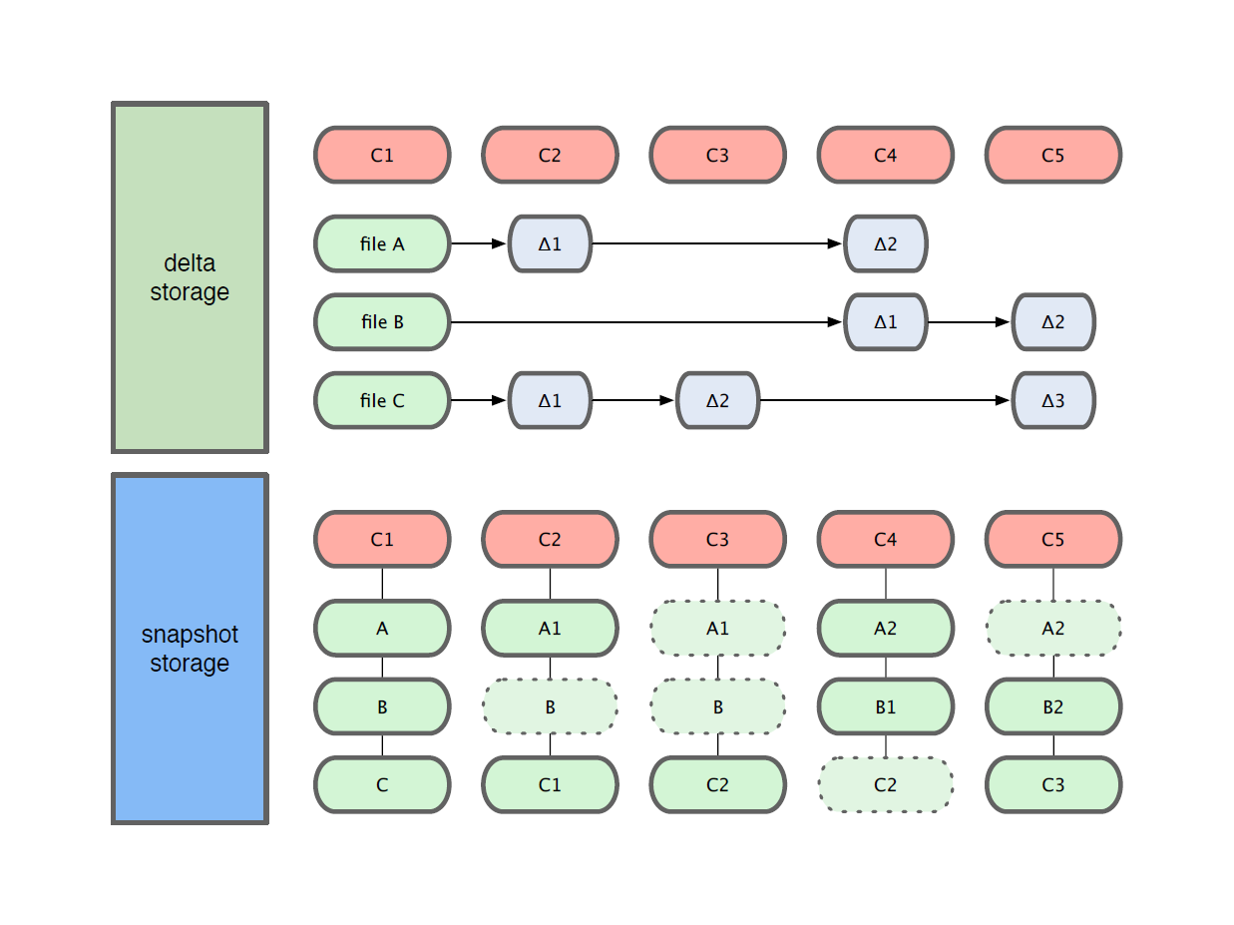
Getting Started
Git use snapshot storage

Slide 14
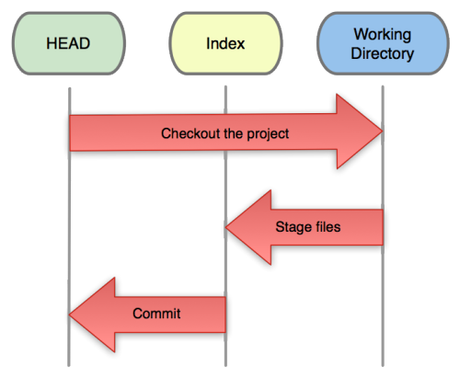
Getting Started
Three trees of Git
  The HEAD
    last commit snapshot, next parent
  Index
    Proposed next commit snapshot
  Working directory
    Sandbox

Slide 15
Getting Started
A basic workflow
  (Possible init or clone) Init a repo
  Edit files
  Stage the changes
  Review your changes
  Commit the changes

Slide 16
Getting Started
Init a repository
Git init
zachary@zachary-desktop:~/code/gitdemo$ git init
Initialized empty Git repository in /home/zachary/code/gitdemo/.git/
zachary@zachary-desktop:~/code/gitdemo$ ls -l .git/
total 32
drwxr-xr-x 2 zachary zachary 4096 2011-08-28 14:51 branches
-rw-r--r-- 1 zachary zachary 92 2011-08-28 14:51 config
-rw-r--r-- 1 zachary zachary 73 2011-08-28 14:51 description
-rw-r--r-- 1 zachary zachary 23 2011-08-28 14:51 HEAD
drwxr-xr-x 2 zachary zachary 4096 2011-08-28 14:51 hooks
drwxr-xr-x 2 zachary zachary 4096 2011-08-28 14:51 info
drwxr-xr-x 4 zachary zachary 4096 2011-08-28 14:51 objects
drwxr-xr-x 4 zachary zachary 4096 2011-08-28 14:51 refs

Slide 17
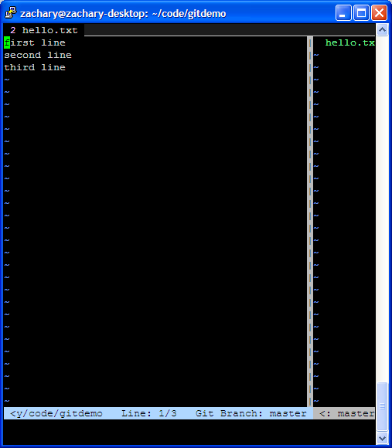
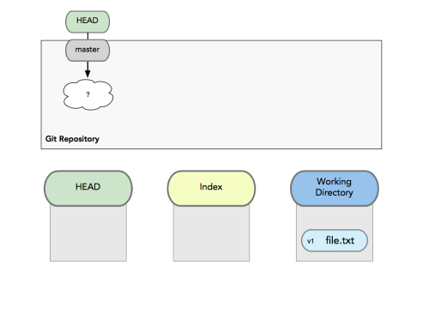
Getting Started
A basic workflow
  Edit files
  Stage the changes
  Review your changes
  Commit the changes
Use your favorite editor

Slide 18
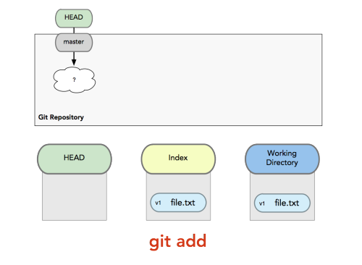
Getting Started
A basic workflow
  Edit files
  Stage the changes
  Review your changes
  Commit the changes
Git add filename
zachary@zachary-desktop:~/code/gitdemo$ git status
# On branch master
# Changes not staged for commit:
# (use "git add <file>..." to update what will be committed)
# (use "git checkout -- <file>..." to discard changes in working directory)
#
# modified: hello.txt
#
no changes added to commit (use "git add" and/or "git commit -a")

Slide 19
Getting Started
A basic workflow
  Edit files
  Stage the changes
  Review your changes
  Commit the changes
Git status
zachary@zachary-desktop:~/code/gitdemo$ git add hello.txt
zachary@zachary-desktop:~/code/gitdemo$ git status
# On branch master
# Changes to be committed:
# (use "git reset HEAD <file>..." to unstage)
#
# modified: hello.txt
#

Slide 20
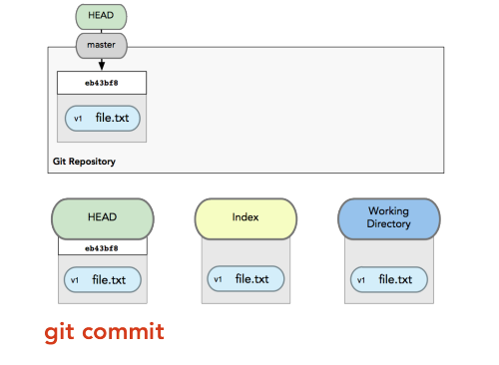
Getting Started
A basic workflow
  Edit files
  Stage the changes
  Review your changes
  Commit the changes
Git commit
# Please enter the commit message for your changes. Lines starting
# with '#' will be ignored, and an empty message aborts the commit.
# On branch master
# Changes to be committed:
# (use "git reset HEAD <file>..." to unstage)
#
# modified: hello.txt
#

Slide 21
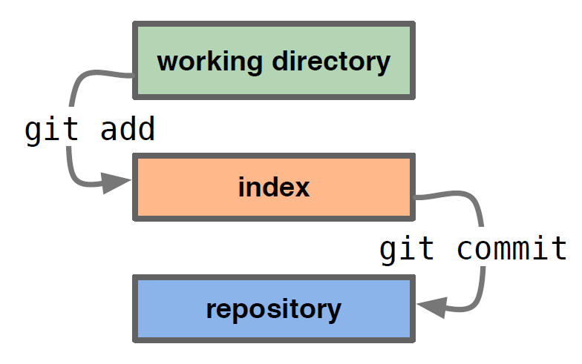
Getting Started
A basic workflow
  Edit files
  Stage the changes
  Review your changes
  Commit the changes

Slide 22
Getting Started
View changes
Git diff
  Show the difference between working directory and staged
Git diff --cached
  Show the difference between staged and the HEAD
View history
Git log
zachary@zachary-desktop:~/code/gitdemo$ git log
commit efb3aeae66029474e28273536a8f52969d705d04
Author: Zachary Ling <zacling@gmail.com>
Date: Sun Aug 28 15:02:08 2011 +0800
Add second line
commit 453914143eae3fc5a57b9504343e2595365a7357
Author: Zachary Ling <zacling@gmail.com>
Date: Sun Aug 28 14:59:13 2011 +0800
Initial commit

Slide 23
Getting Started
Revert changes (Get back to a previous version)
  Git checkout commit_hash
zachary@zachary-desktop:~/code/gitdemo$ git log
commit efb3aeae66029474e28273536a8f52969d705d04
Author: Zachary Ling <zacling@gmail.com>
Date: Sun Aug 28 15:02:08 2011 +0800
Add second line
commit 453914143eae3fc5a57b9504343e2595365a7357
Author: Zachary Ling <zacling@gmail.com>
Date: Sun Aug 28 14:59:13 2011 +0800
Initial commit
zachary@zachary-desktop:~/code/gitdemo$ git checkout 4539
Note: checking out '4539'.
You are in 'detached HEAD' state. You can look around, make experimental
changes and commit them, and you can discard any commits you make in this
state without impacting any branches by performing another checkout.
If you want to create a new branch to retain commits you create, you may
do so (now or later) by using -b with the checkout command again. Example:
git checkout -b new_branch_name
HEAD is now at 4539141... Initial commit

Slide 24
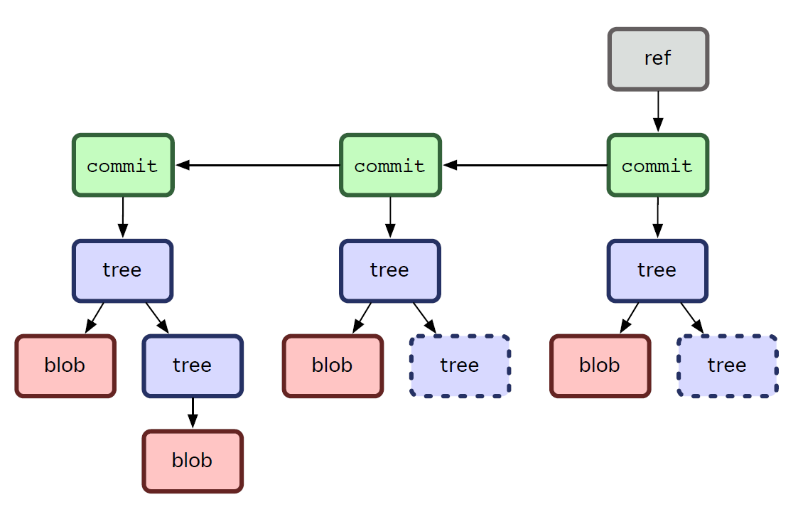
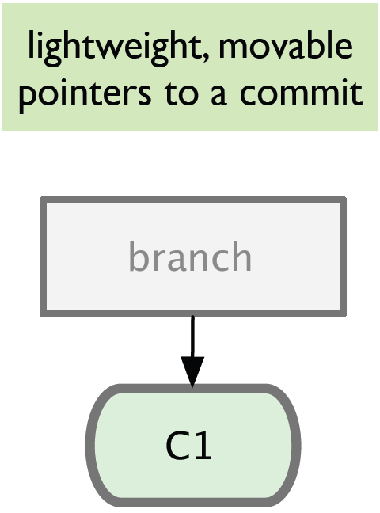
Branching
Git sees commit this way…
Branch annotates which commit we are working on

Slide 25
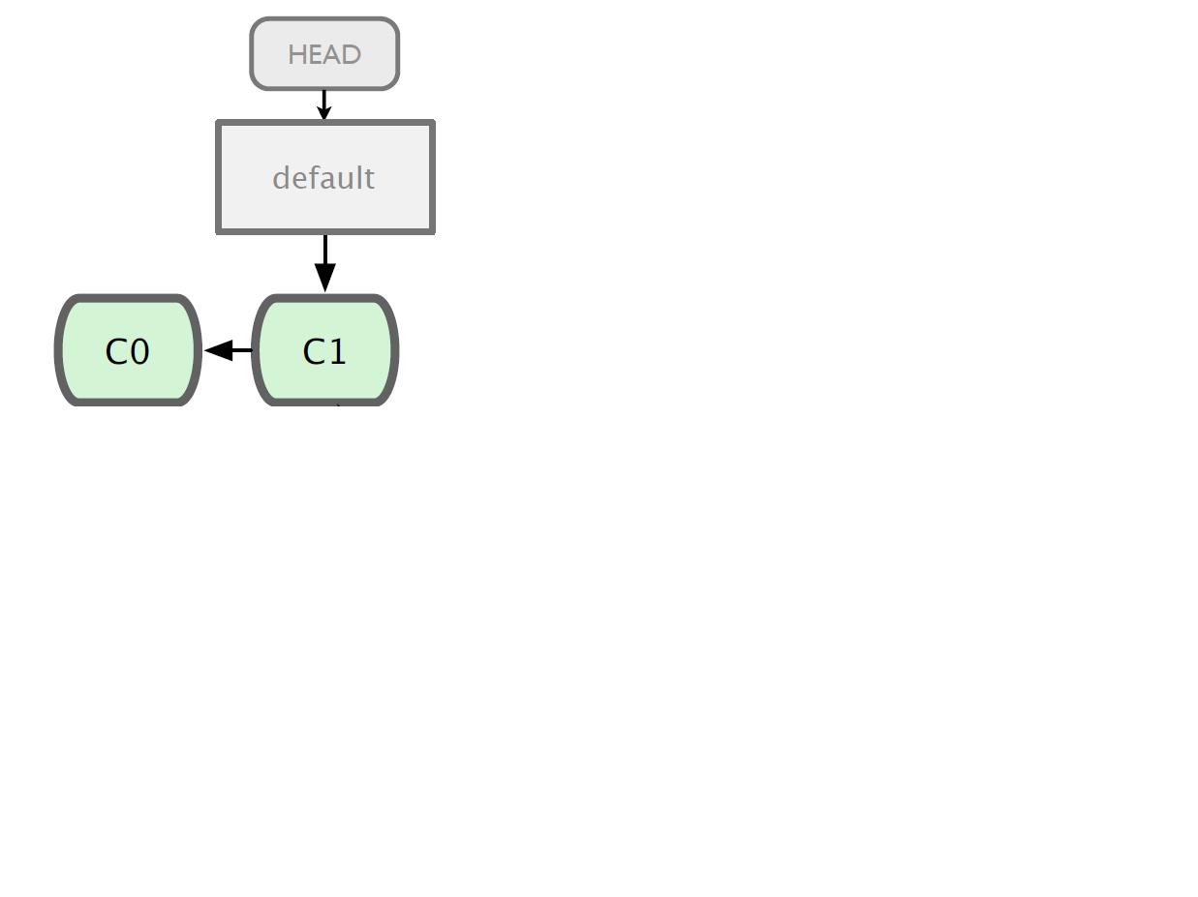

Branching

Slide 26
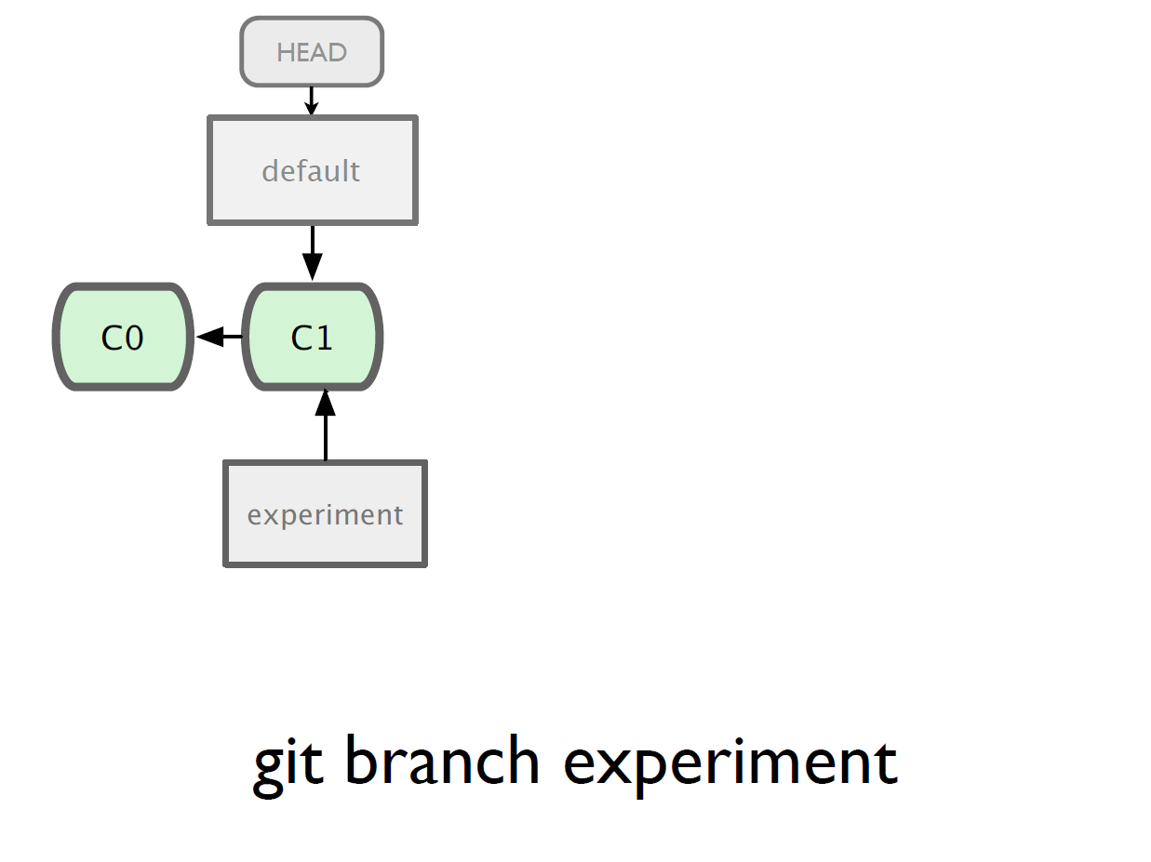

Slide 27
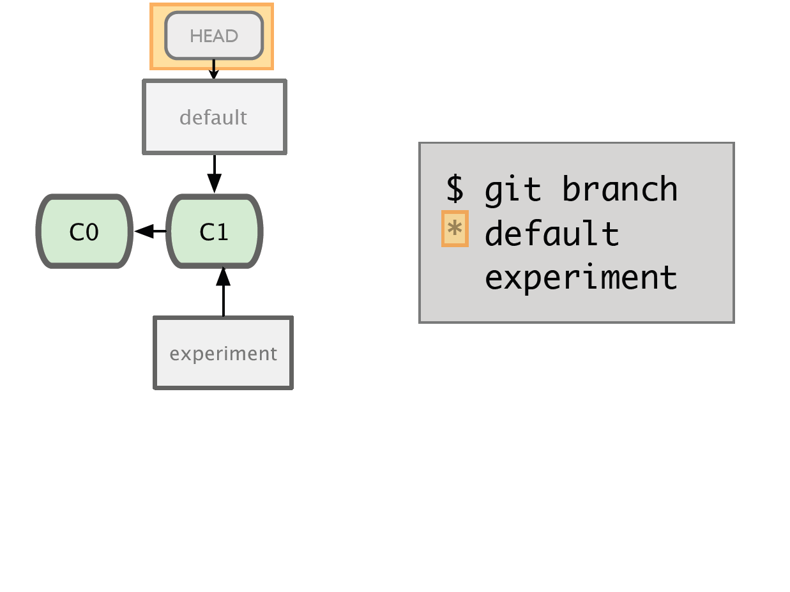

Slide 28
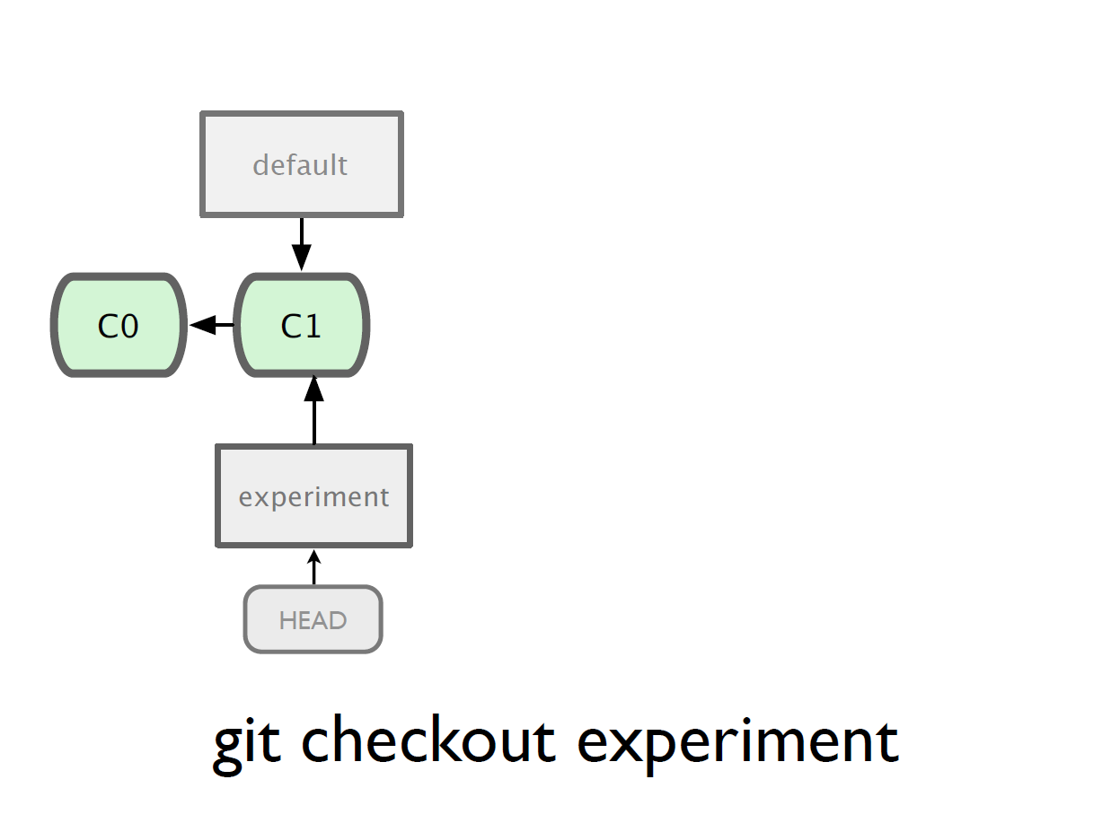

Slide 29
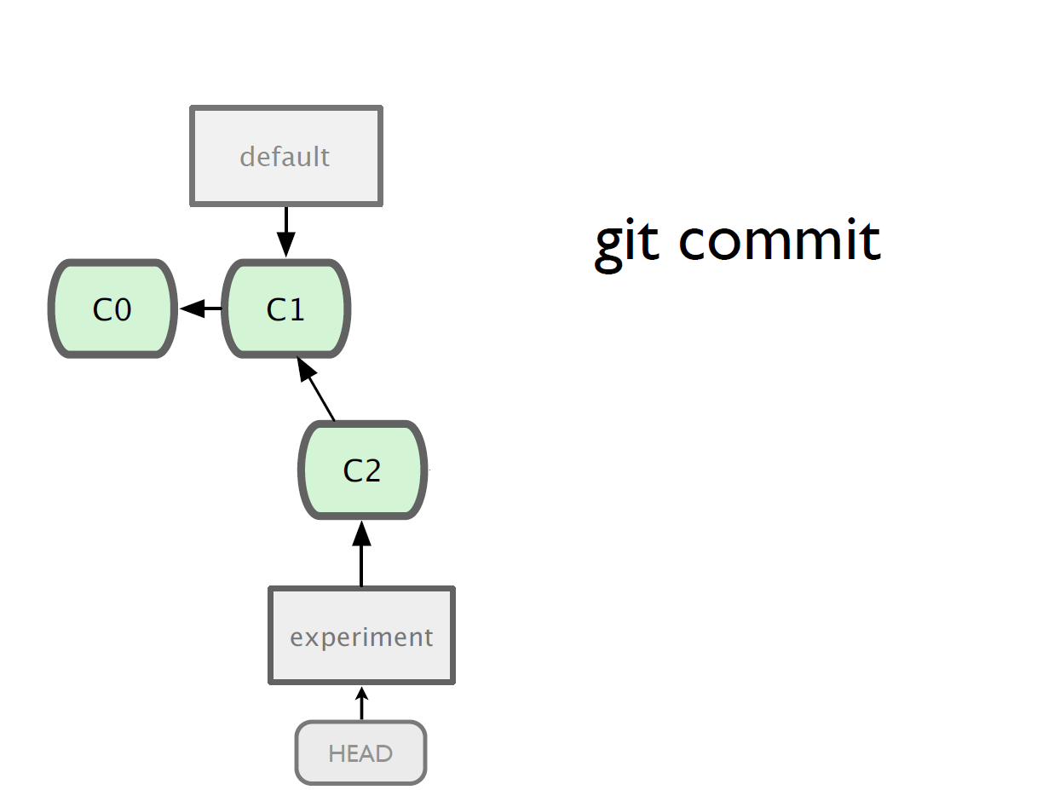

Slide 30
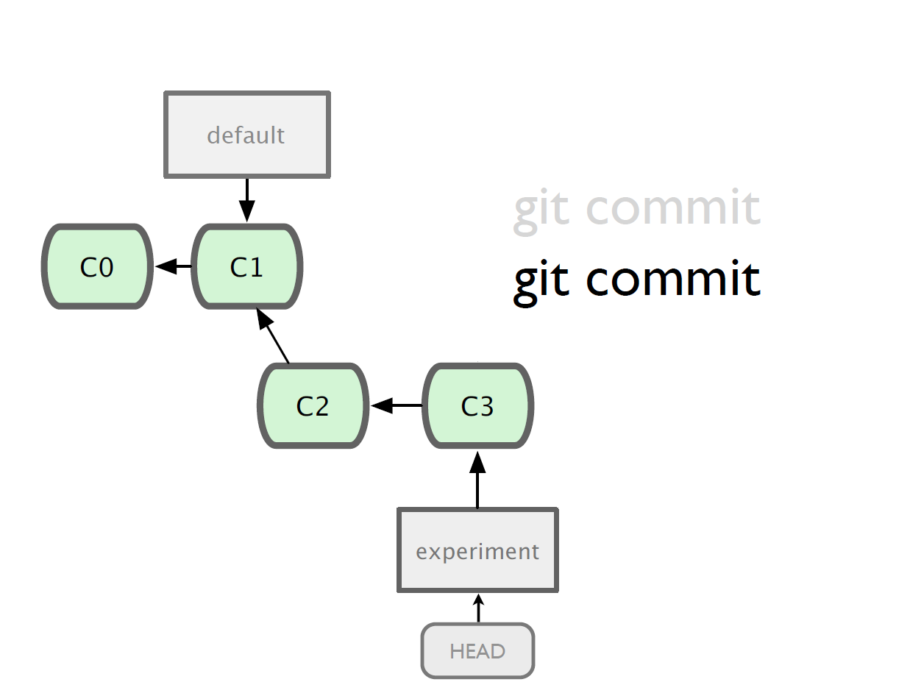

Slide 31
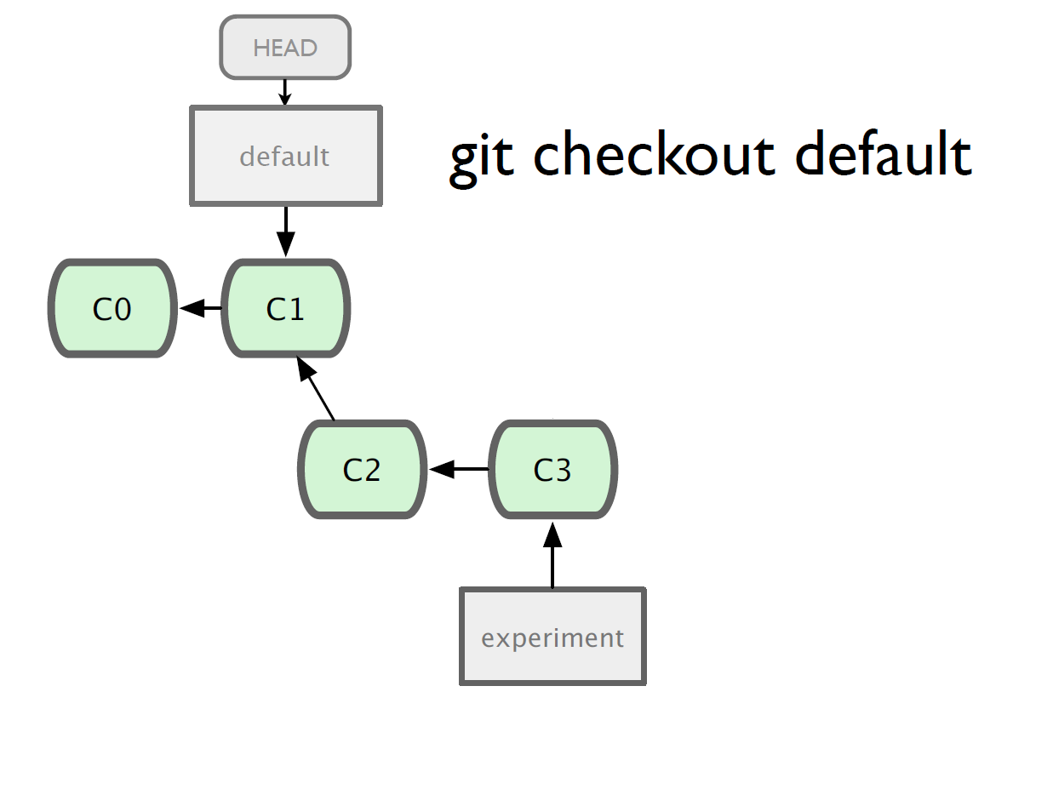

Slide 32
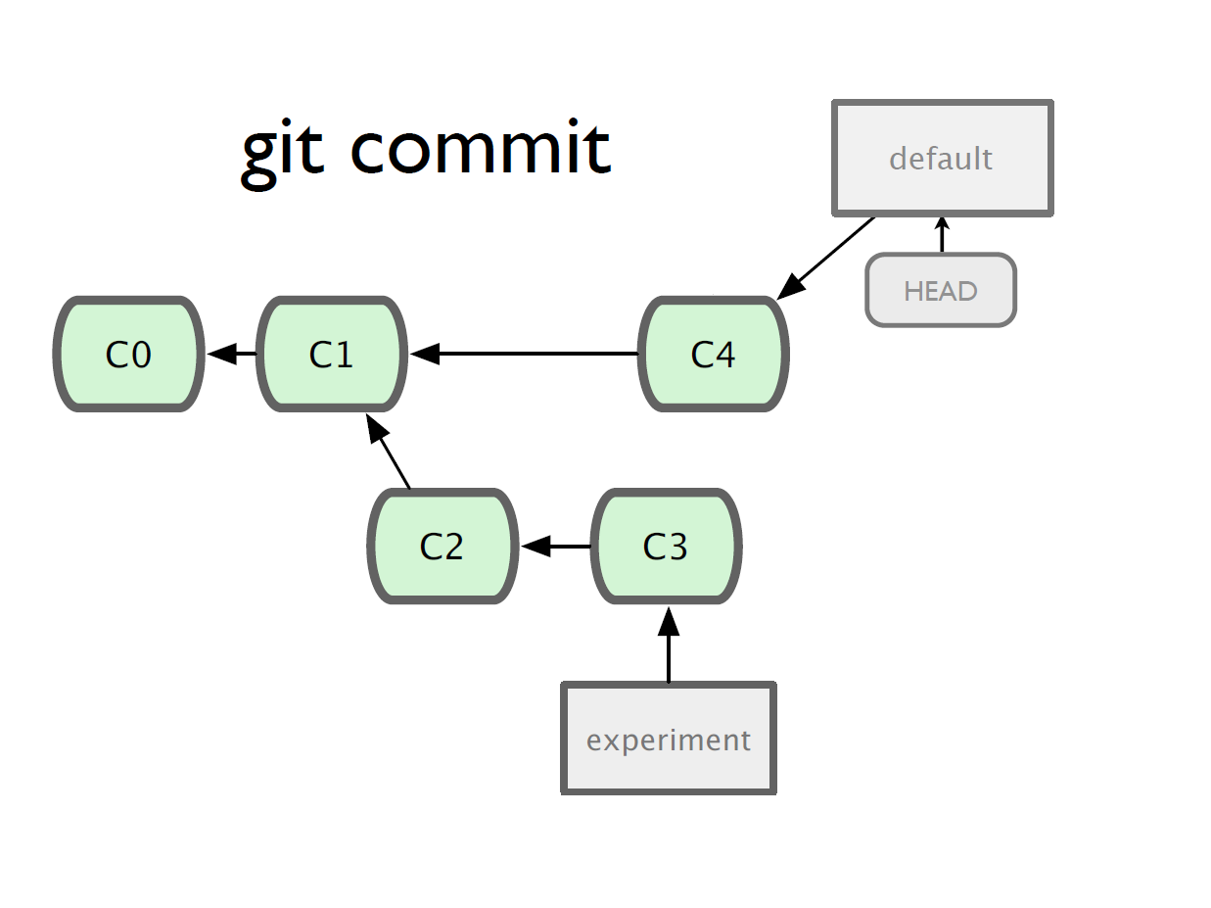

Slide 33
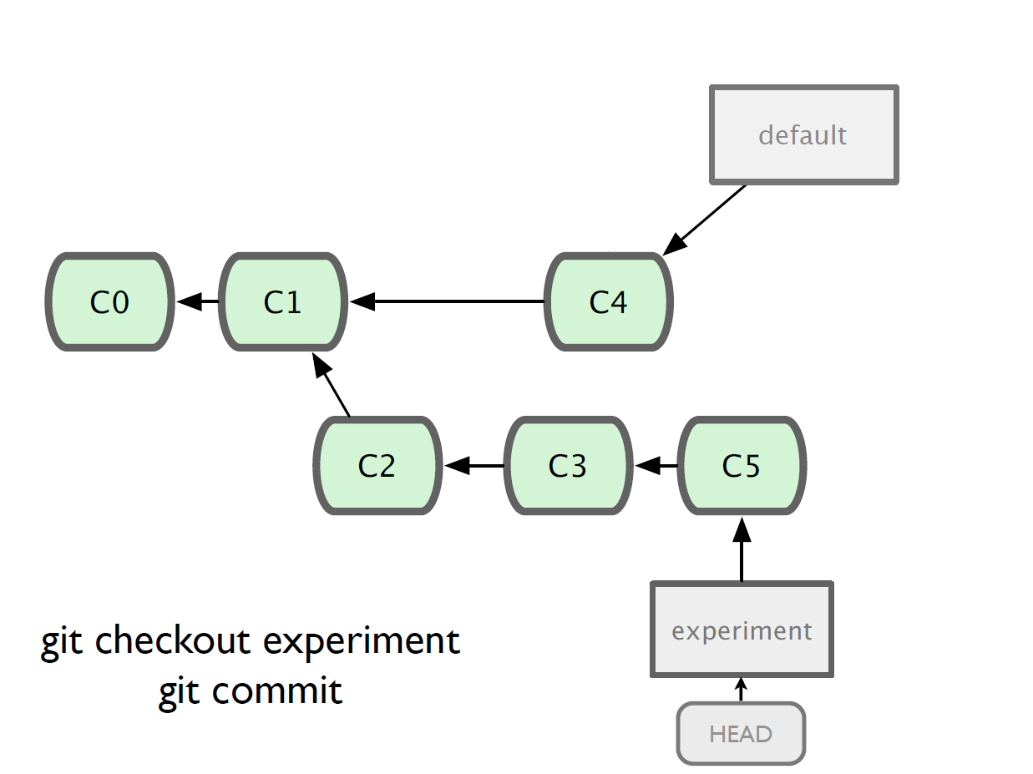

Slide 34
Merging
What do we do with this mess?
  Merge them

Slide 35
Merging
Steps to merge two branch
  Checkout the branch you want to merge onto
  Merge the branch you want to merge

Slide 36
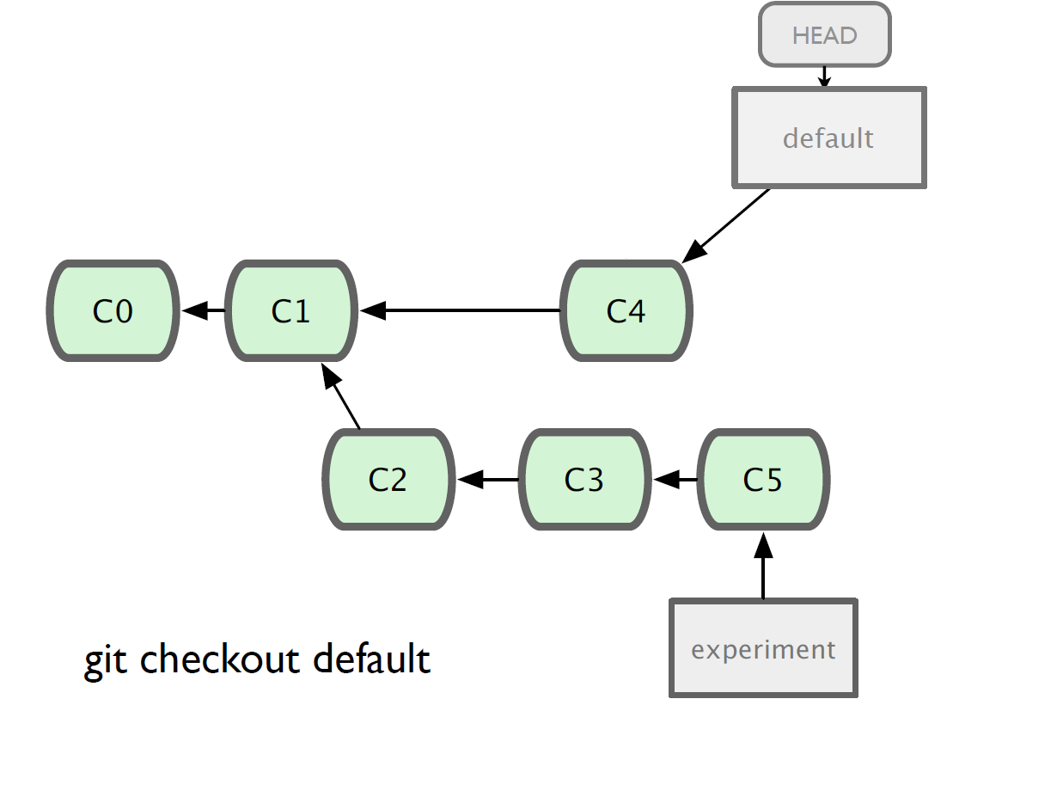

Slide 37
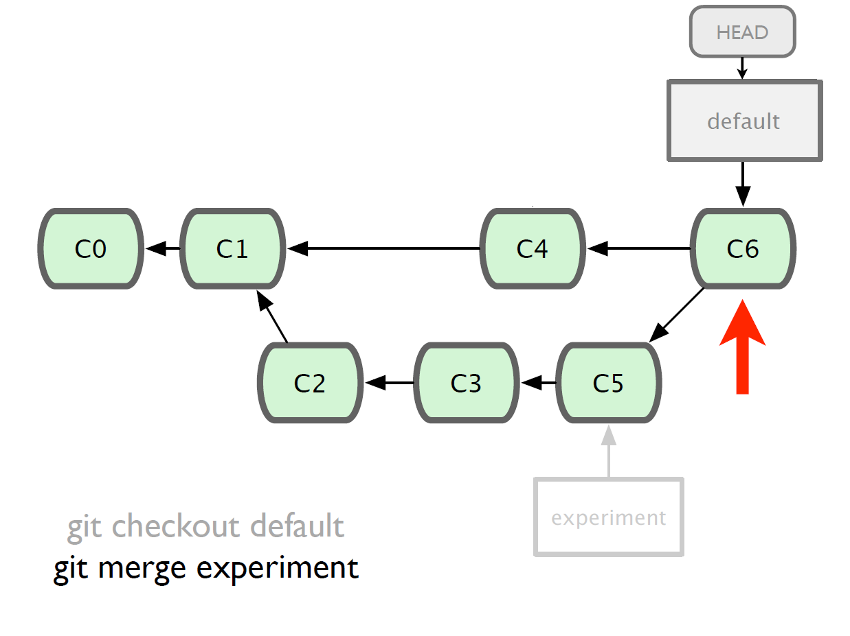

Slide 38
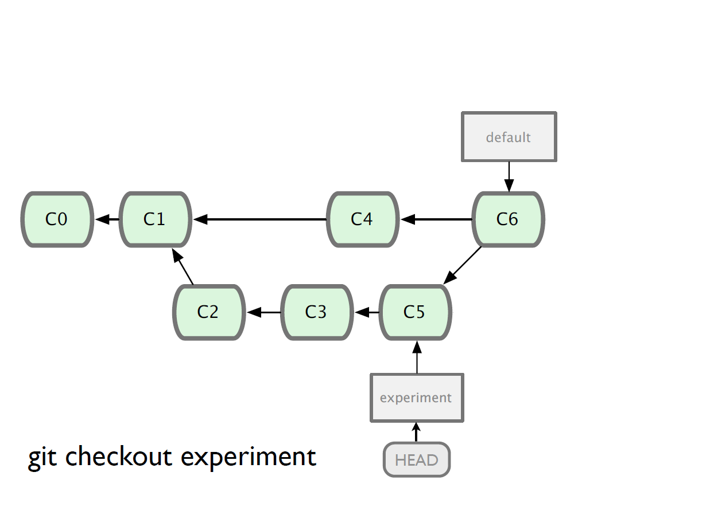

Slide 39
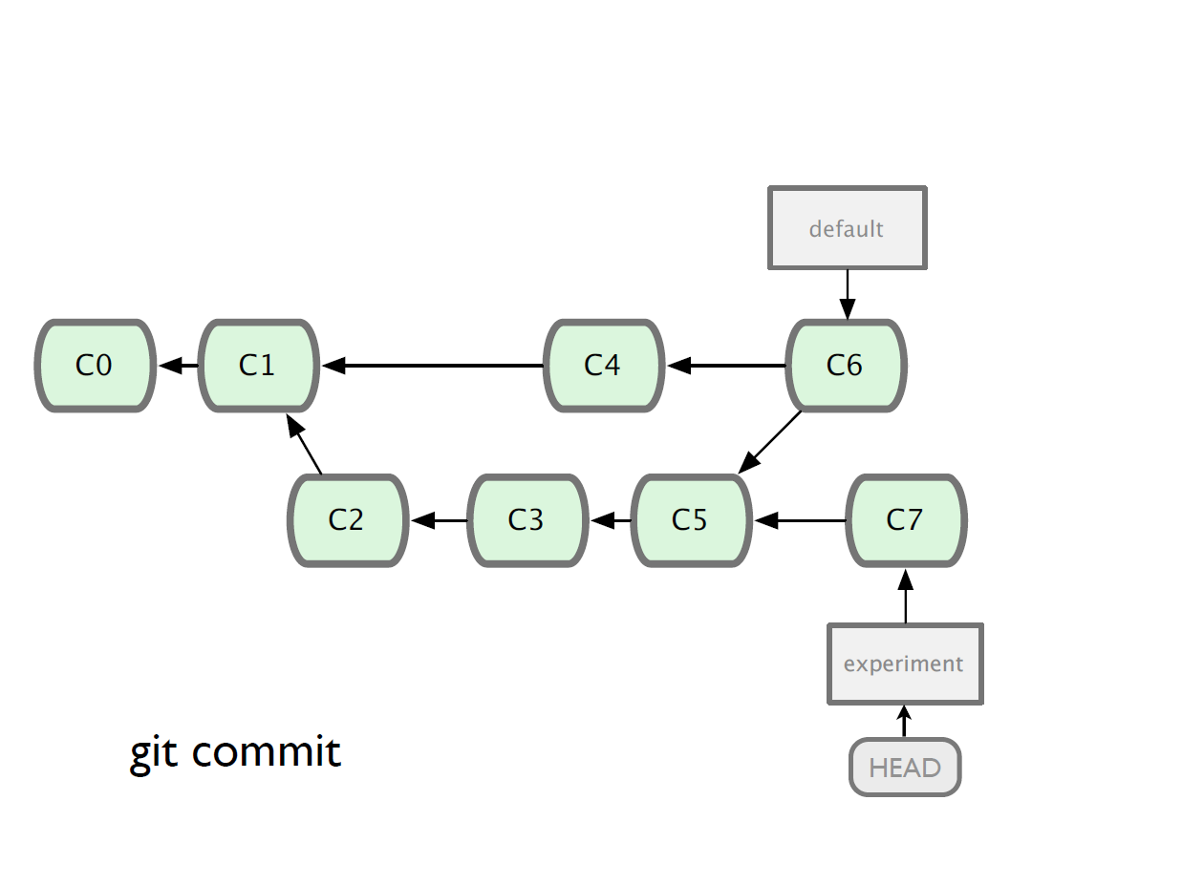

Slide 40
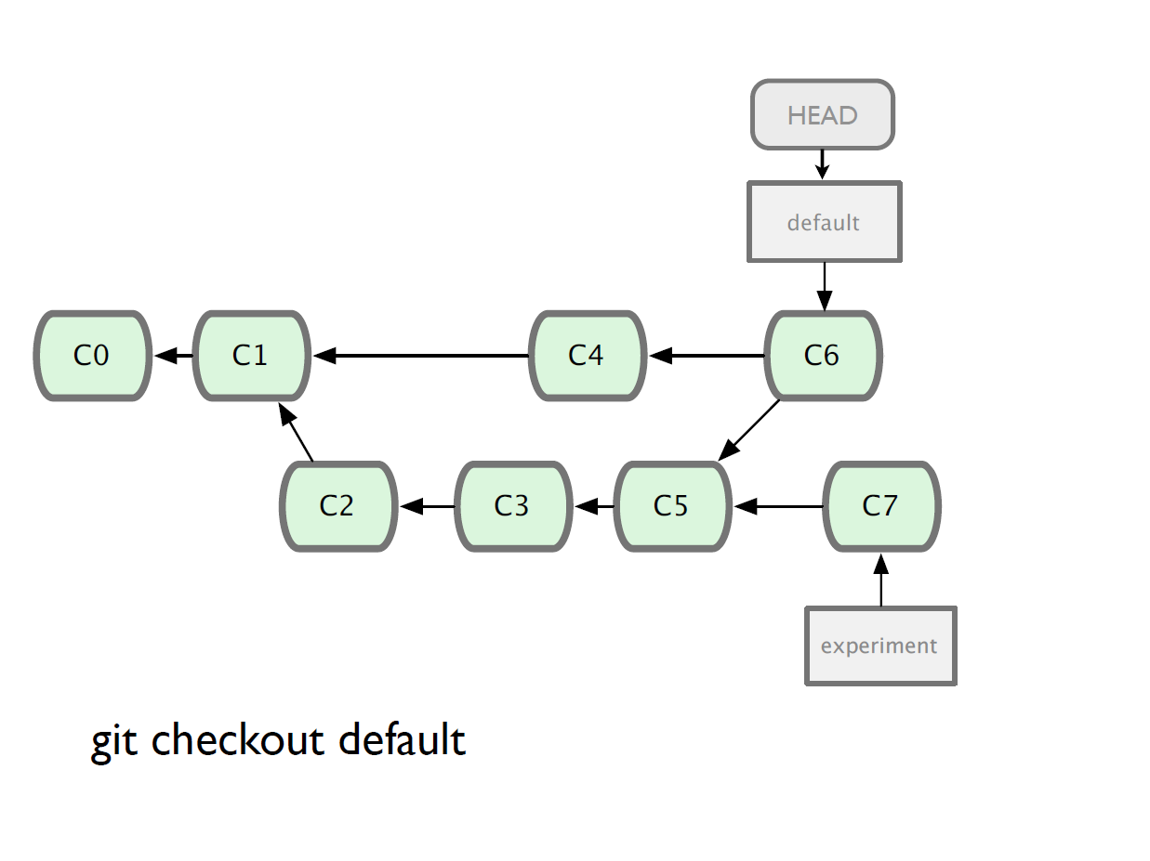

Slide 41
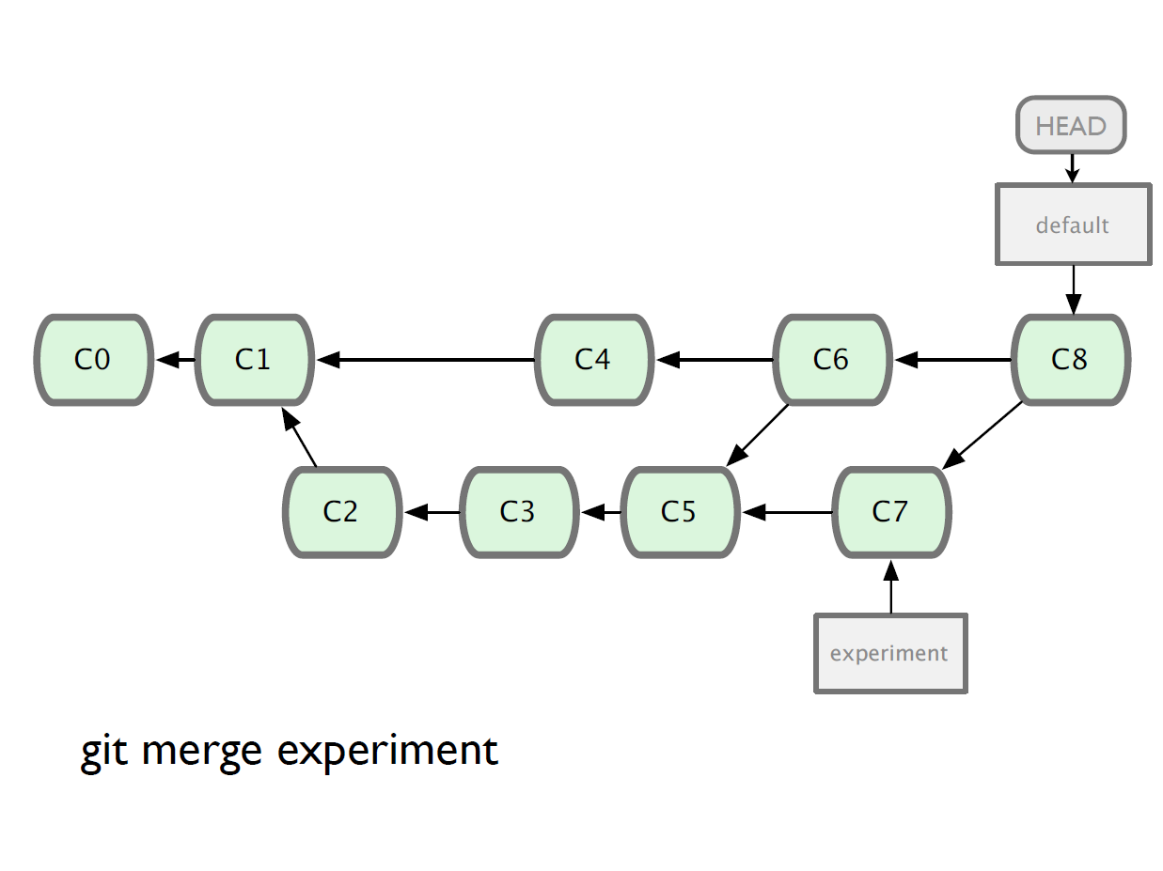

Slide 42
Branching and Merging
Why this is cool?
  Non-linear development
clone the code that is in production
create a branch for issue #53 (iss53)
work for 10 minutes
someone asks for a hotfix for issue #102
checkout ‘production’
create a branch (iss102)
fix the issue
checkout ‘production’, merge ‘iss102’
push ‘production’
checkout ‘iss53’ and keep working

Slide 43
Working with remote
Use git clone to replicate repository
Get changes with
  git fetch
  git pull (fetches and merges)
Propagate changes with
  git push
Protocols
  Local filesystem (file://)
  SSH (ssh://)
  HTTP (http:// https://)
  Git protocol (git://)

Slide 44
Working with remote
Local filesystem
Pros
  Simple
  Support existing access control
  NFS enabled
Cons
  Public share is difficult to set up
  Slow on top of NFS

Slide 45
Working with remote
SSH
Pros
  Support authenticated write access
  Easy to set up as most system provide ssh toolsets
  Fast
    Compression before transfer
Cons
  No anonymous access
    Not even for read access

Slide 46
Working with remote
GIT
Pros
  Fastest protocal
  Allow public anonymous access
Cons
  Lack of authentication
  Difficult to set up
  Use port 9418
    Not standard port
    Can be blocked

Slide 47
Working with remote
HTTP/HTTPS
Pros
  Very easy to set up
  Unlikely to be blocked
    Using standard port
Cons
  Inefficient

Slide 48
Working with remote
One person project
  Local repo is enough
  No need to bother with remote
Small team project
  SSH write access for a few core developers
  GIT public read access

Slide 49
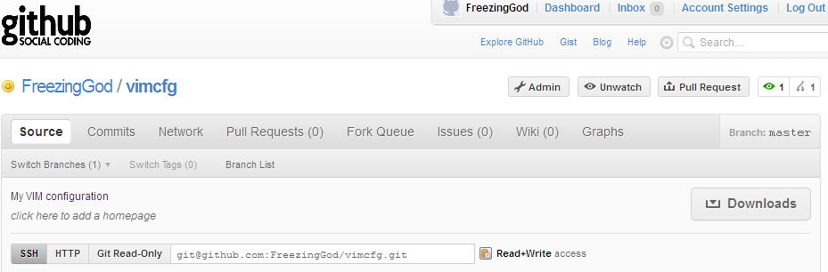
Working with remote
Use git remote add to add an remote repository
Git remote add origin git@github.com:FreezingGod/vimcfg.git
zachary@zachary-desktop:~/.vim_runtime$ git remote
origin

Slide 50
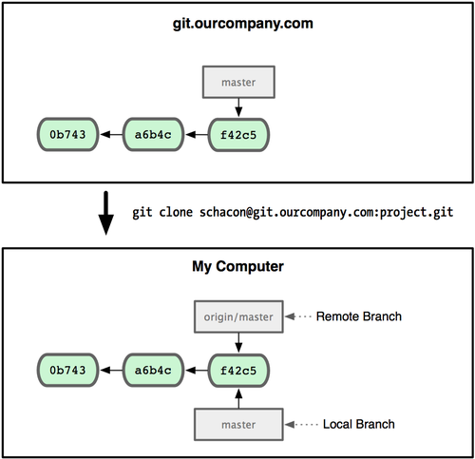
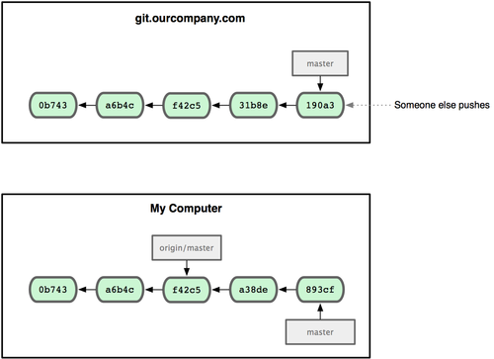
Working with remote
Remote branching
  Branch on remote are different from local branch

Slide 51
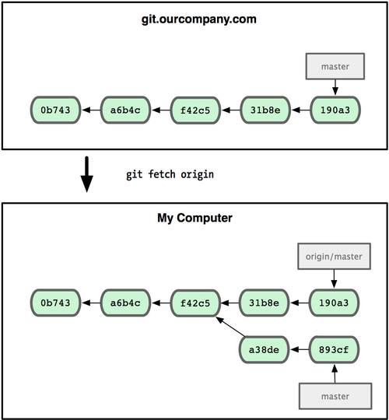
Working with remote
Remote branching
  Branch on remote are different from local branch
  Git fetch origin to get remote changes
  Git pull origin try to fetch reomte changes and merge it onto current branch

Slide 52
Working with remote
Git push remote_name branch_name
  Share your work done on branch_name to remote remote_name

Slide 53
Summary
We covered fundamentals of Git
  Three trees of git
    HEAD, INDEX and working directory
  Basic work flow
    Modify, stage and commit cycle
  Branching and merging
    Branch and merge
  Remote
    Add remote, push, pull, fetch
  Other commands
    Revert change, history view

Slide 54

Summary
However, this is by no means a complete portray of git, some advanced topics are skipped:
  Rebasing
  Commit amend
  Distributed workflow
For more information, consult
  Official document
  Pro Git
    Free book available at http://progit.org/book/

Slide 55
Q&A
Any questions?

Slide 56
References
Some of the slides are adopted from “Introduction to Git” available at http://innovationontherun.com/presentation-files/Introduction%20To%20GIT.ppt
Some of the figure are adopted from Pro GIT by Chacon, which is available at http://progit.org/book/
Some of the slides are adopted from “Git 101” available at http://assets.en.oreilly.com/1/event/45/Git%20101%20Tutorial%20Presentation.pdf

