Slide 1
How to Use Fiddler2 (Proxy Recorder) for Application Testing

Slide 2
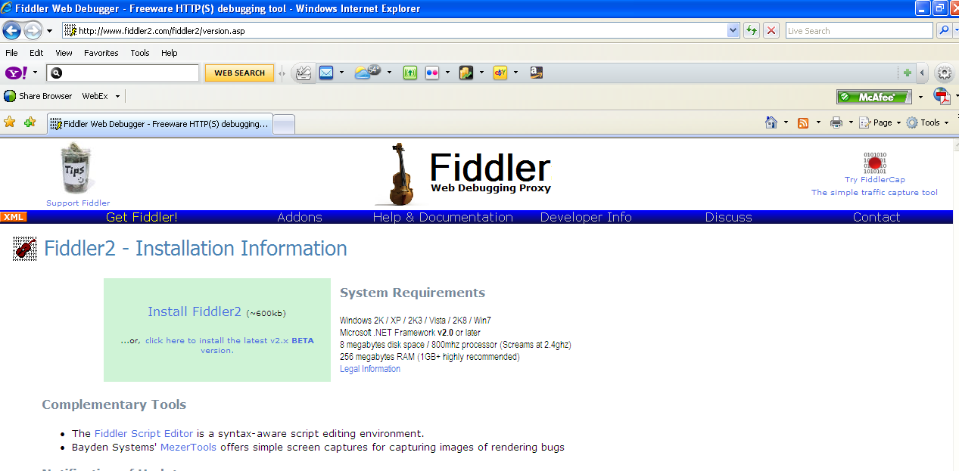
Download Fiddler2
It is a Web Proxy Recorder
It is available and download from:
  http://www.fiddler2.com/fiddler2/version.asp

Slide 3
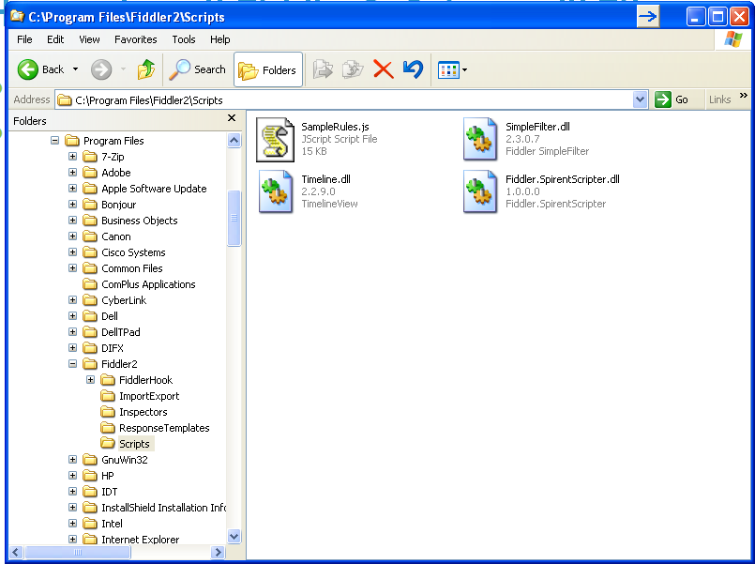
How to Install Fiddler2_Spirent.dll File
After you download and install Fiddler2 on your computer/laptop
Go to Fiddler2 Proxy Recorder\Misc folder (from Fiddler2 demopacks) and copy the Fiddler.SpirentScripter.dll to c:\Program Files\Fiddler2\Scripts directory (to the location where you installed Fiddler2)

Slide 4
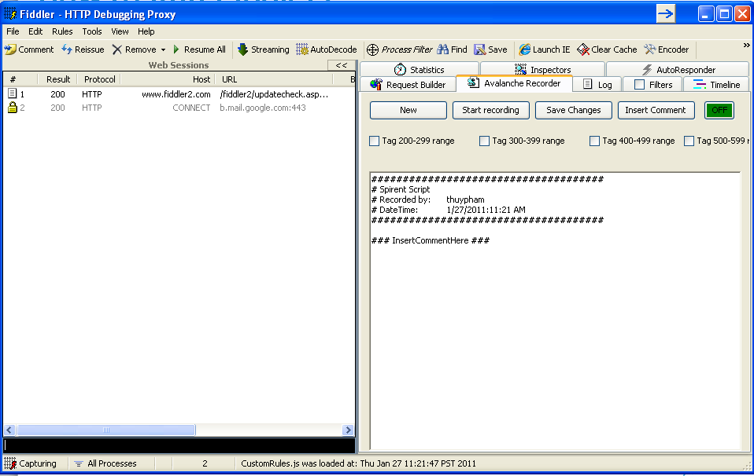
How to Run Fiddler2
After you copied the Fiddler.SpirentScripter.dll to the Fiddler2\Scripts directory
  Run the Fiddler2 program
  You will see the Avalanche Recorder tab on the right panel
  Click on Start Recoding button to start recoding your web application transactions

Slide 5
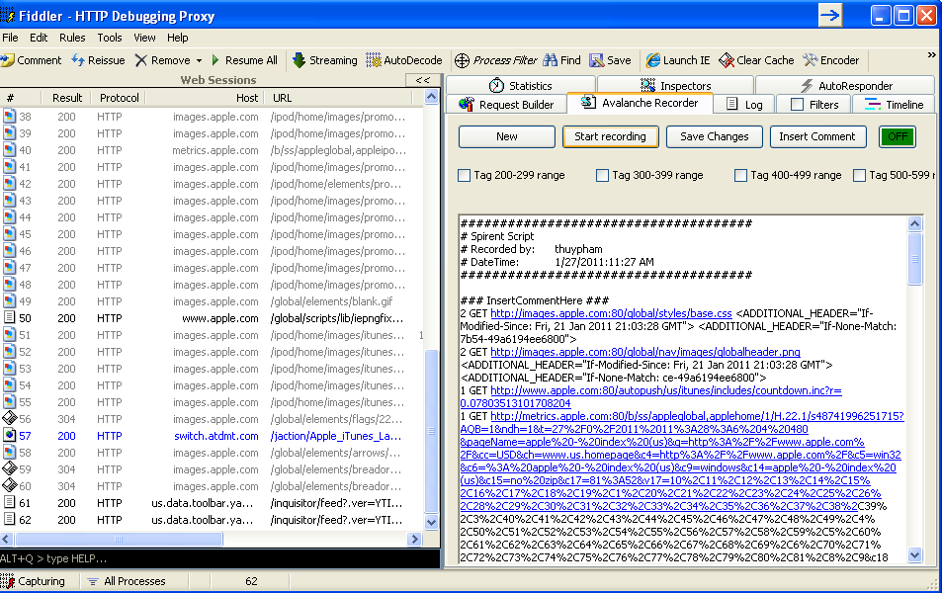
How to Record Fiddler2 Sessions
Open the web/IE browser
Go to the customer’s web application that you want to record the web transactions then click on Start Recording. For example: www.apple.com (see example screenshot below). When you’re done recording then click on Stop Recording.

Slide 6
How to Create Action List in Avalanche
Select all the URIs in the list below then COPY everything from this list.

Slide 7
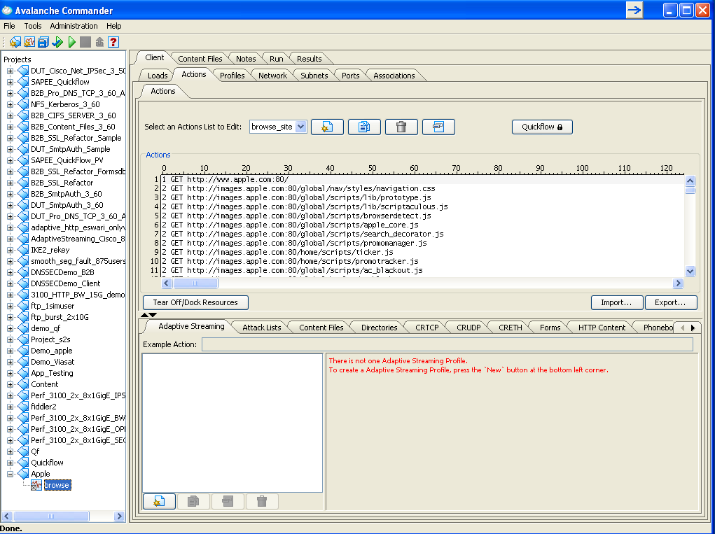
How to Create Action List in Avalanche
Open Avalanche Commander
  Create a new project
  Create a new Client only test
  Create a new action list
From the action list, select PASTE so all the URIs from Fiddler2 will get copy to the Action List

Slide 8
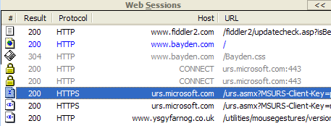
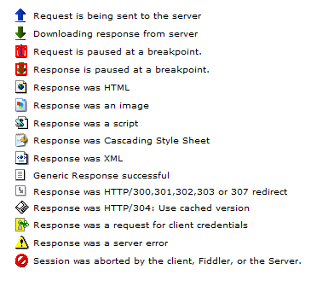
Requests and Reponses in Fiddler2
Icons show status of request/response
You can use the web sessions to find prefix and postfix for setting up the search criteria in Commander
Lists all traffic
URLs, size, and key headers
Icons show status of request/response

Slide 9
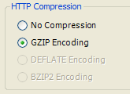
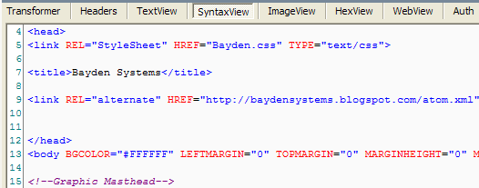
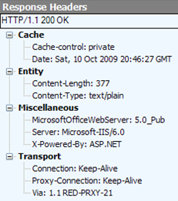
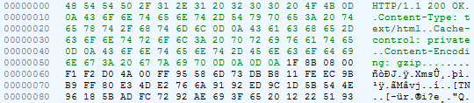
Fiddler2: Inspectors
Inspectors allow you to visualize requests and responses in meaningful ways.

Slide 10
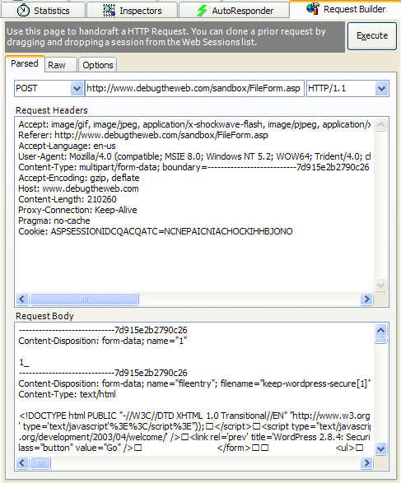
Fiddler2: Request Builder
Create hand-built HTTP requests, or modify and reissue a request previously captured.

