Slide 1
Reliability Automation Code using Python
Hari Udayakumar

Slide 2
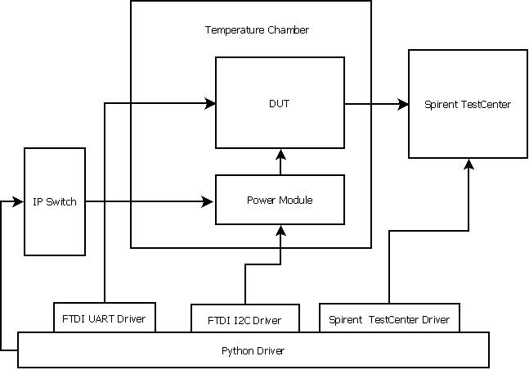
RAC - Block Diagram

Slide 3
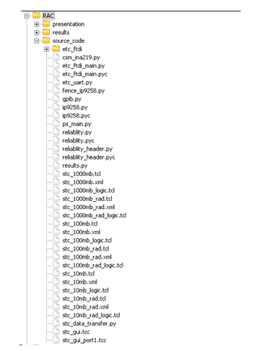
Python and Automation Script Structure
The Reliability Automation Test is executed using the Python Script.
The Automation PC is required to have the following Instrument Drivers.
D2xx Driver for FTDI Device
Pyvisa for GPIB Devices
Pyserial for com ports
Socket programming for IP Switch

Slide 4
FTDI – I2C Driver/UART Driver
The FT4232H are USB to UART/FIFO ICs. They also have the capability of being configured in a variety of serial interfaces using the internal MPSSE (Multi-Protocol Synchronous Serial Engine).
Using MPSSE can simplify the synchronous serial protocol (USB to SPI, I2C, JTAG, etc.)
The FTDI Driver is mainly used for communicating with etc_uart
For enabling all switch ports
Verifying Link Speed and Status
Check FW version of each gphy ports

Slide 5
Temperature Chamber and IP Switch
The Temperature Chamber ES- 240 is controlled by Agilent USB-GPIB cable via pyvisa.
The gpib.py library provides all the function calls to control the temperature chamber(on, off, set temperature, monitor temperature etc.)
The Power Module is Switched ON/OFF using IP Switch.
IP Power Switch 9258 – is controlled via network using python socket programming
Ip9258.py library provides all the function calls require to control the IP Switch

Slide 6
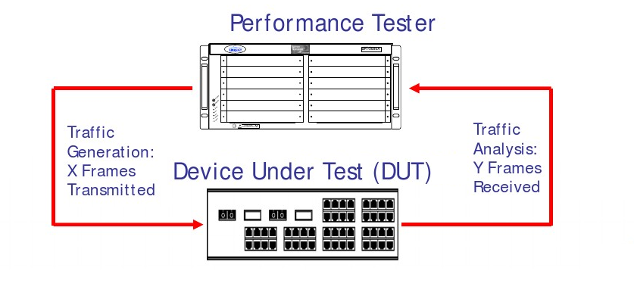
Spirent Testcenter(3.60)
The Spirent Testcenter contains all the tools and functionality required to transmit, receive and analyze traffic
Traffic using raw stream blocks

Slide 7
Spirent Testcenter(3.60) – Step to Setup and Run a Test
Configure and Connect to the Device (GUI or TCL Script)
Connect and Reserve Ports
Configure Physical Parameters
Define traffic Endpoints
Create the traffic and traffic attributes – Stream Blocks
Modify transmit properties – Traffic Generator
Modify receive properties – Traffic Analyzer
Setup the test Schedule – Command Sequencer
Run and view your results
When the Spirent Testcenter is run via TCL Scripts – the results are saved to CSV file
Here we use Python Subprocess Module to Call the TCL Script, As the Python Support from Spirent Testcenter Automation is Licensed

Slide 8
GIT
Created a central repository in K drive.
Download a Clone from the central repository
Setup the Automation PC.
Execute the script(reliablity.py)
Distributed version control system
Originally developed by Linus Torvalds for development of Linux Kernel in 2005
Its an Open Source software → Free ☺
Quite a unique design and quite a difficult understand.
GIT Extension solves this problem, provides a fantastic GUI

Slide 9
User Inputs
The Basic user parameters are modified under the reliability_header/reliability_header_brd2.py. The below are the few parameter that needs to be taken care before executing RAC.
Modify STC_TR_SIZE and Packet size for required Speed Condition
Correct STC Spirent TCL Script
The correct format is stc_’transfersize’_’additional_parameters.tcl’
For example stc_1000mb_600M_100L.tcl
Runs the Spirent test center at 1G Mode for 600 Million Packets at 100% Load condition per Port
Save the script under RAC/source_code/scripts folder

Slide 10
User Inputs
Analog and Digital Voltage Conditions
Modify DIG_TPS_Voltage list and ANA_TPS_Voltage for required voltage condition for the test.
Email address/password to receive the rac test report.
Modify the rac_email.py parameters

Slide 11
A
A
Main Colors
A
A
A
A
A
Agenda/Highlight
Color
A
A
Extended Color Palette
A
A
A
Warning Colors
A
A
A
A
A

