Slide 1
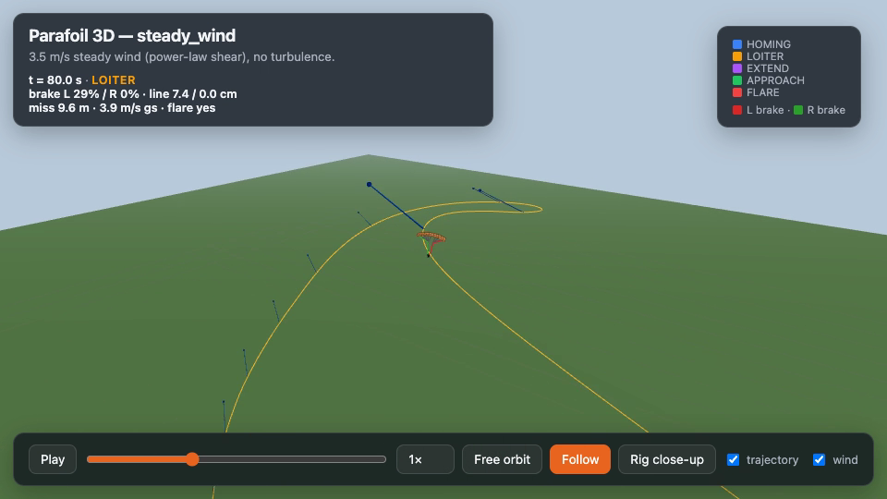
GUIDED PARACHUTE PROJECT · MATH WALKTHROUGH
Nonlinear MPC for Parafoil Return-to-Pad
Equations from papers/parafoil_mpc_math.pdf — kinematic plant, power-law + OU wind, GPS wind estimate, shrinking-horizon NMPC — plus results and frames from the project simulator.
Hudson Kim · editable PowerPoint · project assets only
Luna · Parafoil NMPC math · source: papers/parafoil_mpc_math
1/16

Slide 2
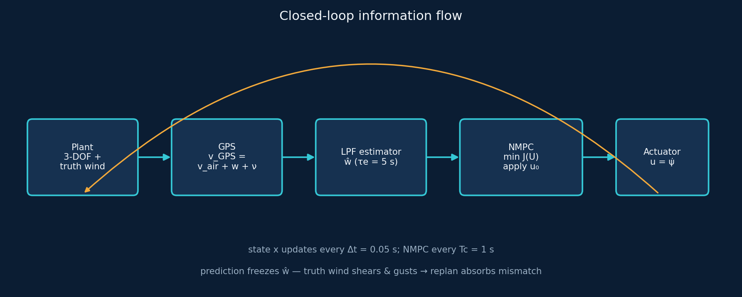
SYSTEM
How the pieces connect
Key idea
The plant always feels truth wind (shear + gusts). The controller never sees that wind — only a filtered estimate ŵ held constant inside each NMPC prediction. Receding-horizon replanning every Tc = 1 s is what absorbs the mismatch.
Luna · Parafoil NMPC math · source: papers/parafoil_mpc_math
2/16

Slide 3
VEHICLE MODEL
State, control, coordinated turn
Definitions
1. State x
Planar position, altitude above the pad plane, air-relative heading.
x = [ p_x, p_y, h, ψ ]ᵀ
u = ψ̇ |u| ≤ u_max = 0.35 rad/s
u = (g / V_h) tan φ (coordinated turn)
2. Control u
Commanded heading rate. Physical actuator = asymmetric brake deflection.
3. Bank limit
The bound on u is a bank-angle limit via the coordinated-turn map.
Defaults used in the paper / algo/mpc_v1
V_h = 7.0 m/s V_v = 3.5 m/s glide ratio = 2
x₀ = [650, −450, 500, π/2]ᵀ m,rad r_t = [0, 0]ᵀ (pad)
Why this order? Fixed glide numbers make time-to-go a pure function of altitude: t_go = h / V_v. That fact drives the shrinking horizon later.
Luna · Parafoil NMPC math · source: papers/parafoil_mpc_math
3/16

Slide 4
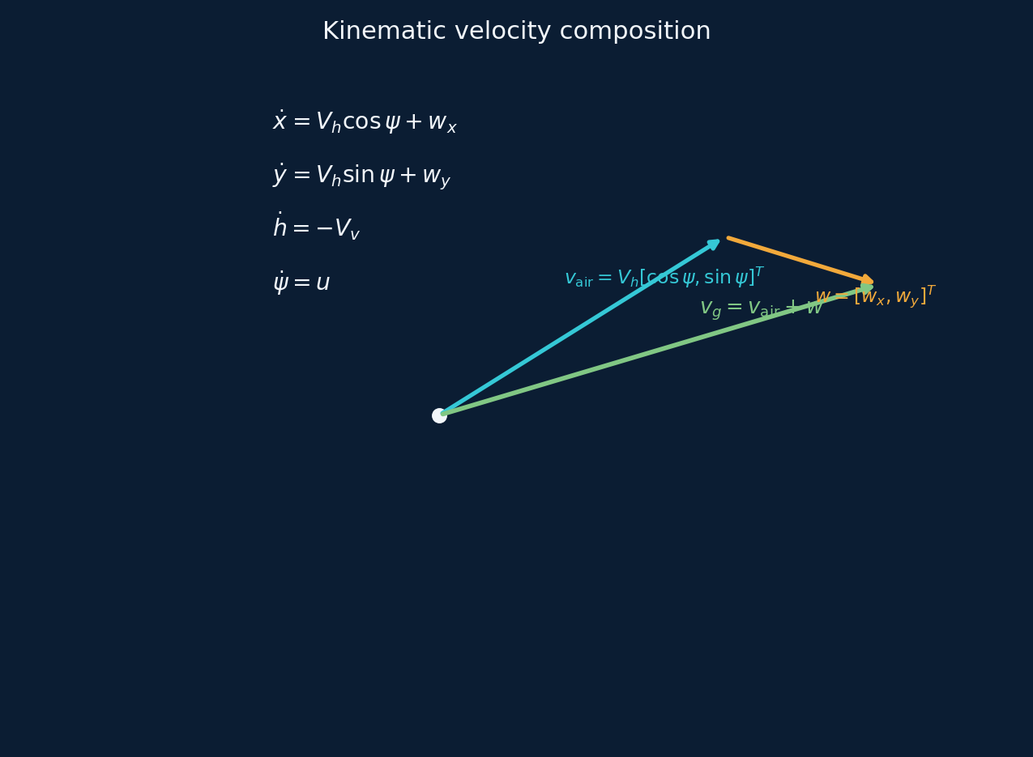
VEHICLE MODEL
Kinematic dynamics — where wind enters
3-DOF plant (eq. dynamics)
ẋ = V_h cos ψ + w_x
ẏ = V_h sin ψ + w_y
ḣ = −V_v
ψ̇ = u
t_go = h / V_v
Reading the equations
• Horizontal ground velocity is air velocity plus wind — wind can rival V_h near the surface. • Altitude falls at a fixed sink rate, so remaining flight time is a clock. • The only decision the guidance law makes is the heading-rate sequence u(t).
Luna · Parafoil NMPC math · source: papers/parafoil_mpc_math
4/16

Slide 5
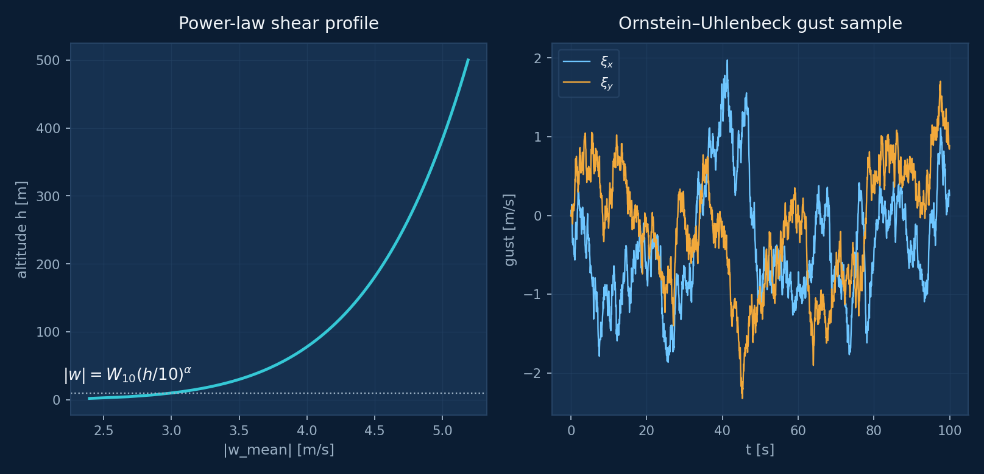
ATMOSPHERE
Truth wind: shear + gusts (controller never sees this)
Power law + Ornstein–Uhlenbeck
w(h,t) = w_mean(h) + ξ(t)
|w_mean| = W₁₀ (max(h,h_min)/10)^α
w_mean = |w_mean| [cos θ_w, sin θ_w]ᵀ
ξ_{k+1} = (1 − Δt/τ_g) ξ_k
+ σ_g √(2Δt/τ_g) η_k
η_k ~ N(0, I₂)
Defaults: W₁₀ = 3 m/s, θ_w = 210°, α = 0.14, h_min = 2 m, τ_g = 8 s, σ_g = 0.8 m/s. OU is a lightweight stand-in for Dryden turbulence — enough to stress guidance without full spectral fidelity.
Luna · Parafoil NMPC math · source: papers/parafoil_mpc_math
5/16

Slide 6
SENSING
GPS sensing → low-pass wind estimate
Estimator (runs every plant step Δt)
1. Assumes known airspeed & heading
Navigation errors beyond ground-velocity noise are out of scope in the paper.
v_air = V_h [cos ψ, sin ψ]ᵀ
v_GPS = v_air + w + ν, ν ~ N(0, σ_GPS² I)
w_raw = v_GPS − v_air
ŵ ← ŵ + a (w_raw − ŵ)
a = Δt / (Δt + τ_e)
NMPC holds ŵ constant over the horizon
2. σ_GPS = 0.2 m/s, τ_e = 5 s
Filter trades noise rejection against lag on shear changes.
3. Frozen ŵ in prediction
Structural mismatch vs altitude-varying truth — fixed by replanning.
Luna · Parafoil NMPC math · source: papers/parafoil_mpc_math
6/16

Slide 7
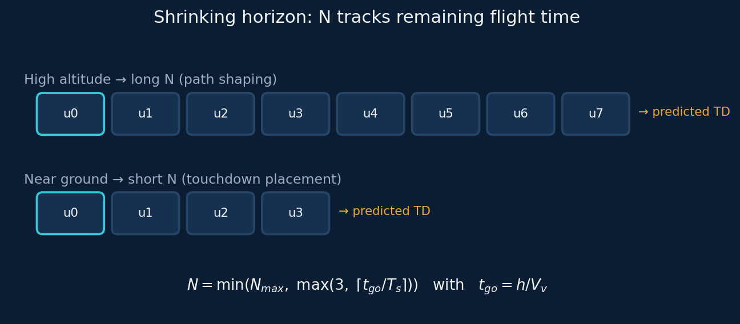
NMPC
Decision variables and shrinking horizon
Program
U = [u₀, u₁, …, u_{N−1}]ᵀ , |u_i| ≤ u_max
N = min( N_max, max(3, ⌈ t_go / T_s ⌉) ) N_max=25, T_s=2 s, T_c=1 s
Warm start: shift previous U one step; pad/trim to length N. Predict with RK4 under frozen ŵ.
Luna · Parafoil NMPC math · source: papers/parafoil_mpc_math
7/16

Slide 8
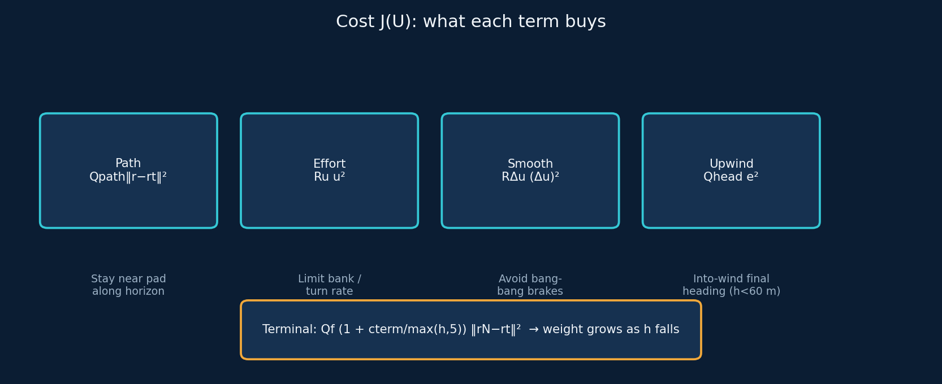
NMPC
Cost function — what “good” means
Scalar cost (solve with SQP / fmincon; apply only u₀)
J(U) = Σ [ Q_path‖r_i−r_t‖² + R_u u_i² + R_Δu (u_i−u_{i−1})² + 1_{h<h_ap} Q_head e_i² ]
+ Q_f (1 + c_term / max(h_{N'}, 5)) ‖r_{N'}−r_t‖²
e_i = wrapped heading error to upwind of ŵ h_ap=60 m
Weights: Q_path=0.02, R_u=2, R_Δu=4, Q_f=1, c_term=200, Q_head=40
Luna · Parafoil NMPC math · source: papers/parafoil_mpc_math
8/16

Slide 9
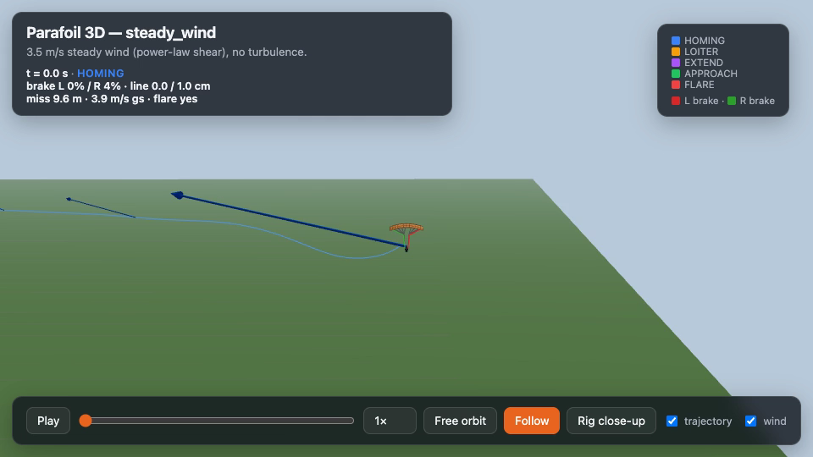
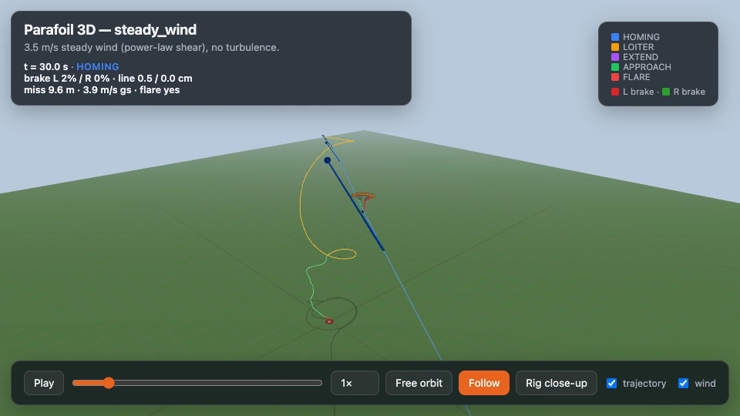
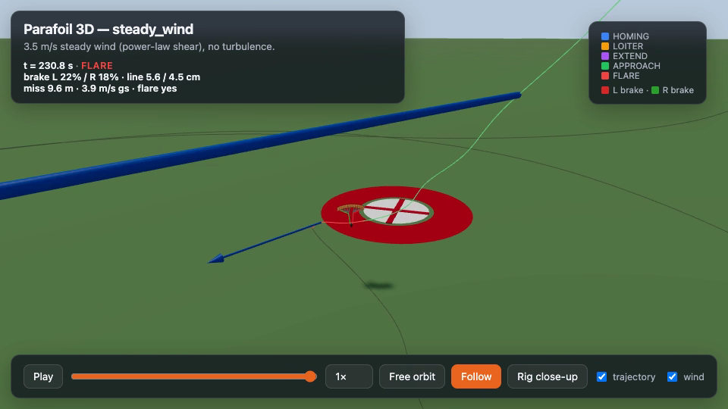
SIMULATION VIDEO
Frames from steady_wind_flight.mp4
t ≈ 0 s · release
t ≈ 15 s · homing
t ≈ 40 s · mid / loiter
touchdown
Luna · Parafoil NMPC math · source: papers/parafoil_mpc_math
9/16

Slide 10


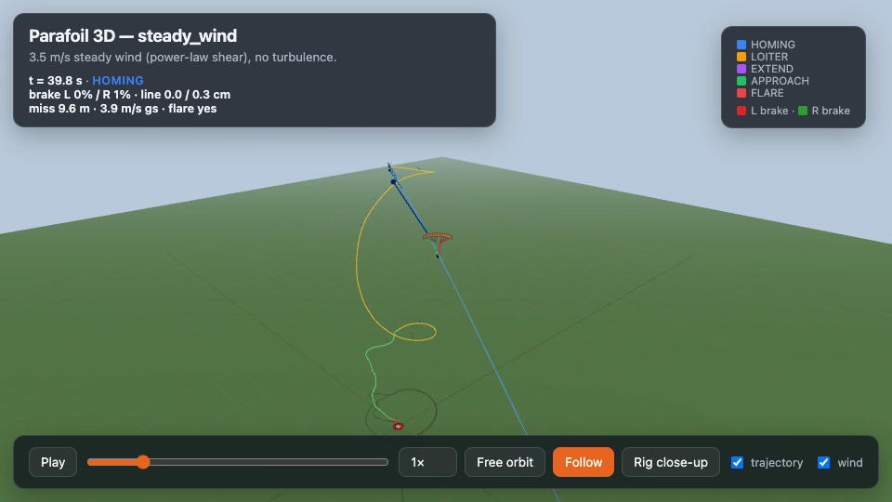
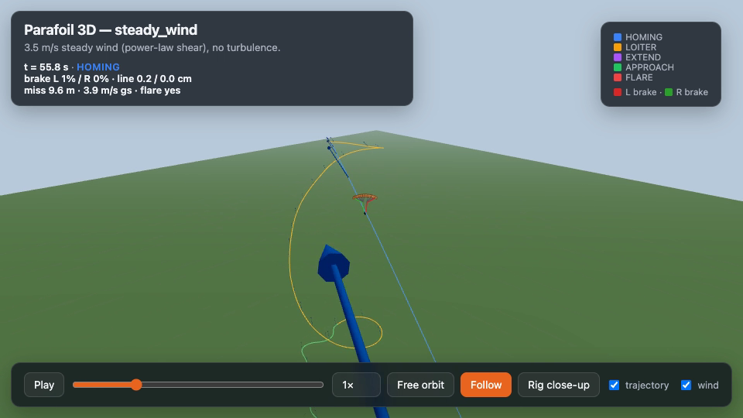
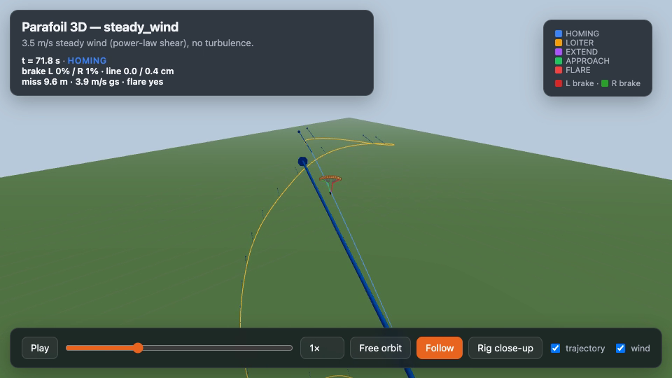
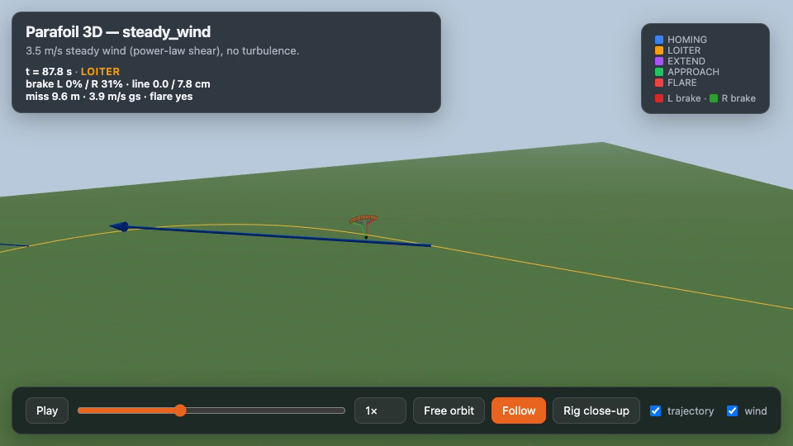
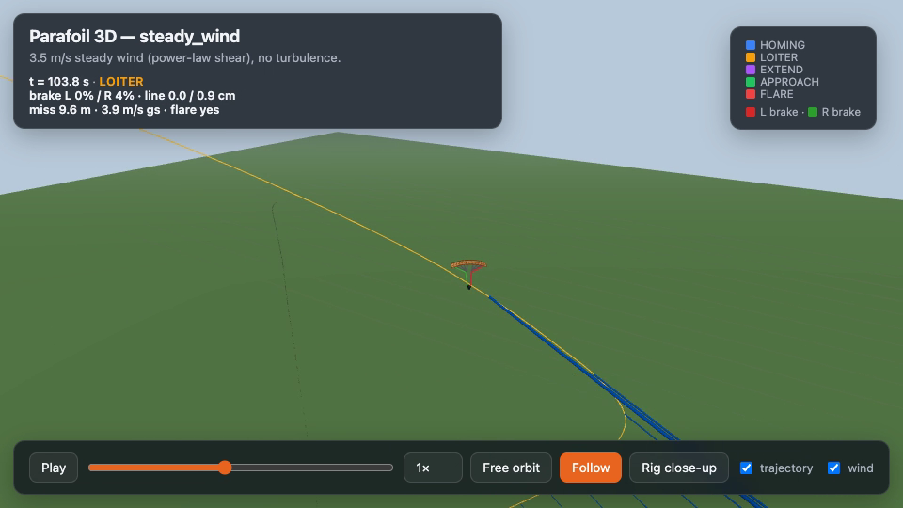
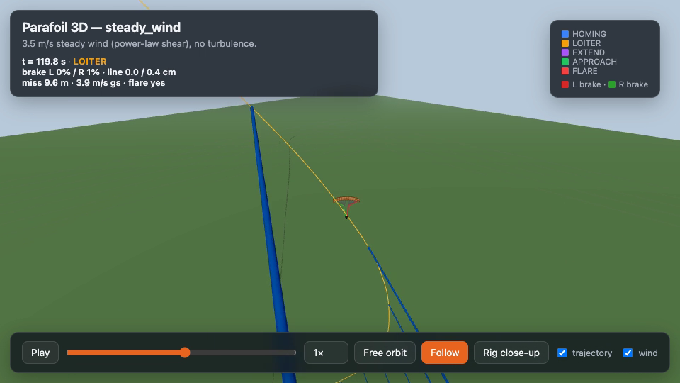
SIMULATION VIDEO
Evenly spaced sequence (every ~8 s)
frame 1/8
frame 2/8
frame 3/8
frame 4/8
frame 5/8
frame 6/8
frame 7/8
frame 8/8
Full video: presentation/assets/steady_wind_flight.mp4 (also parafoil_sim/output/steady_wind_flight.mp4)
Luna · Parafoil NMPC math · source: papers/parafoil_mpc_math
10/16

Slide 11
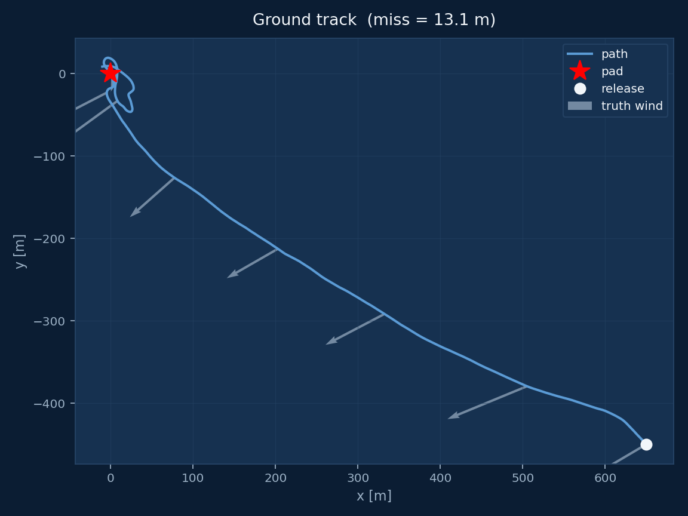
RESULTS · KINEMATIC NMPC (ALGO/MPC_V1)
Ground track under sheared / gusty truth wind
What this plot shows
• Flight time ≈ 142.9 s • Python-port miss ≈ 13.1 m (seed 2) • Paper (MATLAB rng) miss ≈ 22.2 m (seed 2) • Same equations; RNG streams differ Grey arrows = truth wind samples along the path. Red star = pad. White circle = release. Qualitative pattern (paper): clear large offset early; terminal weight + upwind heading dominate the last tens of meters.
Luna · Parafoil NMPC math · source: papers/parafoil_mpc_math
11/16

Slide 12
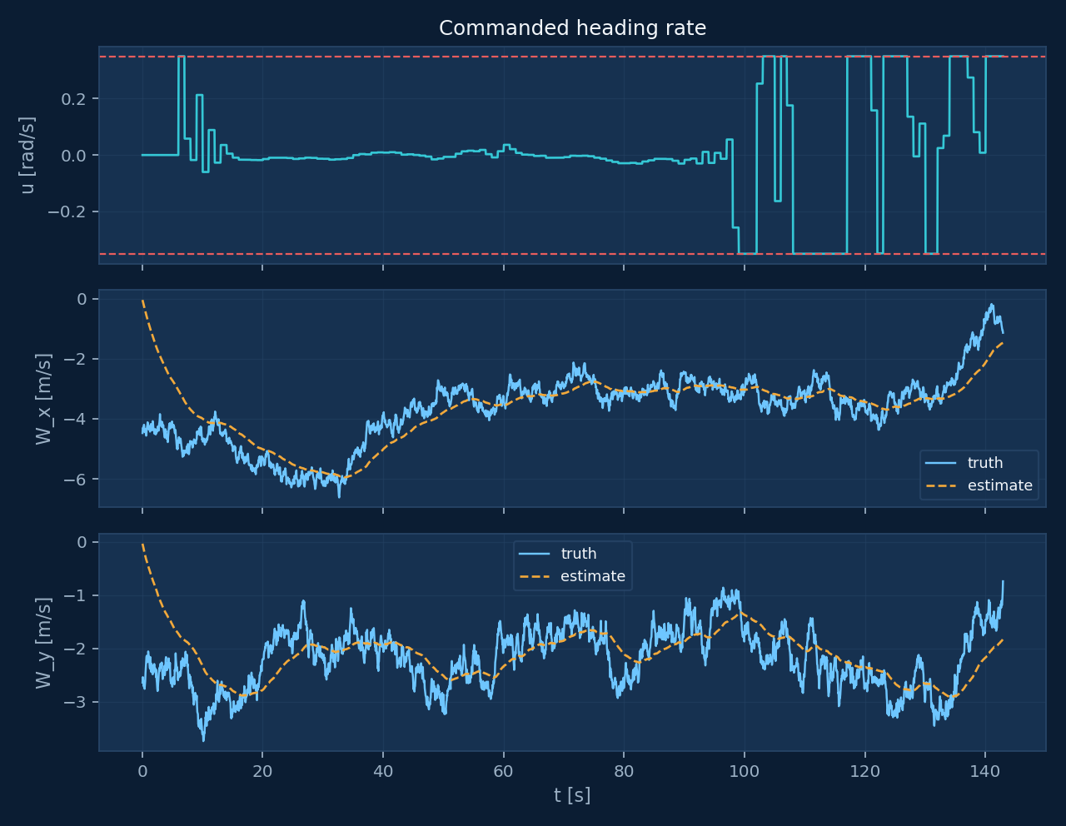
RESULTS · KINEMATIC NMPC
Control effort and wind estimate vs truth
1. Heading rate u(t)
Stays inside ±u_max. Red dashed = bank limits.
2. W_x / W_y
Blue = truth (shear + OU). Orange dashed = ŵ from GPS LPF.
3. Lag is visible
Estimator trails gusts; NMPC still closes because it replans.
Luna · Parafoil NMPC math · source: papers/parafoil_mpc_math
12/16

Slide 13
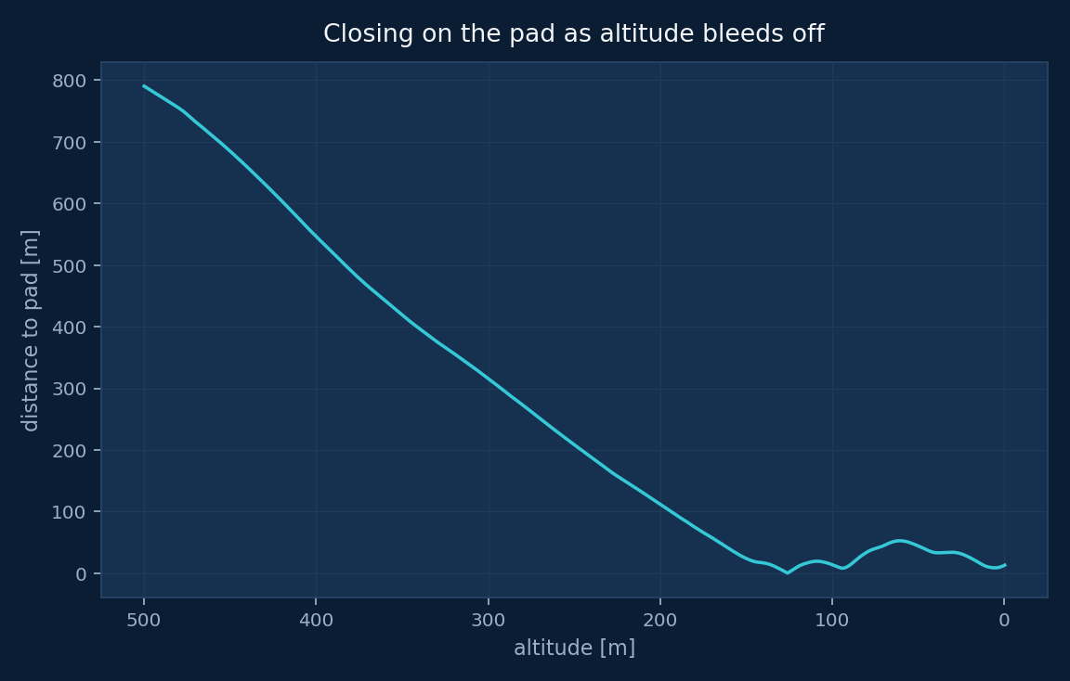
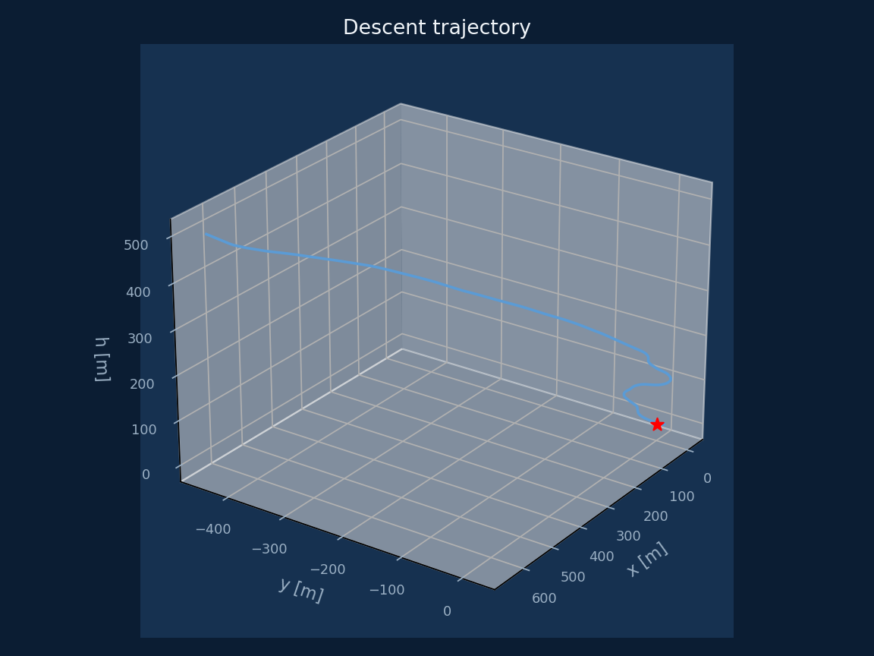
RESULTS · KINEMATIC NMPC
Closing the pad & 3-D descent
Left: distance-to-pad vs altitude (altitude axis reversed — reading left→right is descending). Right: same trajectory in 3-D.
Luna · Parafoil NMPC math · source: papers/parafoil_mpc_math
13/16

Slide 14
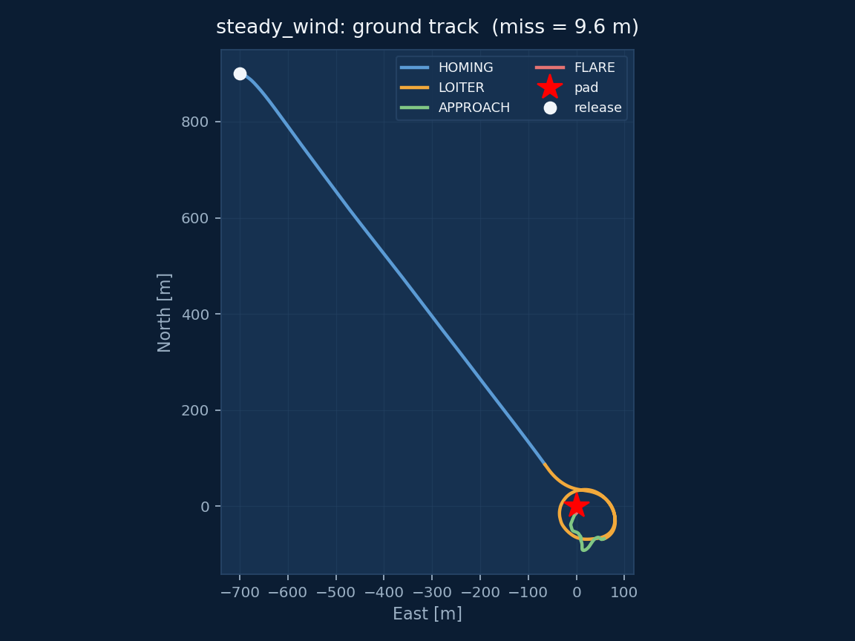
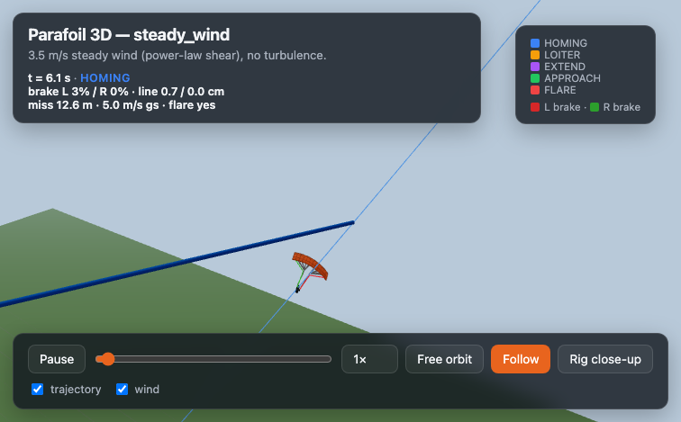
RESULTS · 6-DOF PROJECT SIMULATOR
parafoil_sim steady_wind — phased ground track
steady_wind summary
miss = 9.6 m flight = 233 s touchdown ground speed = 3.9 m/s flare triggered = True
Luna · Parafoil NMPC math · source: papers/parafoil_mpc_math
14/16

Slide 15
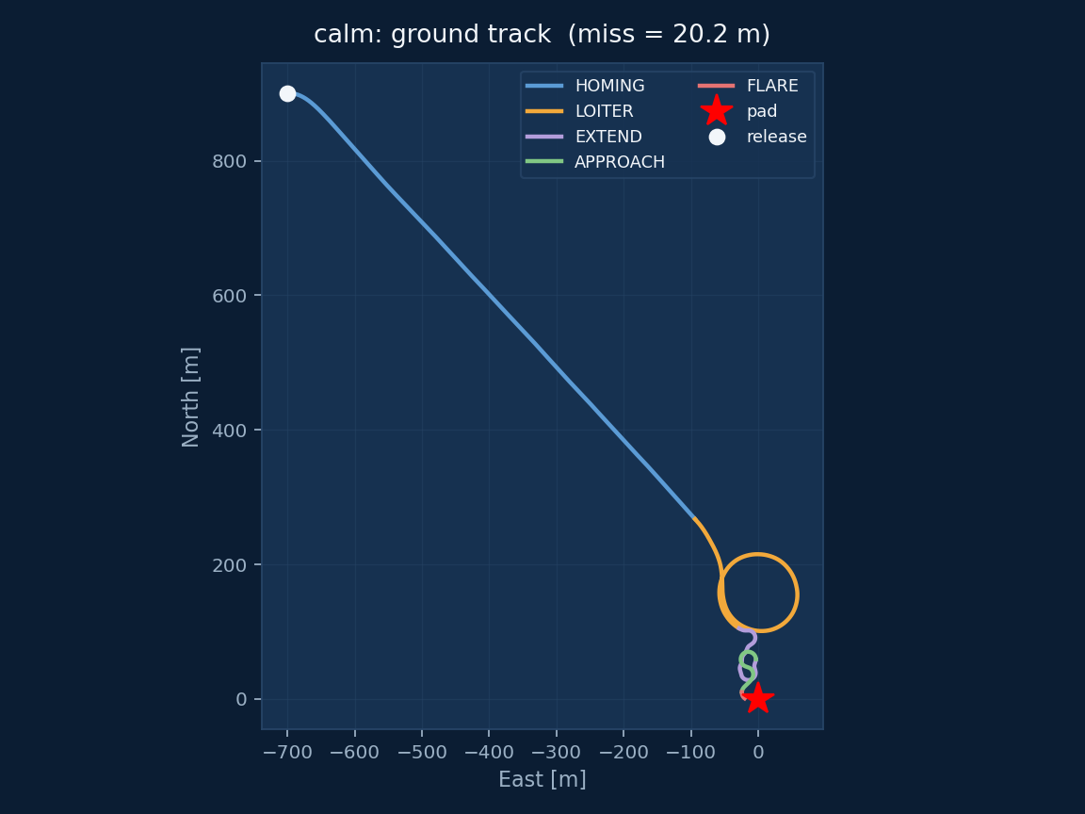
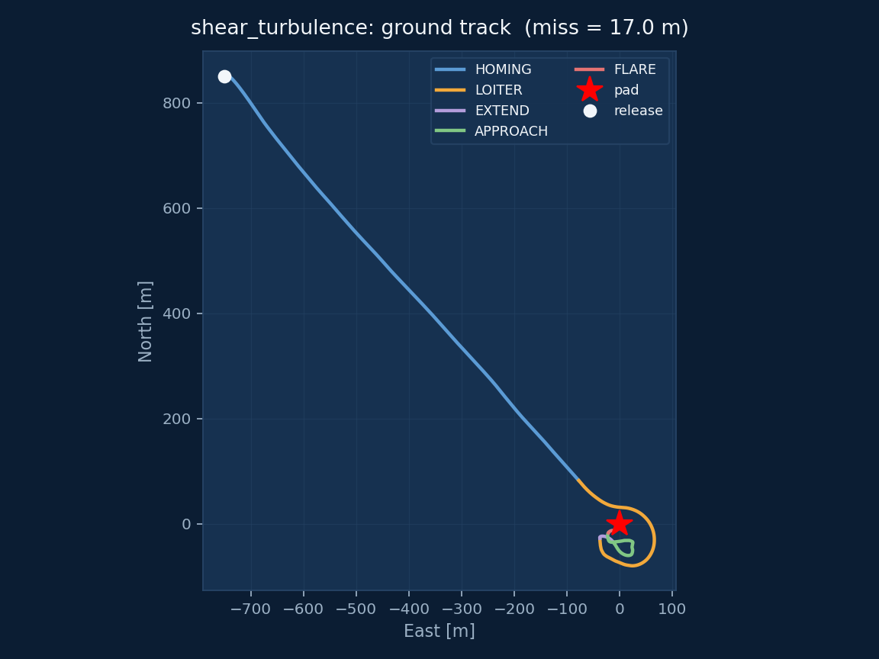
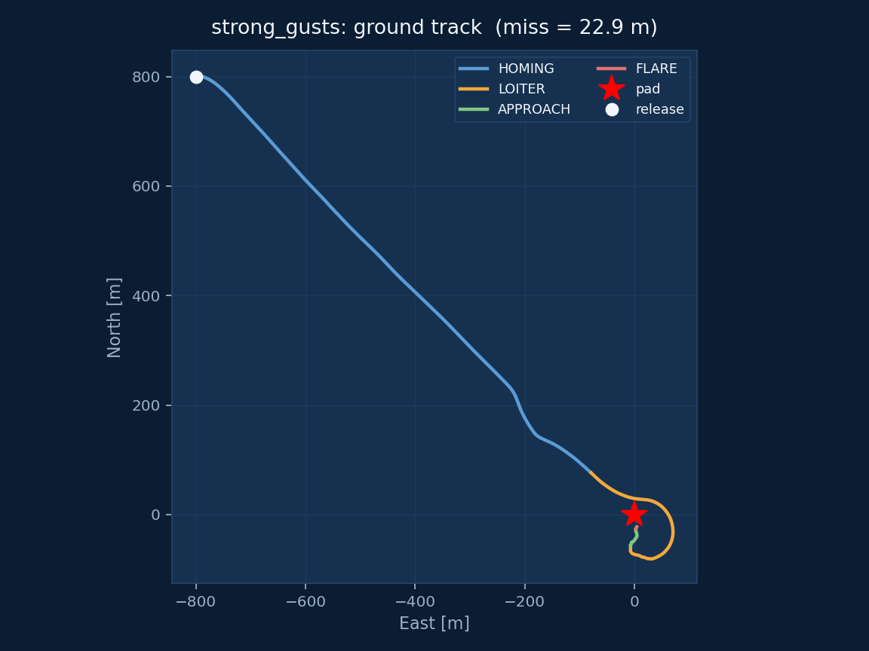
RESULTS · 6-DOF PROJECT SIMULATOR
Scenario sweep — miss distances
Calm: miss 20.2 m
Steady wind: miss 9.6 m
Shear + turbulence: miss 17.0 m
Strong gusts: miss 22.9 m
Luna · Parafoil NMPC math · source: papers/parafoil_mpc_math
15/16

Slide 16
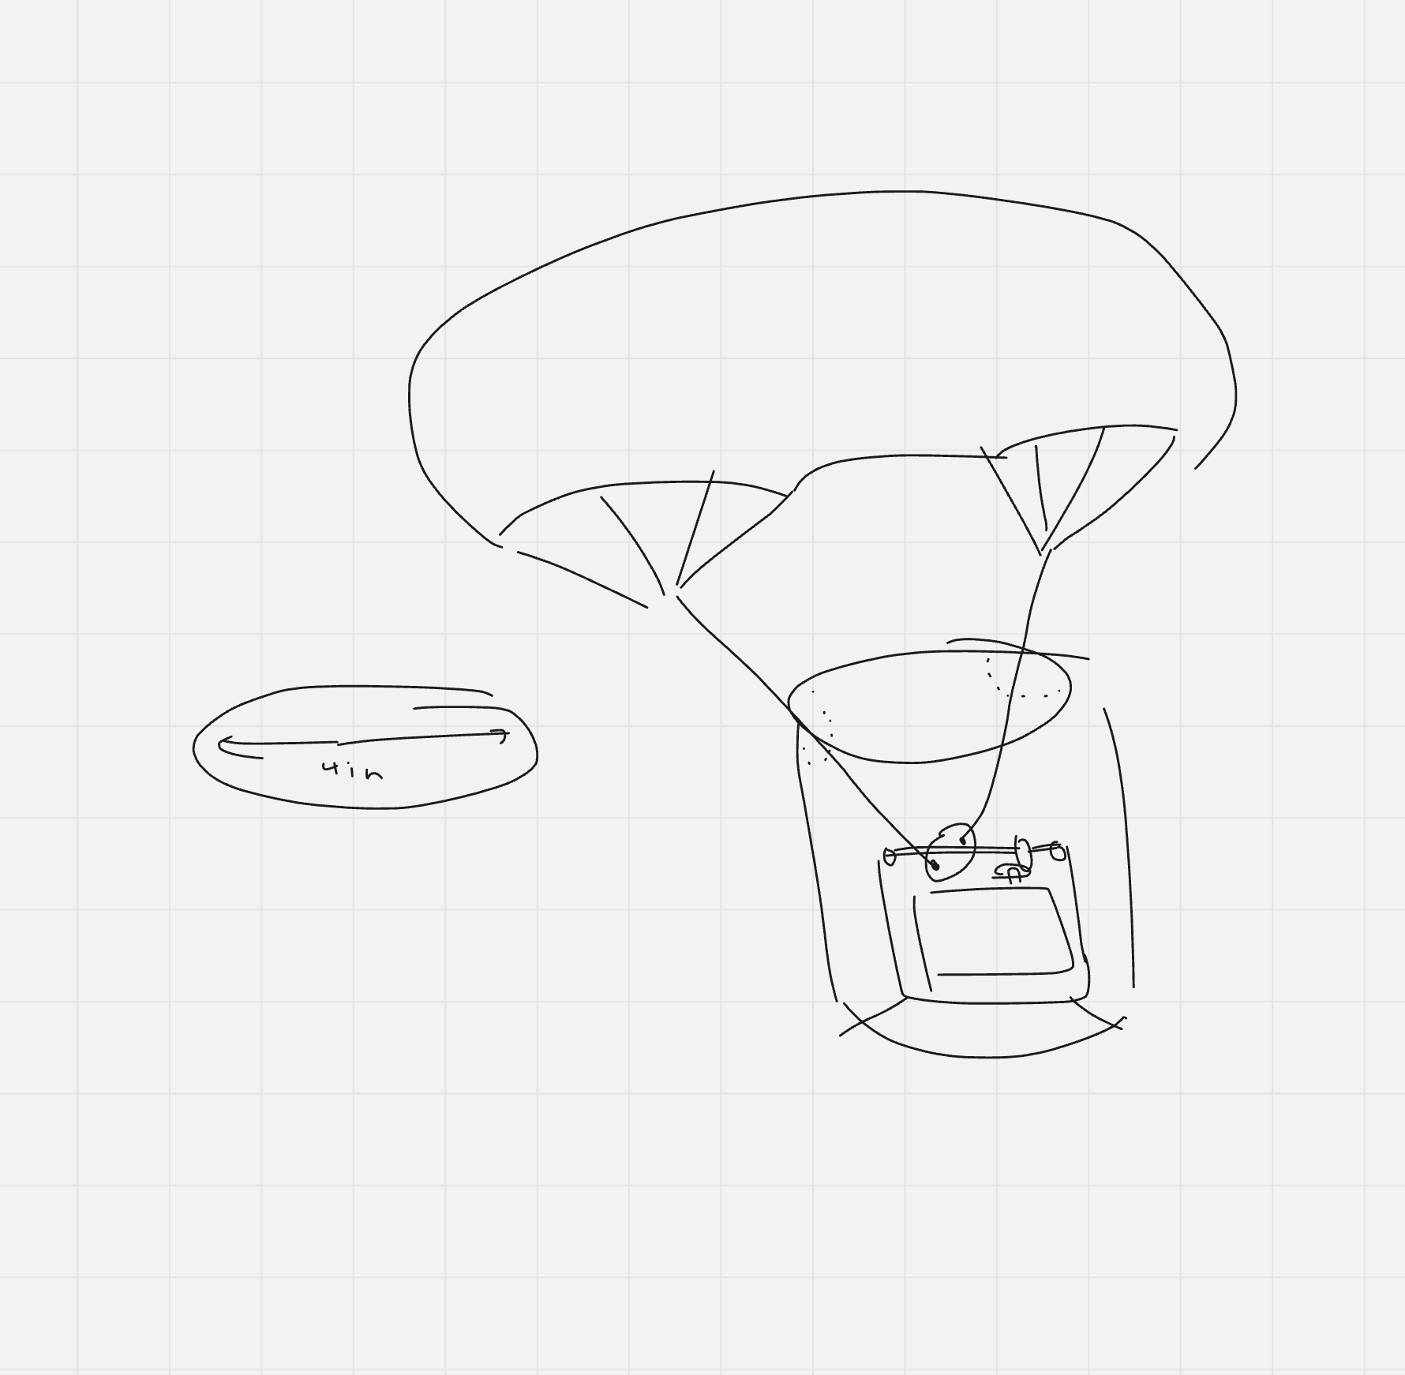
TAKEAWAYS
What the math is saying
Transparent plant
3-DOF kinematics + fixed glide. Wind is the hard part, not aeroelasticity.
Estimate ≠ truth
ŵ is a lagged, noisy reconstruction held frozen in prediction.
Replan absorbs mismatch
Structural shear/gust error is acceptable if you replan every Tc.
Sources in this deck
• Math: papers/parafoil_mpc_math.pdf + algo/mpc_v1/*.m • Plots: regenerated by presentation/gen_math_assets.py • Video / frames: parafoil_sim/output/steady_wind_flight.mp4 • 6-DOF results: parafoil_sim/output/*_flight.json • Hardware sketch: rough sketch.png (project)
Luna · Parafoil NMPC math · source: papers/parafoil_mpc_math
16/16

