Slide 1


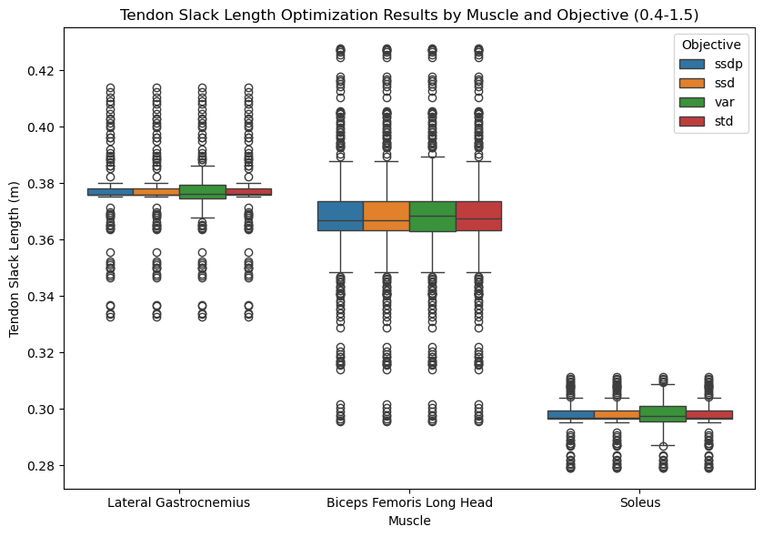
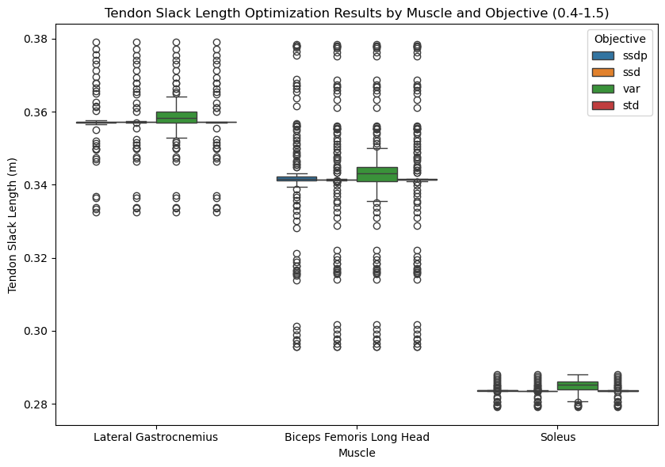


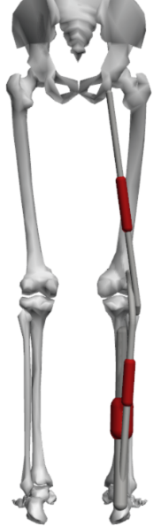
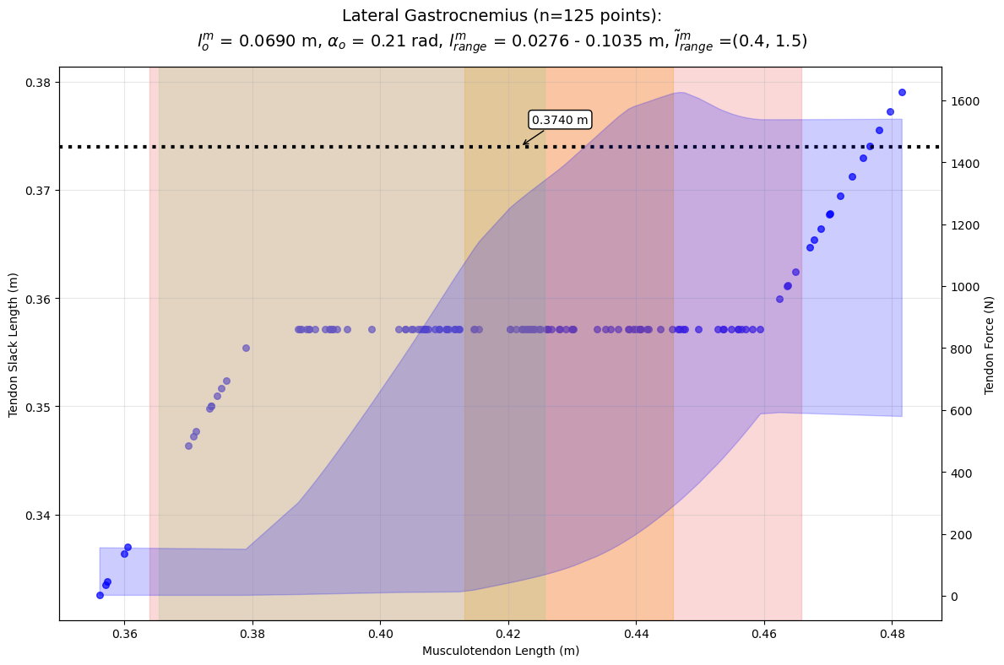
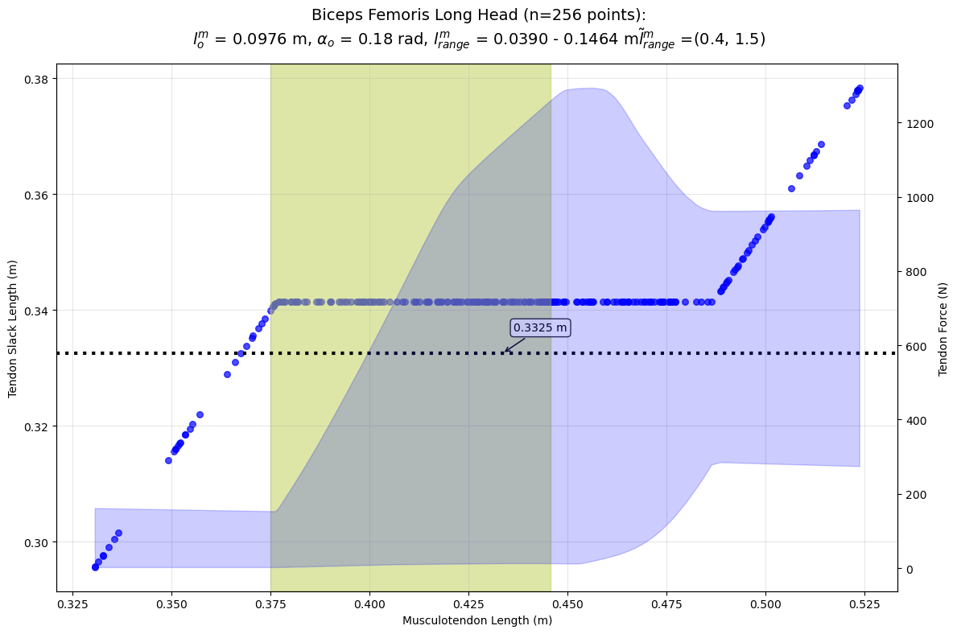
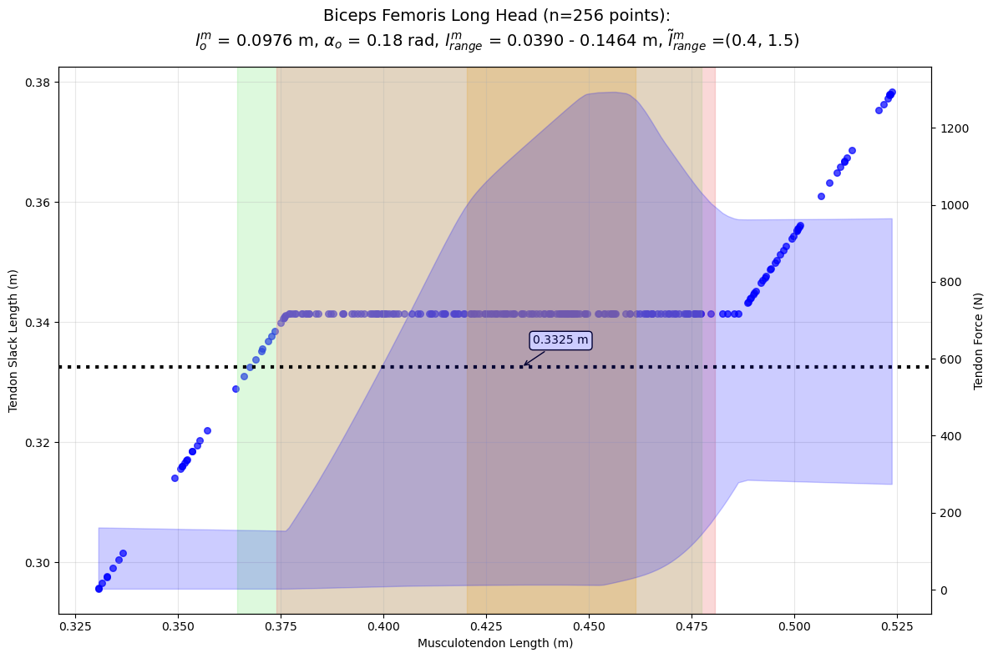
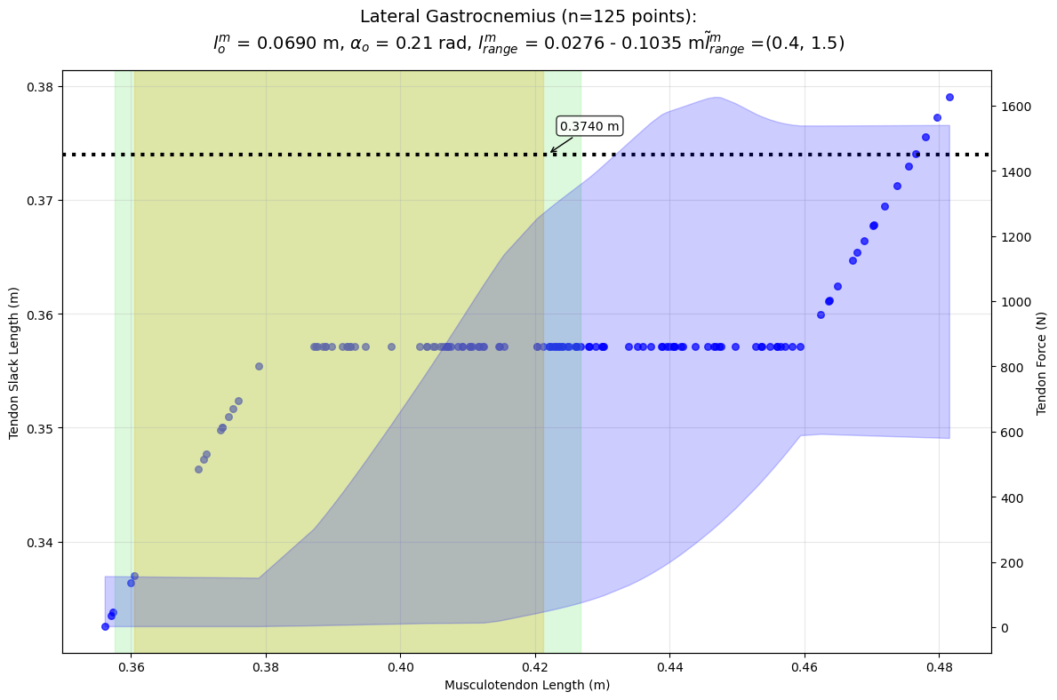
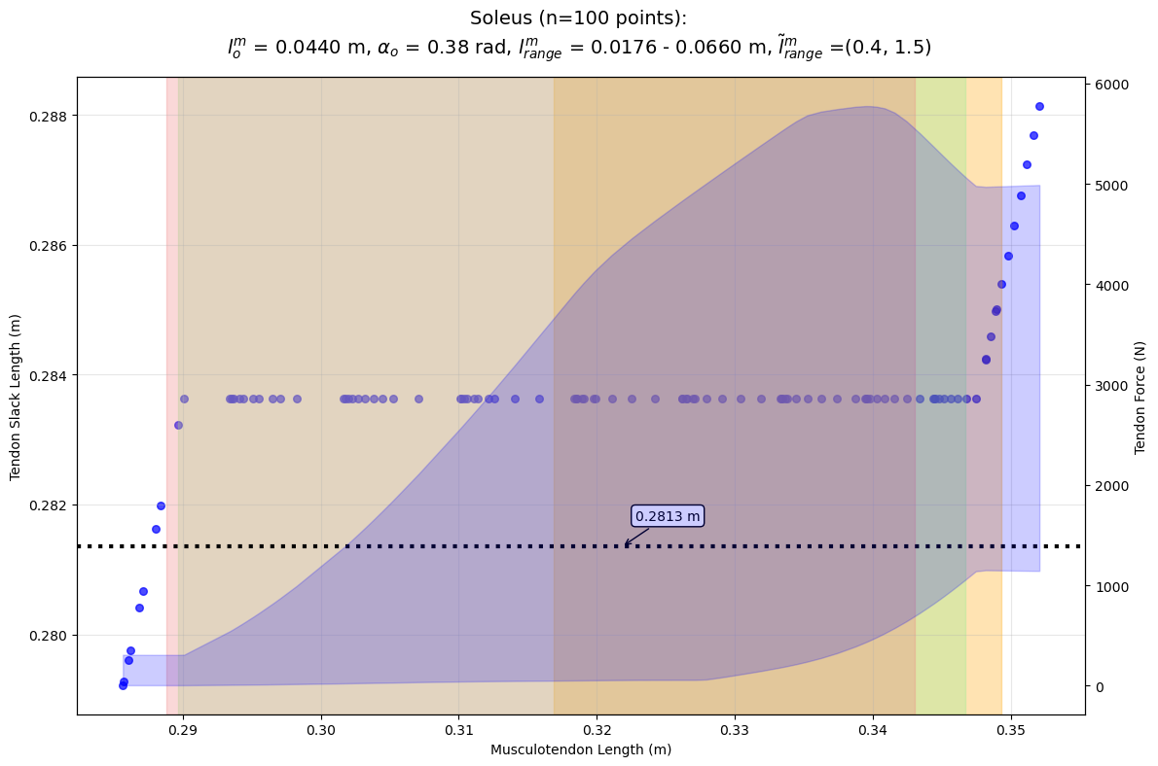

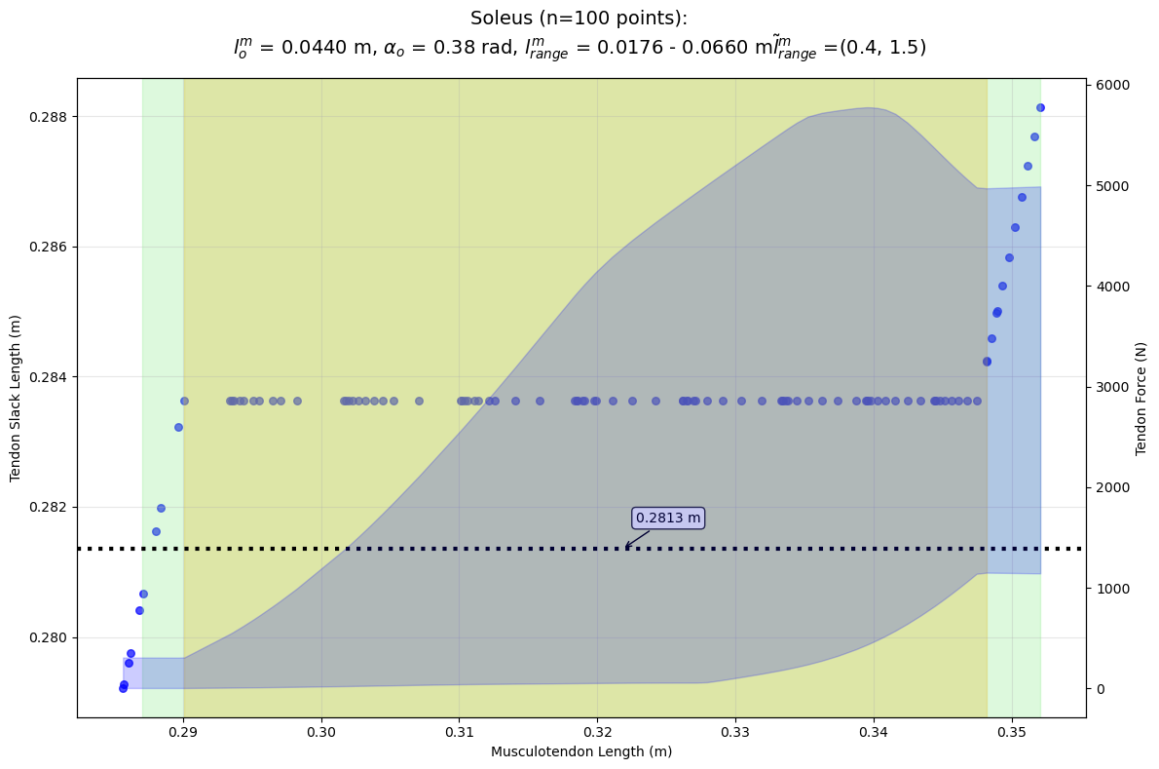


Effects of error function selection and normalized fiber length range in numerical estimation of tendon slack length
Hudson Burke, Xiao Hu Ph.D., Shawn Russell Ph.D.
Motion Analysis and Motor Performance Lab, University of Virginia
Departments of Orthopaedic Surgery and Mechanical Engineering, Charlottesville, VA, USA
INTRODUCTION
RESULTS
DISCUSSION
In Hill-type muscle models, tendon slack length (l^{t} s ) is a highly influential parameter.
This value is difficult to measure directly because tendons often run parallel to muscle fibers.
In simulations of extreme motion, force production is often physiologically unreasonable.
Manal (2004) used an optimization technique to estimate muscle fiber lengths that would produce a consistent tendon slack length by deriving an equation using architectural parameters and force-length curves from Zajac (1989):
This research extends Manal's technique to analyze how different factors (like fiber length range and error functions) affect the estimation, aiming to create a more robust tuning methodology for new muscles and models.
Changing the error functions produced little difference compared to each other, but the range of tendon slack length estimates changed substantially with normalized fiber length range.
The tendon slack length plots only show the estimates produced by SSDP, used in Manal’s original method.
For each muscle, the tendon slack length estimated at each musculotendon length across a normalized fiber length range of 0.4 to 1.5 is plotted along with the corresponding force range.
The highlighted regions show the range of musculotendon lengths in different activities, particularly an athletic cutting motion and squatting.
In the middle of the musculotendon length range, a consistent value for tendon slack length emerges, but it deviates at the short and long ends of the range of motion
The discrepancy comes as a result of the constrained optimal fiber length range as once the range reaches that limit, the tendon slack length is the only component that can compensate.
This could introduce activity dependent inaccuracies when the musculotendon length is close to the ends of its range.
For example, the tendon slack length estimate for the soleus may work for a squatting motion but not for an athletic cutting motion.
AIMS
1) Identify different error functions for use in tendon slack length optimization
2) Analyze role of normalized fiber length range in tendon slack length estimation for different muscles
METHODS
The refined approach uses:
SLSQP (Sequential Least SQuares Programming) for optimization.
Force-length curves from Millard et al.
Musculotendon lengths sampled across the full range of motion of the RajagopalLaiUhlrich2023 model.
Utilized four different error functions:
Applied the methodology to the lateral gastrocnemius, biceps femoris long head, and soleus muscles.
Ran the optimization on both the full and the ascending-only portions of the fiber force-length curve.
SIGNIFICANCE
A comparison should be performed between the forces and lengths produced via this optimization method, and those using the values estimated in the standard Rajagopal model.
Estimates for tendon slack length must take into account the range of motion used in the activity being analyzed and the corresponding musculotendon lengths to ensure consistency.
Using time-series dynamic data in the future would allow the use of force-velocity curves in the optimization process which are currently neglected in this methodology and may become increasingly important with athletic motions.
Sum of Squared Difference of Pairs (ssdp):
Sum of Squared Differences (ssd):
Standard Deviation (std):
Variance (var):
References
Manal 2004, Journal of Applied Biomechanics
Zajac 1989, Critical Reviews in Biomedical Engineering
Rajagopal 2016, IEEE Transactions on Biomedical Engineering
Uhlrich 2022, Scientific Reports
Millard 2014, Journal of Biomechanical Engineering
Silder 2007, Journal of Biomechanics
Presented at American Society of Biomechanics 2025 PS2 - 155

