Slide 1
AI in Psychology and its effects on counseling Montclair State University
Ivy Hudson April 7, 2026 CSIT 100_08

Slide 2

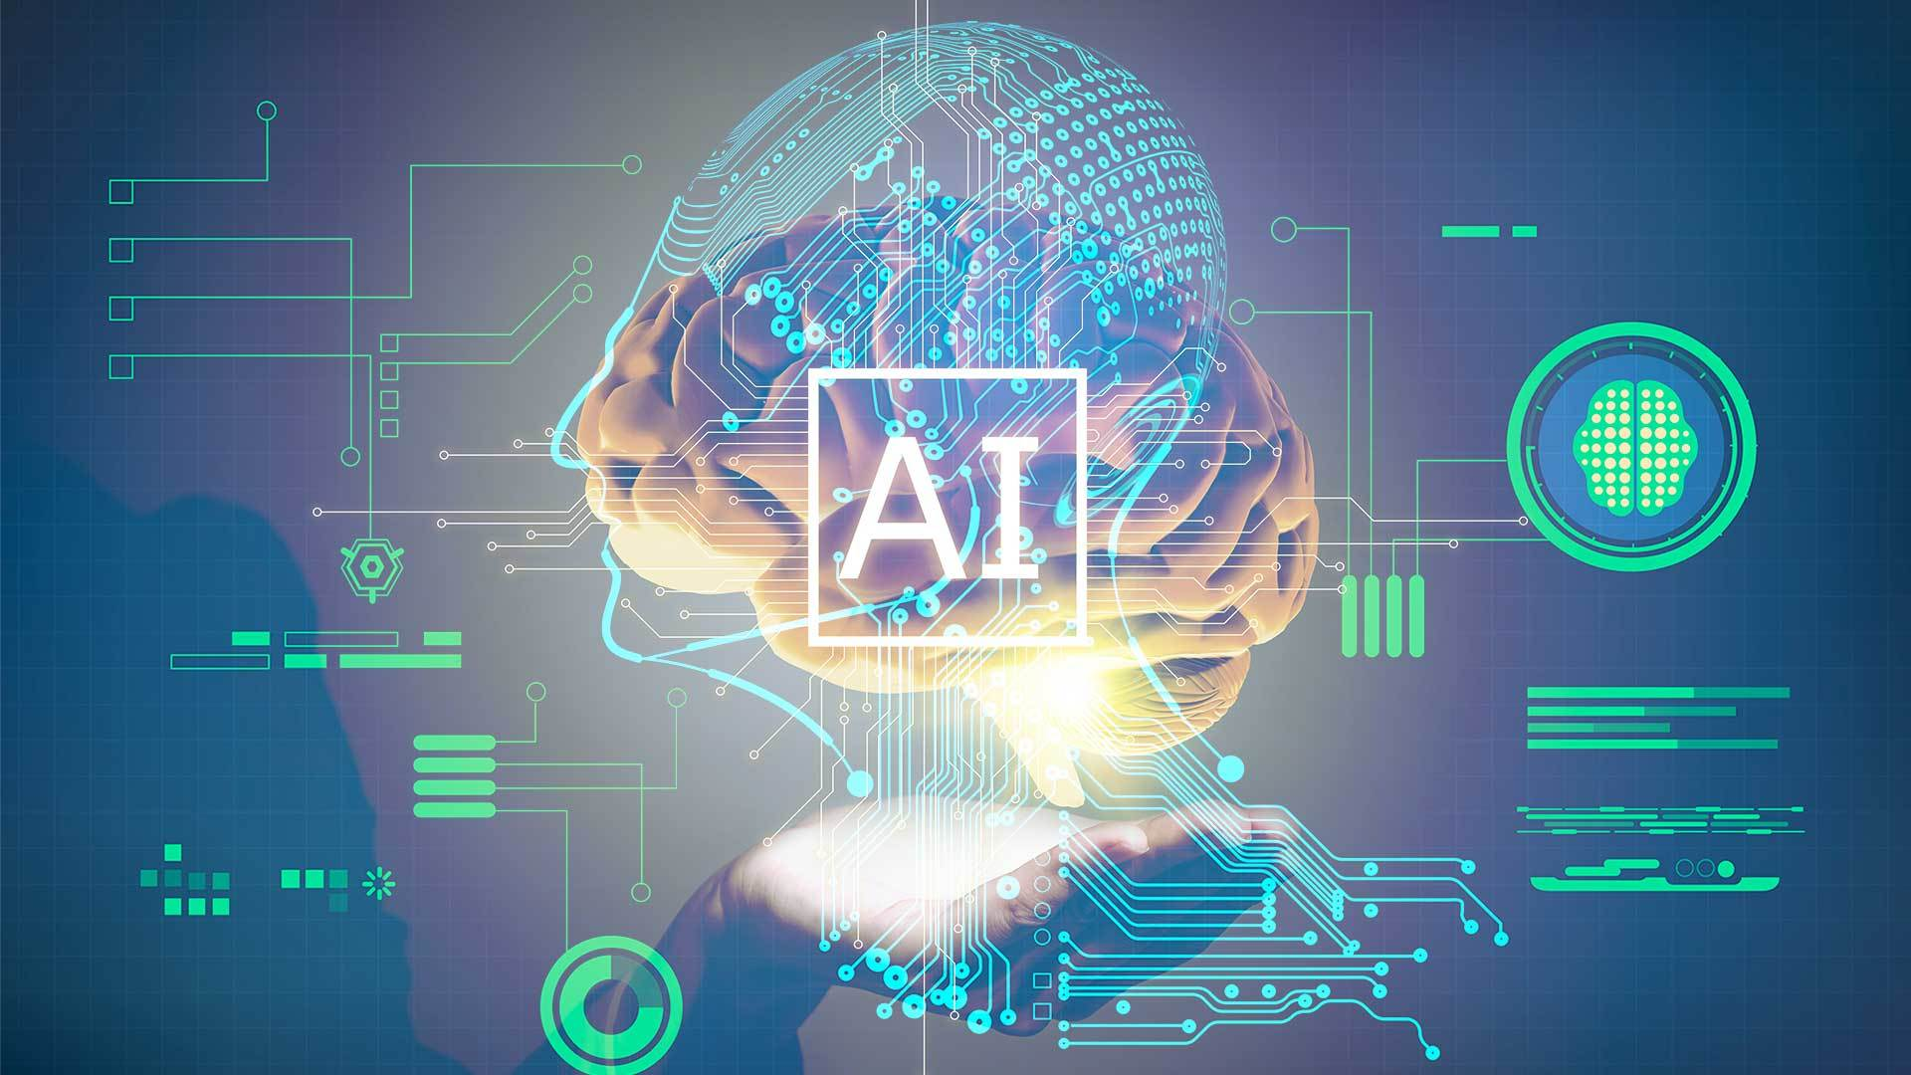
Introduction
Artificial Intelligence (AI) has become prominent in the field of psychology alongside new technological developments
A recent poll conducted by the American Psychological Association showed that 56% of the participating licensed psychologists reported using AI to help with their work at least once in the past year (Vilhauer, 2025).
This Photo by Unknown Author is licensed under CC BY-SA-NC

Slide 3
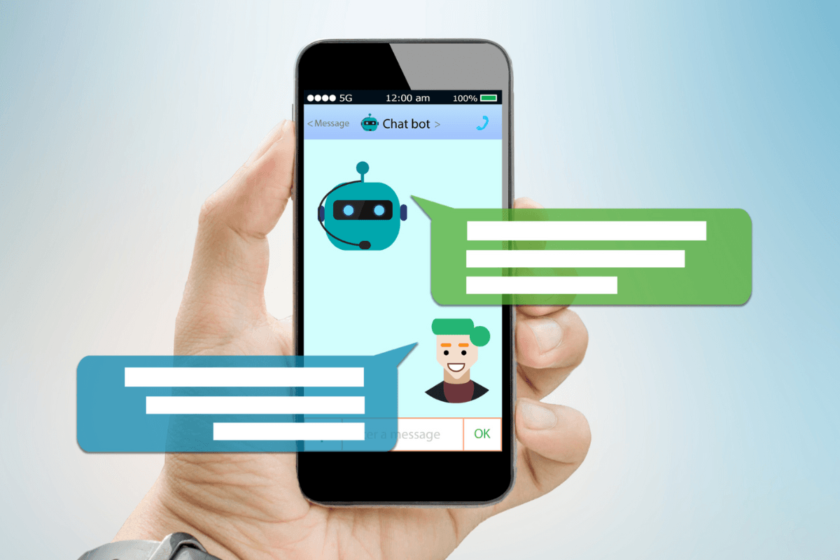
AI in Mental Health Counseling
AI Chatbots can provide easy access to mental health support to everyone
This specifically appeals to those who do not have access to mental health care
Therapy becomes accessible and affordable
Further, those who do not feel comfortable going to in-person therapy, may find comfort in talking to a chat bot instead.
This Photo by Unknown Author is licensed under CC BY-NC-ND

Slide 4
The Negative Aspects
AI chatbots are not a guaranteed source of accurate information
Chatbots can spread potentially sensitive or harmful misinformation
AI-based healthcare has been found to discriminate, and may provide inappropriate or irrelevant resources
Could AI chatbots replace human therapists? BBC World Service

Slide 5
AI in Clinical Diagnosis
A recent study by “Nature’s Scientific Report” shows how AI can hold highly accurate clinical diagnoses for common mental health disorders
AI clinical interviews, powered by LLMs (large language models) to simulate doctor-patient conversation
Structured data collection can lead to accuracy in complex scenarios
New AI-driven technology – imaging and molecular signaling – show signs for accurate prognoses as well

Slide 6
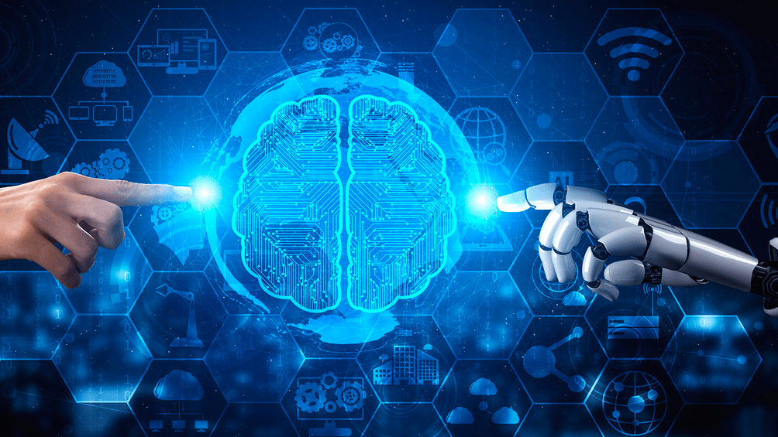
Clinical Diagnosis – Aspects to Keep in Mind
AI is not yet fully credible, because of issues in replicability, scalability, and generalizability
As of now, many AI tools lack clinical validation
Therefore, it can support a clinical psychologist, but it should not replace a credentialed psychologist
AI in psychology: improving diagnosis and therapy, Crowdy ai

Slide 7
AI-Patient Relationships
Some pros include reduction of bias that may come from an in-person provider
AI chat bots can act as a digital companion offering 24/7 support
They can simulate empathy and a nonjudgemental outlook on given situations
Users may feel understood and feel comfortable to share sensitive personal information

Slide 8
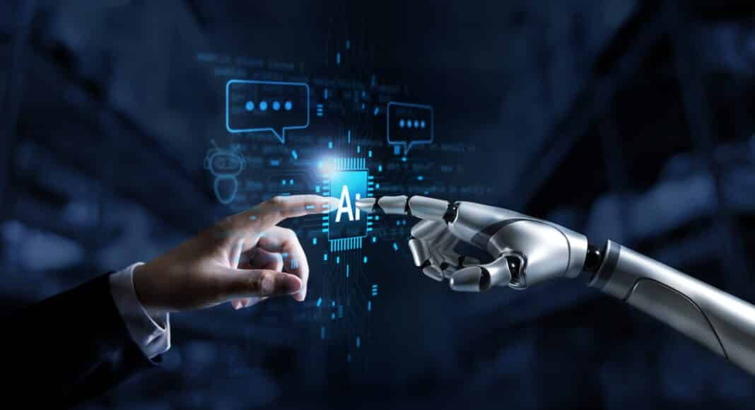
But Can AI Replace Human Interaction?
Risks of dependency on the chatbot increases; it is a one-sided interaction
Human authenticity cannot be replaced by technology
Nonverbal cues – large part of clinical diagnosis
AI cannot assess behavior cues like a human can
Other negative aspects:
Loss of personal interaction
Therapeutic misconceptions
Inauthentic care
How AI companions are destroying human intimacy, Angela Ivy Leong
This Photo by Unknown Author is licensed under CC BY-NC

Slide 9
Key Applications
Diagnosis and screening
24/7 therapeutic support
Administrative efficiency
Predictive modeling
Benefits:
Improved accessibility
Scalability in research
enhanced decision making
Challenges:
Bias and discrimination
Data privacy
Reduced human interaction
Limitations in clinical use

Slide 10
Reflections – Are There Positives?
Yes, I think there can be
AI can limit the common human errors and mistakes we see in healthcare
I also appreciate how it provides access to mental health care to those who do not have access to it, whether because of insurance or finances

Slide 11
Reflections – Precautionary Measures
AI is not a credentialed provider
While it has access to many reliable resources, it is still not a verified source of information
Mental health and clinical diagnosis should not be used stand alone with AI
Rather, providers can work alongside AI.

Slide 12

Impacts Ethical Issues and Challenges
As we can see, there are many pros and cons to the integration of AI into psychology
Many question the ethics of removing the humanistic side of psychology
The inclusion of AI into psychology is vastly dependent on personal preference
While AI may be shown to more accurately diagnose and treat than a human psychologist, some may prefer to have an in-person provider-patient relationship

Slide 13
Conclusions
Based on this research, it seems as though AI can be a positive addition to the world of psychology
1
However, just like everything, there are drawbacks
2
Many argue that these new technologies are not properly equipped to provide safe care and empathy, especially in culturally diverse populations
3
Before being fully integrated into the field, a lot of research and consideration needs to take place first
4

Slide 14
Thank you!
Questions?

Slide 15
References
Abrams, Z. (2023). AI is changing every aspect of psychology. Here’s what to watch for. American Psychological Association, 54(5)
Gardner, S. (2025). Experts caution against using AI chatbots for emotional support. Teachers College Columbia University
Gao, W., Lu, L., Yin, X. (2024). Editorial: AI approach to the psychiatric diagnosis and prediction. Frontiers in Psychiatry, 15. https://doi.org/10.3389/fpsyt.2024.1387370
Opel, N & Breakspear, M. (2026). Transforming mental health research and care through artificial intelligence. Science, 391(6782).
Vilhauer, M. (2025). AI diagnoses mental health disorders with high accuracy. Psychology Today
Weir, I. B., Stroud, A. M., Stout, J. J., Barry, B. A., Athreya, A. P., Bobo, W. V., Sharp, R. R. (2025). Physician perspectives on the impact of artificial intelligence on the therapeutic relationship in mental health care: Qualitative study. JMRI Ment Health. https://doi.org/10.2196/81970

