Slide 1
CS 347 Project
Matthew Hudson and Michael mccrory

Slide 2
Project Links
Part 1 Apex Application
Part 2 Apex Application
Github Page

Slide 3
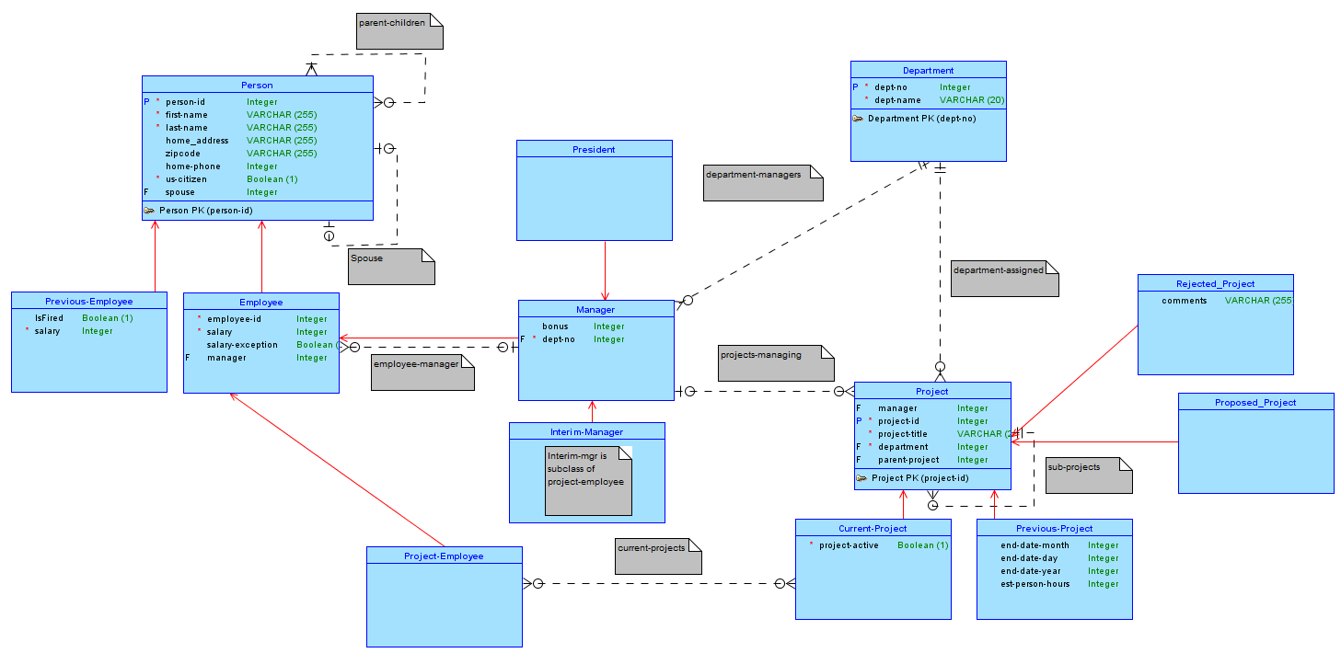
Conceptual

Slide 4
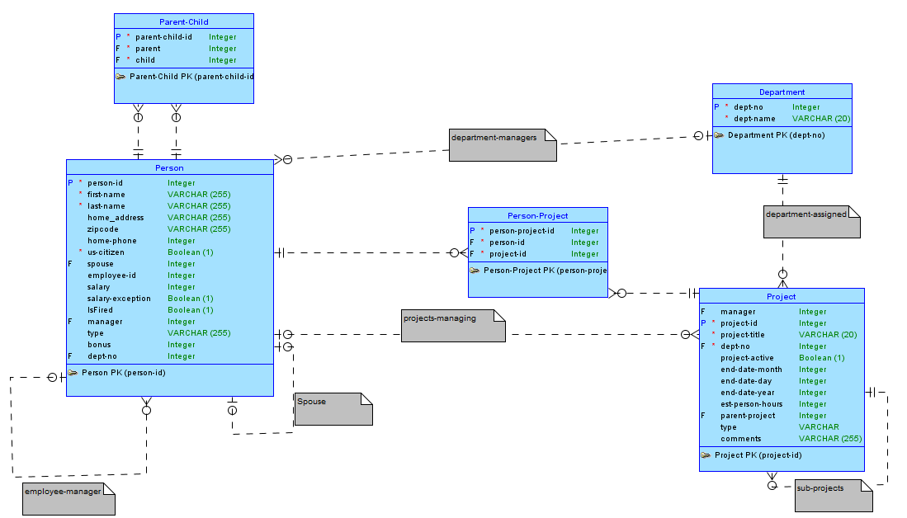
Logical

Slide 5
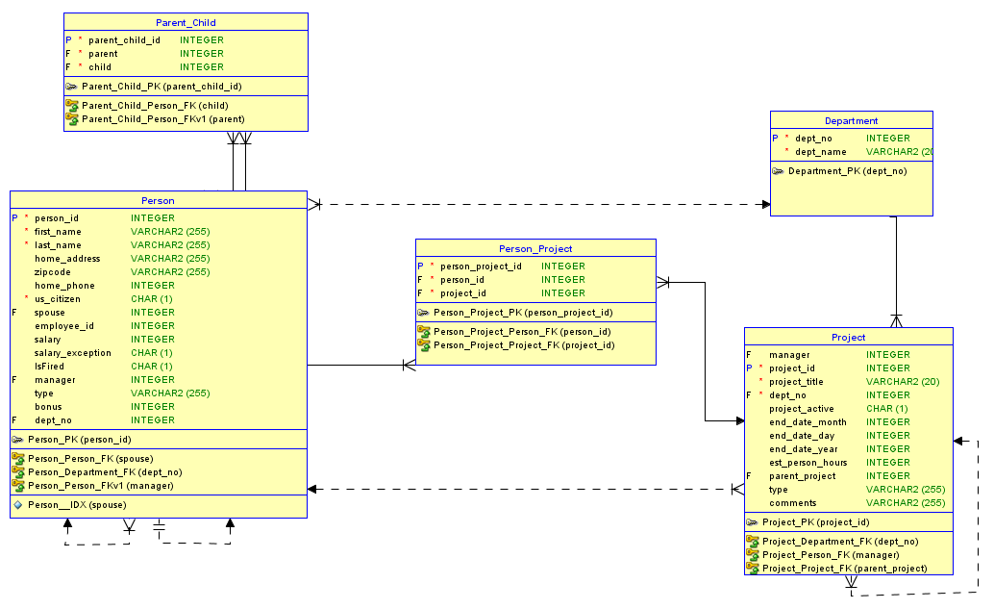
Relational

Slide 6
Part 1

Slide 7
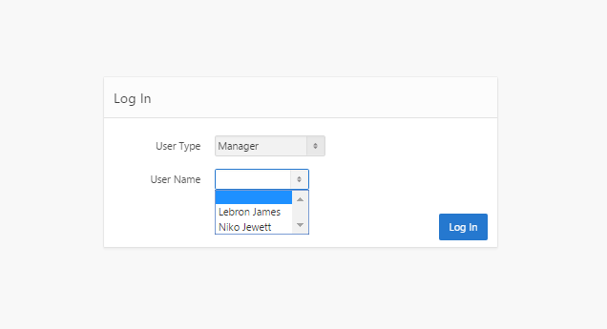
Log In

Slide 8
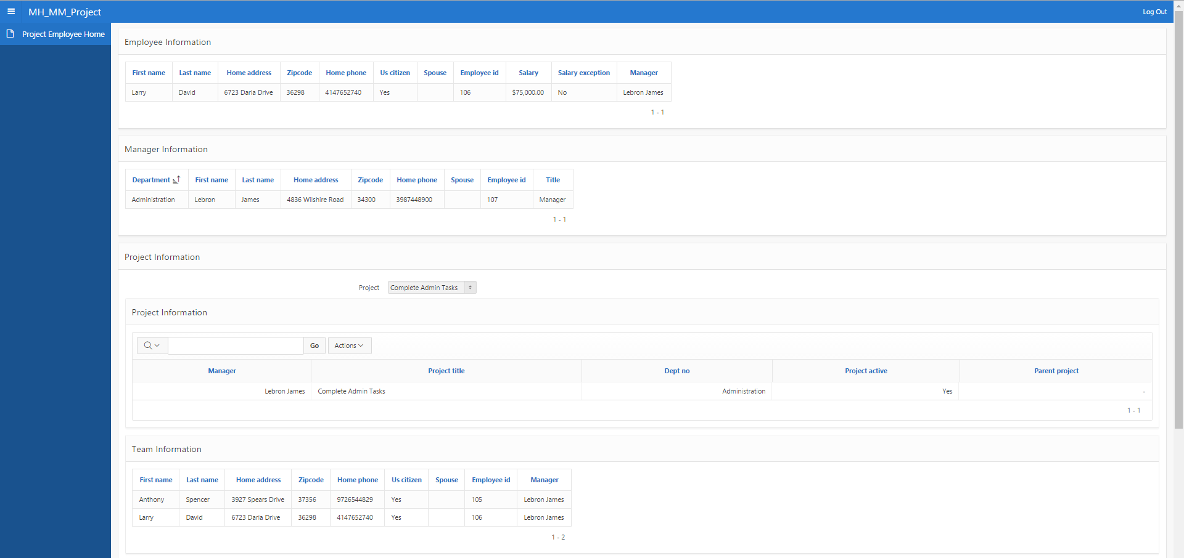
Project Employee

Slide 9
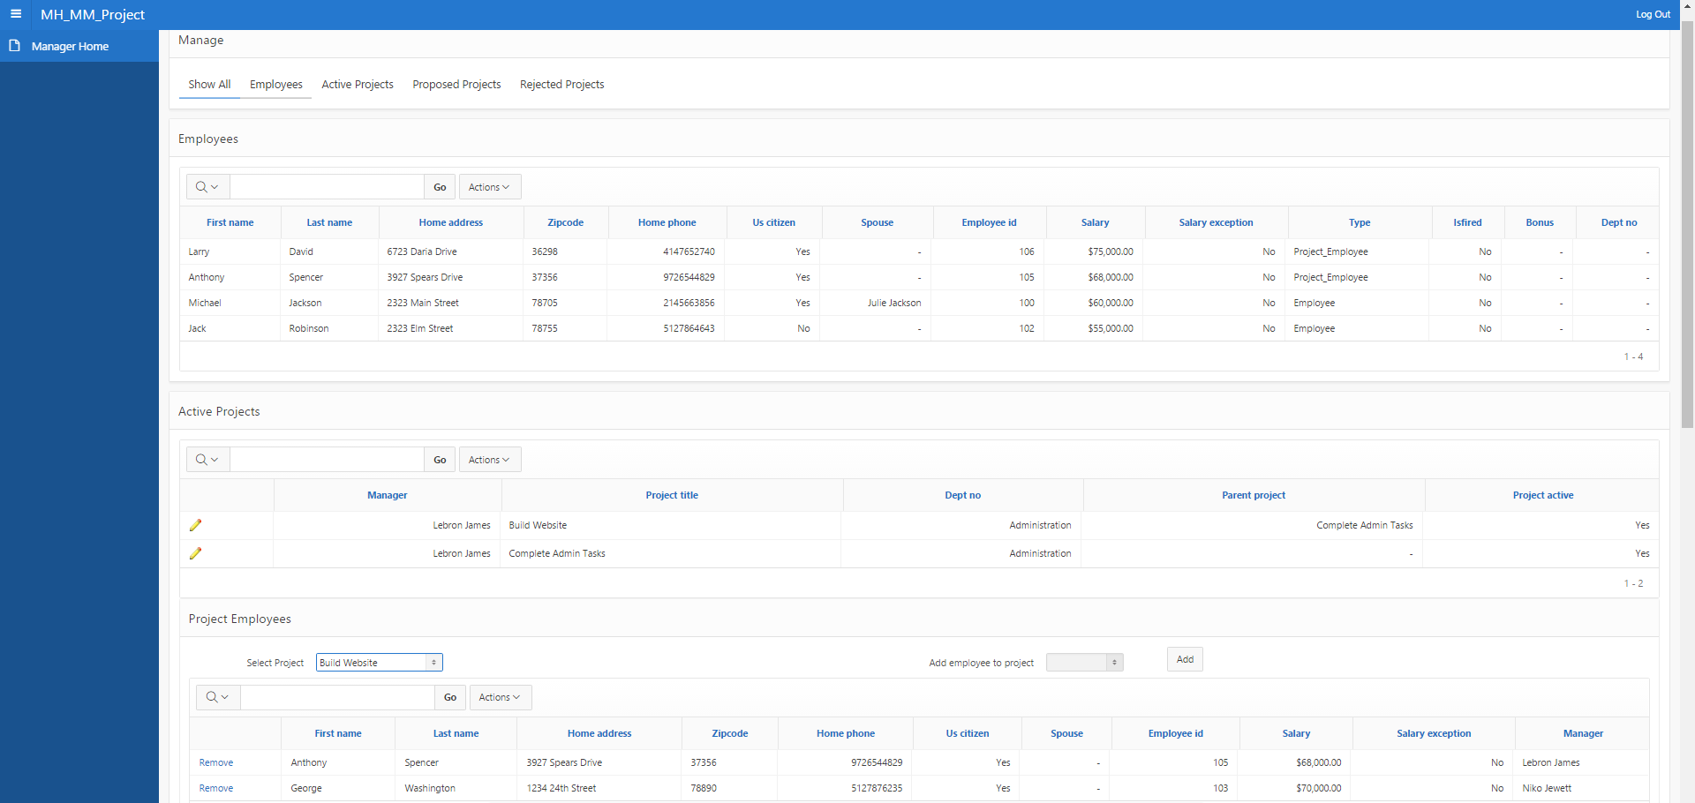
Manager

Slide 10
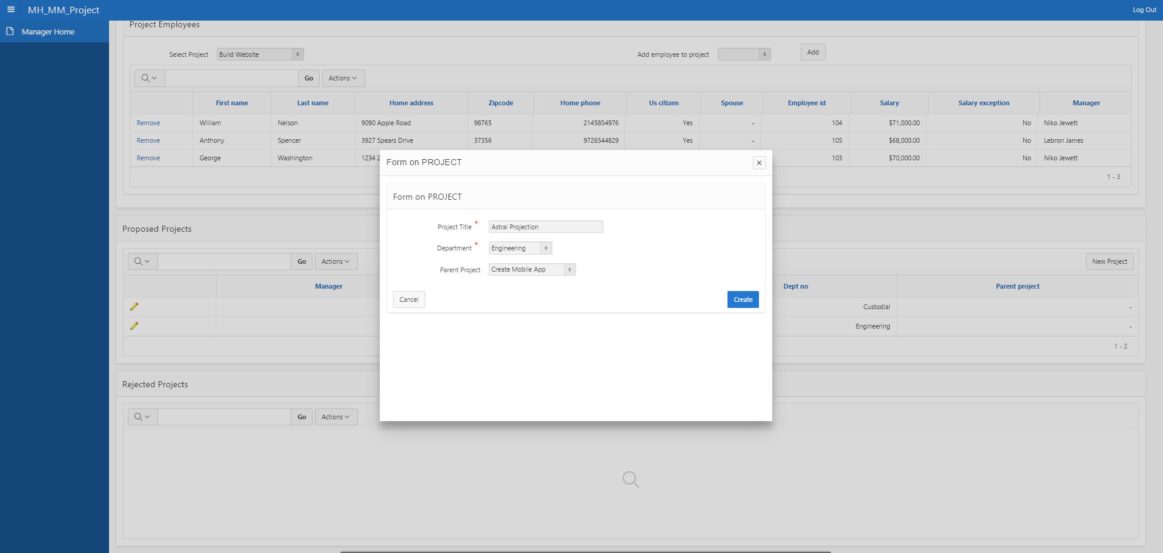
Manager Proposing Project

Slide 11
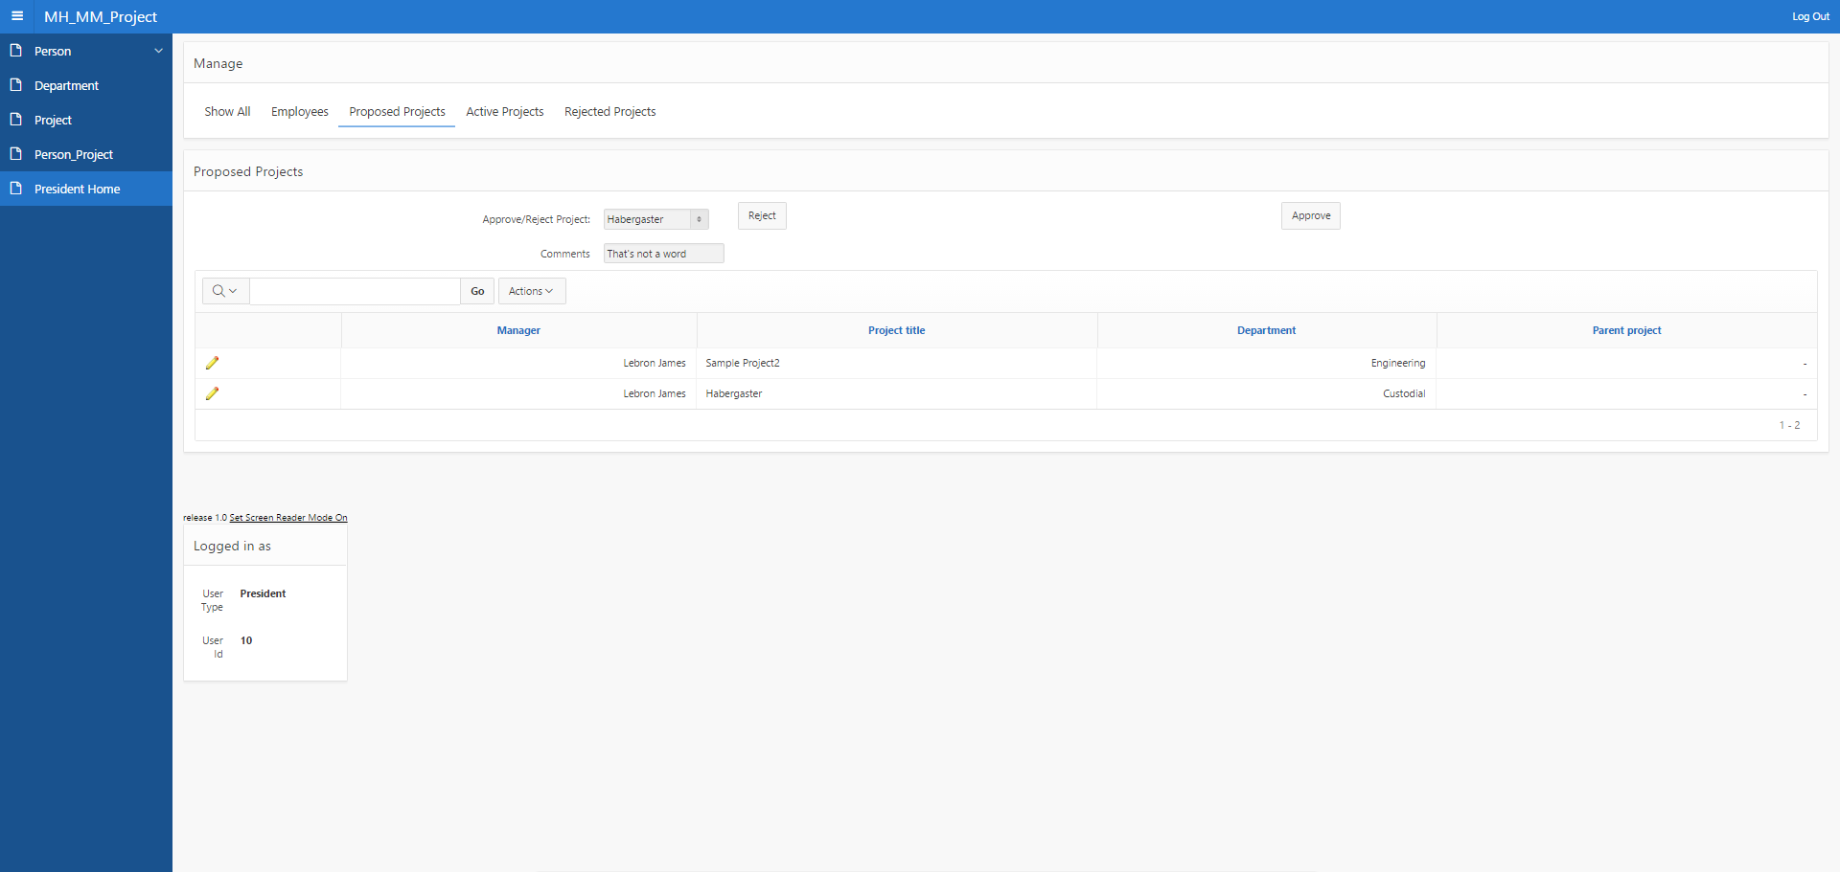
President Judging Projects

Slide 12
Part 2

Slide 13
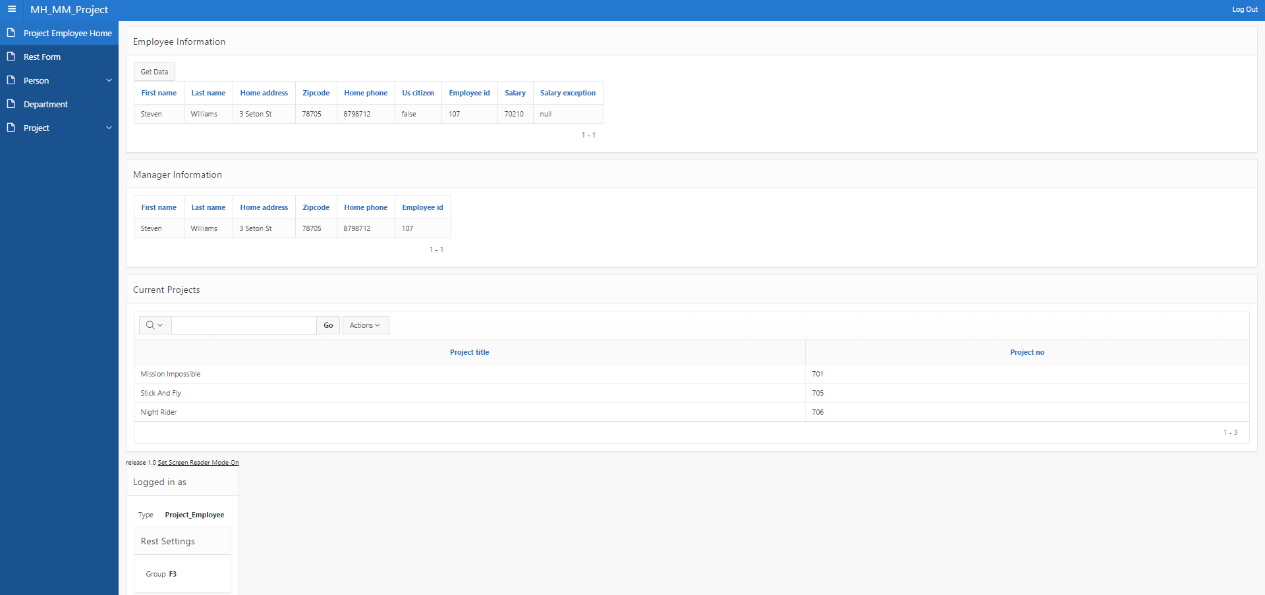
Project Employee

Slide 14
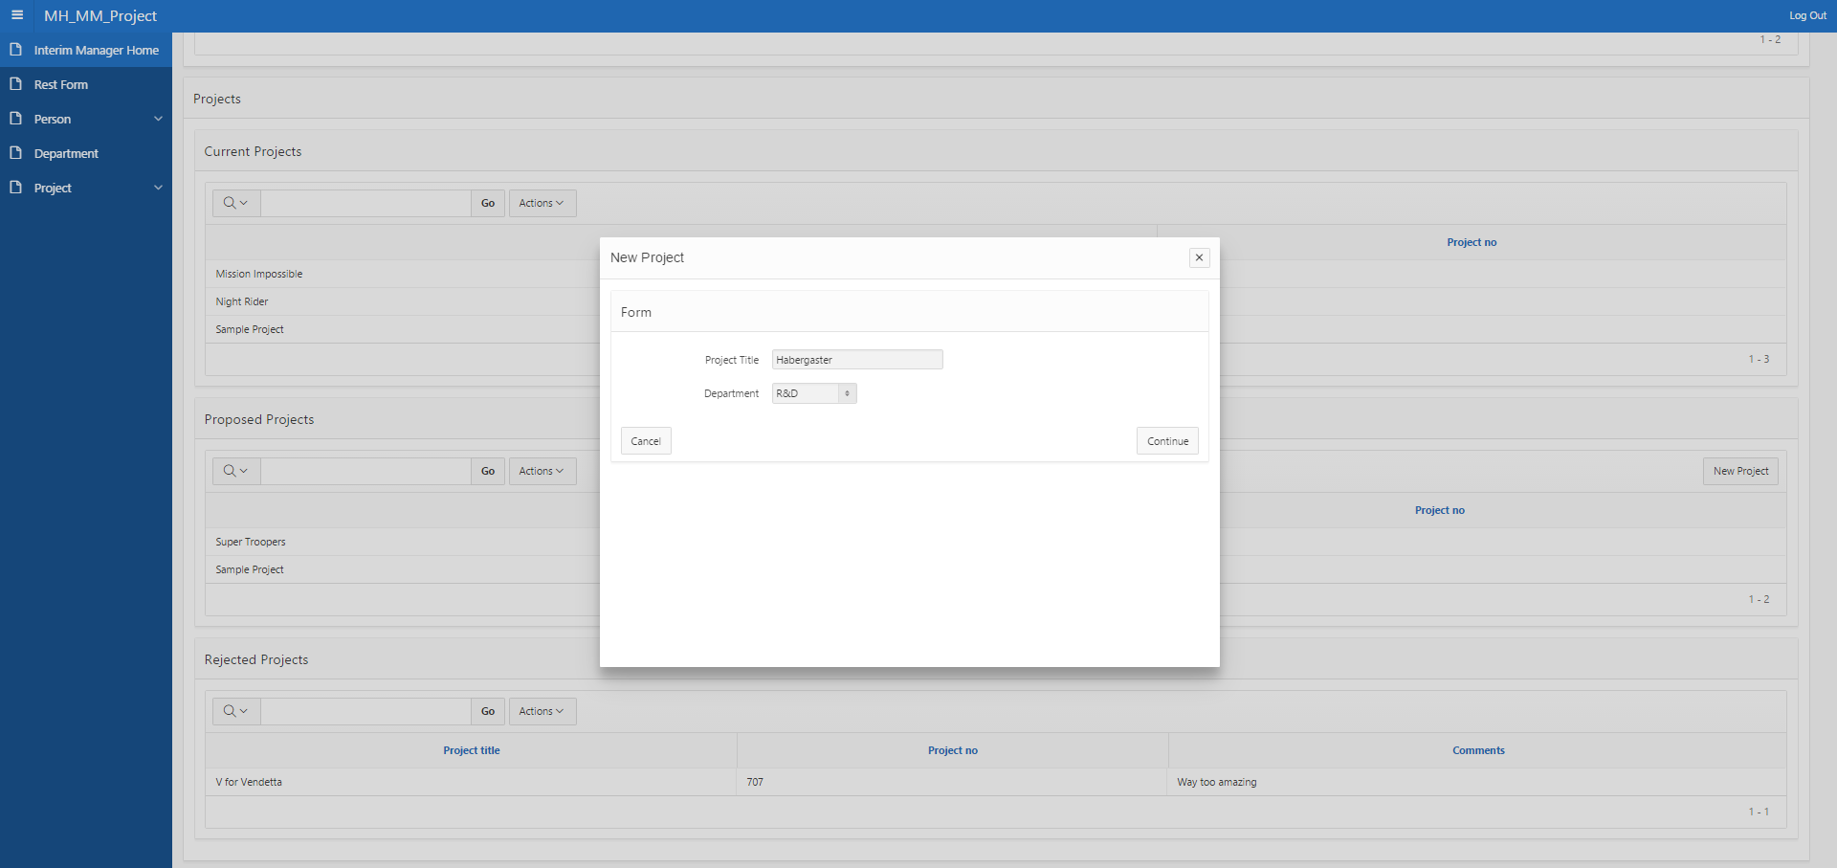
Interim Manager Proposing Project

Slide 15
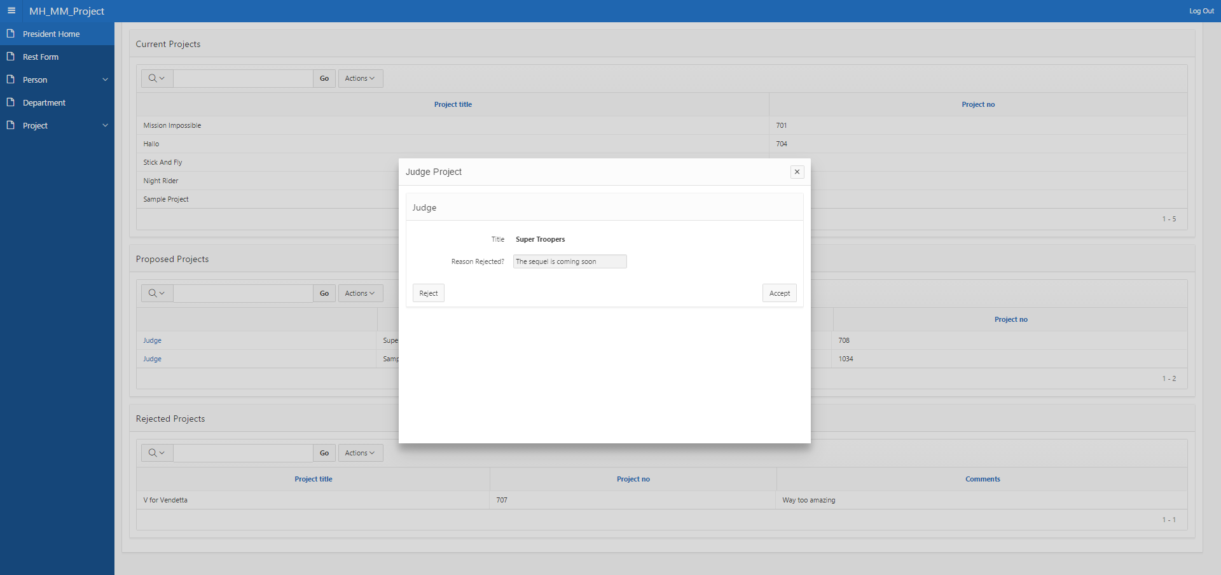
President Judging Project

Slide 16
SQL vs SIM The Epic Showdown
Relational
Mature development tools
SIM
Relationships through foreign keys
Difficulty in combining data
True logical relationships
Object Oriented
Intuitive relationship data combination
SIMple

Slide 17
Apex Bugs
When creating a process, changing the select list from “pl/sql” to “web service” will not change the dialog and will create an error that stops the page from being saved. Our workaround was to change it to “tabular forms” then to “web service”
When using a page item as a source for the rest “web service” query parameter, the query parameter would inconsistently reflect the value of the page item if the page item was updated after page load. This was counterintuitive because the “web service” process was triggered by page submit and the page item was set prior to page submit.
Seemingly randomly, web service processes would not have the header values set even when sourced by global page items. Closing all web browsers and re-navigating to apex seemed to fix this issue but if only one of multiple apex instances was closed the issue would persist.

Slide 18
Sim/Carnot bugs
Using the modify keyword to create relationships inconsistently causes errors and null pointer exceptions, but will also create the relationships properly despite the errors.
When using the modify keyword to create relationships through the rest form, it will not execute the instruction unless the returnFor header value is null.
Supplying multiple semi-colon separated sim statements as a query parameter to a rest service will only execute the first statement.

