Slide 1
CS 347 Project
Matthew Hudson and Michael mccrory

Slide 2
Project Links
Part 1 Apex Application
Part 2 Apex Application
Github Page

Slide 3
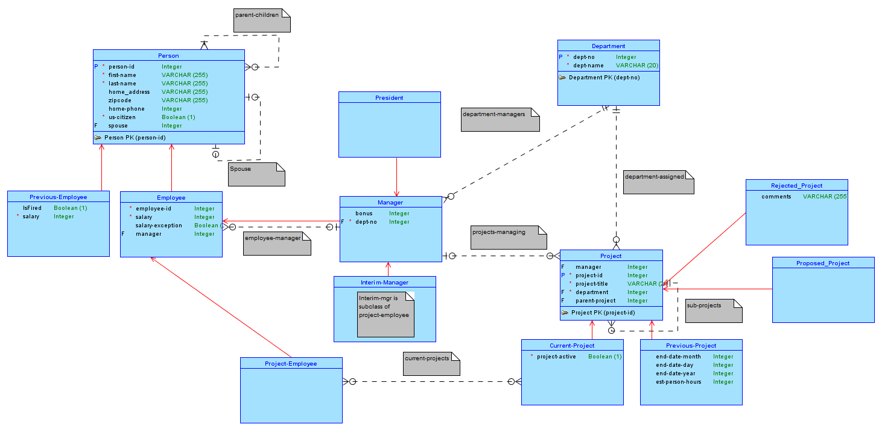
Conceptual

Slide 4
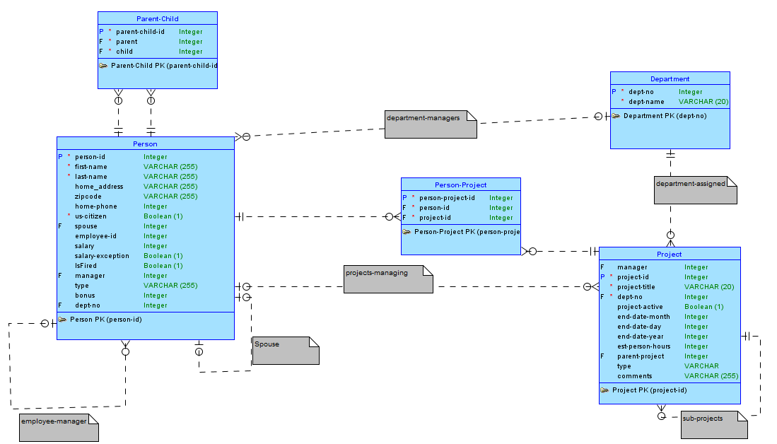
Logical

Slide 5
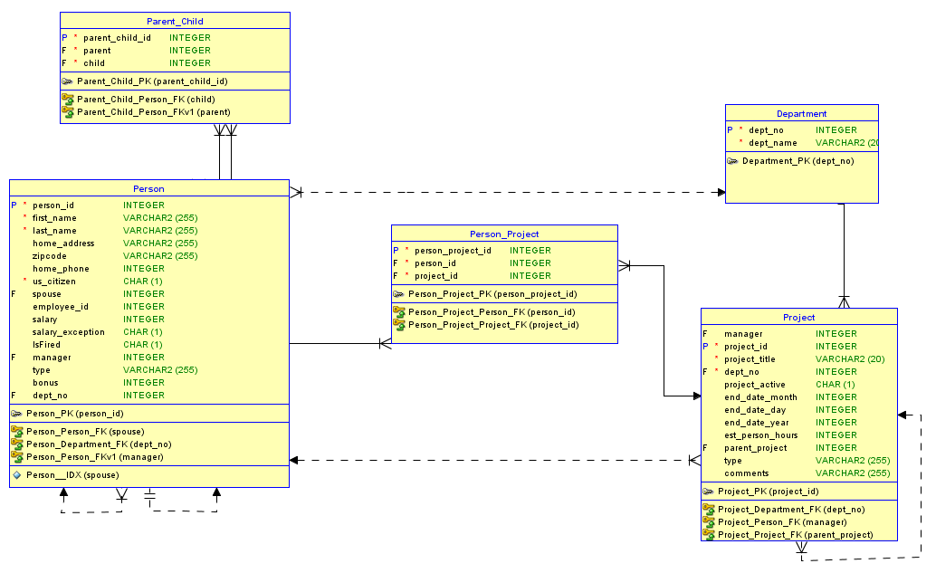
Relational

Slide 6
Part 1

Slide 7
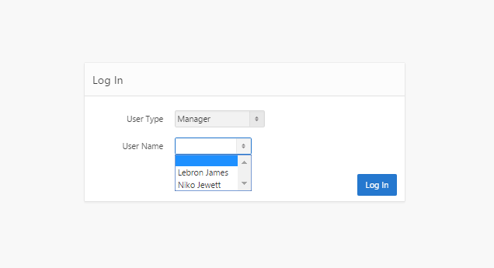
Log In

Slide 8
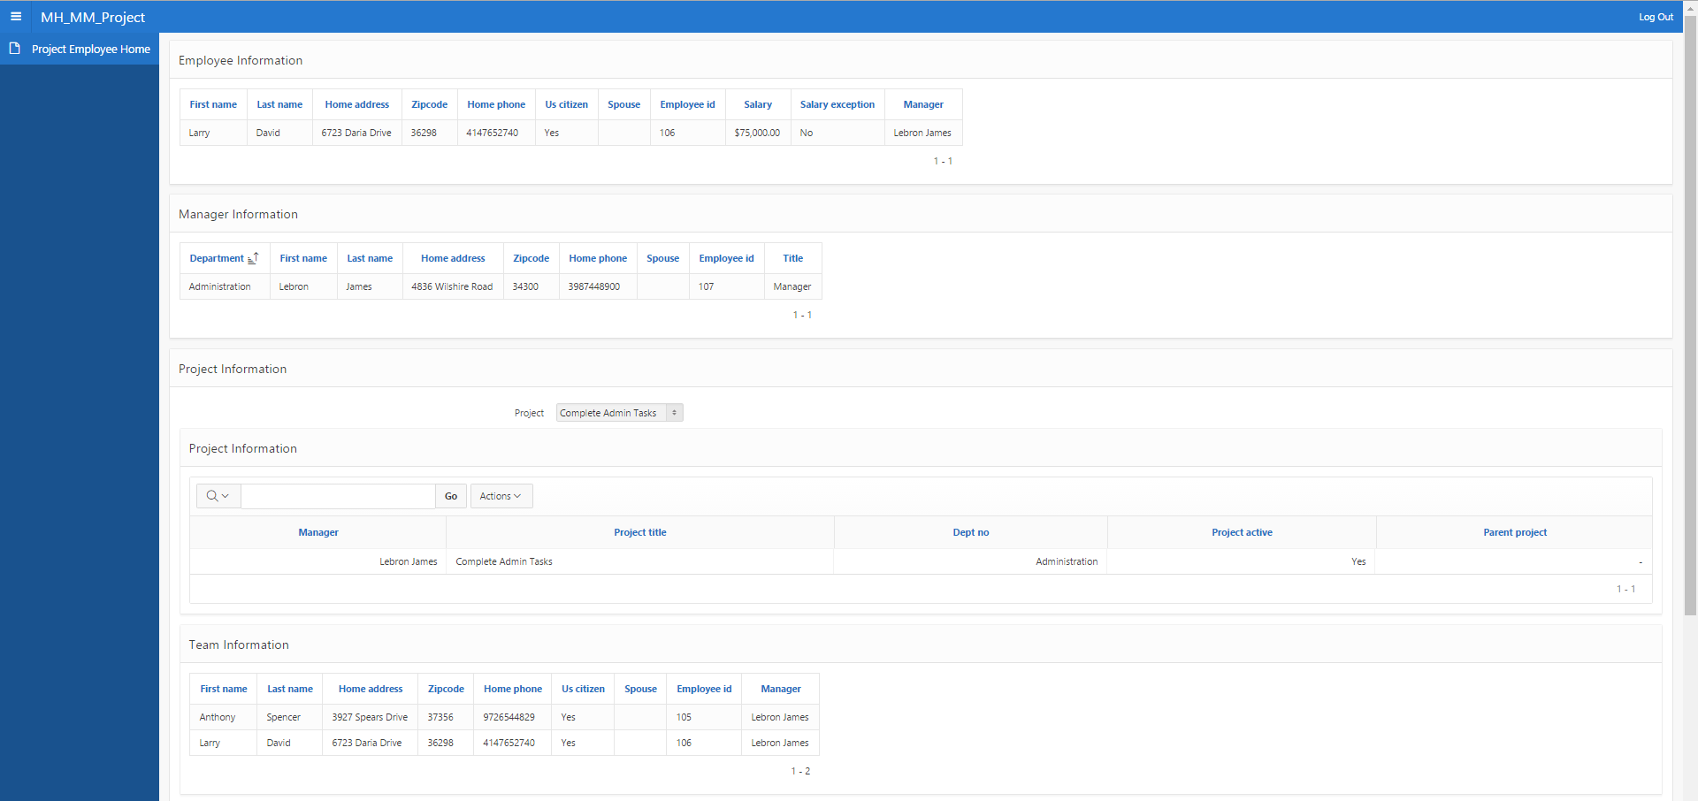
Project Employee

Slide 9
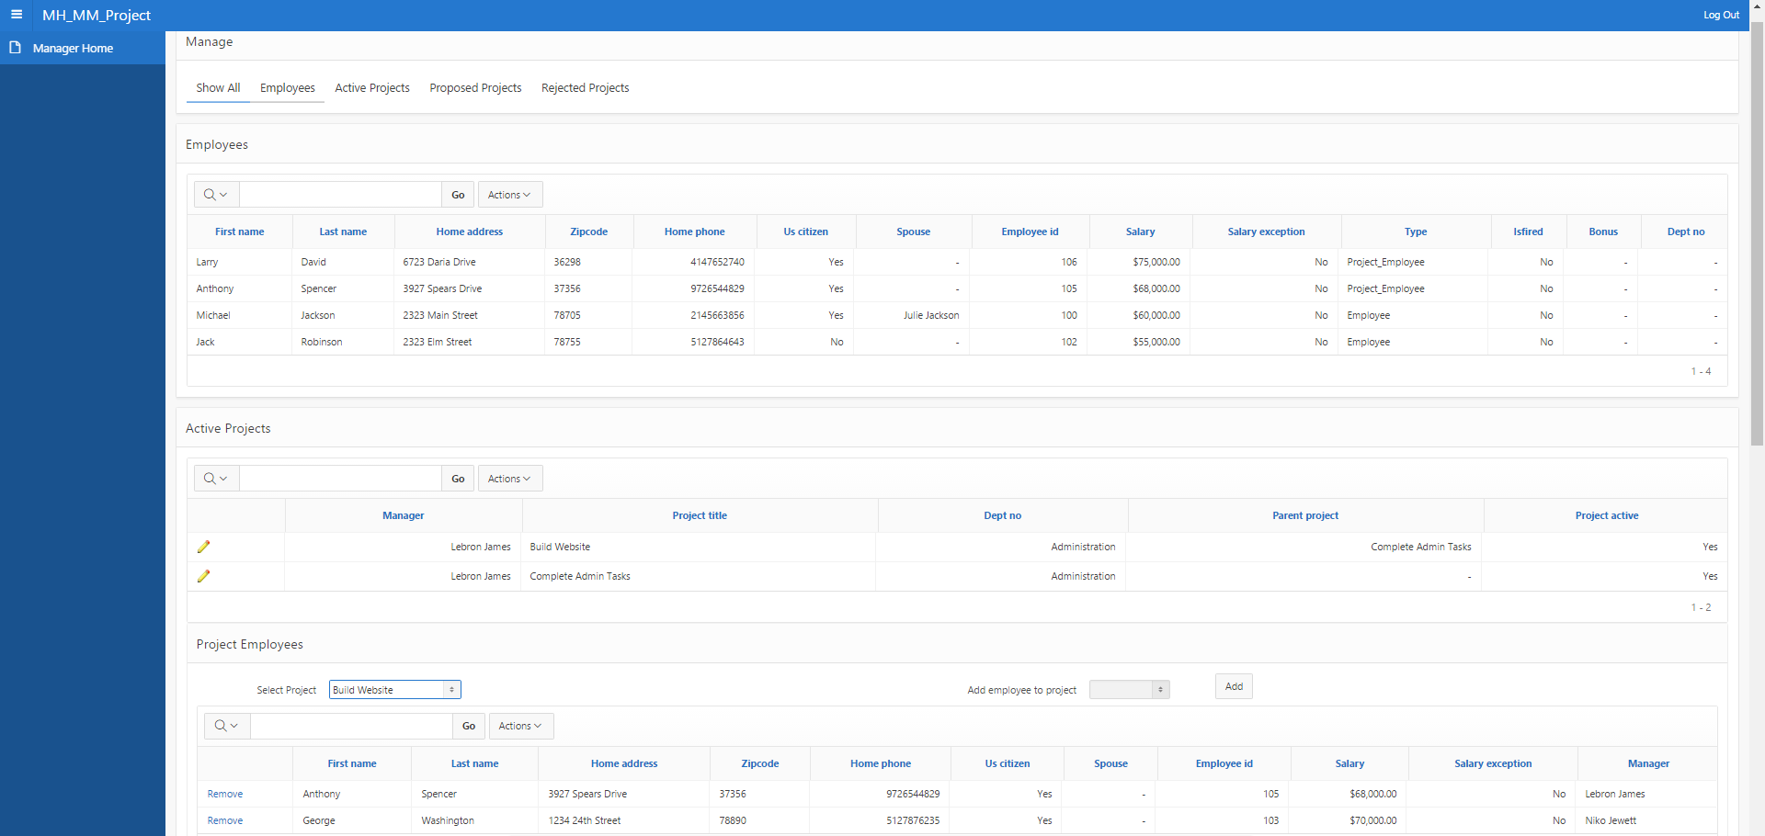
Manager

Slide 10
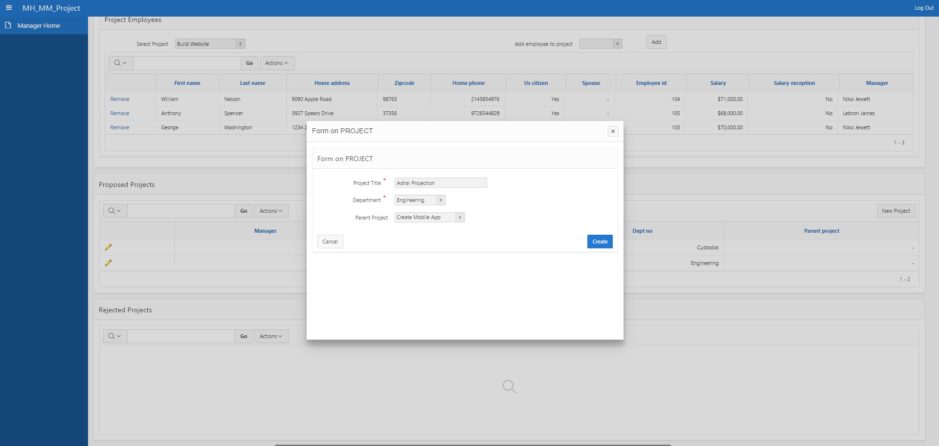
Manager Proposing Project

Slide 11
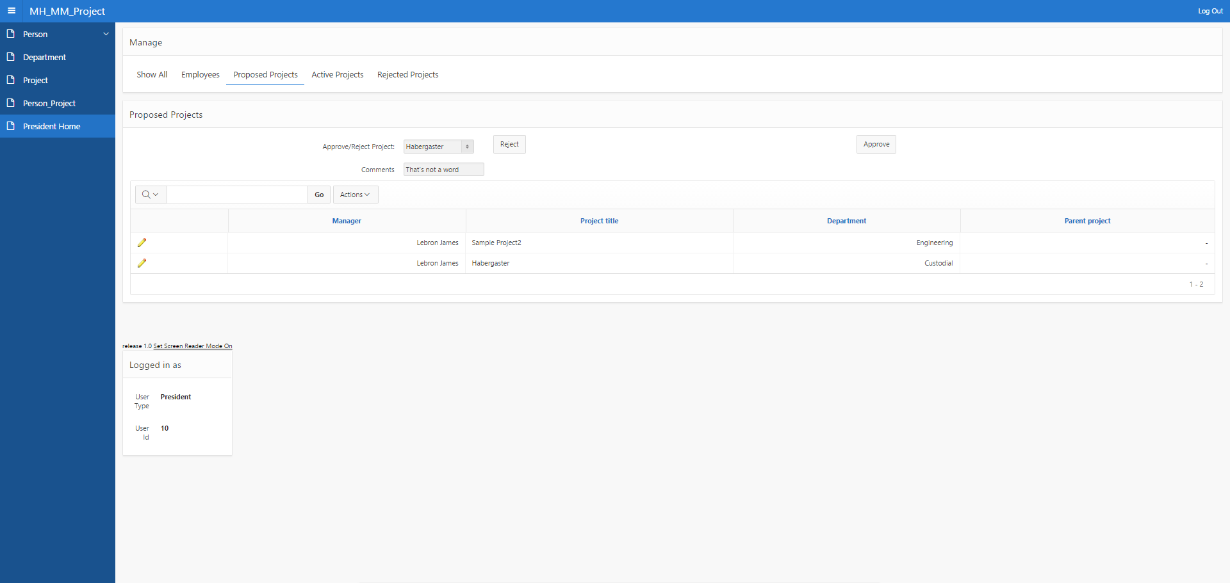
President Judging Projects

Slide 12
Part 2

Slide 13
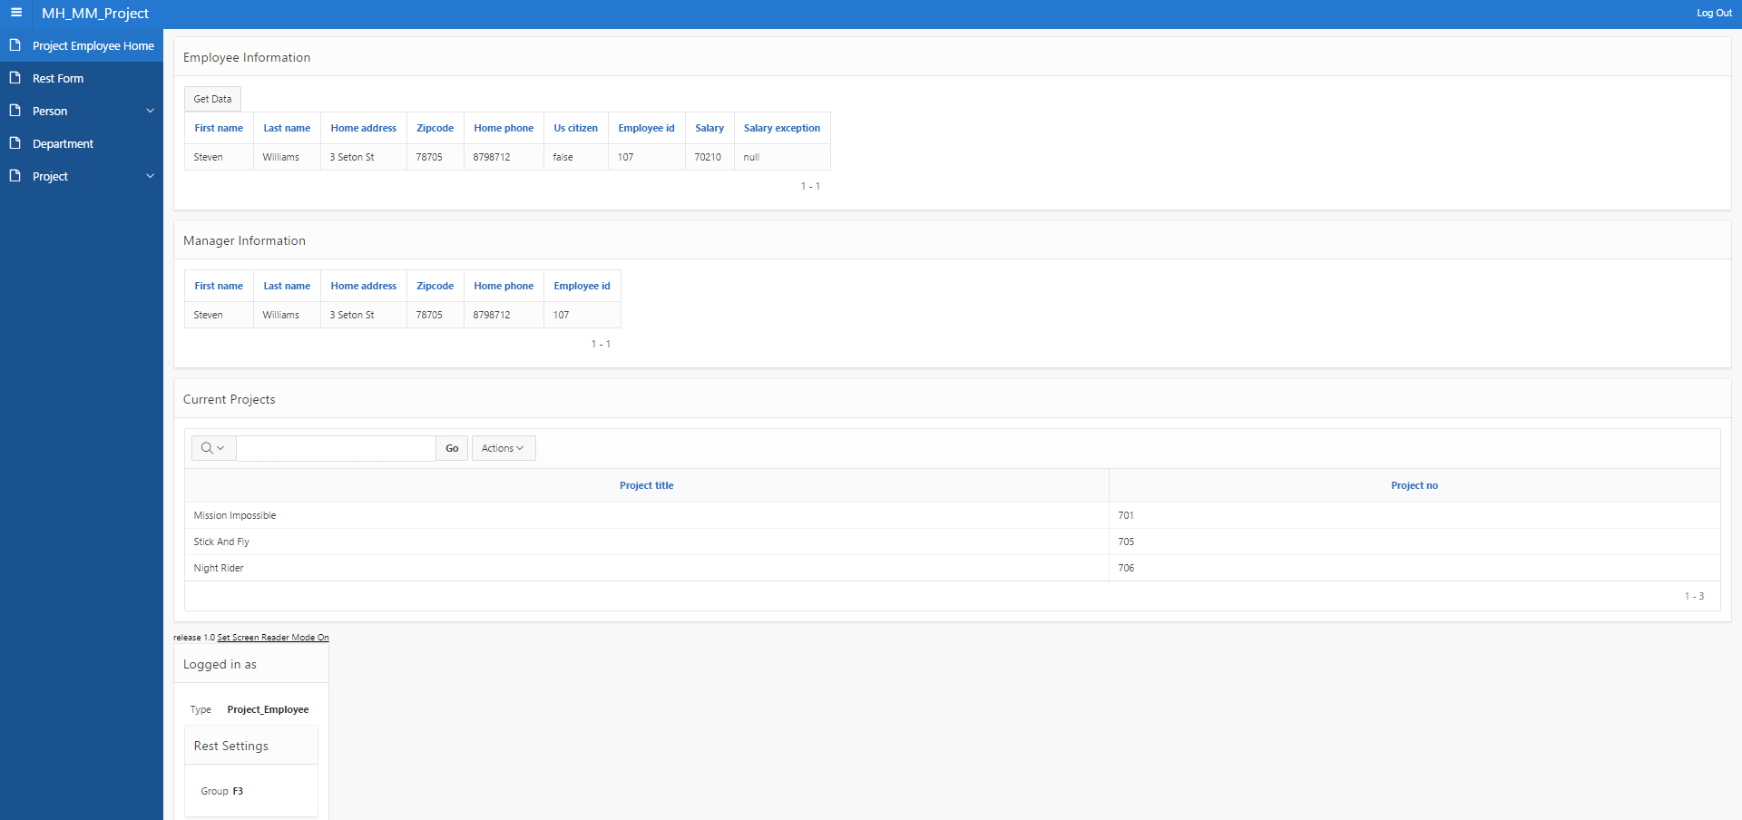
Project Employee

Slide 14
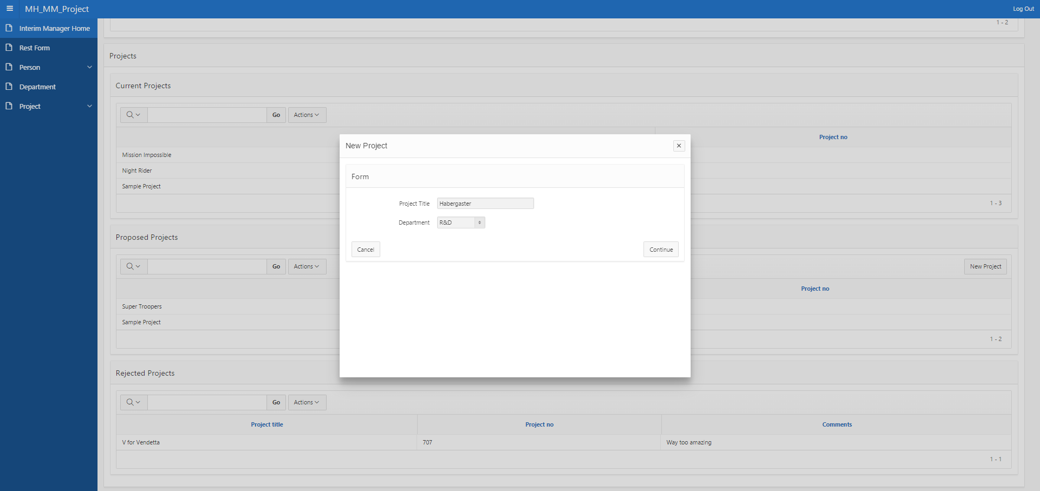
Interim Manager Proposing Project

Slide 15
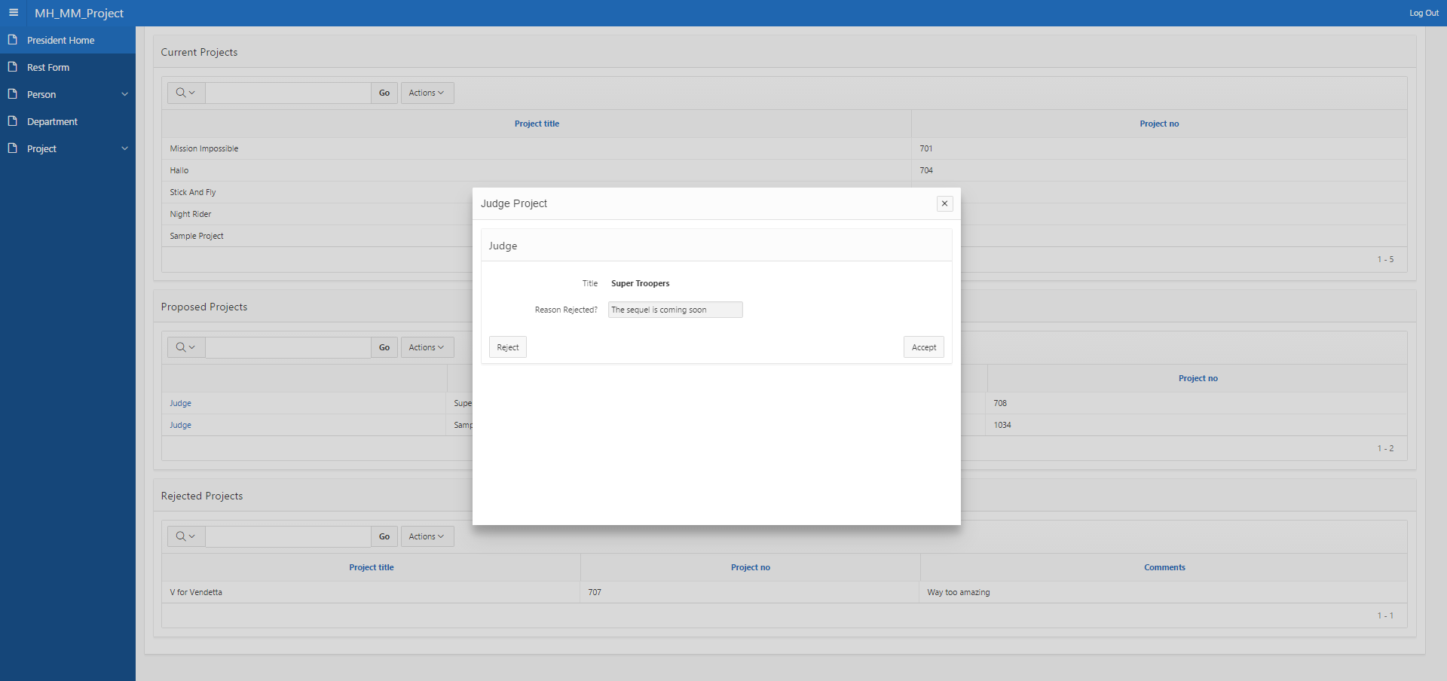
President Judging Project

Slide 16
SQL vs SIM The Epic Showdown
Relational
Mature development tools
SIM
Relationships through foreign keys
Difficulty in combining data
True logical relationships
Object Oriented
Intuitive relationship data combination
SIMple

Slide 17
Project Links
Part 1 Apex Application
Part 2 Apex Application
Github Page

