Slide 1
Qomo 3.0
左洪盛 zuohongsheng@redflag-linux.com
Qomo 3.0 系统介绍
Qomo 3.0 system init 系统——systemd

Slide 2
Qomo 3.0 系统介绍
新的主要特征包括：
1，启用新型的初始化系统——systemd，代替upstart。systemd负责内核启动后的所有系统启动工作、特别是守护进程的启动和监管。 从设计的角度systemd可以提高启动速度。不过3.0仅仅是引入了systemd，还有很多工作还需要做。
2， 汉化了部分package summary（引入社区的成果）
3， 主菜单增加了程序搜索功能，支持中文搜索。
4， 更换了默认壁纸。
5， 用libreoffice替换openoffice，为了控制iso的大小在700M以内（否则刻DVD太浪费了），把iso没有集成libreoffice。
6， 由于prism项目停止，后续产品没有跟上，导致依赖于prism 的sanguosha和webqqq没有集成。
重要的升级及其当前版本号：
dbus 1.4.10

Slide 3
Qomo 3.0 系统介绍
firefox 5.0.1
glibc 2.14
gcc 4.6.1
gtk 3.0.9
Ibus 1.3.9
initscripts 9.30
iputils 20100214
kde 4.6.5
kernel 3.0.3 （注：kernel3.0的硬件驱动更加丰富）
kpackagekit 0.6.3.3
Libreoffice 3.4
NetworkManager 0.8.4

Slide 4
Qomo 3.0 系统介绍
pam 1.1.3
plymouth 0.8.4
samba 3.5.9
systemd 28
udev 171
xorg-x11 7.6
xulrunner 5.0.1
修正的问题有：
1， 桌面时钟和bios时钟不一致的问题，
2， 系统设置中的打印机和相机设置缺失的问题，
3， “我的文档”打开后不显示其中的文件的问题。

Slide 5

Qomo 3.0 系统介绍

Slide 6
Qomo3.0 System Init 系统
Linux init system 介绍
Systemd ——新型的Linux init系统
cgroup——进程分组控制

Slide 7
Linux init system 介绍-init
Init 程序
unix-based系统的用户空间初始化程序（所有其它进程的祖先）；
daemon方式运行；
PID=1；
由kernel启动(/sbin/init)；
失败导致kernel panic；

Slide 8
Linux init system 介绍-服务守护进程（daemon）
后台常驻运行（background）
监护系统、提供服务功能
守护进程的管理：启动、关闭、查看

Slide 9
Linux init system 介绍-历史
19世纪80到90年代，Sys V 和 BSD
Gentoo 的openRC——sysV派生，完全用C写的、event-based；
Upstart ——是sysV init的event-based替代。
systemd——New-Style Daemons、cgroup-based.

Slide 10
Systemd
Qomo中的systemd——认识、使用systemd
new style daemon
理解cgroup

Slide 11
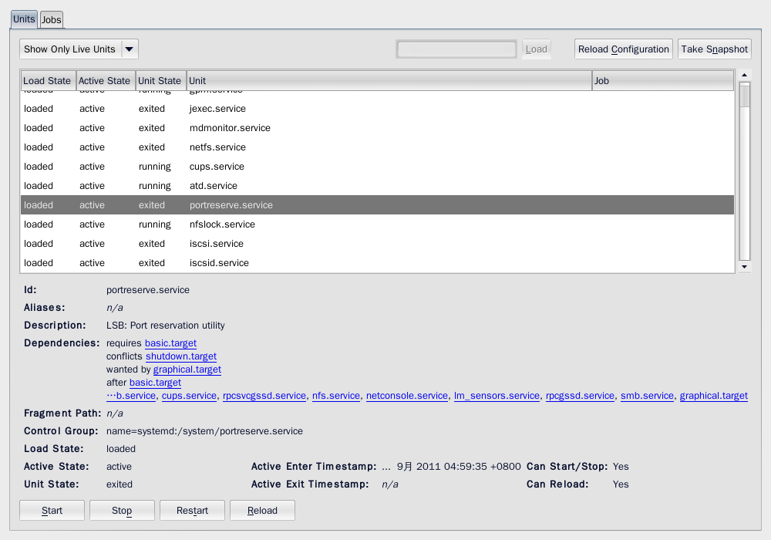
Systemd In Qomo
1, systemadm——服务管理的图形程序

Slide 12
Systemd In Qomo
2，systemd 和SYSV的兼容
root@localhost ~ pts1 # systemctl status sshd.service
sshd.service - SYSV: OpenSSH server daemon
Loaded: loaded (/etc/rc.d/init.d/sshd)
Active: active (running) since Thu, 08 Sep 2011 16:56:07 +0800; 6min ago
Main PID: 3445 (sshd)
CGroup: name=systemd:/system/sshd.service
└ 3445 /usr/sbin/sshd
注： 通过 状态查询可以看出daemon遵循SysV的格式。

Slide 13
Systemd In Qomo
root@localhost /lib/systemd/system pts2 # systemctl is-enabled sshd.service
sshd.service is not a native service, redirecting to /sbin/chkconfig.
Executing /sbin/chkconfig sshd –level=5
注：1，Returns an exit code of 0 if at least one is enabled；2，sshd不是systemd的native 服务，转给chkconfig处理。
root@localhost /lib/systemd/system pts2 # systemctl enable sshd.service
sshd.service is not a native service, redirecting to /sbin/chkconfig.
Executing /sbin/chkconfig sshd on
root@localhost /lib/systemd/system pts2 # /sbin/chkconfig |grep sshd
sshd 0:关闭 1:关闭 2:启用 3:启用 4:启用 5:启用 6:关闭
注：enable sshd 服务以后，用chkconfig查询其开关状态

Slide 14
Systemd In Qomo
3，服务的开启、关闭、查询
root@localhost /etc/rc.d/init.d pts2 # systemctl disable acpid.service
rm '/etc/systemd/system/multi-user.target.wants/acpid.service'
注：关闭服务。该服务是systemd的native服务，注意打印信息没有出现chkconfig。实际上删除链接就是关闭服务。
root@localhost /etc/rc.d/init.d pts2 # systemctl enable acpid.service
ln -s '/lib/systemd/system/acpid.service' '/etc/systemd/system/multi-user.target.wants/acpid.service'
注：打开服务就是建立链接，注意.wants类型的目录。

Slide 15
Systemd In Qomo
4， systemctl 的常用命令:
start [NAME...] Start (activate) one or more units
stop [NAME...] Stop (deactivate) one or more units
restart [NAME...] Start or restart one or more units
kill [NAME...] Send signal to processes of a unit
status [NAME...|PID...] Show runtime status of one or more units
enable [NAME...] Enable one or more unit files
disable [NAME...] Disable one or more unit files
is-enabled [NAME...] Check whether unit files are enabled
补充：systemctl的命令、service的名称支持自动补全。

Slide 16
Systemd的新型守护进程
传统的SysV Daemons
When a traditional SysV daemon starts, it should execute the following steps as part of the initialization（初始化）. Note that these steps are unnecessary for new-style daemons (see below), and should only be implemented if compatibility with SysV is essential.
1, Close all open file descriptors except STDIN, STDOUT, STDERR (i.e. the first three file descriptors 0, 1, 2). This ensures that no accidentally passed file descriptor stays around in the daemon process. On Linux this is best implemented by iterating through /proc/self/fd, with a fallback of iterating from file descriptor 3 to the value returned by getrlimit() for RLIMIT_NOFILE.
2, Reset all signal handlers to their default. This is best done by iterating through the available signals up to the limit of _NSIG and resetting them to SIG_DFL.
3, Reset the signal mask using sigprocmask().
4, Sanitize the environment block, removing or resetting environment variables that might negatively impact daemon runtime.
5, Call fork(), to create a background process.

Slide 17
Systemd的新型守护进程
6, In the child, call setsid() to detach from any terminal and create an independent session.
7, In the child, call fork() again, to ensure the daemon can never re-acquire a terminal again.
8, Call exit() in the first child, so that only the second child (the actual daemon process) stays around. This ensures that the daemon process is reparented to init/PID 1, as all daemons should be.
9,In the daemon process, connect /dev/null to STDIN, STDOUT, STDERR.
10, In the daemon process, reset the umask to 0, so that the file modes passed to open(), mkdir() and suchlike directly control the access mode of the created files and directories.
11, In the daemon process, change the current directory to the root directory (/), in order to avoid that the daemon involuntarily blocks mount points from being unmounted.
12, In the daemon process, write the daemon PID (as returned by getpid()) to a PID file, for example /var/run/foobar.pid (for a hypothetical daemon "foobar"), to ensure that the daemon cannot be started more than once. This must be implemented in race-free fashion so that the PID file is only updated when at the same time it is verified that the PID previously stored in the PID file no longer exists or belongs to a foreign process. Commonly some kind of file locking is employed to implement this logic.

Slide 18
Systemd的新型守护进程
13, In the daemon process, drop privileges, if possible and applicable.
14, From the daemon process notify the original process started that initialization is complete. This can be implemented via an unnamed pipe or similar communication channel that is created before the first fork() and hence available in both the original and the daemon process.
15, Call exit() in the original process. The process that invoked the daemon must be able to rely that this exit() happens after initialization is complete and all external communication channels established and accessible.

Slide 19
Systemd的新型守护进程
New-Style Systemd Daemons
现代的Linux服务应该采用新型的守护进程，好处是运行态的监管和控制更容易、简化了程序的部署。
开发新型的守护进程不需要SysV daemon所需的初始化步骤。
值得注意的是新式的init系统保证了守护进程的运行是在干净的进程上下文（in clean process contexts）；因此环境数据是不受其他进程影响的——信号句柄和掩码是重置的、没有文件描述符的衍生传递。守护进程将在它们自己的会话中运行，STDIN/STDOUT/STDERR 默认指向/dev/null ，umask被重置。
新型守护进程的实施步骤推荐如下：
1， If SIGTERM is received, shut down the daemon and exit cleanly.
2， If SIGHUP is received, reload the configuration files, if this applies.
3， Provide a correct exit code from the main daemon process, as this is used by the init system to detect service errors and problems. It is recommended to follow the exit code scheme as defined in the LSB recommendations for SysV init scripts.

Slide 20
Systemd的新型守护进程
4，If possible and applicable expose the daemon's control interface via the D-Bus IPC system and grab a bus name as last step of initialization.
5， For integration in systemd, provide a .service unit file that carries information about starting, stopping and otherwise maintaining the daemon. See systemd.service(5) for details.
6，As much as possible, rely on the init systemd's functionality to limit the access of the daemon to files, services and other resources. i.e. in the case of systemd, rely on systemd's resource limit control instead of implementing your own, rely on systemd's privilege dropping code instead of implementing it in the daemon, and similar. See systemd.exec(5) for the available controls.
7，If D-Bus is used, make your daemon ，bus-activatable, via supplying a D-Bus service activation configuration file. This has multiple advantages: your daemon may be started lazily on-demand; it may be started in parallel to other daemons requiring it -- which maximizes parallelization and boot-up speed; your daemon can be restarted on failure, without losing any bus requests, as the bus queues requests for activatable services. See below for details.
8，If your daemon provides services to other local processes or remote clients via a socket, it should be made socket-activatable following the scheme pointed out below. Like D-Bus activation this enables on-demand starting of services as well as it allows improved

Slide 21
Systemd的新型守护进程
parallelization of service start-up. Also, for state-less protocols (such as syslog, DNS) a daemon implementing socket-based activation can be restarted without losing a single request. See below for details.
9，If applicable a daemon should notify the init system about startup completion or status updates via the sd_notify(3) interface.
10，Instead of using the syslog() call to log directly to the system syslog service, a new-style daemon may choose to simply log to STDERR via fprintf(), which is then forwarded to syslog by the init system. If log priorities are necessary these can be encoded by prefixing individual log lines with strings like "<4>" (for log priority 4 "WARNING" in the syslog priority scheme), following a similar style as the Linux kernel's printk() priority system. In fact, using this style of logging also enables the init system to optionally direct all application logging to the kernel log buffer (kmsg), as accessible via dmesg(1). This kind of logging may be enabled by setting StandardError=syslog in the service unit file. For details see sd-daemon(7) and systemd.exec(5).
守护进程的唤醒——Activation
新型init系统的多方式唤醒， 例如: bluetoothd.service might get activated either when Bluetooth hardware is plugged in, or when an application accesses its programming interfaces via D-Bus. Or, a print server daemon might get activated when traffic arrives at an IPP

Slide 22
Systemd的新型守护进程
port, or when a printer is plugged in, or when a file is queued in the printer spool directory.
即便是对于无条件随系统启动的服务，为了增加并行化程度，也应该尽可能部署更多的启动方式。if a daemon implements a D-Bus service or listening socket, implementing the full bus and socket activation scheme allows starting of the daemon with its clients in parallel (which speeds up boot-up), since all its communication channels are established already, and no request is lost because client requests will be queued by the bus system (in case of D-Bus) or the kernel (in case of sockets), until the activation is completed.
Activation on Boot——a symlink to the unit file in the .wants/ directory of either multi-user.target or graphical.target；
Socket-Based Activation——基于socket的唤醒设计中，socket的建立和绑定不在daemon的代码中、而是在init系统代码中。根据每个daemon的配置，init系统为其建立socket。这样服务的启动就可以延迟到第一笔数据业务到来时，形成按需启动的模式。然而，此种设计的最大收益是socket创建后它的提供者和使用者可以并行启动。 另外服务重启时、socket是可用的、有缓存的。 systemd implements socket-based activation via .socket units。参加手册systemd.socket
Bus-Based Activation——configured in D-Bus service files（/usr/share/dbus-1/system-services/xxx.service）。

Slide 23
Systemd的新型守护进程
重要设定：SystemdService——使D-Bus通过systemd启动和维护daemon。
Device-Based Activation——设备插拔时启动对应的服务
systemd will automatically create dynamic device units for all kernel devices that are marked with the "systemd" udev tag (by default all block and network devices, and a few others). This may be used to define dependencies between devices and other units.
“systemctl status sys-devices-” TAB补全可以看到已有的.device unit
/run/udev/data中的文件包含tag
通常通过专用的targets从设备引导服务.
Path-Based Activation—— .path units
PathExists=, PathChanged=, DirectoryNotEmpty=
Timer-Based Activation——via .timer units。例子：systemd-tmpfiles-clean.service systemd-tmpfiles-clean.timer

Slide 24
Systemd的新型守护进程
已有SysV daemon的移植（porting）
因为systemd兼容SysV，因此porting不是必须的。然而porting可以提高服务的性能、并能简化系统的整合。移植的步骤一般包括：
1,如果systemd还没有部署，为daemon增加一个参数关闭daemonization动作。这样不仅在新型init 系统中可以用，也可以减低调试的难度。参数可以写进
2, 如果daemon 通过本地AF_UNIX套接字为其它程序提供接口，需要实现socket-based唤醒方式。 通常加一个patch：1）， 在daemon代码socket创建部份，首先用sd_listen_fds()(注：Check for file descriptors passed by the init system.)检查传递进来的socket。如果已有socket进来，就跳过创建socket的步骤。2），daemon结束时要确保传递进来的socket没有被移除。3）关闭文件描述符时要略过传递进来的socket。其实在新型系统中可以保证没有其它文件描述符的传递，因此最好省略关闭文件描述符的操作。
3，编写unit 文件： .service 、.socket、.path、.timer。
4，如果有D-Bus接口，编写D-Bus启动接口文件。

Slide 25
理解cgroup—定义
用途：通过对进程分组，实现资源（cpu、mem等）使用的调配和监控。
内核特征： General setup ---
Control Group support --->
kernel version 2.6.24
定义：A control group is a collection of processes that are bound by the same criteria. These groups can be hierarchical（分等级）, where each group inherits（继承） limits from its parent group。

Slide 26
理解cgroup—基础概念
Subsystems, Hierarchies, Control Groups and Tasks
Subsystems，也叫resource controllers（资源控制器）。
Control Groups，具体的控制组；
Hierarchies，控制组的层级结构体；
Tasks，任务即进程
它们之间遵循如下关系规则：
一个控制器不能应用于多个结构体；
一个层级结构体可以部署多个控制器；
新建结构体的默认控制组包含系统的所有进程；默认控制组是层级结构体的根控制组（root cgroup）
一个结构体中，一个进程只能属于一个控制组；
子进程自动归属于父进程所在的控制组（不过可以移动到其他控制组）。

Slide 27
理解cgroup—实践
1，/proc/cgroups ——查看内核提供的控制器
2，/proc/$PID/cgroup ——查看进程所在的控制器
比如，cat /proc/6601/cgroup
8:perf_event:/
7:freezer:/
6:devices:/
5:memory:/
4:cpuacct:/
3:cpu:/system/prefdm.service
2:cpuset:/
1:name=systemd:/system/prefdm.service

Slide 28
理解cgroup—实践
3， ps -o pid,cgroup，
ps -o pid,cgroup -e 说明：查看进程号、控制器、控制组
4，cgroup虚拟文件系统（cgroup virtual file system）
root@localhost ~ pts1 # grep cgroup /proc/mounts |grep tmpfs
tmpfs /sys/fs/cgroup tmpfs rw,nosuid,nodev,noexec,relatime,mode=755 0 0
说明：cgroup-ROOT是层级结构体的根，通过mount建立，包含所有的进程。
5，Qomo3.0中的默认层级结构体
root@localhost ~ pts1 # grep cgroup /proc/mounts
tmpfs /sys/fs/cgroup tmpfs rw,nosuid,nodev,noexec,relatime,mode=755 0 0
cgroup /sys/fs/cgroup/systemd cgroup rw,nosuid,nodev,noexec,relatime,release_agent=/lib/systemd/systemd-cgroups-agent,name=systemd 0 0
cgroup /sys/fs/cgroup/cpuset cgroup rw,nosuid,nodev,noexec,relatime,cpuset 0 0

Slide 29
理解cgroup—实践
cgroup /sys/fs/cgroup/cpu cgroup rw,nosuid,nodev,noexec,relatime,cpu 0 0
cgroup /sys/fs/cgroup/cpuacct cgroup rw,nosuid,nodev,noexec,relatime,cpuacct 0 0
cgroup /sys/fs/cgroup/memory cgroup rw,nosuid,nodev,noexec,relatime,memory 0 0
cgroup /sys/fs/cgroup/devices cgroup rw,nosuid,nodev,noexec,relatime,devices 0 0
cgroup /sys/fs/cgroup/freezer cgroup rw,nosuid,nodev,noexec,relatime,freezer 0 0
cgroup /sys/fs/cgroup/perf_event cgroup rw,nosuid,nodev,noexec,relatime,perf_event 0 0
说明：一个层级结构体对应一个mount，部署控制器对应mount的参数设定，上面例子中的最后一个参数就是控制器。
6，利用mkdir建立cgroup子系统。在cgroup-ROOT里面创建一个目录就是增加了一个子类控制组（目录默认不是空的！）。把需要控制的进程添加到控制组的tasks后该进程将被这个控制组控制。

Slide 30
理解cgroup—实践
7，最特殊的控制器——systemd 控制器，
release_agent=/lib/systemd/systemd-cgroups-agent
控制器由systemd提供（不是内核）。

Slide 31
总结
Qomo 3.0采用systemd后，系统的基础架构虽然发生了很大的变化，但系统还是非常稳定的。
我们将对系统精雕细琢，使系统更加完善。随着系统的逐步完善，会有较多的新版本奉献给大家。
在qomo桌面系统达到较高的健壮程度以后，我们将在应用层面加大工作力度。比如：增加GNOME、XFCE等桌面类型，形成具有实用价值的软件包组，增加社区需要的各种应用程序。
感谢广大社区成员对Qomo的喜爱和支持，也希望有更多的项目出现在社区里面。
本文参考：
http://0pointer.de/public/systemd-man/
http://docs.redhat.com/docs/en-US/Red_Hat_Enterprise_Linux/6/html/Resource_Management_Guide/sec-Relationships_Between_Subsystems_Hierarchies_Control_Groups_and_Tasks.html

Slide 32
谢谢
2011年9月15日

