Slide 1
The College Board:
Board of Trustees
Welcome and thank you!

Slide 2
My Name is Adam Hudziec:
Member of the Data Science Team:
Data Science Team tracks statewide participation and recommends where money is best spent to improve SAT participation rates.

Slide 3
Problem Statement:
Where should the College Board place it's money to best improve SAT participation rates?

Slide 4
The Problem Statement in Context:
Who and What is the College Board?
What is the alternative?

Slide 5
Executive Summary:
My recommendation to you, the board, is to invest resources where ACT isn't.
What do I mean by this?
ACT information for participation has just been released . This information gives us an insight into which states ACT participation is dropping.

Slide 6
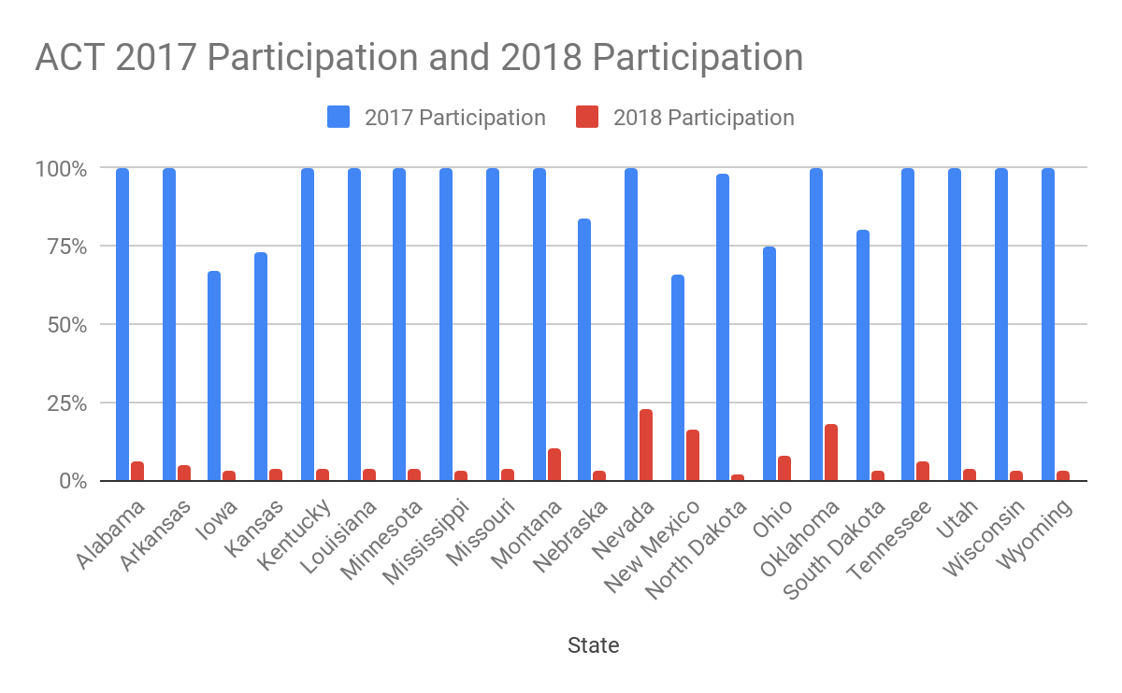

Slide 7
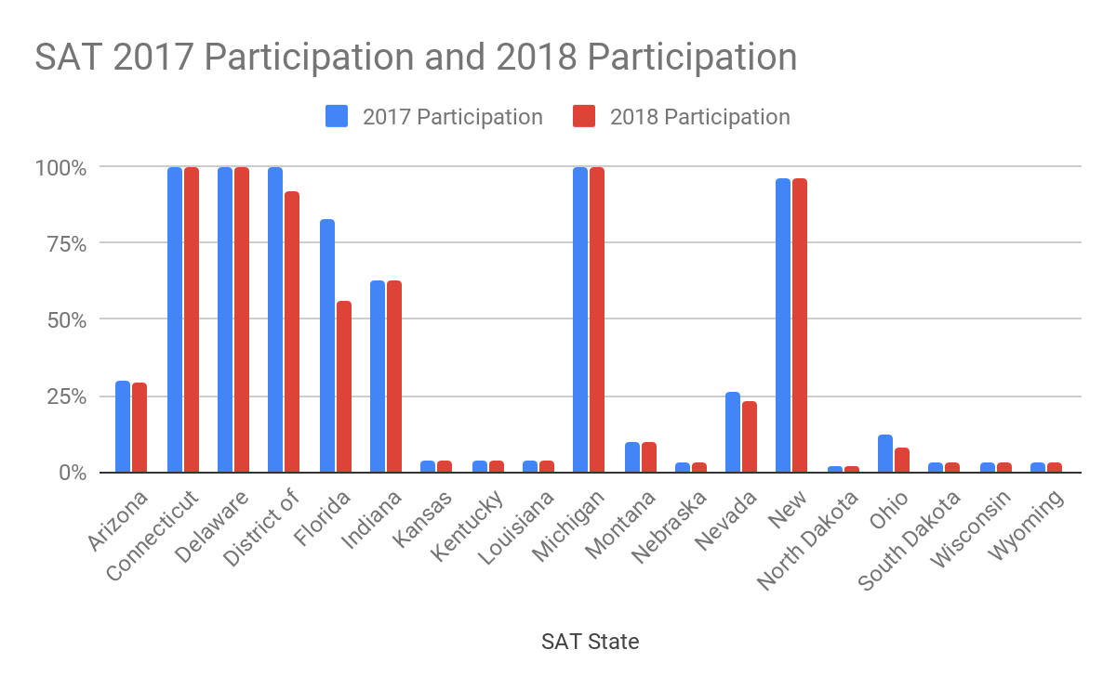

Slide 8
 | SAT | SAT | ACT | ACT
State | 2017 Participation | 2018 Participation | 2017 Participation | 2018 Participation
Kansas | 4% | 4% | 73% | 4%
Kentucky | 4% | 4% | 100% | 4%
Louisiana | 4% | 4% | 100% | 4%
Nebraska | 3% | 3% | 84% | 3%
North Dakota | 2% | 2% | 98% | 2%
Wisconsin | 3% | 3% | 100% | 3%
Wyoming | 3% | 3% | 100% | 3%

Slide 9
Conclusions & Recommendations
Recommended places for the College Board place it's money to best improve SAT participation rates?
Kansas, Kentucky, Louisiana, Nebraska, North Dakota, Wisconsin, and Wyoming.

Slide 10
References
https://blog.collegevine.com/here-are-the-average-sat-scores-by-state/
https://blog.prepscholar.com/act-scores-by-state-averages-highs-and-lows
https://www.princetonreview.com/college/sat-information
https://www.princetonreview.com/college/act-information?ExDT=2&gclid=CjwKCAiAwojkBRBbEiwAeRcJZFZwX7oQBBo4TFcO-_Zf0SylrE30e2y56-T9AhWL6sr5AhrZzEkQuBoCVEoQAvD_BwE
2017 & 2018 ACT & SAT information provided by Bethany Poulin

