Slide 1

  Campus Networks Design

Slide 2


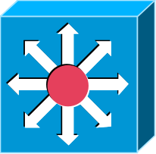

Icons
Router
Workgroup Switch
High-End Switch
Multilayer Switch with Route Processor
- Don’t let the location of the links into this icon confuse you. This will become clearer when we configure this device.

Slide 3
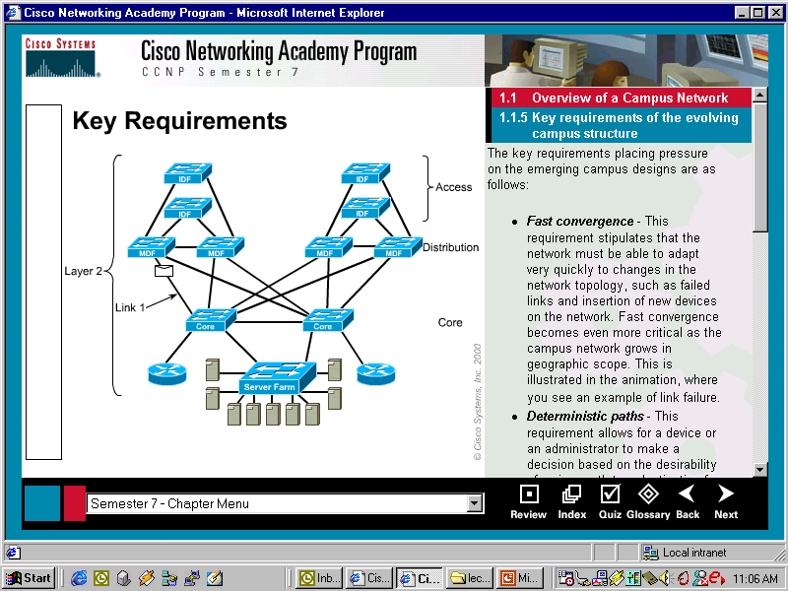
Traditional Campus Networks

Slide 4
Traditional Campus Networks
Campus Network
A building or group of buildings connected into one enterprise network that consists of or more LANs.
The company usually owns the physical wires deployed in the campus.
Generally uses LAN technologies.
Generally deploy a campus design that is optimized for the fastest functional architecture over existing wire.

Slide 5
Traditional Campus Networks
Network Administrator Challenges
LAN run effectively and efficiently
Availability and performance impacted by the amount of bandwidth in the network
Understand, implement and manage traffic flow
Current Issues
Broadcasts: IP ARP requests
Emerging Issues
Multicast traffic (traffic propagated to a specific group of users on a subnet), video conferencing, multimedia traffic
Security and traffic flow

Slide 6
Today’s LANs

Slide 7
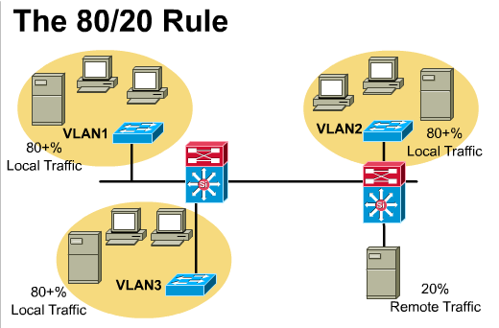
Follow the 20/80 rule, not the 80/20
Traditional 80/20 rule
  80% traffic local to subnet, 20% remote
“Remote” traffic
  Traffic across the backbone or core to enterprise servers, Internet, remote sites, other subnets (more coming)

Slide 8
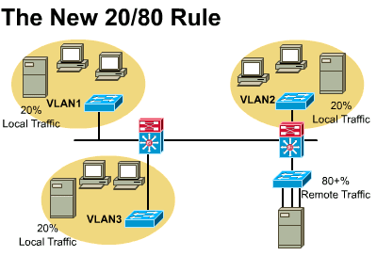
New 20/80 rule
  20% traffic local to subnet, 80% remote
Traffic moving towards new 20/80 rule due to:
  Web based computing
  Servers consolidation of enterprise and workgroup servers into centralized server farms due to reduced TCO, security and ease of management

Slide 9
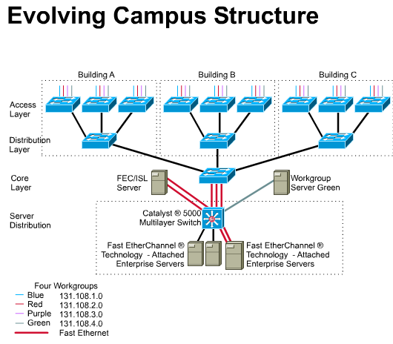
New Campus Model services can be separated into categories:
  Local
  Remote
  Enterprise

Slide 10
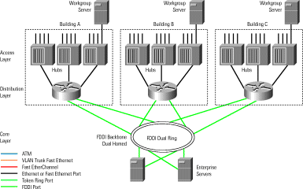
Traditional Router and Hub Campus

Slide 11
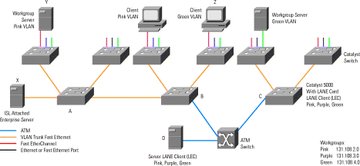
Virtual LAN (VLAN) Technologies
Many of these diagrams have further explanations that follow. Much of this should be review from CIS 183, but will also be covered in much more detail later on this semester. Read on your own. Link at end of presentation.

Slide 12
(FYI: Review) One of the technologies developed to enable campus-wide VLANs is VLAN trunking. A VLAN trunk between two Layer 2 switches allows traffic from several logical networks to be multiplexed. A VLAN trunk between a Layer 2 switch and a router allows the router to connect to several logical networks over a single physical interface. In Figure 2, a VLAN trunk allows server X to talk to all the VLANs simultaneously. The yellow lines in Figure 1 are Inter-Switch Link (ISL) trunks that carry the pink, purple, and green VLANs.
802.1q is a VLAN tagging protocol that was developed to allow VLAN trunking. The VLAN tag is an integer incorporated into the header of frames passing between two devices. The tag value allows the data from multiple VLANs to be multiplexed and demultiplexed.

Slide 13
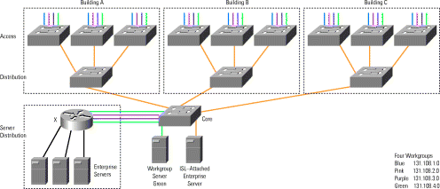
Traditional Campus-Wide VLAN Design

Slide 14
(FYI: Review) Layer 2 switching is used in the access, distribution, and core layers. Four workgroups represented by the colors blue, red, purple, and green are distributed across several access-layer switches. Connectivity between workgroups is by Router X that connects to all four VLANs. Layer 3 switching and services are concentrated at Router X. Enterprise servers are shown behind the router on different logical networks indicated by the black lines.
The various VLAN connections to Router X could be replaced by an ISL trunk. In either case, Router X is typically referred to as a "router on a stick" or a "one-armed router." More routers can be used to distribute the load, and each router attaches to several or all VLANs. Traffic between workgroups must traverse the campus in the source VLAN to a port on the gateway router, then back out into the destination VLAN.

Slide 15
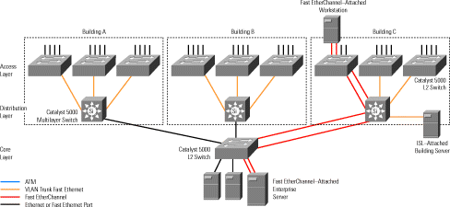
Multilayer Campus Design with Multilayer Switching (Switch Blocks)

Slide 16
(FYI: Review) Because Layer 3 switching is used in the distribution layer of the multilayer model, this is where many of the characteristic advantages of routing apply. The distribution layer forms a broadcast boundary so that broadcasts don't pass from a building to the backbone or vice-versa. Value-added features of the Cisco IOS software apply at the distribution layer. For example, the distribution-layer switches cache information about Novell servers and respond to Get Nearest Server queries from Novell clients in the building. Another example is forwarding Dynamic Host Configuration Protocol (DHCP) messages from mobile IP workstations to a DHCP server.

Slide 17
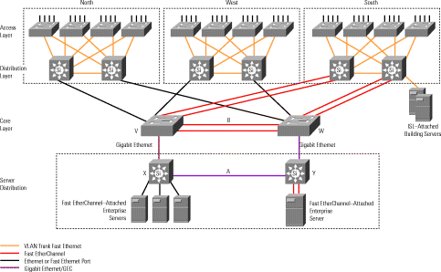
Multilayer Model with Server Farm

Slide 18
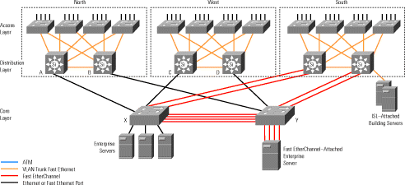
Redundant Multilayer Campus Design (Switch Blocks)

Slide 19
Switching
Layer 2 Switching
  Switches based on MAC address
  “hardware based bridging”
  edge of the network (new campus mode)
Layer 3 Switching
  Switching at L2, hardware-based routing at L3
Layer 4 Switching
  Switching at L2, hardware-based routing at L3, with decisions optionally made on L4 information (port numbers)
  Forwarding decisions based on MAC address, IP address, and port numbers
  Help control traffic based on QOS
ASIC (Application-specific Integrated Circuit)
  Specialized hardware that handles frame forwarding in the switch

Slide 20
Router versus Switch
Router typically performs software-based packet switching (process of looking it up first in the routing tables)
Switch typically performs hardware-based frame switching (ASIC)

Slide 21
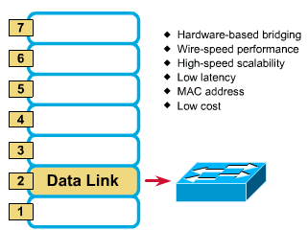
Layer 2 Switching

Slide 22
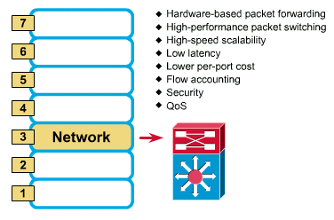
Layer 3 Switching
Hardware-based routing

Slide 23
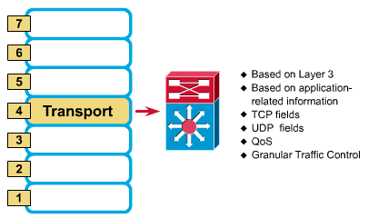
Layer 4 Switching

Slide 24
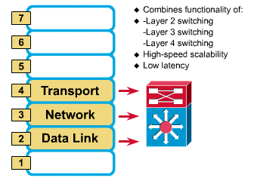
MLS (Multi-Layer Switching)

Slide 25
MLS
Cisco’ specialized form of switching and routing, not generic L3 routing/L2 switching
Multilayer Switches can operate at Layers 2, 3, and 4
cannot be performed using our CCNP lab equipment (Catalyst 4006 switches and 2620 routers)
“route once, switch many”

Slide 26
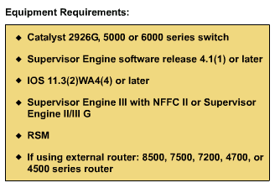
MLS
sometimes referred to as “route once, switch many” (later)

Slide 27
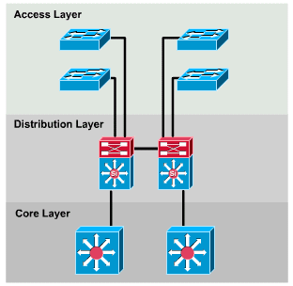
3-Layer Hierarchical Design Model

Slide 28
3-Layer Hierarchical Design Model
The devices and concepts are slightly different then the 3-layer model used in Sem 5 Routing.
Conceptual only!
There will be contradictions and some devices may be argued as one type of device or another.

Slide 29

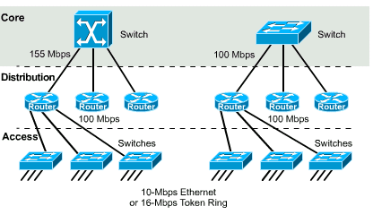

Core Layer
Internet
Remote Site
Various options and implementations possible.

Slide 30
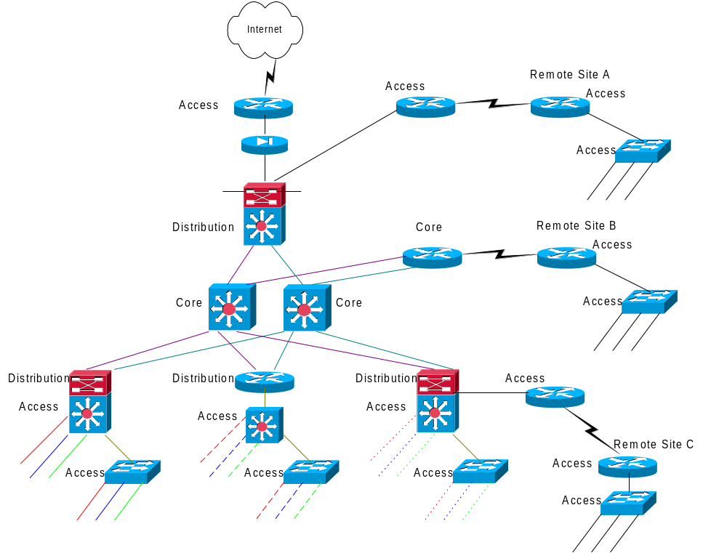
Sample 3-layer hierarchy

Slide 31
Core Layer
Switches packets as fast as possible
Considered the backbone of the network
Should not perform packet manipulation
  No ACLs
  No routing (usually)
  No trunking
  VLANs terminated at distribution device

Slide 32
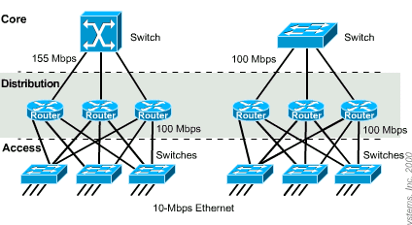
Distribution Layer

Slide 33
Distribution Layer
The distribution layer of the network divides the access and core layers and helps to define and differentiate the core.
  Departmental or workgroup access
  Broadcast/multicast domain definition
  VLAN routing
  Any media transitions that need to occur
  Security
  Packet manipulation occurs here

Slide 34
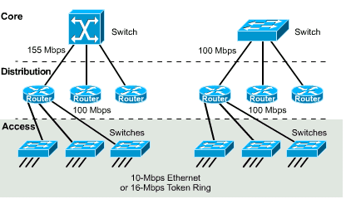
Access Layer

Slide 35
Access Layer
The access layer is the point at which local end users are allowed into the network.
  Shared bandwidth
  Switched bandwidth
  MAC-layer filtering or 802.1x
  Microsegmentation
  Remote users gain network access, VPN

Slide 36
Building Blocks
Network building blocks can be any one of the following fundamental campus elements:
  Switch block
  Core block
Contributing variables
  Server block
  WAN block
  Mainframe block
  Internet connectivity

Slide 37
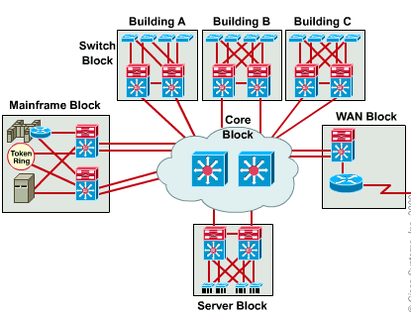
Building Blocks
Internet Block could also be included

Slide 38
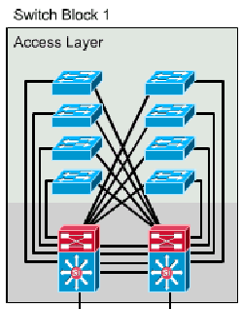
Switch Block
Multiple DL devices shown for load balancing and redundancy. This may not be the case in many networks.
Consists of both switch and router functions.
  Access Layer (AL)
    L2 devices (workgroup switches: Catalyst 2960, 2900, 3500XL)
  Distribution Layer (DL)
    L2/L3 devices (multilayer switches: Catalyst 4500, 6500)
    L2 and separate L3 device (Catalyst 3600XL with 2800 series router-on-a-stick, etc.)

Slide 39
Switch Block
AL – Access Layer
  L2 switches in the wiring closets connect users to the network at the access layer and provide dedicated bandwidth to each port.
DL – Distribution Layer
  L2/L3 switch/routers provide broadcast control, security and connectivity for each switch block.

Slide 40
Switch Block
-AL
Backup
Primary
AL devices merge into one or more DL devices.
L2 AL devices have redundant connections to the DL device to maintain resiliency.
  Spanning-Tree Protocol (STP) makes redundant links possible

Slide 41
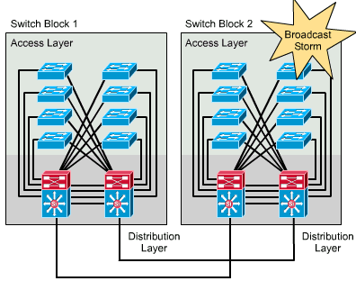
Switch Block - DL
The DL device:
  a switch and external router or
  a multilayer switch (Catalyst 4500)
  provides L2 and L3 services
  shields the switch block against broadcast storms (and L2 errors)

Slide 42
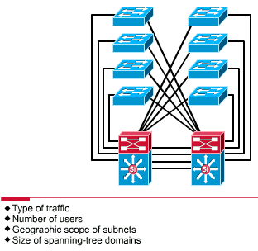
Sizing the Switch Block

Slide 43
Sizing the Switch Block
A switch block is too large if:
  A traffic bottleneck occurs in the routers at the distribution layer because of intensive CPU processing resulting from policy-based filters
  Broadcast or multicast traffic slows down the switches and routers

Slide 44
Core Block
A core is required when there are two or more switch blocks, otherwise the core or backbone is between the distribution switch and the perimeter router.
The core block is responsible for transferring cross-campus traffic without any processor-intensive operations.
All the traffic going to and from the switch blocks, server blocks, the Internet, and the wide-area network must pass through the core.

Slide 45
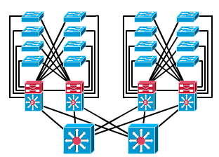
Core Block
Core Switches:
Catalyst 6500
Core Block

Slide 46
Core Block
Traffic going from one switch block to another also must travel through the core.
The core handles much more traffic than any other block.
  must be able to pass the traffic to and from the blocks as quickly as possible

Slide 47
Core Block
Cisco 6500 supports:
  up to 384 10/100 Ethernet
  192 100FX Fast Ethernet
  8 OC12 ATM
  up to 130 Gigabit Ethernet ports
  switching bandwidth up to 256 Gbps
  scalable multilayer switching up to 170 Mpps.

Slide 48
Core Block
Because VLANs terminate at the distribution device, core links are not trunk links and traffic is routed across the core.
  core links do not carry multiple VLANs per link.
One or more switches can make up a core subnet
  a minimum of two devices must be present in the core to provide redundancy

Slide 49
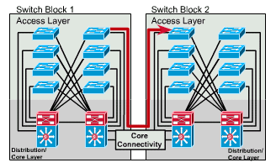
Collapsed Core
Distribution and Core Layer functions performed in the same device.

Slide 50
Collapsed Core
consolidation of DL and core-layer functions into one device.
  prevalent in small campus networks
each AL switch has a redundant link to the DL switch.
Each AL switch may support more than one subnet; however, all subnets terminate on L3 ports on the DL/core switch

Slide 51
Collapsed Core
Redundant uplinks provide L2 resiliency between the AL and DL switches.
  Spanning tree blocks the redundant links to prevent loops.
Redundancy is provided at Layer 3 by the dual distribution switches with Hot Standby Router Protocol (HSRP), providing transparent default gateway operations for IP. (later)

Slide 52
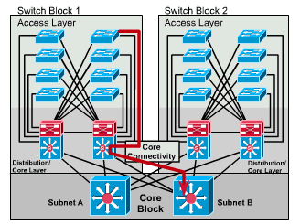
Dual Core

Slide 53
Dual Core
necessary when two or more switch blocks exist and redundant connections are required
provides two equal-cost paths and twice the bandwidth.
Each core switch carries a symmetrical number of subnets to the L3 function of the DL device.
Each switch block is redundantly linked to both core switches, allowing for two distinct, equal path links.

Slide 54
Choosing a Cisco Product
Know particulars! (Number and types of ports)
Access Layer Switches
  2960, 4500
Distribution Layer Switches
  2960G, 6500, 3750
Core Layer Switches
  6500

