Slide 1
Chapter 3
Chapter 3
Basic Foundations:
Standards, Models, and Language
And
Chapter 13
Network Management Applications
Network Management: Principles and Practice
© Mani Subramanian 2000

Slide 2
Chapter 3
Introduction
Standards
  Standards organizations
  Protocol standards of transport layers
  Protocol standards of management
  (application) layer
Management Models
Language
  Notes
Network Management: Principles and Practice
© Mani Subramanian 2000

Slide 3
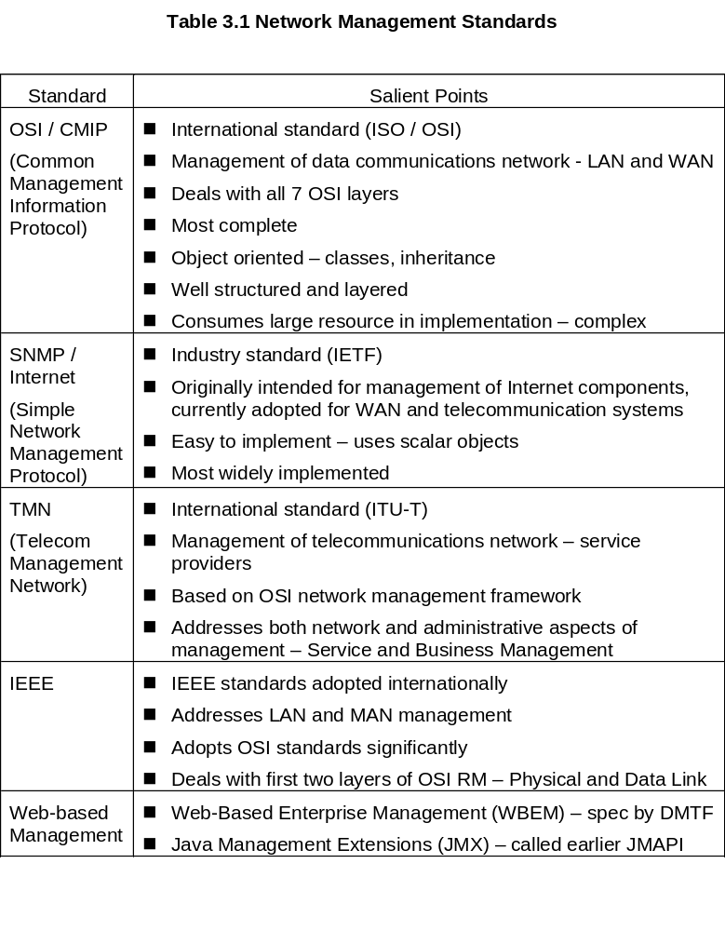
Chapter 3
Network Management: Principles and Practice
© Mani Subramanian 2000

Slide 4
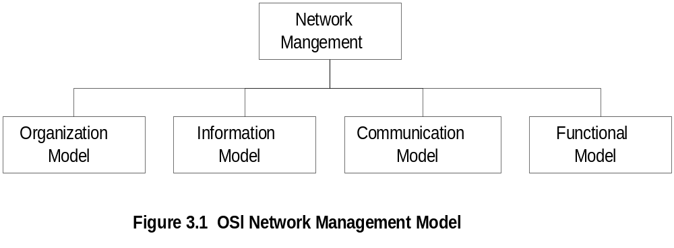
Chapter 3
OSI NM Architecture and Model
  Notes
Organization model
  Network management components
    object, agent, and manager
  Functions of components
  Relationships
Information model
  Structure of management information (SMI)
    Syntax and semantics
  Management information base (MIB)
    Organization of management information
  Object-oriented
Network Management: Principles and Practice
© Mani Subramanian 2000

Slide 5
Chapter 3
OSI NM Architecture and Model
  Notes
Communication model
  Transfer syntax with bi-directional messages
    M-SET, M-GET
  Transfer structure (PDU)
Functional model – User oriented requirements of NM
  Application functions (Covered in chapter 13)
    Configure components (CM)
    Monitor components (FM)
    Measure performance (PM)
    Secure information (SM)
    Usage accounting (AM)
Network Management: Principles and Practice
© Mani Subramanian 2000

Slide 6
Chapter 3
SNMP Architecture and Model
(Not defined explicitly)
  Notes
Organization model
  Same as OSI model
Information model
  Same as OSI, but scalar
Communication model
  Messages less complex than OSI
  and unidirectional (request, response)
  Transfer structure (PDU)
Functional model
  Application functions in terms of
    Operations (get, set)
    Administration – who has access to what
    Security – community-based
Network Management: Principles and Practice
© Mani Subramanian 2000

Slide 7
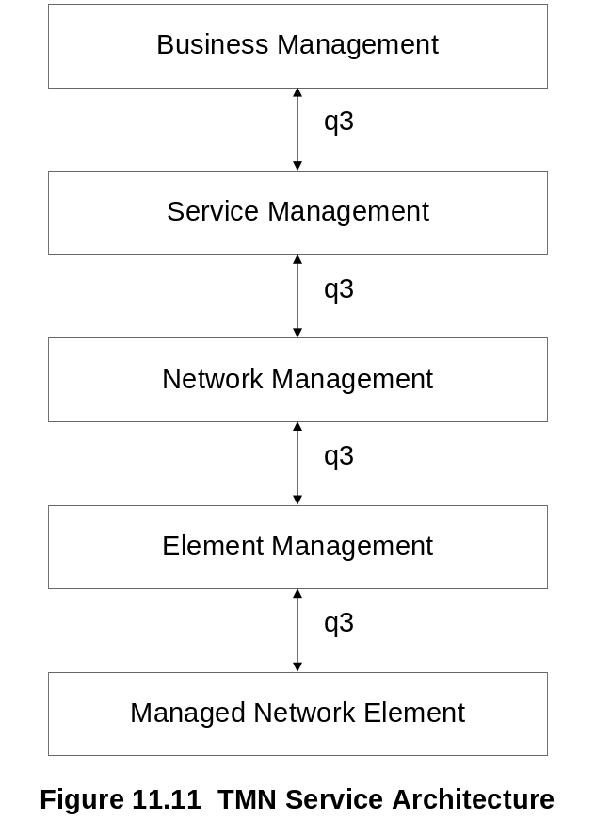
Chapter 3
TMN Architecture
Addresses management of telecommunication
networks
Based on OSI model
Superstructure on OSI network
Addresses network, service, and business
management
See chapter 11 for more details
Network Management: Principles and Practice
© Mani Subramanian 2000

Slide 8
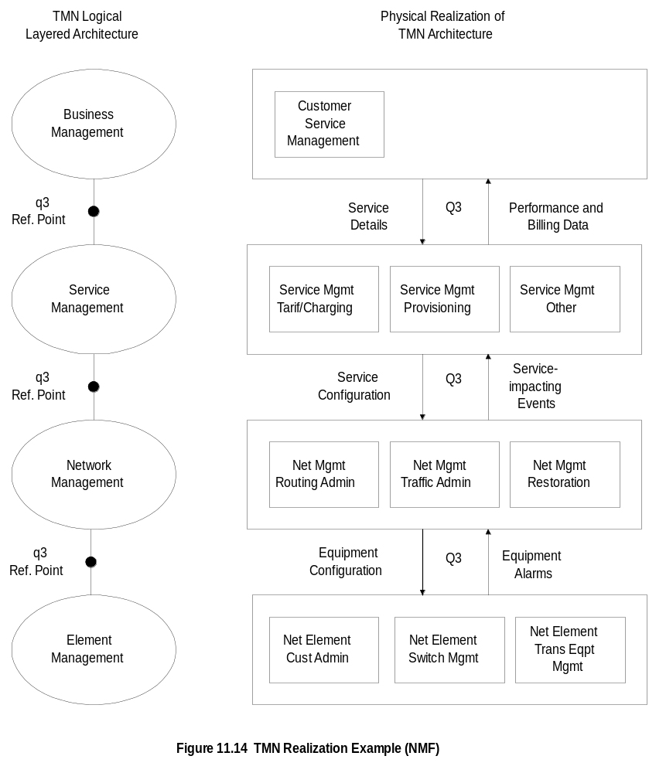
Chapter 11
Example (NMF)
Network Management: Principles and Practice
© Mani Subramanian 2000

Slide 9
Chapter 3
Organization Model
Manager
  Manages the managed elements
  Sends requests to agents, retrieves management information & stores it in MDB
  Monitors alarms – unsolicited traps/notifications from agents
  Houses applications, e.g., CM, FM, etc.
  Provides user interface, e.g., HPOpenview
Agent
  Gathers information from objects – get
  Configures parameters of objects – set
  Responds to managers’ requests – response
  Generates alarms and sends them to
  managers (unsolicited) – trap
Managed object
  Network element that is managed, e.g., hubs, bridges, etc.
  Houses management agent – process running
  All objects are either not managed or
  manageable (more expensive)
Network Management: Principles and Practice
© Mani Subramanian 2000

Slide 10
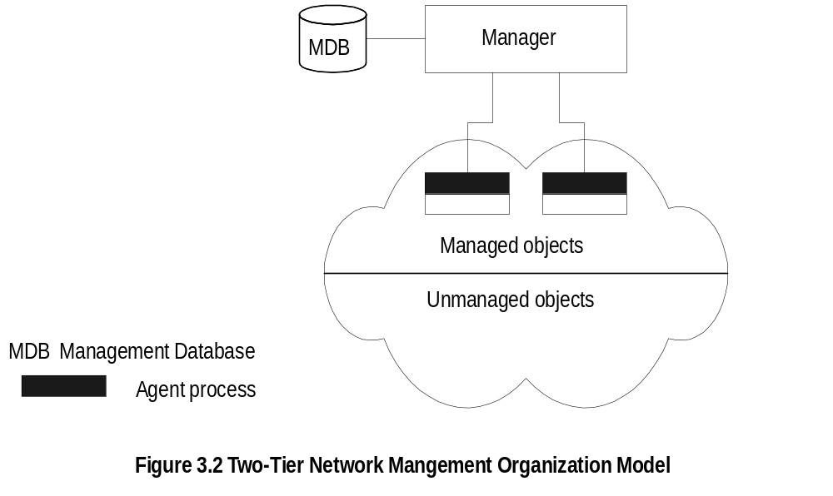
Chapter 3
Two-Tier Model
  Notes
Agent built into network element
Example: Managed hub, managed router
A manager can manage multiple elements
Example: Switched hub, ATM switch
MDB is a physical database
Unmanaged objects are network elements
that are not managed - both physical (unmanaged
hub) and logical (passive elements)
Network Management: Principles and Practice
© Mani Subramanian 2000

Slide 11
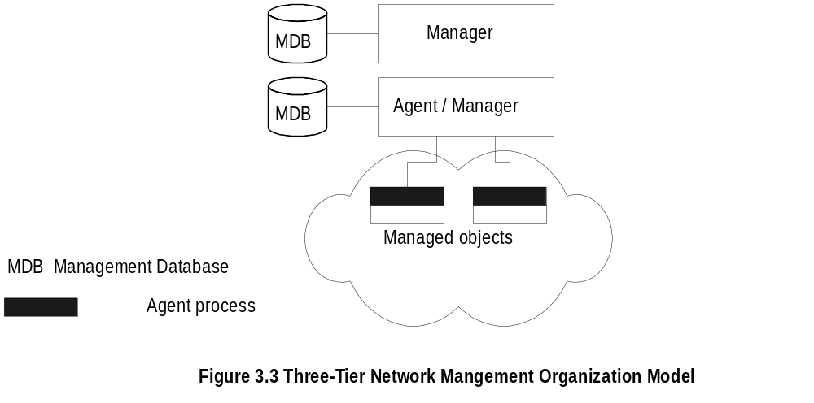
Chapter 3
Three-Tier Model
  Notes
Middle layer plays the dual role
  Agent to the top-level manager
  Manager to the managed objects - e.g., collects data
Example of middle level: Remote monitoring
agent (RMON)
  Examples:
    Statistical measurement on a network
    Local site passes information to a remote site
Network Management: Principles and Practice
© Mani Subramanian 2000

Slide 12
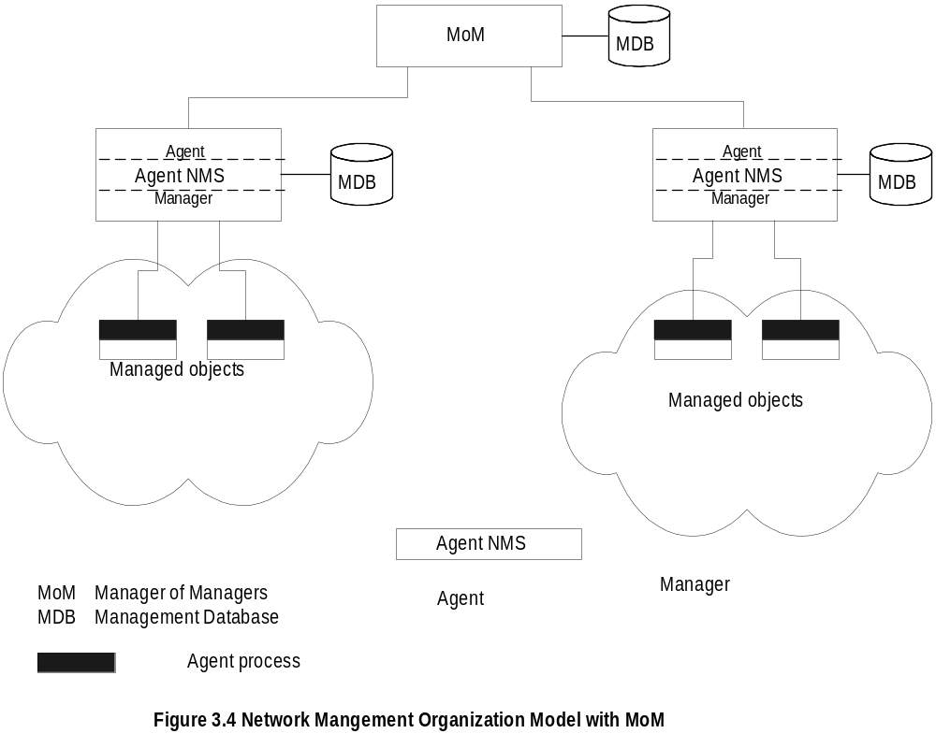
Chapter 3
Manager of Managers
  Notes
Agent NMS manages the domain
MoM presents integrated view of domains
Domain may be geographical (cities), administrative
(departments), vendor-specific products (Cisco), etc.
Network Management: Principles and Practice
© Mani Subramanian 2000

Slide 13
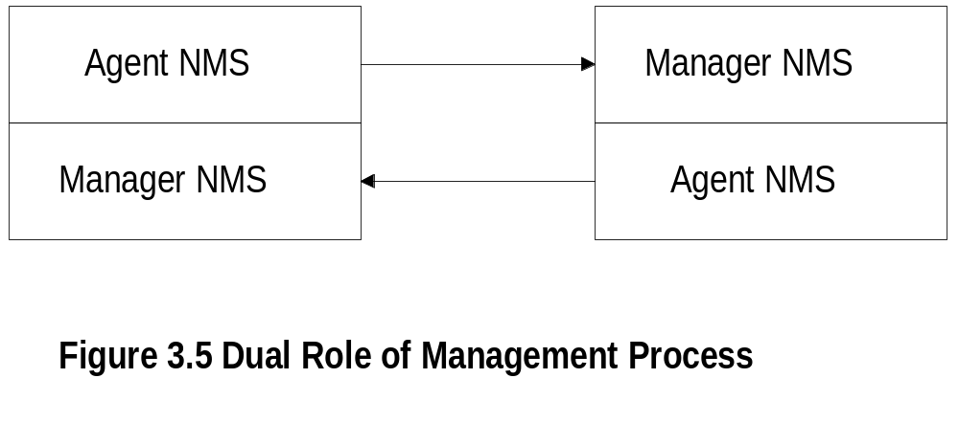
Chapter 3
Peer NMSs
  Notes
NMSs configured in a peer-to-peer relationship
Network management system acts as peers
Dual role of both NMSs
Example: Two network service providers exchange
Management information
Dumbbell architecture discussed in Chapter 1
Notice that the manager and agent functions are
processes and not systems
Network Management: Principles and Practice
© Mani Subramanian 2000

Slide 14
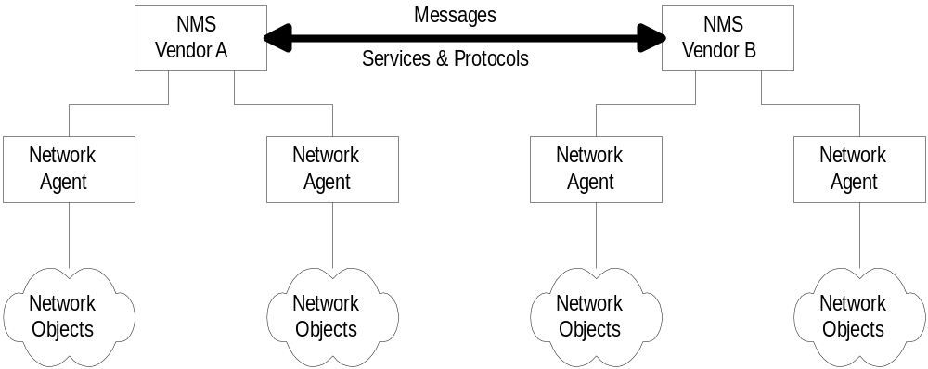
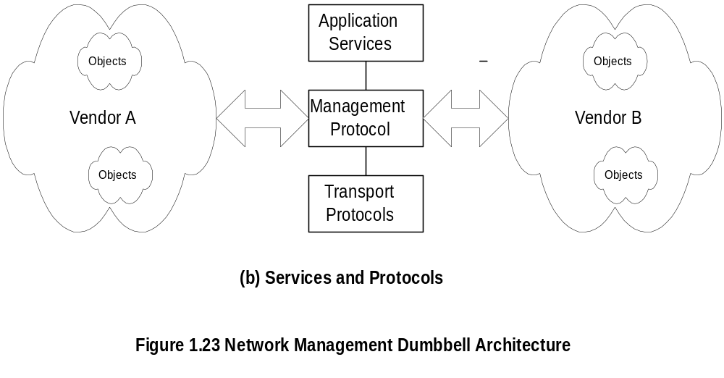
Chapter 1
Interoperability
  Notes
Message exchange between NMSs managing
different domains
Network Management: Principles and Practice
© Mani Subramanian 2000

Slide 15
Chapter 3
Information Model: Analogy
Information model – Structure & storage of information
Figure in a book uniquely identified by
  ISBN, Chapter, and Figure number in that
  hierarchical order
ID: {ISBN, chapter, figure} – Hierarchy of designation
The three elements above define the syntax – format
Semantics is the meaning of the three
entities according to Webster’s dictionary
The information comprises syntax and semantics
about an object
  Notes
Management information model =
objects representation (SMI) +
management information of objects (MIB)
SMI defines the syntax & semantics of management
information stored in the MIB
Information model specifies the information base to
describe managed objects and their relationships
(i.e., MIB)
Network Management: Principles and Practice
© Mani Subramanian 2000

Slide 16
Chapter 3
Structure of Management Information (SMI)
SMI defines for a managed object:
  Syntax
  Semantics – i.e., definition
  plus additional information such as status
Example
sysDescr: { system 1 }
Syntax: OCTET STRING
Definition: "A textual description of the entity. "
Access: read-only
Status: mandatory
  Notes
Uses ASN.1: Abstract Syntax Notation One
See RFC 1155:
  Section 4. Managed objects
  Section 4.3. Macros
Network Management: Principles and Practice
© Mani Subramanian 2000

Slide 17
Chapter 3
Management Information Base (MIB)
Used by manager & agents to store & exchange
management information
Information base contains information about objects
Organized by grouping of related objects (e.g., IP group)
Defines relationship between objects (e.g., object system
is a parent of object sysDescr)
It is NOT a physical database. It is a virtual
database that is compiled into management module
  Notes
The agent MIB is used for accessing local information
requested by the manager, and sending a response back
The manager MIB is used for accessing information
on all network components the manager manages.
See RFC 1213
Network Management: Principles and Practice
© Mani Subramanian 2000

Slide 18
Chapter 3
Information Base View: An Analogy
Fulton County library system has many branches
Each branch has a set of books
The books in each branch is a different set
The information base of the county has the
view (catalog) of all books
The information base of each branch has the
catalog of books that belong to that branch.
That is, each branch has its view (catalog) of
the information base
Let us apply this to MIB view
  Notes
Network Management: Principles and Practice
© Mani Subramanian 2000

Slide 19
Chapter 3
MIB View and Access of an Object
A managed object has many attributes - its
information base (e.g., IPAddress, # of ports)
There are several operations that can be
performed on the objects (get, set)
A user (manager) can view and perform only
certain operations on the object by invoking
the management agent – privileges depends on
the user and the managed object
The view of the object attributes that the agent
perceives is the MIB view
The operation that a user can perform is the
MIB access
  Notes
Network Management: Principles and Practice
© Mani Subramanian 2000

Slide 20
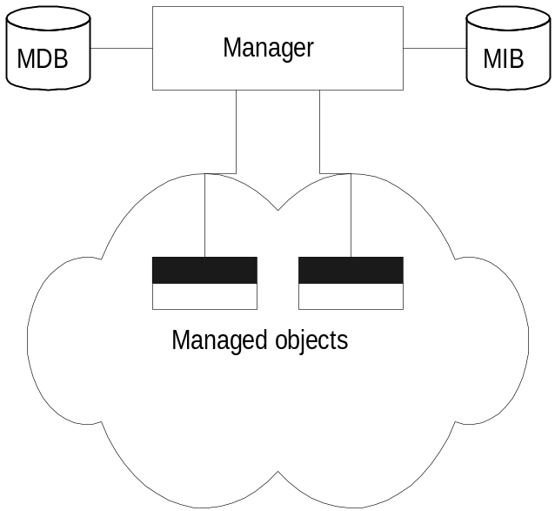
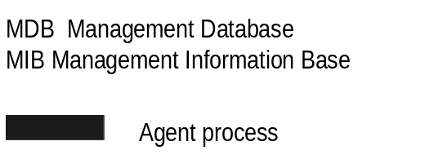
Chapter 3
Management Data Base / Information Base
  Notes
Distinction between MDB and MIB
  MDB physical database; e.g.. Oracle, Sybase
  MIB virtual database; schema compiled into
  management software (for processes to
  exchange information)
An NMS can automatically discover a managed
object, such as a hub, when added to the network
The NMS can identify the new object as hub only
after the MIB schema of the hub is compiled into
NMS software
Network Management: Principles and Practice
© Mani Subramanian 2000

Slide 21
Chapter 3
Managed Object
Managed objects can be
  Network elements (hardware, system)
    hubs, bridges, routers, transmission facilities
  Software (non-physical)
    programs, algorithms
  Administrative information
    contact person, name of group of objects
    (IP group)
  Notes
In fact, any type of info that can be included in the
MIB can be managed.
Network Management: Principles and Practice
© Mani Subramanian 2000

Slide 22
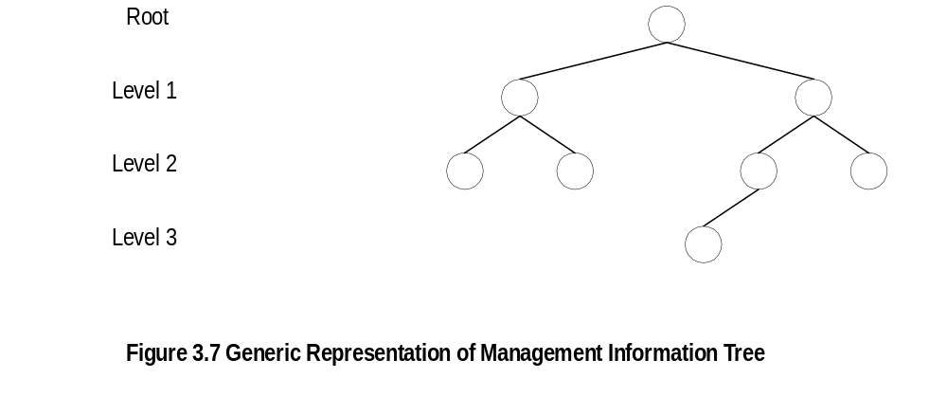
Chapter 3
Management Information Tree
  Notes
Network Management: Principles and Practice
© Mani Subramanian 2000

Slide 23
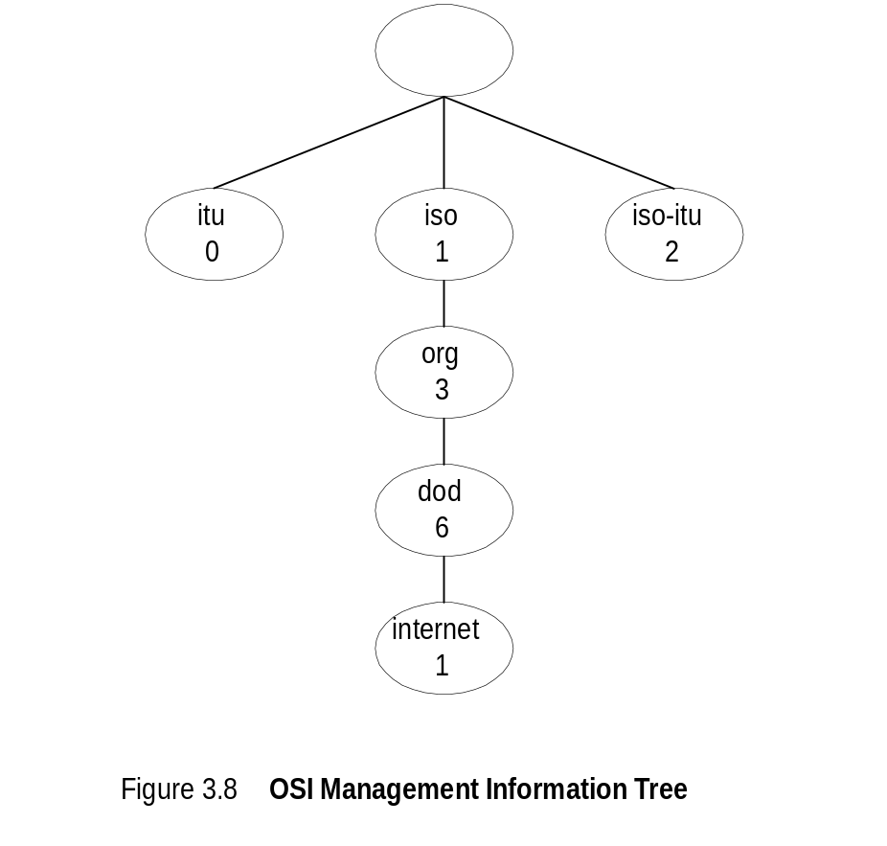
Chapter 3
OSI Management Information Tree
  Notes
iso International Standards Organization
itu International Telecommunications Union
dod Department of Defense
Designation:
  iso 1
  org 1.3
  dod 1.3.6
  internet 1.3.6.1 – all internet managed
  objects will start with this
Network Management: Principles and Practice
© Mani Subramanian 2000

Slide 24
Chapter 3
Object Type and Instance
Type
  Name
  Syntax
  Definition
  Status
  Access
Instance
  Notes
Example of a circle
  “circle” is syntax
  Semantics is definition from dictionary
  “A plane figure bounded by a single curved
  line, every point of which is of equal distance
  from the center of the figure.”
Analogy of nursery school
Network Management: Principles and Practice
© Mani Subramanian 2000

Slide 25
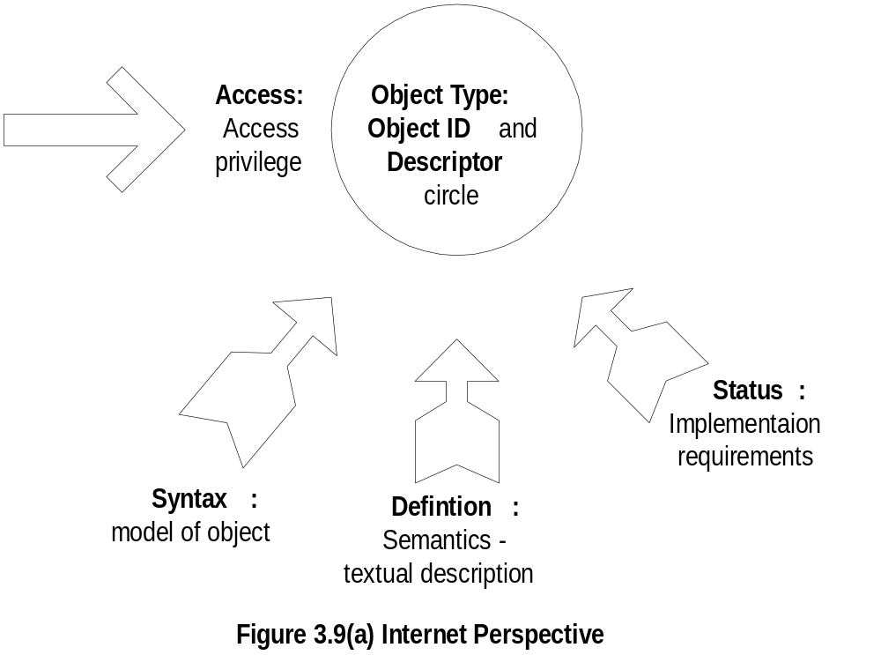
Chapter 3
Managed Object:
Internet Perspective
  Notes
    object ID unique ID
    and descriptor and name for the object
    syntax used to model the object
    access access privilege to a managed object
    status implementation requirements
    definition textual description of the semantics of object type
Network Management: Principles and Practice
© Mani Subramanian 2000

Slide 26
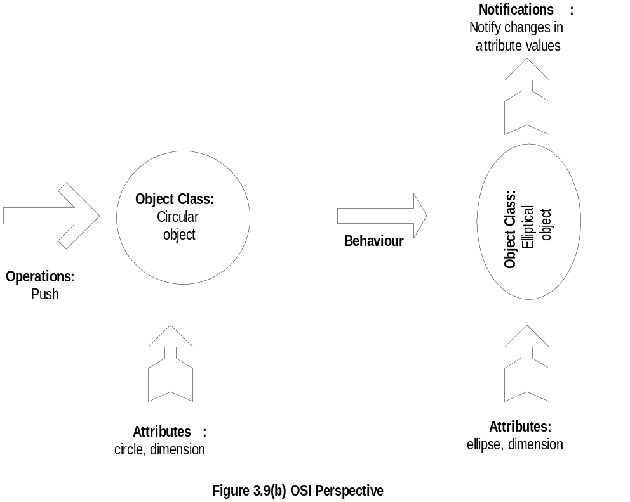
Managed Object:
OSI Perspective
Chapter 3
  Notes
    object class managed object
    attributes attributes visible at its boundary
    operations operations which may be applied to it
    behaviour behaviour exhibited by it in response to operation
    notifications notifications emitted by the object
Network Management: Principles and Practice
© Mani Subramanian 2000

Slide 27
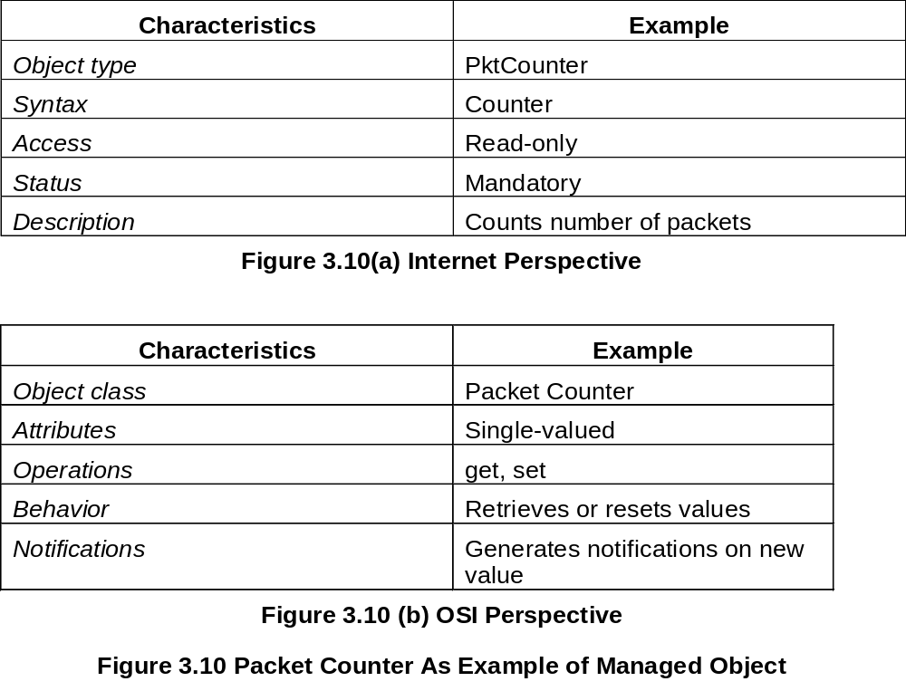
Chapter 3
Packet Counter Example
  Notes
Network Management: Principles and Practice
© Mani Subramanian 2000

Slide 28
Chapter 3
Internet Vs OSI Managed Object
Scalar object in Internet vs. Object-Oriented
approach in OSI
OSI characteristics of operations, behavior, and
notification are part of communication model in
Internet: get/set and response/alarm
Internet syntax is absorbed as part of OSI attributes
Internet access is part of OSI security model
Internet status is part of OSI conformance application
OSI permits creation and deletion of objects;
Internet does not. However, enhancement in SNMPv2
include:
  Defining new data types
  Adding or deleting conceptual rows in tables
  Notes
Network Management: Principles and Practice
© Mani Subramanian 2000

Slide 29
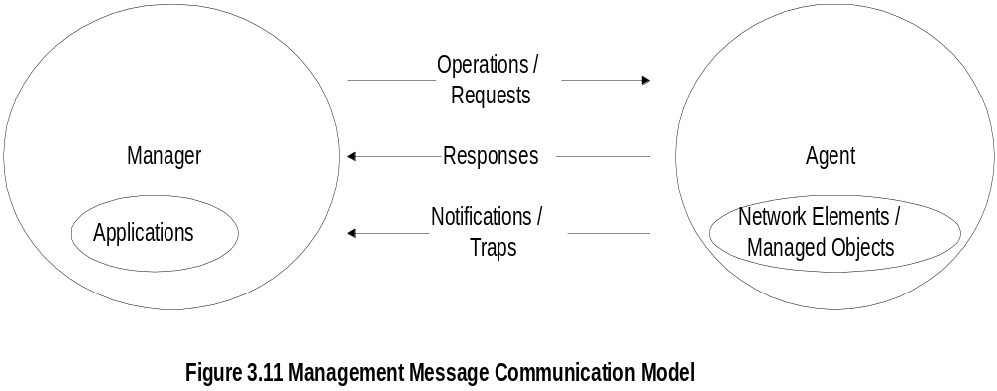
Chapter 3
Mgmt. Communication Model
  Notes
In Internet requests/responses, in OSI operations
In Internet traps and notifications (SNMPv2),
in OSI notifications
Network Management: Principles and Practice
© Mani Subramanian 2000

Slide 30
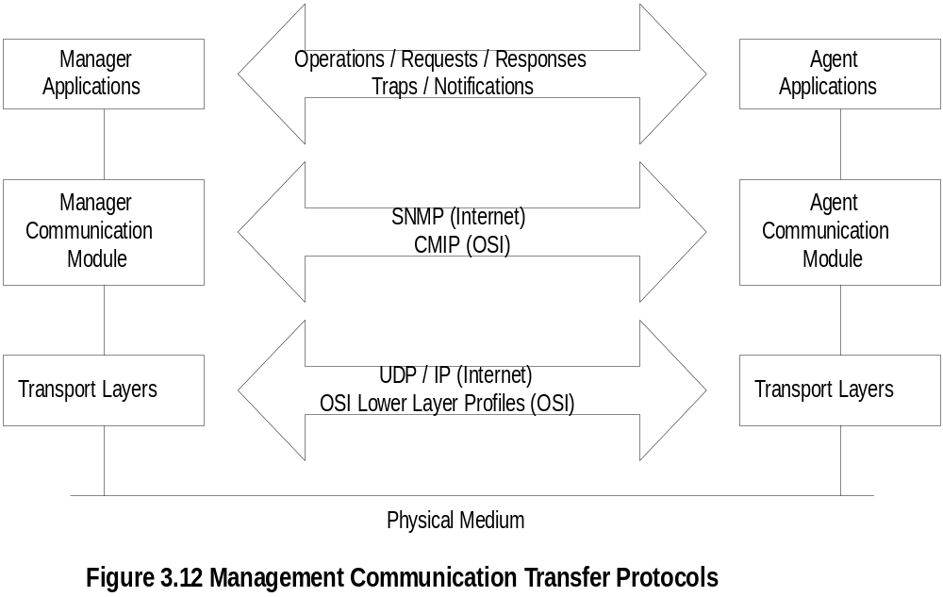
Chapter 3
Transfer Protocols
  Notes
Internet is based on SNMP; OSI is based on CMIP
OSI uses CMISE (Common Management Information
Service Element) application with CMIP
OSI specifies both c-o and connectionless transport
protocol; SNMPv2 extended to c-o, but rarely used
Network Management: Principles and Practice
© Mani Subramanian 2000

Slide 31
Chapter 3
Abstract Syntax Notation One
ASN.1 is more than a syntax; it’s a formal language
Addresses both syntax and semantics
Two type of syntax
  Abstract syntax: set of rules that specify
  data type and structure for information storage
  Transfer syntax: set of rules for communicating
  information between systems
Makes application layer protocols independent
of lower layer protocols
Can generate machine-readable code: Basic
Encoding Rules (BER) is used in management
modules
  Notes
ASN.1 developed jointly by ITU-T and ISO
Abstract syntax → Information model
Transfer model → communication model
Network Management: Principles and Practice
© Mani Subramanian 2000

Slide 32
Chapter 3
Backus-Nauer Form (BNF)
Definition:
<name> ::= <definition>
Rules:
<digit> ::= 0|1|2|3|4|5|6|7|8|9
<number> ::= <number> | <digit> <number>
<op> ::= +|-|x|/
<SAE> ::= <number>|<SAE>|<SAE><op><SAE>
Example:
9 is primitive 9
19 is construct of 1 and 9
619 is construct of 6 and 19
  Notes
BNF is used for ASN.1 constructs
Constructs developed from primitives
The above example illustrates how numbers are constructed from the primitive <digit>
Simple Arithmetic Expression entity (<SAE>) is constructed from the primitives <digit> and <op>
Network Management: Principles and Practice
© Mani Subramanian 2000

Slide 33
Chapter 3
Simple Arithmetic Expression
<SAE> ::= <number> | <SAE><op><number>
Example: 26 = 13 x 2
Constructs and primitives
  Notes
Network Management: Principles and Practice
© Mani Subramanian 2000

Slide 34
Chapter 3
Type and Value
Assignments
  <BooleanType> ::= BOOLEAN
  <BooleanValue> ::= TRUE | FALSE
ASN.1 module is a group of assignments
person-name Person-Name::=
{
    first "John",
middle "I",
last "Smith"
}
  Notes
Two basic parameters associated with an entity (e.g., BOOLEAN)
  Data type
  Value (assigned to this data type)
Keywords: entities with all capital letters (e.g., TRUE)
Network Management: Principles and Practice
© Mani Subramanian 2000

Slide 35
Chapter 3
Data Type: Example 1
PersonnelRecord
::= SET
{
Name,
title
GraphicString,
division CHOICE {
marketing
[0]
SEQUENCE
{Sector,
Country},
research
[1]
CHOICE
{
product-based
[0]
NULL,
basic
[1]
NULL},
production
[2]
SEQUENCE
{Product-line
,
Country
}
} }
etc.
Figure 3.13 ASN.1 Data Type Definition Example 1
  Notes
Module name starts with capital letters
Data types:
  Primitives: NULL, GraphicString
  Constructs
    Alternatives : CHOICE
    List maker: SET, SEQUENCE
    Repetition: SET OF, SEQUENCE OF
Difference between SET and SEQUENCE
Network Management: Principles and Practice
© Mani Subramanian 2000

Slide 36
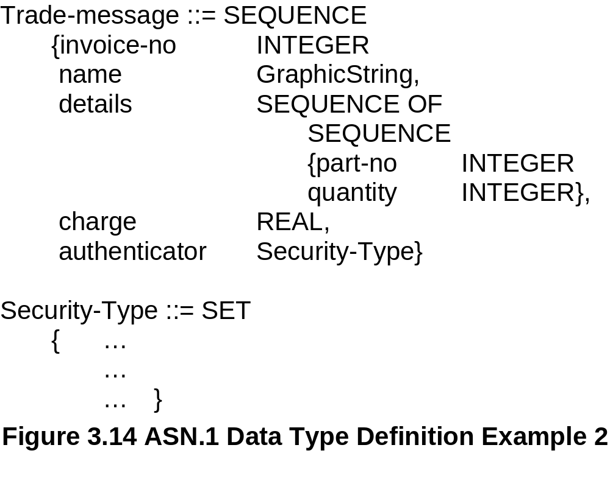
Chapter 3
Data Type: Example 2
  Notes
SET
  – No order required
  – Order not important
  – Data types should all be distinct
SEQUENCE
  – the order in the list is maintained
SEQUENCE OF SEQUENCE makes tables of rows
Network Management: Principles and Practice
© Mani Subramanian 2000

Slide 37
Chapter 3
Modules
Formal Definition:
<module name> DEFINITIONS ::= BEGIN
<name> ::= <definition>
<name> ::= <definition>
END
Example:
RFC1213 DEFINITIONS ::= BEGIN
…
…
END
  Notes
A module is a group of assignments.
Modules can be imported into and exported from other modules.
Network Management: Principles and Practice
© Mani Subramanian 2000

Slide 38
Chapter 3
ASN.1 Symbols
Symbol Meaning
::= Defined as
| or, alternative, options of a list
- Signed number
-- Following the symbol are comments
{} Start and end of a list
[] Start and end of a tag
() Start and end of subtype
.. Range
  Notes
Network Management: Principles and Practice
© Mani Subramanian 2000

Slide 39
Chapter 3
Keyword Examples
CHOICE
SET
SEQUENCE
OF
NULL
  Notes
Keywords are in all UPPERCASE letters
Network Management: Principles and Practice
© Mani Subramanian 2000

Slide 40
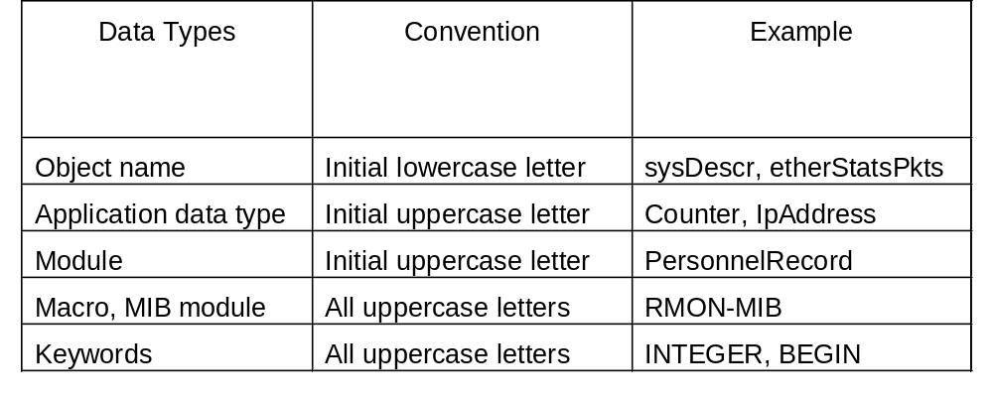
Chapter 3
ASN.1 Data Type Conventions
  Notes
Network Management: Principles and Practice
© Mani Subramanian 2000

Slide 41
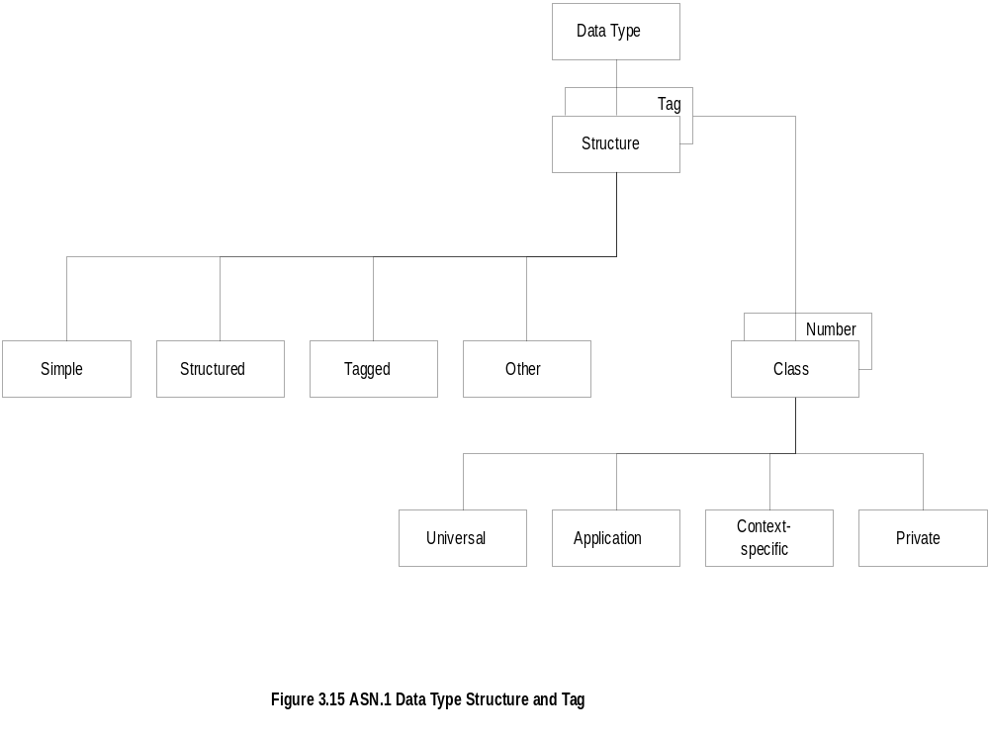
Chapter 3
Data Type: Structure & Tag
  Notes
A Data Type is defined based on a structure and a tag
Structure defines how data type is built
Tag uniquely identifies the data type
Network Management: Principles and Practice
© Mani Subramanian 2000

Slide 42
Chapter 3
Structure
Simple
  PageNumber ::= INTEGER
  ChapterNumber ::= INTEGER
Structured / Construct
  BookPageNumber ::=
  SEQUENCE
  {ChapterNumber, Separator, PageNumber}
  Example: {1-1, 2-3, 3-39}
Tagged
  Derived from another type; given a new ID
  In Fig. 3-14, INTEGER could be either universal
  or application specific
Other types:
  CHOICE, ANY
  Notes
BookPages ::= SEQUENCE OF { BookPageNumber}
or
BookPages ::=
SEQUENCE OF
{
SEQUENCE
    {ChapterNumber, Separator, PageNumber}
}
Network Management: Principles and Practice
© Mani Subramanian 2000

Slide 43
Chapter 3
Tag
Tag uniquely identifies a data type
Comprises class and tag number
Class:
  Universal - always true
  Application - only in the application used
  Context-specific - specific context in application
  Private - used extensively by commercial
  vendors
Example (RFC 1155):
  IpAddress ::= [APPLICATION 0] IMPLICIT OCTET STRING (SIZE (4))
  Counter ::= [APPLICATION 1] IMPLICIT INTEGER (0..4294967295)
  Notes
Example:
BOOLEAN Universal 1
INTEGER Universal 2
research [Application 1] (Figure 3.13)
product-based Context-specific under research [0]
Network Management: Principles and Practice
© Mani Subramanian 2000

Slide 44

Chapter 3
Enumerated Integer
Example From the SNMP MIB (RFC 1157):
ErrorStatus ::=
INTEGER {
noError (0),
tooBig (1),
noSuchName (2),
badValues (3),
readOnly(4),
genErr (5)
}
  Notes
ENUMERATED is a special case of INTEGER
Does not have INTEGER semantics → Arithmetic
operations should not be performed on enumerated
values.
Example: RainbowColors (5) is orange
Network Management: Principles and Practice
© Mani Subramanian 2000

Slide 45
Chapter 3
Subtype Data Type
A subtype data type is derived from a parent type.
Example:
PageNumber ::= INTEGER (0..255)
Limits the maximum page number to 255
Example (RFC 1213):
sysDescr OBJECT-TYPE
SYNTAX DisplayString (SIZE (0..255))
ACCESS …
…
  Notes
Network Management: Principles and Practice
© Mani Subramanian 2000

Slide 46
Chapter 3
ASN.1 Module Example
An entry of the address translation table in SNMP IP MIB (RFC 1213) is the following:
IpNetToMediaEntry ::= SEQUENCE {
ipNetToMediaIfIndex
INTEGER,
ipNetToMediaPhysAddress
PhysAddress,
ipNetToMediaNetAddress
IpAddress,
ipNetToMediaType
INTEGER}
  Notes
Network Management: Principles and Practice
© Mani Subramanian 2000

Slide 47
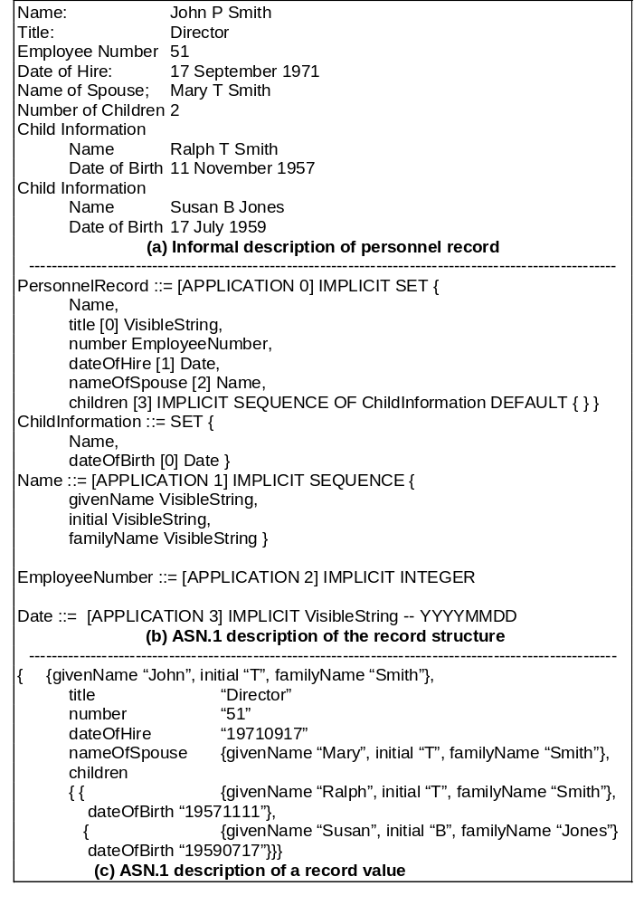
Chapter 3
ASN.1 Example from ISO 8824
Network Management: Principles and Practice
© Mani Subramanian 2000

Slide 48
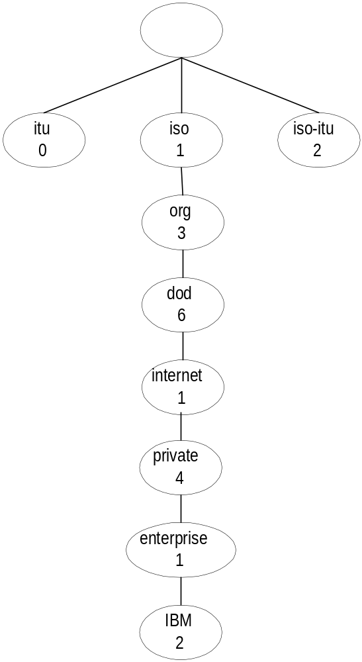
Chapter 3
Object Name
  Notes
Example from RFC 1155:
internet OBJECT IDENTIFIER ::= {iso(1) org(3) dod(6) 1}
Network Management: Principles and Practice
© Mani Subramanian 2000

Slide 49
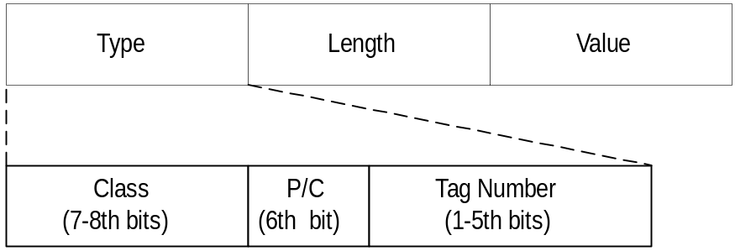

Chapter 3
TLV Encoding
P/C bit:
0: primitive
1: construct
  Notes
ASN.1 syntax containing management info is encoded
using the BER (Basic Encoding Rules) → defined for
the transfer syntax.
ASCII text data is converted to bit-oriented data.
TLV: Type, Length, and Value are components
of the structure.
Length: of the Value field in number of octets.
Value: is encoded based on the data type.
Network Management: Principles and Practice
© Mani Subramanian 2000

Slide 50
Chapter 3
TLV Encoding- INTEGER
P/C bit:
0: primitive
1: construct
INTEGER: Universal 2
  Type: 00000010 [Class (00), P/C (0), Tag (00010)]
  Length:
    If Value length ≤ 127 → Use 1 octet (with b8 = 0)
    If Value length > 127 → Use >1 octet (with b8 = 1)
      First octet indicates number of octets
      that follow to specify the Value length.
      Example: 128 → 10000001 10000000
  Value:
    If Value > 0 (always MSB = 0 → add more octets if needed)
      Example: 255 → 00000000 11111111
    If Value < 0 → twos-complement
      Takes the absolute value and inverts all 1s to 0s
      and all 0s to 1s, then adds 1.
      Example: -5 → 11111011
  Example: TLV for 255
        → 00000010 00000010 00000000 11111111
Network Management: Principles and Practice
© Mani Subramanian 2000

Slide 51
Chapter 3
TLV Encoding- OCTET STRING
P/C bit:
0: primitive
1: construct
  Notes
OCTET STRING: Universal 4
  Type: 00000100 [Class (00), P/C (0), Tag (00100)]
  Length: Number of octets in Value.
  Value: Binary representation of string.
  Example: TLV for ‘0C1B’ →
        00000100 00000010 00001100 00011011
Network Management: Principles and Practice
© Mani Subramanian 2000

Slide 52
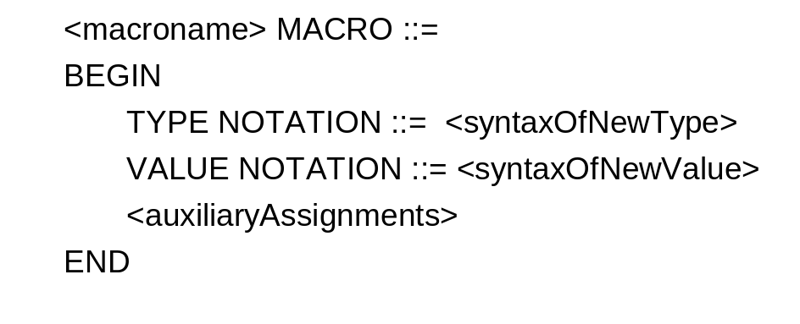

Chapter 3
Macro
Macro from RFC 2578 (SMIv2):
OBJECT-IDENTITY MACRO ::=
BEGIN
TYPE NOTATION ::=
"STATUS" Status
"DESCRIPTION" Text
ReferPart
VALUE NOTATION ::= value (VALUE OBJECT IDENTIFIER)
Status ::= "current" | "deprecated" | "obsolete“
ReferPart ::= "REFERENCE" Text | empty
Text ::= value(IA5String)
END
Example:
  Notes
Macro is used to create new data types
TYPE NOTATION → defines the syntax of new types
VALUE NOTATION → defines the syntax of new values
Network Management: Principles and Practice
© Mani Subramanian 2000

