Slide 1
Chapter 4
Chapter 4
SNMPv1:
Organization and Information Models
Network Management: Principles and Practice
© Mani Subramanian 2000

Slide 2
Chapter 4
Case Histories
AT&T Network Management Centers
  Network Operations Center
  Network Control Centers
    Monitors the network status
    Self-healing
CNN World Headquarters
  Performance Management
  Fault Management
    Monitoring alarms
    Determines causes of failures
    (Artificial Intelligence)
Centralized troubleshooting of NIC (remotely)
Performance degradation due to NMS
  Network may come down due to NM traffic
  Need to manage NM tools
Bell Operating company procedure
  NM tools can help in standardization of NM process
Network Management: Principles and Practice
© Mani Subramanian 2000

Slide 3
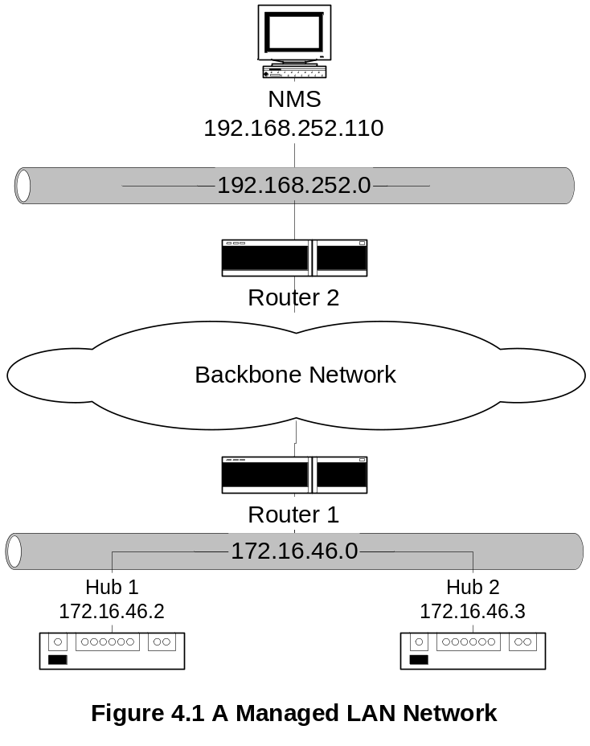
Chapter 4
Managed LAN
Notes
NMS can automatically discover any component in the
network as long as this component has a management agent.
NMS on subnet 192.168.252.1 manages the router and
the hubs on subnet 172.16.46.0 across the backbone
network
Network Management: Principles and Practice
© Mani Subramanian 2000

Slide 4
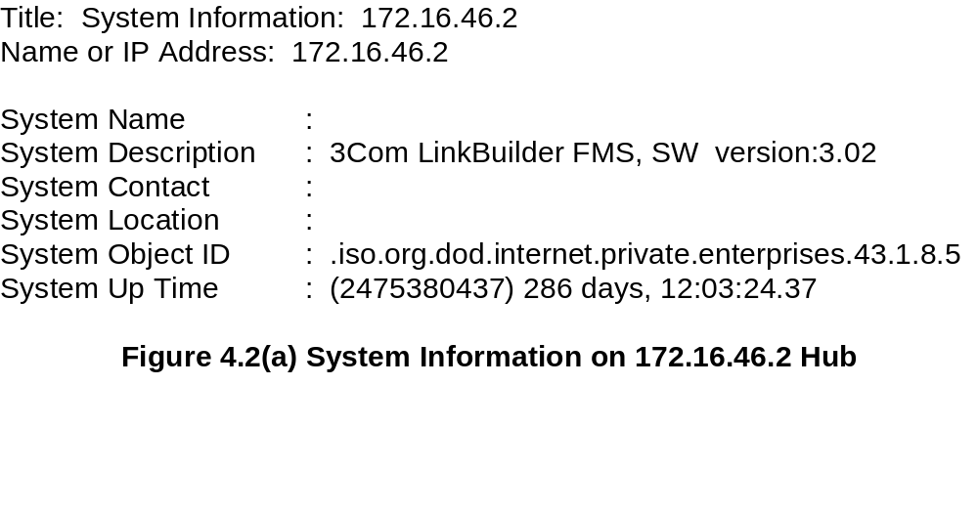
Chapter 4
Managed Hub:
System Information
Notes
Information obtained querying the hub
Data truly reflects what is stored in the hub
System Description and System Object ID are set
at the factory and can’t be modified → read-only.
Time unit :1/100th of a second
Network Management: Principles and Practice
© Mani Subramanian 2000

Slide 5
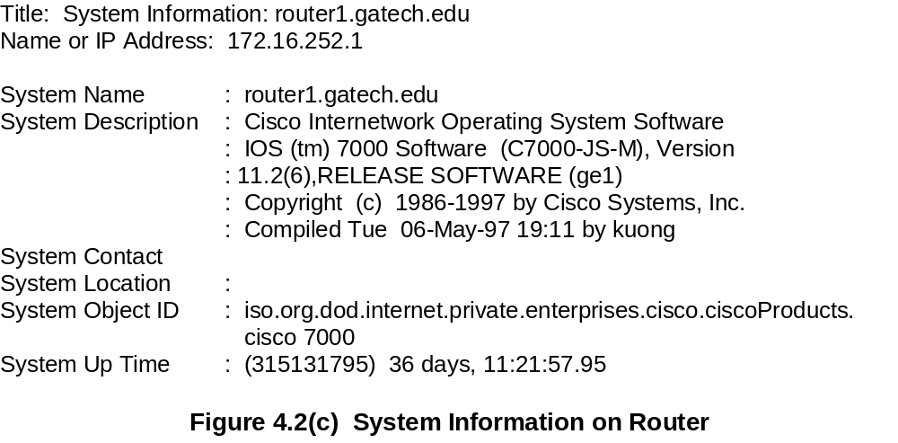
Chapter 4
Managed Router:
System Information
Notes
Network Management: Principles and Practice
© Mani Subramanian 2000

Slide 6
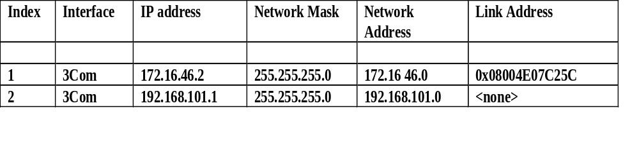
Chapter 4
Managed Hub:
Port Addresses
Notes
Information acquired by the NMS on hub interfaces
Index refers to the interface on the hub
Link address is the MAC address
The second row data is a serial link
Network Management: Principles and Practice
© Mani Subramanian 2000

Slide 7
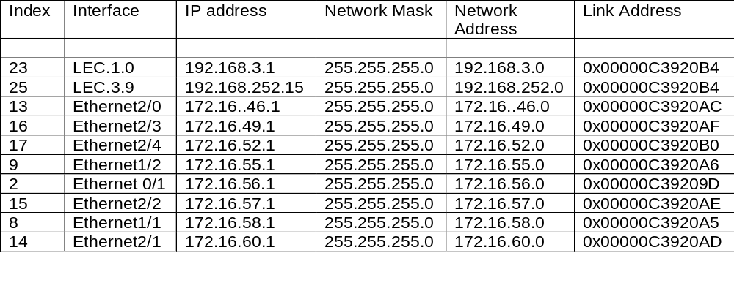
Chapter 4
Managed Router:
Port Addresses
Notes
Information acquired by NMS on the router interfaces
Index refers to the interface on the router
LEC is the LAN emulation card
Ethernet 2/0 interface refers to the interface
card 2 and port 0 in that card
Network Management: Principles and Practice
© Mani Subramanian 2000

Slide 8
Chapter 4
Internet SNMP Management
1970 - Internet control Message Protocol (ICMP)
      To manage ARPANET (Advanced Research
      Project Agency Network)
      Transfers control messages between nodes
      Example: ping
1984: ARPANET → Internet
Simple Gateway Monitoring Protocol (SGMP)
  To monitor and configure gateways remotely
  Interim solution
Simple Network Management Protocol (SNMP)
  Enhancement of SGMP
  Recommended by IAB (Internet Advisory Board)
  Intended as an interim solution
  Plan to migrate to OSI (CMIP/CMIS)
  Became the de facto standard due to its simplicity
Internet Engineering Task Force (IETF)
  1990 SNMPv1
  1995 SNMPv2 (independent of the OSI standard)
  1998 SNMPv3 (addresses the security feature)
Network Management: Principles and Practice
© Mani Subramanian 2000

Slide 9
Chapter 4
Internet Organizations & Standards
Internet documents (archived by the InterNIC (Internet Network Information Center)):
  Request for Comments (RFC)
  IETF STD: Internet Standard RFC
  FYI: For Your Information RFC
IANA (Internet Assigned Numbers Authority)
  Assigns and coordinates the use of Internet protocol parameters: IP addresses, domain names, AS numbers, MIB OIDs, etc.
Source for RFCs
  ftp://nic.mil/rfc
  ftp://ftp.internic.net/rfc
  http://nic/internet.net/
Network Management: Principles and Practice
© Mani Subramanian 2000

Slide 10
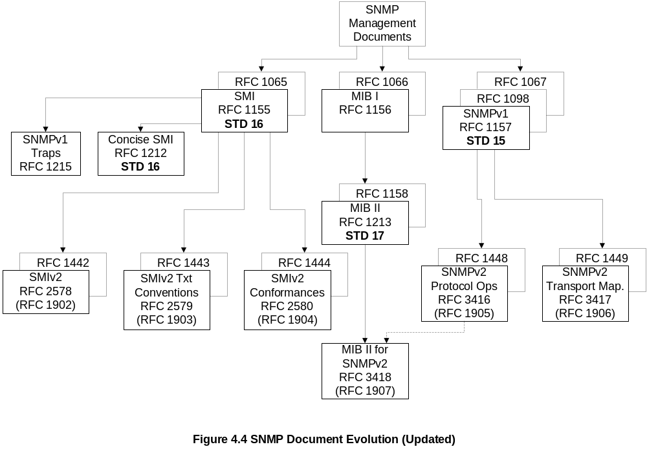
Chapter 4
SNMPv1 & SNMPv2
Documents
Network Management: Principles and Practice
© Mani Subramanian 2000

Slide 11
Chapter 4
SNMP Model
Organization Model
  Relationship between network element,
  agent, and manager
  Hierarchical architecture
Information Model
  Uses ASN.1 syntax
  SMI (Structure of Management Information)
  MIB (Management Information Base)
Communication Model
  Transfer syntax
  SNMP over TCP/IP
  Communication services addressed by messages
  Security framework community-based model
Notes
Network Management: Principles and Practice
© Mani Subramanian 2000

Slide 12
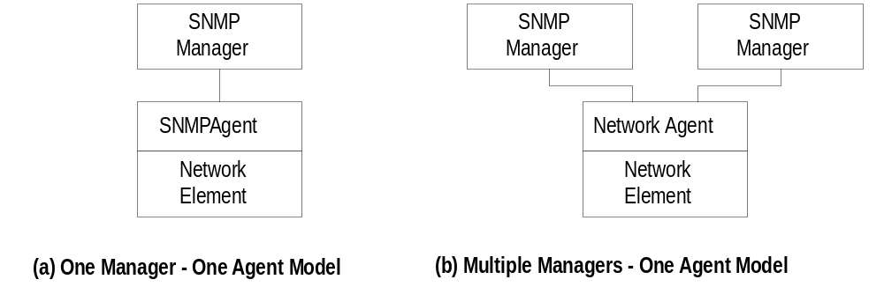
Chapter 4
Two-Tier Organization Model
Notes
Any host that could query an agent is a manager
Network Management: Principles and Practice
© Mani Subramanian 2000

Slide 13
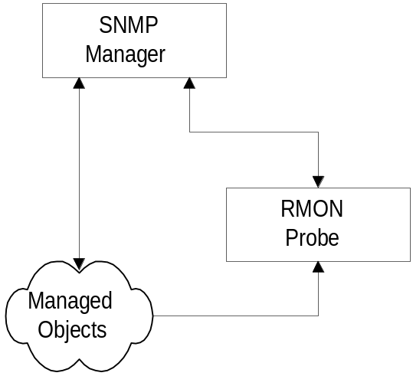
Chapter 4
Three-Tier Organization Model:
RMON
Notes
Managed object comprises network element and
management agent
RMON acts as an agent and a manager
RMON (Remote Monitoring) gathers data from MO,
analyses the data, and stores the data
Communicates the statistics to the manager (solicited
or unsolicited)
Network Management: Principles and Practice
© Mani Subramanian 2000

Slide 14
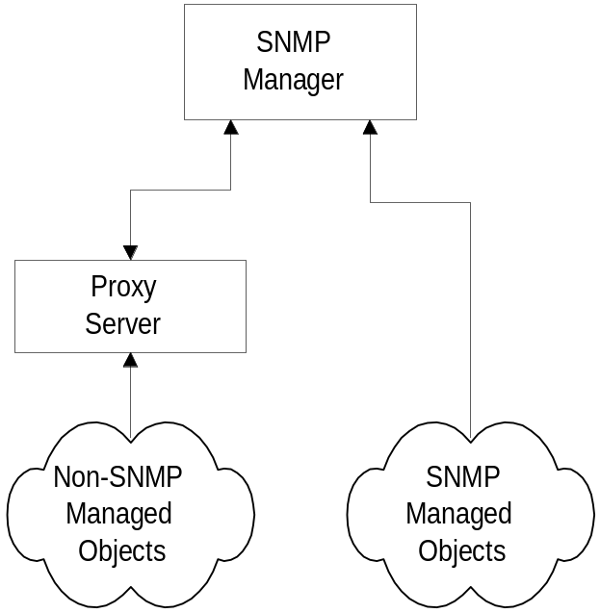
Chapter 4
Three-Tier Organization Model:
Proxy Server
Notes
Proxy server converts non-SNMP data from
non-SNMP objects to SNMP compatible objects
and messages
Network Management: Principles and Practice
© Mani Subramanian 2000

Slide 15
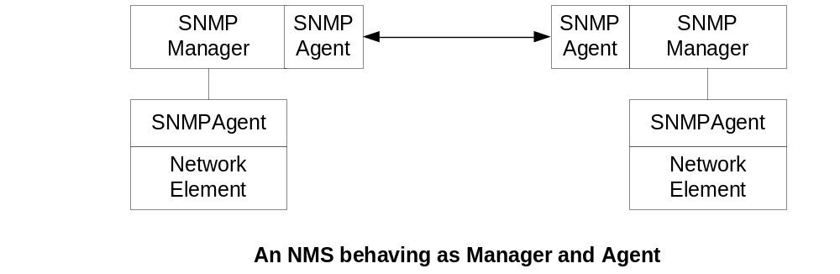
Chapter 4
Two-Tier Organization Model
Notes
Exchange of management information, for example,
between two service providers managing their
respective networks.
Network Management: Principles and Practice
© Mani Subramanian 2000

Slide 16
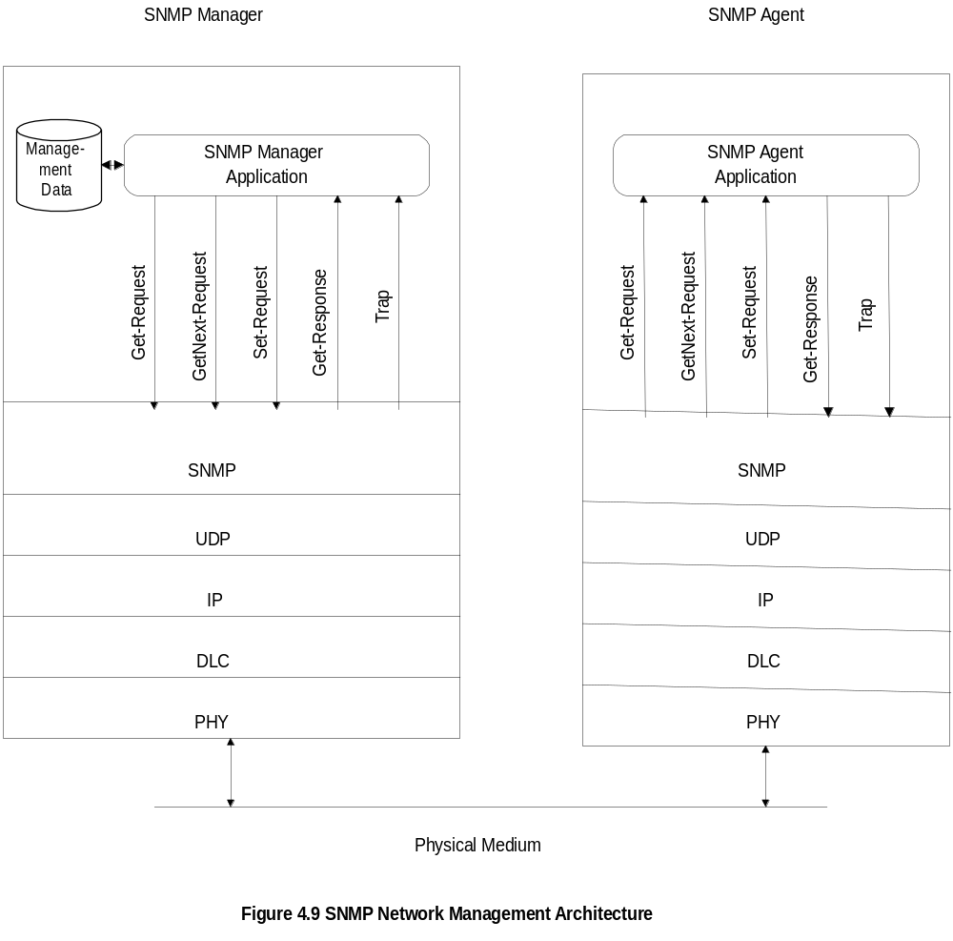
Chapter 4
System Architecture (RFC 1157/STD 15)
Notes
Messages between manager and agent
Direction of messages - 3 from manager and
2 from agent
Network Management: Principles and Practice
© Mani Subramanian 2000

Slide 17
Chapter 4
SNMP Messages
Get-Request
  Sent by manager requesting data from agent
  (e.g., sysDescr)
Get-Next-Request
  Sent by manager requesting data on the next
  MO to the one specified (e.g., table with
  multiple instances of the same object)
Set-Request
  Initializes or changes the value of network
  element
Get-Response
  Agent responds with data for get and set
  requests from the manager
  Includes values, and error info if any.
Trap
  Alarm generated by an agent (unsolicited)
Notes
Manager monitors network by polling agents about
status and characteristics
Generation of unsolicited alarm messages increased
efficiency
Network Management: Principles and Practice
© Mani Subramanian 2000

Slide 18
Chapter 4
Information Model
Structure of Management Information (SMI)
(RFC 1155)
  Specification and organizational aspects of MOs
Managed Object
  Scalar
  Aggregate or tabular object
Management Information Base (RFC 1213)
  Definition of MOs
  Grouping of MOs
  Relationship between MOs
Notes
RFCs can be downloaded from ftp.internic.net/rfc
  Some address standard network objects
  Others address specialized network objects,
  e.g., OSPF (RFC 1253), ATM (RFC 1695), etc.
Private vendor objects are specified in the private MIBs
  Provided by vendors for their products
Network Management: Principles and Practice
© Mani Subramanian 2000

Slide 19
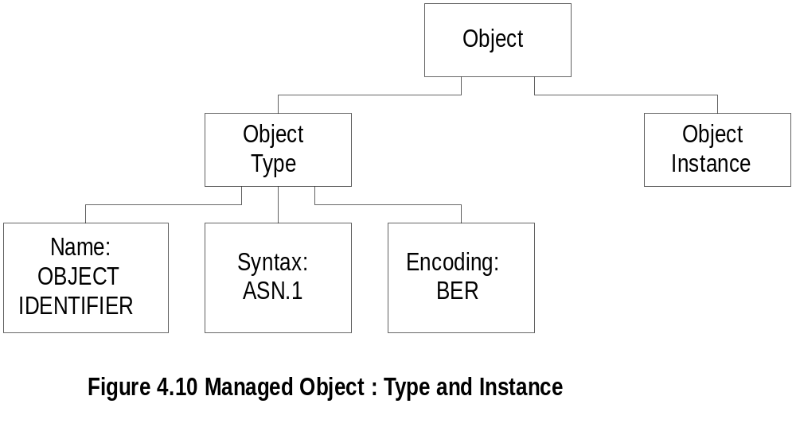
Chapter 4
Managed Object
Notes
Object type and data type are synonymous
Object identifier is data type, not instance
Object instance: IP address
Two identical hubs have the same object type with
the same OID, but each one represents a different
object instance with a different IP address. (See Figure 4.2)
Network Management: Principles and Practice
© Mani Subramanian 2000

Slide 20
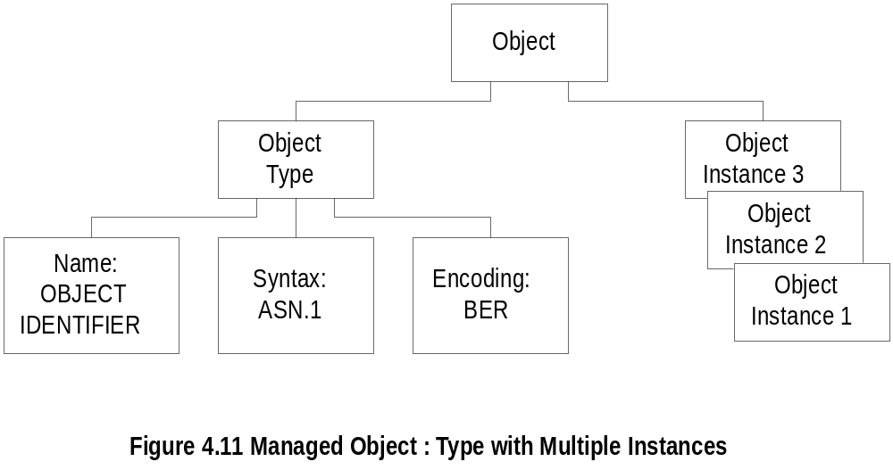
Chapter 4
Managed Object: Multiple Instances
Notes
All 3 Com hubs of the same version have identical
identifier; they are distinguished by the IP address
Each IP address is an instance of the object
Network Management: Principles and Practice
© Mani Subramanian 2000

Slide 21
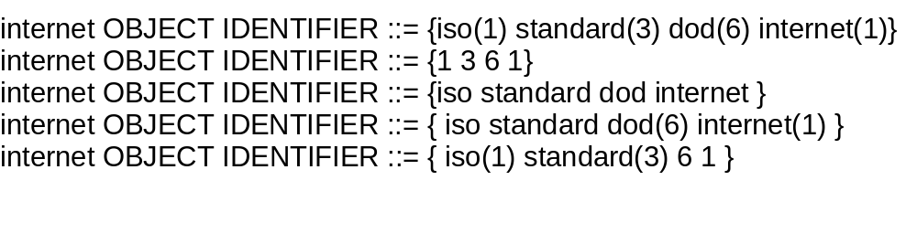
Chapter 4
Name
Uniquely defined by:
  DESCRIPTOR, and
  OBJECT IDENTIFIER
Notes
Example: ipAddrTable ip 20
    DESCRIPTOR → ipAddrTable
    OBJECT IDENTIFIER → ip 20
DESCRIPTOR is a mnemonic name that:
  Has to be unique
  Begins with a lowercase letter
Network Management: Principles and Practice
© Mani Subramanian 2000

Slide 22
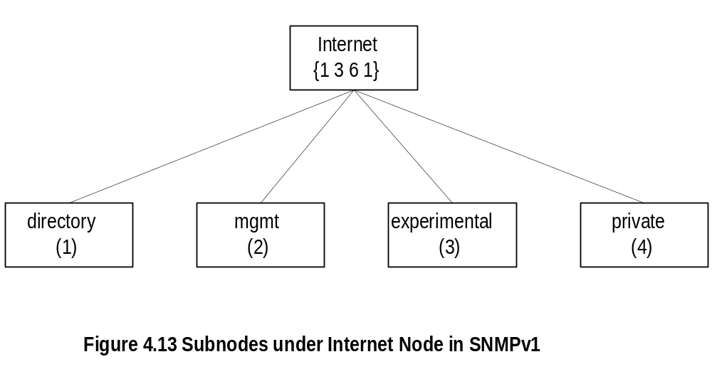
Chapter 4
Internet Subnodes
Notes
directory OBJECT IDENTIFIER ::= {internet 1}
mgmt OBJECT IDENTIFIER ::= {internet 2}
experimental OBJECT IDENTIFIER ::= {internet 3}
private OBJECT IDENTIFIER ::= {internet 4}
mib-2 OBJECT IDENTIFIER ::= {mgmt 1}
Network Management: Principles and Practice
© Mani Subramanian 2000

Slide 23
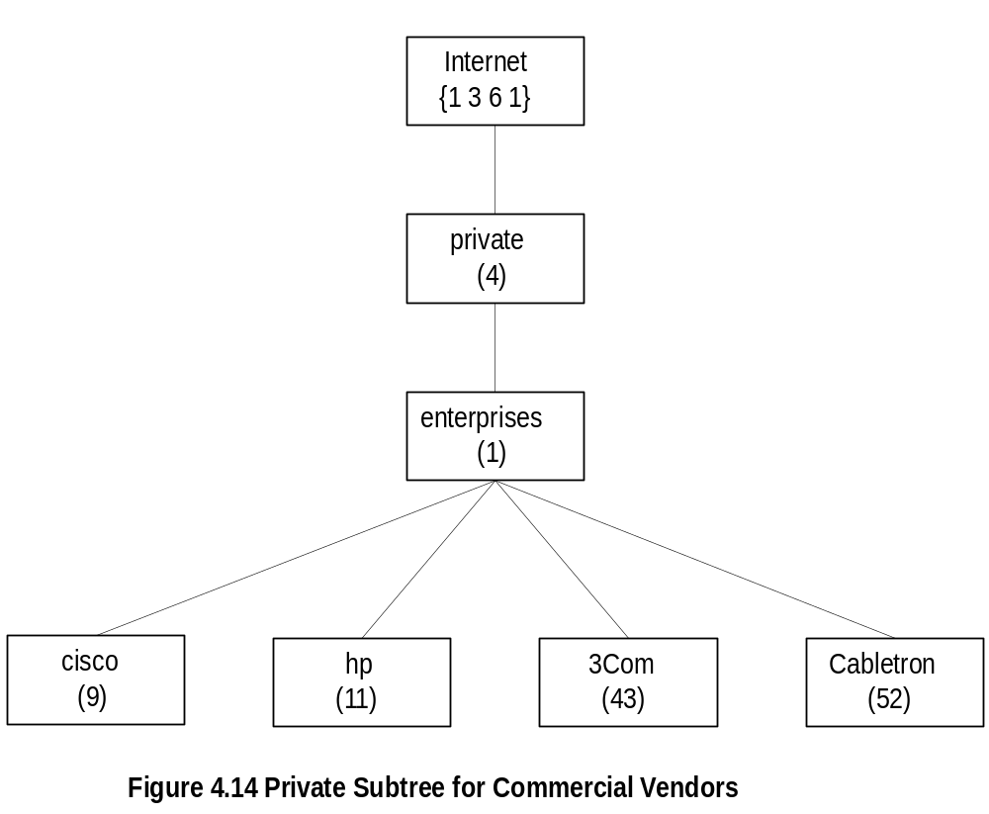
Chapter 4
Private MIB Example
Notes
private MIB intended for vendor equipment
  The objects to be included are left to the discretion
  of the vendors
IANA (Internet Assigned Numbers Authority) assigns
identifiers
Network Management: Principles and Practice
© Mani Subramanian 2000

Slide 24
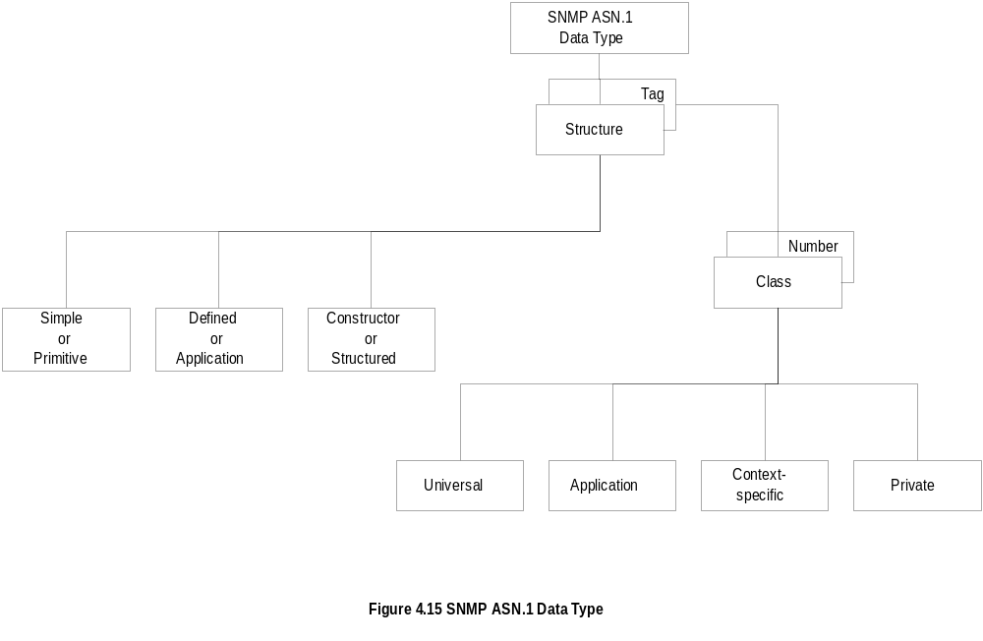
Chapter 4
SNMP ASN.1 Data Type
Notes
Not all ASN.1 constructs are used in SNMP
Tagged type not explicitly used
  However, IMPLICIT and EXTERNAL keywords
  are used for derived application data types.
CHOICE is used as well
Network Management: Principles and Practice
© Mani Subramanian 2000

Slide 25
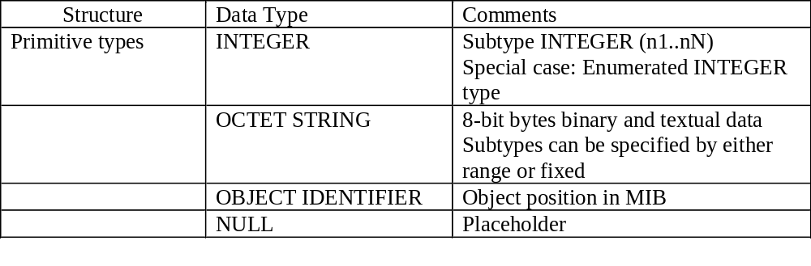
Chapter 4
Primitive Data Types
Notes
get-request message has NULL for value fields and
get-response from agent has the values filled in
subtype:
  INTEGER (0..255)
  OCTET STRING (SIZE 0..255)
  OCTET STRING (SIZE 8)
Network Management: Principles and Practice
© Mani Subramanian 2000

Slide 26
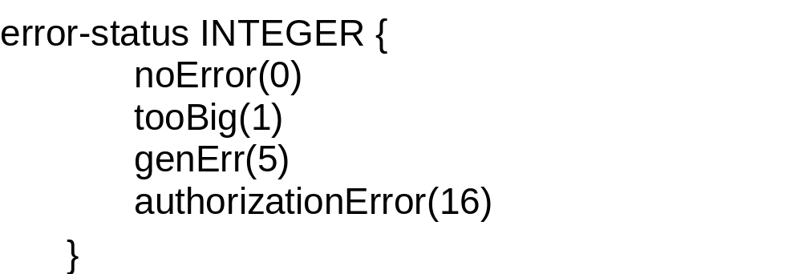
Chapter 4
Enumerated
Special case of INTEGER data type
Notes
noError NULL by convention
Network Management: Principles and Practice
© Mani Subramanian 2000

Slide 27
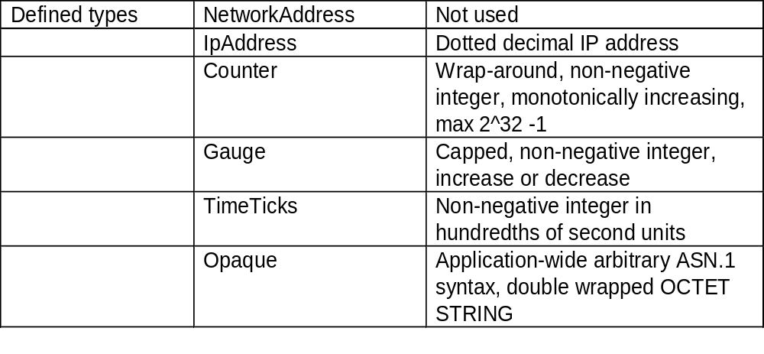
Chapter 4
Defined or Application Data Type
Notes
Defined data types are simple or base types
Opaque is used to create data types based on
previously defined data types
  TLV for the new definition is wrapped around the
  TLV of the previously defined type
  Supports the capability to pass arbitrary ASN.1
  syntax
Network Management: Principles and Practice
© Mani Subramanian 2000

Slide 28
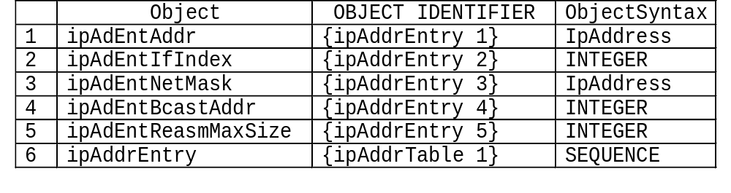
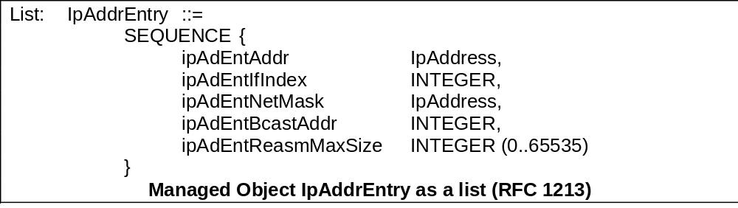
Chapter 4
Constructor or Structured Data Type:
SEQUENCE
List maker
Notes
SEQUENCE is used to build a list
SEQUENCE OF is used to build a table
SET and SET OF are not included in SNMP-based
management syntax
Network Management: Principles and Practice
© Mani Subramanian 2000

Slide 29
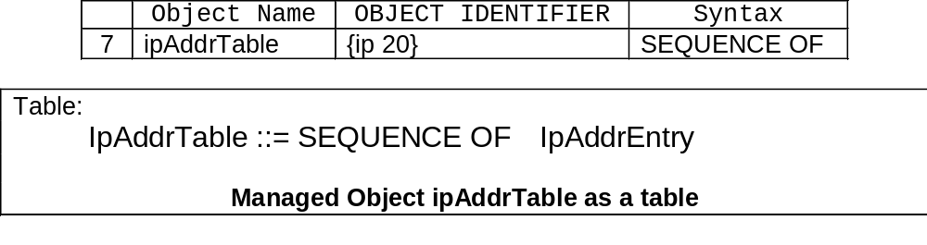
Chapter 4
Constructor or Structured Data Type:
SEQUENCE OF
Notes
Network Management: Principles and Practice
© Mani Subramanian 2000

Slide 30
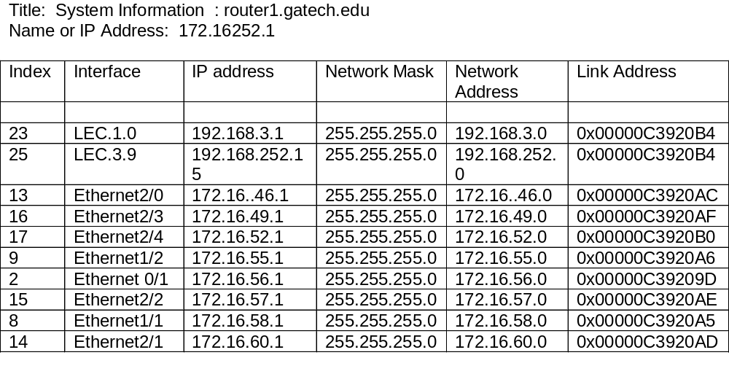
Chapter 4
SEQUENCE OF
- Example -
Notes
The above example (Figure 4.3) uses part of the
IP MIB discussed for SEQUENCE OF construct
Network Management: Principles and Practice
© Mani Subramanian 2000

Slide 31
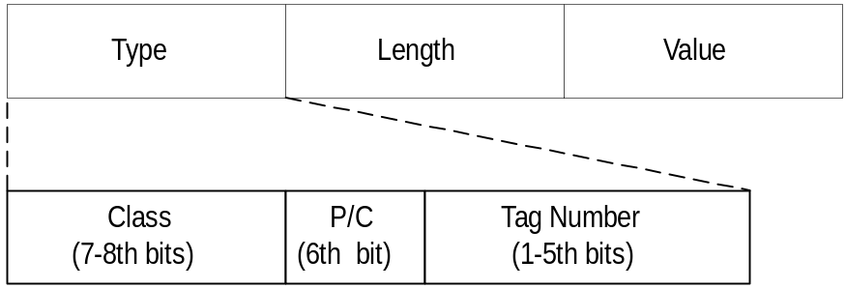
Chapter 4
Encoding
Basic Encoding Rules (BER)
  Tag, Length, and Value (TLV)
SNMP Data Types and Tags
Type Tag
OBJECT IDENTIFIER UNIVERSAL 6
SEQUENCE UNIVERSAL 16
IpAddress APPLICATION 0
Counter APPLICATION 1
Gauge APPLICATION 2
TimeTicks APPLICATION 3
Opaque APPLICATION 4
Notes
SEQUENCE Encoding:
  P/C = 1
  Value: contains the concatenation of the complete
  BER encoding (TLV) of the components of the value
Network Management: Principles and Practice
© Mani Subramanian 2000

Slide 32
Chapter 4
OBJECT IDENTIFIER and IP
Encoding
Each subidentifier is encoded as an octet
All subidentifiers are concatenated to form the object identifier
If subidentifier > 127 → first octet represents the number of subsequent octets representing the subidentifier. In this case, the 8th bit of the first octet is set to 1.
Exception to this rule is for iso(1) and standard (3) → both are coded as one subidentifier = 43
Example: internet {1 3 6 1}
00000110 00000011 00101011 00000110 00000001
Type Length 43 6 1
IP Address is encoded as straight octet strings
Example: 10.11.10.11 →
01000000 00000100 00001010 00001011 00001010 00001011
Type Length 10 11 10 11
Network Management: Principles and Practice
© Mani Subramanian 2000

Slide 33
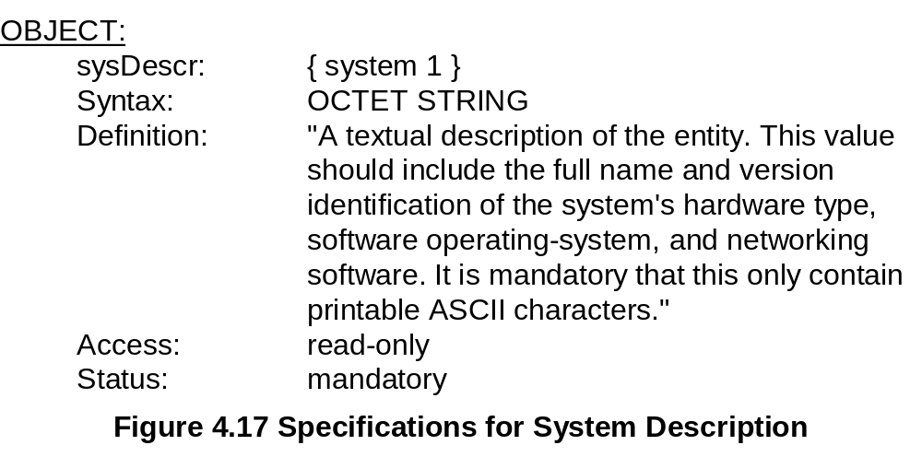
Chapter 4
Managed Object: Structure
Notes
Network Management: Principles and Practice
© Mani Subramanian 2000

Slide 34
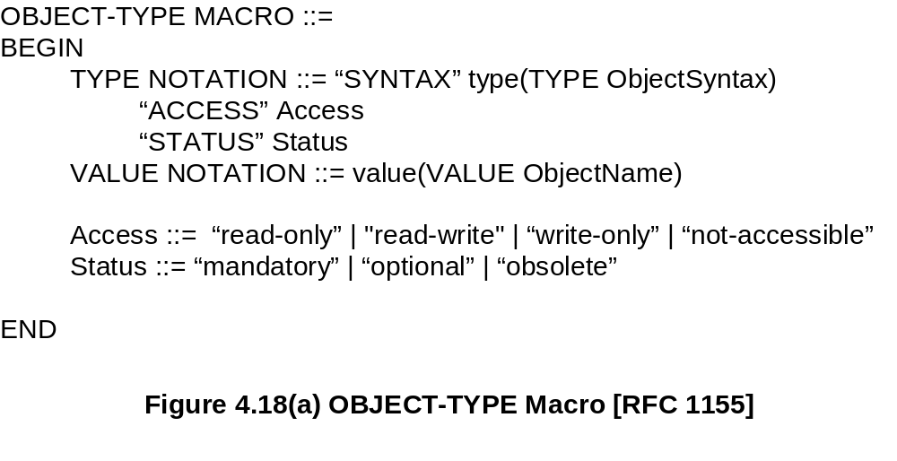
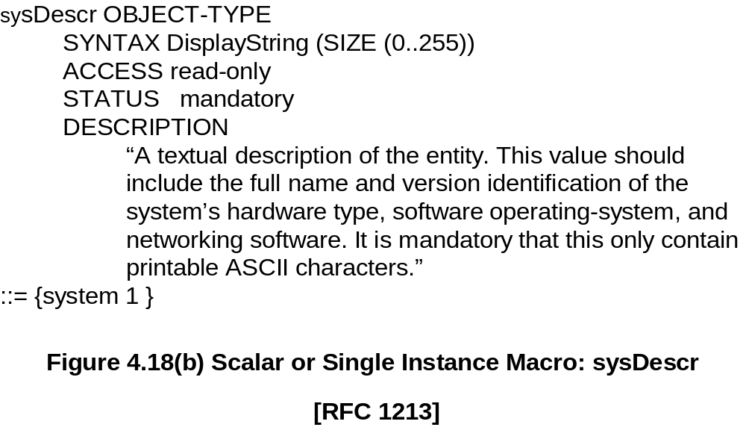
Chapter 4
Managed Object: Macro
Notes
Network Management: Principles and Practice
© Mani Subramanian 2000

Slide 35
Chapter 4
Aggregate Managed Object
A group of related objects
Also called tabular objects
Can be represented by a table with
  Columns of objects
  Rows of instances
Table of Objects
List of Objects
Objects
Notes
Example: IP address table
Consists of objects:
  IP address
  Interface
  Subnet mask (which subnet this address
  belongs to)
  Broadcast address (value of l.s.b. in IP
  broadcast address)
  Largest IP datagram that can be assembled
Multiple instances of these objects associated with
the node
Network Management: Principles and Practice
© Mani Subramanian 2000

Slide 36
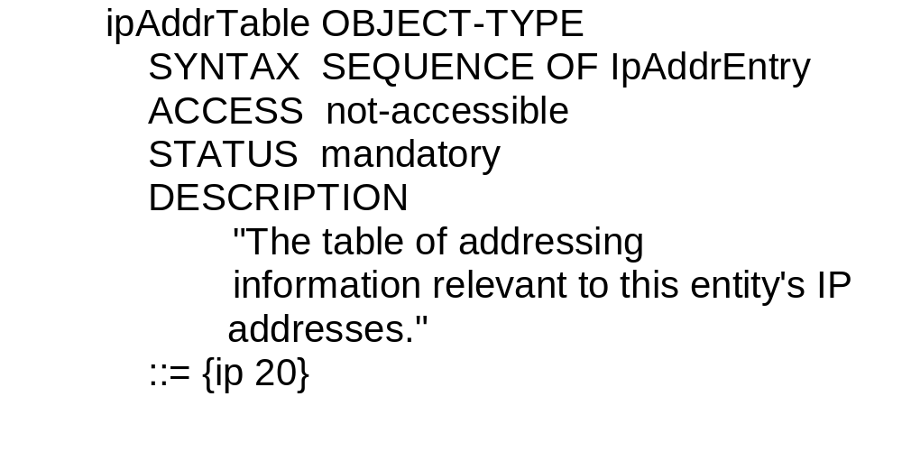
Chapter 4
Aggregate M.O. Macro:
Table Object [RFC 1213/STD 17]
Notes
ipAddrTable OBJECT-TYPE
::= {ip 20}
ipAddrEntry OBJECT-TYPE
::= {ipAddrTable 1}
Network Management: Principles and Practice
© Mani Subramanian 2000

Slide 37
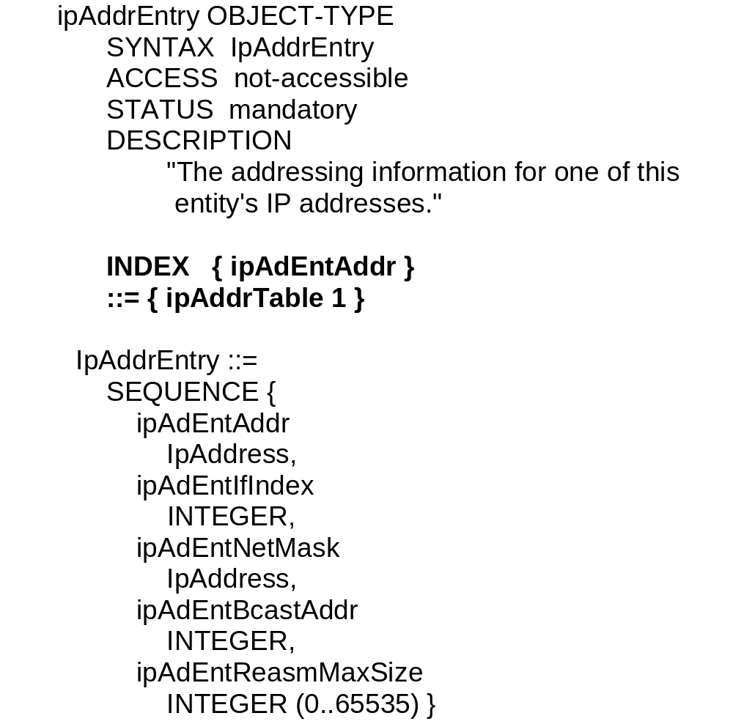
Chapter 4
Aggregate M.O. Macro:
Entry Object [RFC 1213/STD 17]
Notes
Index ipAdEntAddr uniquely identifies an instance
May require more than one object in the instance to
uniquely identify it
Network Management: Principles and Practice
© Mani Subramanian 2000

Slide 38
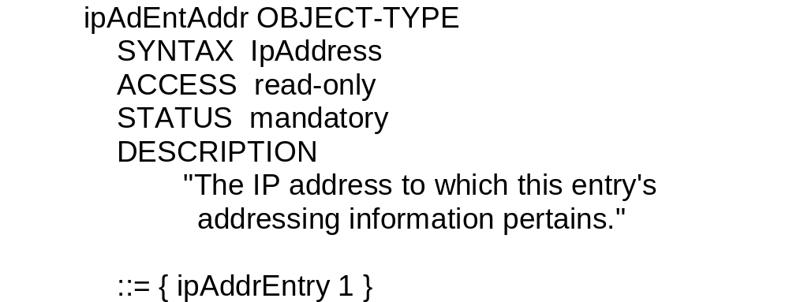
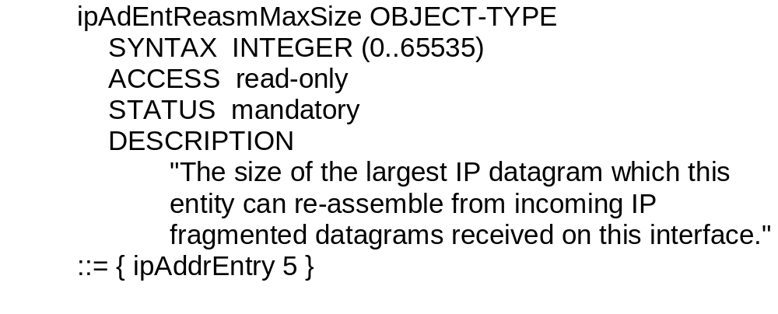
Chapter 4
Aggregate M.O. Macro:
Columnar Objects [RFC 1213/STD 17]
Notes
Network Management: Principles and Practice
© Mani Subramanian 2000

Slide 39
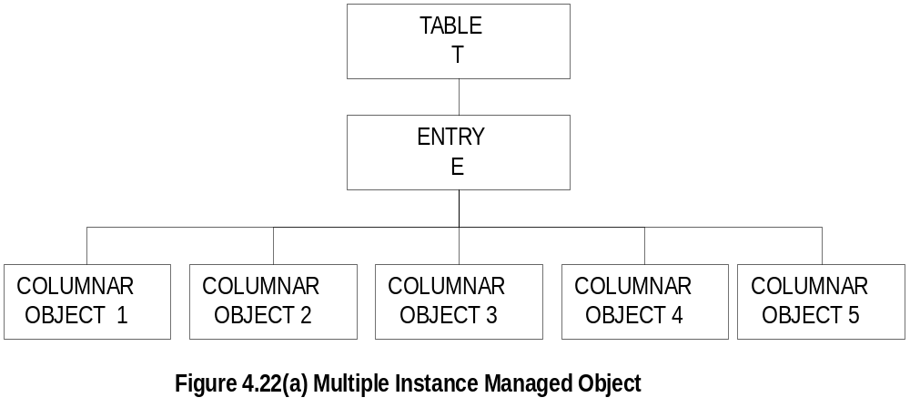
Chapter 4
Tabular Representation of
Aggregate Object
Notes
The objects TABLE T and ENTRY E are objects that
are logical objects. They define the grouping and are
not accessible
Columnar objects are objects that represent the
attributes and hence are accessible
Each instance of E is a row of columnar objects
1 through 5
Multiple instances of E are represented by multiple rows
Network Management: Principles and Practice
© Mani Subramanian 2000

Slide 40
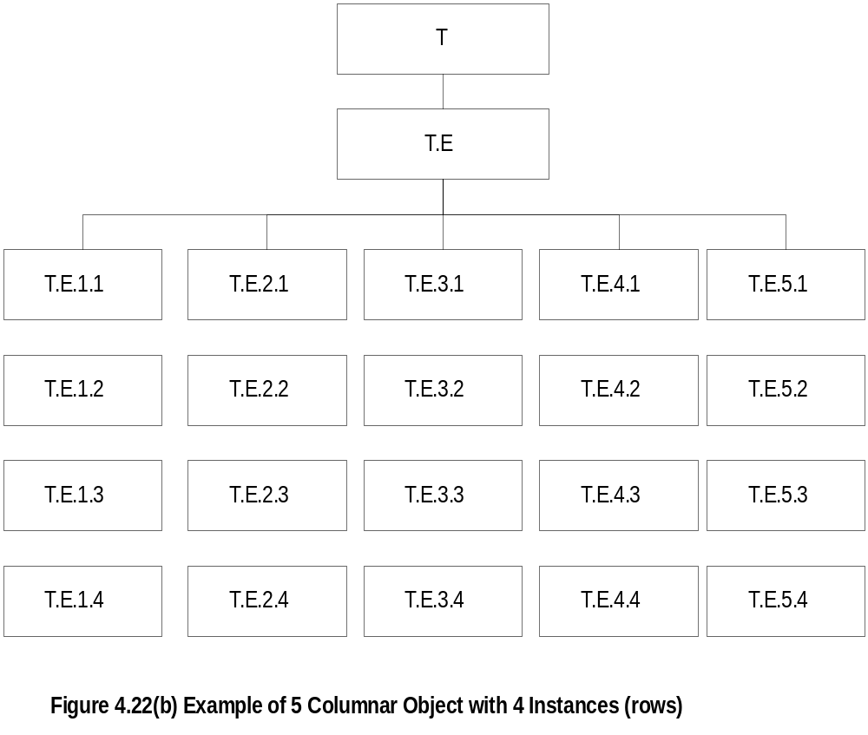
Chapter 4
Tabular Representation of
Aggregate Object
Notes
Notice that the column-row numeric designation is
reverse of what we are used to as row-column
Network Management: Principles and Practice
© Mani Subramanian 2000

Slide 41
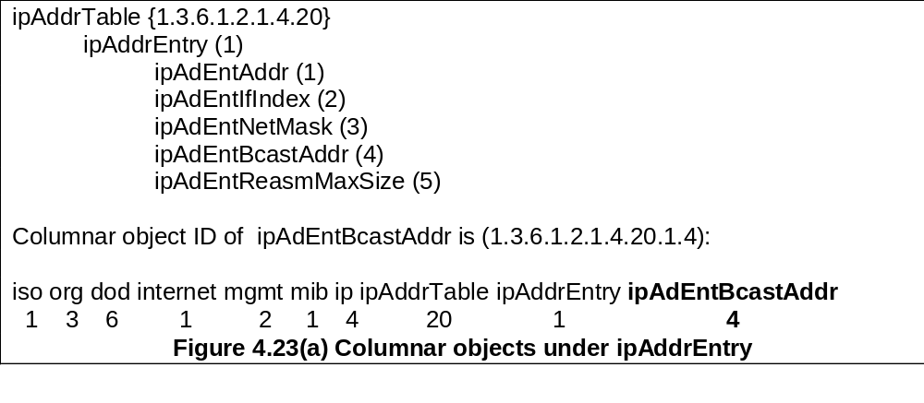
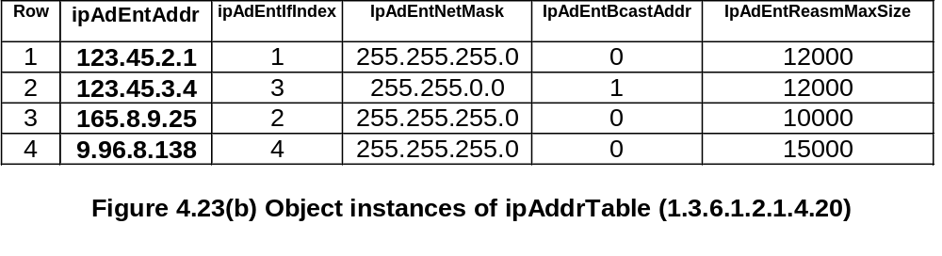
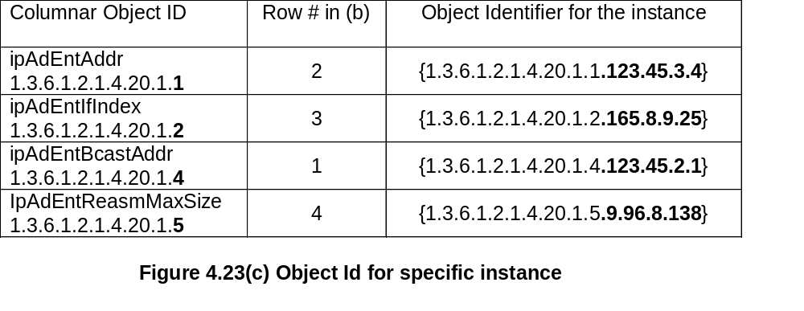
Chapter 4
Multiple Instances of
Aggregate Managed Object
Network Management: Principles and Practice
© Mani Subramanian 2000

Slide 42
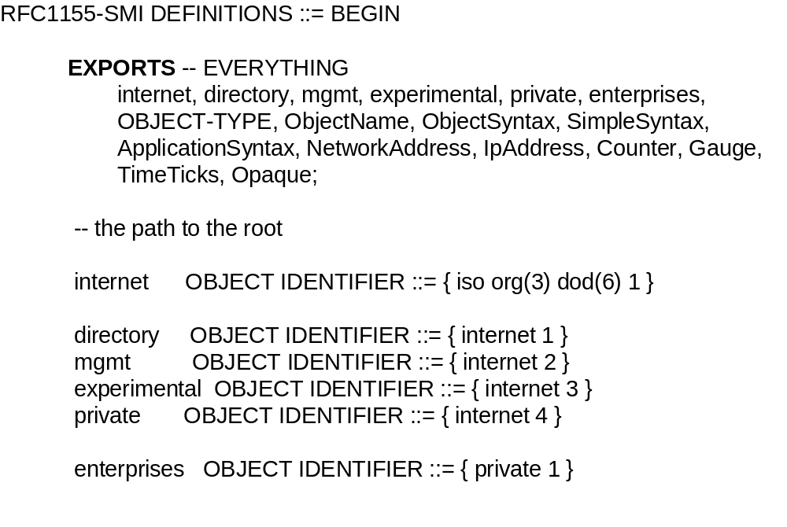
Chapter 4
SMI Definition [STD 16 / RFC 1155]
Notes
EXPORTS identifies the objects that any other module
could import
Network Management: Principles and Practice
© Mani Subramanian 2000

Slide 43
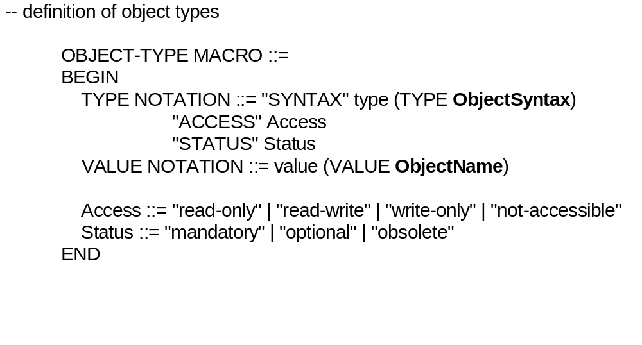
Chapter 4
SMI Definition [STD 16 / RFC 1155]
Notes
Network Management: Principles and Practice
© Mani Subramanian 2000

Slide 44
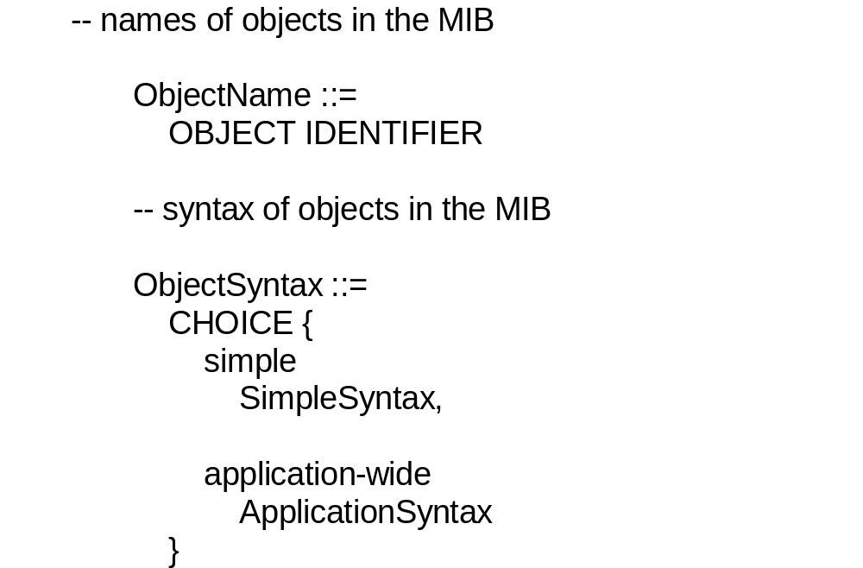
Chapter 4
SMI Definition [STD 16 / RFC 1155]
Notes
Network Management: Principles and Practice
© Mani Subramanian 2000

Slide 45
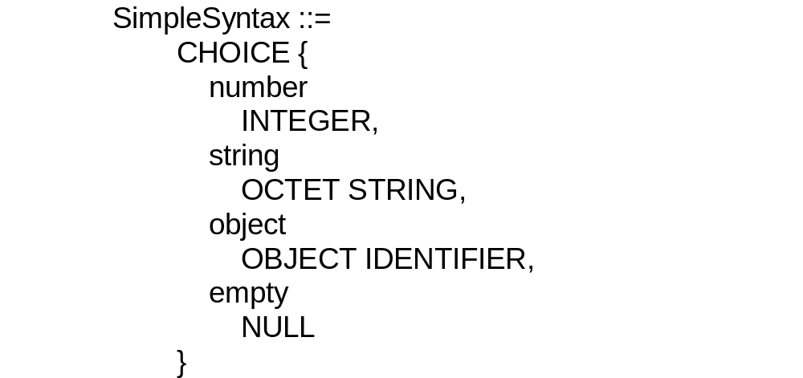
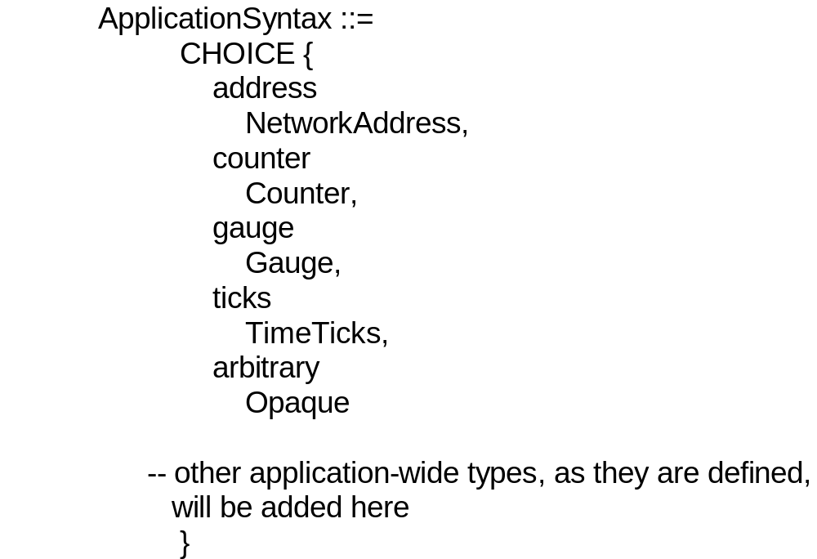
Chapter 4
SMI Definition [STD 16 / RFC 1155]
Network Management: Principles and Practice
© Mani Subramanian 2000

Slide 46
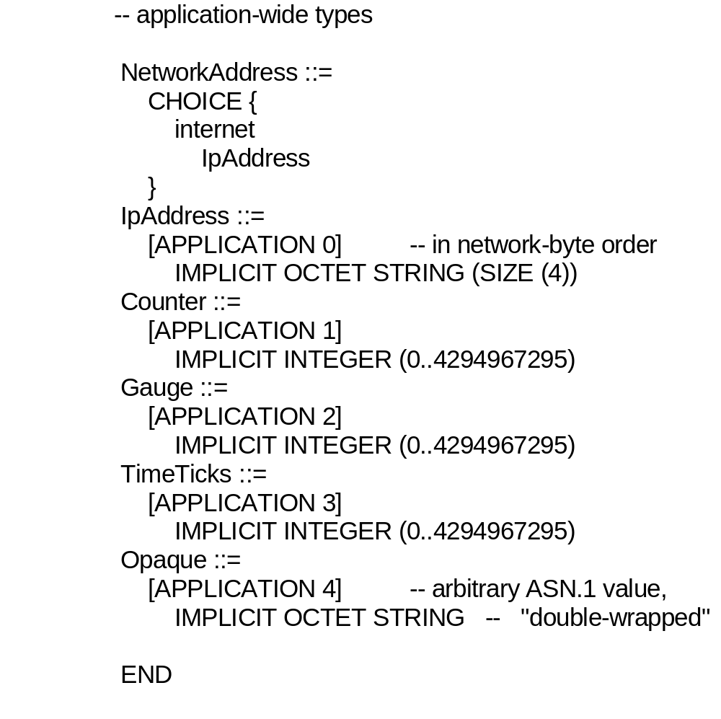
Chapter 4
SMI Definition [STD 16 / RFC 1155]
Notes
Network Management: Principles and Practice
© Mani Subramanian 2000

Slide 47
Chapter 4
Criteria for including an object in MIB-II
[RFC 1213/ STD 17]
(1) An object needed to be essential for either fault
or configuration management
(2) Only weak control objects were permitted (by weak,
it is meant that tampering with them can do only limited
damage). This criterion reflects the fact that the current
management protocols are not sufficiently secure to do
more powerful control operations.
(3) Evidence of current use and utility was required.
(4) In MIB-I, an attempt was made to limit the number
of objects to about 100 to make it easier for vendors to
fully instrument their software. In MIB-II, this limit was
raised given the wide technological base now
implementing MIB-I.
(5) To avoid redundant variables, it was required that
no object be included that can be derived from others
in the MIB.
(6) Implementation specific objects (e.g., for BSD UNIX)
were excluded.
(7) It was agreed to avoid heavily instrumenting critical
sections of code. The general guideline was one counter
per critical section per layer.

Slide 48
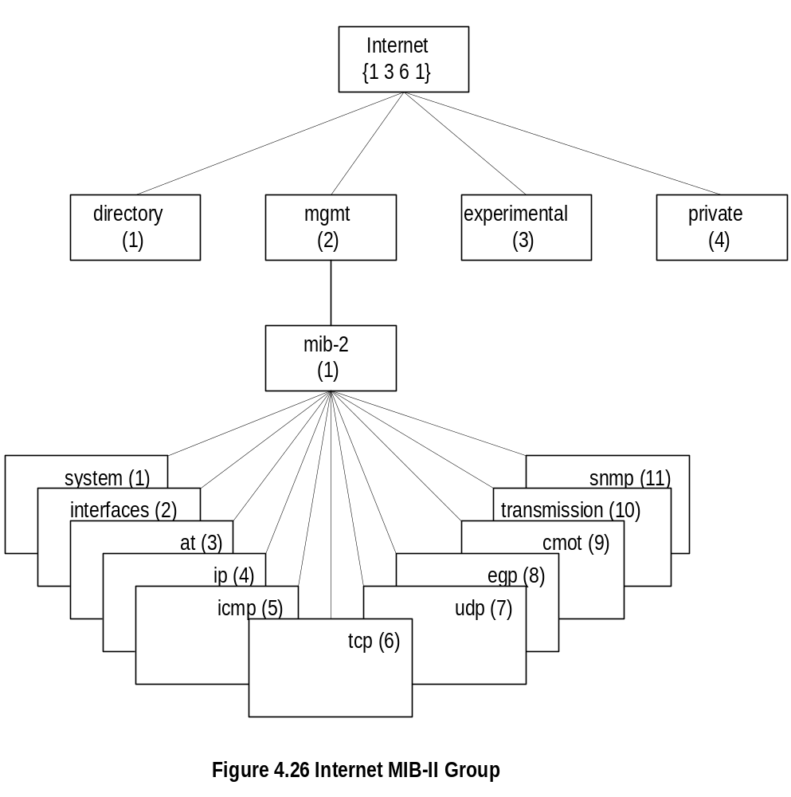
Chapter 4
MIB [STD 17/ RFC 1213]
Notes
MIB-II (RFC 1213) is superset of MIB-I
Objects that are related grouped into object groups
MIB module comprises module name, imports from
other modules, and definitions of current module
RFC 1213 defines eleven groups; expanded later
at → deprecated
Network Management: Principles and Practice
© Mani Subramanian 2000

Slide 49
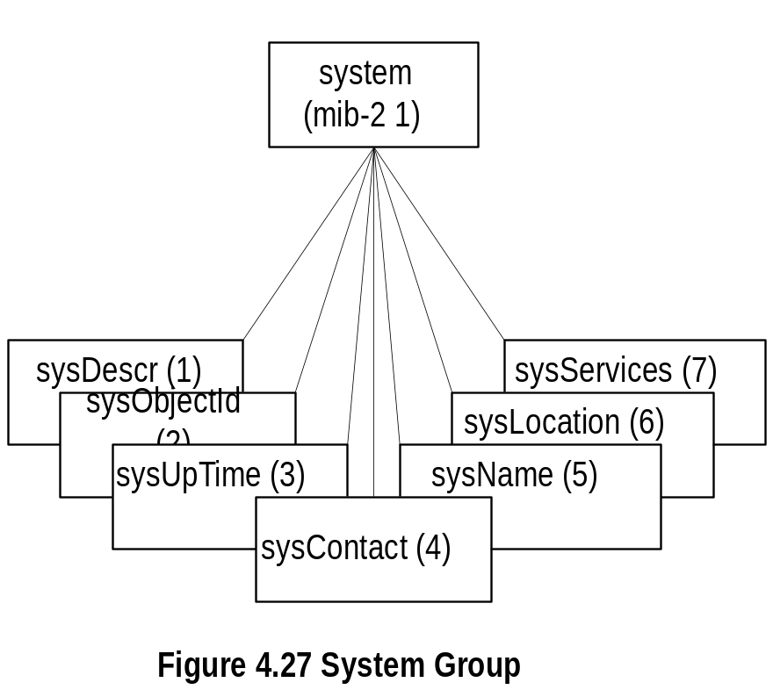
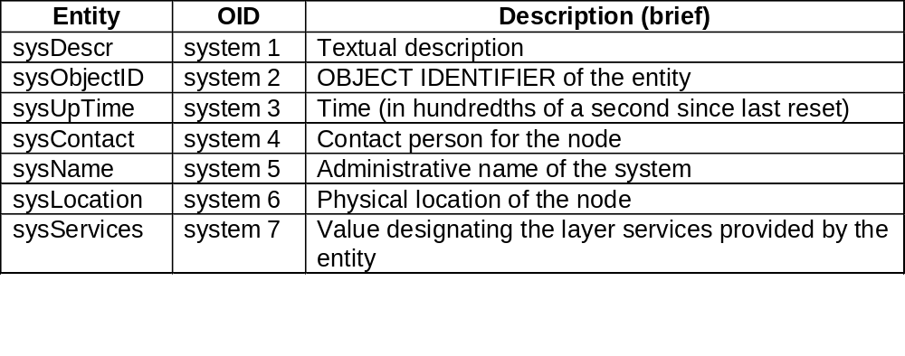
Chapter 4
System Group
Notes
Network Management: Principles and Practice
© Mani Subramanian 2000

Slide 50
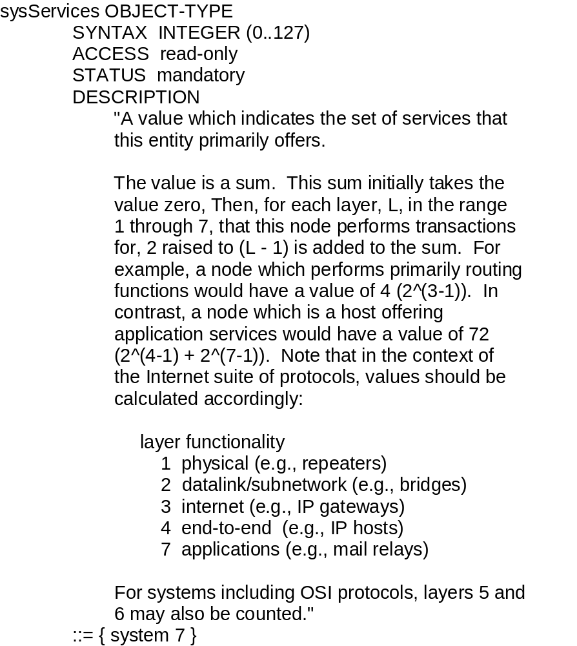
Chapter 4
sysServices
Notes
Network Management: Principles and Practice
© Mani Subramanian 2000

Slide 51
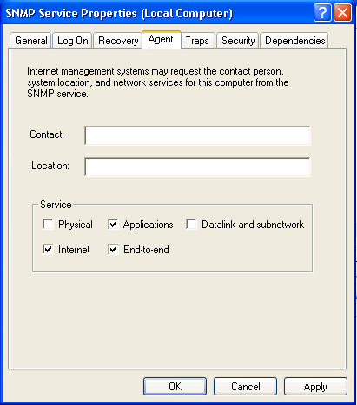
Chapter 4
sysServices
- Example -
Notes

Slide 52
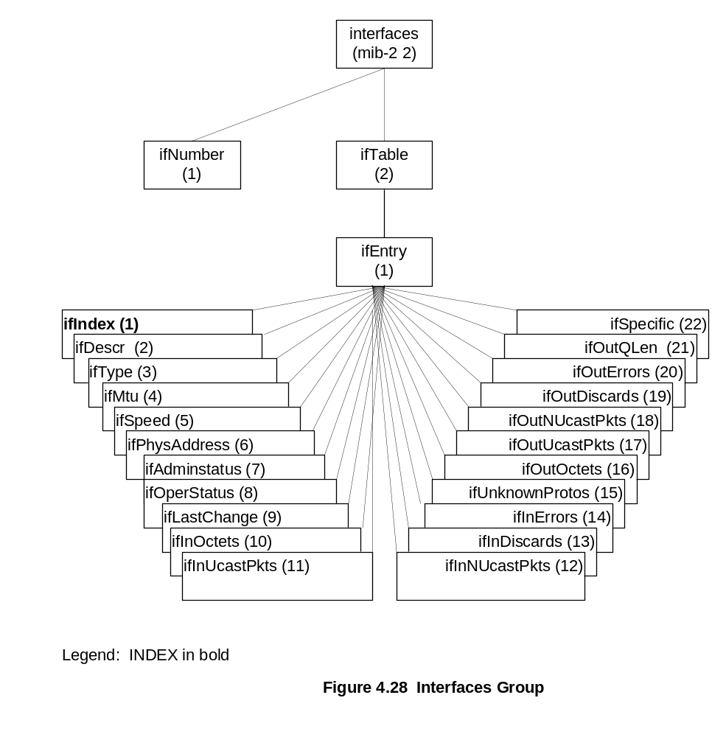
Chapter 4
Interfaces Group
Notes
Info about specific interfaces addressed in specific MIBs
Example: dot3 OBJECT IDENTIFER ::= { transmission 7 }
[RFC 2358, Definitions of Managed Objects for
the Ethernet-like Interface Types]
Network Management: Principles and Practice
© Mani Subramanian 2000

Slide 53
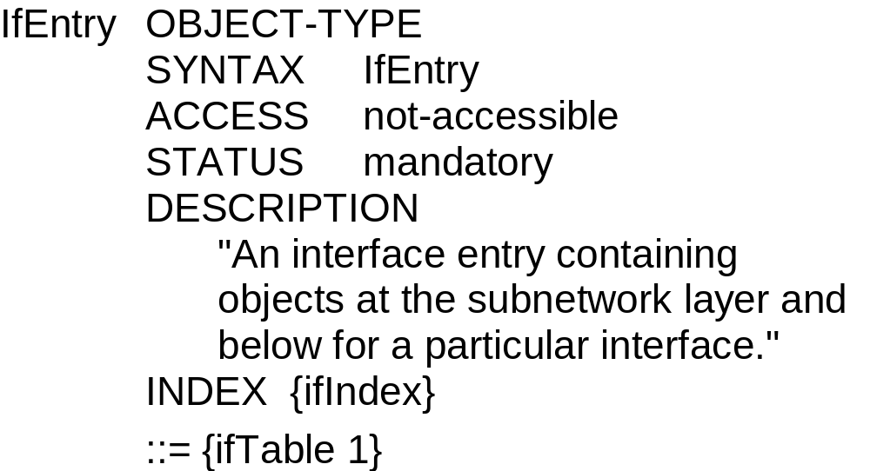
Chapter 4
ifEntry
Notes
ifEntry specifies the objects in a row in the ifTable
Each interface is defined as a row in the table
Network Management: Principles and Practice
© Mani Subramanian 2000

Slide 54

Chapter 4
ifType (Data-Link Layer Protocol)
Notes
Type of interface below the network layer defined as
enumerated integer
Network Management: Principles and Practice
© Mani Subramanian 2000

Slide 55

Chapter 4
IP Group
Notes
ipForwarding: Forwarding Router/Gateway (1) and
non-forwarding/host (2)
IP Address Table contains table of IP addresses
IP Route Table contains an entry for each route
IP Network-to-Media Table is address translation table
mapping IP addresses to physical addresses
Network Management: Principles and Practice
© Mani Subramanian 2000

Slide 56


Chapter 4
IP Address Table
Notes
Network Management: Principles and Practice
© Mani Subramanian 2000

Slide 57


Chapter 4
IP Routing Table
Network Management: Principles and Practice
© Mani Subramanian 2000

Slide 58


Chapter 4
IP Address Translation Table
Notes
Network Management: Principles and Practice
© Mani Subramanian 2000

Slide 59

Chapter 4
ICMP Group
Notes
Objects associated with ping
  icmpOutEchos # ICMP echo messages sent
  icmpInEchoReps # ICMP echo reply messages
  received
Objects associated with traceroute/tracert
  icmpInTimeExcs # ICMP time exceeded messages received
Network Management: Principles and Practice
© Mani Subramanian 2000

Slide 60

Chapter 4
TCP Group
Notes
Connection-oriented transport protocol group
Has one table
Network Management: Principles and Practice
© Mani Subramanian 2000

Slide 61


Chapter 4
TCP Connection Table
Notes
Network Management: Principles and Practice
© Mani Subramanian 2000

Slide 62


Chapter 4
UDP Group
Notes
Connectionless transport protocol group
Has one table, UDP table
Network Management: Principles and Practice
© Mani Subramanian 2000

