Slide 1
SC2001/CE2101/ CZ2101: Algorithm Design and Analysis
Greedy Algorithms;
Dijkstra’s Algorithm; Prim’s Algorithm
Instructor: Assoc. Prof. ZHANG Hanwang
Courtesy of Dr. Ke Yiping, Kelly’s slides

Slide 2
Greedy Algorithms
Notes:
In this module, we will learn greedy algorithms for solving optimization problems in graphs.
Greedy algorithm is a general strategy of algorithm design with many applications. Here it is applied to graphs.

Slide 3
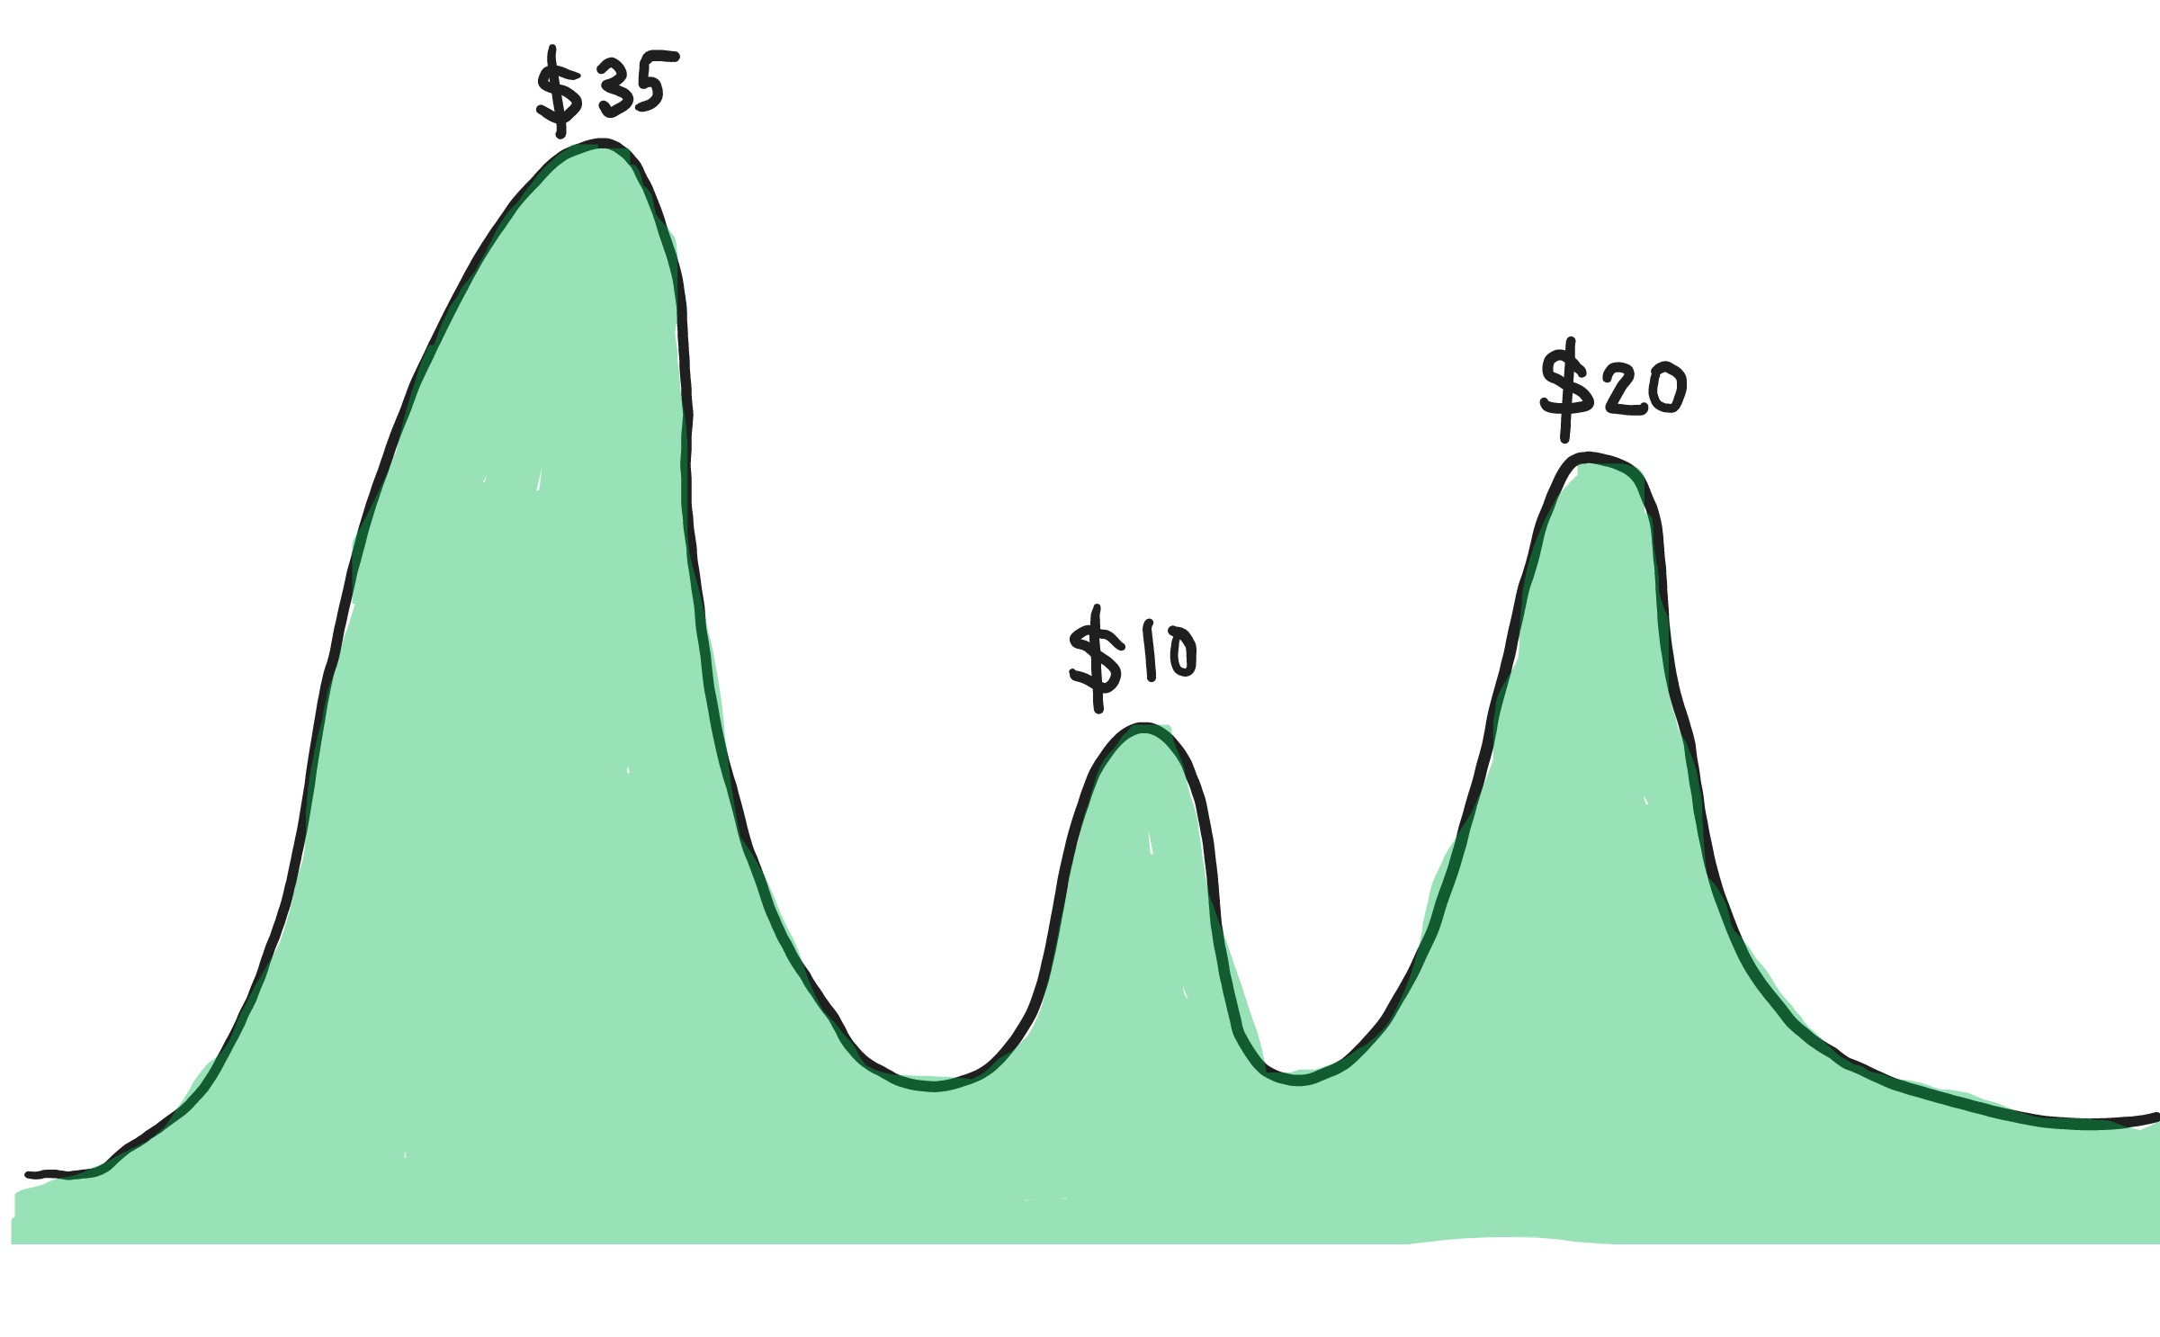
Local optimality generally does NOT imply global optimality!!
You are here

Slide 4
Learning Objectives
At the end of this lecture, students should be able to:
Explain the strategy of Greedy algorithms
Solve single-source shortest paths problem using Dijkstra’s algorithm
Prove the correctness of Dijkstra’s algorithm
Describe Prim’s algorithm for finding minimum spanning trees (MSTs)
Prove the correctness of Prim’s algorithm
Notes:
This module basically consists of three parts.
The first part is about the general strategy of greedy algorithms. The other two parts are the Dijkstra’s algorithm and Prim’s algorithm respectively.
The following are our objectives of learning.
First, we should be able to explain the strategy of greedy algorithms, for solving optimization problems. When faced with tough choices, how would
a greedy algorithm make a decision? Would that decision be good or bad? We will discuss about such questions soon.
Then, we will learn the Dijkstra’s algorithm for solving the problem of finding single-source shortest paths. After the learning, we should be able to
describe the ideas and pseudo code of the Dijkstra’s algorithm, including what data structures should be used.
Although greedy algorithms are powerful, sometimes their solutions may not be optimal. However, in the case of Dijkstra’s algorithm, the
greedy algorithm turns out to be optimal. In other words, the paths found by Dijkstra’s algorithm is truly the shortest. That, however, need to be proved mathematically.
Therefore, we should be able to prove the correctness of Dijkstra’s algorithm, using the mathematical language.
The second greedy algorithm we will learn is the Prim’s algorithm, which is for finding the minimum spanning trees of graphs, or MST in short.
Again, Prim’s algorithm is a greedy algorithm, but can return the optimal solution. And we should be able to mathematically prove its correctness.

Slide 5
Greedy Algorithms
In optimization problems, the algorithm needs to make a series of choices whose overall effect is to minimize the total cost, or maximize the total benefit, of some system.
There is a class of algorithms, called the greedy algorithms, in which we can find a solution by using only knowledge available at the time when the next choice (or guess) must be made.
Each individual choice is the best within the knowledge available at the time.
Notes:
Greedy algorithms represent a general strategy for algorithm design. Typically greedy algorithms are used to solve the so-called optimization problems. In such a problem, the objective is for the algorithm to find a solution to either minimize the total cost, or to maximize the total benefit. This makes sense in reality, where we want to reduce the loss, and increase the gain or profit. To this end, the algorithm needs to make a series of choices, so that in totality, we can achieve the desired outcome.
The greedy algorithms are a class of algorithms to solve optimization problems. Here, we call them “greedy” because these algorithms only use the knowledge available at the time, to make the next choice. So “greedy” implicates a certain kind of short-sightedness. For example, when you try to find a job, there could be different objectives: one is the generosity of the pay scale and another is to have a good career development, or simply whether you like the job or not. Which one is easier to judge? Often times, the pay scale is easier to compare and make a choice. So, if among several job offers, you simply choose the one with the highest salary, it means you have used the greedy algorithm.
In the greedy algorithm, each individual choice will look the best with the knowledge available at the time, that is, in the short term. But in the long term, it may not be the best. The strength of greedy algorithm is that it’s easy to make an individual choice, but we cannot guarantee that it is optimal overall.

Slide 6
Greedy Algorithms
Each individual choice is not very expensive to compute.
A choice cannot be undone, even if it is found to be a bad choice later.
Greedy algorithms cannot guarantee to produce the optimal solution for a problem.
Notes:
It is not expensive to compute each individual choices because they are easy to make.
However, once a choice has been made, it cannot be undone even if you find out later that it was a bad choice. For example, if you choose a job with high salary but later you find that it is very demanding or has low job security, your choice cannot be undone, and you will have to pay the cost for your greedy choice.
Therefore, we cannot guarantee that greedy algorithms can always produce the optimal solution for a problem. In this module, however, we are going to see that greedy algorithms actually work well. Under certain conditions, they can indeed give you the optimal solutions. Hence this is a short overview of the greedy algorithms. In the next lecture, we are going to learn two examples on using greedy algorithms to solve optimization problems in graphs. One is to find the shortest paths in a graph, and the other is to find the minimum spanning tree of a graph.

Slide 7
Dijkstra’s Algorithm

Slide 8
Dijkstra's Algorithm
Shortest Path Problem:
The problem of finding the shortest path from one vertex in a graph G to another vertex. "Shortest" may be the least number of edges, or the least total weight, etc.
edge set
G = (V, E)
Dijkstra's Algorithm:
This is an algorithm to find the shortest paths from a single source vertex to all other vertices in a weighted, directed graph. All weights must be nonnegative.
vertex set

Slide 9
Dijkstra's Algorithm
Dijkstra's algorithm keeps two sets of vertices:
S: the set of vertices whose shortest paths from the source node have already been determined
they form the tree
V − S: the remaining vertices
The other data structures needed are:
d: an array of size |V| to store the estimated lengths of shortest paths from the source node to all vertices
pi: an array of size |V| to store the predecessors for each vertex

Slide 10
Basic Steps
The basic steps are:
Initialise d and pi
Set S to empty
While there are still vertices in V − S
Move u, the vertex in V − S that has the shortest path estimate from source, to S
For all the vertices in V − S that are connected to u, update their estimates of shortest distances to the source

Slide 11
A Toy Example
S: {
}
Shortest paths from s to other vertices
u
v
1
1
10
∞
v
∞
14
8
9
u
13
10
s
2
3
9
4
6
3
0
s
∞
7
5
∞
∞
5
x
y
5
7
2
2
x
y
d
s | x | u | v | y
pi
s | x | u | v | y

Slide 12
Pseudocode of Dijkstra's Algorithm
Dijkstra_ShortestPath ( Graph G, Node source ) {
for each vertex v {
d[v] = infinity;
pi[v] = null pointer;
S[v] = 0; // S[v] is 1 if v is in S
} // S[v] is 0 if v is not in S
d[source] = 0;
put all vertices in priority queue, Q, in d[v]’s increasing order;
while not Empty(Q) {
u = ExtractCheapest(Q);
S[u] = 1; /* Add u to S */

Slide 13
Pseudocode of Dijkstra's Algorithm
for each vertex v adjacent to u
if (S[v] ≠ 1 and d[v] > d[u] + w[u, v]) {
remove v from Q;
d[v] = d[u] + w[u, v];
pi[v] = u;
insert v into Q according to its d[v];
}
} // end of while loop
}
S
s
…
v
u
Worst case time complexity of Dijkstra’s algorithm is O(|V|²)
(analysis not required).

Slide 14
Proof of Correctness
Property of Shortest Path
Lemma 1: In a weighted graph G, suppose that a shortest path from x to z consists of a path P from x to y followed by a path Q from y to z. Then P is a shortest path from x to y and Q is a shortest path from y to z.
P
Q
x
y
z
Proof (By Contradiction):
Assume that P is not the shortest path from x to y. Then there will be another path from x to y, P’ which is shorter than P. As a result P’ followed by Q will be a path shorter than P followed by Q. But it was known that P followed by Q is the shortest path. Contradiction. Same can be said about Q.

Slide 15
Greedy choice is optimal
Theorem D1: Let G = (V, E, W) be a weighted graph with nonnegative weights. Let S be a subset of V and let s be a member of S. Assume that d[y] is the shortest distance in G from s to y, for each y in S. Let z be the next vertex chosen to go into S. If edge (y, z) is chosen to minimise d[y] + W(y, z) over all edges with one vertex in S and one vertex in V – S, then the path consisting of a shortest path from s to y followed by the edge (y, z) is the shortest path from s to z.
Proof:
We will show that there is no other path from s to z that is shorter.

Slide 16


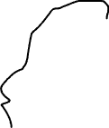












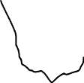














Greedy choice is optimal
$$d\left[x_{i}\right]$$
: shortest distance from s to
$$x_{i}$$
: shortest distance from s to
$$d\left[y\right]$$
$$y$$
$$d\left[x_{1}\right]$$
$$x_{1}$$
Consider one arbitrary vertex z
$$x_{2}$$
$$d\left[x_{1}\right]+W(x_{1},z)$$
$$d\left[x_{2}\right]$$
$$⋮$$
$$d\left[x_{2}\right]+W(x_{2},z)$$
$$⋮$$
$$⋮$$
$$s$$
$$⋮$$
$$y$$
$$z$$
$$d\left[y\right]+W(y,z)$$
min
$$d\left[y\right]$$
$$⋮$$
$$⋮$$
$$⋮$$
$$⋮$$
$$x_{n}$$
$$d\left[x_{n}\right]+W(x_{n},z)$$
$$d\left[x_{n}\right]$$
$$V−S$$
$$S$$

Slide 17











Greedy choice is optimal
Which vertex to select to include into S?
$$d\left[x_{1}\right]$$
$$x_{1}$$
$$v_{1}$$
$$d\left[x_{2}\right]+W(x_{2},v_{1})$$
$$x_{2}$$
$$v_{2}$$
$$d\left[x_{2}\right]+W(x_{2},v_{1})$$
$$d\left[x_{2}\right]$$
$$⋮$$
$$⋮$$
$$⋮$$
$$⋮$$
$$s$$
$$z$$
$$d\left[y\right]+W(y,z)$$
min
$$y$$
$$d\left[y\right]$$
$$⋮$$
$$⋮$$
$$⋮$$
$$⋮$$
$$x_{n}$$
$$v_{m}$$
$$d\left[x_{n}\right]+W(x_{n},v_{m})$$
$$d\left[x_{n}\right]$$
$$V−S$$
$$S$$
$$s⟶∗y⟶z$$
: shortest path from s to z

Slide 18
Greedy choice is optimal
Proof of Theorem D1 (continued)
u
v
P: s →y → z (shortest path for z)
W(P) = d[y] + W(y, z)
P’: s → y → u → … → z (an alternative shortest path)
W(P’) = d[y] + W(y, u) + distance from u to z
Because d[y] + W(y, u) ≥ d[y] + W(y, z),
1
10
∞
∞
14
8
9
13
10
s
2
3
9
4
6
0
∞
7
5
∞
∞
5
7
2
y
z
Edge (y, z) is chosen to minimise d[y] + W(y, z) over all edges with one vertex in S and one vertex in V – S
and distance from u to z is nonnegative,
therefore W(P) ≤ W(P’).

Slide 19
Greedy choice is optimal
Proof of Theorem D1 (continued)
Let P be a shortest path from s to y followed by edge (y, z)
Let W(P) = the distance travelled along P
Let P’ = any shortest path different from P, i.e., P’ = s, z₁, …, z_{k}, …, z
Assume that z_{k} is the first vertex in P’ not in set S.
s
W(P) = d[y] + W(y, z)
W(P’) = d[z_{k–1}] + W(z_{k–1}, z_{k}) + distance from z_{k} to z
Note that: d[z_{k–1}] + W(z_{k–1}, z_{k}) ≥ d[y] + W(y, z)
Since distance from z_{k} to z is non-negative, therefore, W(P) <= W(P’).
z_{k-1}
y
z
z_{k}

Slide 20
Theorem D2 and Proof
Theorem D2: Given a directed weighted graph G with nonnegative weights and a source vertex s, Dijkstra’s algorithm computes the shortest distance from s to each vertex of G that is reachable from s.
Proof (By induction):
We will show by induction that as each vertex v is added into set S, d[v] is the shortest distance from s to v.
Basis:
The algorithm assigns d[s] to zero when the source vertex s is added to S. So d[s] is the shortest distance from s to s when S has the first vertex in it.

Slide 21
Theorem D2 and Proof (Continued)
Inductive Hypothesis:
Assume the theorem is true when S has k vertices. That is, assume v₀, v₁, v₂, …, v_{k–1} are added where d[v₁], d[v₂]… are the shortest distances.
When v_{k} is chosen by Dijkstra’s algorithm, it means an edge (v_{i}, v_{k}), where i ∈ {0, 1, 2, …, k – 1}, is chosen to minimise d[v_{i}] + W(v_{i}, v_{k}) among all edges with one vertex in S and one vertex not in S.
v₀
v₁
v₂
.
.
.
v_{k – 1}
S
v_{k}
By Theorem D1, d[v_{k}] is the shortest distance from source to v_{k}. So the theorem is true when S has k + 1 vertices.

Slide 22
Minimum Spanning Tree

Slide 23
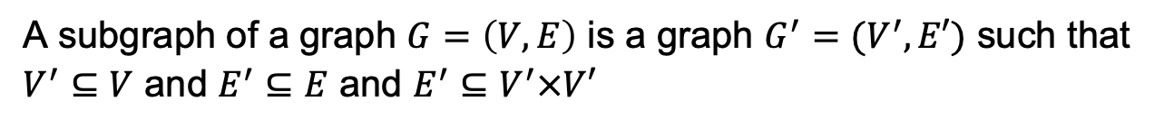
Minimum Spanning Tree
Definition of Subgraph
G
✓ subgraph
✗ subgraph
✗ subgraph
A subgraph of a graph $G=\left(V,E\right)$ is a graph $G^{′}=(V^{′},E′)$ such that $V^{′}⊆V$ and $E^{′}⊆E$ and $E^{′}⊆V^{′}×V′$
Definition of Spanning Tree
A connected, acyclic subgraph containing all the vertices of a graph.
Definition of Minimum Spanning Tree
A minimum-weight spanning tree in a weighted graph.

Slide 24
Spanning Tree
A
D
B
F
C
Spanning Tree
Another Spanning Tree
A
D
A
D
B
B
F
C
F
C

Slide 25
Minimum Spanning Tree
2
2
A
B
A
B
3
2
1
3
2
Spanning Tree
C
D
C
D
4
A
B
2
A
B
3
2
1
Minimum Spanning Tree
3
1
Minimum Spanning Tree
C
D
C
D

Slide 26
Main Idea of Prim's Algorithm
Prim’s Algorithm
It works on undirected graph.
It builds upon a single partial minimum spanning tree, at each step adding an edge connecting the vertex nearest to but not already in the current partial minimum spanning tree.
At first a vertex is chosen, this vertex will be the first node in T.
Set P is initialised: P = set of vertices not in tree T but are adjacent to some vertices in T.
T
…
P

Slide 27
Main Idea of Prim's Algorithm
…
T
…
…
P
T
…
P
minimum
cost
u
u
z
Prim’s Algorithm (Cont.)
In every iteration in the Prim’s Algorithm, a new vertex u from set P will be connected to the tree T. The vertex u will be deleted from the set P. The vertices adjacent to u and not already in P will be added to P.
When all vertices are connected into T, P will be empty. This means the end of the algorithm.
The new vertex in every iteration will be chosen by using greedy method, i.e. among all vertices in P which are connected to some vertices already inserted in the tree T but themselves are not in T, we choose one with the minimum cost.
z

Slide 28
An Example of Prim's Algorithm
Prim’s MST
9
5
3
6
11
5
4
2
2
9
9
2
1
1
4
8
12
9
8
8
8
5
9
2
5
7
10
14
2
7
5
5
13
Black vertices: unseen vertices
Pink vertices: tree vertices
Blue vertices: fringe vertices

Slide 29
3 subsets of vertices
Prim's Algorithm classifies vertices into three disjoint categories:
Tree vertices - in the tree being constructed so far
Fringe vertices - not in the tree but adjacent to some vertices in the tree
Unseen vertices - all others

Slide 30
Greedy choice of Prim’s Algo
Key step in the algorithm is the selection of a vertex from the fringe (which, of course, depends on the weights on incident edges).
Prim's Algorithm always chooses a minimum weight edge from tree vertex to fringe vertex.

Slide 31
Main Idea of Prim’s Algorithm
T
F (vertices adjacent to, but not in T)
w
x
y
z
Choose min(w, x, y, z)

Slide 32
Pseudocode of Prim's Algo
primMST(G, s, n) // outline of Prim’s algorithm
{
Initialise all vertices as unseen.
Reclassify s as tree vertex.
Reclassify all vertices adjacent to s as fringe.
While (there are fringe vertices)
{
Select an edge of minimum weight between a tree
vertex t and a fringe vertex v;
Reclassify v as tree; add edge tv to the tree;
Reclassify all unseen vertices adjacent to v as fringe.
}
}

Slide 33
Implementing Prim's Algo
Data Structures Used:
Array d: distance of a fringe vertex from the tree
Array pi: vertex connecting a fringe vertex to a tree vertex
Array S: whether a vertex is in the minimum spanning tree being built
Priority queue pq: queue of fringe vertices in the order of the distances from the tree
At the end of the algorithm, array pi has the minimum spanning tree.

Slide 34
Implementing Prim's Algo
primMST(G, s, n) {
initialise priority queue pq as empty;
for each vertex v {
d[v] = infinity; S[v] = 0;
pi[v] = null pointer; }
d[s] = 0; S[s] = 1;
insert(pq, s, 0);
while (pq is not empty) {
u = getMin(pq); deleteMin(pq);
S[u] = 1;
updateFringe(pq, G, u); }
}

Slide 35
Update Fringe Set of Vertices
updateFringe(pq, G, v) {
for all vertices w adjacent to v {
if (S[w] != 1) { //if w is not a tree vertex
newWgt = weight of edge vw;
if (d[w] == infinity) {
d[w] = newWgt; pi[w] = v;
insert(pq, w, newWgt);
} else if (newWgt < d[w]) {
d[w] = newWgt; pi[w] = v;
decreaseKey(pq, w, newWgt);}
} // if w is not a tree vertex
} // for all vertices
}
v
w
v
w
2
v
1
3
w
2
v
1
3
w

Slide 36
MST Property
Minimum Spanning Tree Property
Let T be a spanning tree of G, where G = (V, E, W) is a connected, weighted graph. Suppose that for every edge (u, v) of G that is not in T, if (u, v) is added to T it creates a cycle such that (u, v) is a maximum-weight edge on that cycle. Then T has the Minimum Spanning Tree Property (or MST Property, in short).
A
2
A
B
A
2
B
B
3
2
1
3
2
1
3
2
C
D
C
D
C
D
4
✓ MST Property
✗ MST Property
G

Slide 37
Lemma 1 and Proof
Lemma 1: In a connected weighted graph G = (V, E, W), if T₁ and T₂ are two spanning trees that have the MST property, then they have the same total weight.
Proof by induction on k, the number of edges in T₁ but not T₂ (there are also k edges in T₂ but not in T₁).
Basis:
k = 0; i.e. T₁ = T₂. Therefore, they have the same weight.

Slide 38
Proof of Lemma 1 (continued)
Inductive hypothesis: For k > 0, assume the lemma holds when there are j differing edges where 0 ≤ j < k.
Let uv be the minimum weight edge among the differing edges (assume uv is in T₂ but not T₁).
Look at unique path in T₁ from u to v.
Suppose it is made up of w₀,w₁,…,w_{p} where w₀ = u, …, w_{p}= v. This path must contain some edge different from T₂'s.
Let w_{i}w_{i + 1} be this differing edge.
By MST property of T₁, w_{i}w_{i + 1} cannot be > uv's weight.
T₁
u
w₁
v
w₂
T₂
u
w₁
v
w₂

Slide 39
Proof of Lemma 1 (continued)
But since uv was chosen to be the minimum weight among differing edges, w_{i}w_{i+1} cannot have weight less than uv.
Therefore, W(w_{i}w_{i+1}) = W(uv).
Add uv to T₁ (creating a cycle). Remove w_{i}w_{i+1} leaving tree T ’₁ (which has the same weight as T₁).
But T ’₁ and T₂ differ only on k – 1 edges.
So by inductive hypothesis, T ’₁ and T₂ have the same total weight. Therefore, T₁ and T₂ have same weight.
Page 392 Baase & Van Gelder

Slide 40
Theorem 1 and Proof
Theorem 1: In a connected weighted graph G = (V, E, W), a tree T is a minimum spanning tree if and only if T has the MST property.
Proof (Only if): Assume T is an MST for graph G.
Suppose T does not satisfy the MST property, i.e. there is some edge uv that is not in T such that adding uv creates a cycle, in which some other edge xy has weight W(xy) > W(uv).
Then, by removing xy and adding uv ,we create a new spanning tree whose total weight is < W(T); This contradicts the assumption that T is an MST.
x
y
u
v

Slide 41
Proof of Theorem 1 (continued)
Theorem 1: In a connected weighted graph G = (V, E, W), a tree T is a minimum spanning tree if and only if T has the MST property.
Proof (Only if): Assume T is an MST for graph G.
(Cont.)
(If) Assume T has MST property.
If T_{min} is an MST, then T_{min} has MST property by the first half of the proof.
By Lemma 1, W(T) = W(T_{min}), so T is also an MST.

Slide 42
Prim's Algorithm is Optimal
Lemma 2: Let G = (V, E, W) be a connected weighted graph; Let T_{k} be the tree with k vertices constructed by Prim’s Algorithm, for k = 1, 2, …, n; and let G_{k} be the subgraph induced by the vertices of T_{k}. Then T_{k} has the MST property in G_{k}. (Proof is not required)
Theorem 2: Prim’s Algorithm outputs a minimum spanning tree.
Proof:
From Lemma 2, T_{n} has the MST property.
By Theorem 1, T_{n} is a minimum spanning tree.

Slide 43
Priority Queue for MST (Optional)
Inserted by order of priority (not chronological, as in 'normal' queues – FIFO)
Elements to be inserted have a 'key' - contains the priority; element with highest priority will be selected first. [priority can be largest value (e.g. if we're computing max profit) or smallest value (e.g. if we're interested in min cost)]
Think of pq as a sequence of pairs: (id₁,w₁), (id₂,w₂),…, (id_{k},w_{k}). The order is in increasing w_{i} and id is a unique identifier for an element

Slide 44
Methods of Priority Queue (Optional)
The Priority Queue consists of:
Create: Constructor to set up PQ
isEmpty; getMin; getPriority: Access functions
insert; deleteMin; decreaseKey: Manipulation procedures
Insert(pq, id, w): Inserts (id, w) into an existing pq - position depends on w
decreaseKey(pq, id, neww): Rearranges pq based on new wt of element id
getMin(pq): Returns id₁;
getPriorty(pq): Returns weight of min element

Slide 45
Summary
Greedy algorithm is a general strategy to solve optimization problems
Dijkstra’s algorithm finds single-source shortest paths in a weighted graph of nonnegative edge weights
Prim’s algorithm finds the minimum spanning trees in weighted graphs
Both are greedy algorithms, and use priority queue

