Slide 1


Renku Checklist
UES Lab

Slide 2
Overview
What is Renku?
Open project on Renku (5 min)
Migrate Code & Data (Dennis) (15 min)
Install all project relevant packages (5 min)
Create a demo Jupyter Notebook: main.py (15 min)
Attachment email
Create a renku run limit to Model (5 min)
Add Model data to the model catalogue
Attachment email
Create Sphinx Documentation (5 min)
PDF plus HTML
Create a DOI and link it on Zenodo (?)
Will be added at a later stage
Final Review (Dennis, Michael)
Share via Git → Public (5 min)

Slide 3
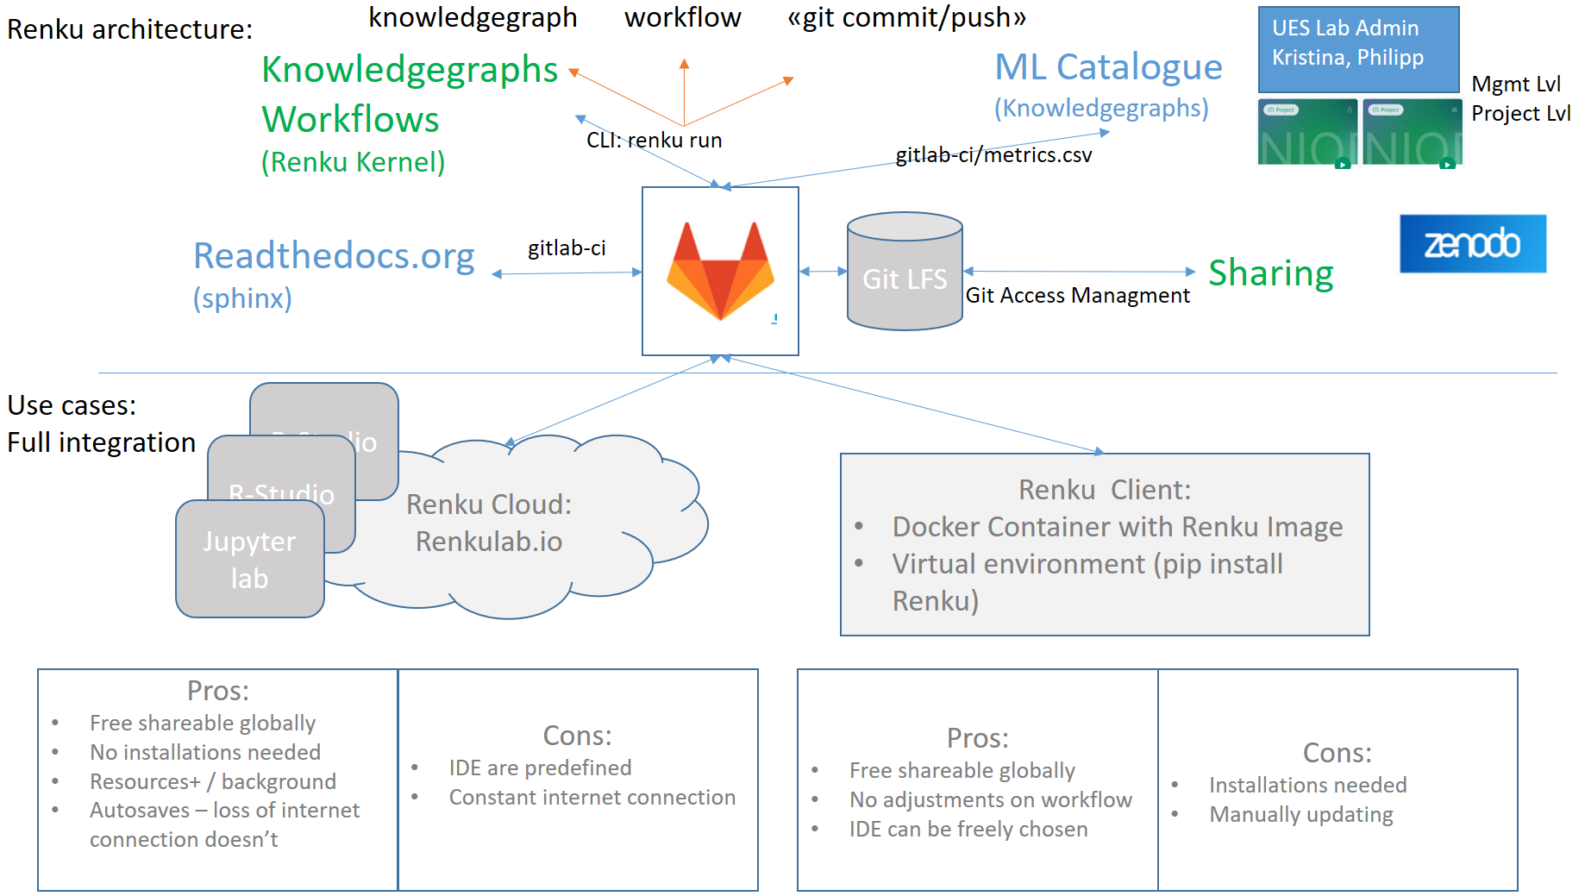
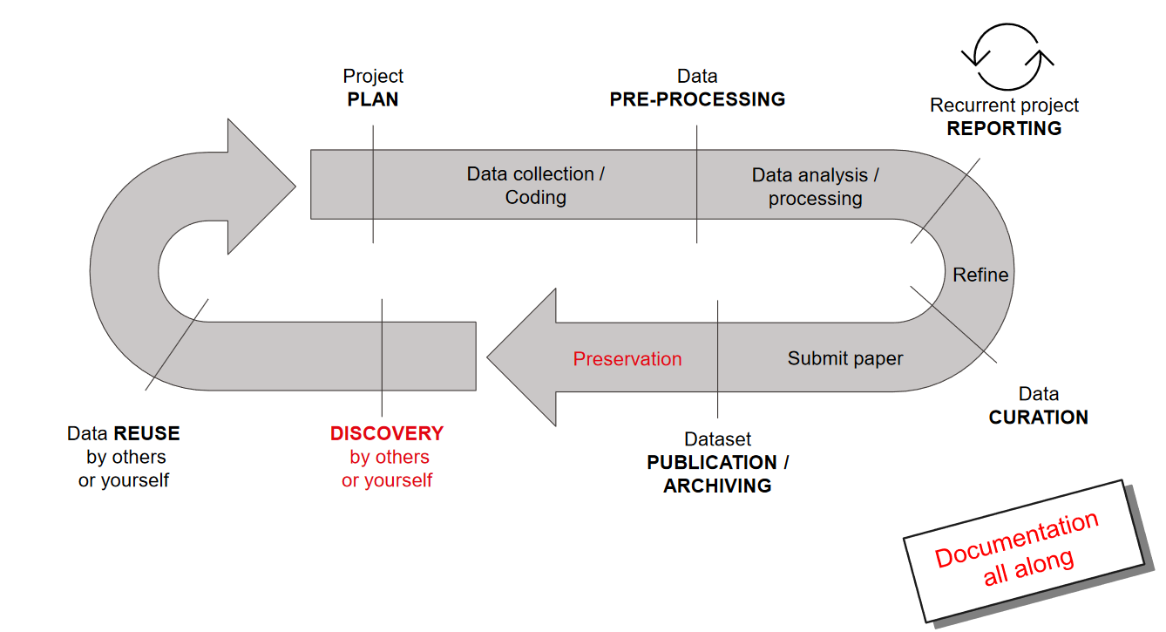

What is Renku? RDM Renku = Git + IDE + enhancements to be in alignment with FAIR principles aka knowledgegraph
Renku is a research data management platform (RDM) designed to help researchers efficiently manage and collaborate on data-intensive projects. Renku integrates with Git, development environments on top and offers features such as data versioning, workflow management, and project organization to support the entire research lifecycle. We want to use Renku for Preservation, Publication and to gain an overview of the developed models and results.
Renku
Custom
https://renku.readthedocs.io/en/stable/introduction/what-is-renku.html

Slide 4
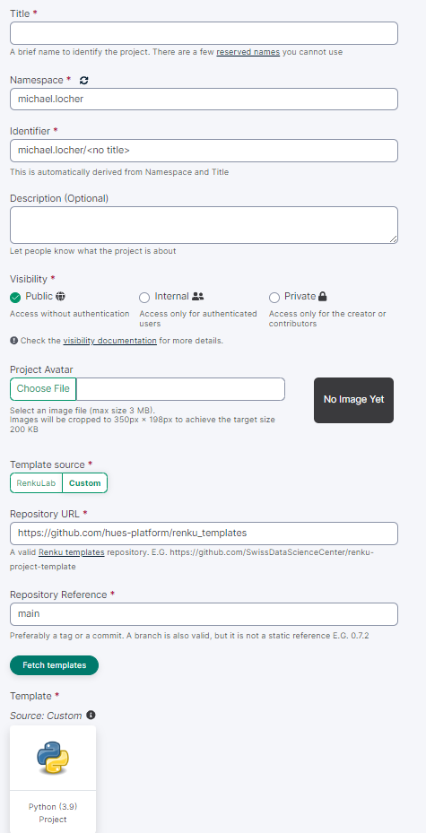
Renku – open project
Reproducible Data Science | Open Research | Renku (renkulab.io)
Create an account & Login
Go to Dashboard and «+Create a new project»
Fill in the mandatory cells
Use our template:
https://github.com/hues-platform/renku_templates
Branch is «main»
Click «Create project»

Slide 5

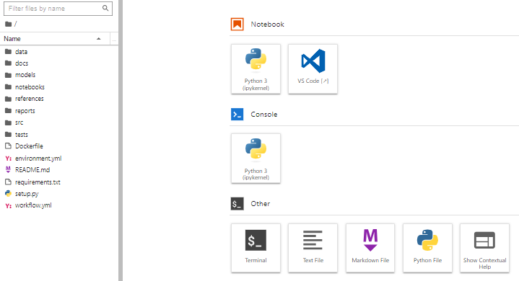


Overview Folder Structure
*Data vs src/name/data
Data: Data that is stored on Renku (LFS) e.g. as .csv
Src/data: Data that is accessed / generated / loaded during runtime
This data is lost if not intentionally stored e.g. NEST Data see next slide
1
Template folder structure:
Data*: Data that is stored on Renku (LFS)
Docs: default sphinx project → slide
Models: trained / serialized models
Notebooks: Jupyter Notebooks for demo purposes
References: literature and explantory materials
Report: Publication / main results e.g. as PDF
Src/name: source code / scripts of your project
Data*: download data during runtime
Features: script to process raw data for ML and feature engineering
Models: script to train models
Visualization: script for EDA
Tests: unit tests
1

Slide 6
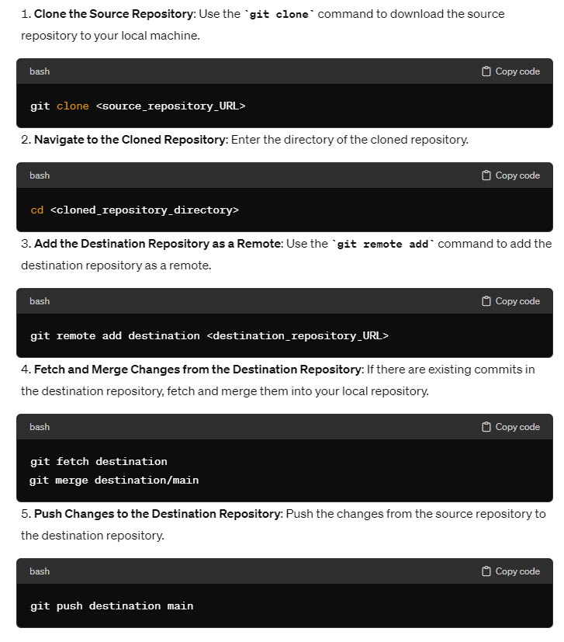
Migrate Code & Data: Code
Migrate Code from an existing Git Repo to your project
Migrate Code from an existing Git Repo to your project
Download files from existing Git Repo and upload it to your new project

Slide 7
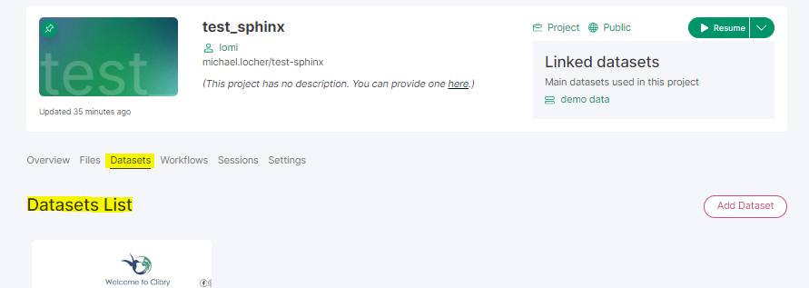
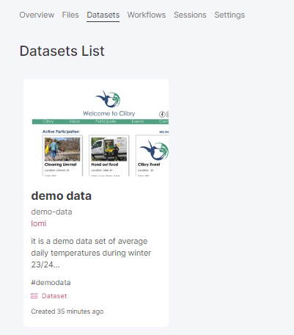

Migrate Code & Data: Data
Migrate data to you project:
Create a dataset on your project:
Dataset are an entity of the renkuverse: shareable among other projects and allow for metadata like description
Dataset will be directly linked with your data folder → demo-data
No URL / API: Upload your data directly into the respective folder
Go to the folder click:
URL / API: → dataset
renku dataset import https://example.com/data/file.csv
renku dataset import --name "My Dataset" --description "Description of my dataset" --tag "tag1" https://example.com/data/file.csv
1
1
Demo-data: created dataset
External: data from 3rd party
Processed: final, canonical data for modeling / analysis
Raw: original, immutable data e.g. from datapoints of NEST
Add data to your project — Renku documentation
Data in Renku — Renku documentation

Slide 8
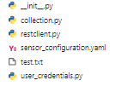
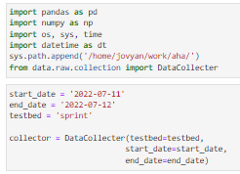
Migrate Code & Data: Access NEST Data during runtime
We have written a script to directly download the data from the installed sensors connected with the nestcloud:
The main script is collection.py. It queries the nestcloud data and makes use of the restclient.py for this.
To download the data you have to define the datapoints, this is done in the sensor_configuration.yaml
The data can then be directly loaded during the runtime e.g. within a jupyternotebook
Set start and end date you wan to collect data
Testbed is the name of the datapoints in the sensor_configuration.yml

Slide 9
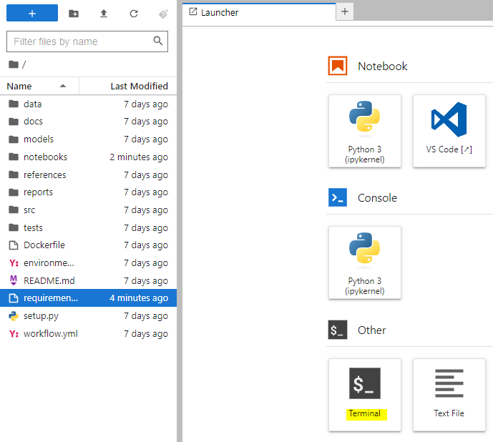

Run requirements
When your project is created it automatically runs the requirements.txt file and installs the defined packages, currently the following packages are installed:
renku-mls
sphinxcontrib-napoleon
sphinx
sphinx-rtd-theme
In case you need further modules for your project, open requirements.txt and add them. E.g. you need pandas:
check the latest version e.g. pandas 2.2.2 (30.04.2024)
add it to the requirements.txt
Open the terminal and run this command: pip install -r requirements.txt

Slide 10
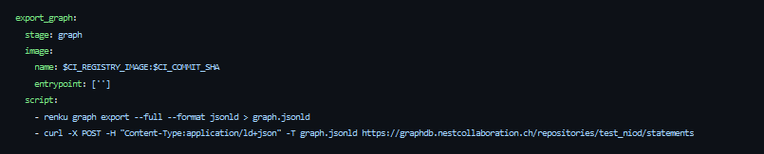
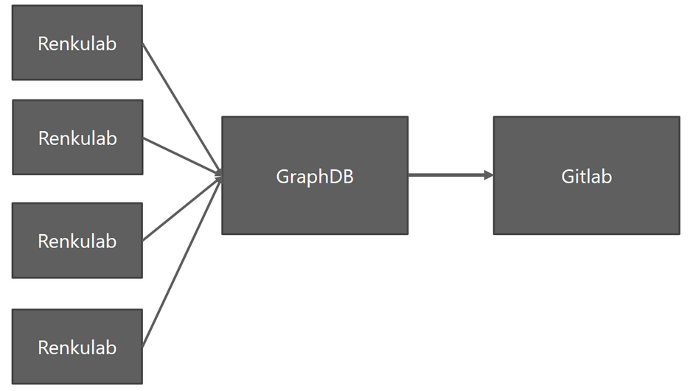
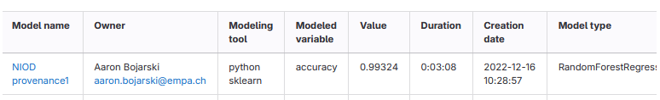

Add Model data to the model catalogue
Everytime you commit and push your project changes to your git-repo the customized renku graph is posted to our GraphDB. The GraphDB is scraped every 24 hours and it’s attributes is stored on the model wiki page. The model wiki page shall generate a complete overview of all models and its performances among the lab.
The attribute and the model needs to be specified in the main.py file. A demo main.py can be looked up. We defined just mse for this purpose. The model itself and all the metrics to be tracked have to be added to the export statement:

Slide 11
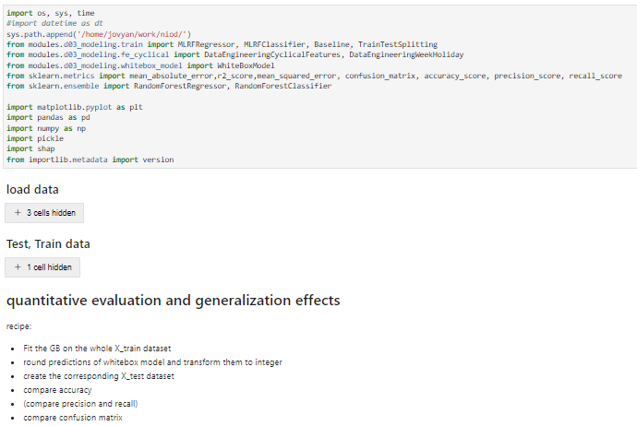
Create a demo Jupyter Notebook
Purpose is to have a jupyter notebook that can be run and reproduces the main results of the publication
This means you have to load all necessary libraries / modules, data and models and provide a min set of instructions that are carried out to obtain the results

Slide 12
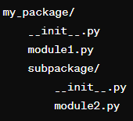
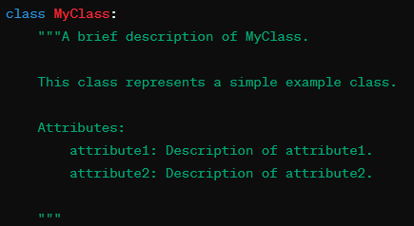
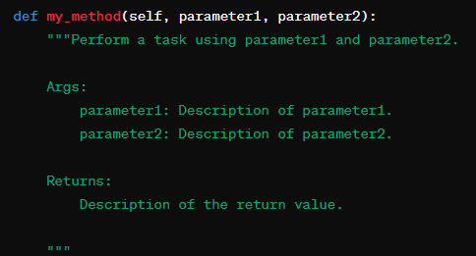
Create Sphinx Documentation
1
To obtain the Sphinx Documentation run the following code within the terminal:
sphinx-apidoc -f -o docs/source/api modules
cd docs/source
sphinx-build -b latex . ./_latex
cd _latex
make
Prerequisites:
each module need an __init__.py file. This file is required to mark the directory as a Python package
Each python file, class and methods, should be commented accodring to the following docstring standard:
It is recommended to have description of your overall project in form of a readme.md. This is displayed on your renku project and will be also included in your sphinx documentation.
2
1
2

Slide 13
Links
Template
Das Template kann beim Erstellen eines neuen Projektes auf renkulab.io ausgewählt werden. Dazu muss man den folgenden Link angeben.
https://github.com/hues-platform/renku_templates

