Slide 1


Renku Checklist
UES Lab

Slide 2
Overview
What is Renku?
Open project on Renku (5 min)
Migrate Code & Data (Dennis) (15 min)
Install all project relevant packages (5 min)
Create a demo Jupyter Notebook: main.py (15 min)
Attachment email
Create a renku run limit to Model (5 min)
Add Model data to the model catalogue
Attachment email
Create Sphinx Documentation (5 min)
PDF plus HTML
Create a DOI and link it on Zenodo (?)
Will be added at a later stage
Final Review (Dennis, Michael)
Share via Git → Public (5 min)

Slide 3
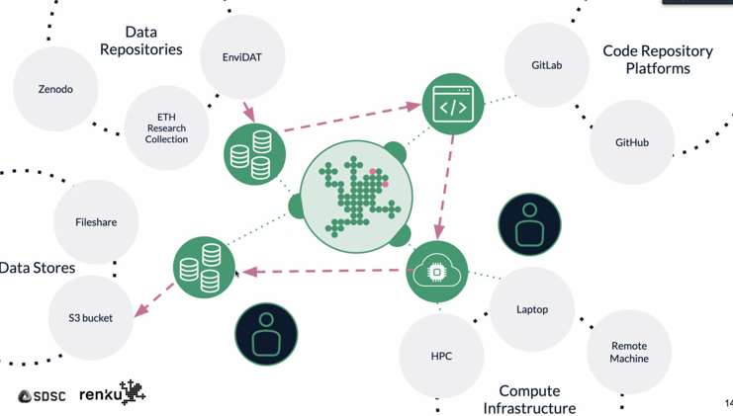
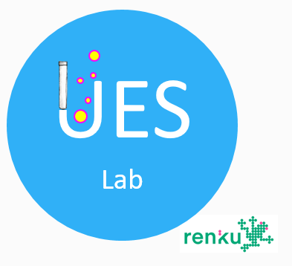
Renku Look and Feel
Open project on Renku
What is Renku

Slide 4
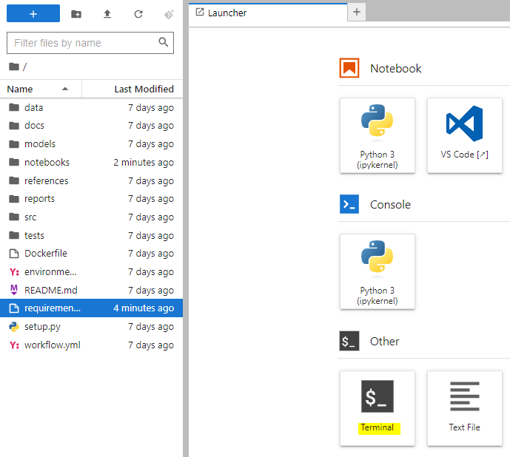
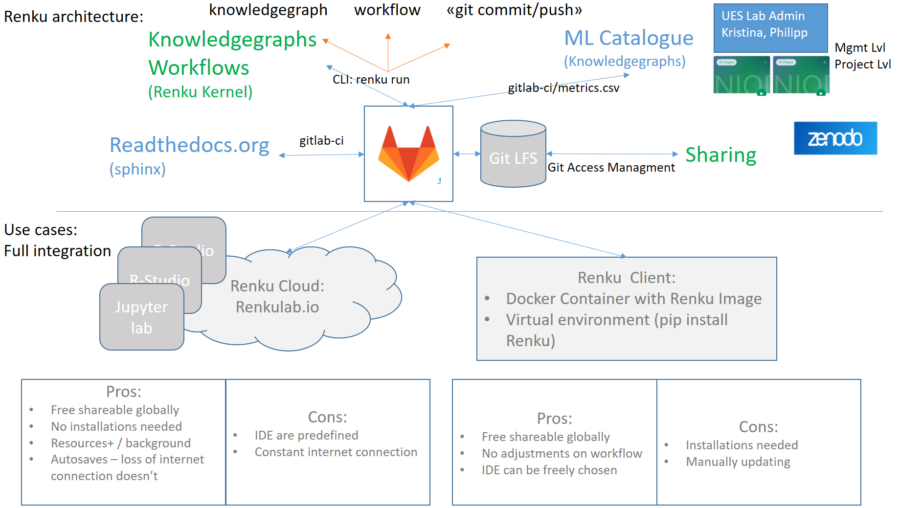
What is Renku? Tool and Architecture
Further information can be looked up here:
https://renku.readthedocs.io/en/stable/introduction/what-is-renku.html
Renku is a research data management platform (RDM) designed to help researchers efficiently manage and collaborate on data-intensive projects. Renku integrates with Git, development environments on top and offers features such as data versioning, workflow management, and project organization to support the entire research lifecycle (see next slide). The rough architecture and it’s mean features are depictured on the left.
In short: RDM Renku = Git + IDE + enhancements to be in alignment with FAIR principles aka knowledgegraph
FAIR principles:
https://go.epfl.ch/rdm-fastguide02
Renku
Custom
The diagram outlines the basic structure of Renku, encompassing Git, development environment, and data storage. Renku includes features such as a knowledge graph for workflow management (green frame) and customized features (blue frame) like the ML catalogue (refer to X) and automated documentation generation via Sphinx (refer to Y). Users can access Renku either through their local machine using the Renku Client or directly through the Renku cloud. The advantages and disadvantages of utilizing the Renku Client versus accessing it directly via the cloud are also discussed.
2 slides
Clearly split between what is renku and motivation
and we need to use renku and upload your projects
Screenshots: tutorial of Renku upload data sets,
create a new project – generic workflow of Renku and refer to other resources for more detail
Install all the packages!

Slide 5
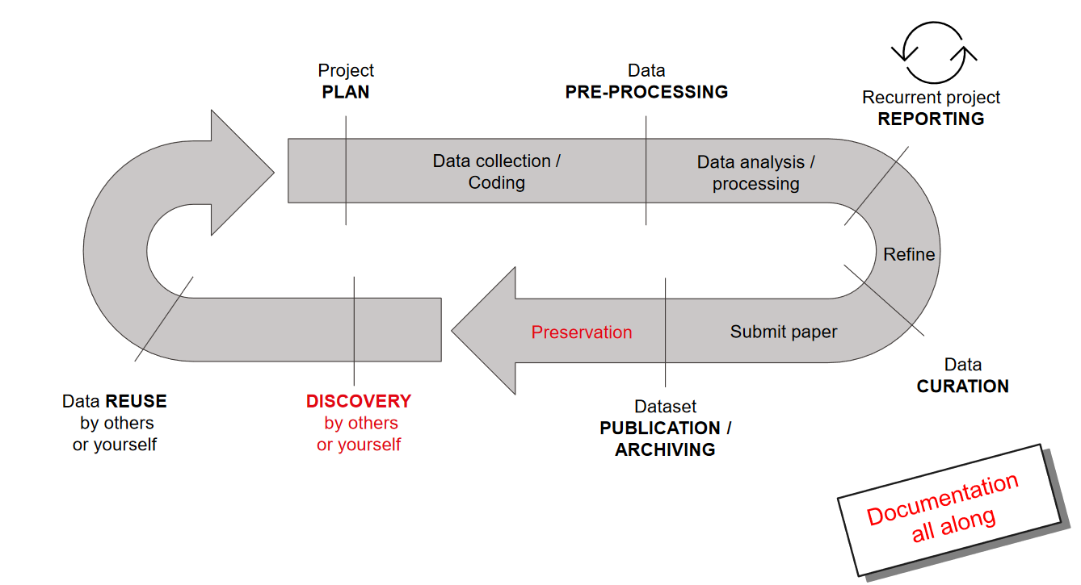
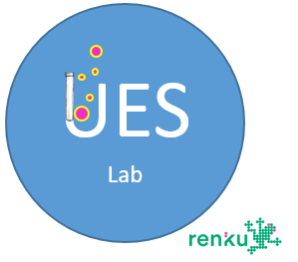
Motivation to use Renku and potential use cases for the UES Lab
Depictured is a generic research lifecycle
Renku could be used from the very beginning of a research project
We want to use Renku for Preservation, Publication and to gain an overview of the developed models and results. The idea after – no work will be lost, quality check at the end, it can be easily found, accessed and the results can be obtained online. We see the following benefits for the lab and the benefits for you

Slide 6
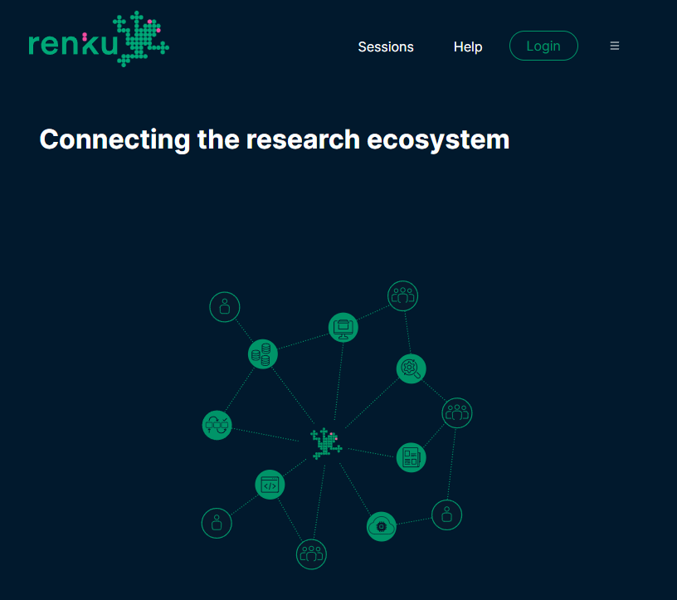
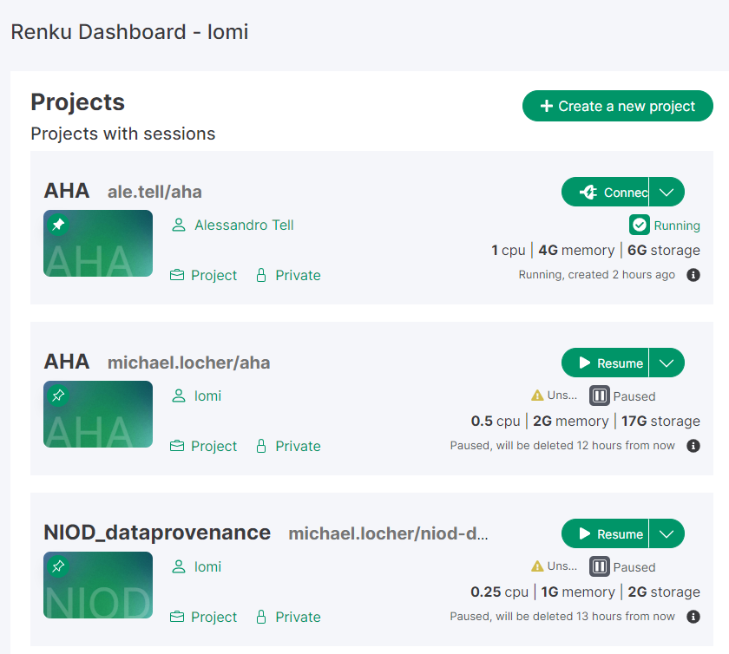
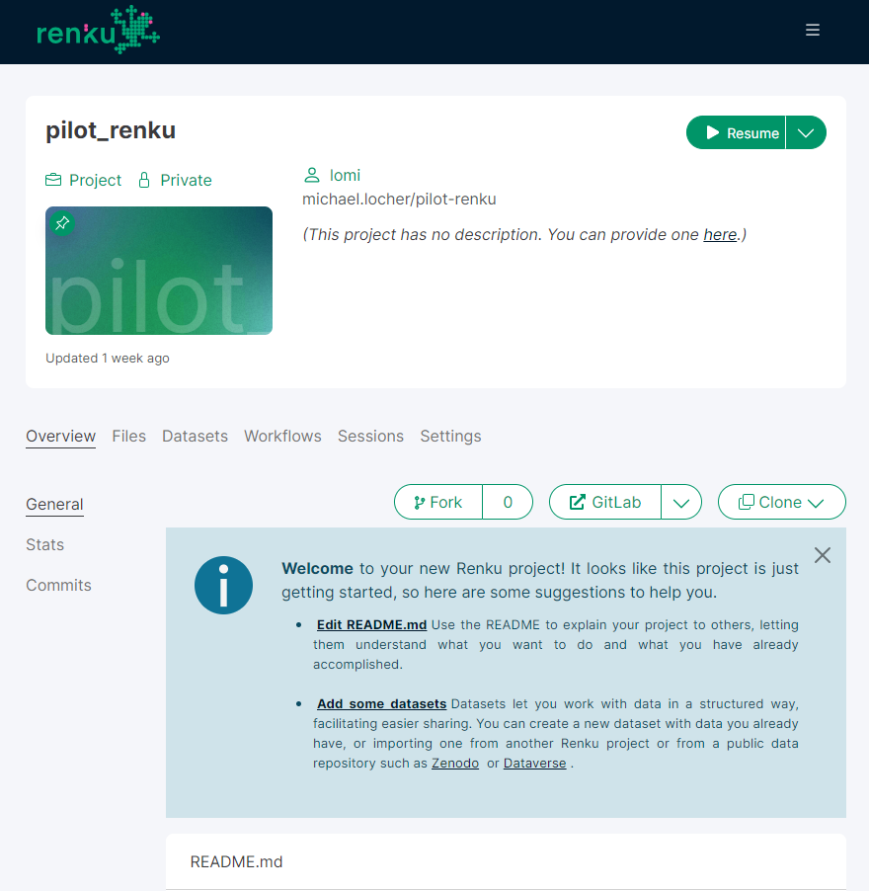
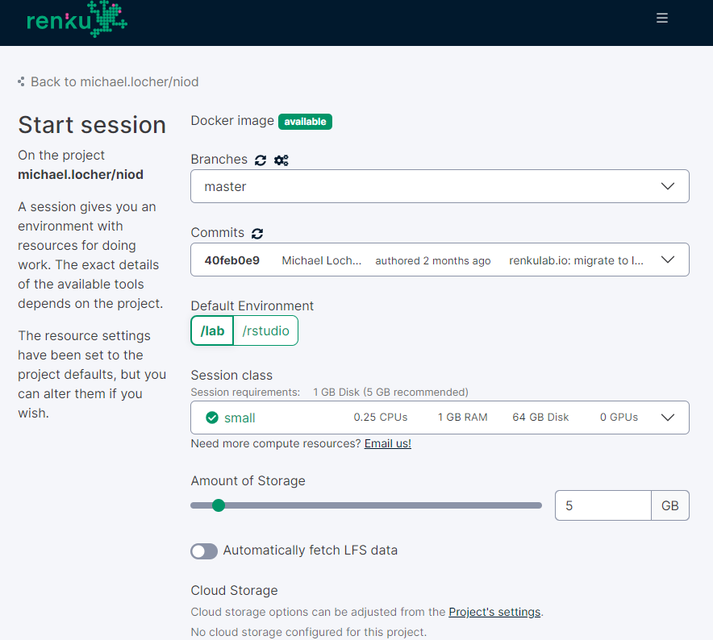
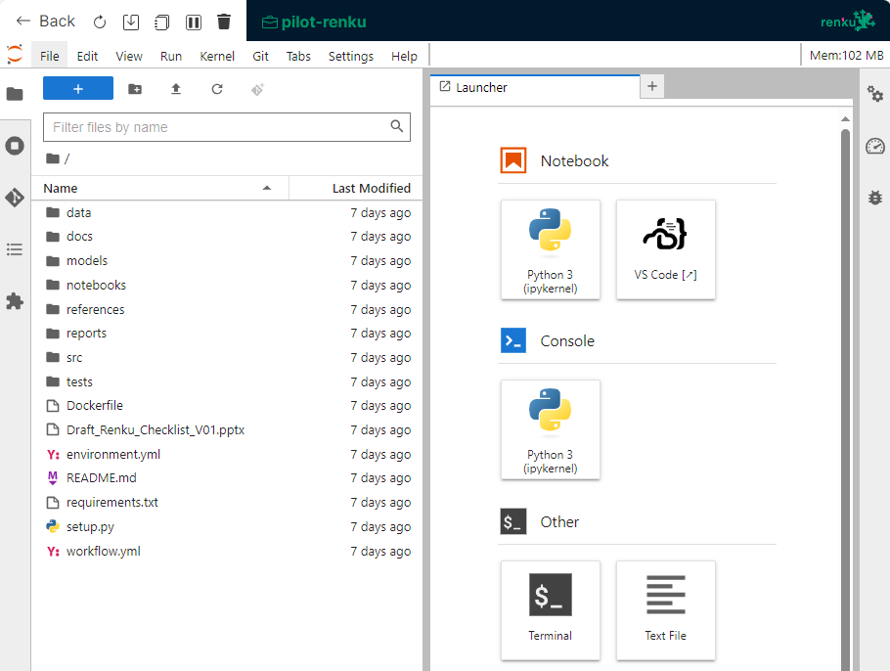
Renku: Different Views
1
1. View: Login Page Renkulab.io
2. View: Personal Dashboard
3. View: Project page
Direct access to your Renku Git repo
4. View: Run your session
1
5. View: Running session
this is how the IDE in the browser looks like

Slide 7

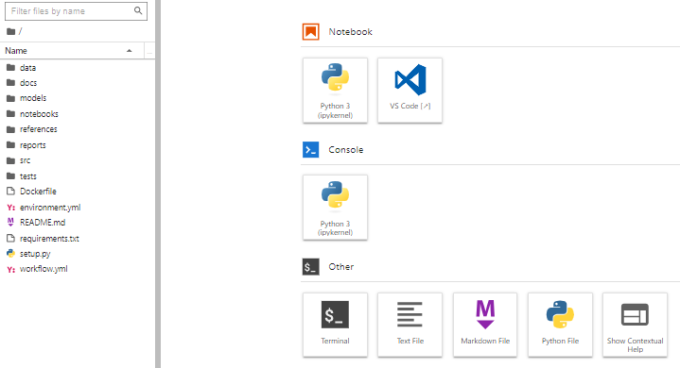


Overview Folder Structure
*Data vs src/name/data
Data: Data that is stored on Renku (LFS) e.g. as .csv
Src/data: Data that is accessed / generated / loaded during runtime
This data is lost if not intentionally stored e.g. NEST Data see next slide
1
Template folder structure:
Data*: Data that is stored on Renku (LFS)
Docs: default sphinx project → slide
Models: trained / serialized models
Notebooks: Jupyter Notebooks for demo purposes
References: literature and explantory materials
Report: Publication / main results e.g. as PDF
Src/name: source code / scripts of your project
Data*: download data during runtime
Features: script to process raw data for ML and feature engineering
Models: script to train models
Visualization: script for EDA
Tests: unit tests
1
Move this slide before setting up your project
Running sessions looks different from static page
overview – describe the different views from Renku

Slide 8
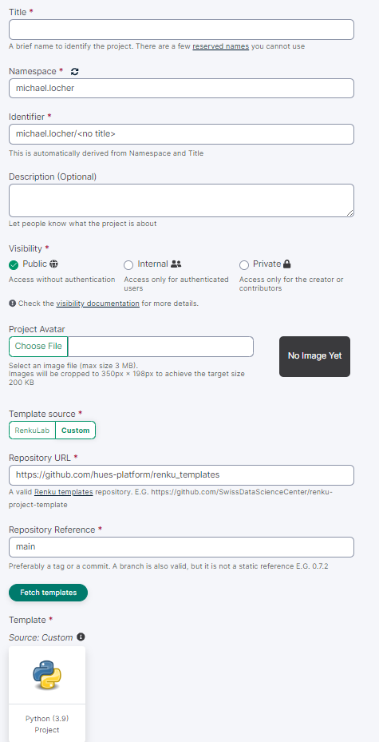
Renku – open project
To short, needs more elaboration:
Fill in the mandatory:
Recommendaitons visibility – public
Can it be changed later / visibility?
Use our template and refer to the picture
Select the custom source
Creating an account – renku linked with git
In order to initiate a project on Renku, please navigate to the Renku Cloud at https://renkulab.io/ and follow the subsequent instructions provided:
Create an account & Login
Either you create a new account on Renku or you reuse your existing accounts e.g. git – the choice is yours, depending on your preference.
Go to Dashboard and «+Create a new project»
In terms of visibility, we suggest keeping it private until the review process is complete, at which point the project can be made public
Fill in the mandatory cells: title, namespace, identifier, visibility, template source, repository URL, repository reference and template
Use our template:
Repo URL: https://github.com/hues-platform/renku_templates
Repo reference: branch is «main»
Click «Fetch template»
Click «Create project» and Renku will built and start a docker container
1
2
1
3
4
2
3
4
View create a new Renku project

Slide 9
Migration of Code and Data to your Renku Git Repo

Slide 10
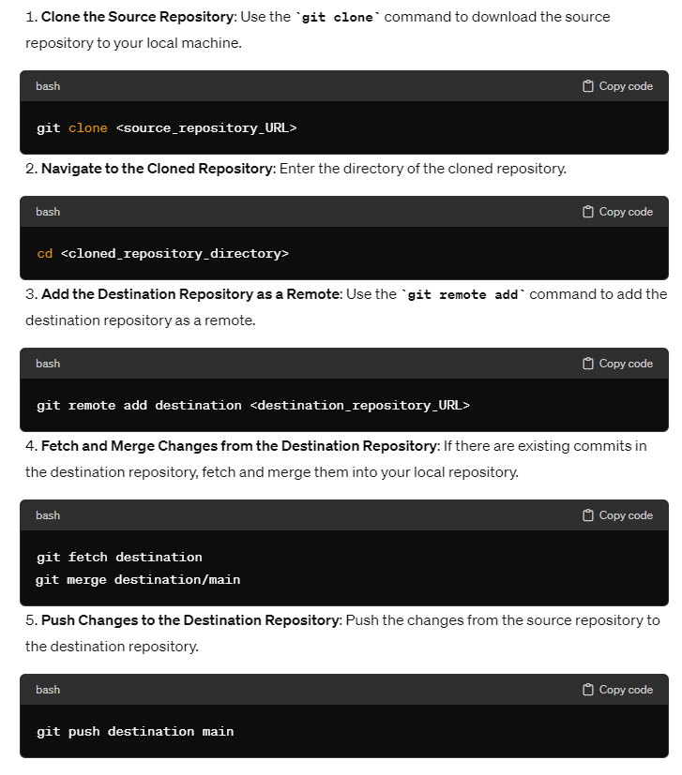
Migrate Code & Data from existing Git Repo to Renku Git Repo
Git needs to be installed
Open your command prompt and type it there
Not clear about point 3
trying to upload gitlab interface while on the overview page
Migrate Code from an existing Git Repo to your project: For this
Install a Git client on your machine: https://git-scm.com/downloads
Create a folder where you want to clone your existing git repo, open the folder and Git Bash to clone from your existing get repo
Follow the instructions 1. and 2. on the right:
First clone from your existing git repo to your local machine
Change directory to your cloned file
Go to renkulab.io, open the project overview page for your new project and open the renku git repo, see slide «Renku Look and Feel»
Upload now manually the needed files into the corresponding folders, see slide «Overview Folder Structure»

Slide 11
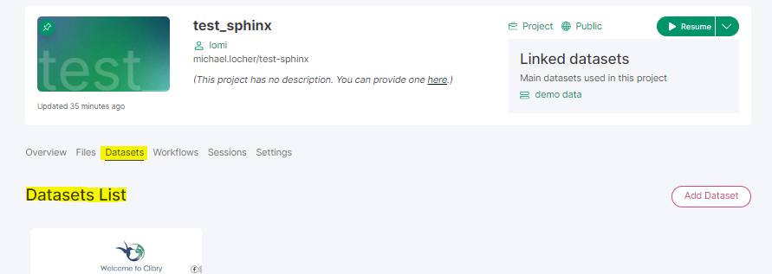
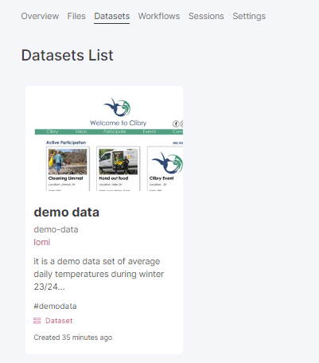

Migrate Code & Data: more Data
How to upload data depending on the size of the data
Migrate different data sets to you project: there exists several ways to migrate data to your proejct depending on personal preferences, accessibility and size of your data:
Create a dataset on your project: advantages can be linked with other projects and further meta data / documentation can be added
Go to renkulab.io, open the project overview page for your new project and
Dataset are an entity of the renkuverse: shareable among other projects and allow for metadata like description
Dataset will be directly linked with your data folder → demo-data
No URL / API: Upload your data directly into the respective folder
During the "Running session," navigate to the appropriate folders and select the upward arrow icon
Manually upload the required data to the appropriate folders as outlined in the "Overview Folder Structure" slide into the Renku Git repository, accessible through your project page
URL / API: will automatically create a dataset, see point 1 «create a dataset»
renku dataset import through (example) URL: https://example.com/data/file.csv with the following command: renku dataset import --name "My Dataset" --description "Description of my dataset" --tag "tag1" https://example.com/data/file.csv
1
1
appropriate folders
2
Demo-data: created dataset
External: data from 3rd party
Processed: final, canonical data for modeling / analysis
Raw: original, immutable data e.g. from datapoints of NEST
2
Add data to your project — Renku documentation
Data in Renku — Renku documentation
Best practice for handling external data? - General - Renku forum

Slide 12
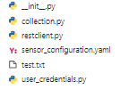
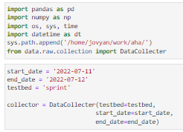
Migrate Code & Data: Access NEST Data during runtime
In our UES-lab, we depend extensively on NEST data. Consequently, we've developed a script to streamline the downloading process of data from the sensors connected to the Nestcloud directly into a running Jupyter notebook. If you frequently utilize this data, it's advisable to establish a permanent link with your project. For detailed instructions, refer to the ”Migrate Code & Data: more Data" slide:
The main script is collection.py. It queries the nestcloud data and makes use of the restclient.py for this.
To download the data you have to define the datapoints, this is done in the sensor_configuration.yaml
The data can then be directly loaded during the runtime e.g. within a jupyternotebook
Set start and end date you wan to collect data
Testbed is the name of the datapoints in the sensor_configuration.yml

Slide 13

Install libraries and modules through pip install requirements.txt
Not yet Matlab and Gurobi (Gabriele)
When your project is created it automatically runs the requirements.txt file and installs the defined packages, currently the following packages are installed:
renku-mls
sphinxcontrib-napoleon
sphinx
sphinx-rtd-theme
In case you need further modules for your project, open requirements.txt and add them. E.g. you need pandas:
check the latest version e.g. pandas 2.2.2 (30.04.2024)
add it to the requirements.txt
Open the terminal and run this command: pip install -r requirements.txt

Slide 14
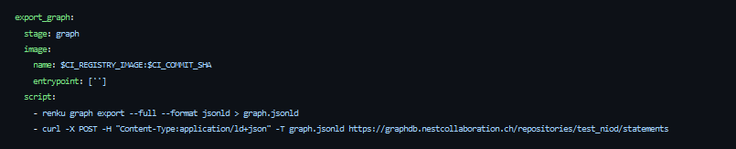
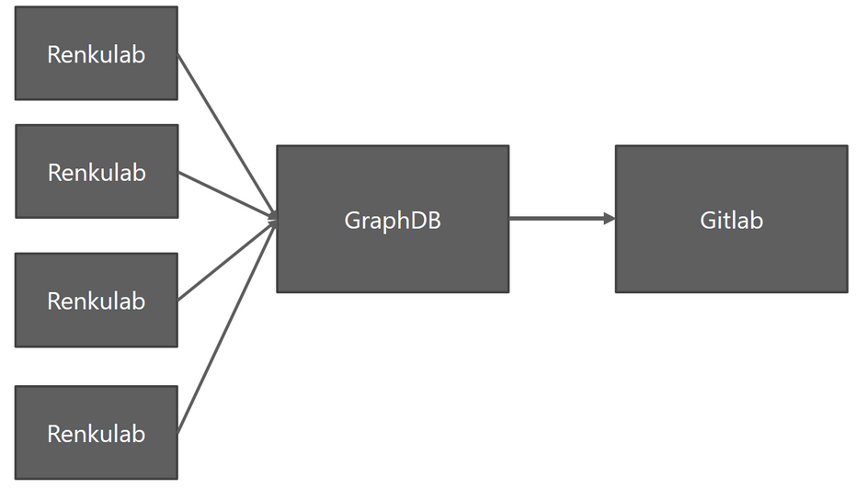
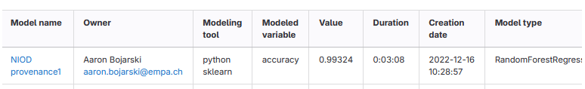

Add Model attribute / meta to the model catalogue
Everytime you commit and push your project changes to your git-repo the customized renku graph is posted to our GraphDB. The GraphDB is scraped every 24 hours and it’s attributes is stored on the model wiki page. The model wiki page shall generate a complete overview of all models and its performances among the lab.
The attribute and the model needs to be specified in the main.py file. A demo main.py can be looked up. We defined just mse for this purpose. The model itself and all the metrics to be tracked have to be added to the export statement:
Idea and purpose of the model catalogue and how to use it
And add the steps
Overview: different algorithms – detail this

Slide 15
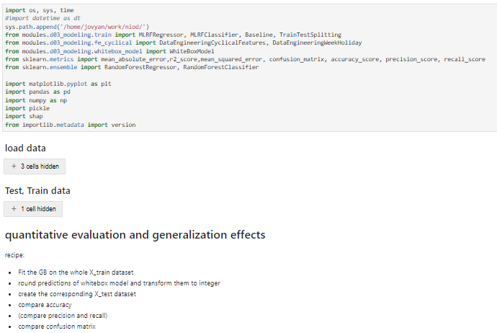
Create a demo Jupyter Notebook
Purpose is to have a jupyter notebook that can be run and reproduces the main results of the publication
This means you have to load all necessary libraries / modules, data and models and provide a min set of instructions that are carried out to obtain the results
References to datasets – are open source
Add data-sets – open source – link it
Open source data sets: meter data of buildings electricity etc. resolution of 1 sec – 800 MB, unzipped ~ 6GB
https://app.data-archive.ethz.ch/delivery/DeliveryManagerServlet?dps_pid=IE594964

Slide 16
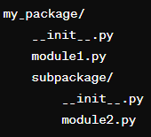
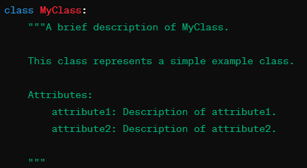
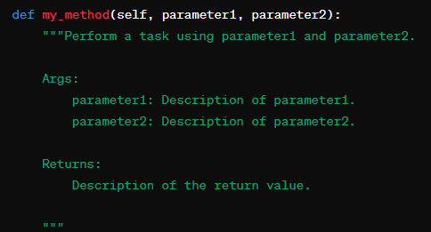
Create Sphinx Documentation
1
To obtain the Sphinx Documentation run the following code within the terminal:
sphinx-apidoc -f -o docs/source/api modules
cd docs/source
sphinx-build -b latex . ./_latex
cd _latex
make
Prerequisites:
each module need an __init__.py file. This file is required to mark the directory as a Python package
Each python file, class and methods, should be commented accodring to the following docstring standard:
It is recommended to have description of your overall project in form of a readme.md. This is displayed on your renku project and will be also included in your sphinx documentation.
2
1
2

Slide 17
Links
Template
Das Template kann beim Erstellen eines neuen Projektes auf renkulab.io ausgewählt werden. Dazu muss man den folgenden Link angeben.
https://github.com/hues-platform/renku_templates
Steps: create make your project

Slide 18
