Slide 1
📈
Sales
$100K
+ $50K
+ 100%
vs last year 50K

Slide 2
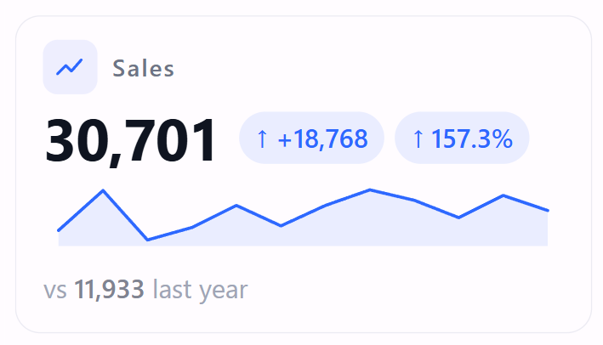
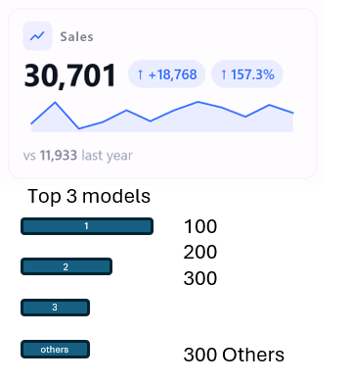
Top 3 models
1
100
200
300
300 Others
2
3
others

