Slide 1
Coupling of ALFF and CBF (BASIL) modalities
Fengling Hu
10/29/21

Slide 2
Order of content
Barplots on networks and subcortical structures
Coupling
Descriptive images (voxel means and variance across 760 subjects)
Coupling
Binary thresholded p-value maps (FDR 0.05)
Coupling

Slide 3
Of note
CBF images are BASIL-corrected.
Global_wcov means 1) Globally, each brain was scaled to mean 0, sd 1. 2) In neighborhoods, PCA was run on a weighted covariance matrix. 3) Coupling coefficient is logit of first eigenvalue transformed to scale of 0-1.
Unscaled_wcor means 1) Globally, no scaling was done. 2) In neighborhoods, PCA was run on a weighted correlation matrix. 3) Coupling coefficient is logit of first eigenvalue transformed to scale of 0-1.
Surfaces are projected from MNI-space using PySurfer
Sex (B₁) and age (B₂) effects are from the model Y ~ B₁*sex + B₂*age
Sex-age (B₃) interaction effects are from the model Y ~ B₁*sex + B₂*age + B₃*sex*age

Slide 4
Barplots

Slide 5
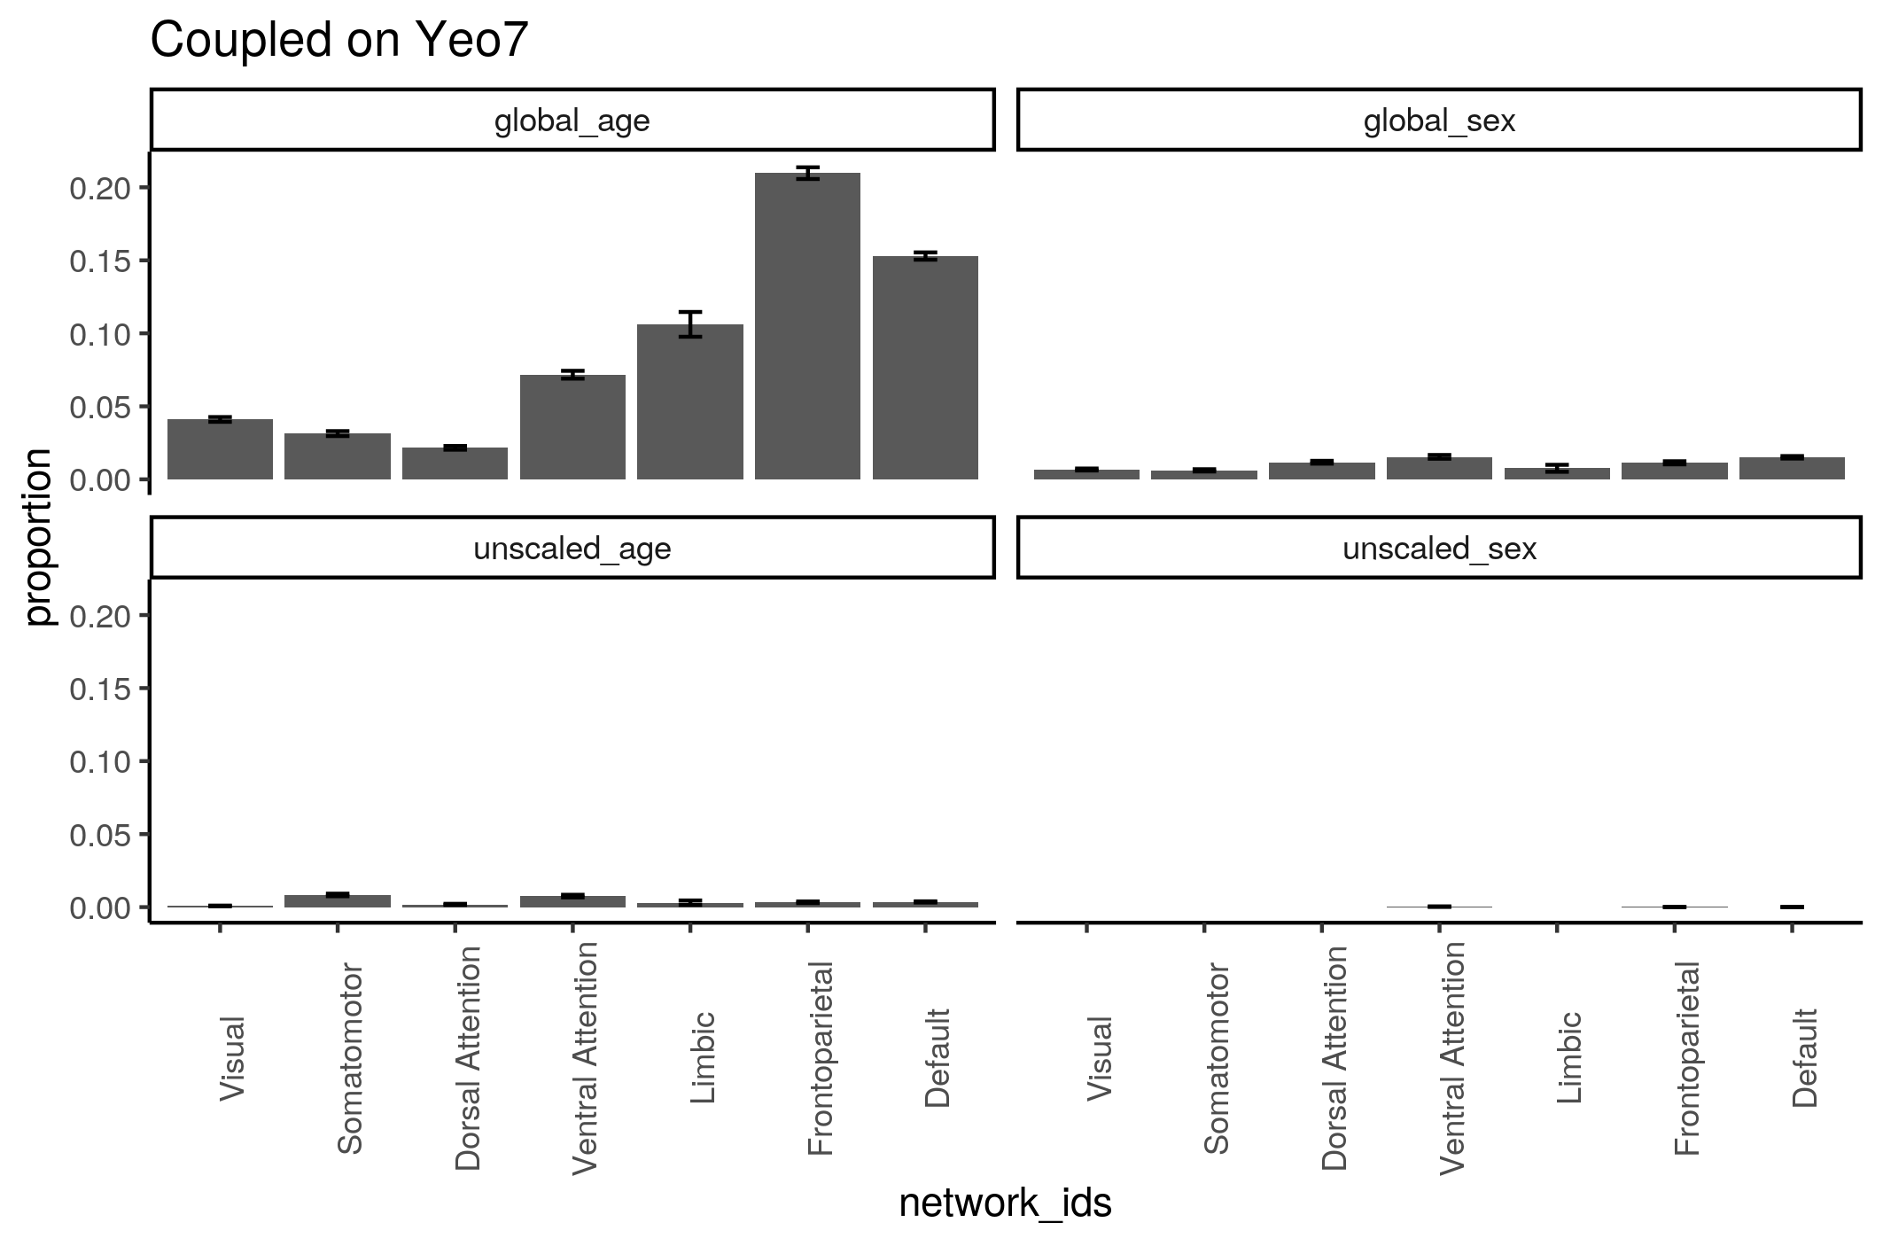

Slide 6
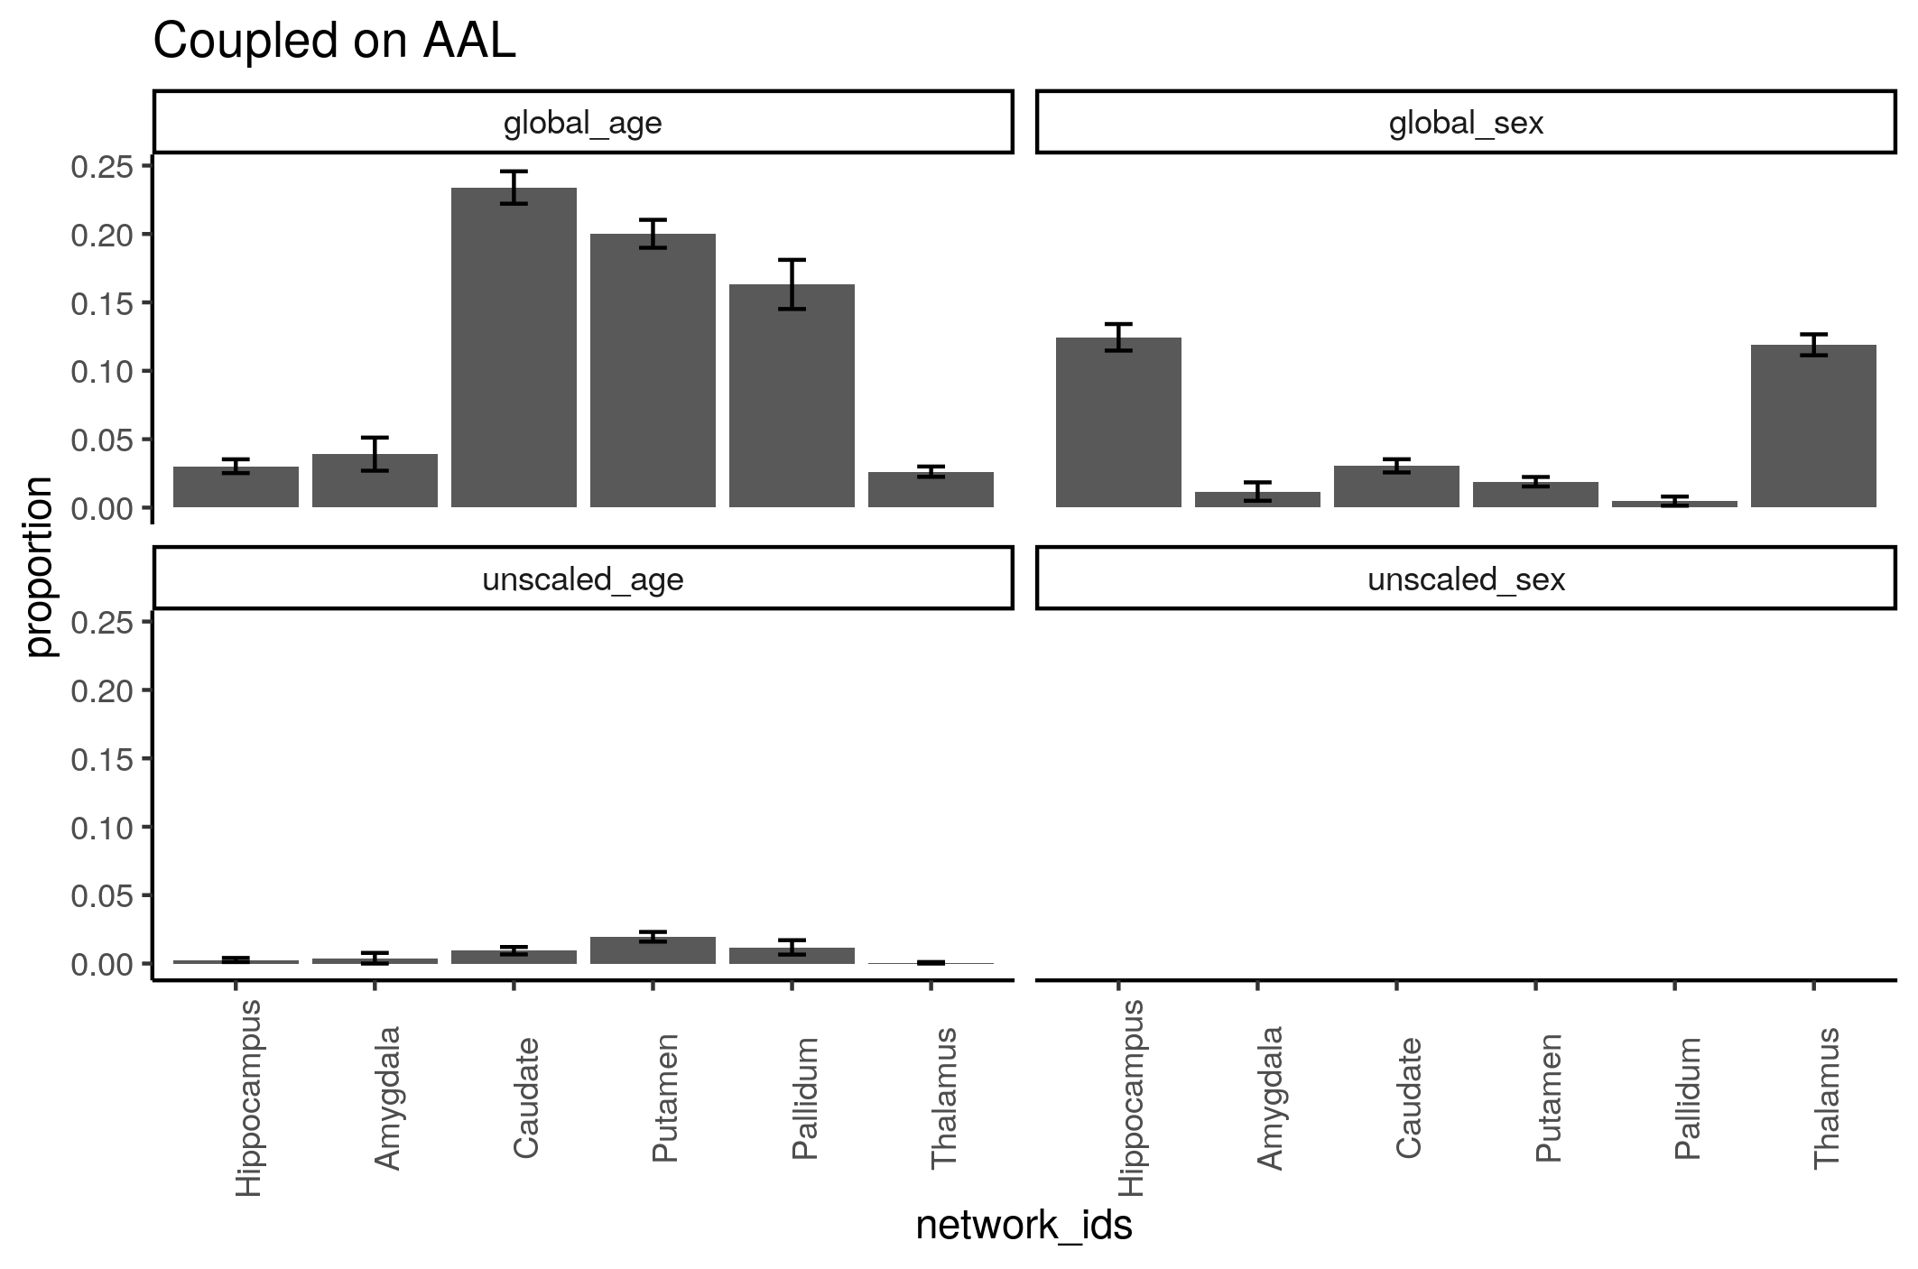

Slide 7
Descriptive Images

Slide 8
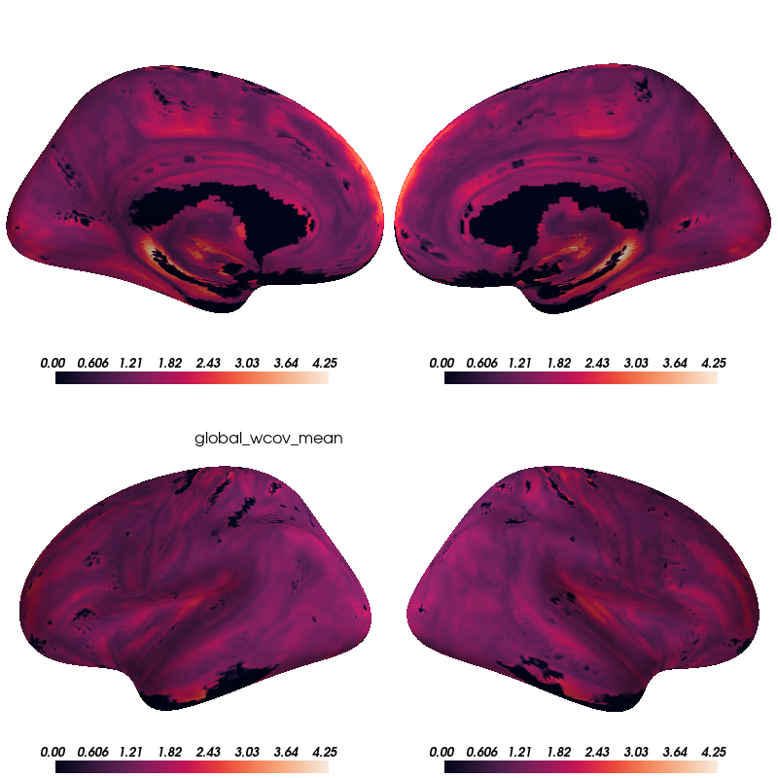

Slide 9
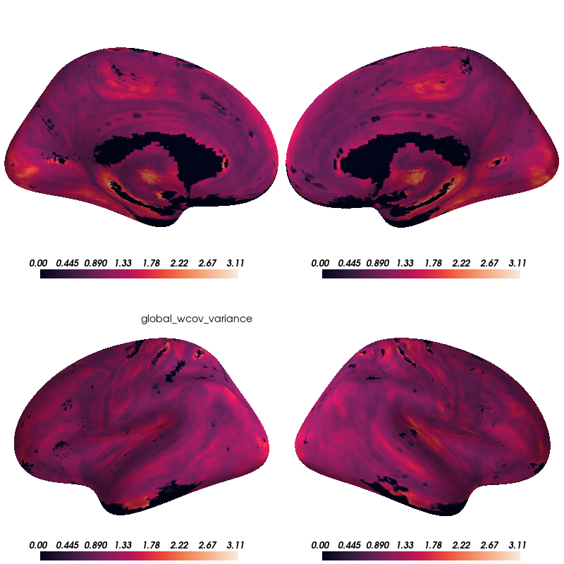

Slide 10
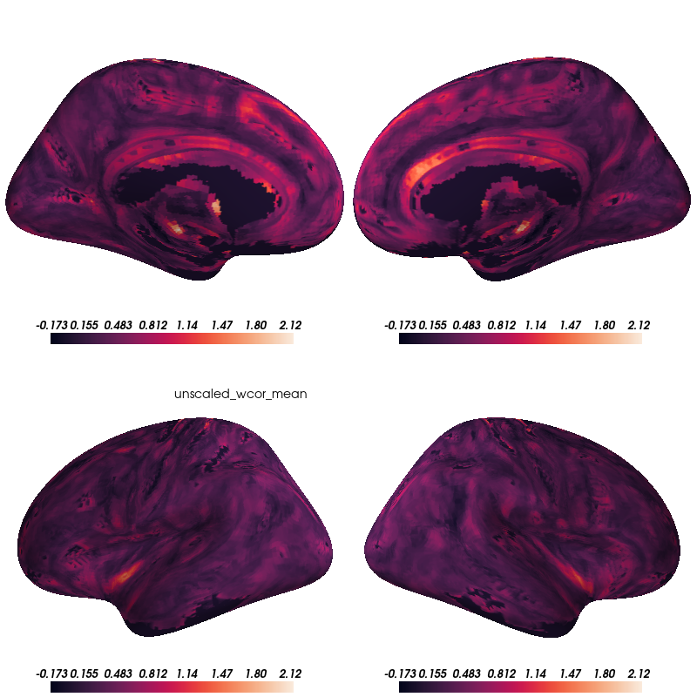

Slide 11
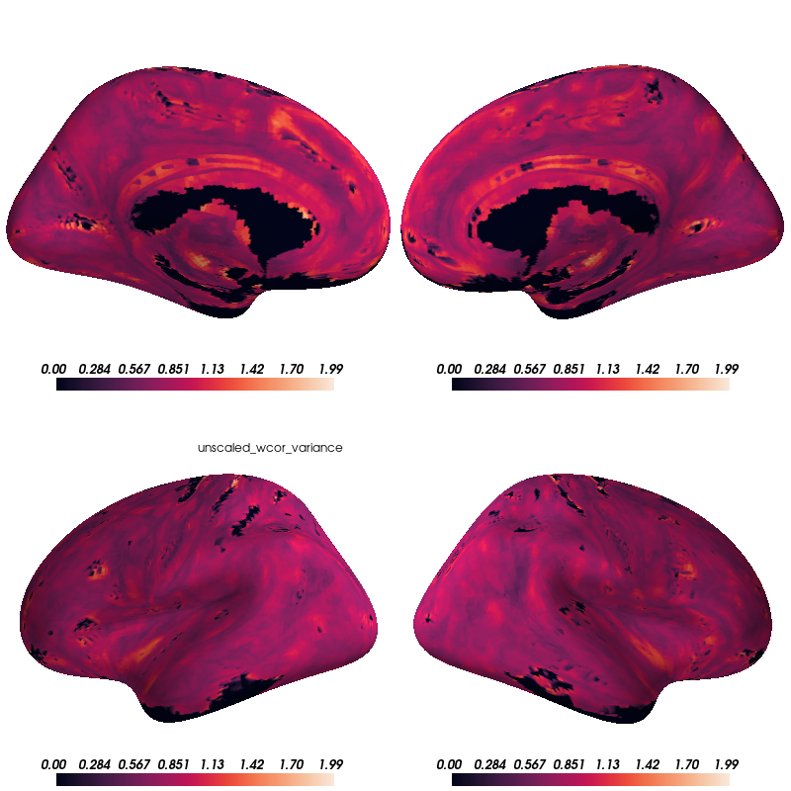

Slide 12
Thresholded P-value Maps (FDR 0.05)

Slide 13
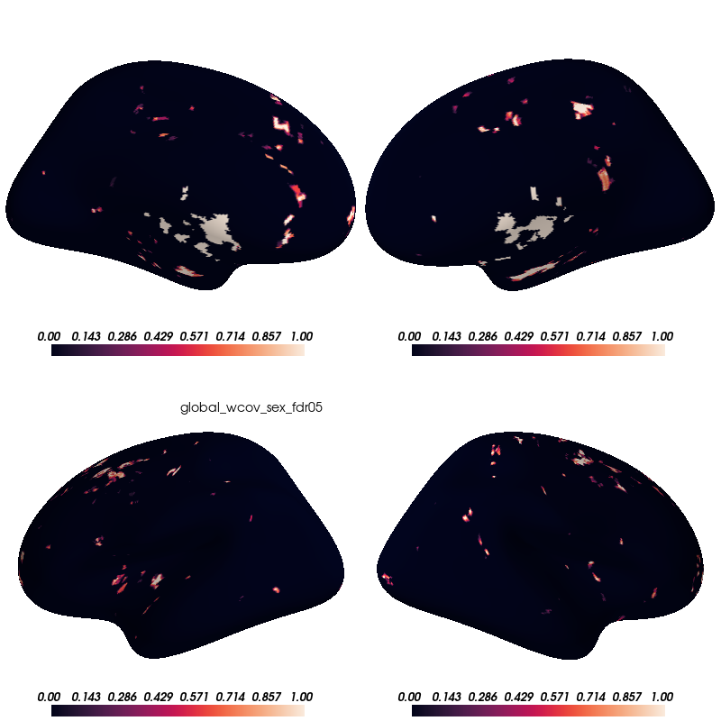

Slide 14
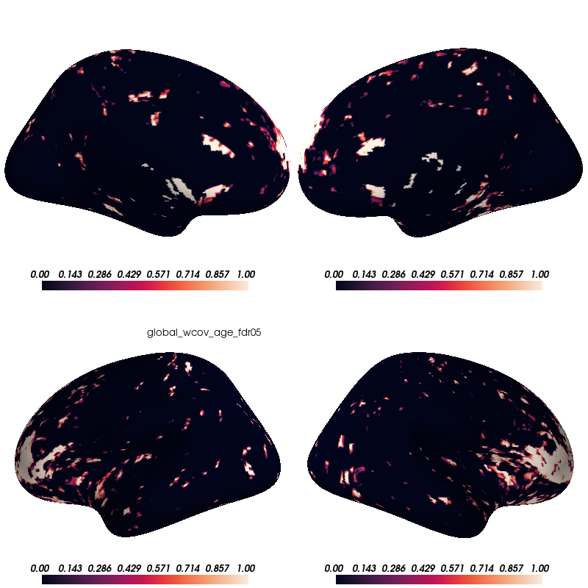

Slide 15
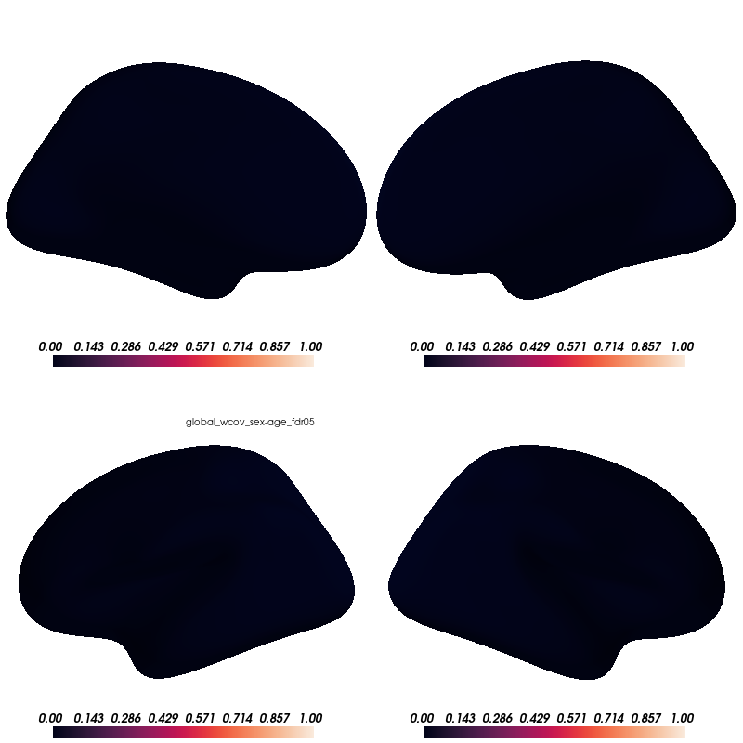

Slide 16
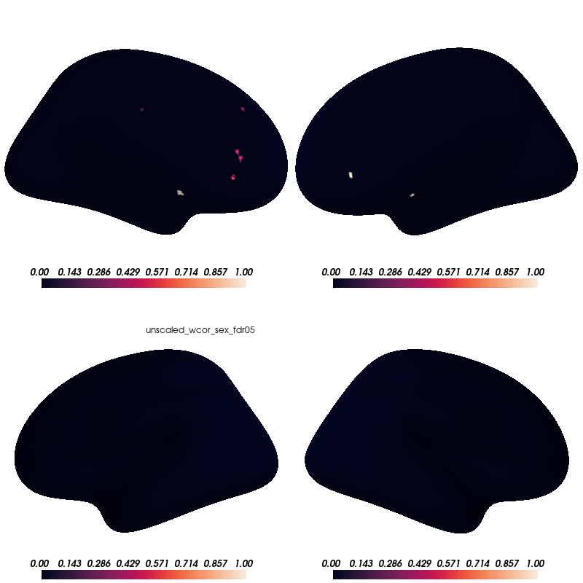

Slide 17
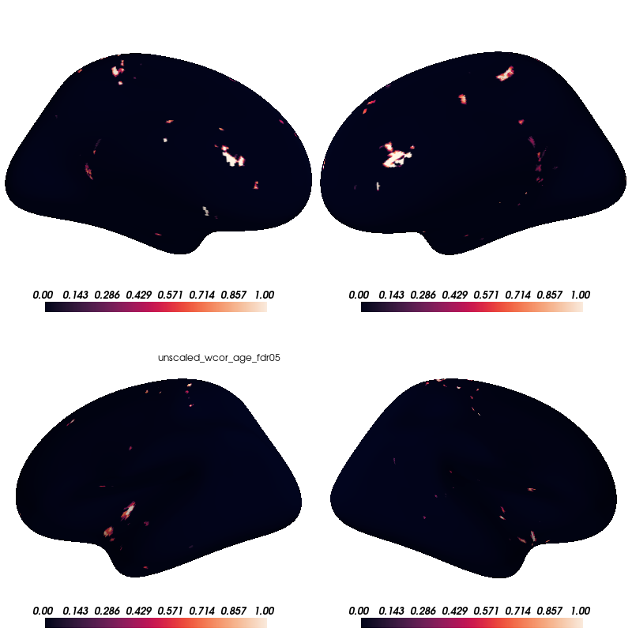

Slide 18


