Slide 1
NBA Quizzer
Isaac Brimner, Aaron Huff

Slide 2
Core Game Idea
NBA knowledge game with a query search built in to help find answers.
Utilizes NBA Statistics from the 2020 season
Two main functions:
Create a Quiz
Take a Quiz

Slide 3
Data storage solution
Utilize Microsoft Azure to store our data in blob storage
SQL Server Databases used to reference data-sets
NBA Stats database
User login database
Quiz database
To connect this database to our program the PyODBC library injects information from the Python program into the server so we can connect

Slide 4
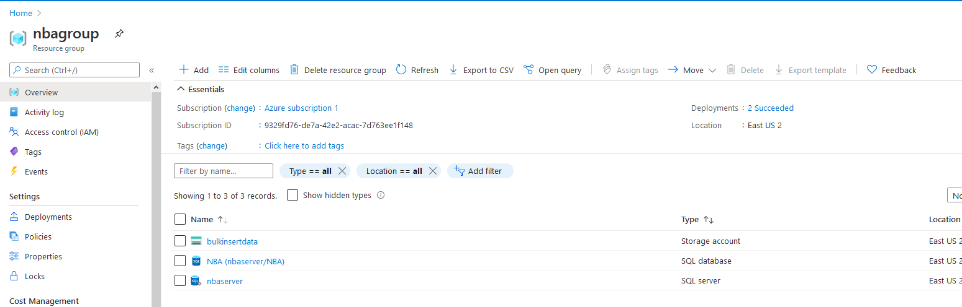
Microsoft Azure

Slide 5
Libraries
BeautifulSoup is utilized in our web scraper to parse html data from a website into CSV values.
These values are then able to be bulk inserted into a SQL table that can then be referenced by the program.
To configure our tables properly we utilized SQL Server Management Studio
This program allowed us to both access the server simultaneously and see what changes were taking place in the database as we completed actions in the program

Slide 6
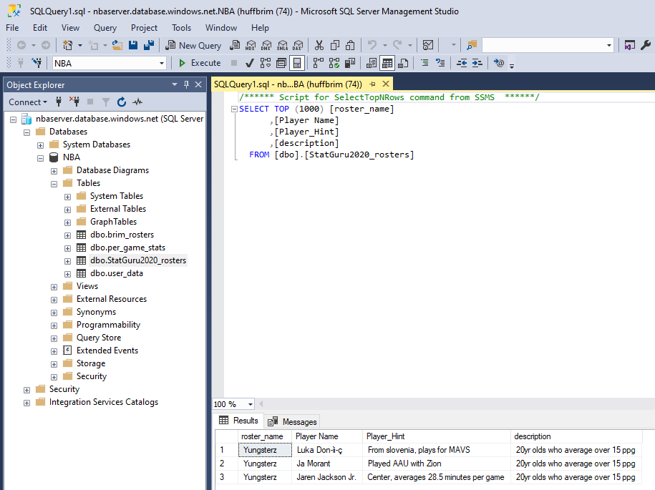
SQL Server Management Studio

