Slide 1

Estruturas de Dados / Programação 2
Trie
Equipe: Igor Hutson, Jhonnye Gabriel, Mateus Felismino, Hugo Melo
https://github.com/huffz/Huffman_Coding

Slide 2
Word Suggestion / Predictive Text

Slide 3
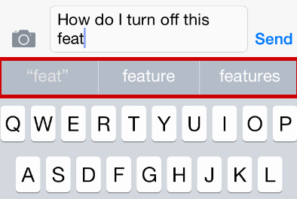
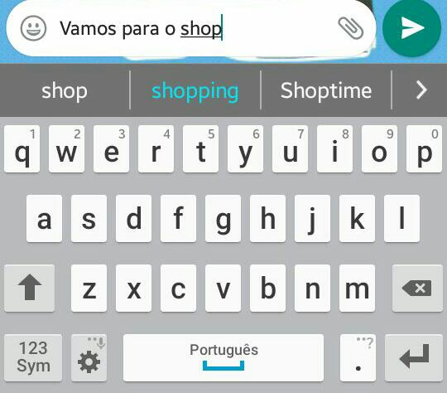

Slide 4
How can we do this?

Slide 5
Arrays?!
Hash Tables?!

Slide 6
Trie!

Slide 7
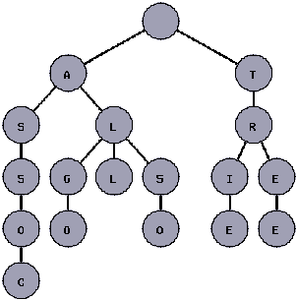
Trie
Trie is an efficient information retrieval data structure.
Used to store a dynamic set or associative key where the keys are usually strings.

Slide 8
Why should we use trie?
Easier to Insert/search - O(n) - length of the string that you search or insert.
No collisions.
We can add each node according with new letters that are being added.

Slide 9
Definitions
Leaf → A node which doesn’t have sons
Internal Node → A node that completes a word in the middle of the TRIE.
Edge → Connects two nodes.
Path → Is a collection of nodes and edges.
Depth → Is the length of the path from that node to the root.

Slide 10
Abstract Data Type:
Trie

Slide 11

Trie ADT
trie *create_node();
Int haveChildren(trie *current);
void insert(trie *head, char *str);
int search(trie *head, char *str);
trie *delete(trie *root, char *str, int depth);

Slide 12
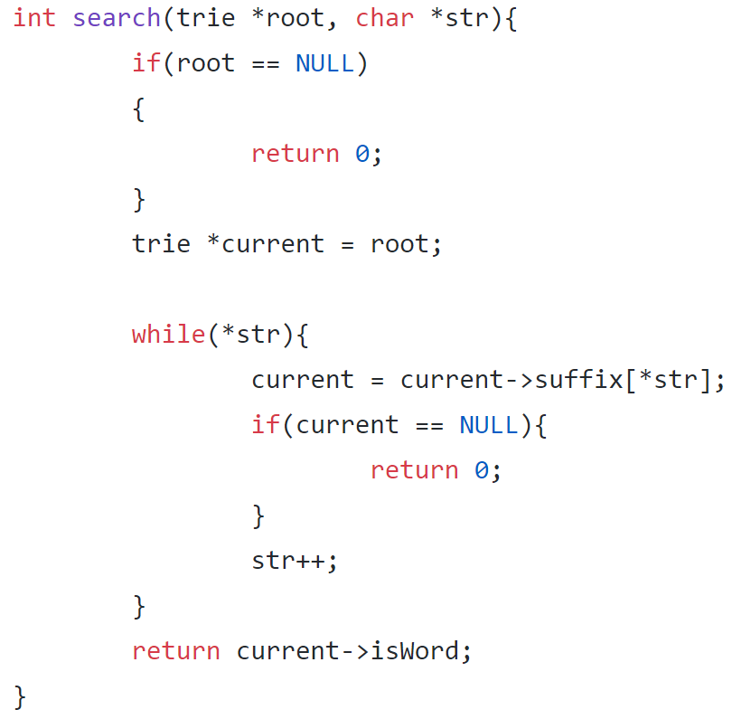
Search( )

Slide 13
Animação
ANIMAÇÃO_INTERATIVA_TRIE

Slide 14
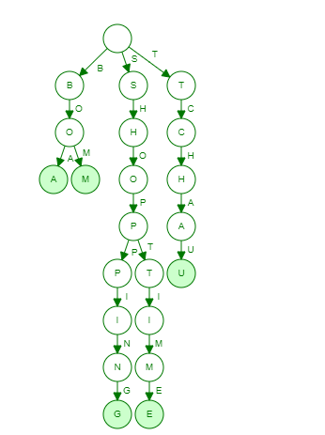
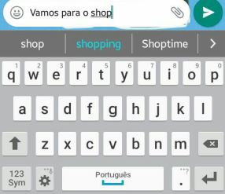
Coming back to word suggestion
- We can predict which word the user is going to text by the prefix already texted.

